Slide 1
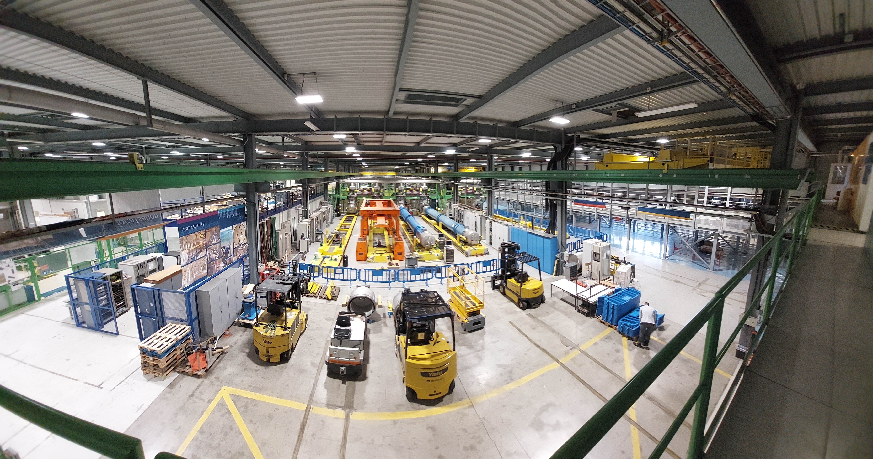
Overview of Magnet
Test Activities at CERN
M. Buzio on behalf of the Test & Measurement team
Contents
Part 1 – Team, projects and infrastructure
Team and infrastructure news
Part 2 – Instrumentation highlights
Sensors, systems and methods R&D

Slide 2
Part I
Team, Projects,
Infrastructure

Slide 3
The Team
SM18 (superconducting test station) and magnetic measurement teams merged in 2020
Now 45 strong (20 staff, 17 students, 8 associates and industrial support)
Slowed-down but not stopped by Covid 19 !

Slide 4
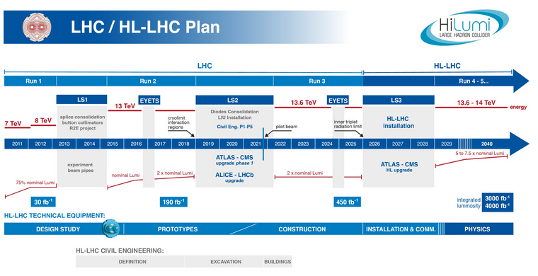
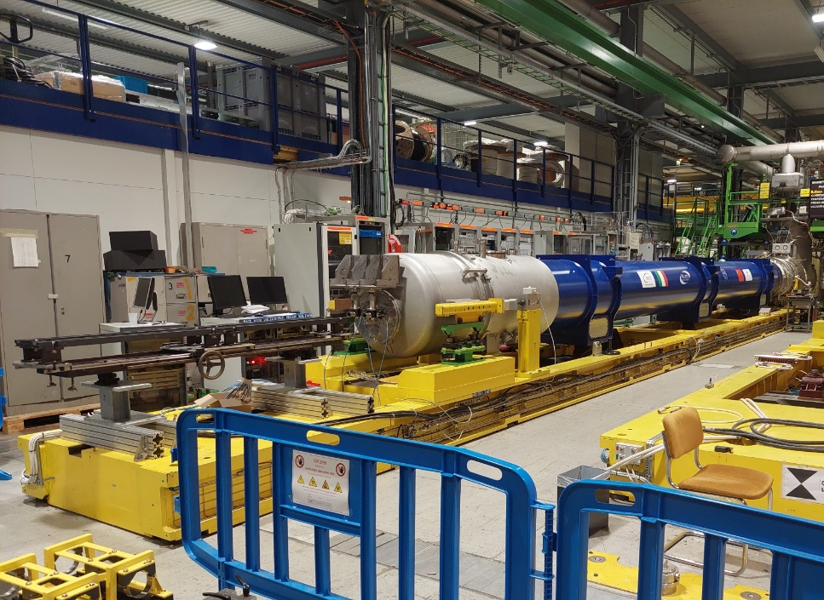
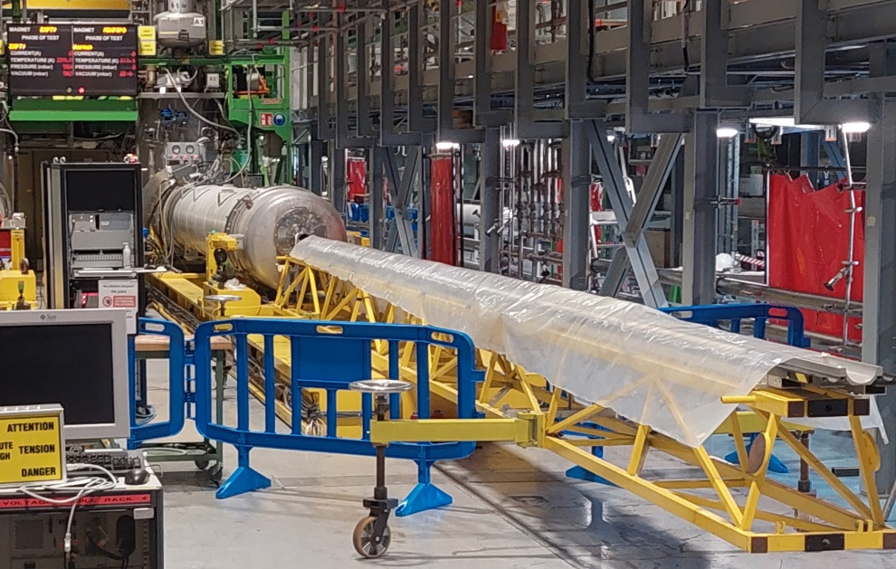
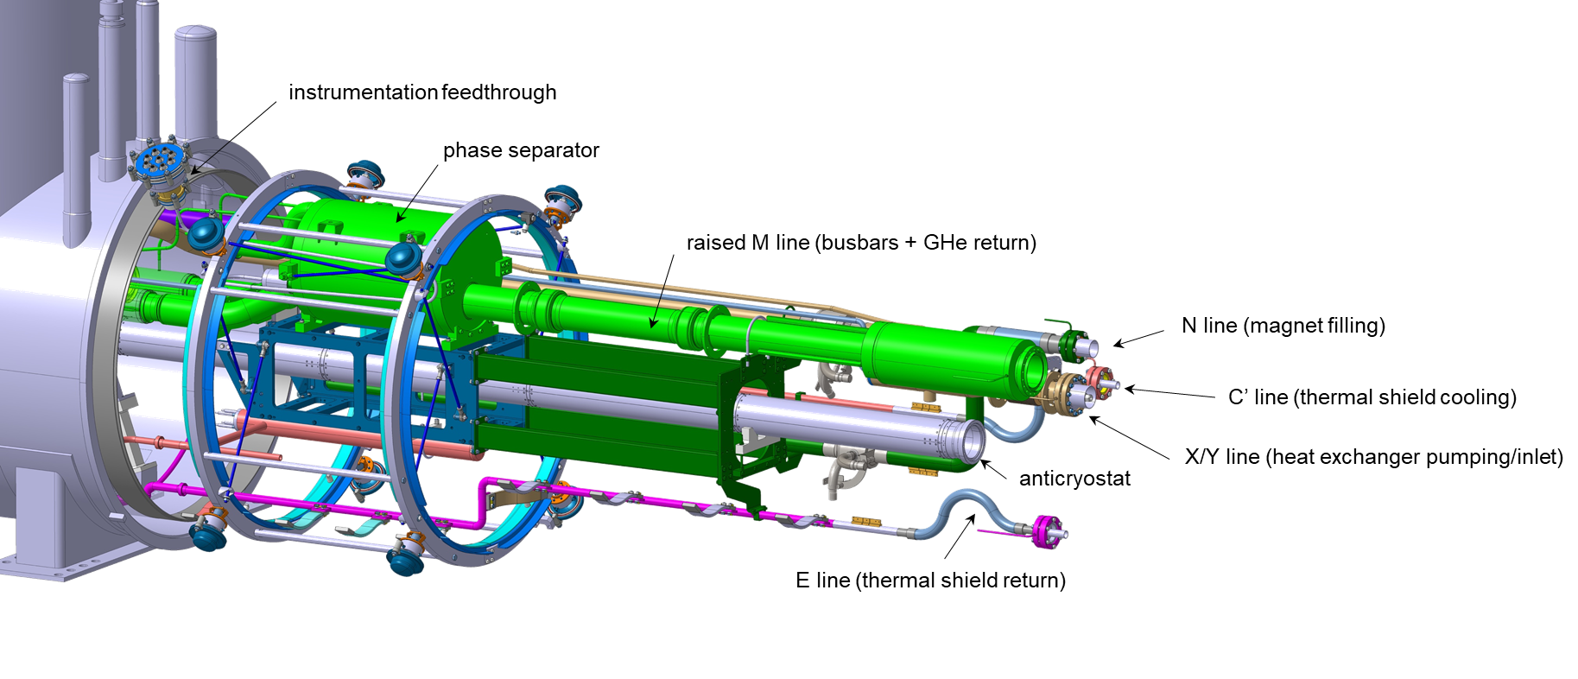
High-Luminosity LHC
2026
https://espace.cern.ch/HiLumi
currently under test: MQXFB Q2 P3, D2 prototype
Notes:
Highest-priority project:
- replace rad-damaged IR quads
- 10 × luminosity = +25% discovery range
100 cryomagnets to be tested <2026
First operational accelerator-quality
Nb3Sn magnets
11 T in stand-by, detraining with thermal cycles
Nb3Sn: no direct He c
ooing (no voids), operation at low field with large thermal margin -> large heat capacity -> slow quench + noise = difficult quench detection
Extend and “shuffle” cryogenic lines from CFB to HL-LHC magnets
Add a phase separator to control LHe level and temperature (4.5 K tests)
Add 400 W heaters to pre-load He control system (increased ramp losses)
Add instrumentation
Upgrade of vertical/horizontal test benches
Shuffling modules with phase separators
Innovations: PLC interlocks with SCADA …
New UQDS protection/DAQ system

Slide 5
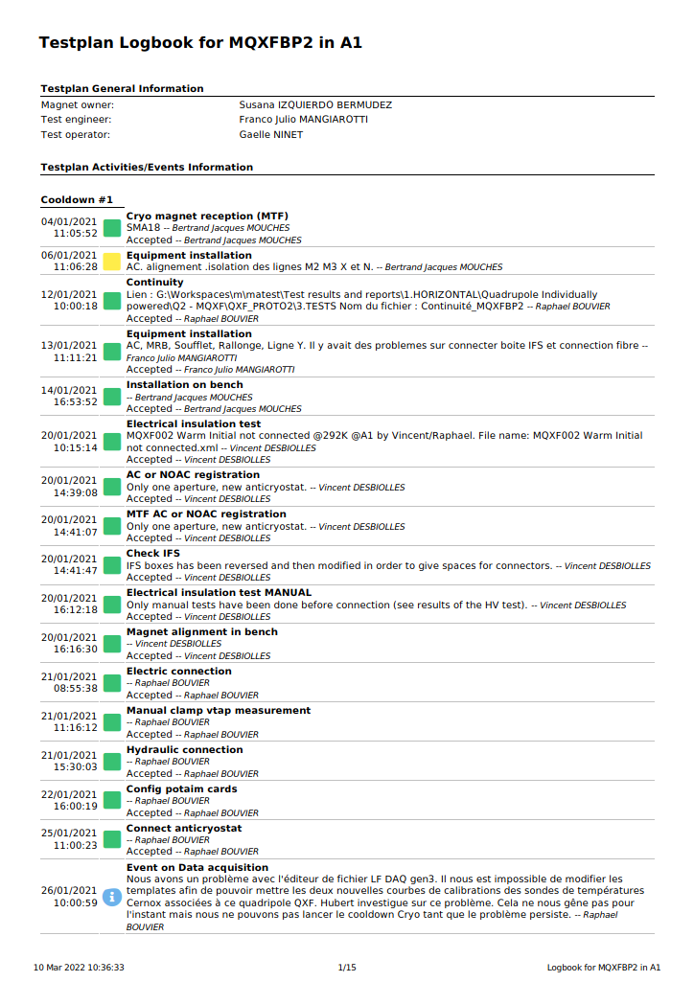
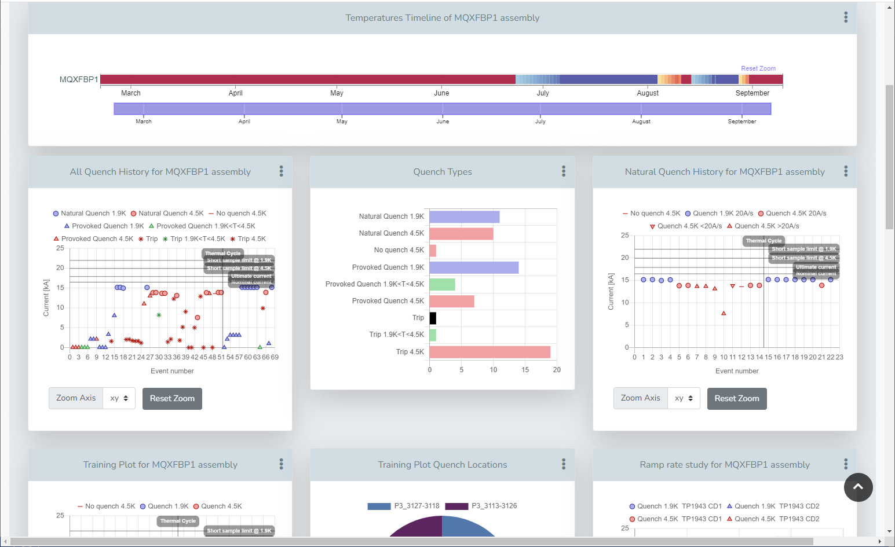
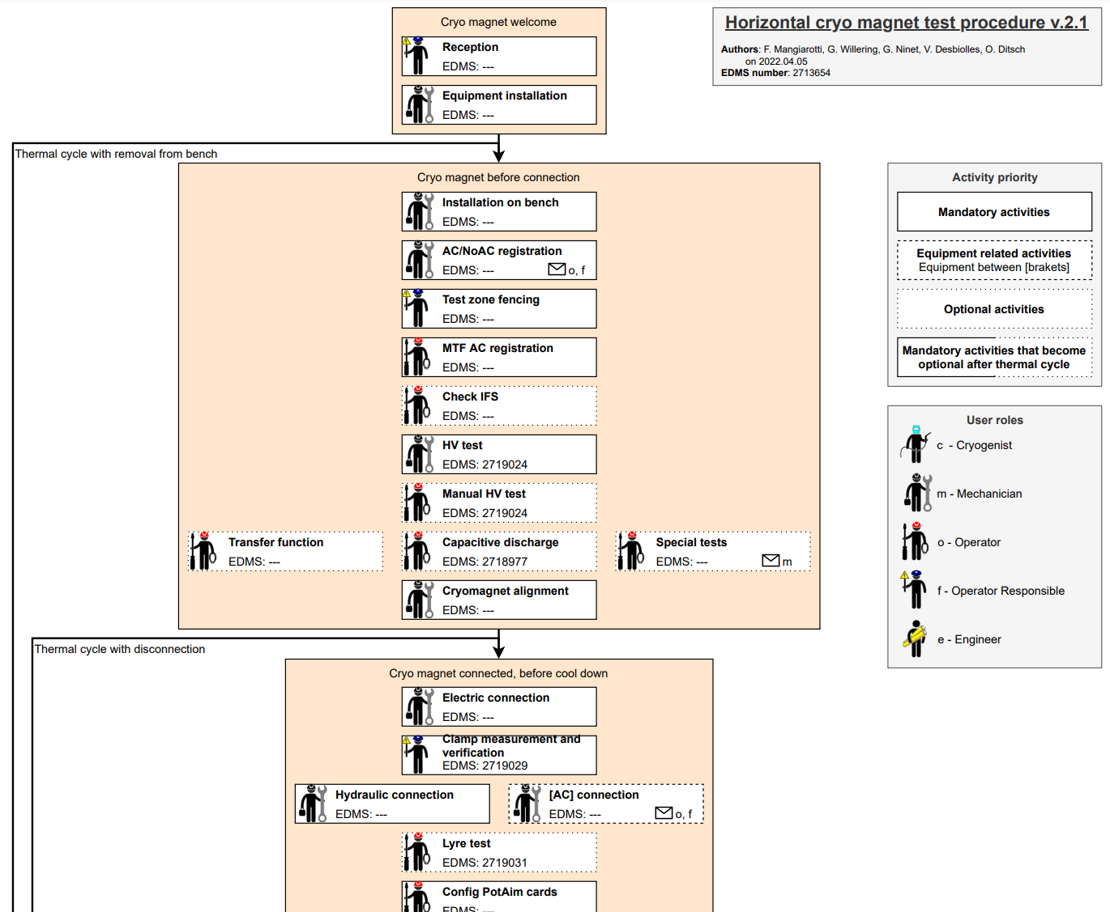
Carpenter test logbook
Oracle DB interface via OpenShift, developed in PHP on Laravel framework
Used for all cryomagnet tests in SM18 for safety, QA and result visualization
Current test status and
responsible engineers clearly marked
Status, date/time and operator in charge of each step appear in the
test chronology
Levels and sequence of tests
conform to fixed templates
Standardized stats and plots
include timeline of temperature, current etc.
Different user roles for each step
Each step linked to formally approved
procedure documents and checklists
Credit: F. Mangiarotti

Slide 6
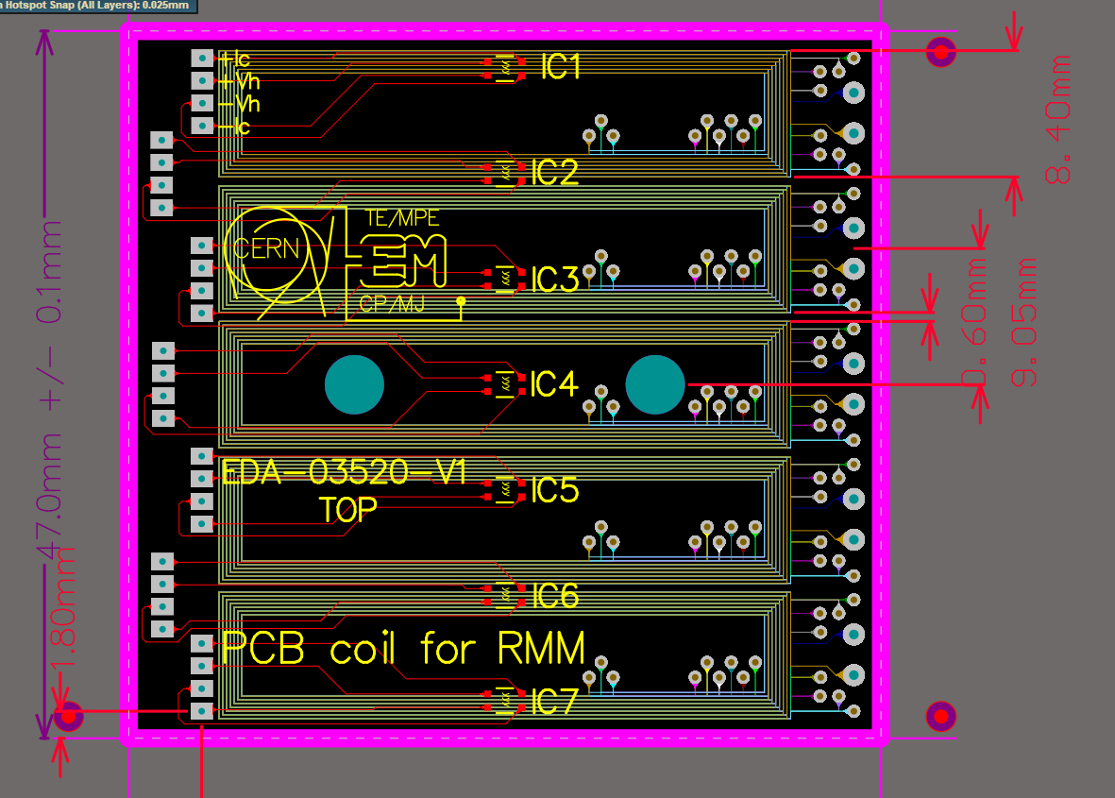
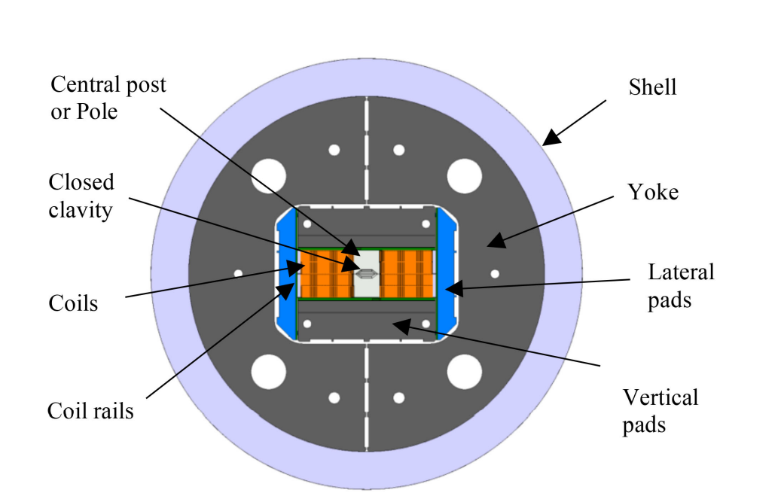
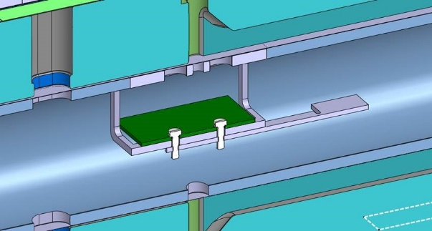
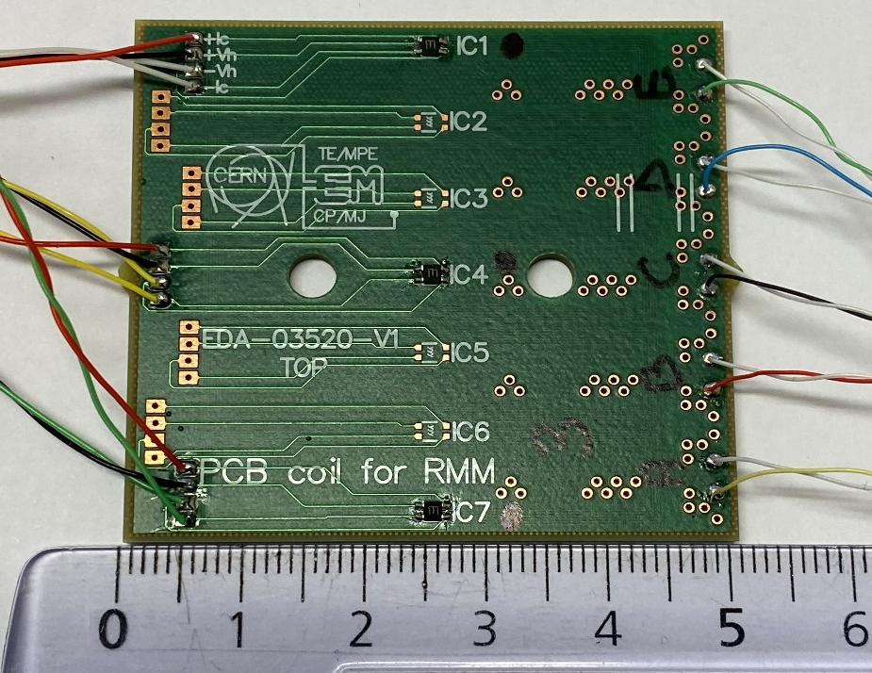
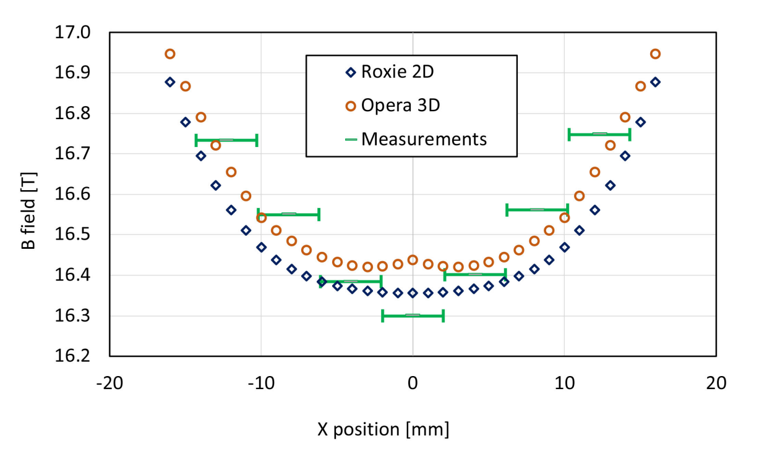
High Field Magnets for the Future Circular Collider
Enhanced Nb3Sn racetrack model coil eRMS
16.5 T peak field @ 13.8 kA, 1.9 K
5×transversal coil array PCB
in the middle of the gap
3× LakeShore HGT 2101 Hall probes
J C Perez, C. Petrone et al, “Construction and Test of the Enhanced Racetrack Model Coil”, IEEE Trans. on Appl. Supercond. Vol 32 n. 6, Sep 2022

Slide 7
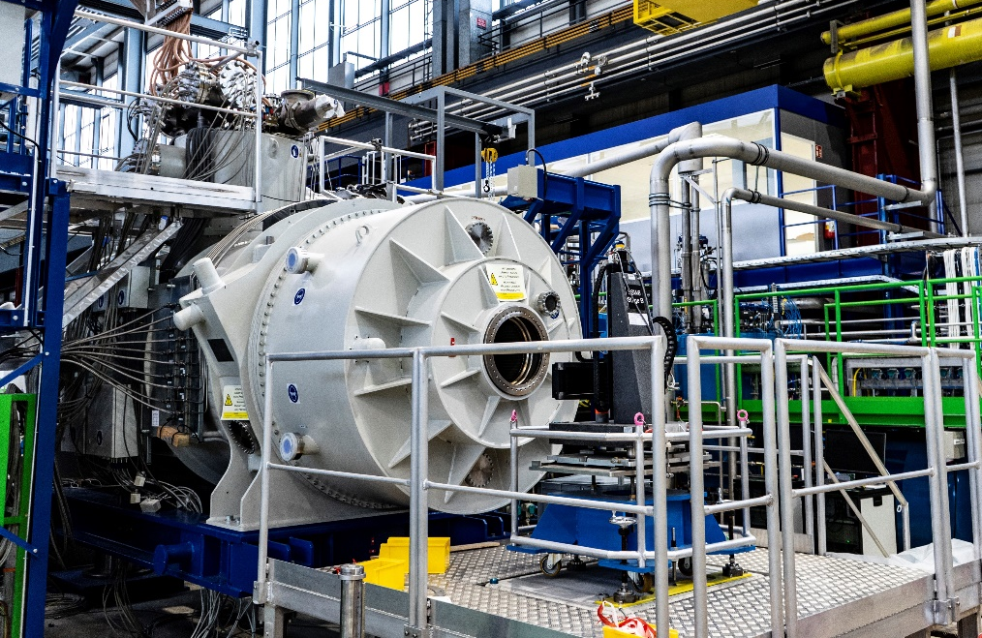
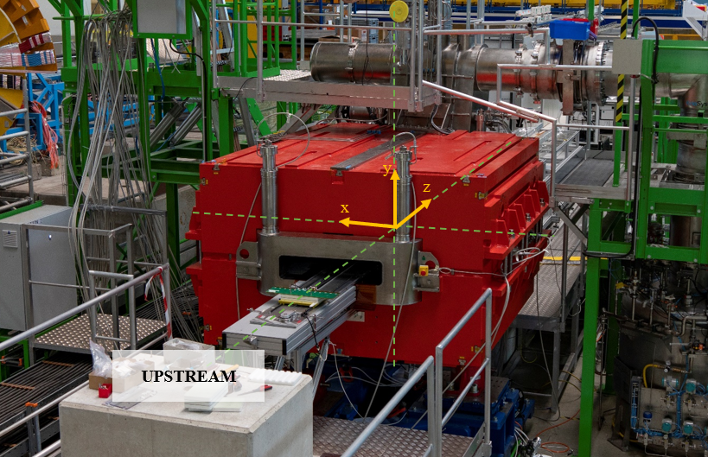
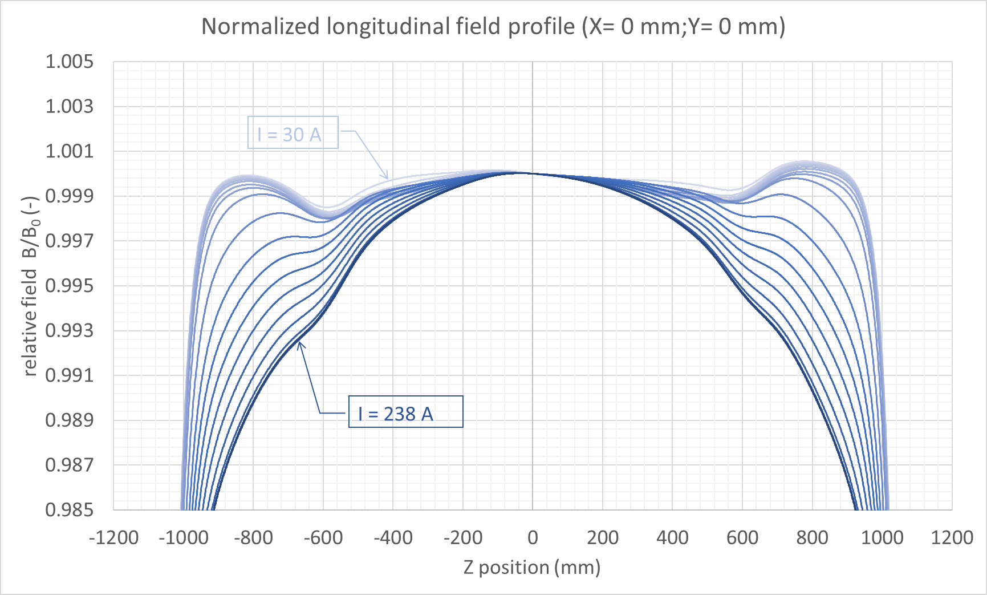
GSI/FAIR - SuperFRS
26 multiplets (ASG, 170 magnets), ∅192 mm warm bore, tested with rotating coil scanner/SSW
24 bending dipoles (Elytt), super-ferric with supercritical He cooling, 380 × 180 mm² warm bore, tested with translating fluxmeter/SSW
3 reconfigurable benches ready in b. 181
Test campaign now ramping up …
First short multiples being tested with SSW
First main bending dipole being tested with translating fluxmeter
Credit: P. Kosek

Slide 8
Part II
Instrumentation
Highlights

Slide 9
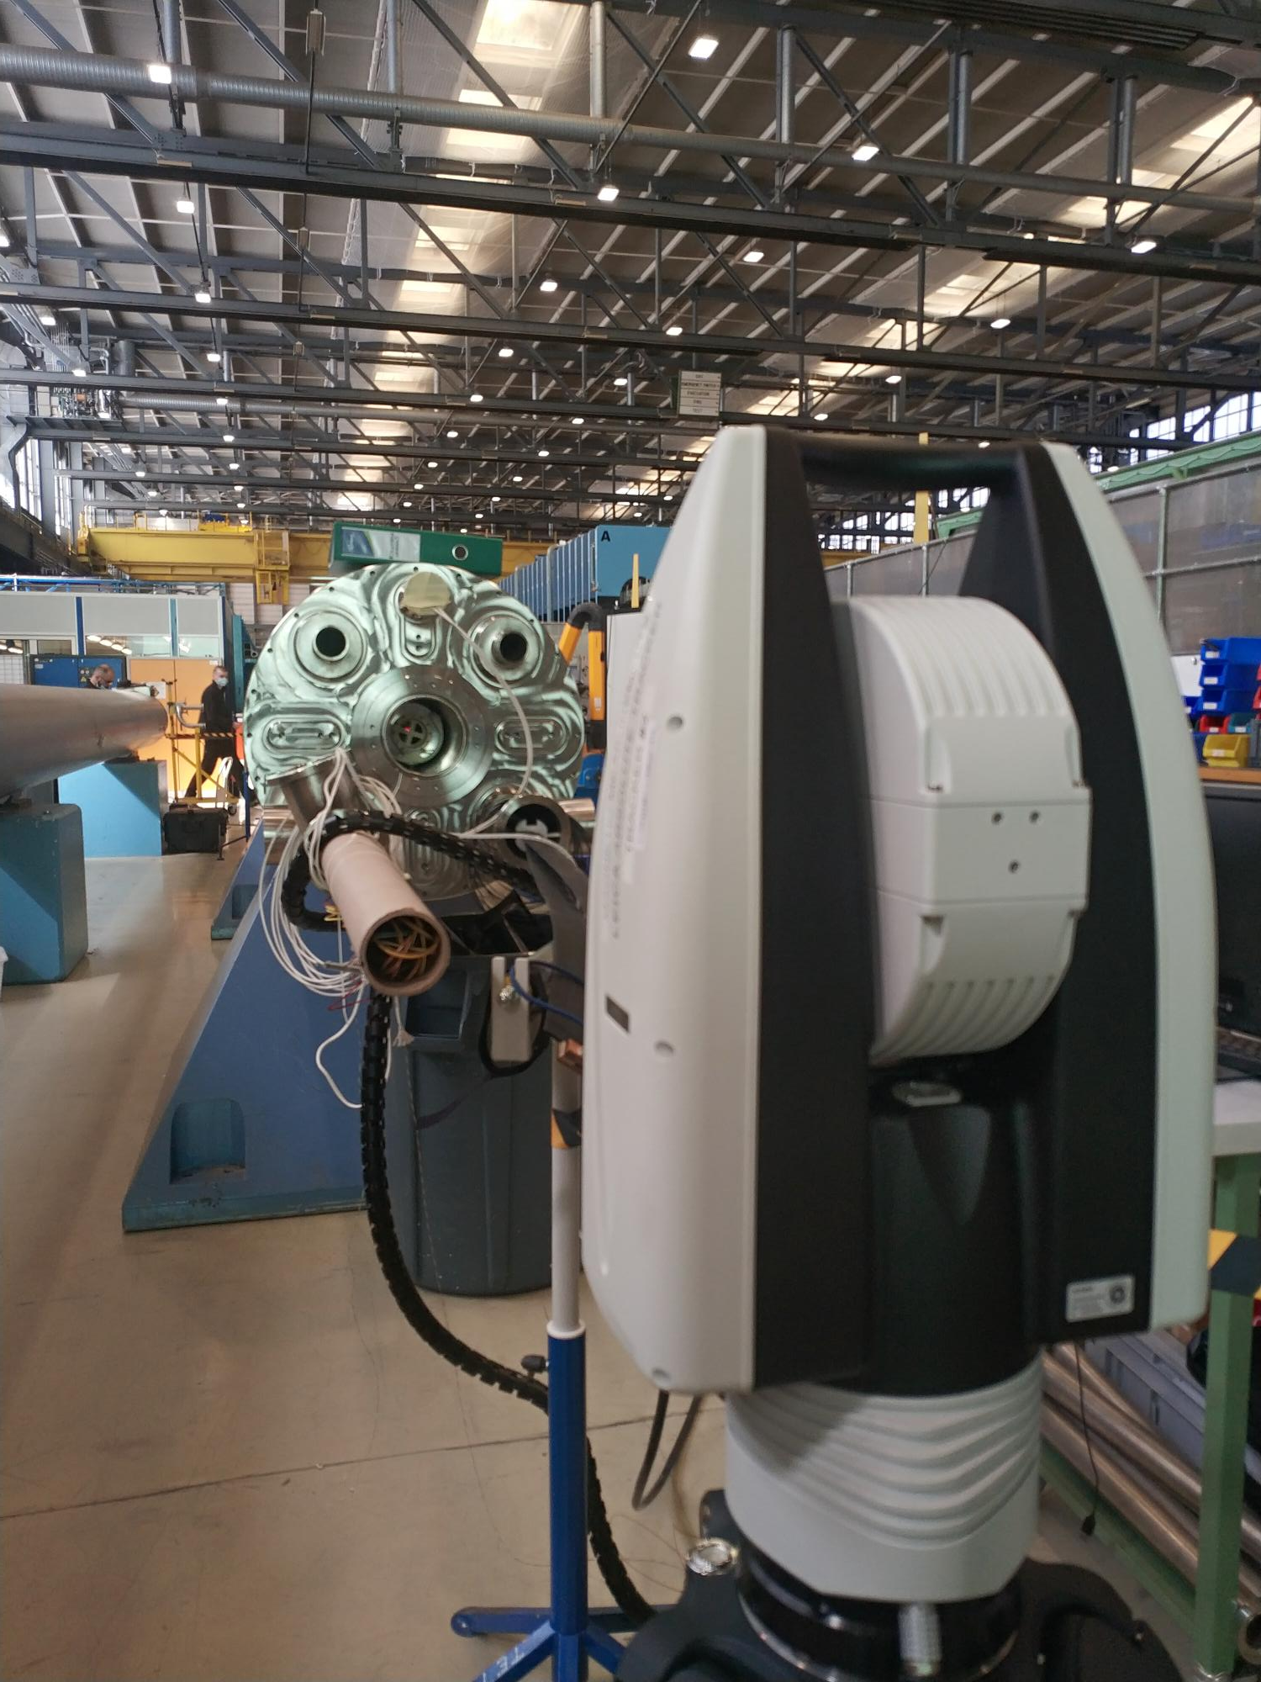
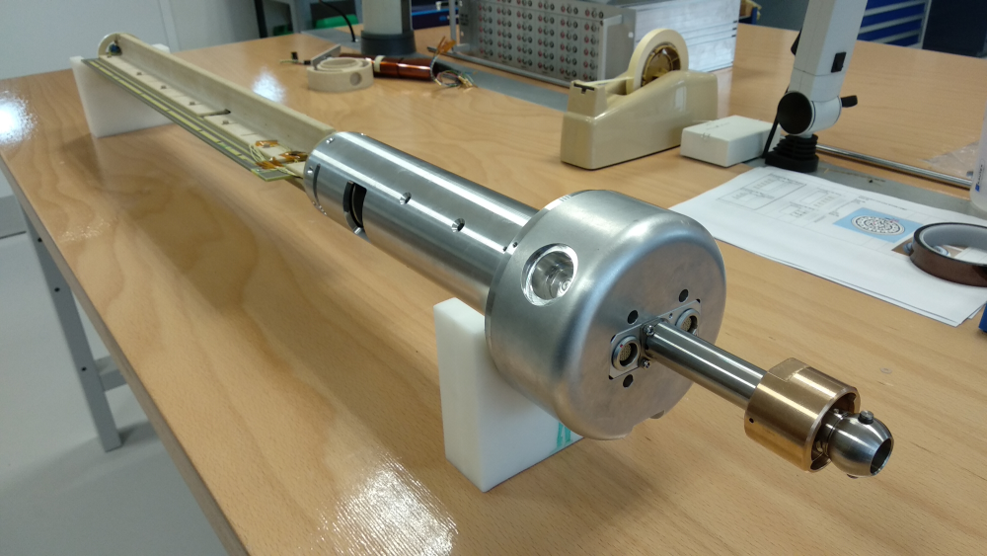
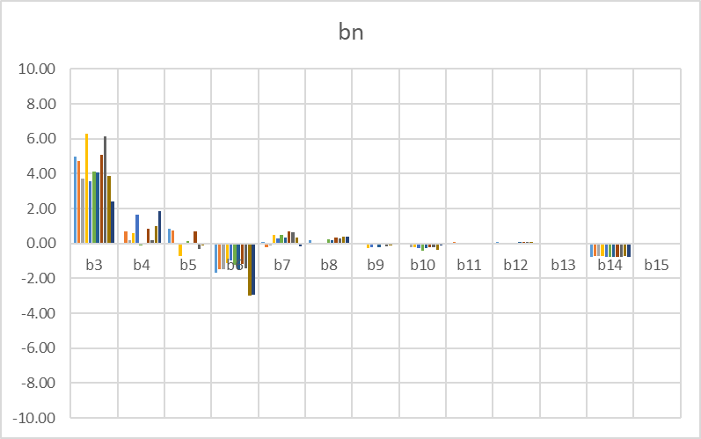
Warm rotating coil scanner
600 mm long, interchangeable PCB design for bores ∅ 90 to 150 mm
Measurement of warm HL-LHC MQXFB magnets @ 10 A, 4.4 mT @ 50 mm
3 units at CERN + 1 deployed to CIEMAT
interchangeable PCB
tilt sensor for
gravity leveling
PCB-mounted
retroreflector
hand-operated
longitudinal positioning
with prolongations
Credit: P. Rogacki, L. Fiscarelli

Slide 10
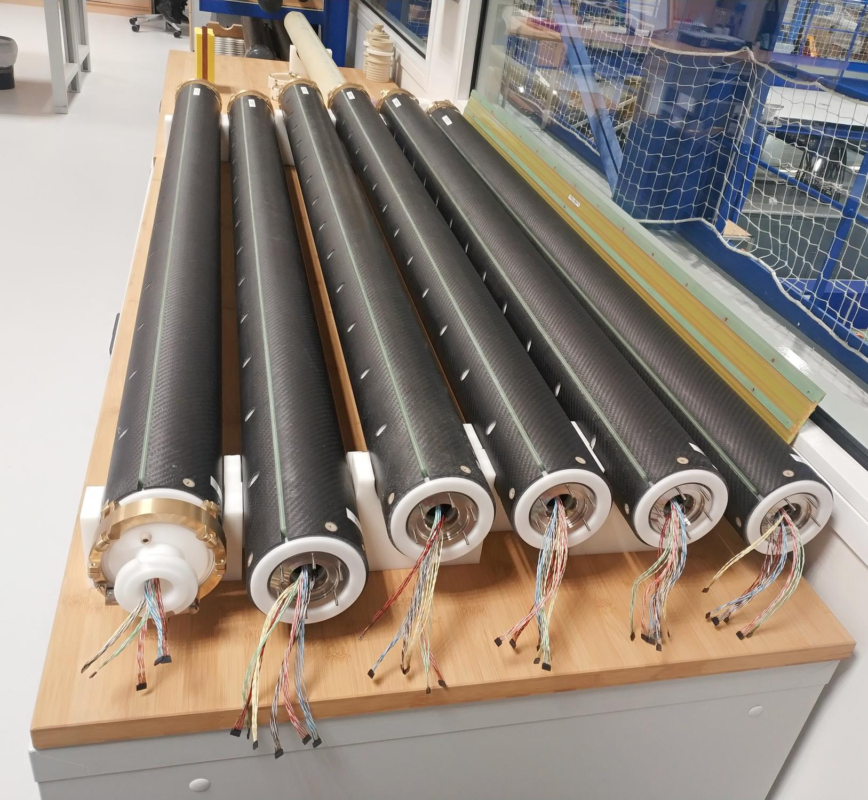
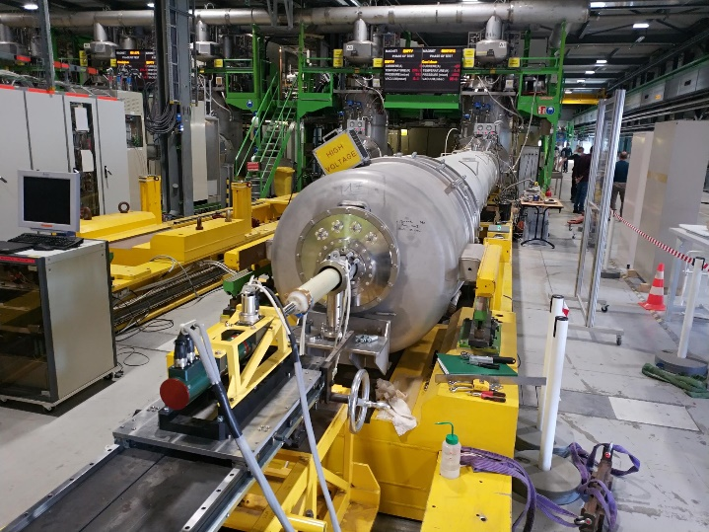
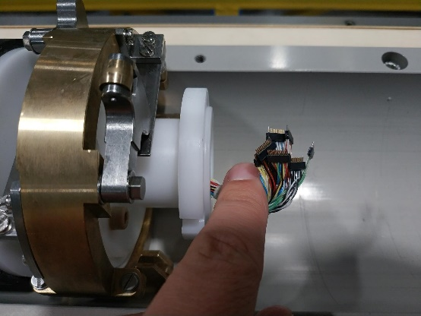
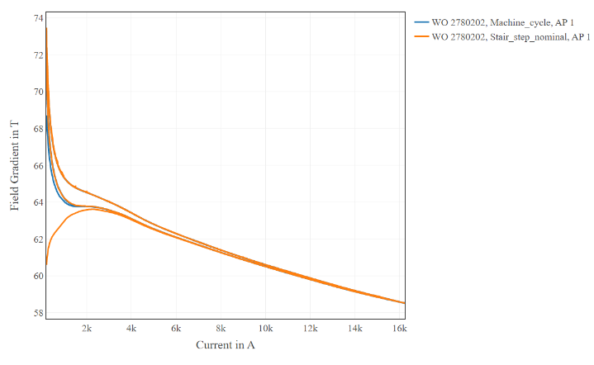
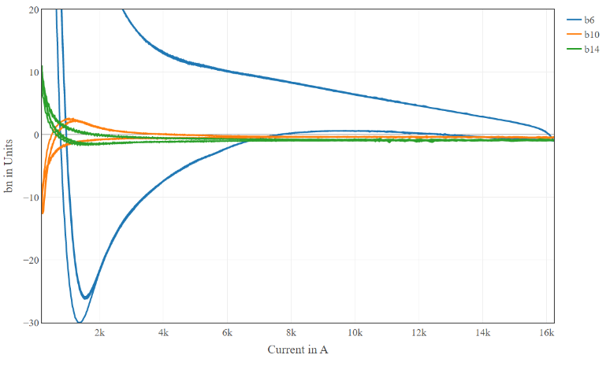
Long rotating coil shafts
4 × Ø109 mm, ~8 m long shafts being procured for HL-LHC magnets
Prototype unit w/ PCB coil array sandwiched between high-precision C-fiber half-shells
Good results, but price hikes and supply problems …
Double C-fiber half-shells for torsional and flexural stiffness
1.4 m long
~50 µm tolerance
6 micro-connections per segment
50-channel
Mobile Rotation Unit
MQXFB integrated field
Shaft prolongation
(no coils)
Sliding tracks
MQXFB harmonics
hysteresis
Credit: R. Beltron, O. Dunkel, G. Deferne, L. Fiscarelli

Slide 11
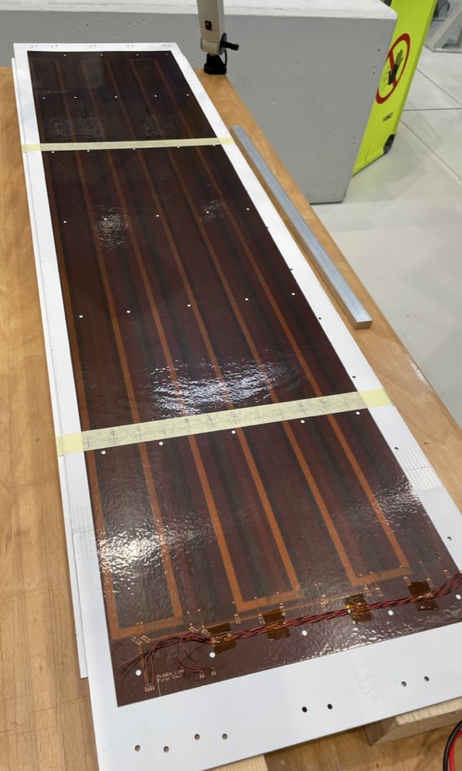
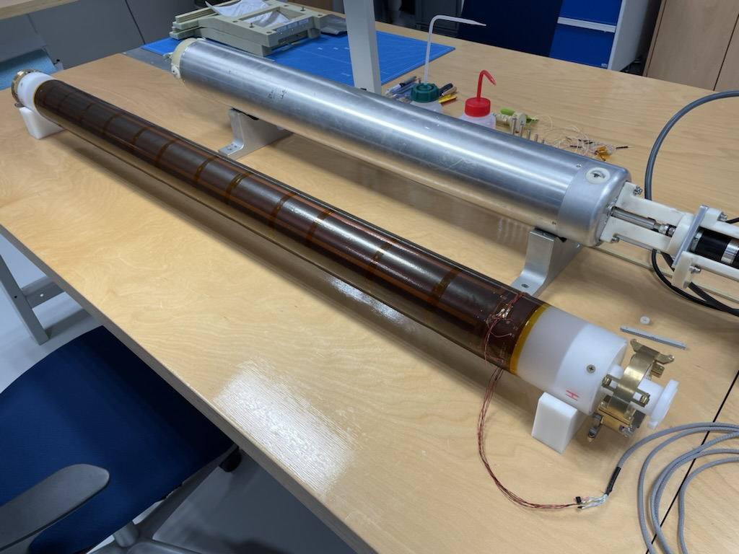
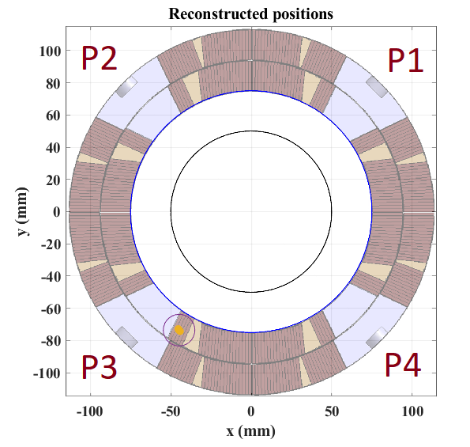
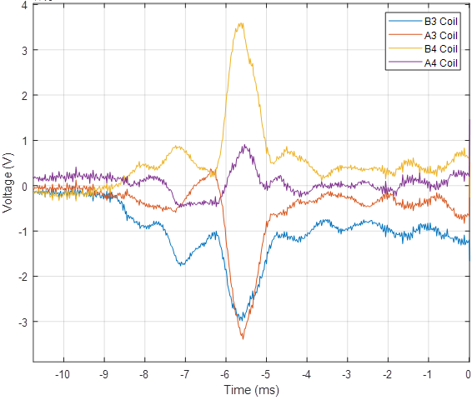
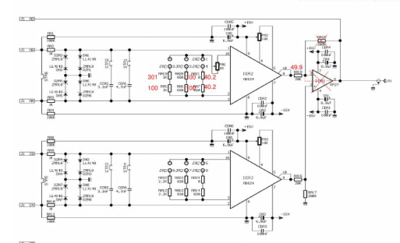
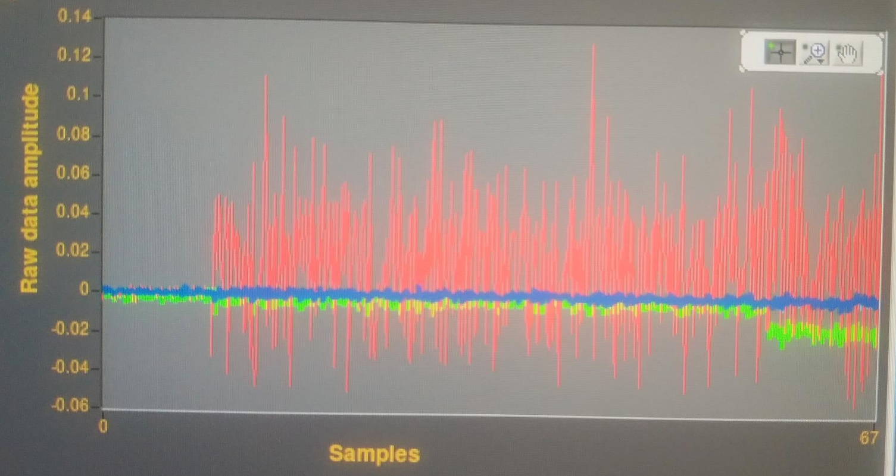
Ø110 mm Quench Antenna
A4
B4
A3
B3
5 pins, 1 used, tape
2 × double-layer flexi PCB glued together,
4 × 16-turn tangential coils per layer
Ø100 mm, 0.6 long antenna segment
Quench reconstruction resolution:
- tangential: 5°
- radial: 5 mm
12-segment quench antenna designed to improve quench localization in critical MQXF quads
New design: rolled-up flexi PCB
On-board analog bucking → B3, A3, B4, A4 outputs
Extremely easy to assemble/disassemble
Bypass of analog-bucking op-amp on existing amplifier cards (G=100 to 500)
Zin adapted to compensate the capacitive load of long coax cables
10× S/N improvement !
Credit: J. Kaeske, P. Rogacki, V. Di Capua, R. Beltron, L. Fiscarelli

Slide 12
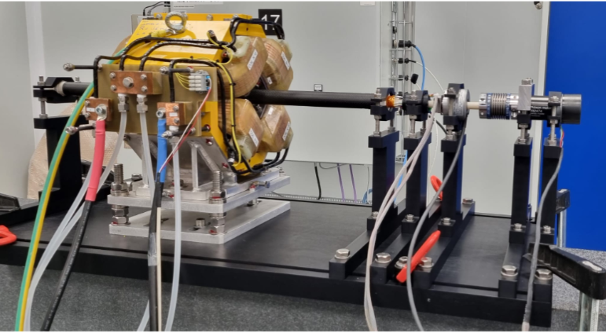
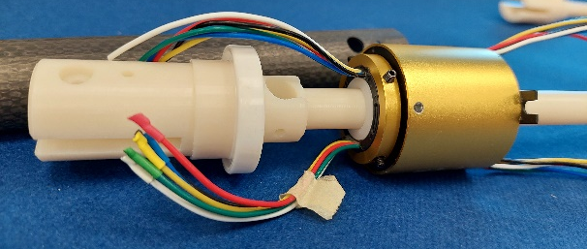
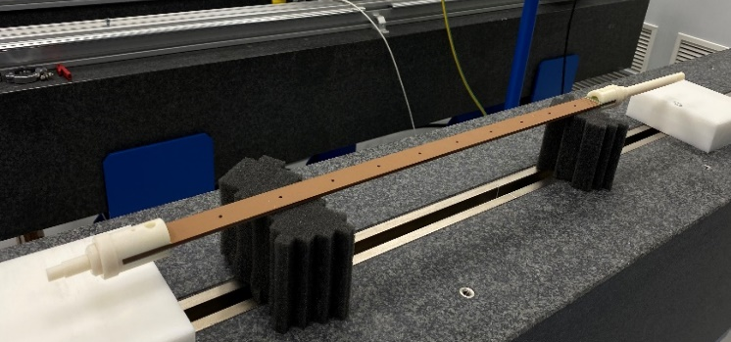
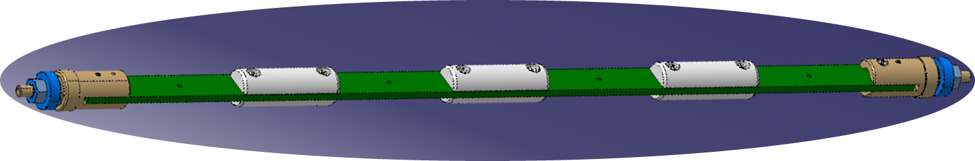
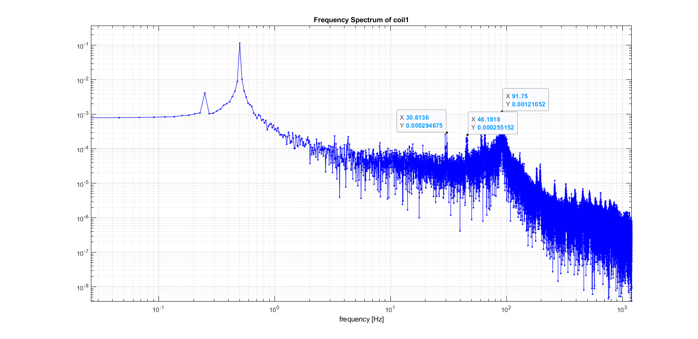
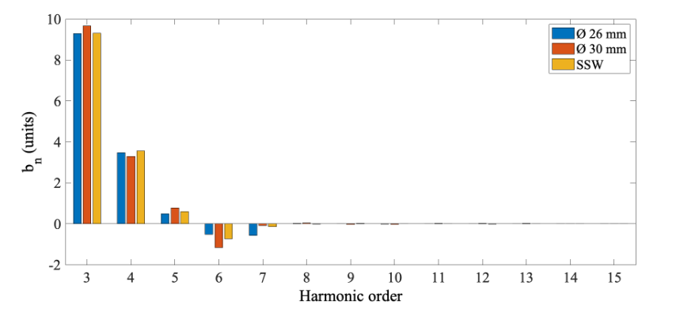
Small-diameter rotating coils for INFN-LNF’s EuPRAXIA
Ceramic ball bearings
Low-cost Ø26 mm C-fiber tube (20 µm RMS tolerance)
Maxon DC motor
Accura 25® 3D-printed parts with 0.2 mm tolerance (required machining)
Adjustable anodized
Alu supports
Harmonic torsional vibrations @ 4, 8, 15, 30, 90 Hz
visible in the outermost coil signal (< 1%)
5×256-turn, 32-layer radial PCB coils
inserted and pinned in the C-fiber tube
<0.5 units RMS @ 10 mm
low-order differences w.r.t.
other instruments
Vcoil output at 0.25 rev/s
Credit: A. Lauria, M. Pentella

Slide 13
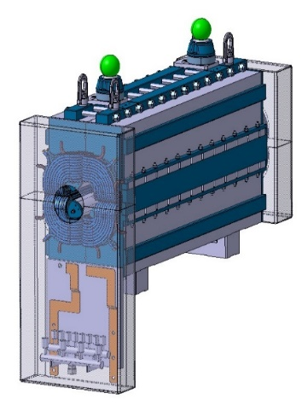
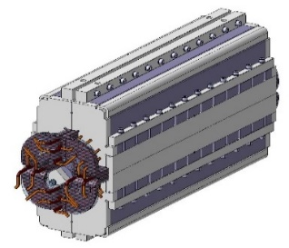
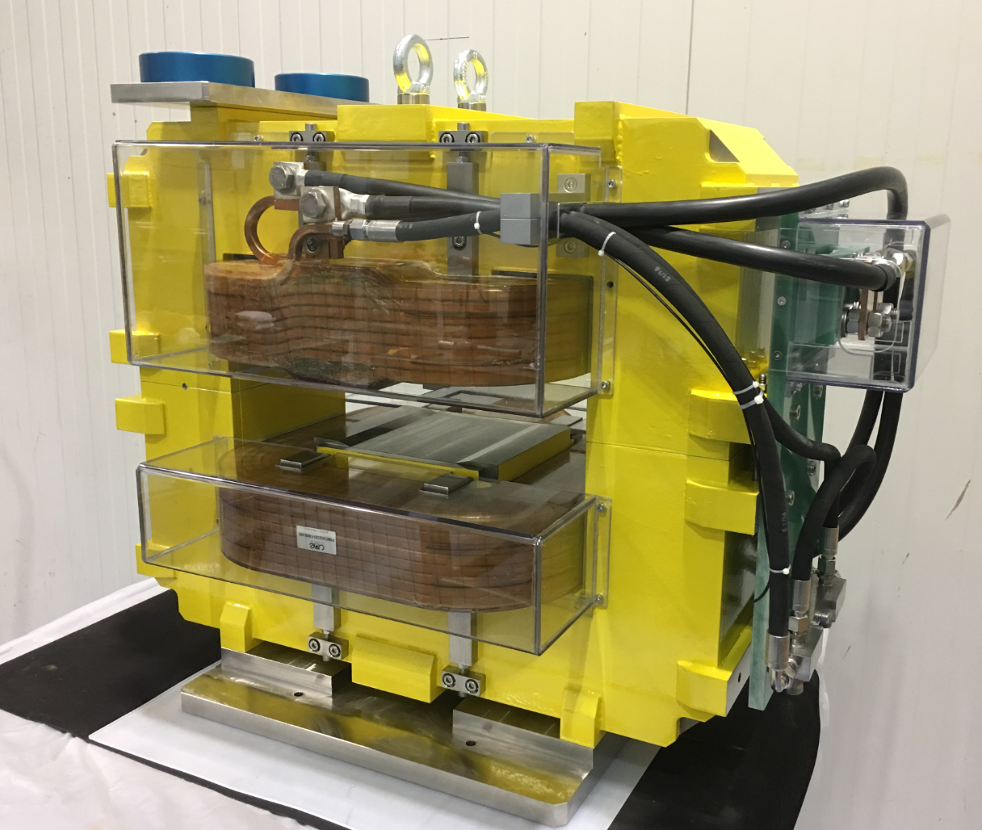
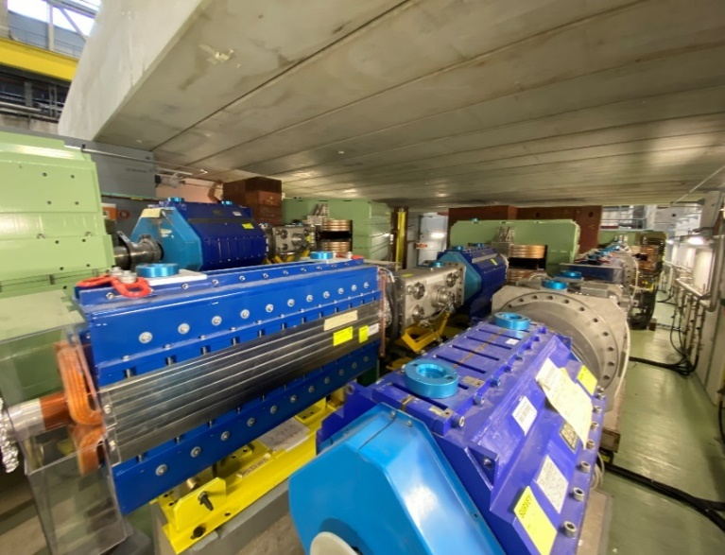
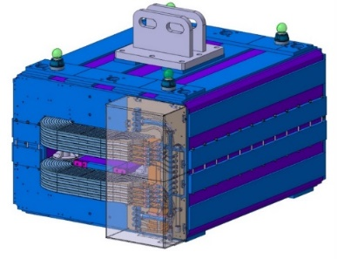
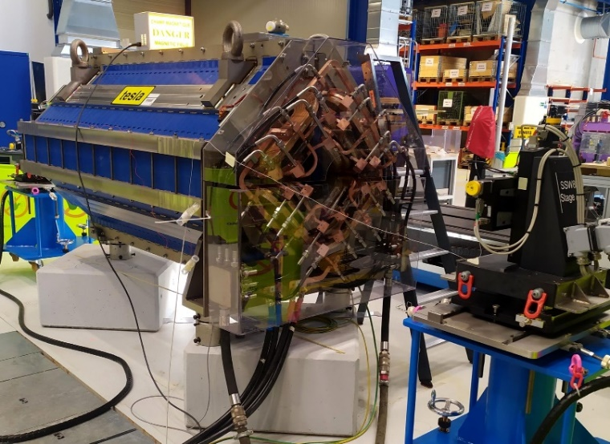
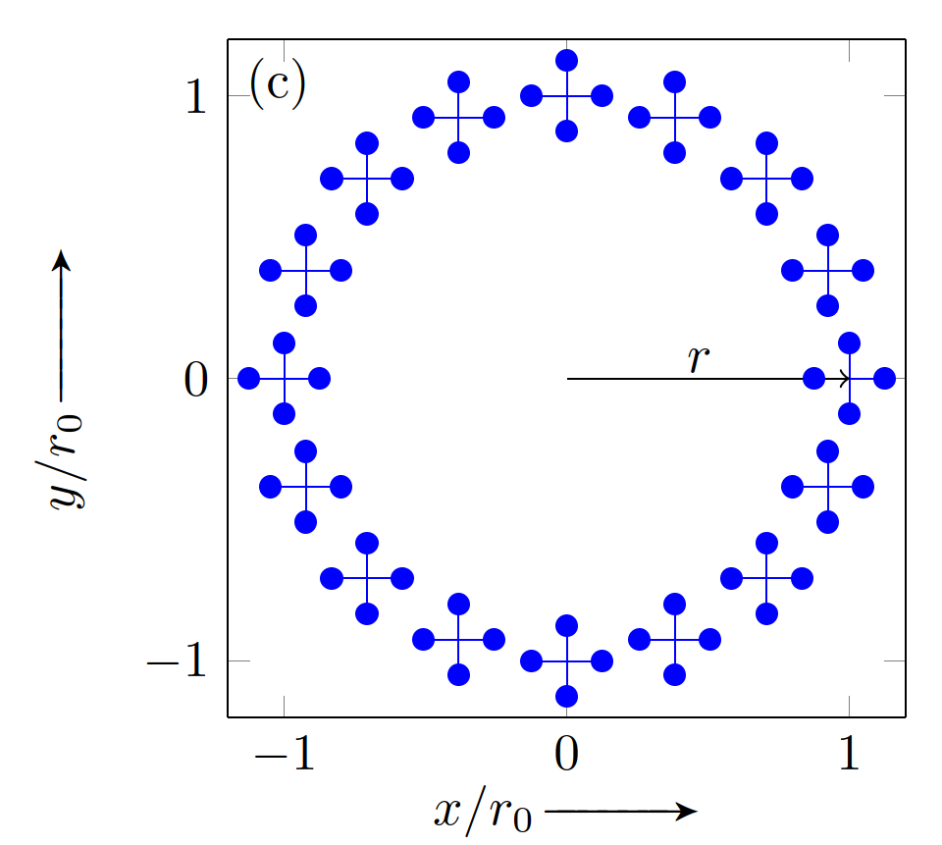
Rotating DC mode SSW
58 new/refurbished magnets for fixed-target East Area measured over ~one year
Extensive use of SSW for integral harmonics
0.2 units RMS difference
Ø140 mm quad used for cross-validation
up to 128 × 3 mm × 3 mm
standard DC SSW measurements
Harmonics fitted to actual flux spanned
Credit: R. Chritin, C. Petrone, P. Rogacki
Notes:
64/128 points,
3 mm
Fit includes harmonics

Slide 14
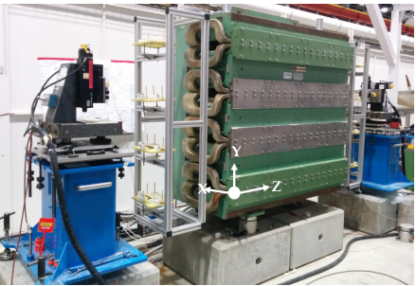
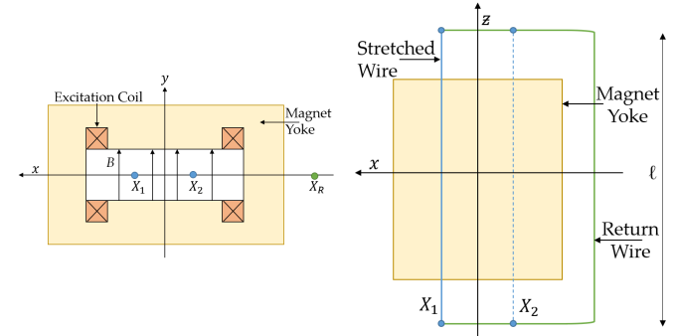
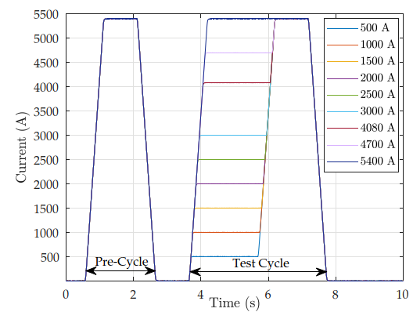

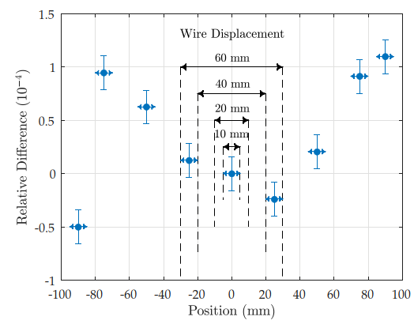
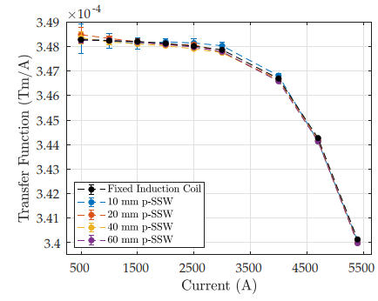
Pulsed excitation mode SSW
Pulsed-mode flux integration
in PS Booster main dipoles
50-ppm excitation
current reproducibility
Create a 1-turn virtual coil by subtracting measurements at different wire positions
Standard static SSW measurement
added in to recover initial level at I0
200 ppm RMS difference
vs. fixed integral coil
Wire offset X2-X1: trade-off between
higher S/N and effect of B3
C Petrone, J Vella Wallbank et. al, “Implementation of the SSW system in pulsed mode”, to be submitted to Sensors

Slide 15
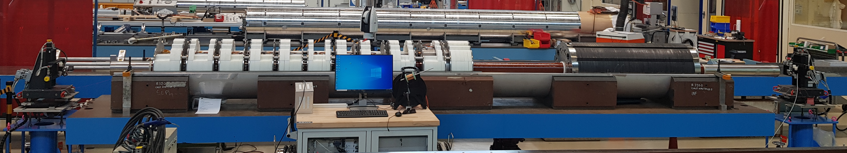
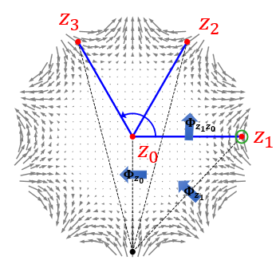




AC excitation mode SSW
Goal: warm check of axis/field direction in HL-LHC corrector package MXBXFA
Stepwise circular wire movement to mimic a radial search coil: $Φ_{{z_{n}z}_{0}}={Φ_{z_{n}}−Φ}_{z_{0}}$
$\text{Analytical} \text{sag} \text{correction}$ vs. longitudinal position
$\text{Higher} \text{harmonics} \text{not} \text{precise} \text{enough} →\text{only} \text{measured} \text{when} \text{cold}$
A3 B3 A4 B4 A5 B5 A6 B6 A3
SSW
Stage A
SSW
Stage B
$$Φ_{{z_{n}z}_{0}} (Vs)$$
Validated vs. DC-SSW on NC quad
return wire
Magnets excited sequentially @ 19 Hz
(compromise sensitivity/eddy current effects/available voltage)
N=1 central + 256 tangential
6-second acquisitions
(oversampling)
Credit: E. Dalane, C. Petrone

Slide 16





Translating Transversal Fluxmeter
Used for warm measurement of HL-LHC correctors
Flux measurement taken on-the-fly
C-fiber guiding tube
12×30° 160-turn,
16-layer PCB coils
One additional coil shifted by 15° /30 mm
to improve pitch/yaw misalignment
Prototype Accura 25®
3D-printed head
Sick® PFG08
wire draw encoder
(14 µm resolution,
300 µm reproducibility)
C-fiber moving rod
and guiding tube
(square !)
Longitudinal field profile of individual correctors in HL-LHC CP
(deconvolved with coil sensitivity kernel)
Localization accuracy << target 1 mm
Credit: E. Dalane, C. Petrone
Notes:
Longitudinal position of in corr pack 1 mm required

Slide 17







Translating Axial Fluxmeter
Goal: Quick in-situ measurement of field map/magnetic axis of 20 solenoids in the upcoming Antiproton Decelerator
electron cooler
SSW not possible (clearances, magnet cross-talk)
Based on translating disc-shaped 8-layer PCB coil array
C Petrone, S. Russenschuck et al. , “Induction-coil measurement system for normal and superconducting solenoids”, IEEE Trans. on Appl. Supercond. Vol 32, n. 6 Sept 2022
10 ppm field resolution
Axis defined by centers @ both end gradient peak planes
100 µm axis resolution with one pass
50 µm by repeating 9 passes w/ 5 mm offset
4×360° + 1 central, 6-turn concentric coils
for axial and radial field profile
4×4×90°, 6-turn coils
for magnetic axis localization

Slide 18






Real-time measurement systems
6 B-train measurement systems now operational in all normal-conducting CERN rings
250 kHz data rate, 30 µs latency, 2 µT resolution, ~100 µT absolute accuracy
Complex, many challenges, simplified systems for smaller scale applications under study
LEIR main
bending dipole
FMR marker
coil
Sensors in the
fringe field region
Simplest solution under test so far …
Integral coil proposal for PS system
(U17 unit under test in b. 867)
NMR probes
ISOLDE spectrometer challenges: only fringe region accessible, no spare, no validated FE model
Credit: A. Beaumont, V. DI Capua, M. Pentella

Slide 19






Integrator drift cancellation with data fusion
Problem: indefinitely long integration of fixed-coil output
Kalman filtering for optimal estimation of the field in the presence of model (voltage offset V0) + measurement noise
Combining coil/Hall probe → three orders of magnitude improvement
Field = hidden state
Coil voltage = input variable
Uncorrected drift
60 ppm/s
State-space model
V0 updated on plateaus
3 ppm/s
Case I: measurement = Hall probe
Case II: measurement = excitation current
V0 estimated 0—50 s
53 ppm/s
Arepoc HHP-NP 2067 Hall Probe
594 cm² 160-turn 16-layer PCB coil
Kalman + exc. current
0.08 ppm/s
DCCT
Kalman + Hall probe
0.03 ppm/s
V. Di Capua, M. Pentella et al., “Drift-free integration in magnetic measurements
achieved by data fusion ”, Sensors 2022, 22, 182
Actual eddy current
decay transient

Slide 20

Thanks for your attention
… don’t miss these other presentations from CERN:
Improving the performance of a three-axes Hall probe mapper system (Melvin Liebsch)
“Hysteresis Modeling in Iron-Dominated Magnets Based on a Multi-Layered NARX Neural Network Approach” (Vincenzo Di Capua)
“A Static-Sample Magnetometer for Characterizing Weak Magnetic Materials”(Mariano Pentella)
“Encoderless harmonic coil measurements” (Piotr Rogacki)

