Slide 1

Magnet section activities at ALBA
Jordi Marcos on behalf of ID, Magnets and Front Ends section
29 September 2022

Slide 2
Outline
Effect of Covid-19 pandemics
Magnetic measurement activities at ALBA
Upgrade plans at ALBA
Magnetic measurement group reorganization
Conclusions

Slide 3
Outline
Effect of Covid-19 pandemics
Magnetic measurement activities at ALBA
Upgrade plans at ALBA
Magnetic measurement group reorganization
Conclusions

Slide 4
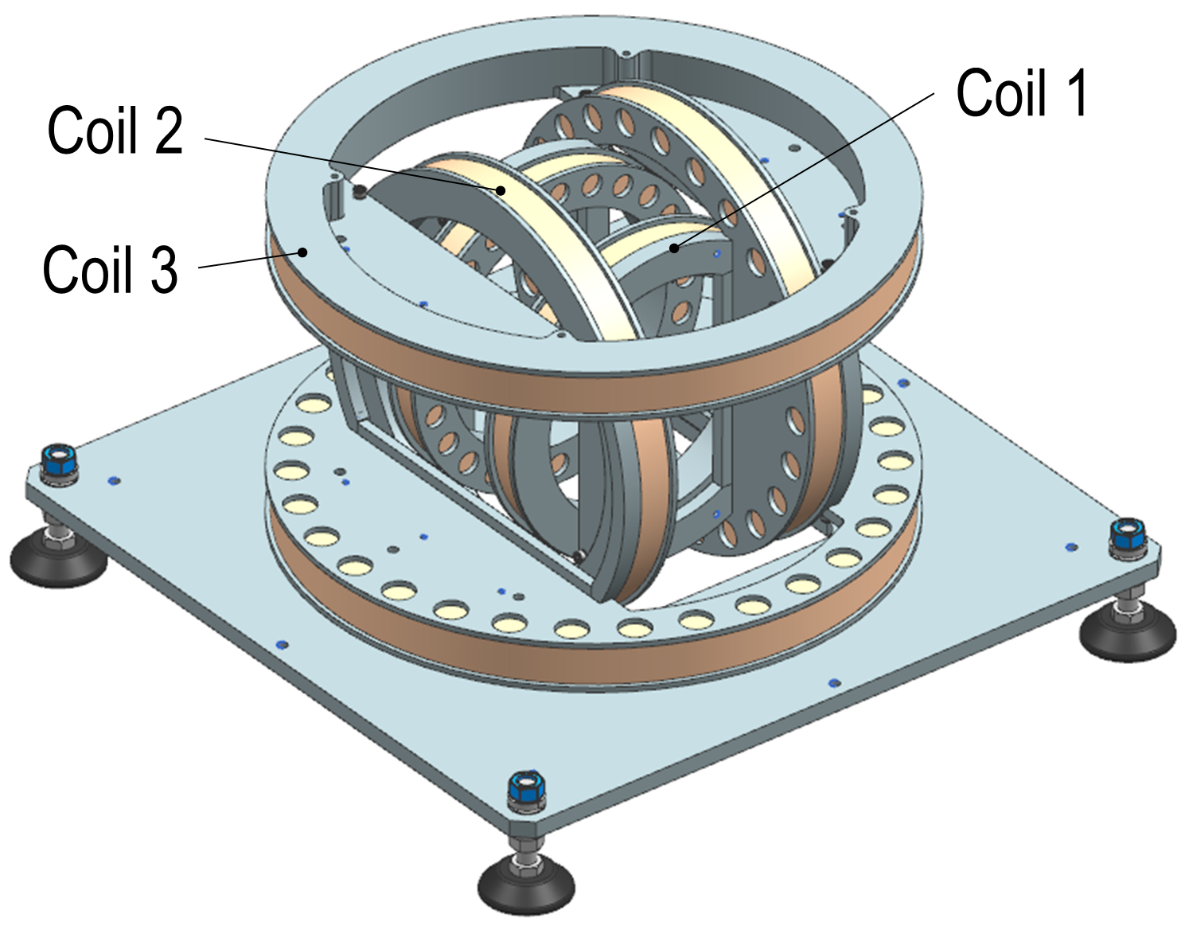

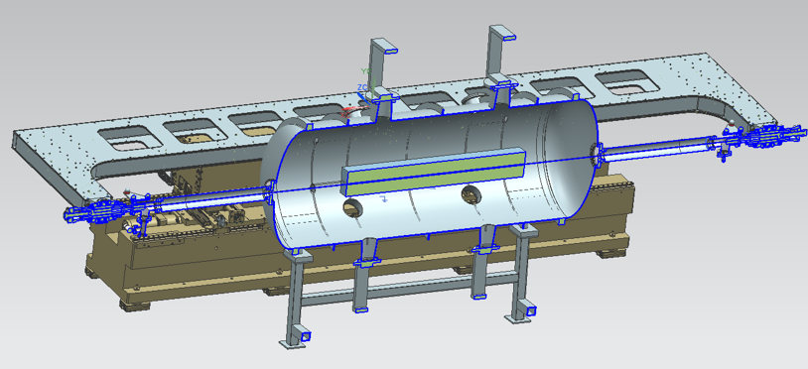
Effect of Covid-19 pandemics
As a consequence of the Covid-19 outbreak, there has been a drastic reduction in the number of requests for ALBA magnetic measurements lab from external companies/institutions:
  It has reduced from 2-3 requests/year down to 1 single request in 3 years.
At an internal level, Covid-19 forced us to concentrate on high priority activities (daily operation, construction of new beamlines) and to put on hold lower priority projects:
  3D Helmholtz coils.
  Adaptation of Hall probe bench for cryogenic measurements under vacuum.
  After recovery of some normality by mid-2021, our focus has displaced to ALBA upgrade-related activities (more about this later on).

Slide 5
Outline
Effect of Covid-19 pandemics
Magnetic measurement activities at ALBA
Upgrade plans at ALBA
Magnetic measurement group reorganization
Conclusions

Slide 6

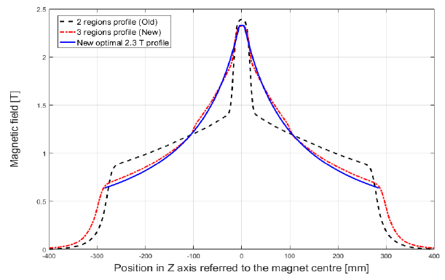
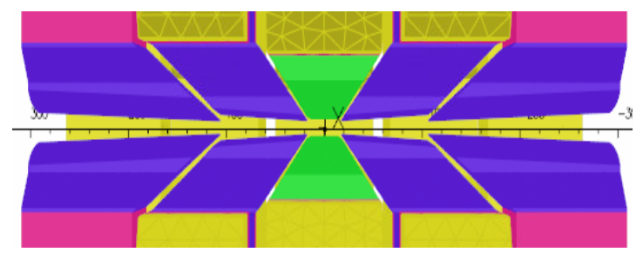

Magnetic measurement activities at ALBA
Characterization of Permanent Magnet longitudinal gradient dipole for CIEMAT.
Prototype of main bending magnets for CLIC Damping Rings:
  Hyperbolic field profile along longitudinal direction will allow to minimize electron beam emittance
  Combined function magnet: dipolar and quadrupolar fields
Papadopoulou et al, Phy. Rev. Accel. Beams. 22, 091601 (2019)
M. A. Domínguez et al, IEEE Trans. Appl. Supercond. 28, 1 (2018)
High field pole
Low field poles
Drawings courtesy of M.A. Domínguez (CIEMAT)

Slide 7
Magnetic measurement activities at ALBA
Magnet characteristics
e-beam energy [GeV] | 2.98
Peak field [T] | 2.4
Iron length [mm] | 560
Central gap [mm] | 12.7
GFR diameter [mm] | 10
Deflection angle [deg] | 4
Sagitta [mm] | 5.06
Trans. Gradient [T/m] | ~11
Drawings courtesy of M.A. Domínguez (CIEMAT)

Slide 8
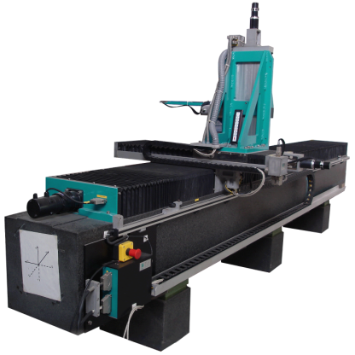

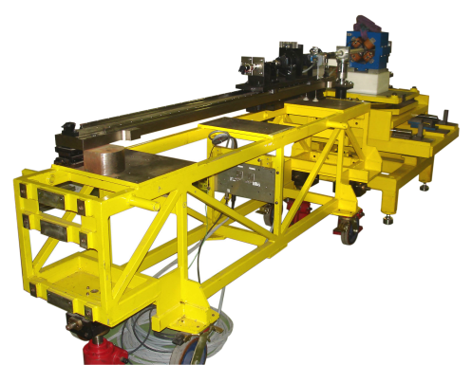

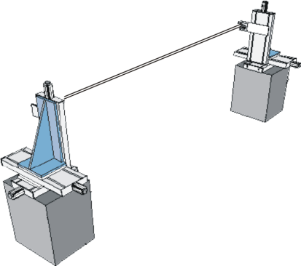

Magnetic measurement activities at ALBA
Requested measurements:
Field map within magnetic midplane
Conventional Hall probe bench
Integrated field quality along straight lines
Rotating coil bench
No coil available with the required dimensions
(∅ <12mm , length >600mm)
Flipping coil with eccentric pieces
Wire supporting pieces defining a radial coil with a width of 7.6mm and an offset of 1.8mm

Slide 9
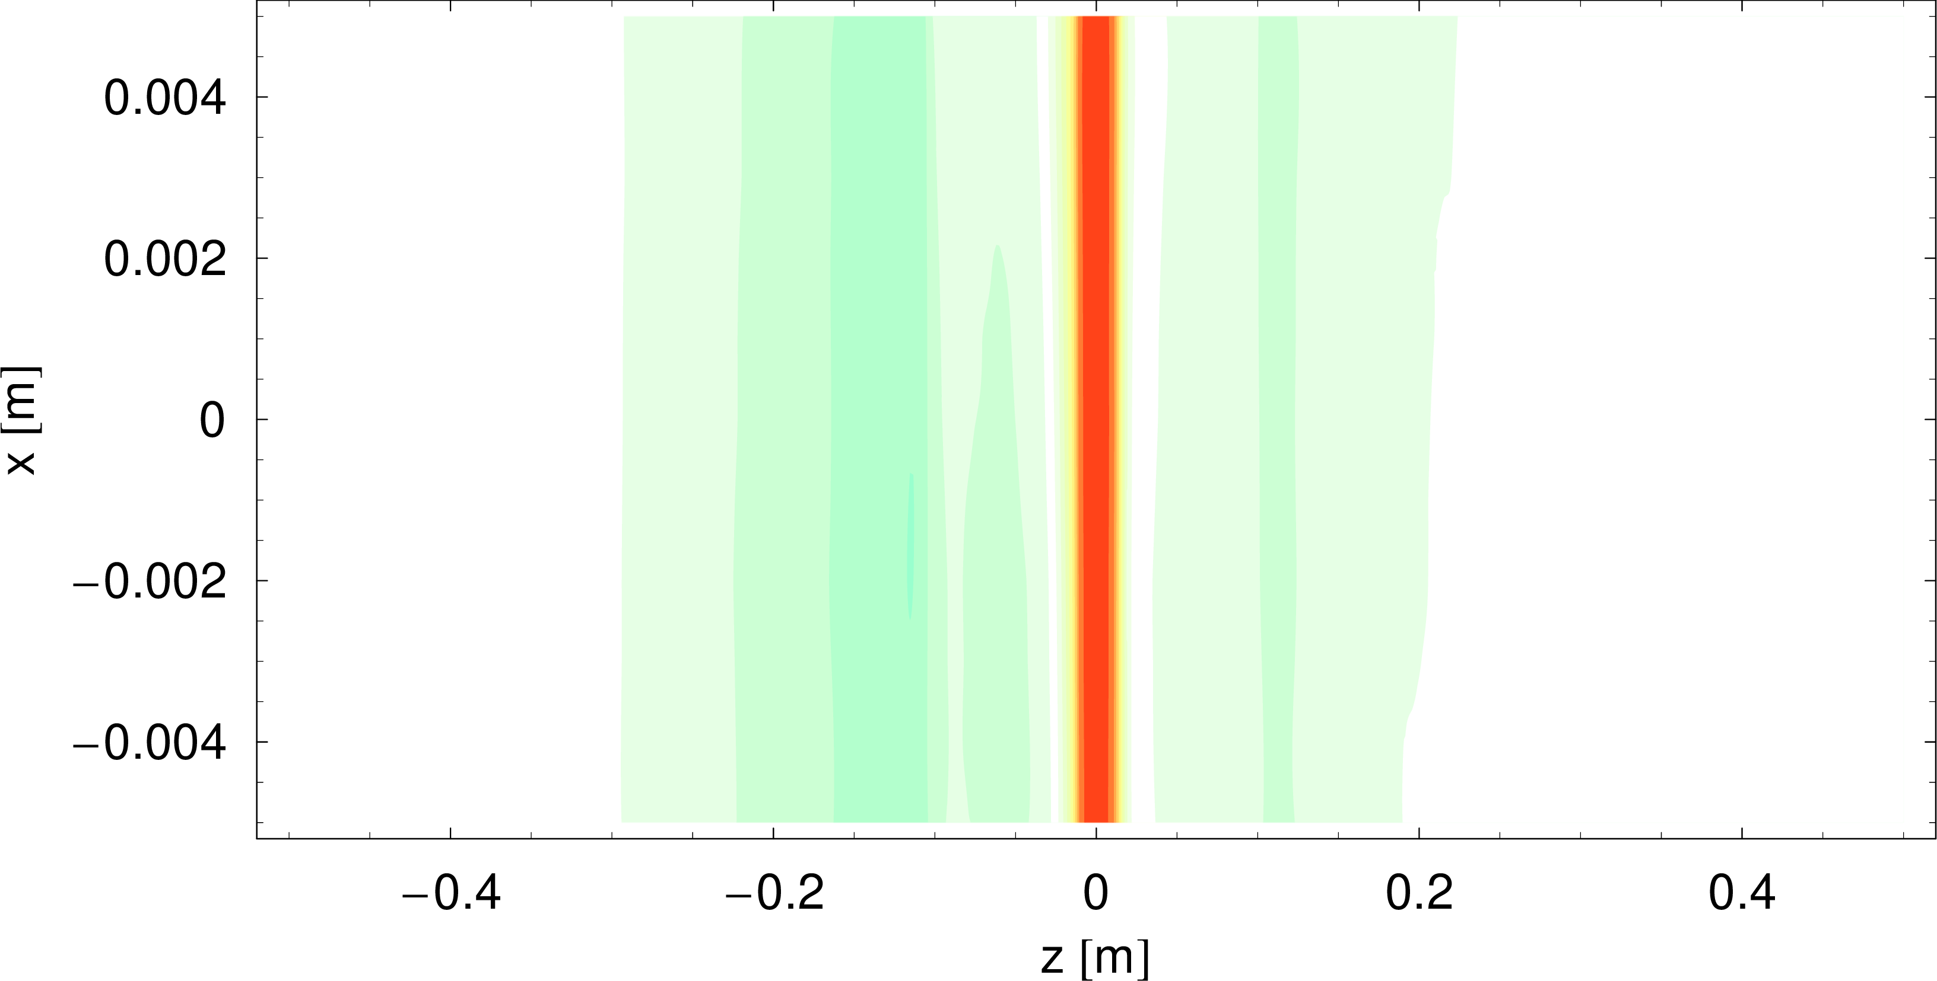
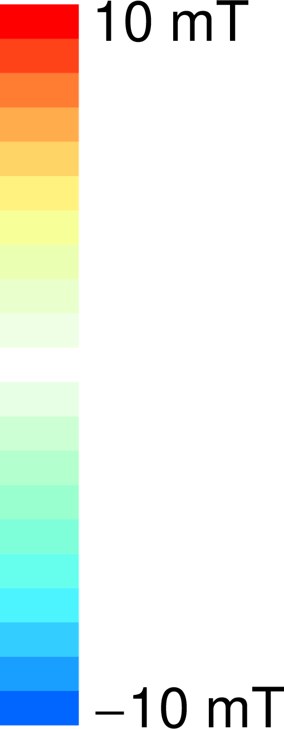
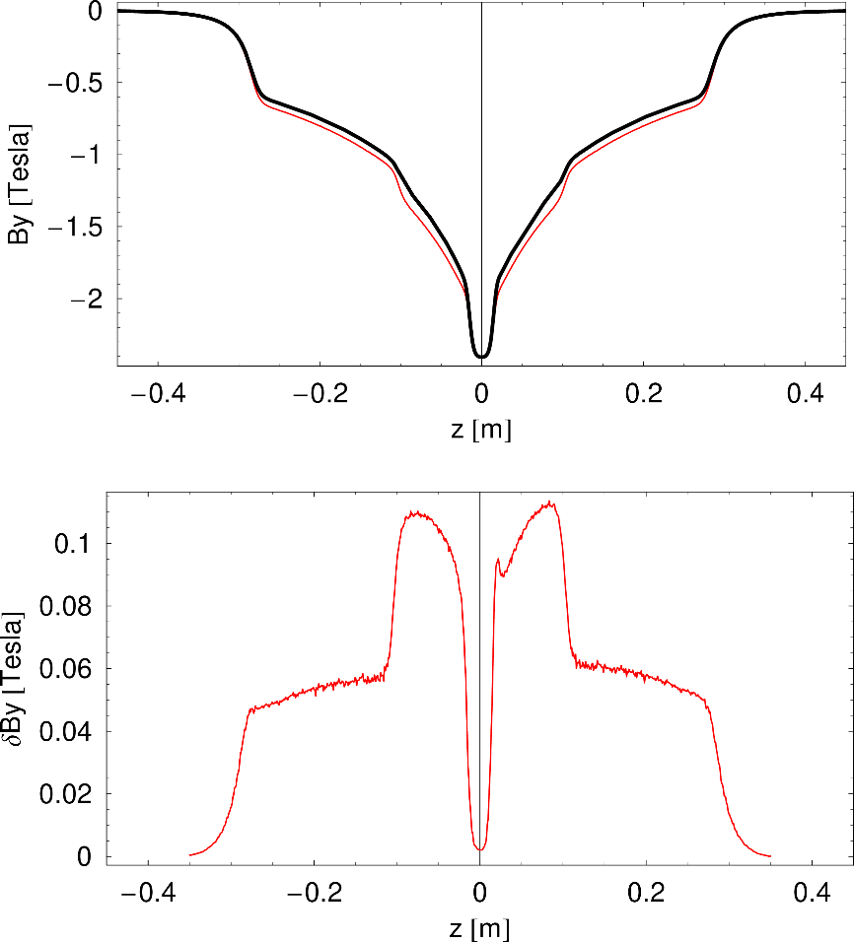
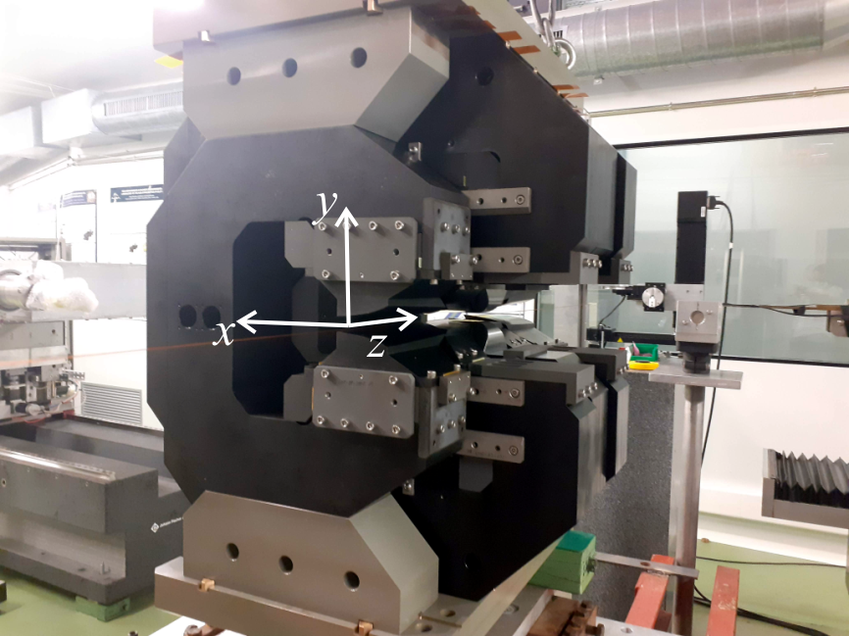
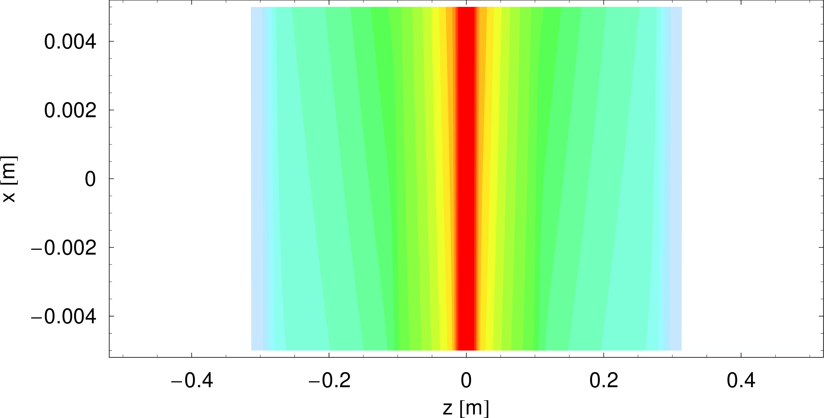
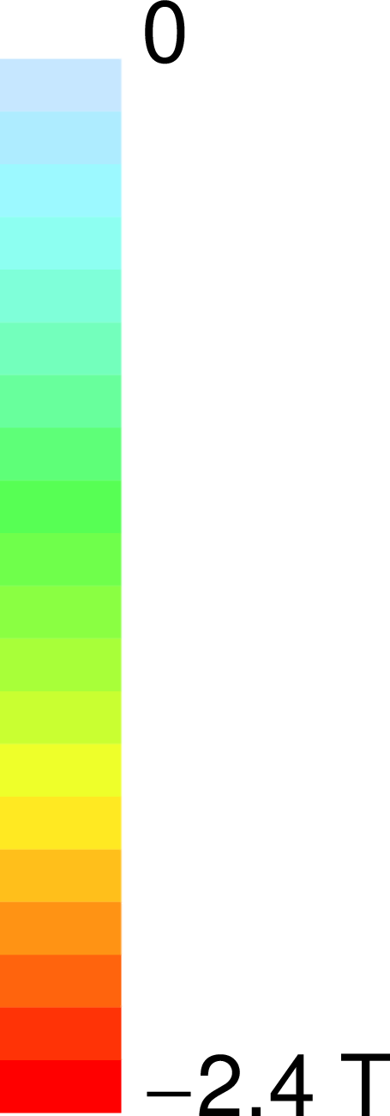

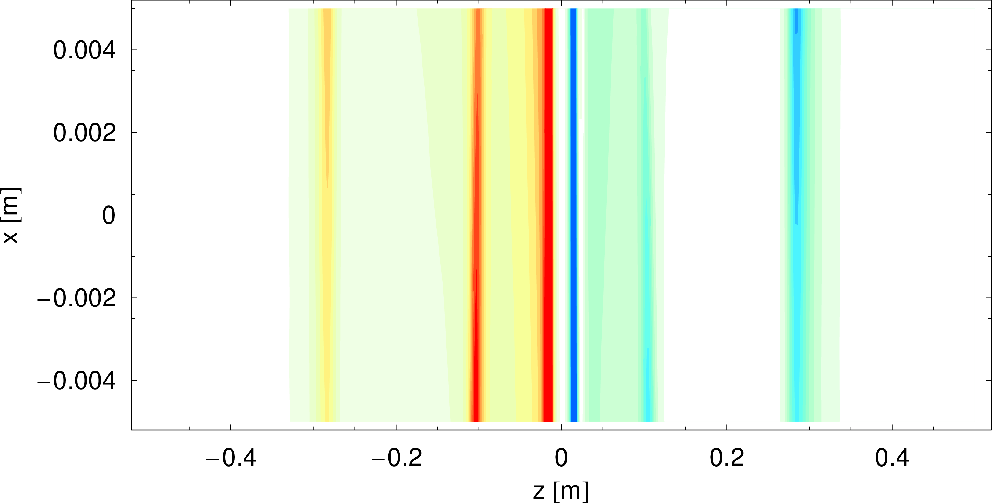



Magnetic measurement activities at ALBA
Results
$$B_{x}$$
Magnetic field profile along z at x=y=0
Hall probe field mapping
$$B_{y}$$
measurement
simulation
$$B_{z}$$
5-6% field defect in medium and low field poles, most likely due to change of Armco poles properties upon machining

Slide 10
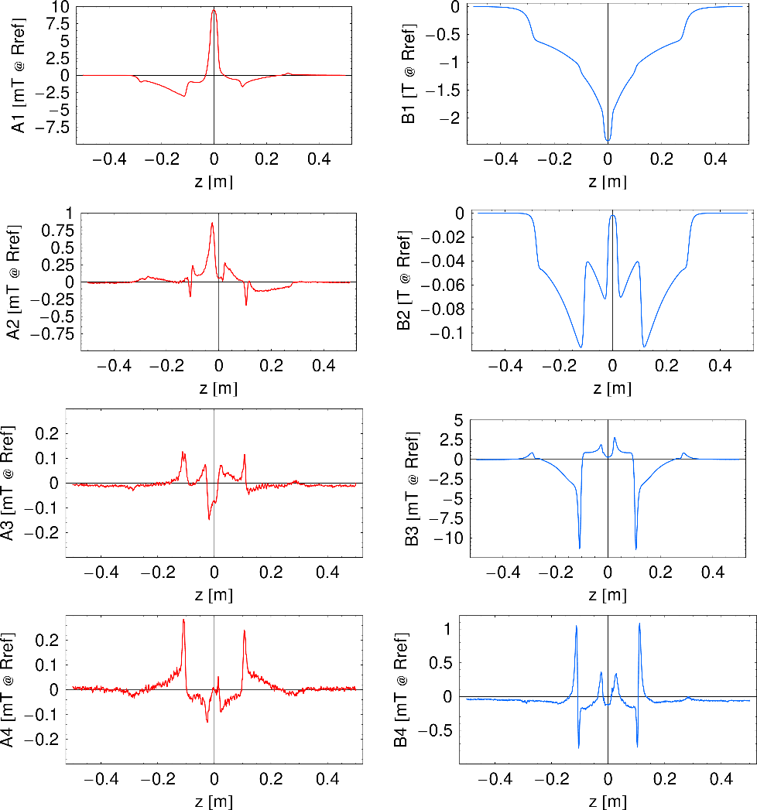
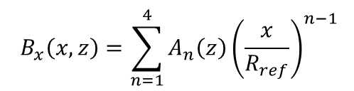
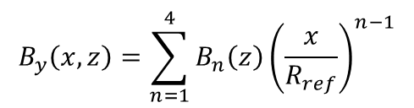
Magnetic measurement activities at ALBA
Computed multipoles at R_{ref}=5mm
Polynomial adjustment of field map data:
Results
Hall probe field mapping
$$B_{y}\left(x,z\right)=\sum_{n=1}^{4}{B_{n}\left(z\right){\left(\frac{x}{R_{ref}}\right)}^{n−1}}$$
$$B_{x}\left(x,z\right)=\sum_{n=1}^{4}{A_{n}\left(z\right){\left(\frac{x}{R_{ref}}\right)}^{n−1}}$$

Slide 11
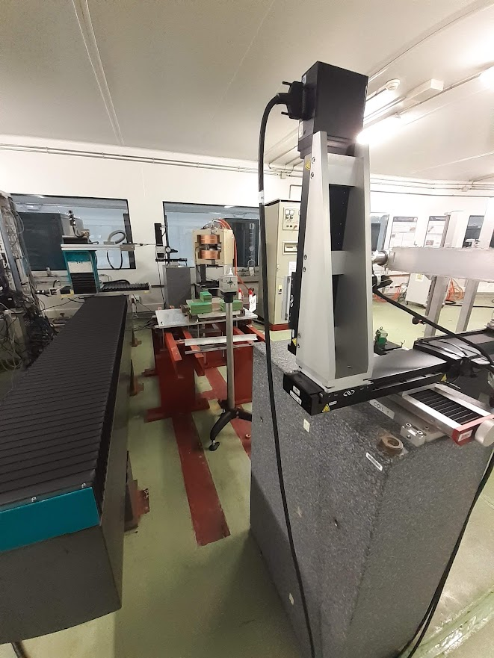
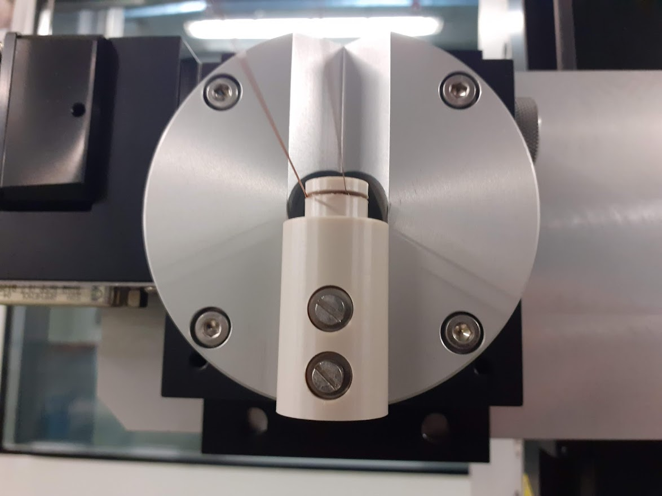
Magnetic measurement activities at ALBA
Results
Flipping coil measurements
Flipping coil at ALBA used to determine residual field integrals of IDs → it is not intended to measure large field integral values with a high accuracy.
We decided to give it a try (“just in case”) to complement Hall probe data.
Stage 2
Stage 1
New support pieces defining a coil displaced wrt the rotation axis.
Support pieces made of PEEK.
5 turns coil with 0.1mm Cu wire.
Exact values of coil parameters calibrated by comparison with Hall probe data (coil width) and self-consistency of B₁ and B₂ when measuring at different horizontal positions (coil offset)
Tension adjustment system

Slide 12
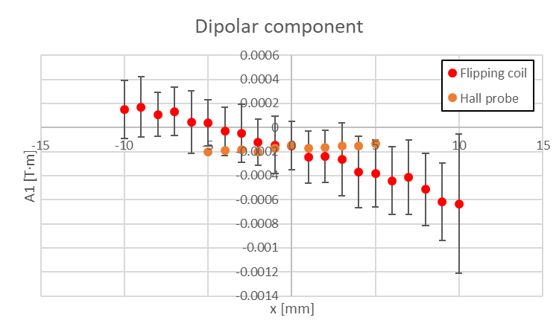
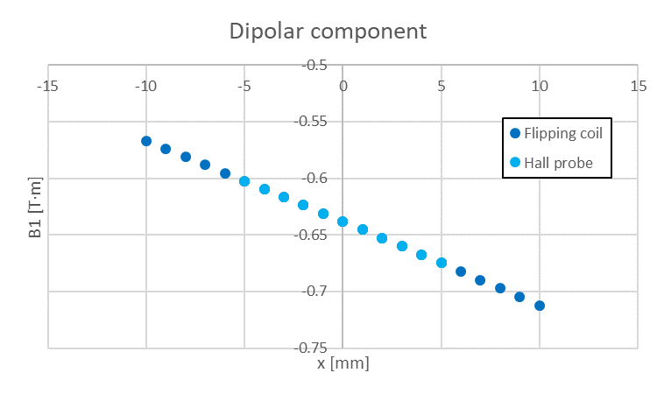
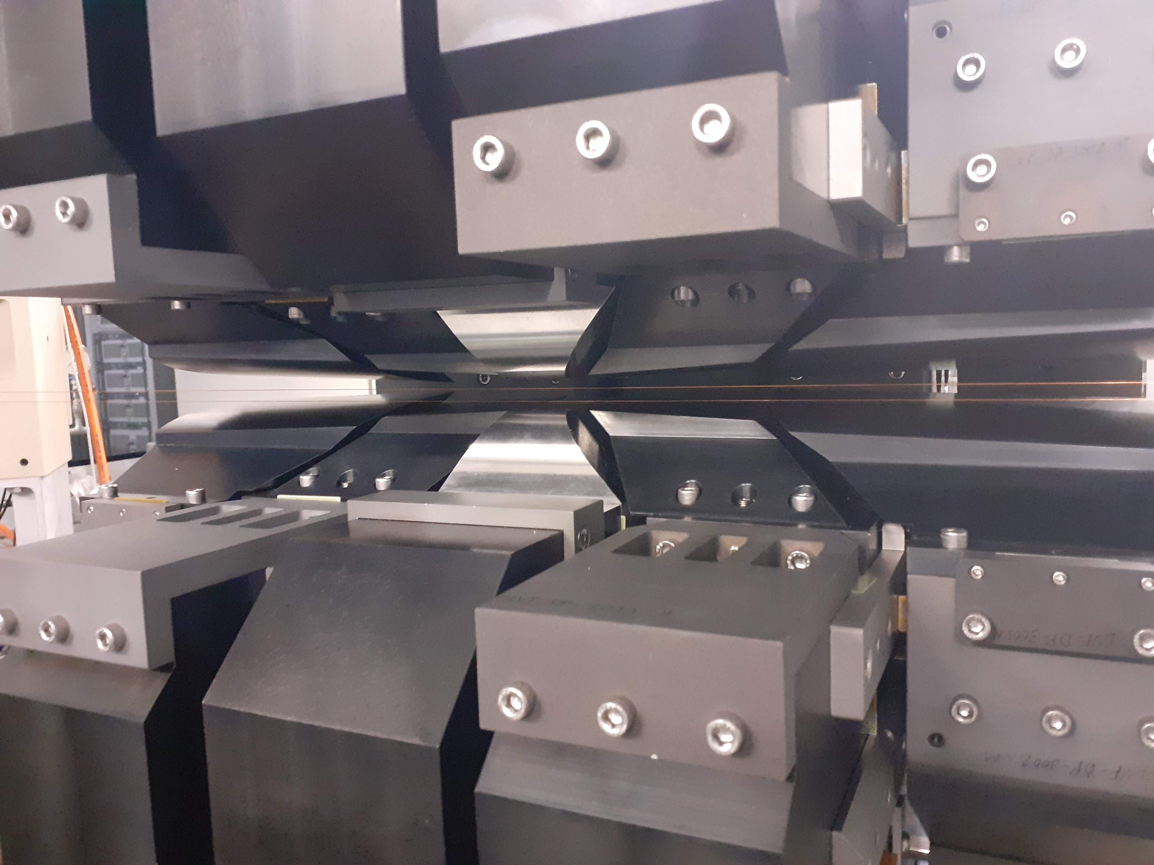
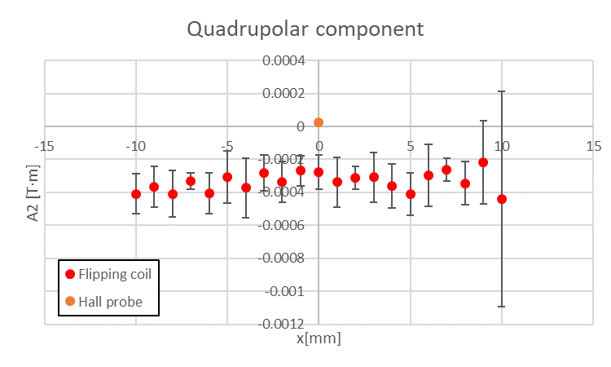
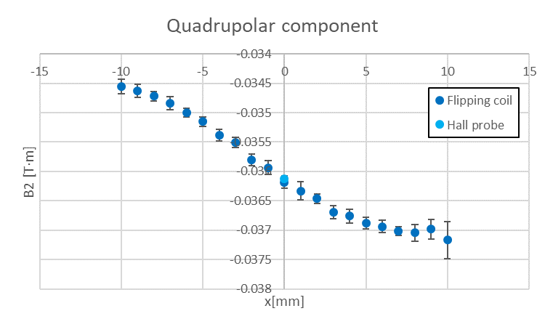
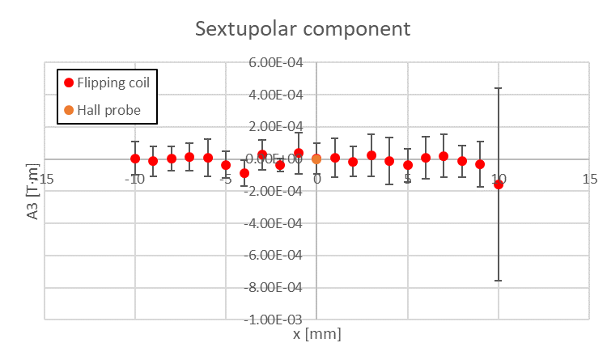
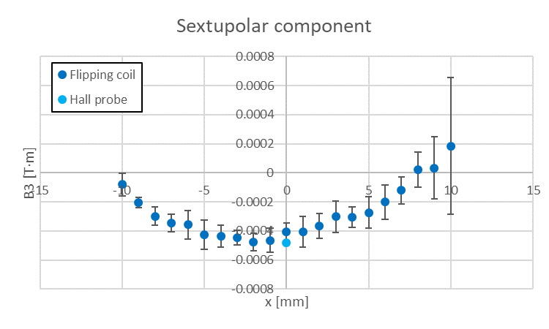
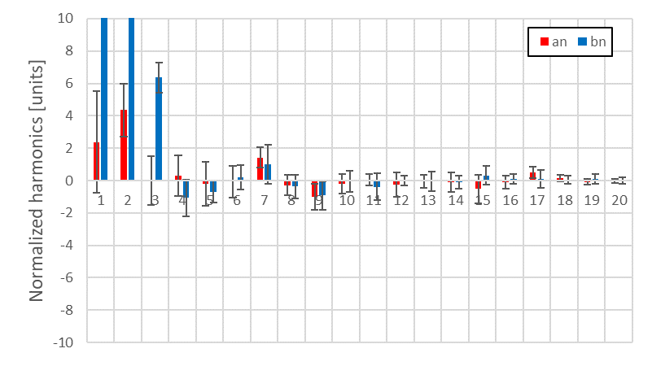
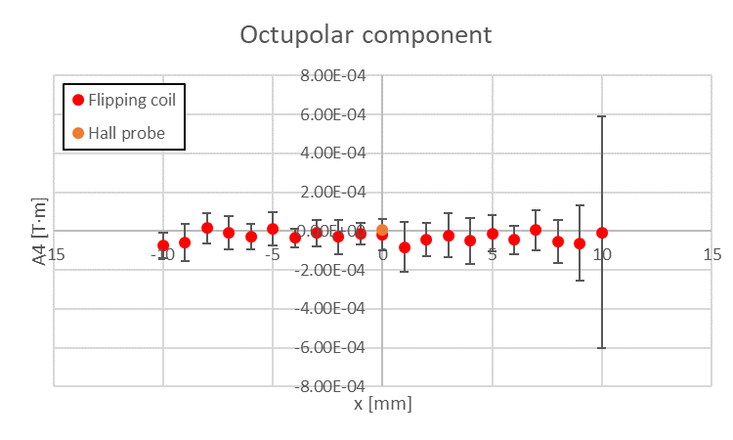
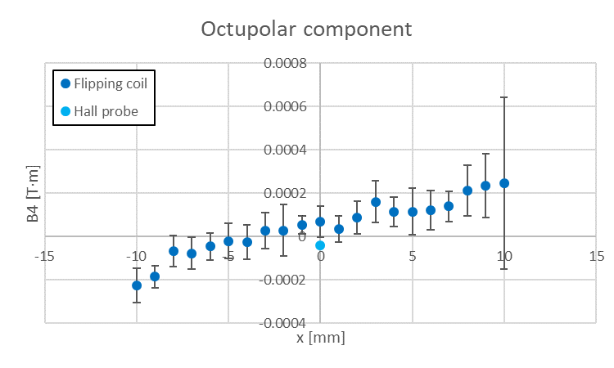
Magnetic measurement activities at ALBA
Integrated multipoles at R_{ref}=5mm
Results
Acquisition system of Flipping coil adapted in order to acquire flux data along the continuous rotation of the wire.
Measurements at different horizontal positions within GFR.
Good agreement between Hall probe and Flipping coil results.
Good magnetic field homogeneity, with high order multipoles smaller than 2 units.
Flipping coil measurements

Slide 13
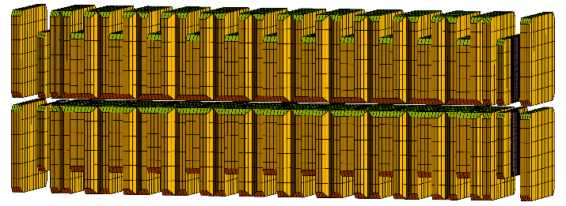
Magnetic measurement activities at ALBA
Insertion Device for FAXTOR beamline at ALBA (fast X-ray microcomputed tomography at high resolution).
In-vacuum multipole wiggler MPW54
ID characteristics
Magnetic configuration | Planar hybrid
Period length [mm] | 54
PM blocks | NdFeB (B_{r}=1.25T)
Iron poles | Vanadium Permendur
Number of periods | 5.5
Magnetic length [mm] | 362
Minimum magnetic gap [mm] | 5.2
Maximum peak field [T] | 2.5
Maximum K | 11.5
5½ periods wiggler RADIA model
(courtesy of AVS)

Slide 14


Magnetic measurement activities at ALBA
Manufacturing contract was awarded to AVS company:
  US division of the company (AVS|US, former ADC) took care of the magnetic structure assembly and tuning and its integration into the vacuum chamber.
  Spanish headquarters of the company took care of the mechanical support structure and the final integration of the whole device.

Slide 15
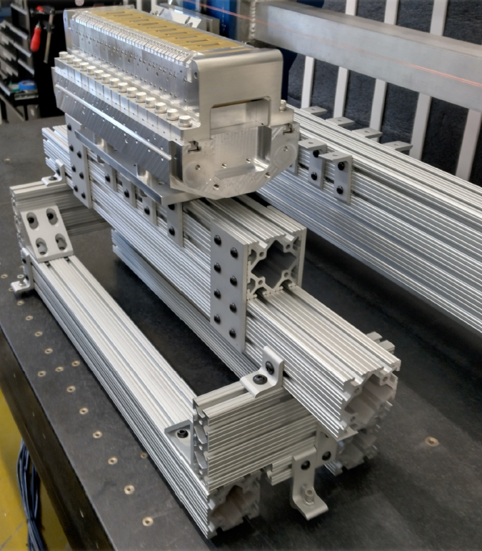
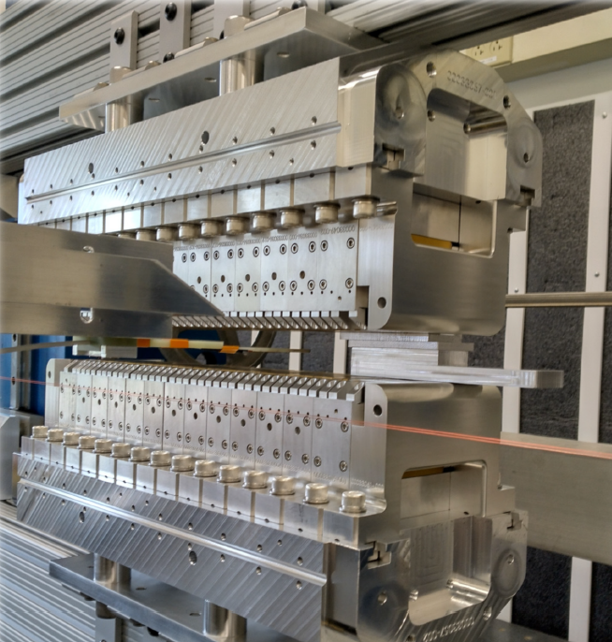
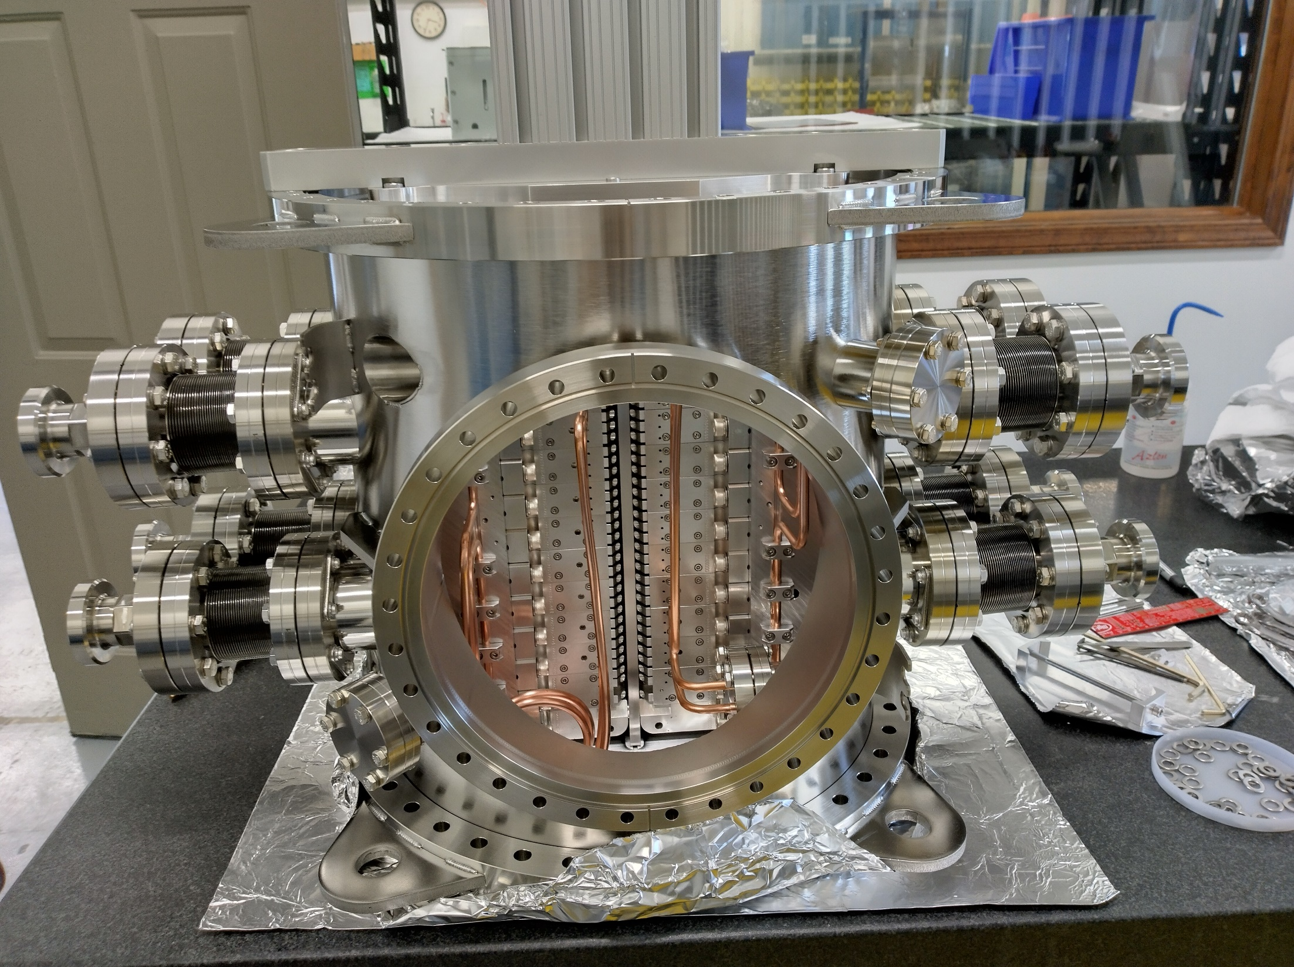
Magnetic measurement activities at ALBA
AVS|US assembled and shimmed the individual magnet arrays, and afterwards transferred them to a temporary support carriage to determine and adjust their combined effect at different gaps.
Once within specs, the arrays where mounted inside the vacuum chamber, and the assembly shipped to AVS headquarters for its integration into the final support structure.
Single array tuning
Combined arrays on temporary carriage
Assembly into vacuum chamber prior to shipping

Slide 16
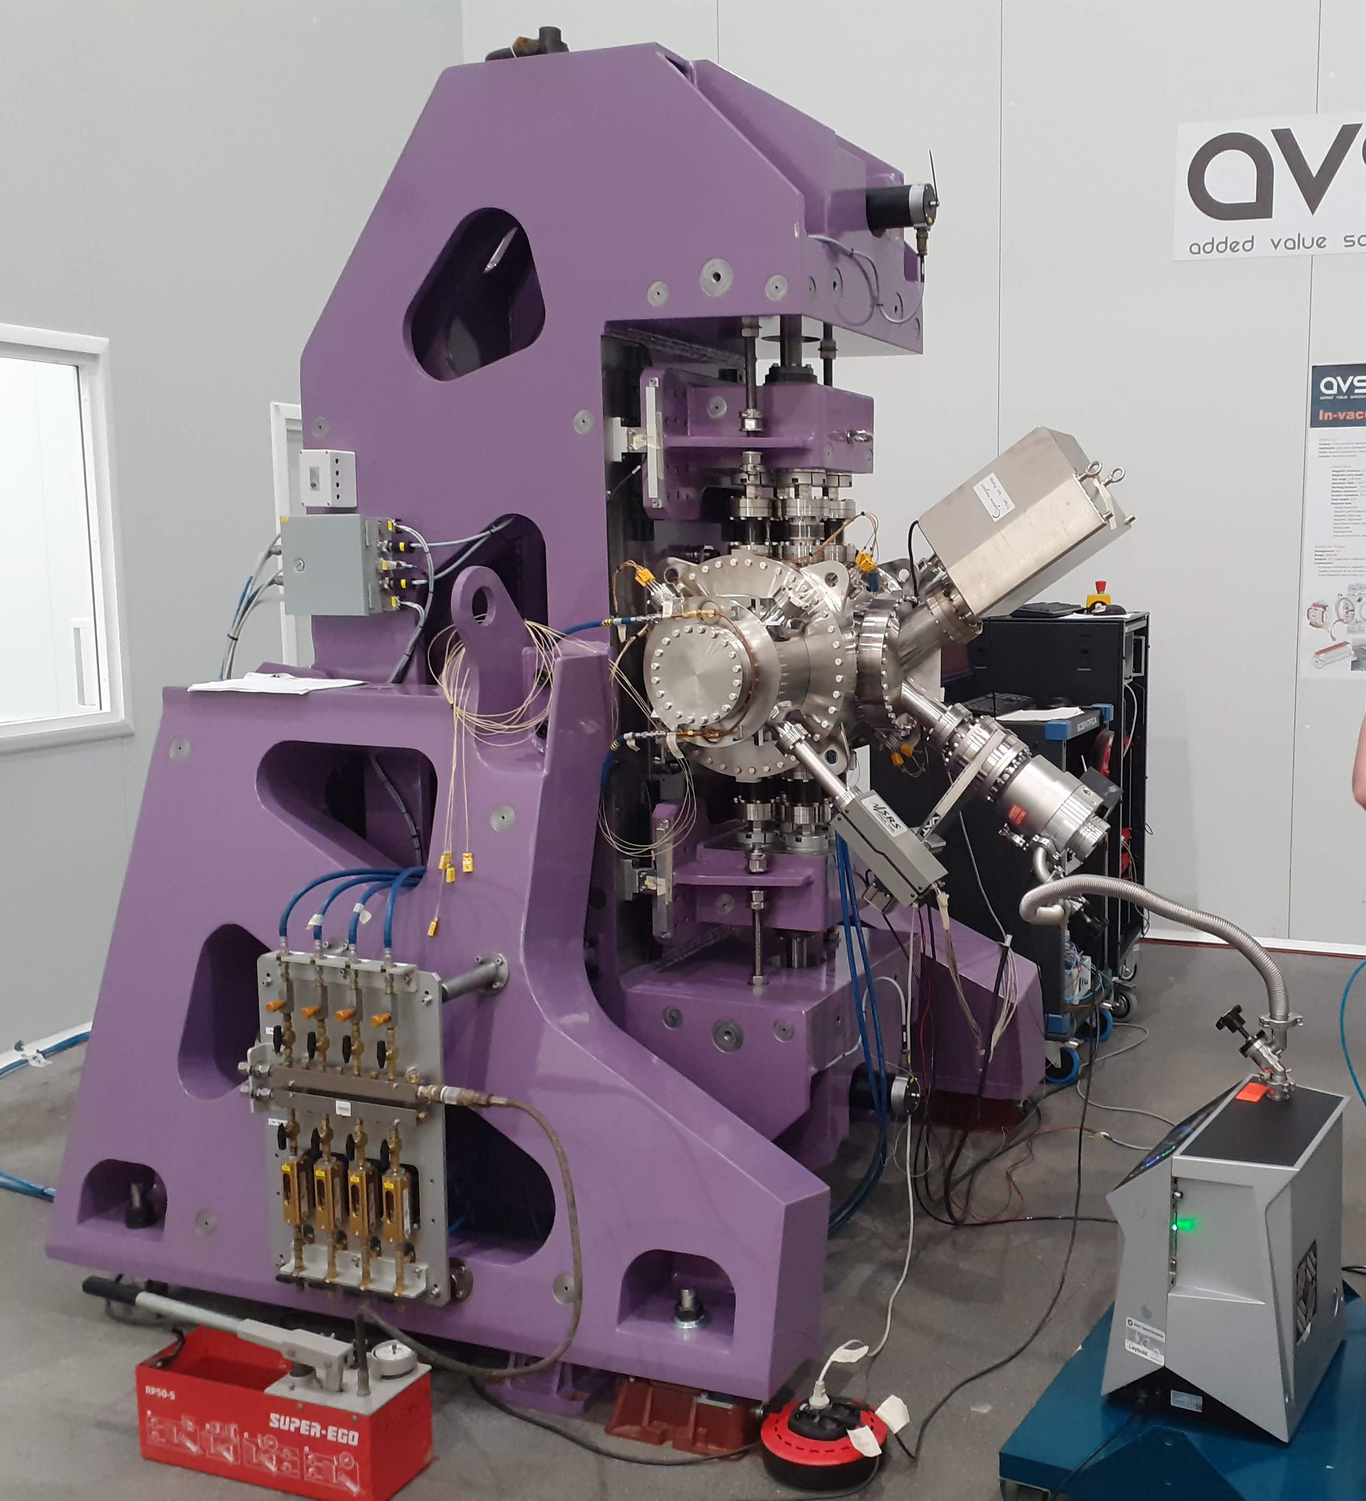
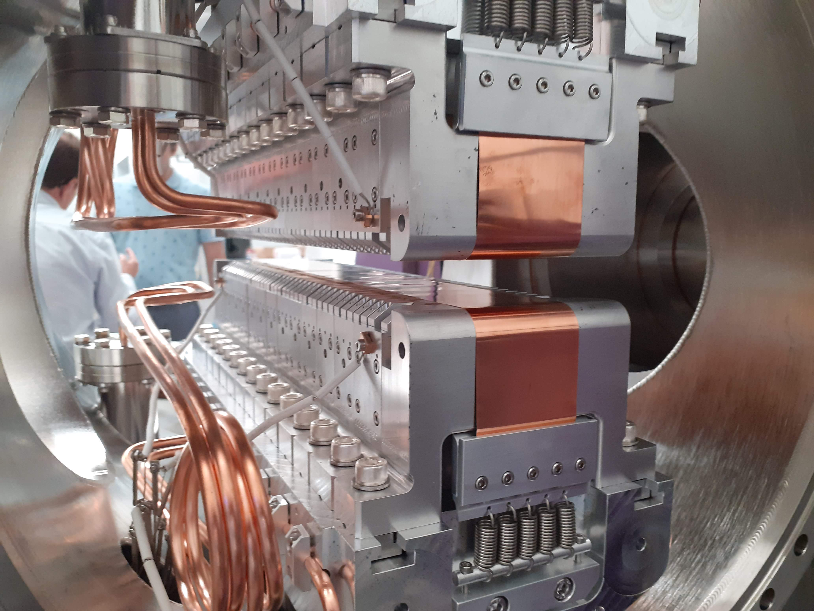
Magnetic measurement activities at ALBA
Final integration at AVS (Spain) has already taken place, and the FAT of the mechanical aspects of the device was carried on the 21—22 of Sept ‘22.
Assembled ID at AVS headquarters
Detail of magnet arrays inside vacuum chamber

Slide 17


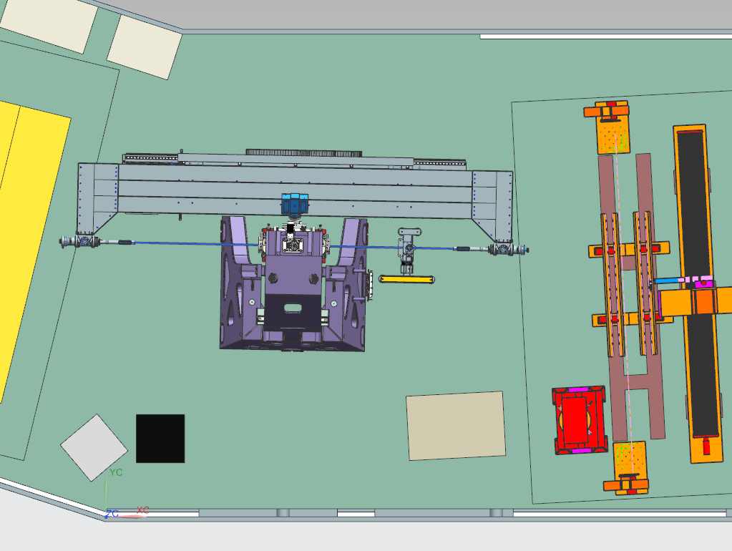
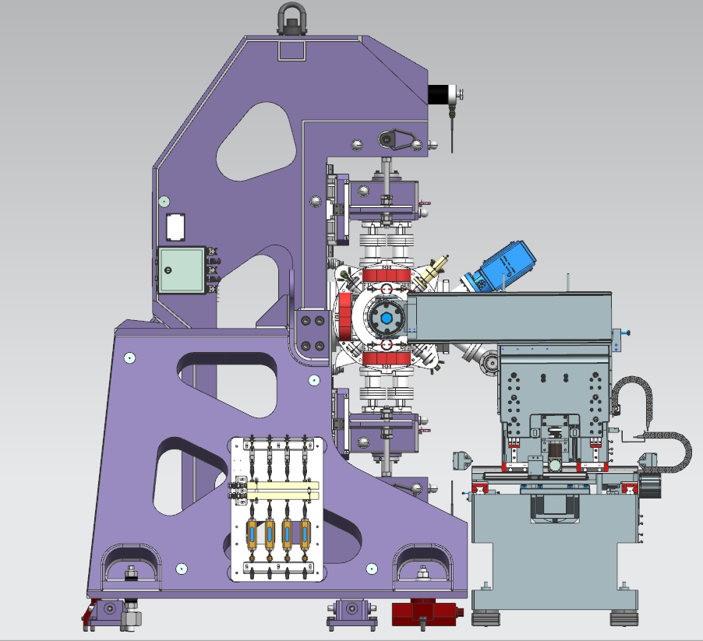
Magnetic measurement activities at ALBA
Final adjustments of the magnetic structure (relative alignment between magnet arrays, optimization of magic fingers for integrated multipole correction, verification of correction coils, etc) will be carried out at ALBA magnetic measurements laboratory using our dedicated Hall probe bench for closed structures

Slide 18
Outline
Effect of Covid-19 pandemics
Magnetic measurement activities at ALBA
Upgrade plans at ALBA
Magnetic measurement group reorganization
Conclusions

Slide 19

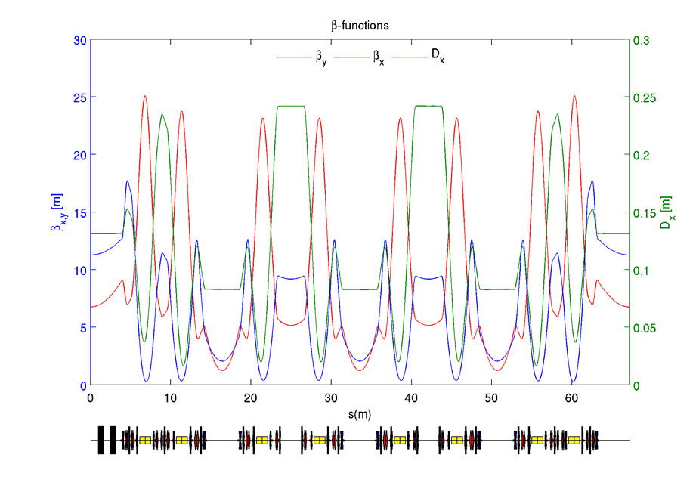
Upgrade plans at ALBA
ALBA lattice
  8+8 DBA-like cells

Slide 20

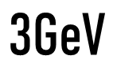
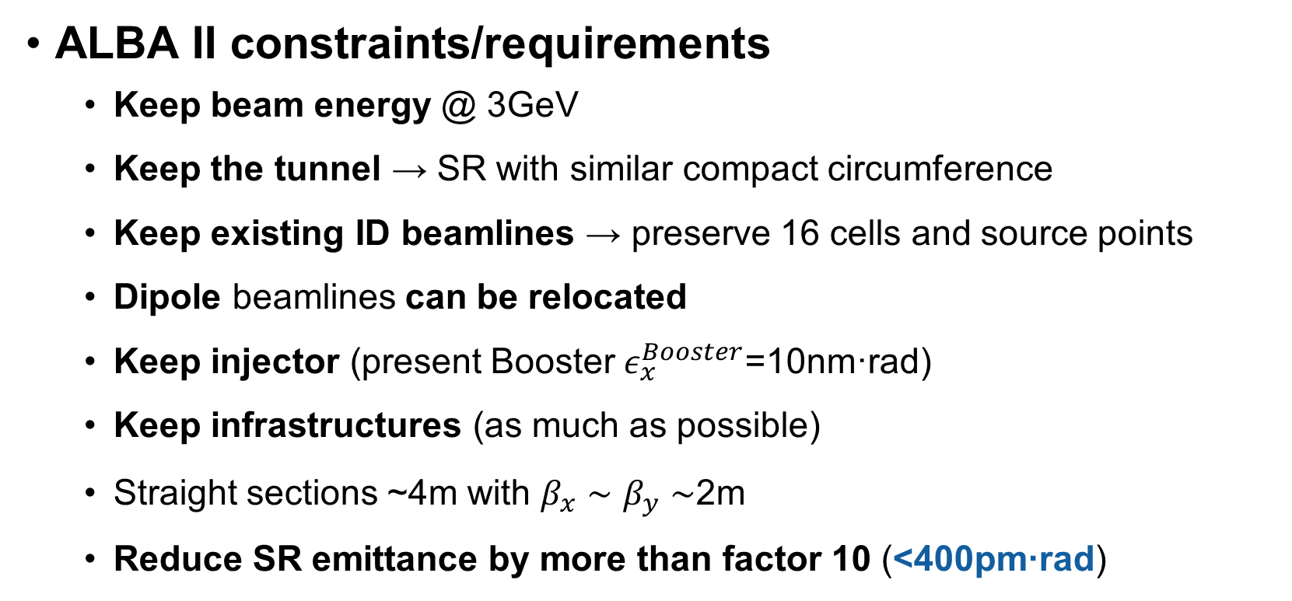
Upgrade plans at ALBA
ALBA II constraints/requirements
  Keep beam energy @ 3GeV
  Keep the tunnel → SR with similar compact circumference
  Keep existing ID beamlines → preserve 16 cells and source points
  Dipole beamlines can be relocated
  Keep injector (present Booster $ε_{x}^{Booster}$=10nm·rad)
  Keep infrastructures (as much as possible)
  Straight sections ~4m with $β_{x}∼β_{y}∼$2m
  Reduce SR emittance by more than factor 10 (<400pm·rad)

Slide 21

Upgrade plans at ALBA
Proposed solution:
  From 2×8 double-bend lattice (DBA)
  To 1×16 multi-bend lattice (6BA)
IPAC21 contribution (WEPB074)

Slide 22
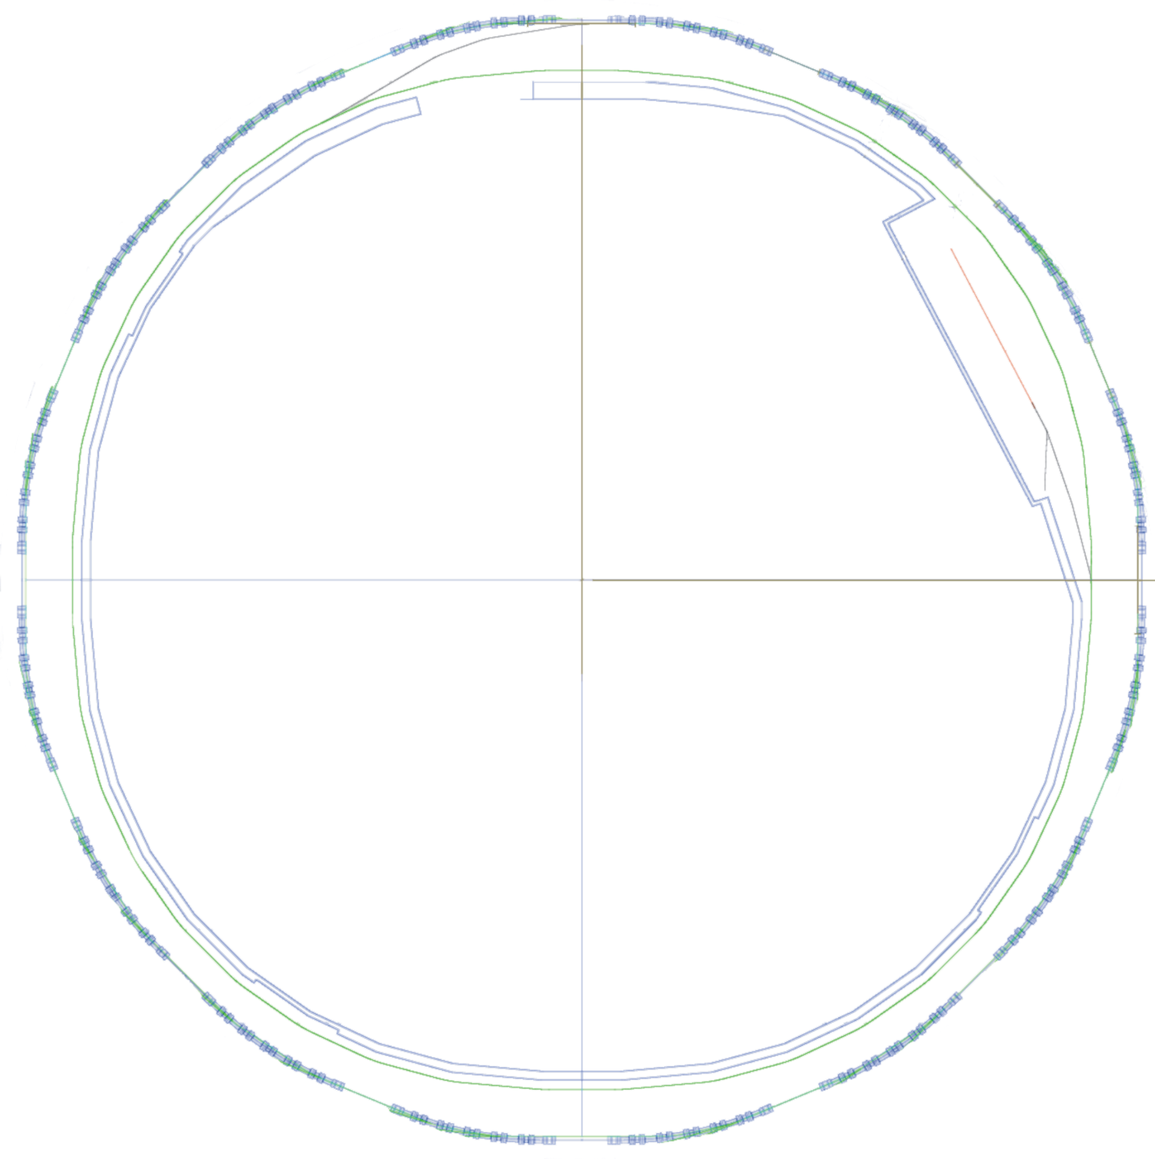
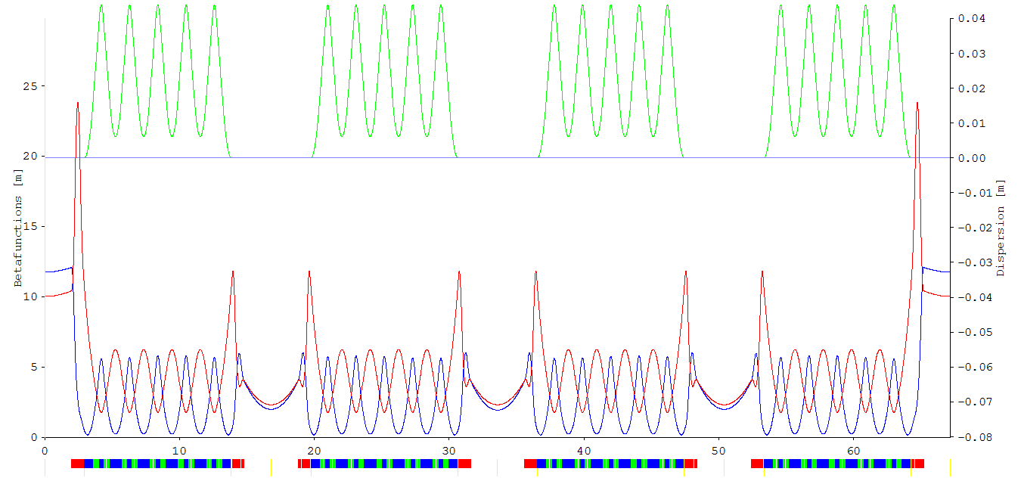
Upgrade plans at ALBA
ALBA II lattice
  16 6BA cells
Parameters
 | ALBA | ALBA II
Energy | 3 GeV | 3 GeV
Circumference | 268.8 m | 268.8
Symmetry | 4-fold | 4-fold
Emittance | 4.5 nm·rad | 140 pm·rad
Nº of cells | 8+8 | 16
# of straights | 4 / 12 /8 | 16
Straight length | 7.8 / 4.0 / 2.3m | 4.0 m
High beta required for injection

Slide 23
Upgrade plans at ALBA
The tentative cost for the upgrade is 120M€, to be added to ALBA budget along 10 years (increase of 30% on average)
The upgrade project is still not funded, but we have received the approval (Dec 2020) from our Governing Body to start a design study
The project’s White Paper is foreseen to be issued by the end of 2022
In parallel, a 4-year project (ALBA01) devoted to the development of prototypes and funded with 7.5M€ is already ongoing
  Development of magnets, vacuum chambers, girders, IDs and nanopositioning systems for BL optics & instrumentation

Slide 24
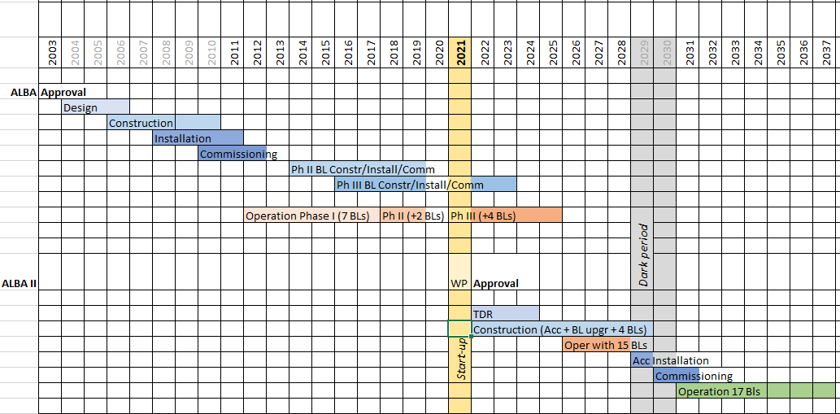


Upgrade plans at ALBA
ALBA II White Paper (Dec ‘22)
Tentative ALBA II timeline
Project ALBA01
“Enabling advanced technologies for ALBA II”

Slide 25
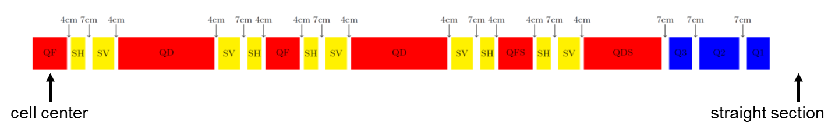
Upgrade plans at ALBA
ALBA II lattice is based in 16 identical 6BA cells, with 9 magnet types, for a total of 592 individual magnets (currently 264 magnets at ALBA SR)
Distances between magnets’ effective lengths
Half 6BA unit cell
Yoke-to-yoke distances will be larger by at least 1cm
Magnet description | Types | # per cell | # in SR
Bend with trans grad | 2 (QD, QDS) | 6 | 96
Antibend with trans grad | 2 (QF, QFS) | 5 | 80
Quadrupoles | 3 (Q1, Q2, Q3) | 6 | 96
Sextupoles | 2 (SH, SV) | 20 | 320
Total | 9 | 37 | 592

Slide 26

Upgrade plans at ALBA
Beam dynamics group has defined a primary set of requirements (field/gradient strengths and lengths) for the magnets of ALBA II lattice:
Magnet description | Types | Length [m] | Field [Tesla] | Gradient (K₁) [T/m] | 2nd order grad (K₂) [T/m²]
Bending with transversal gradient | QD | 0.8669 | 1.009 | -15.41
 | QDS | 0.6310 | 0.819 | 2.03
Antibending with transversal gradient | QF | 0.2972 | -0.394 | 70.05
 | QFS | 0.2972 | -0.425 | 70.05
Quadrupoles | Q1 | 0.2000 |  | -31.54
 | Q2 | 0.3500 |  | 83.16
 | Q3 | 0.2000 |  | -109.83
Quadrupoles (injection) | IQ1 | 0.2000 |  | 44.70
 | IQ2 | 0.3500 |  | -69.61
 | IQ3 | 0.2000 |  | 89.71
Sextupoles | SH | 0.1042 |  |  | 4936
 | SV | 0.1823 |  |  | -4084
Relationship between gradients and pole-tip field:
quadrupoles: $B_{tip}≃K_{1} r$
sextupoles: $B_{tip}≃K_{2} r^{2}$
Different current settings for quadrupoles adjacent to injection straight (and equivalent straights)

Slide 27
Outline
Effect of Covid-19 pandemics
Magnetic measurement activities at ALBA
Upgrade plans at ALBA
Magnetic measurement group reorganization
Conclusions

Slide 28


Magnetic measurements group reorganization
By the end of 2021 our section was reorganized in order to face upcoming challenges:
Insertion Devices, Magnets and Front Ends Section
Insertion Devices and Front Ends Section
Jordi Marcos
IDs & Magnets Group
FEs Group
Valentí Massana
Raquel Monge
3 persons since 2005
Andrea Fontanet
Support operator
Open position
Manuel Rodríguez

Slide 29
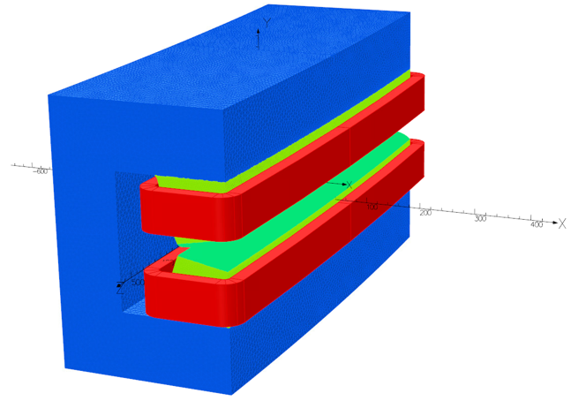
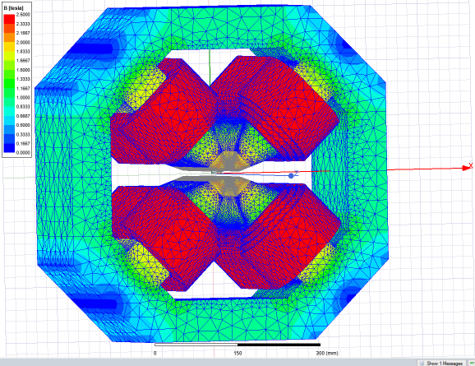
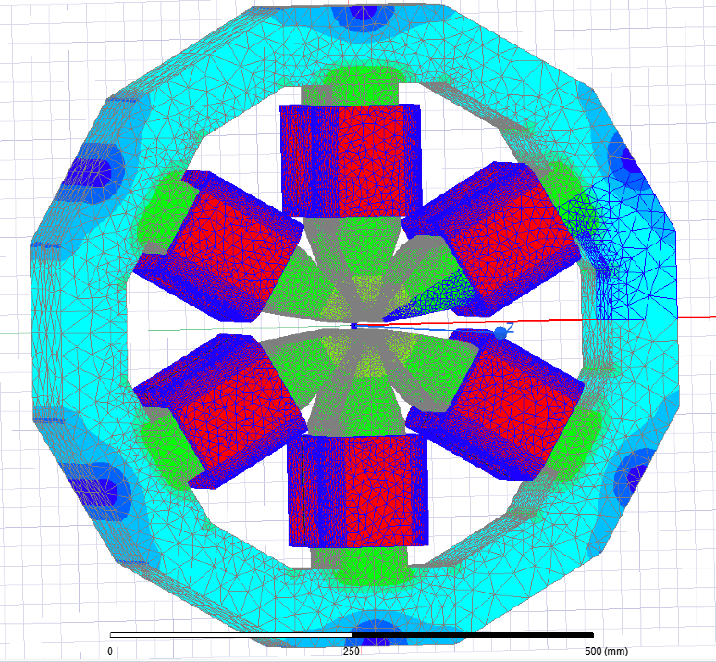
Magnetic measurements group reorganization
Responsibilities of IDs & Magnets Group:
  Maintenance of IDs already installed at ALBA.
  Design, follow-up and test/acceptance of IDs for new Beamlines (~1 ID each 2 years).
  Operate and upgrade magnetic measurements lab (internal and external requests).
  Design of prototypes for ALBA II magnets (2022-2025):
    Design work already started.
    CFTs to be launched before end of 2023.
  Definition of strategy for the procurement and characterization of ALBA II series magnets:
    Magnets manufacturing will be completely outsourced (details of the company validation procedure still to be defined).
    Approach to the validation/characterization of magnets still to be devised.

Slide 30
Outline
Effect of Covid-19 pandemics
Magnetic measurement activities at ALBA
Upgrade plans at ALBA
Magnetic measurement group reorganization
Conclusions

Slide 31
Conclusions
Since last IMMW21, the volume of activity at ALBA magnetic measurements lab has decreased. Despite of this, some new measurement modes have been tested with encouraging results.
One year ago the ID & FE section at ALBA underwent a complete renewal in order to face ALBA upgrade challenges, and to take care of all the aspects of ALBA II magnets procurement, validation and characterization
We are confident that at the time of IMMW22 (by 2024) we will be able to show you some interesting advances regarding ALBA II magnets design and procurement/verification strategy (at least we hope so).

Slide 32
Questions?

