Slide 1


Field measurement of a cryogenic permanent magnet undulator at TPS
IMMW22 , Sep. 27, 2022
Chin-Kang Yang, Jui-Che Huang, Chih-Sheng Yang, Chih-Wei Chen, Yun-Liang Chu, and Ching-Shiang Hwang
NSRRC, Taiwan

Slide 2
Outline
Introduction
  CPMU
  Spring module and temperature control
Measurement system–
  upgrade
  Hall probe calibration
Field tuning
  Differential adjusters
  Spring modules
Summary
Notes:
In my presentation, I will first introduce the cryogenic undulator for the TPS. This cryogenic undulator is constructed at NSRRC in cooperation with NEOMAX engineering. The main goals of TPS CPMU developments are low-intrinsic-phase errors and high thermal stability against diverse heat loads. Low-intrinsic-phase errors can be obtained by force-compensation modules on the out-of-vacuum girders in a four-support-point configuration and temperature control.
Then talk about the upgrades of the in-situ measurement system to measure this cryogenic undulator, and the Hall probe calibration against temperature to reduce the field error.
The Field tuning is needed after the magnet cooled down. By adjusting differential adjusters and spring modules, the RMS phase errors can be keep below 2 degrees to meet our goal.
And finally. I will give a summary

Slide 3
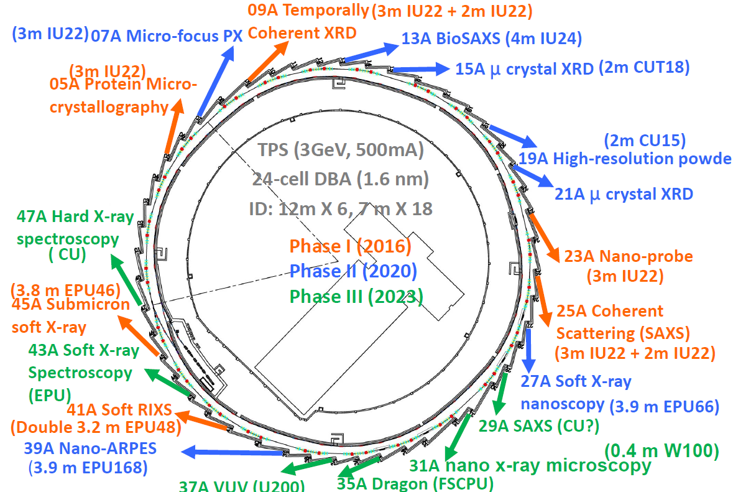
CPMUs of the TPS
Notes:
In TPS phase two beamlines, seven insertion devices are constructed and installed. Among them, two cryogenic type undulators are installed to provide high brilliant X-rays above 10 keV. This presentation will focus on one of these two undulators, a 2 meter long cryogenic undulator fifteen, about its field measurement system and measuring results.

Slide 4
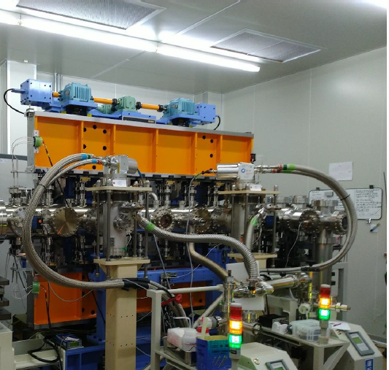
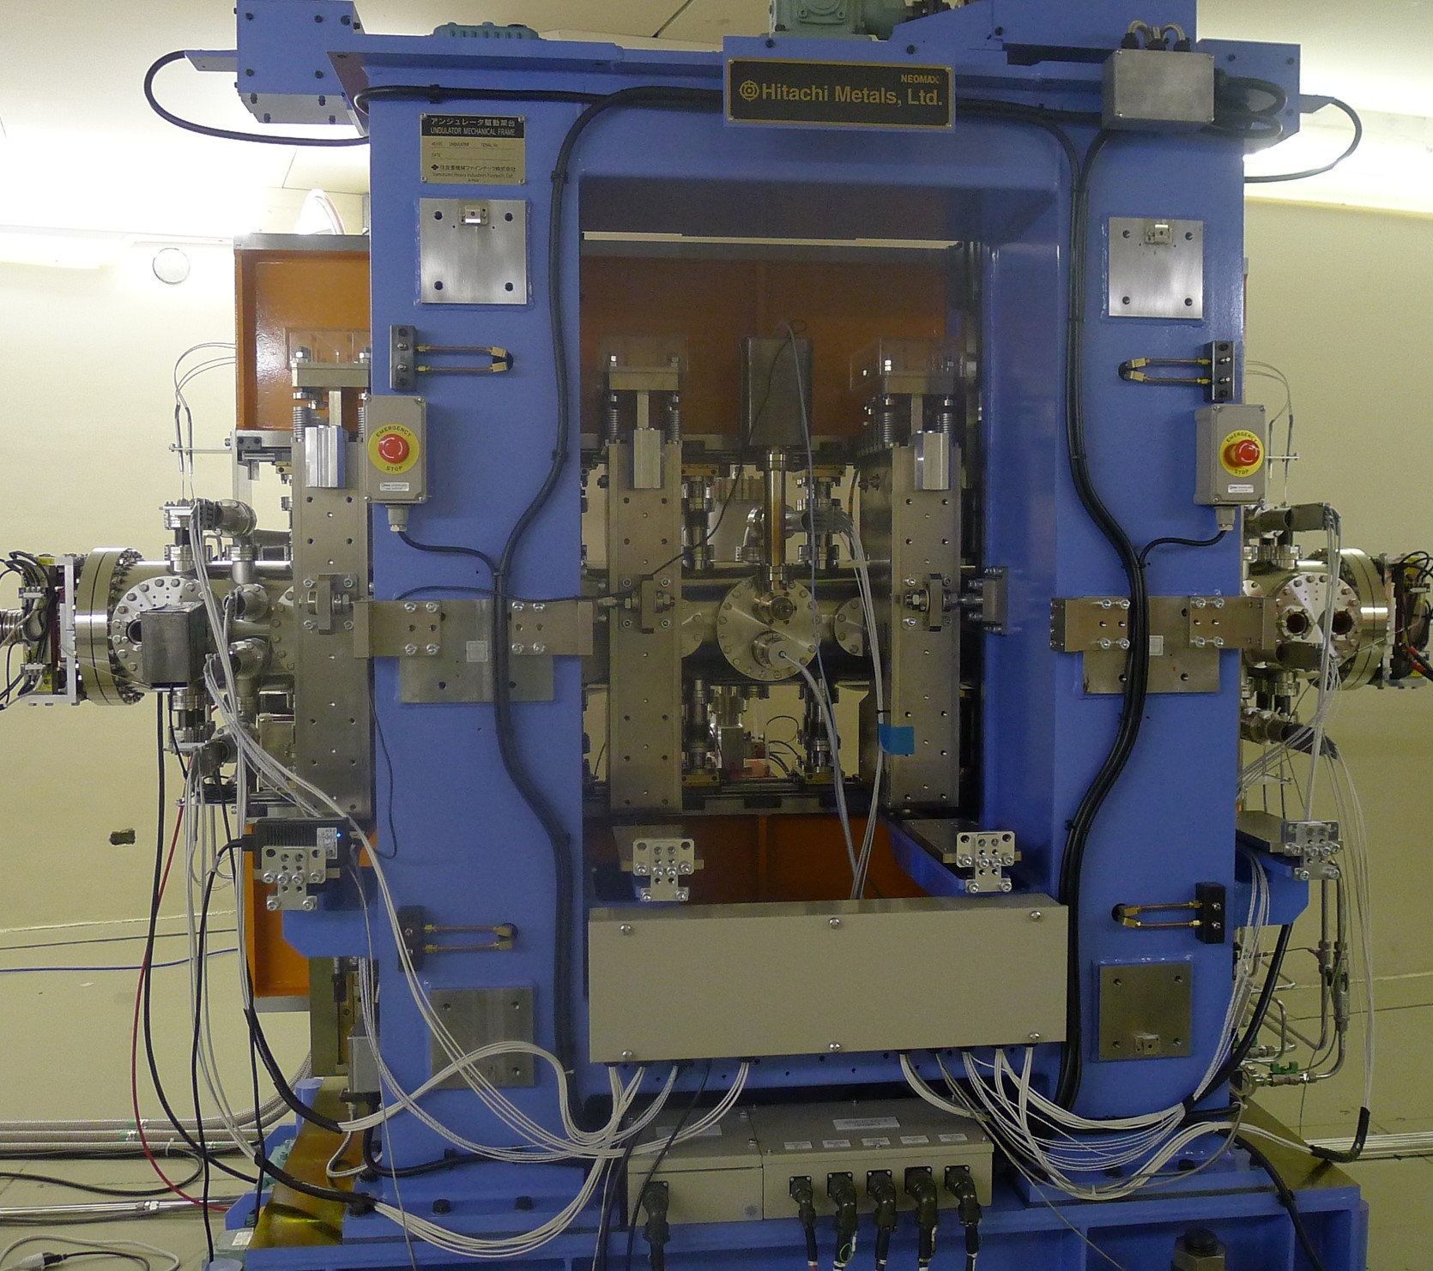
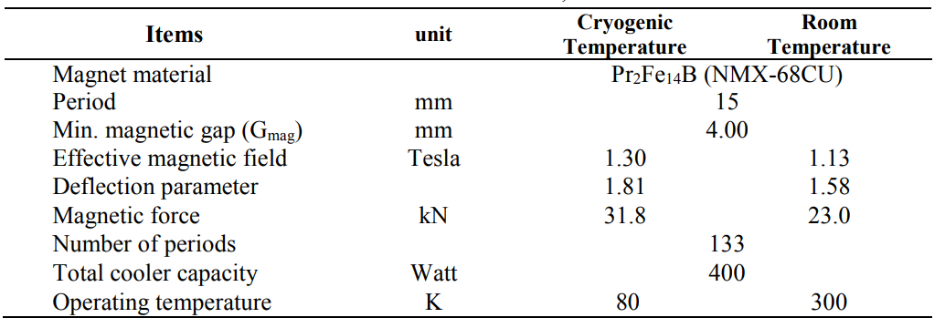
CPMU15
Notes:
The main characteristics of the TPS CU fifteen is shown in this slide. The minimum magnetic gap is 4 mm to achieve an effective K value of 1.81 at eighty kelvin. the main features of the CU fifteen are the uses of a new grade PrFeB permanent magnet material with high remnant fields, a mechanical frame with force-compensating spring modules, and cryo-coolers to compensate for diverse sources of heat loads.

Slide 5
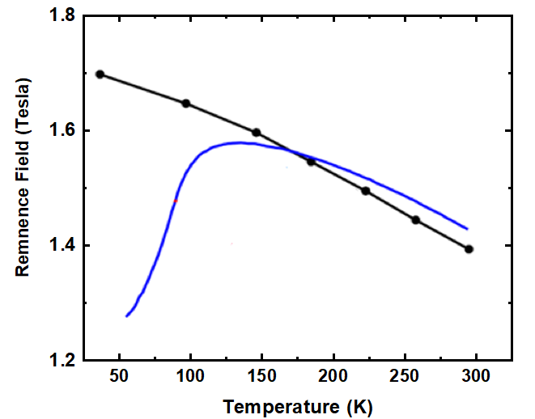
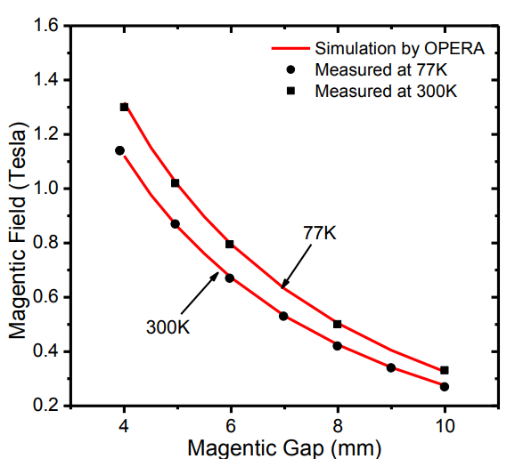
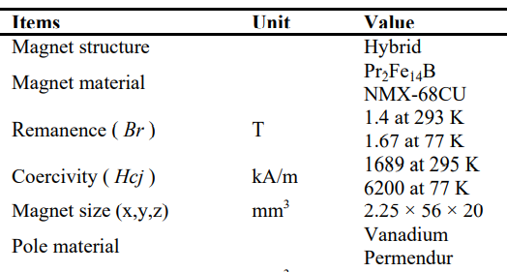
Magnet material
PrFeB
NdFeB
T. Hara and et al, Phys. Rev. ST ACCEL. Beams. 7, 050702 (2004)
J. C. Huang et al., "Development of cryogenic permanent magnet undulators at NSRRC", Proc. AIP Conf., vol. 2054, no. 1, 2019.
Notes:
The CU fifteen has hybrid type magnet structure. The pole material is vanadium permendur. The permanent magnet material is PrFeB. When cooled down to 80K, it has a high remnant field of 1.67 Tesla. Compared to NdFeB material used at TPS in-vacuum undulators at room temperature this is a 35% increase for this material at cryogenic temperature. The coercivity of the PrFeB reaches one thousand and seven hundred kilo-Amper per meter at room temperature so the demagnetization of this material can be minimized during assembly and sea shipment. The magnetic field in a gap of 4 mm is 1.13 T at room temperature and 1.30 Tesla at cryogenic temperature .

Slide 6
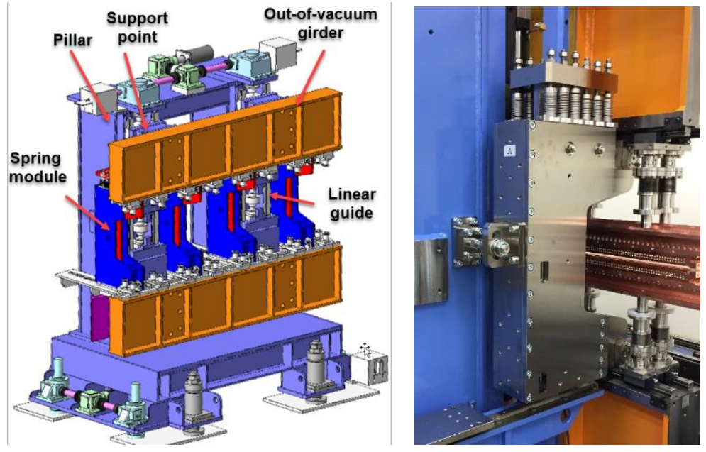
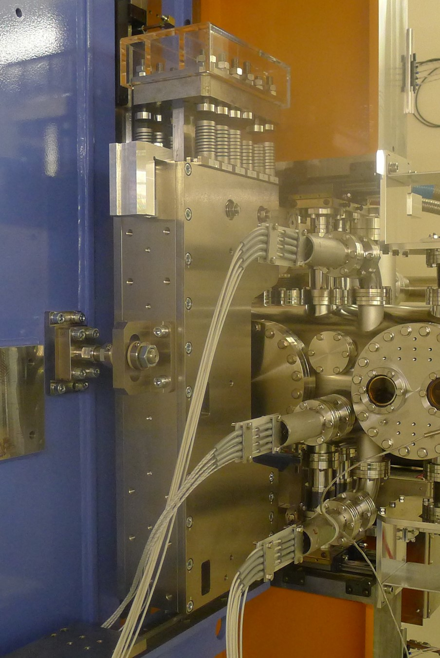
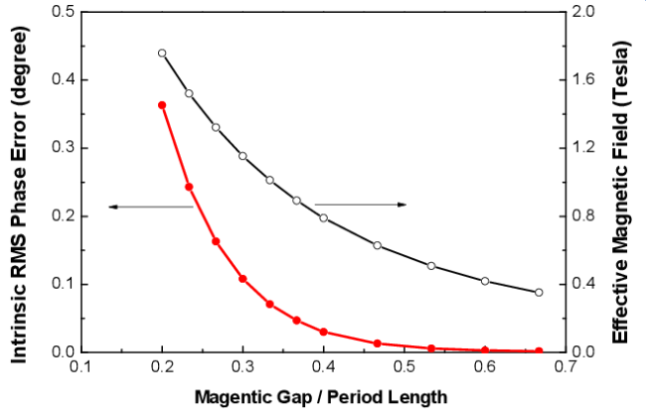
SPRING COMPENSATING MODULES
Increased magnetic forces lead to intrinsic phase error.
Additional four spring module configuration can reduce the intrinsic phase error.
Not only to compensate magnetic forces but also to obtain a mostly stress free mechanical frame.
Set-up in air, installed between upper and lower out of vacuum girder.
Machined-springs to provide good reproducibility
J. C. Huang et al., "Development of cryogenic permanent magnet undulators at NSRRC", Proc. AIP Conf., vol. 2054, no. 1, 2019.
Notes:
The magnetic forces increase exponentially with decreasing undulator gap and reach 32 kN at a gap of 4 mm. A conventional 2-support configuration is no longer rigid enough to keep the net RMS phase errors low. Four spring modules configuration can reduce the intrinsic rms phase errors to less than 0.3 degrees at gap 4 mm. Strong magnetic forces not only cause gap errors but also the deformation of the mechanical frame and heavy load to the gap drive system. . This four spring modules configuration is not only to compensate magnetic force but also to obtain a mostly stress-free mechanical frame. The spring module is installed between upper and lower out-of-vacuum girder and can compensate the attractive magnetic forces by repulsive spring forces. The spring module consists of six sets of machined-springs with various coefficients to allow a close fit to the exponential characteristics of the magnetic forces. The weakest spring starts engaging at a gap of about 11 mm and then as the gap is reduced additional springs come into play.

Slide 7
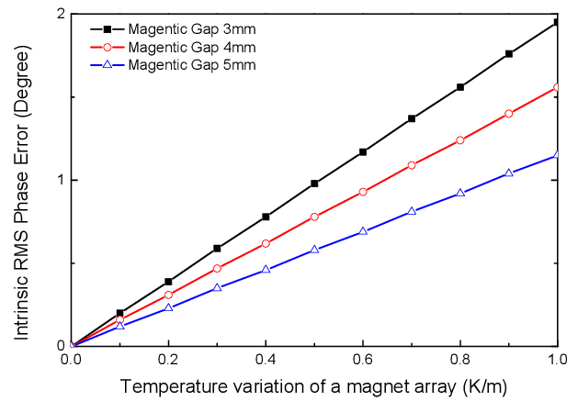
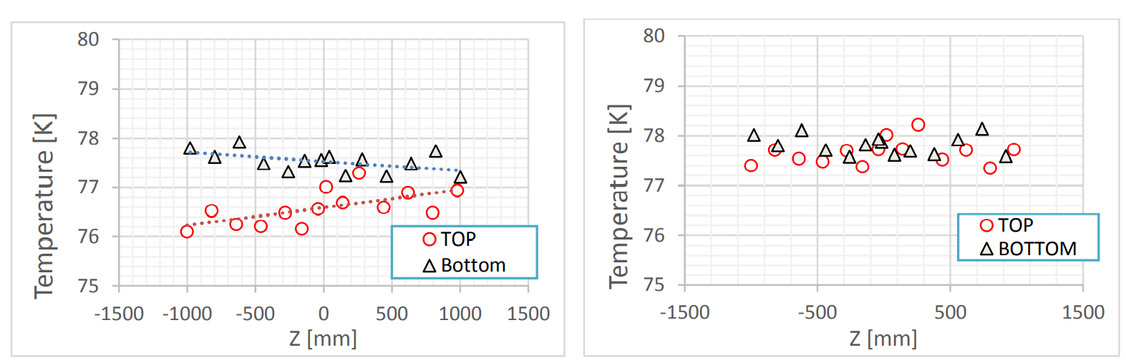
Temperature control
A temperature gradient along the magnet arrays causes a gap tapering and changes in the magnet performance.
The temperature gradient should be controlled to within 0.5 K/m to keep the intrinsic phase error less than 1 degree.
Temperatures are monitored by 32 calibrated resistance temperature detectors (RTDs) with a tolerance of 0.1K.
The temperature is about 80 K and the temperature variation is controlled within 0.5 K in a 2-m magnet array.
J. Huang, et al., Development of a cryogenic permanent magnet undulator for the TPS, in: Proceedings of IPAC, Copenhagen, Denmark, 2017, pp. 1562–1565.
Notes:
The intrinsic phase errors in a CU at cryogenic temperature may be increased from those at RT due to not only the girder deformation derived from the magnetic forces but also the thermal effects on the magnet arrays. a temperature gradient along the magnet arrays causes a gap tapering and changes in the magnet performance. Mixture of gap errors and changes of magnet remanence field can cause field and phase errors. For the same temperature variation along the magnet arrays, the intrinsic phase errors increase with decreasing magnetic gap. Therefore, the temperature gradient should be controlled to within 0.5 K/m ( ± 0.25 K/m) to keep the intrinsic phase error less than 1 degree. The temperature distribution along the magnet arrays are monitored by 32 calibrated resistance temperature detectors with a tolerance of 0.1K. The temperature control system includes four heaters to provide different heating powers to reduce the temperature gradient in the magnet arrays.

Slide 8
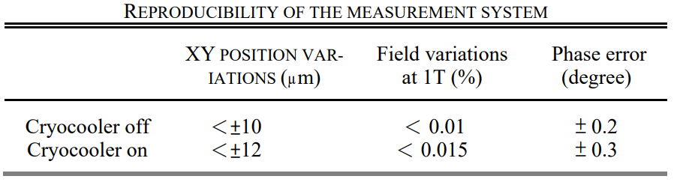
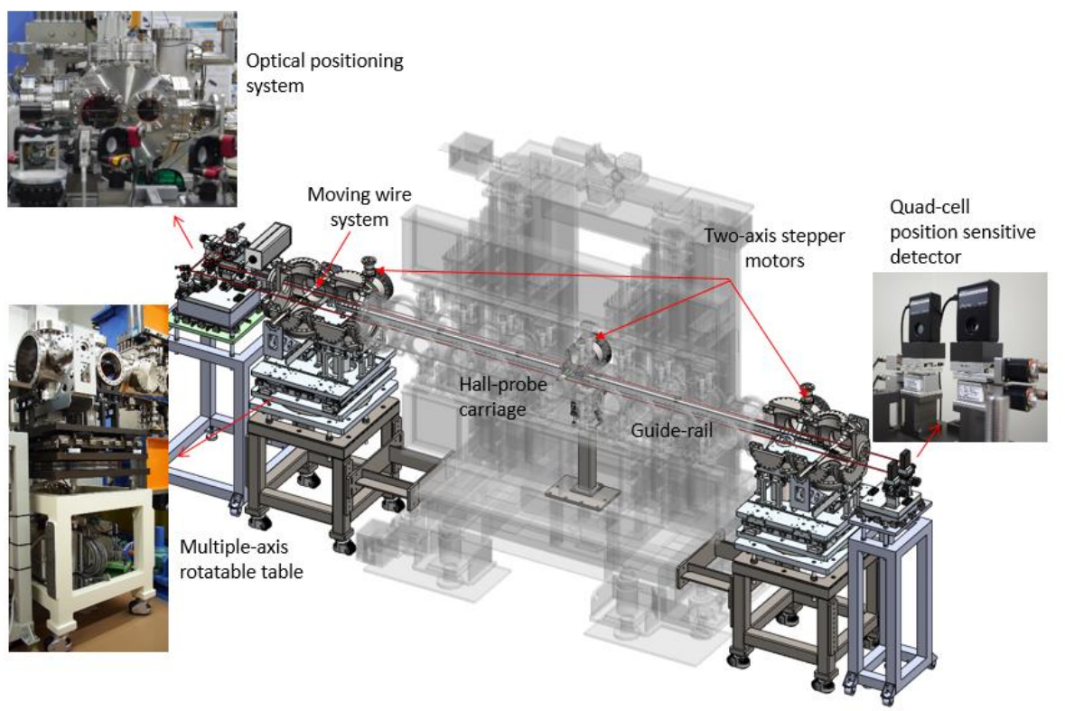
Field measurement system
Notes:
The in-situ measurement system is developed at NSRRC, which is based on laser-positioned components including a feedback system.
The Hall probe is moved along a customized rail located in the vacuum chamber and positions of the Hall probe is determined by two laser systems.
As the rail is movable in the transverse direction by motorized stages, the positional offset of the Hall probe from the proper position can be corrected automatically.
Commercial components are compatible for UHV environment without containing the components inside the vacuum chamber
The reproducibility of measurement system becomes worse when the cryocooler turned on due to the induced vibrations of the Hall probe.
The vibrations cause only few micro-meters position deviations. In horizontal and vertical axes, these deviations have negligible effects on field measurement. However, along longitudinal axis, the field variates more rapidly and few micro-meters results in 1.5 gauss field variation at 1 tesla. Thus, phase error measurement reproducibility gets worse compared to cryocooler off .

Slide 9
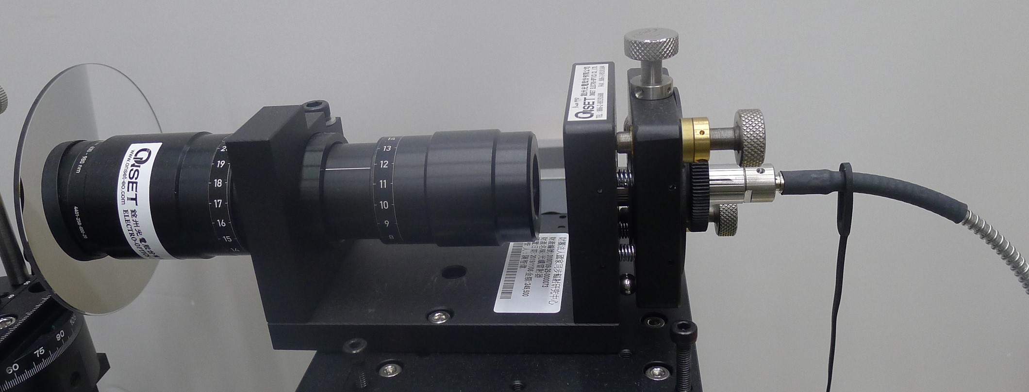
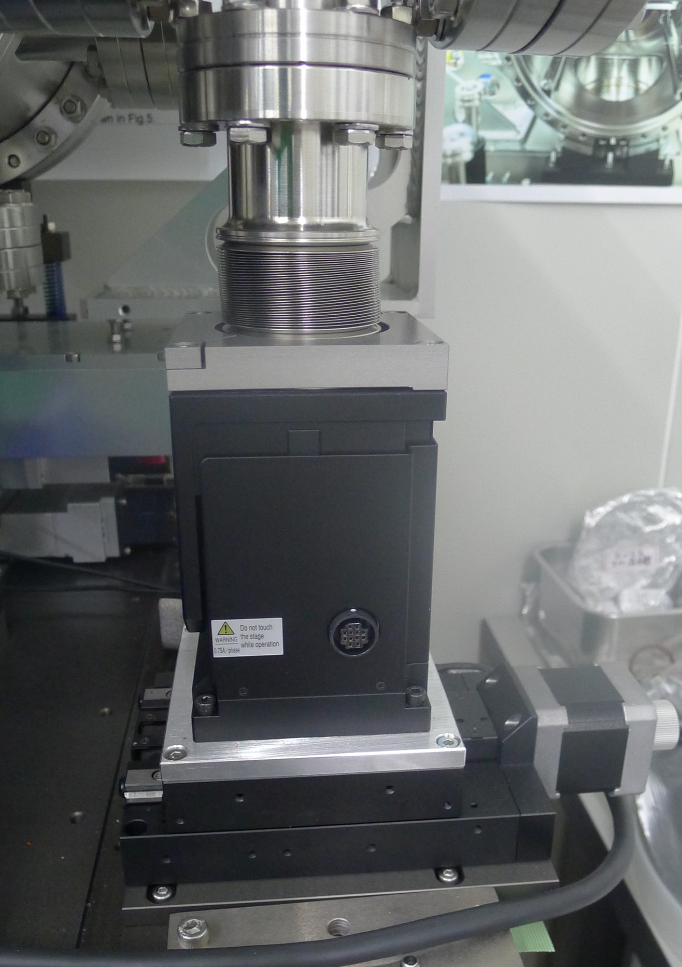
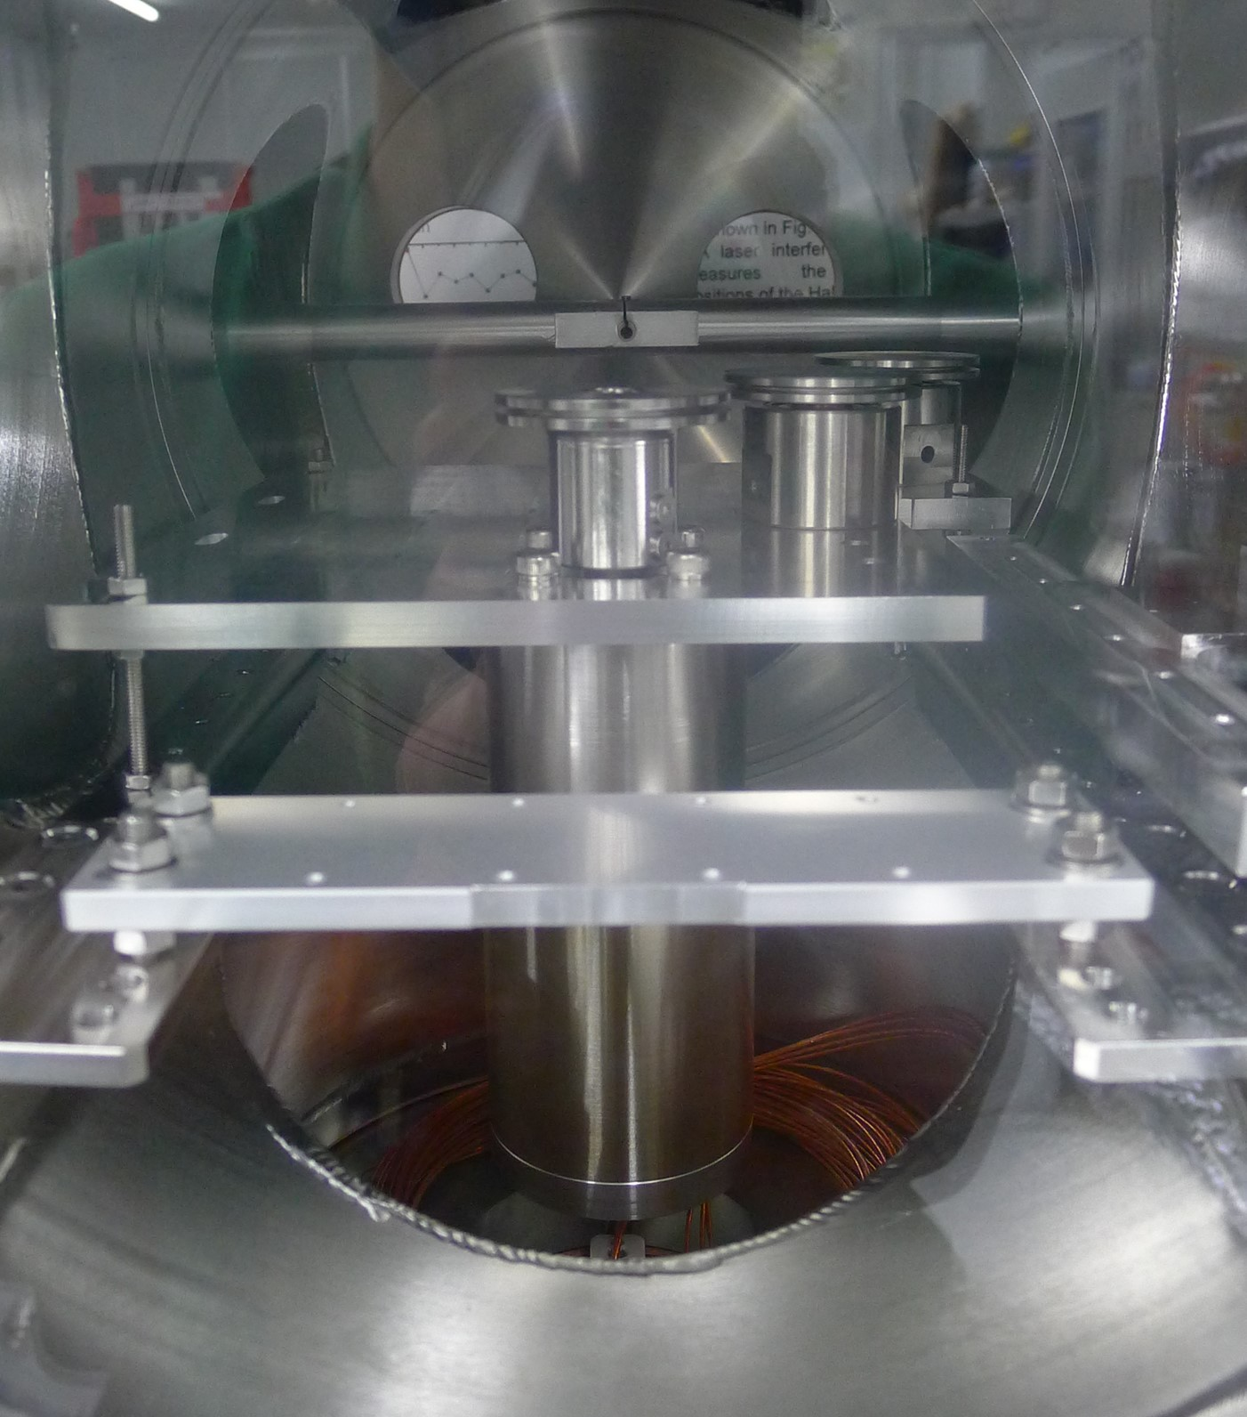
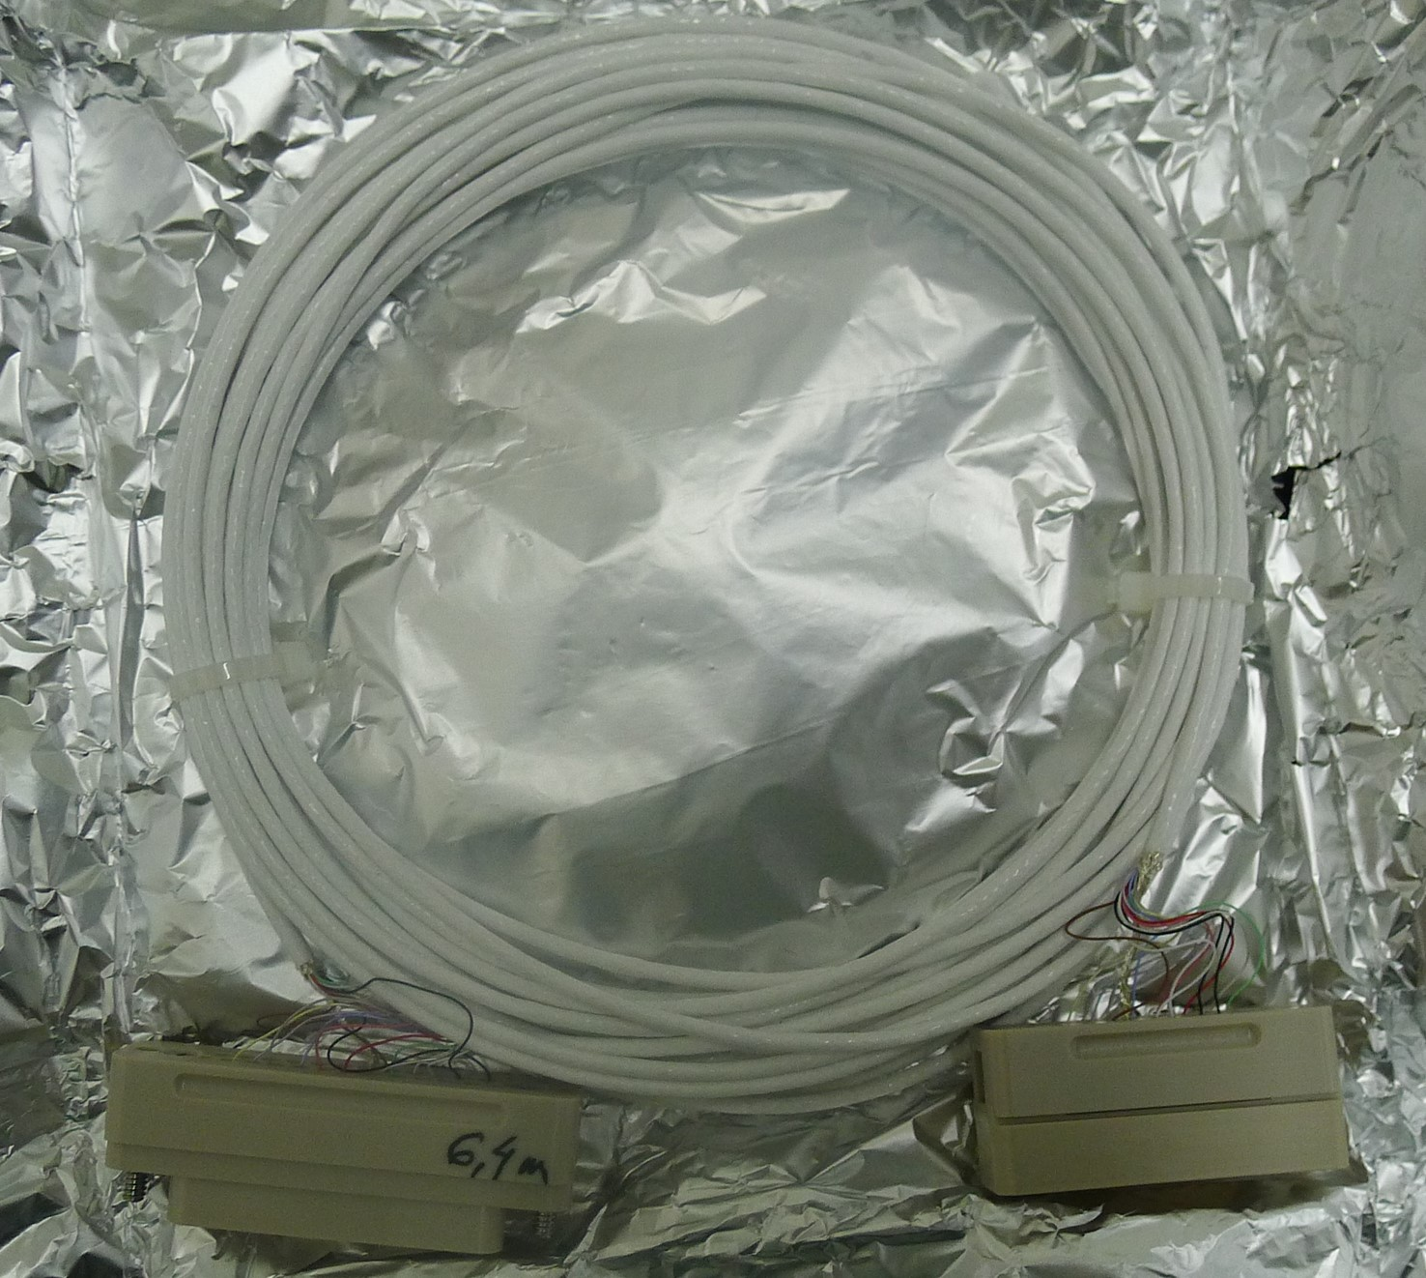
Measurement system upgrades
Further modifications to enhance its durability and simplify its alignment capabilities
Replace the laser to get uniform profile
Higher loading stages to avoid missing steps
In vacuum motor to reduce vibrations
Thicker signal wire to avoid broken
laser
stage
Signal wire
motor
Notes:
To measure the cryogenic undulator, further modifications are needed to enhance the measurement system’s durability and simplify its alignment capabilities.
First , the laser beam profile for the positioning exhibits a diffraction pattern and the beam profile is not uniform causing position errors thus making the alignment of the two pinholes complicated. It is replaced by a new laser without diffraction patterns and uniform on the beam profile.
Secondly, the total weights on the Y-stages almost reached the maximum limit resulting in missing steps during position corrections. A higher loading stage is used to avoid missing steps.
The motor used to move carriage is replaced by an in vacuum type to reduce the vibrations of the Hall probe.
The original signal wires are only 0.2 mm in diameter to lower the tension. But they easily break during measurements. To solve this problem, the wires are replaced by thicker ones.

Slide 10
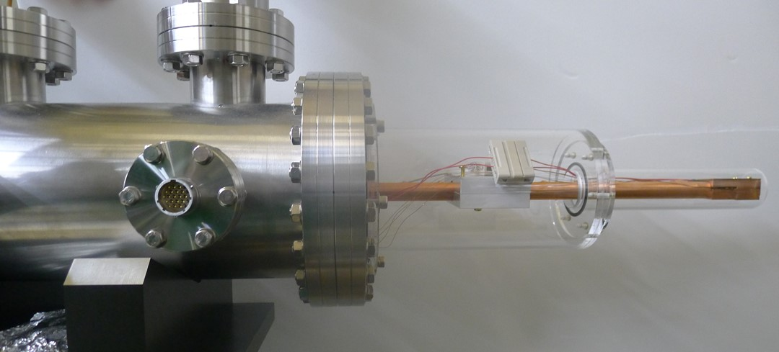
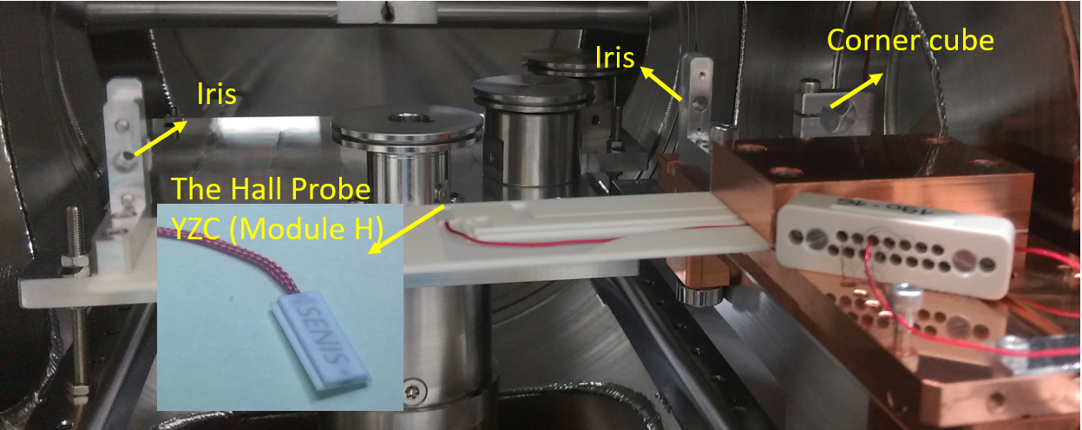
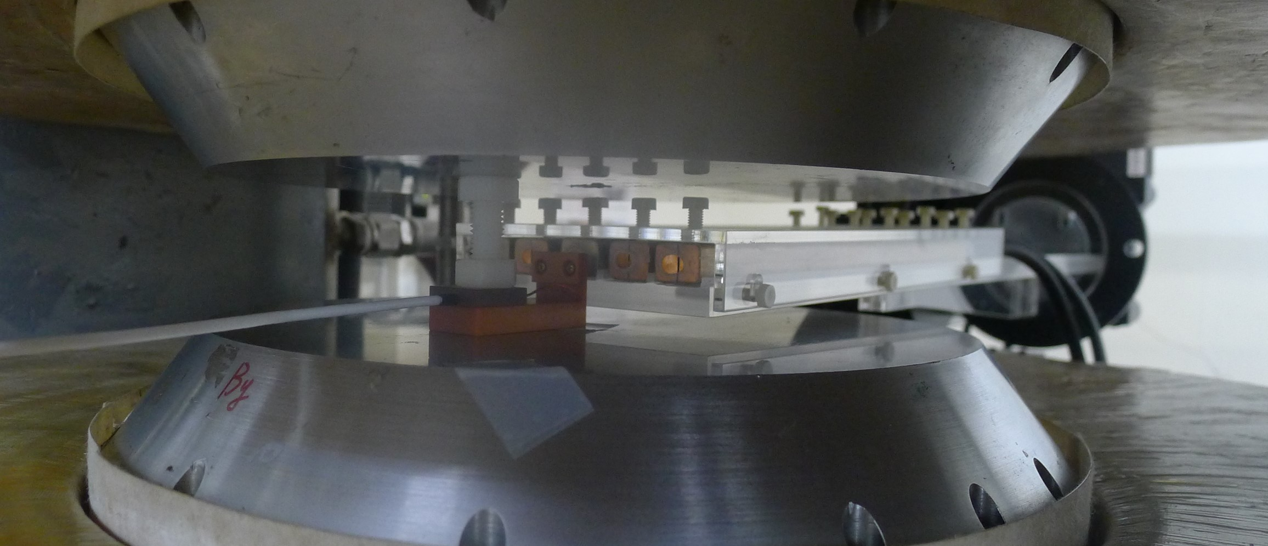
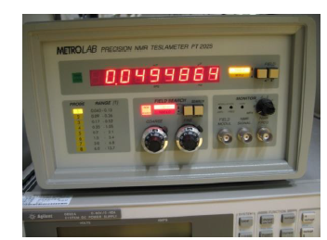
Hall probe calibrations
D. Popovic Renella, S. Dimitrijevic, S. Spasic and R.S. Popovic, “High - accuracy teslameter with thin three -axis Hall probe”, Measurement, vol. 98, 407 (2017).
SENIS YZC (module H) Hall probe
METRO-lab precision NMR tesla meter (PT2025)
Cryo-cooler to change the temperature of the Hall probe.
Motorized stages to change NMR probes
Notes:
A new two-axis SENIS Hall probe is used to measure our CPMU due to its small external dimensions, low flicker noise, nonlinearity and low temperature coefficient of the sensitivity at room temperatures.
As the Hall sensor is cooled by nearby cold magnets, a temperature dependent calibration of the Hall probe is necessary.
A temperature sensor, integrated on the Hall probe chip, allows to monitor the Hall probe temperature during measurements and calibrations.
The Hall probe is calibrated with reference to a Metrolab NMR probe system at different temperatures above zero degrees. field differences between NMR and Hall probes can be reduced to only 0.1 G at a maximum field of 1.5 T.

Slide 11
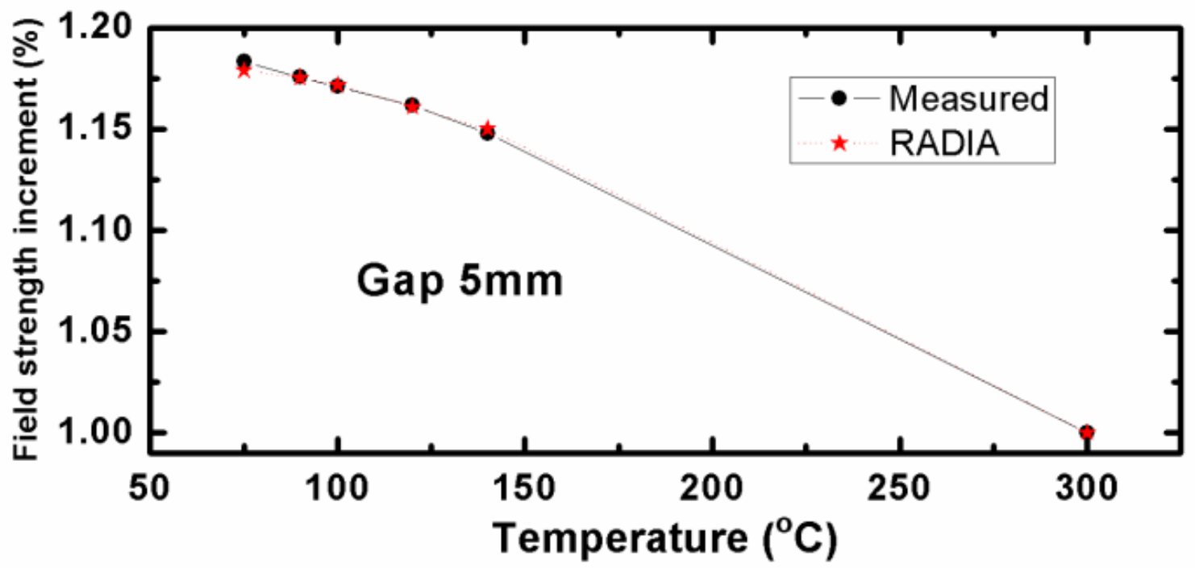
Field strength of different temperature
Temperatures are measured by 32 thermometers.
Supporting rods contract compensated by monitoring two high resolution LED micrometers.
The magnetic field was found to be larger by 18 % at 77 K compared to room temperature, which is very close to the prediction by the RADIA code
Notes:
Field measurements are taken at room temperature and five different cryogenic temperatures.
During the cool down process, the supporting rods contract and the magnet gaps vary with temperature changes.
Magnet gaps are adjusted precisely to the values wanted by monitoring two high resolution LED micrometers.
The magnetic field at gap 5 mm was found to be larger by 18 % at 77 K compared to that at room temperature, which is very close to the prediction by the RADIA code.

Slide 12
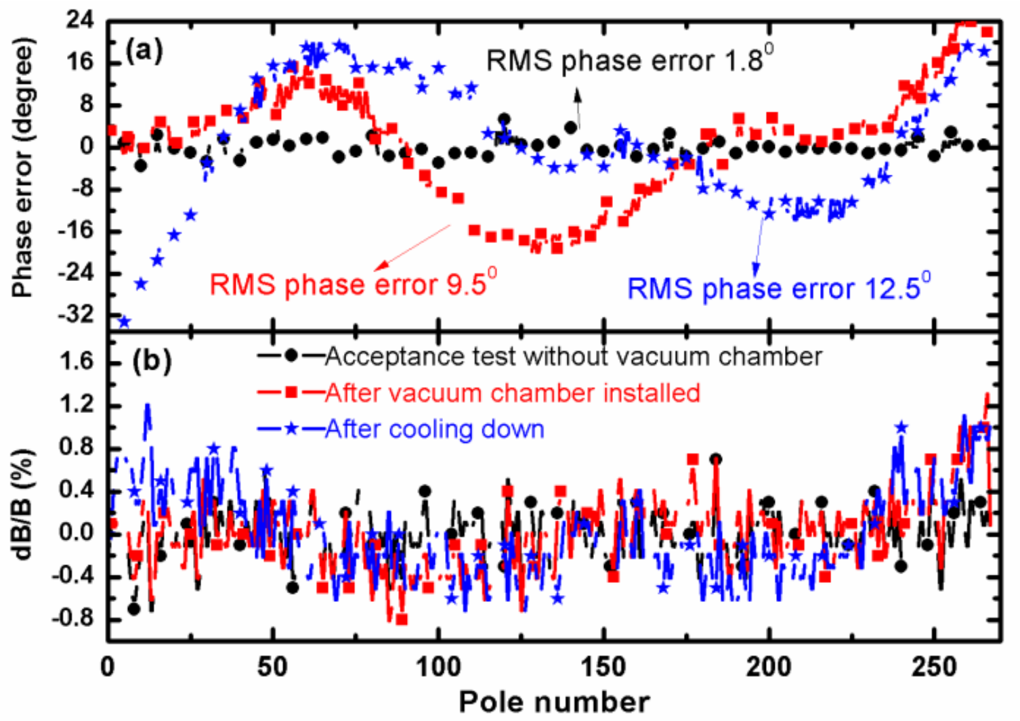
Field performance
RMS phase error degrades after the vacuum chamber is installed.
After cool down, the RMS phase error gets even worse.
Field variations of some poles are larger than 0.3 % after vacuum chamber installed.
Notes:
In addition to the increase of the peak field, the phase errors should be kept smaller than 3 degrees after the vacuum chamber is installed and cooled down. As shown in figure a, before vacuum chamber is installed the RMS phase error was tuned to be 1.8 degrees. However, the phase errors degraded to be 9.5 degrees after the vacuum chamber was installed and get even worse 12.5 degrees after cool down.
Figure B shows that the field variations as a function of pole number are larger than 0.3 % at some poles after vacuum chamber installed and 0.1% further after cool down.
The reasons related to this should be figure out and an in-vacuum field tuning is necessary to keep a good field performance.

Slide 13


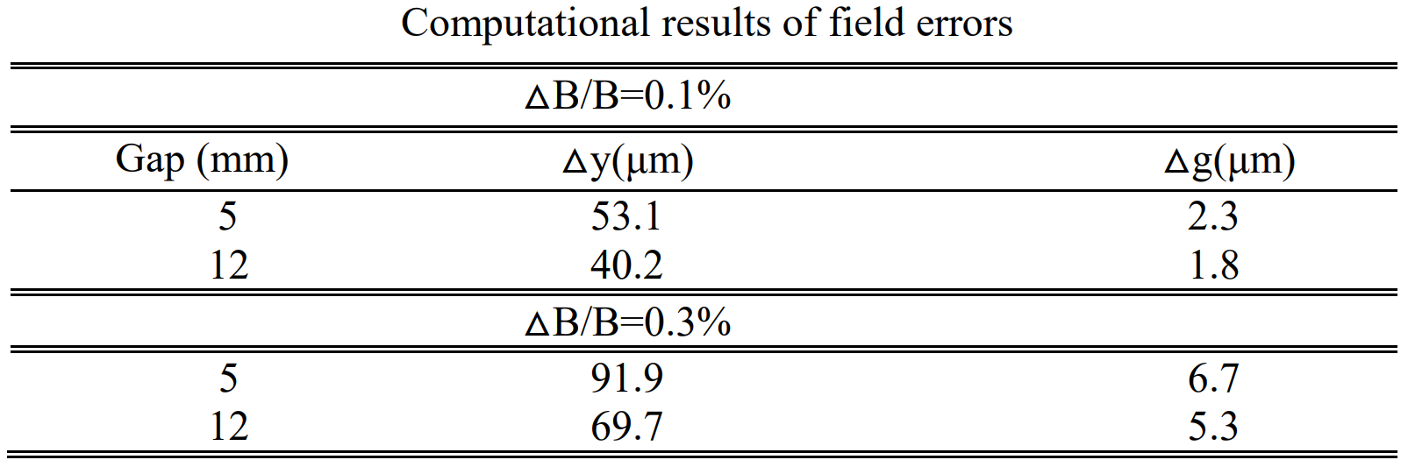
Field error sources
The peak field can be numerically fitted as a function of the magnet parameters
Field errors from magnetic gap variations
Field errors from Hall probe position errors
Notes:
For short periods and small undulator gaps, the fields are very sensitive to Hall probe positions and gap variations.
The peak field can be numerically fitted as a function of the magnet gap and periodic length to get the parameters B zero, B one and B two.
Then the Field errors from magnetic gap variations and Hall probe positions can be obtained from these two equations.
The field errors are very sensitive to gap variations resulting, for example, from thermal gradients and assembly tolerances of the magnetic arrays. A variation of only seven micro-meters will cause a 0.3 % field error at a gap of 5 mm. The reproducibility of magnetic array assembly accuracy is around 10~20 μm, which is the main reason for field degradation after vacuum chamber assembly.
The temperature variations of the magnet arrays are about 0.8 K, which can cause different expansions of the in-vacuum girders and bellows-link rods along the magnet array, which may result in 2.2 micro meters gap difference and causing the field change 0.1%.
Compared to gap variations, the field errors are less sensitive to Hall probe vertical position tolerances. After position correction, the vertical Hall probe position tolerances are smaller than 12 μm, which induces only a 0.004 % field error at a gap of 5 mm.
Therefore we have to adjusting the magnet gap at some specified points to reduce the RMS phase errors.

Slide 14
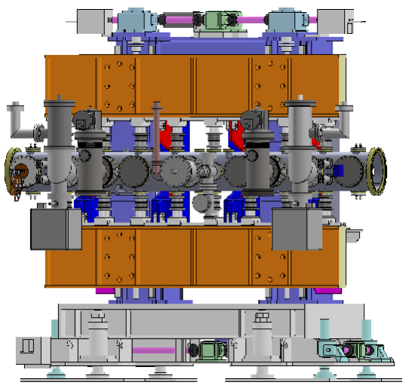
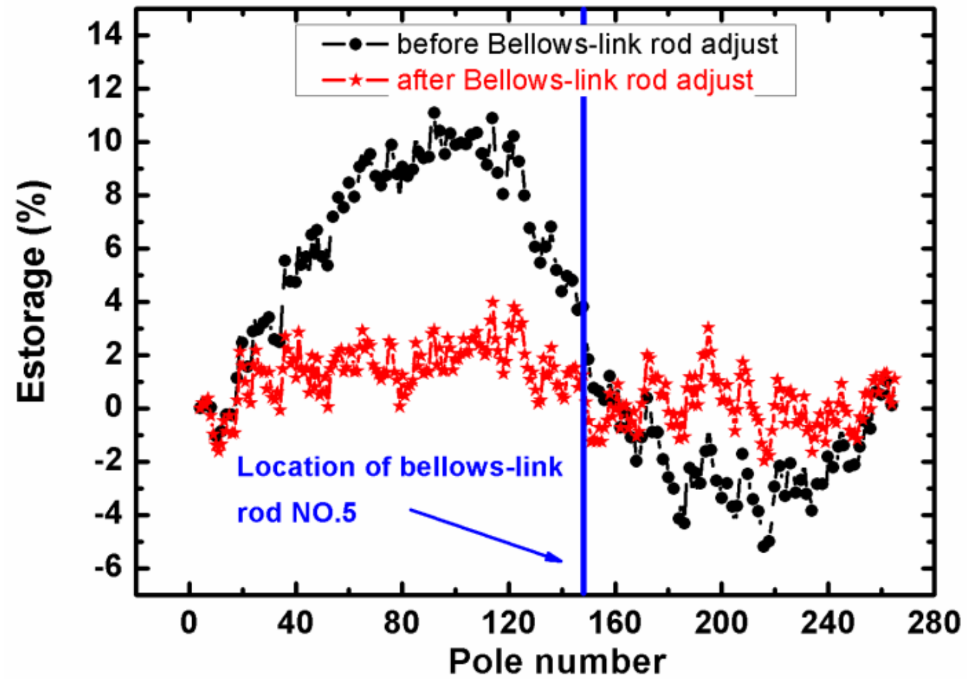
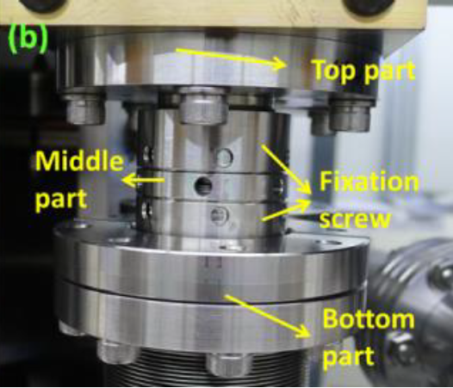
Field tuning – differential adjusters
Thirty two differential adjusters.
Change length with a resolution better than 1 μm.
A program predict the amount of adjustments
First tune at a gap of 12 mm then close gap. (force free)
A Hall probe reads the field strength during tuning.
Notes:
One of the field tuning methods is by differential adjusters. There are total thirty two differential adjusters. Sixteen for each magnetic array.
The differential adjuster with an in-vacuum shaft has a differential screw mechanism to adjust its length. Revolving the middle part which corresponds to a metal loop of a turnbuckle can change the length with a resolution better than 1 micrometer per revolution.
Two fixation screws fix the position of the middle part tightly after adjustment. So the field around this adjuster can be tuned. It is easier to use error storage instead of the phase error for estimating the undulator performance and sorting of spectral improvements.
After cool down, the error storage is first corrected by the differential adjusters at a gap of 12 mm. A program was developed to predict the amount of adjustments. The Hall probe was moved to the corresponding pole to read the field strength variations while adjusting the differential adjuster length.

Slide 15
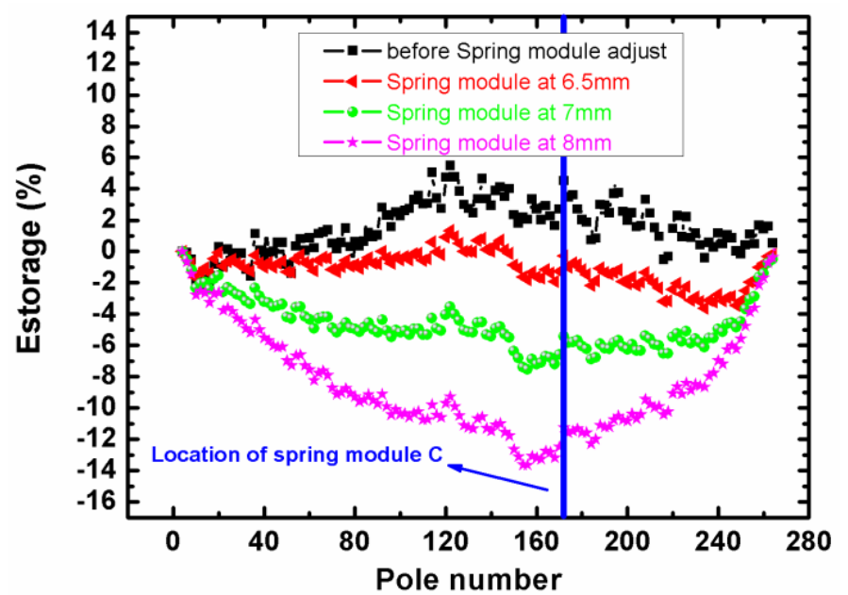
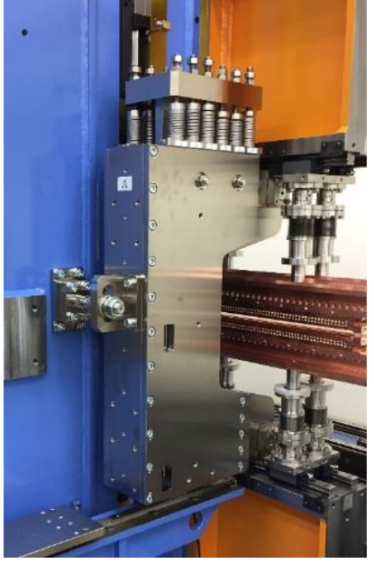
Field tuning – spring modules
Four spring modules attached to the out of vacuum girders.
A program predict the amount of adjustments
First tune spring modules at a gap of 11 mm (weakest spring starting engaging) then close gap to each spring engaging point and tuning.
A Hall probe reads the field strength during tuning.
Notes:
Global field errors should be corrected by spring modules. There are four spring modules attached to the out of vacuum girders.
From gap of 11mm, the weakest spring starts to engage. Measure the field distributions at this gap, and use the program to predict the best engaging point. Fine tune the engaging gap to minimize the phase errors. Then close gap and use the same method to set other springs at different gaps. By doing this , we can minimize the phase errors at all gaps.

Slide 16
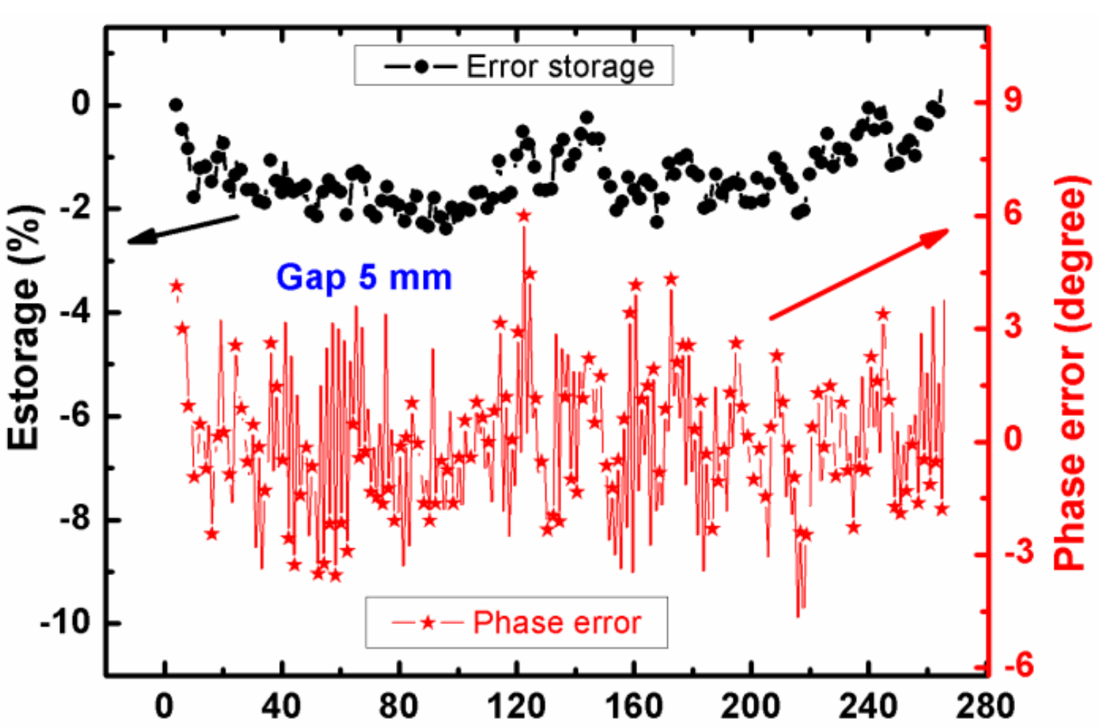
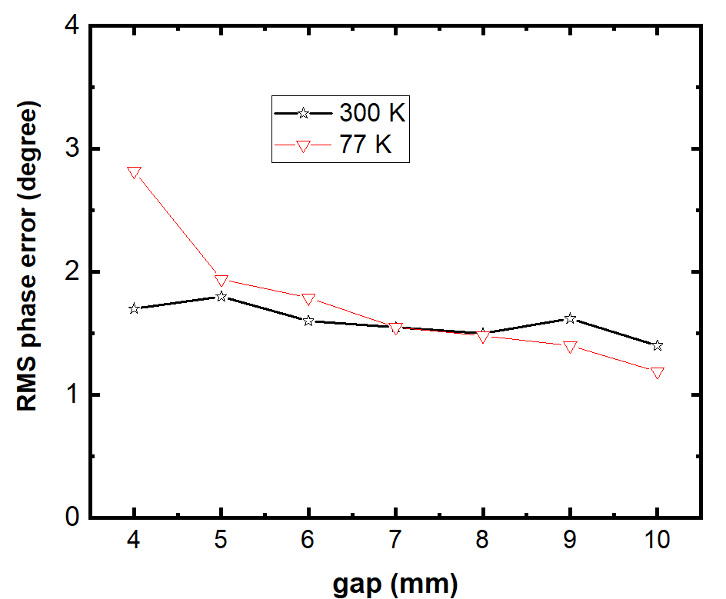
Field performance after tuning
The error storage can be reduced to be smaller than ± 2 % by using these two methods.
After several tuning steps, the RMS phase errors could be reduced to below 2⁰ at 77 K and a gap of 5 mm
Notes:
By adjusting differential adjusters and spring modules, the error storage can be reduced to be smaller than ± 2 %.
After several tuning steps, the RMS phase errors could be reduced to below 2 degrees at 77 K and a gap of 5 mm to meet our specifications.
However, the phase errors at gap 4 mm is still about 1 degree higher than that at room temperature.

Slide 17
Summary
A cryogenic undulator with period length of 15 mm are constructed for the TPS beamlines.
Several methods, including spring modules, differential adjusters, temperature control system, are applied to ensure the field performance.
The in-situ measurement system is improved to do the measurement at low temperature.
Field tuning methods are necessary to keep low phase errors after the vacuum chamber installed and cooling the magnetic array down.
Notes:
A cryogenic undulator with period length of 15 mm are constructed for the TPS beamlines.
Several methods, including spring modules, differential adjusters, temperature control system, are applied to ensure the field performance.
The in-situ measurement system is improved to do the measurement at low temperature.
Field tuning methods are necessary to keep low phase errors after the vacuum chamber installed and cooling the magnet temperature down.

Slide 18
Thank you for your attentions
Email : yang.ck@nsrrc.org.tw

