Slide 1



Construction and Measurement of a Tuneable Permanent Magnet Quadrupole for Diamond Light Source
Alex Bainbridge
ASTeC, UKRI-STFC Daresbury Laboratory
22nd International magnet measurement workshop
26-30 September 2022
Sao Paulo, Brazil (Virtual)

Slide 2

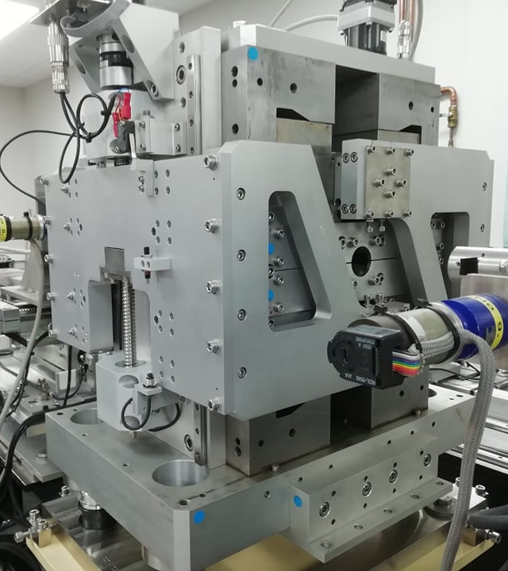
Agenda
1 Introduction to ZEPTO
Development and motivation of ZEPTO tuneable permanent magnet technology.
2 Magnet assembly
Challenges of assembling a tuneable permanent magnet with strong forces present.
3 Measurements to date
Gradients and compensation magnetic centre movements.
4 Conclusions
Current and planned developments.

Slide 3
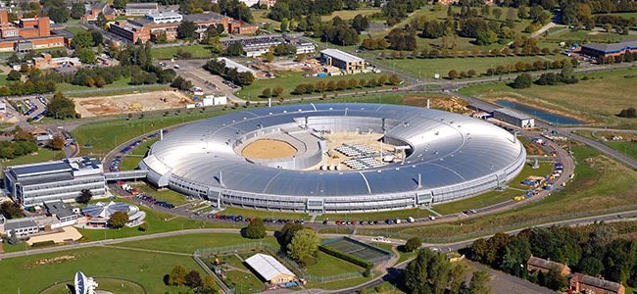
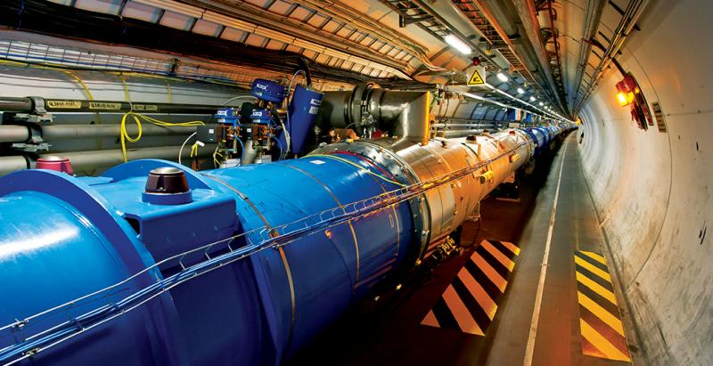
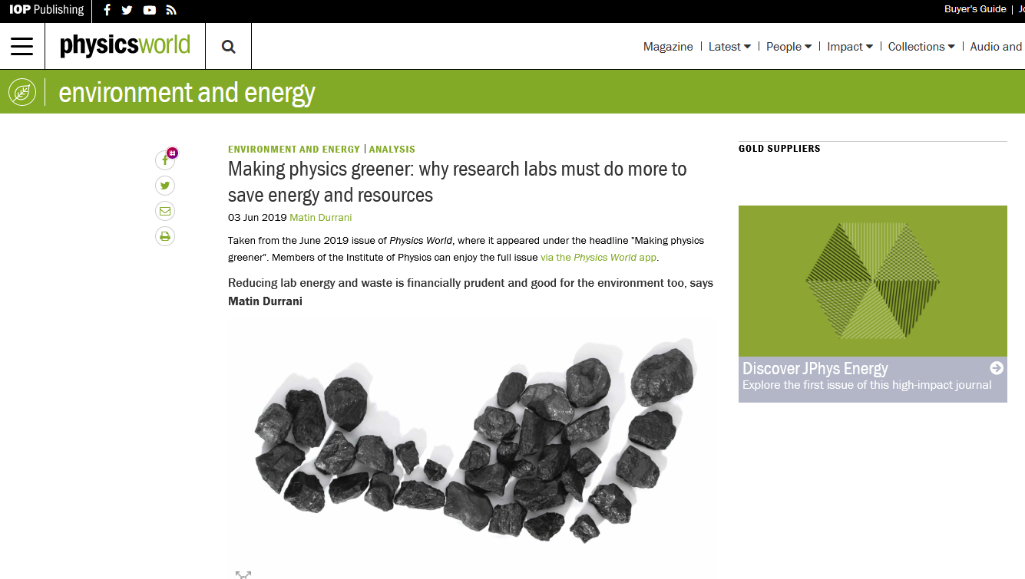
Motivation
ZEPTO (Zero Power Tuneable Optics) project started as a collaboration between CLIC (Compact Linear Collider) and STFC Daresbury Laboratory
Aim is to save power and costs (both financial and environmental) by switching from resistive electromagnets to permanent magnets.
Diamond 7 MW
LHC 90 MW
Image © Physics world (June 2019 edition)

Slide 4
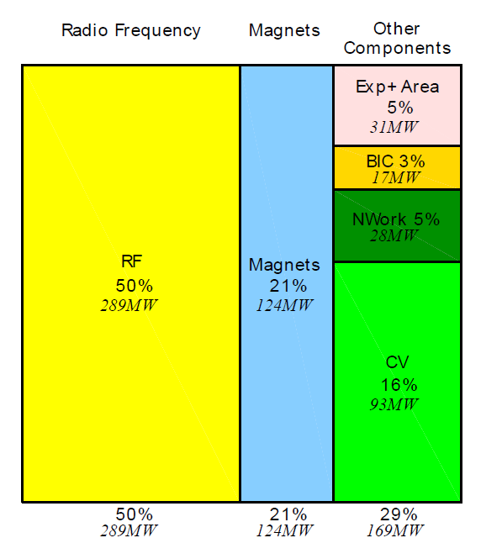
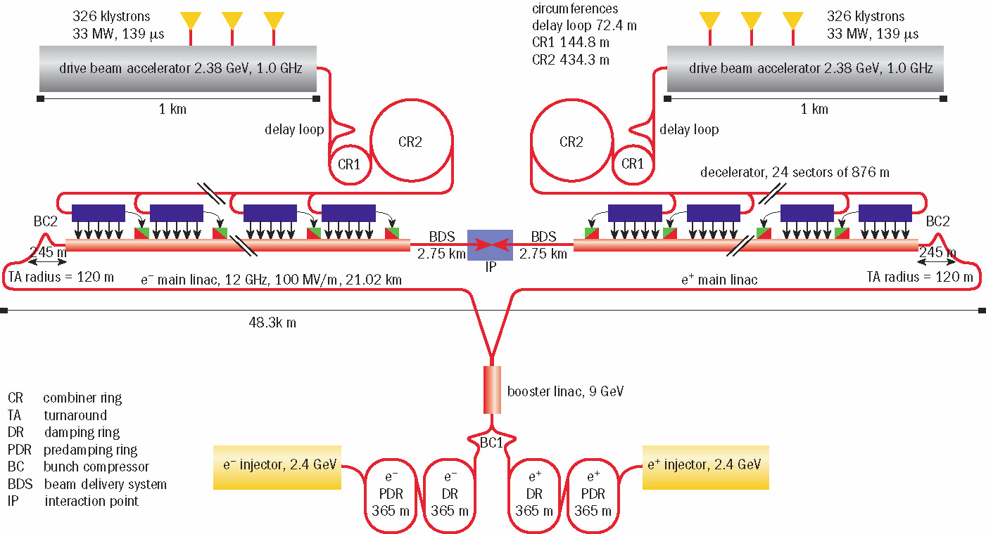
Original project - CLIC
42000 quadrupoles
288 dipoles
288 dipoles
333 dipoles
333 dipoles

Slide 5
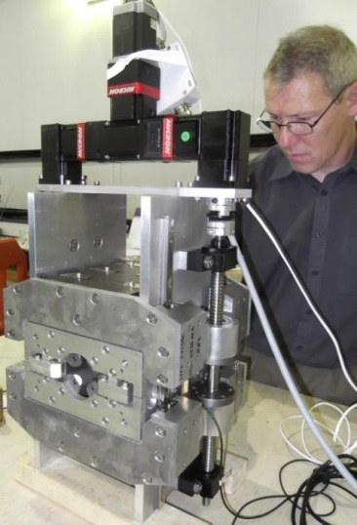
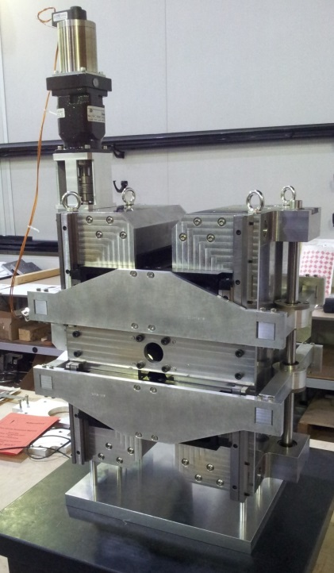
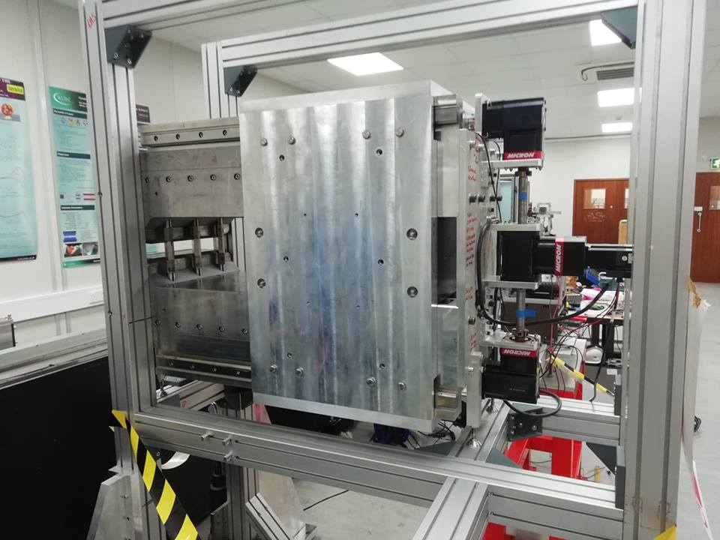
Zero Power Tuneable Optics (ZEPTO)
Project 1: High strength quad
B gradient from 60 – 15 T/m
Shepherd et al, Journal of Instrumentation, Vol 9, T11006, 2014
Project 2: Low strength quad
B gradient from 43 – 3.5 T/m
Shepherd et al, IPAC’14, Dresden, Germany, paper TUPRO113.
Project 3: Wide range dipole
B adjustable from 1.1 T to 0.45 T
Bainbridge et al., IPAC’17, Copenhagen, Denmark,, paper THPIK105.
The ZEPTO project created 3 prototypes for CLIC.
All were designed, constructed and measured at STFC Daresbury Laboratory.
All use NdFeB magnet blocks attached to a motion system, with fixed steel poles defining the field shape.
2017-2019
2012 - 2014

Slide 6
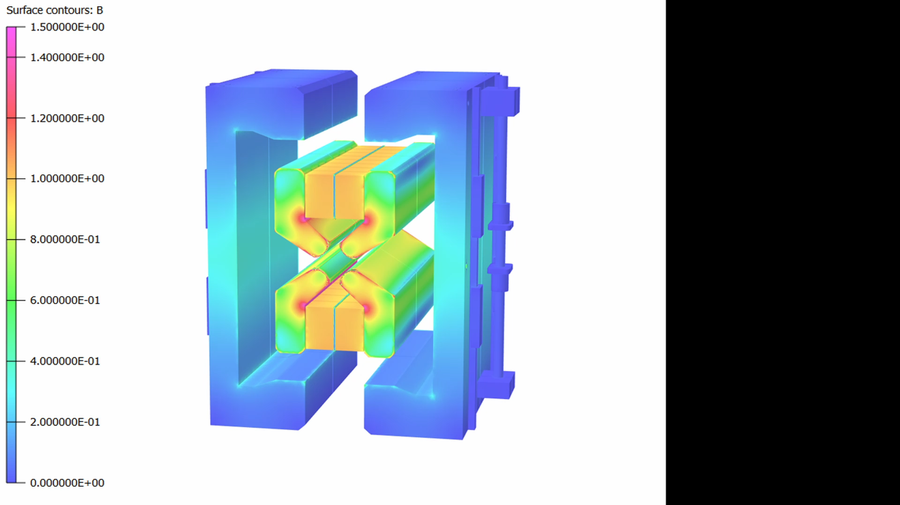
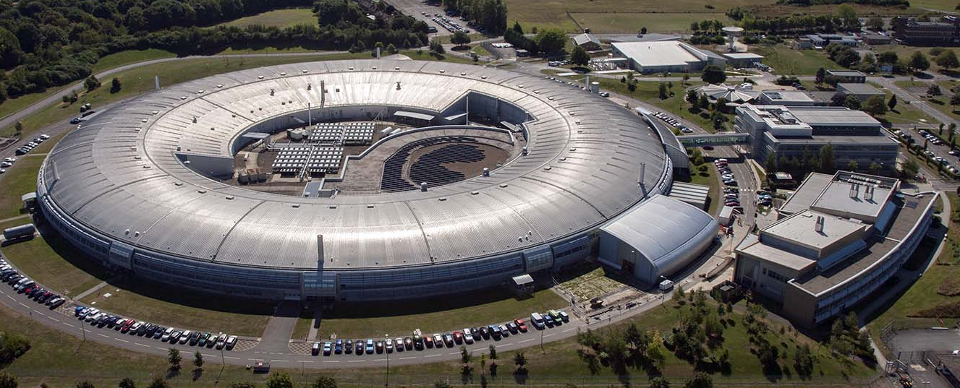
New technology demonstrator
We want to show that the benefits of ZEPTO technology are not limited to CLIC, and can be used as an energy saving `drop-in' replacement for electromagnets on accelerators such as existing light sources.
We have developed a new ZEPTO quadrupole for the booster-to-storage ring section of Diamond Light Source.
Contours B (T)
1.4
1.4
1.2
1.2
1.0
1.0
0.8
0.8
0.6
0.6
0.4
0.4
0.2
0.2
0

Slide 7
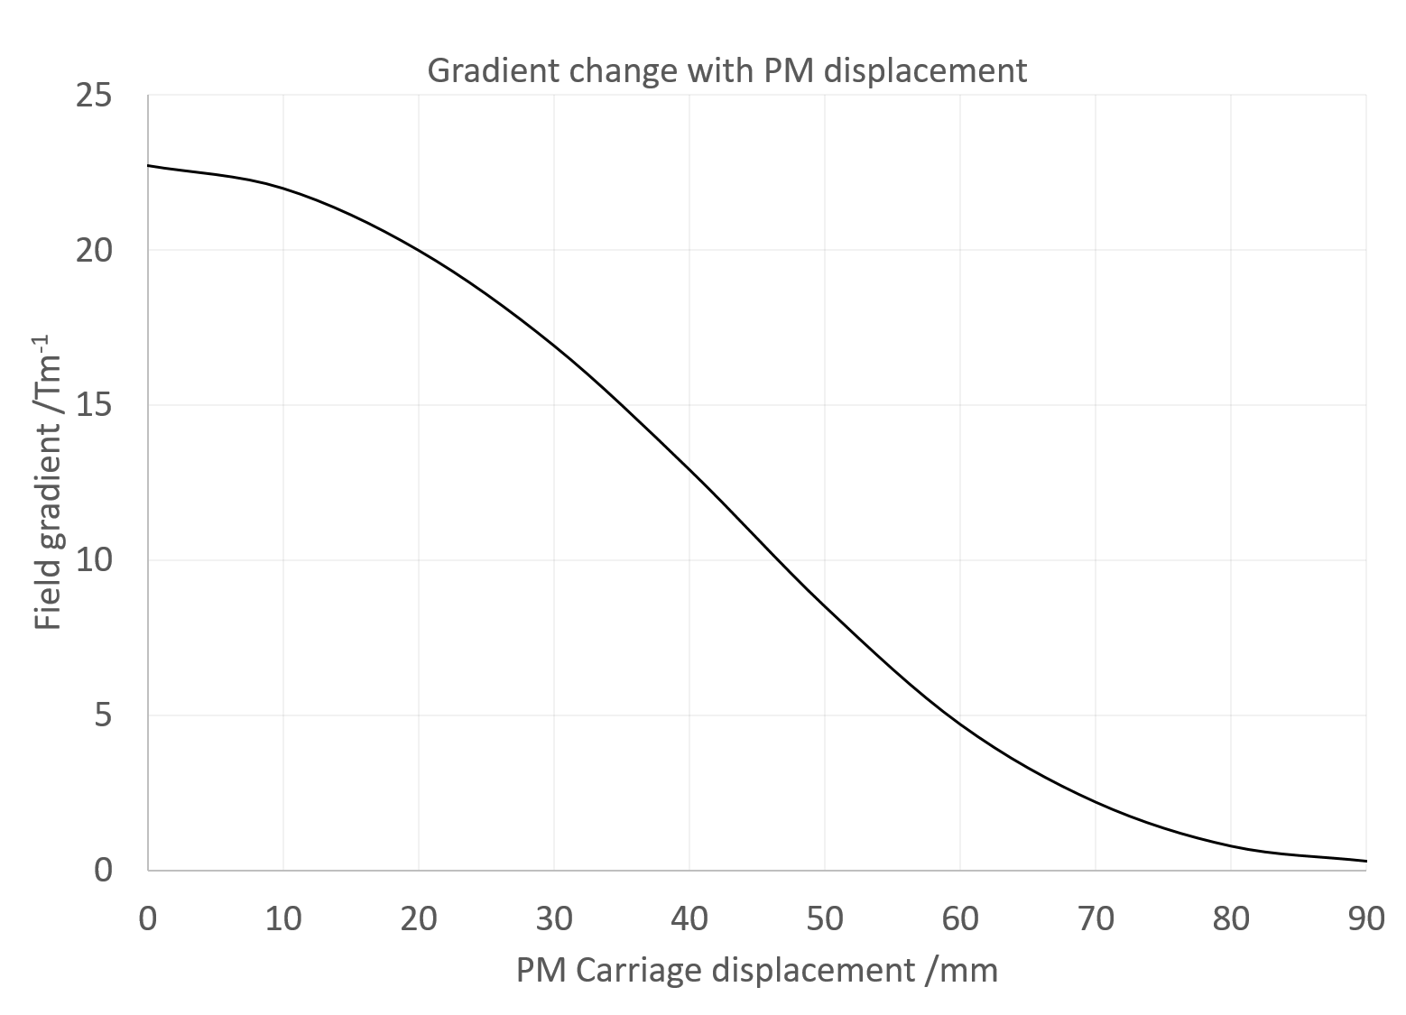
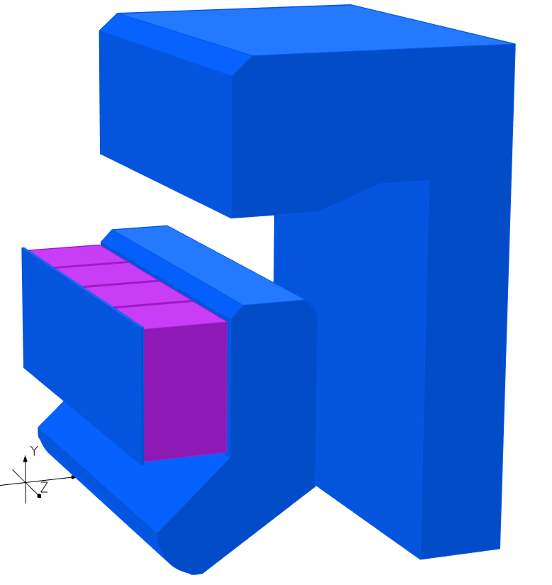
New technology demonstrator
SmCo blocks attached to vertical motion system with 90mm movement range and 1 µm precision
OPERA 3D model
Fixed “inner yoke” defines the quadrupole field
Fixed “outer yoke” can steer flux away from the beam, allowing the gradient to be adjusted
Simulations predicted a gradient tuning range from 23 T/m down to 0.35 T/m
The outer yoke acts as a short circuit for the flux, allowing the magnet to be ‘turned off’.
32 mm aperture
No magnetic contact between yokes, the gap between is filled with aluminium for rigidity

Slide 8
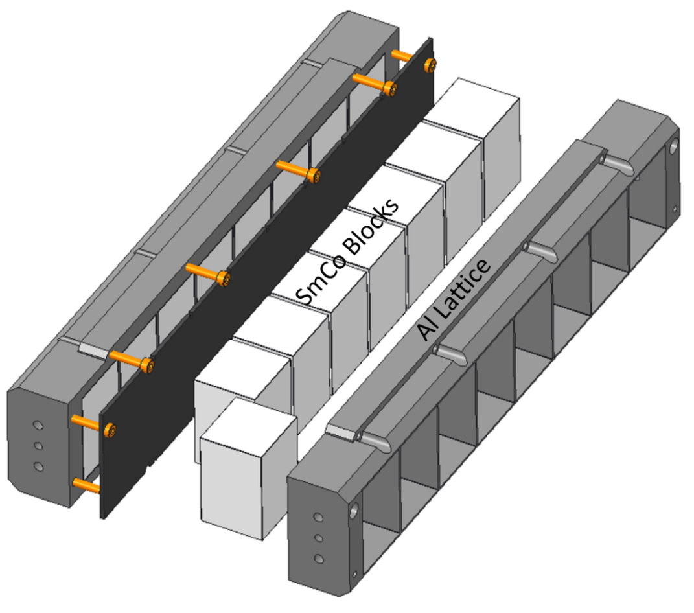
Permanent magnets
Previous ZEPTO magnets used large NdFeB blocks to produce the magnetic flux, which are difficult to manufacture and handle.
New magnet uses a “carriage” with a number of smaller blocks set into an aluminium latticework.
Advantages over larger single blocks which include:
Blocks are easier and cheaper to manufacture.
Damaged single blocks may be replaced instead of the entire carriage.
Variation in block BH curves may be compensated.
Modular magnet "families" may be created by strategic removal of blocks.
The gaps between blocks do not affect field quality as the flux must pass through a steel pole before reaching the beam.
300 mm
50 mm
33 mm
We use SmCo instead of NdFeB for improved radiation hardness and temperature stability.
No thermal shunts are needed

Slide 9
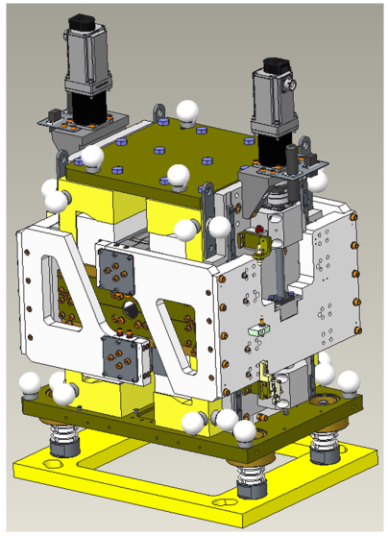
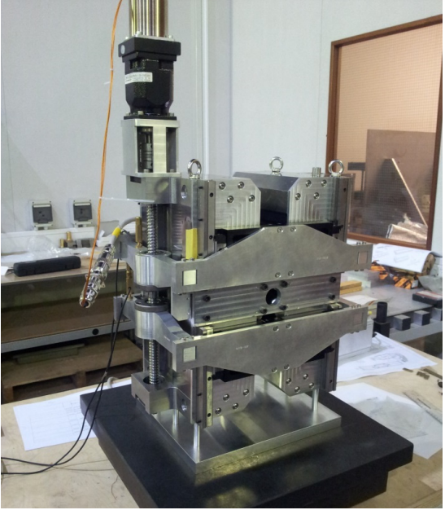
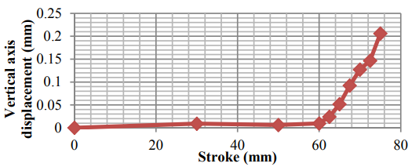
Dual motor system
Motor
PM Carriage
Ball screw
In previous ZEPTO quadrupoles field measurements revealed the magnetic centre moving as function of magnet block position, mostly vertically, due to unexpectedly magnetic components.
Expecting this, each magnet carriage now has a dedicated motor and associated driving ball screw to help compensate.
Look-up table can be applied to either carriage position to compensate and restore the magnetic centre to the geometric centre.
Carriage holder
Shepherd et al, IPAC’14, Dresden, Germany, paper TUPRO113.

Slide 10
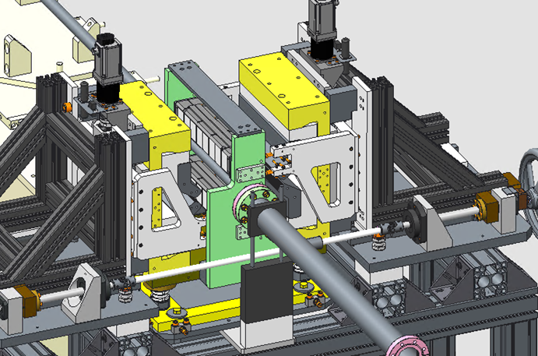
Split design
Pre-bolted inner and outer yokes
Temporary PM carriage holder
Electromagnetic quadrupoles can typically be split for installation around an existing vacuum vessel – previous ZEPTO quadrupoles could not.
The new version may be split about the vertical axis and reassembled around an existing vacuum system using a dedicated assembly frame.
This allows replacements or repair to be conducted without needing to keep the accelerator offline for the additional time needed to restore the quality of the vacuum.
Vacuum chamber
Rail
Yoke supports

Slide 11
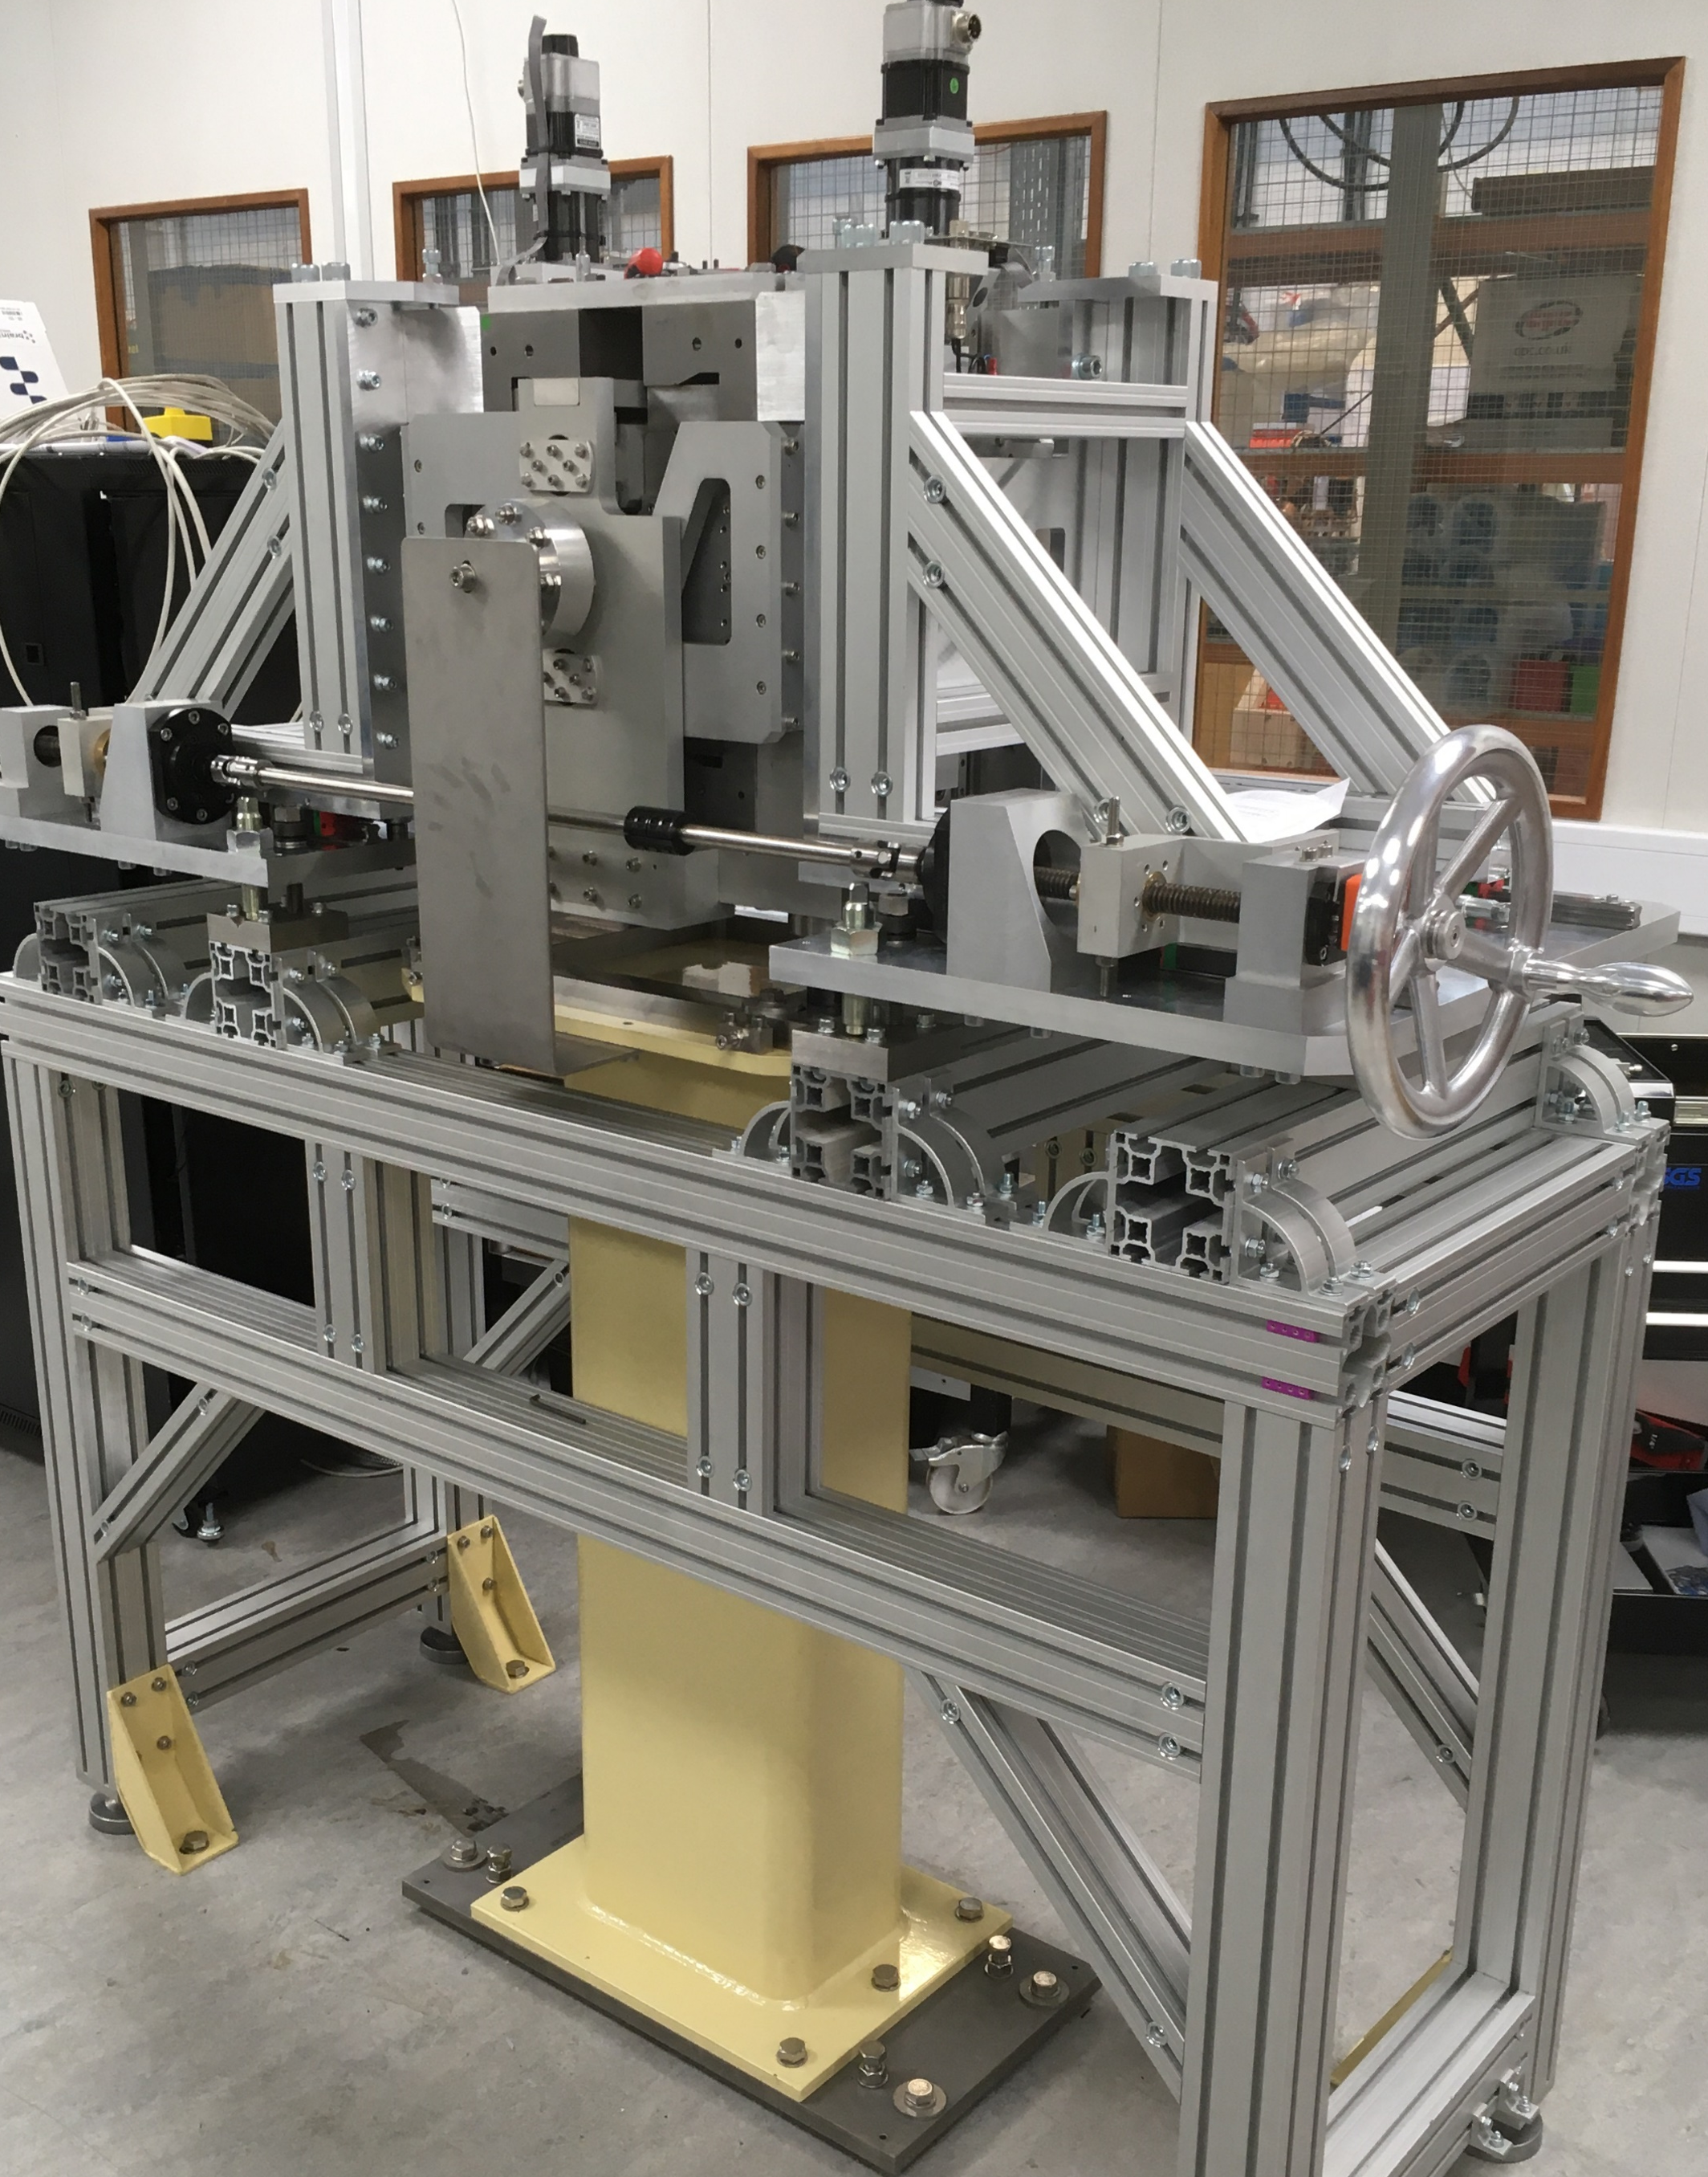
Split design
Electromagnetic quadrupoles can typically be split for installation around an existing vacuum vessel – previous ZEPTO quadrupoles could not.
The new version may be split about the vertical axis and reassembled around an existing vacuum system using a dedicated assembly frame.
This allows replacements or repair to be conducted without needing to keep the accelerator offline for the additional time needed to restore the quality of the vacuum.

Slide 12
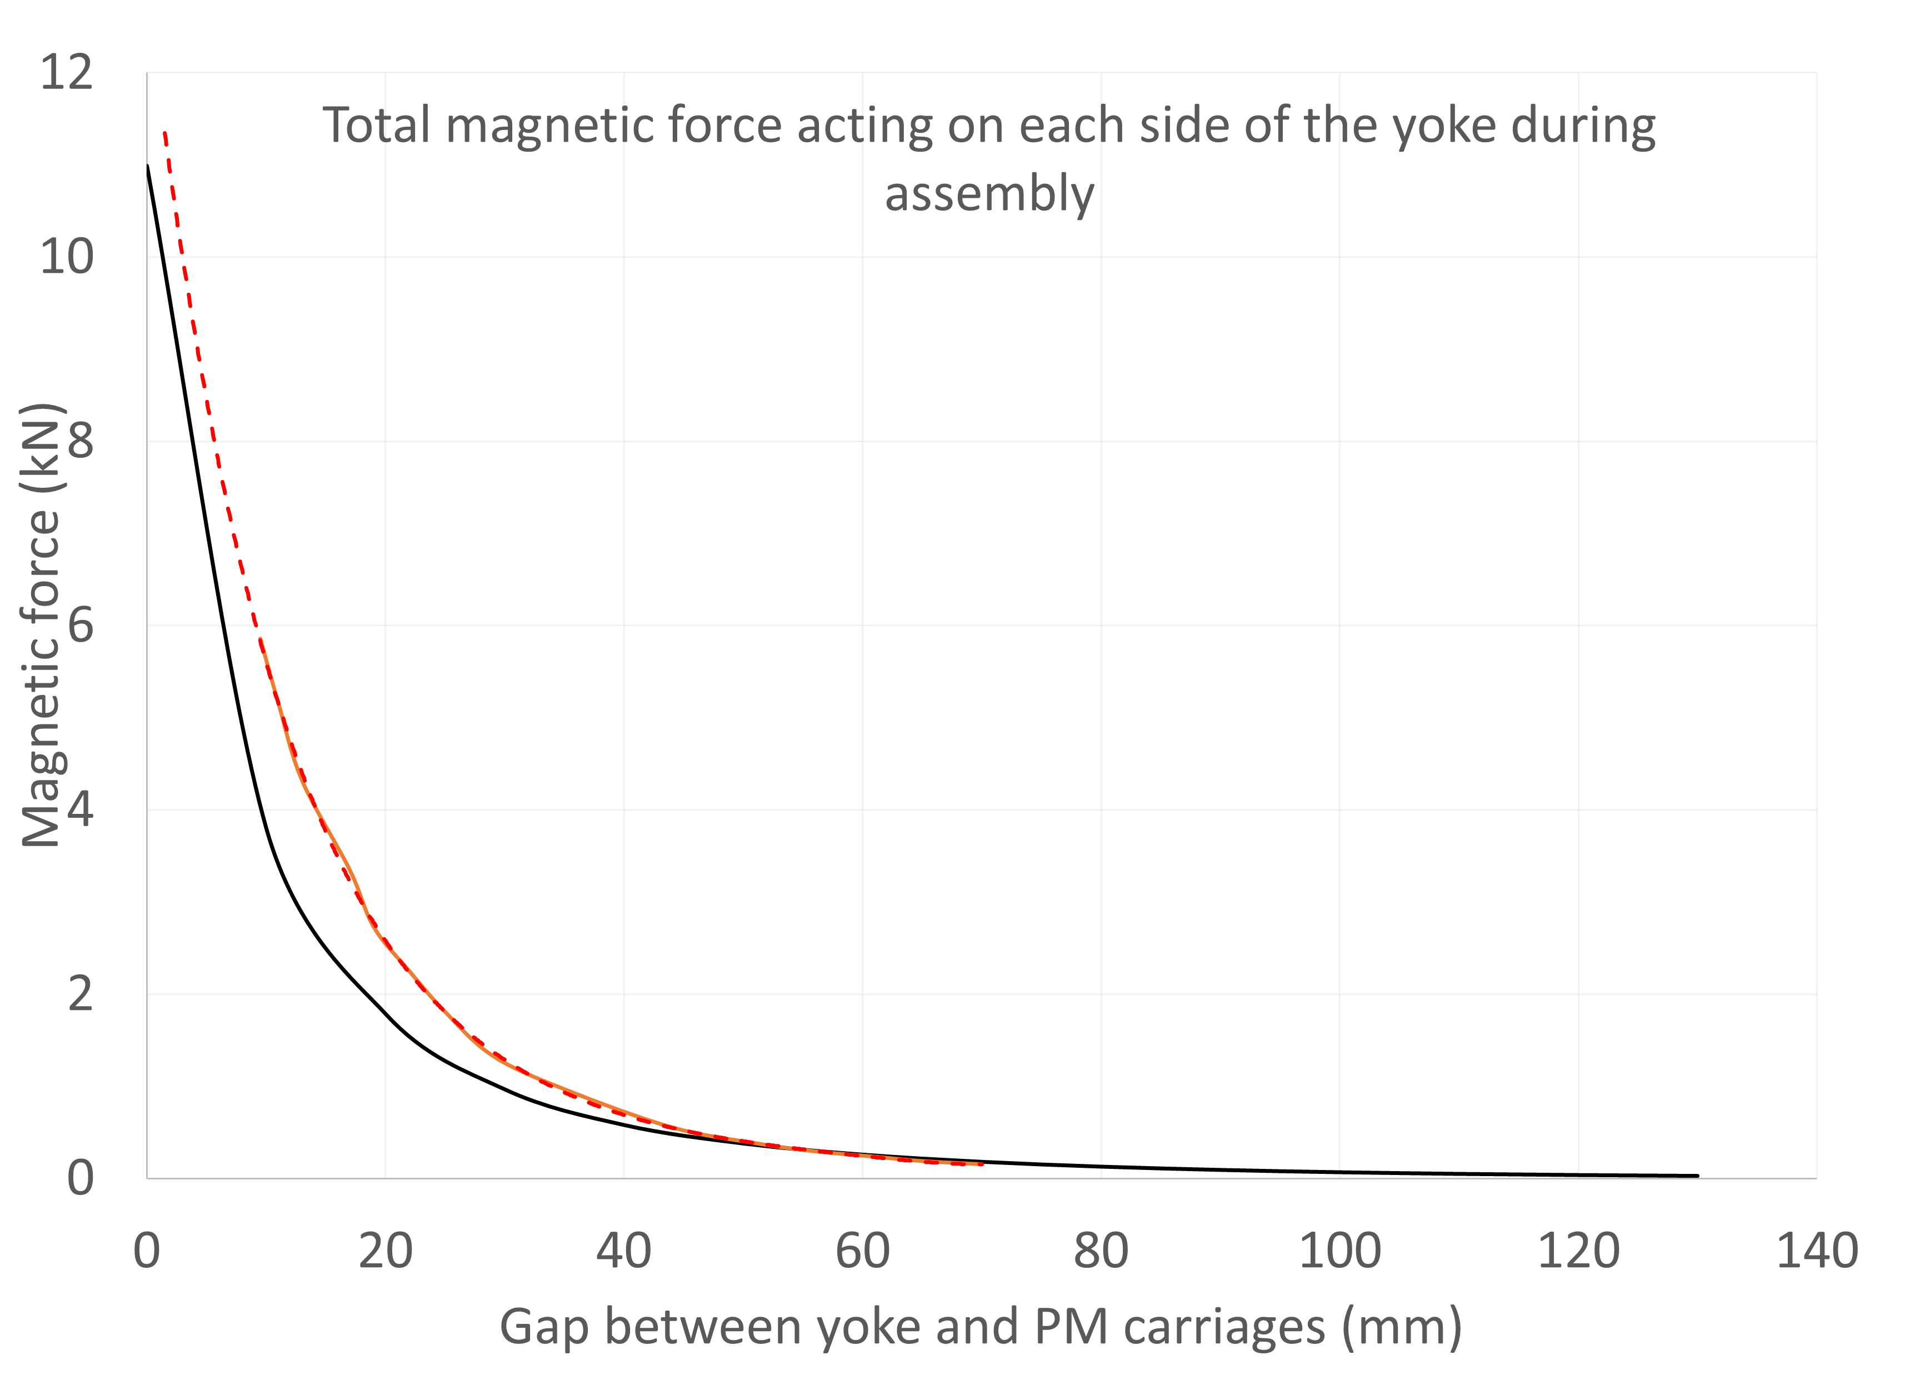
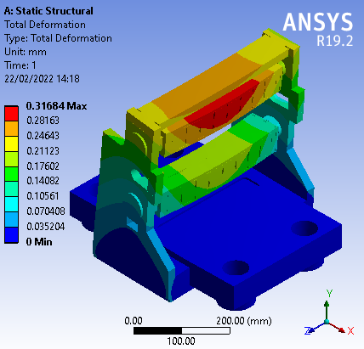
Assembly forces
Forces between the PM blocks and steel yokes must be calculated in advance and managed during assembly!
A Hall probe was used to measure the flux density entering the steel yoke for as much of the approach as possible, and from this an estimate of the actual force was derived
Simulated
Estimated
Extrapolated

Slide 13
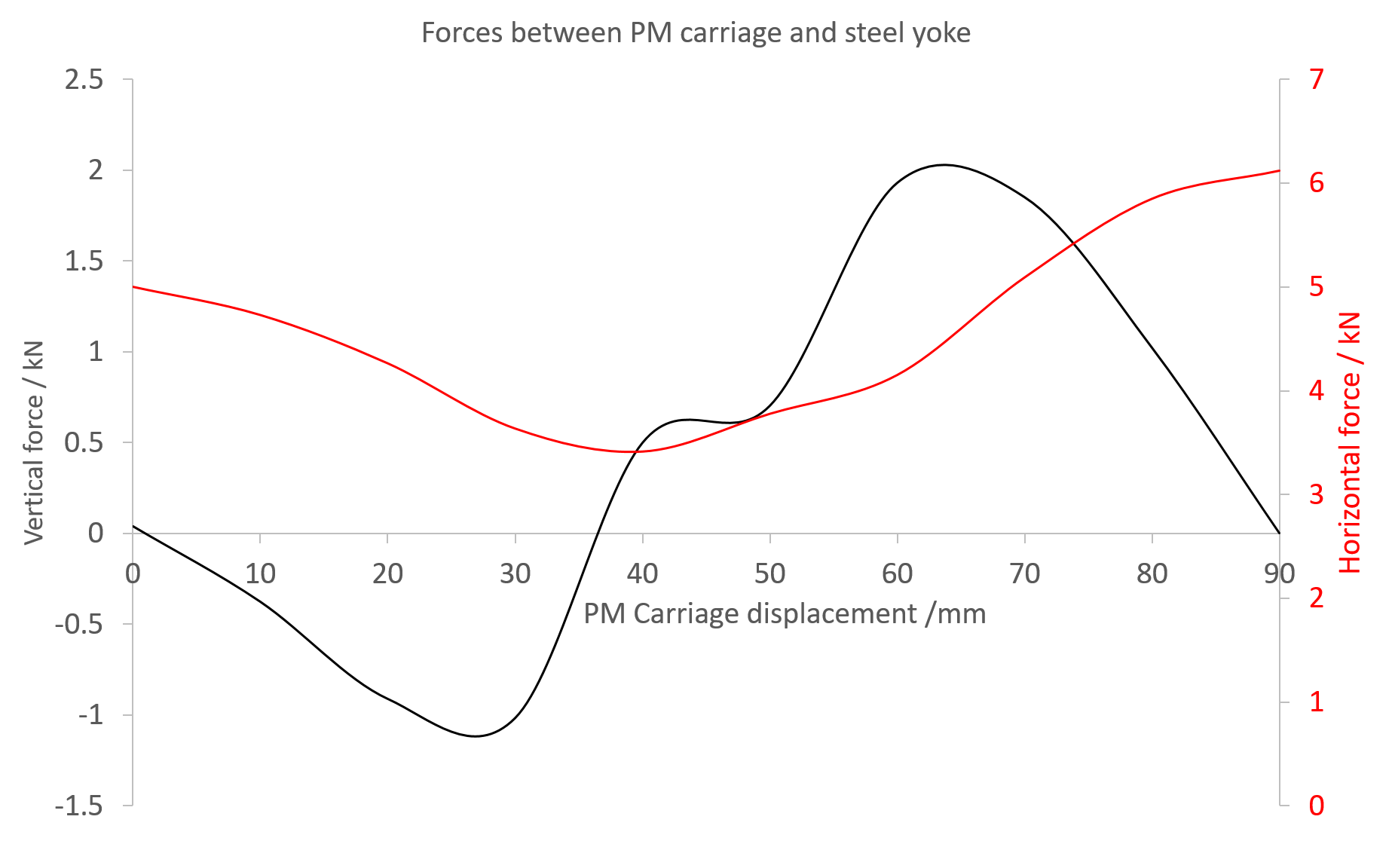
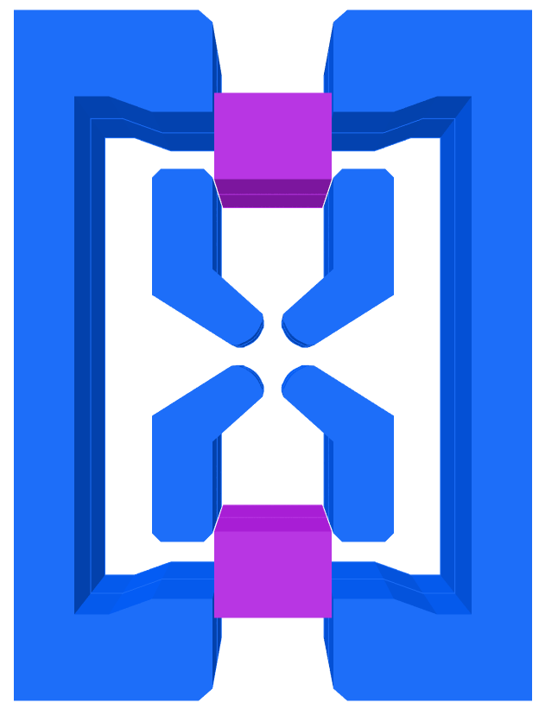
Operational forces
Horizontal forces are balanced on each side of carriages but act on the steel yoke, causing a movement risk to components.
FY
FX
The simulated magnetic forces are a function of PM block position and are highly complex
FY
FX

Slide 14
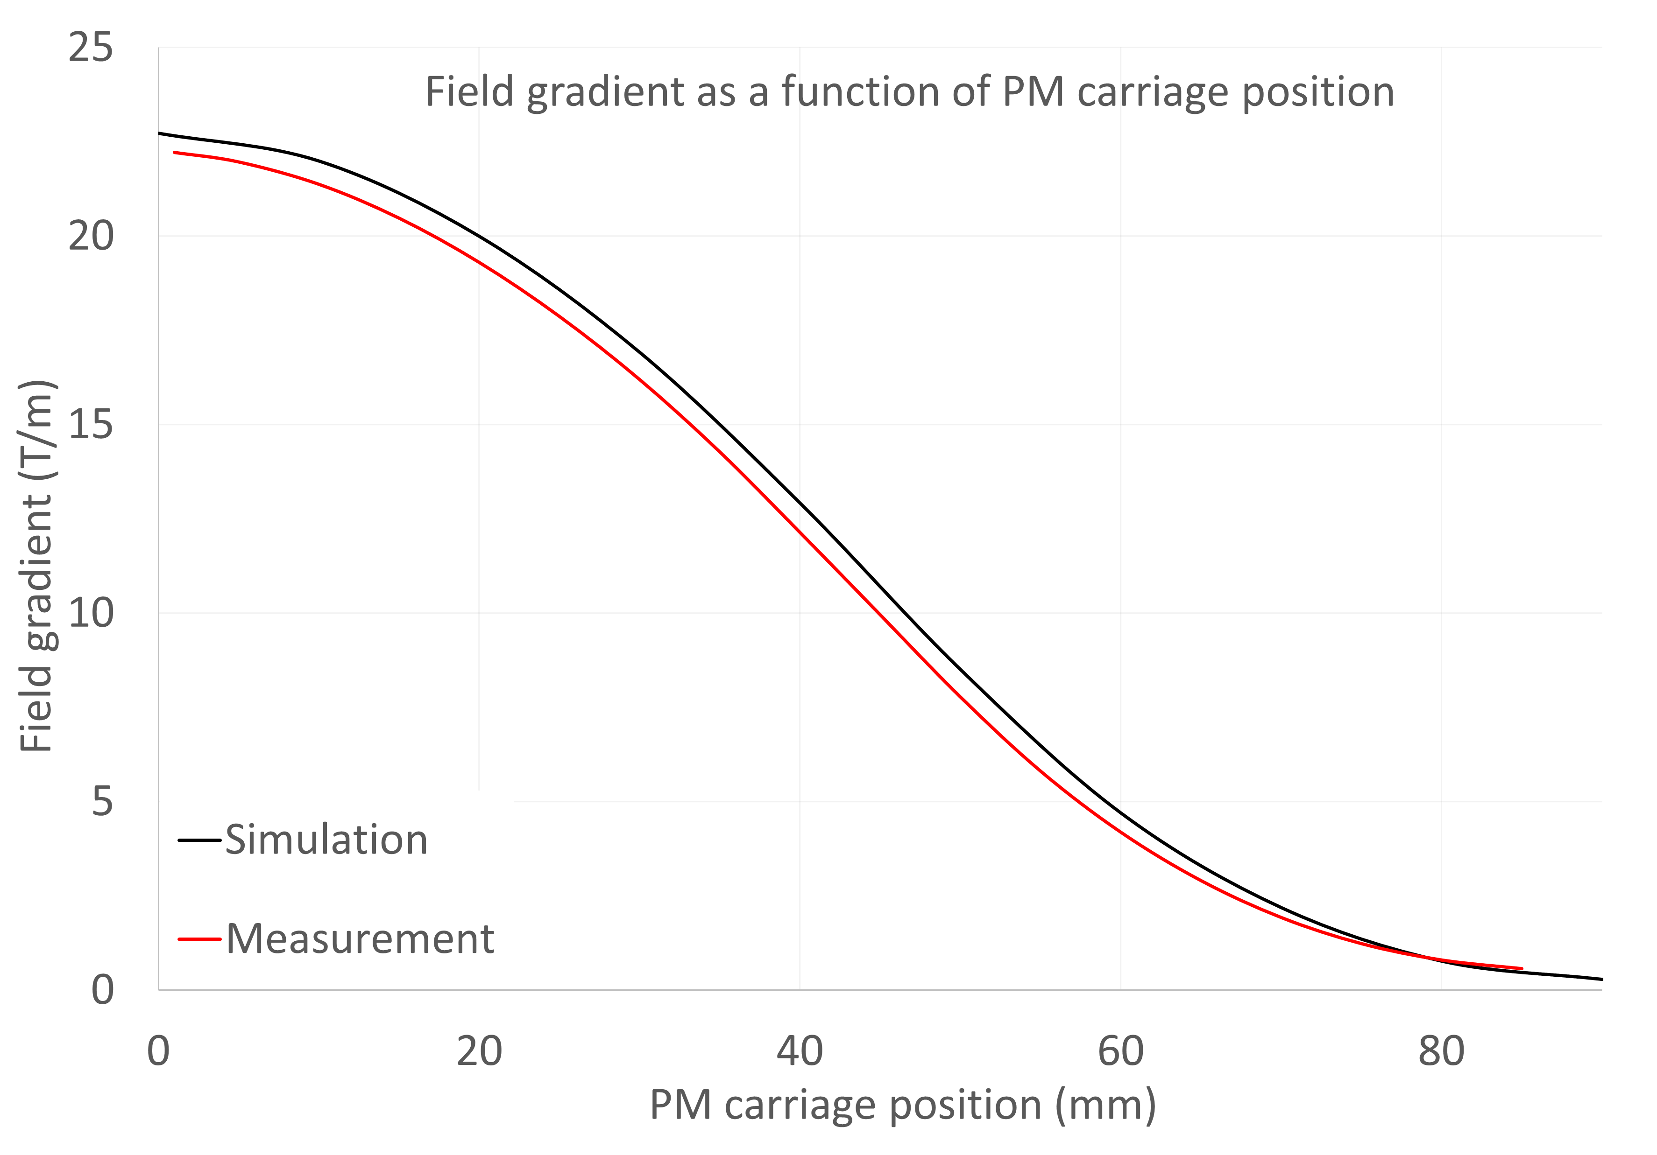
Gradient vs gap
Some variation between simulated and measured gradients observed.
Gradient lower than predicted but still within requirements (19 to 0.5 T/m normal operation)
Actual range of sweep is 1-85 mm (instead of 0-90 mm) due to limit switch positions.
Tuneability 22.37 to 0.47 T/m
Predicted range was 22.72 T/m to 0.3 T/m

Slide 15
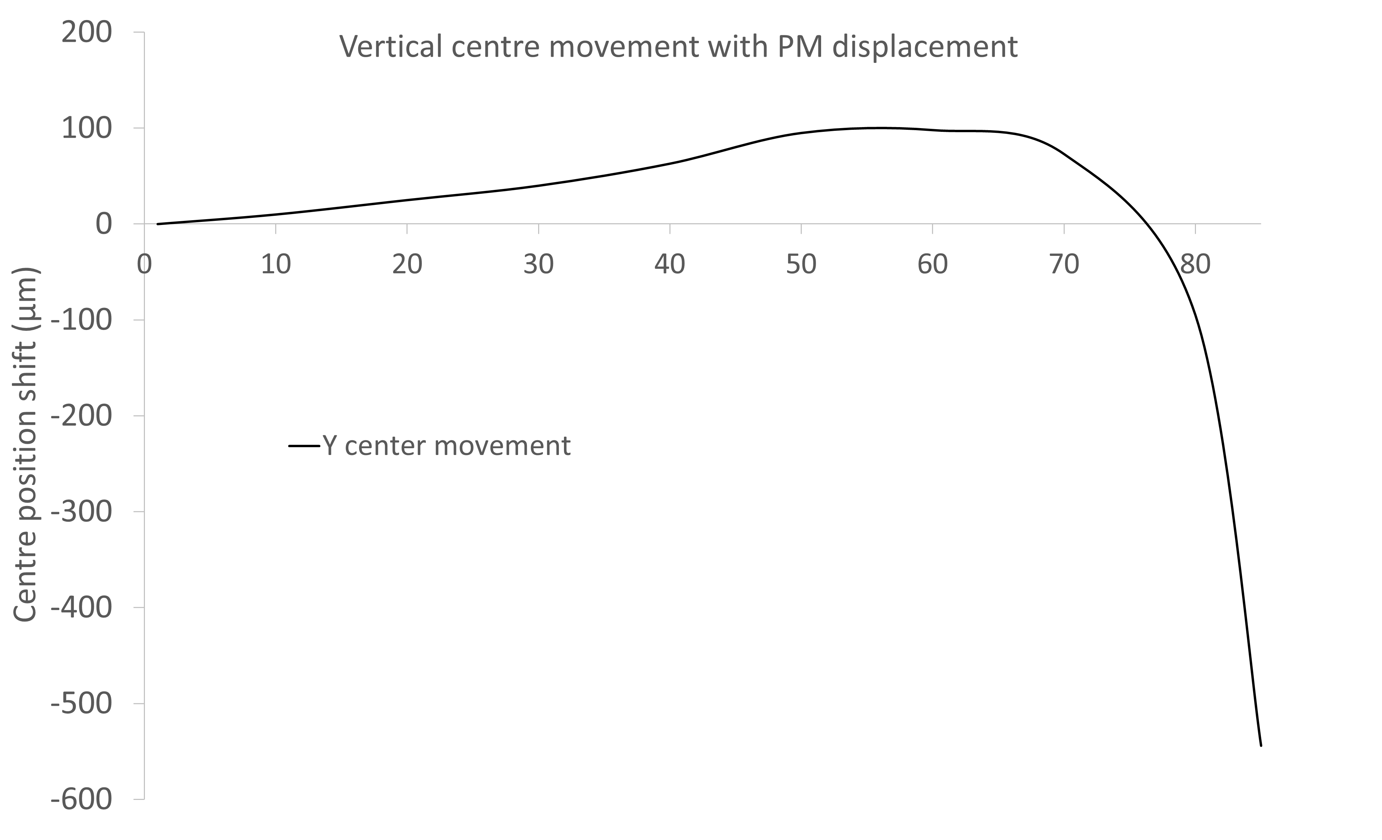
Vertical centre position
Movements in Y centre observed as a function of carriage position.
Y centre slowly rises as gap enlarges and then suddenly starts to drop.
Cause of movement and direction reversal unknown – magnetic materials in pedestal? Uneven motion?

Slide 16
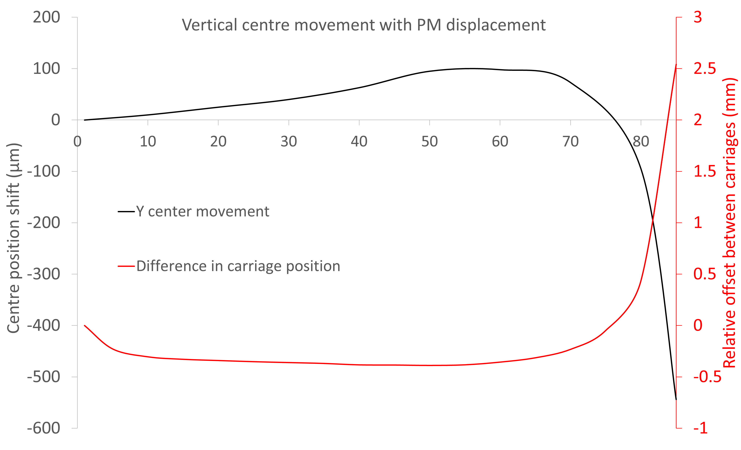
Vertical centre position
By offsetting the bottom carriage position from the top carriage position we have found this is correctable!
Works with either carriage, but resulting look-up table is slightly different.

Slide 17
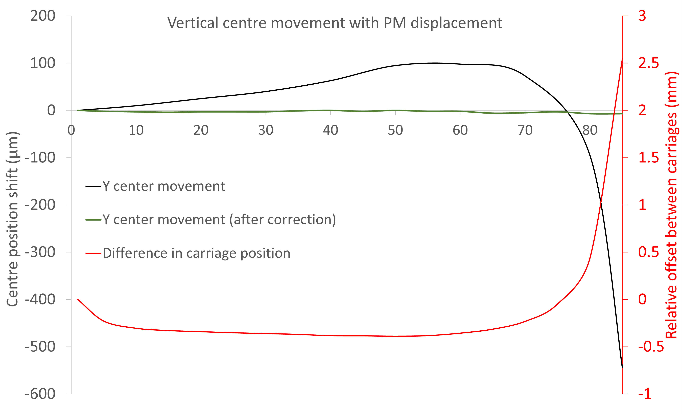
Vertical centre position
By applying the look-up table we can effectively counter all vertical movement of the magnetic centre!
Dataset shown has 7 µm drop in centre position, with 5 µm drop expected from temperature variation alone (contraction of magnet pedestal).

Slide 18
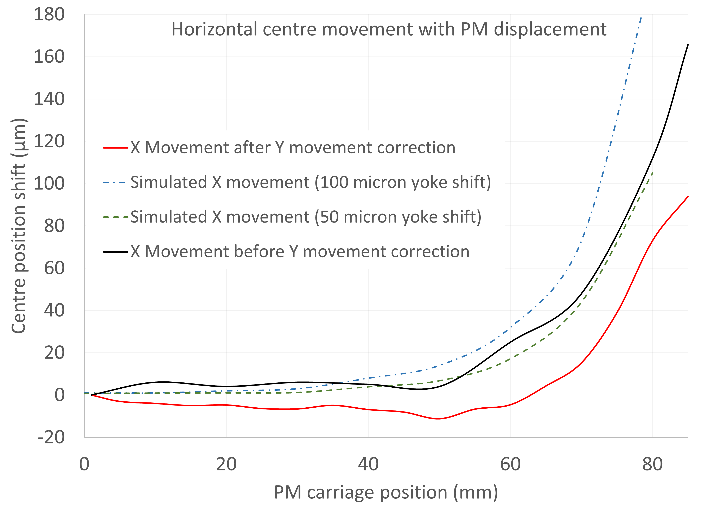
Horizontal centre position
Can replicate trend by offsetting one half of outer yoke – Assembly issue?

Slide 19
Homogeneity – integrated
Integrated gradient homogeneity as function of X at max strength, from ZX map.
Follows similar pattern to sweep across x centre.
Integrated homogeneity is at worst 1.3%
Results almost identical at 40mm carriage position!

Slide 20
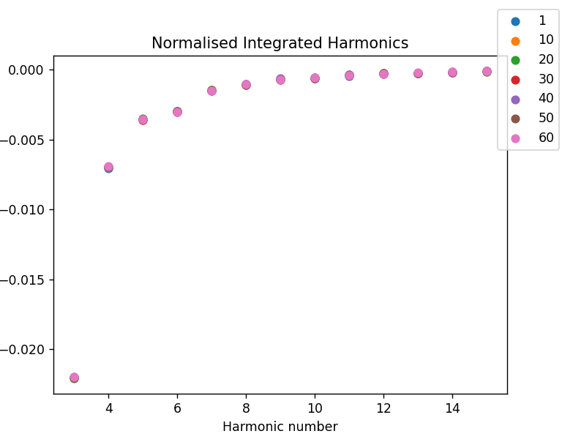
Harmonics
Normalized integrated harmonics measured moving hall probe in a circle of radius 3mm at 5mm intervals in Z along ~43% magnet length.
Harmonics remain proportionally consistent as carriages move.
But design makes usually forbidden octupole harmonic allowed, and a sextupole harmonic suggests imperfect assembly.

Slide 21
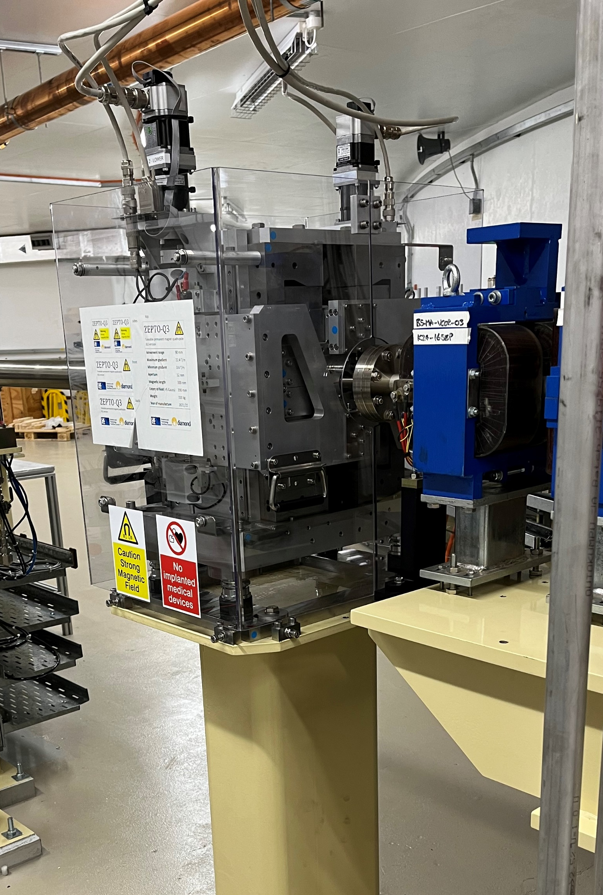
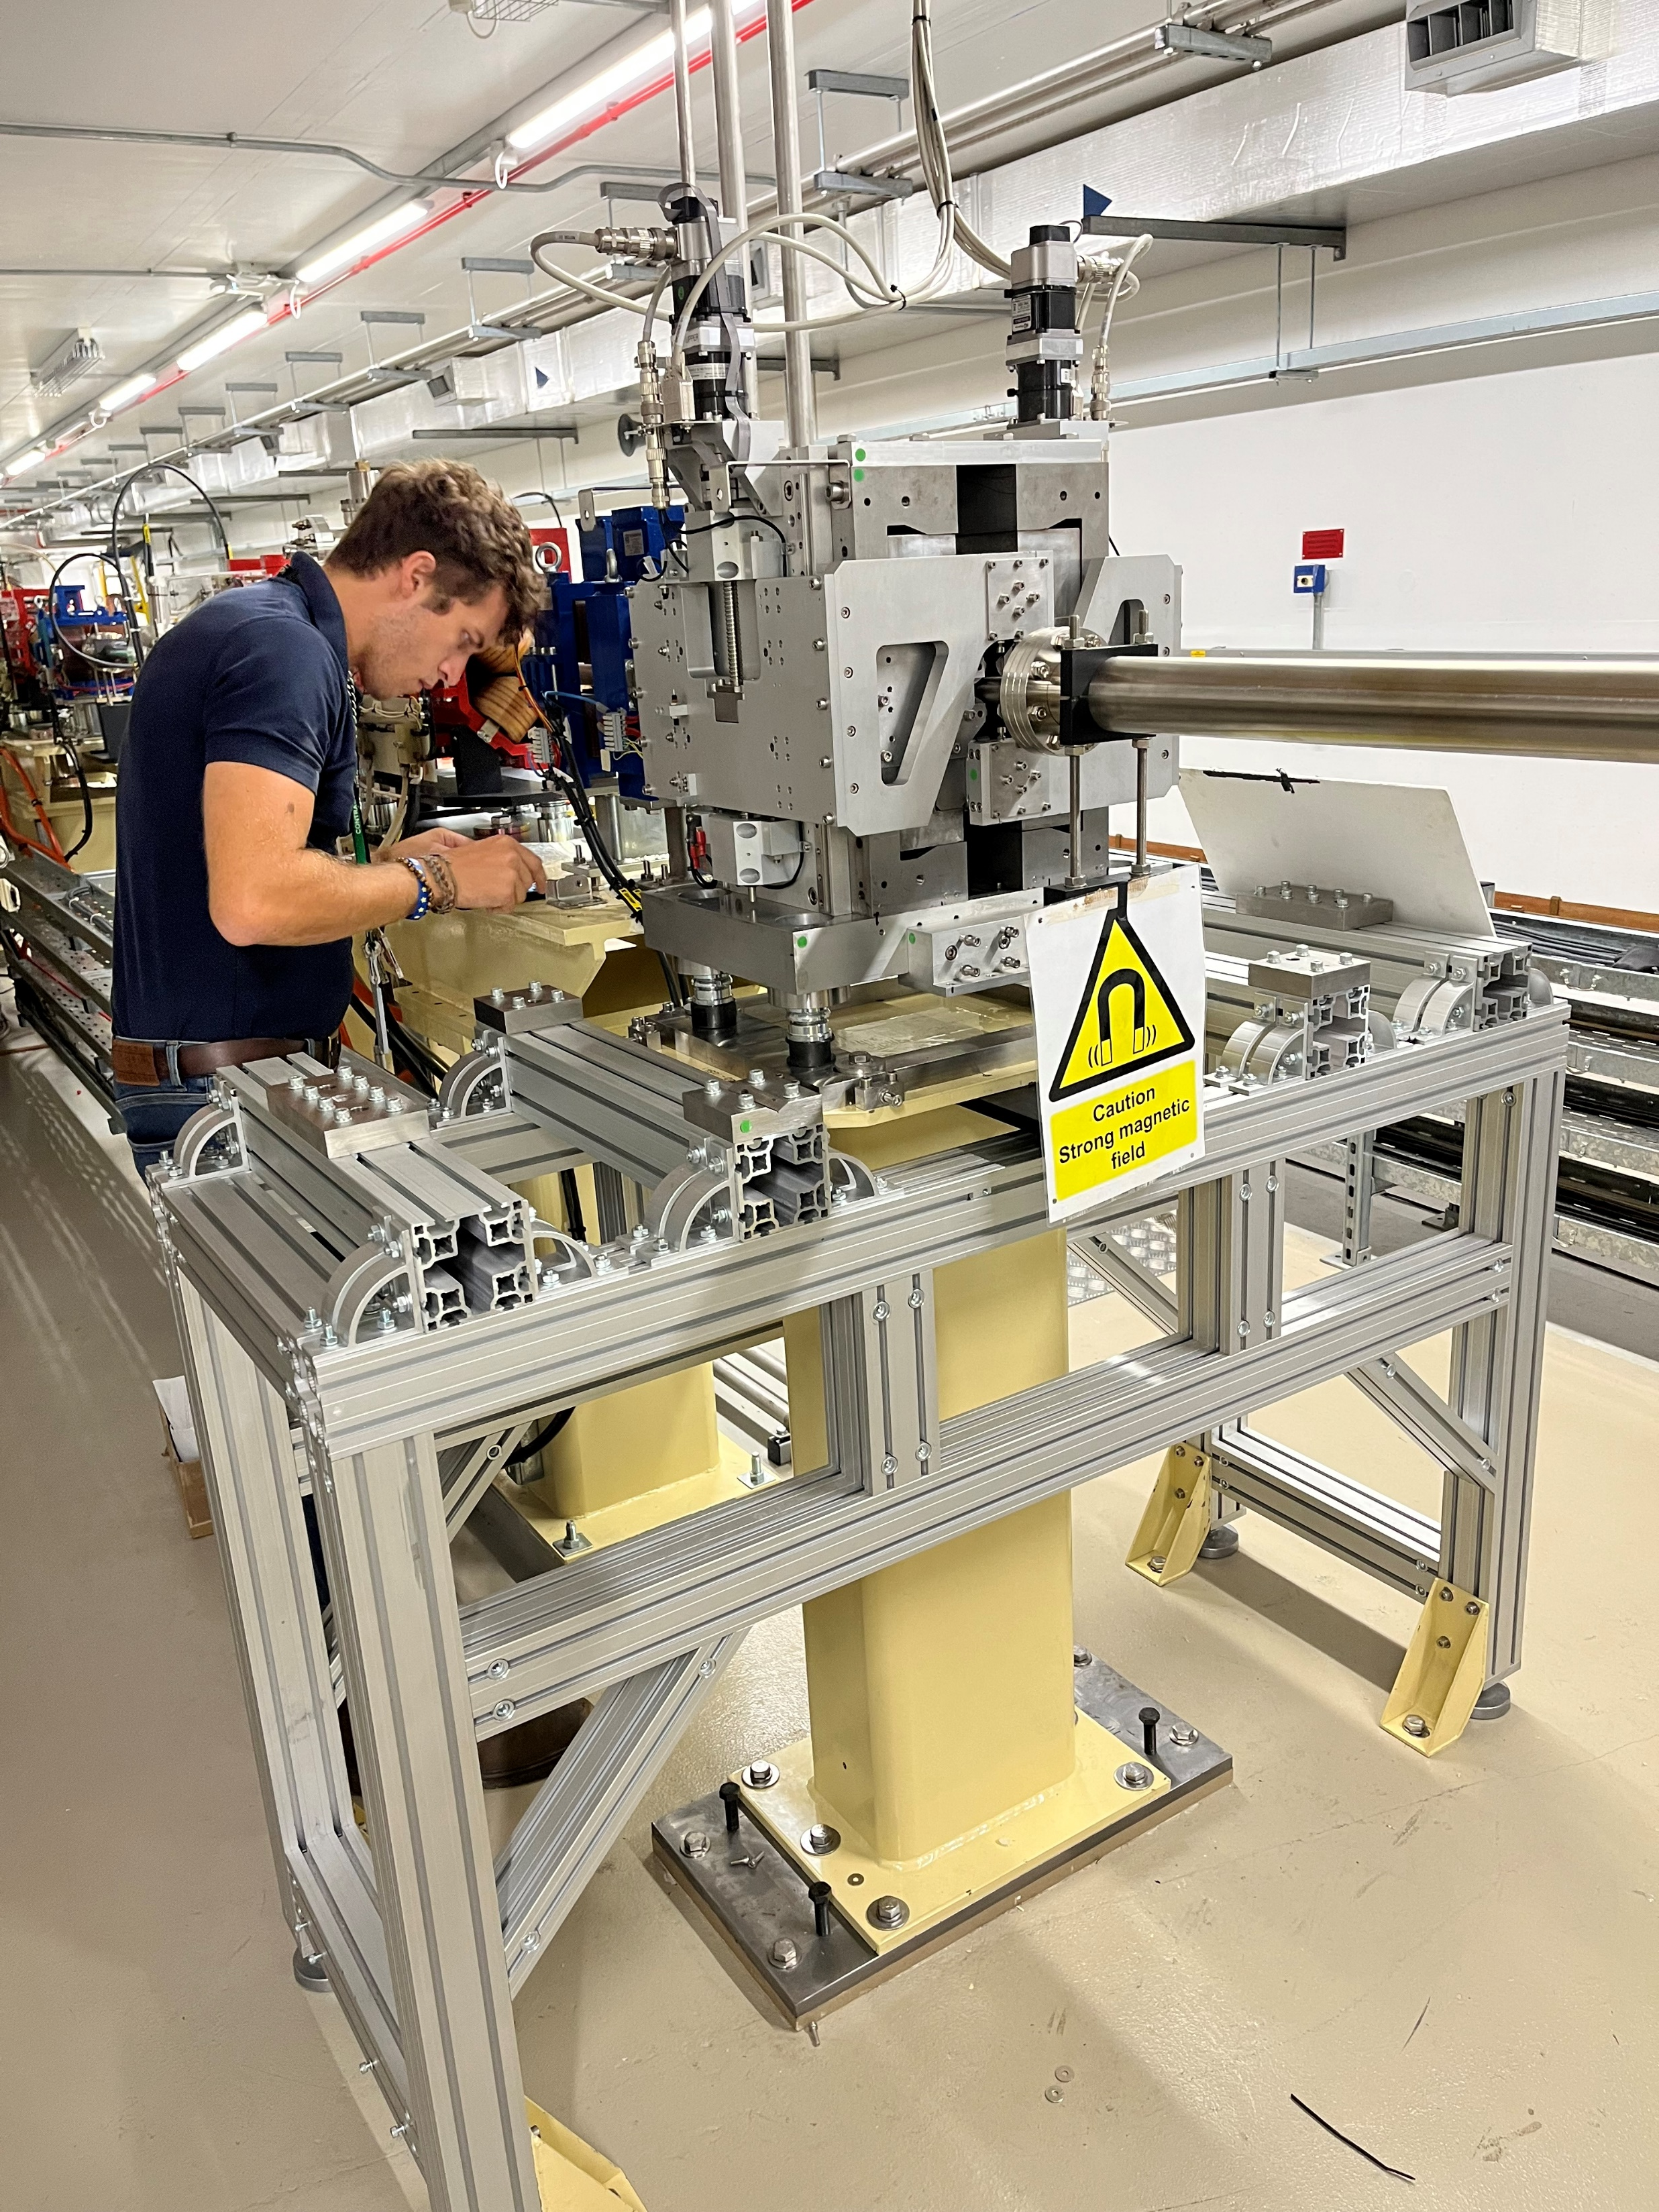
Installation on Diamond
The magnet has now been successfully installed on the booster to storage ring transfer line at Diamond alongside the electromagnet it is “replacing”.
This represents the first use of the ZEPTO technology on a real accelerator, and we hope long term testing will show the viability of the technology for widespread commercial use.

Slide 22
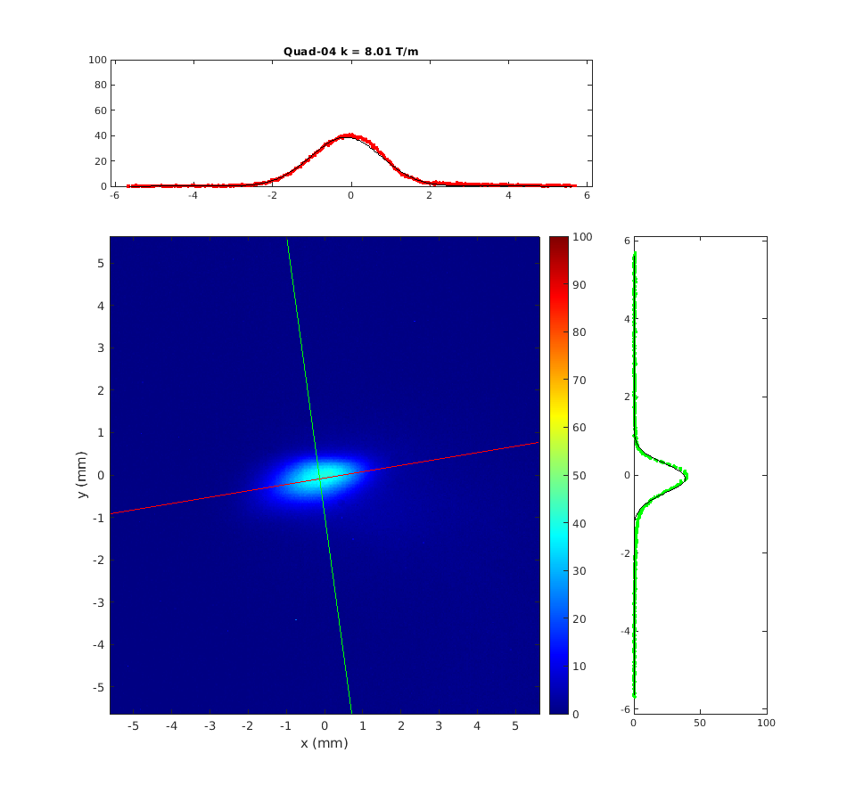
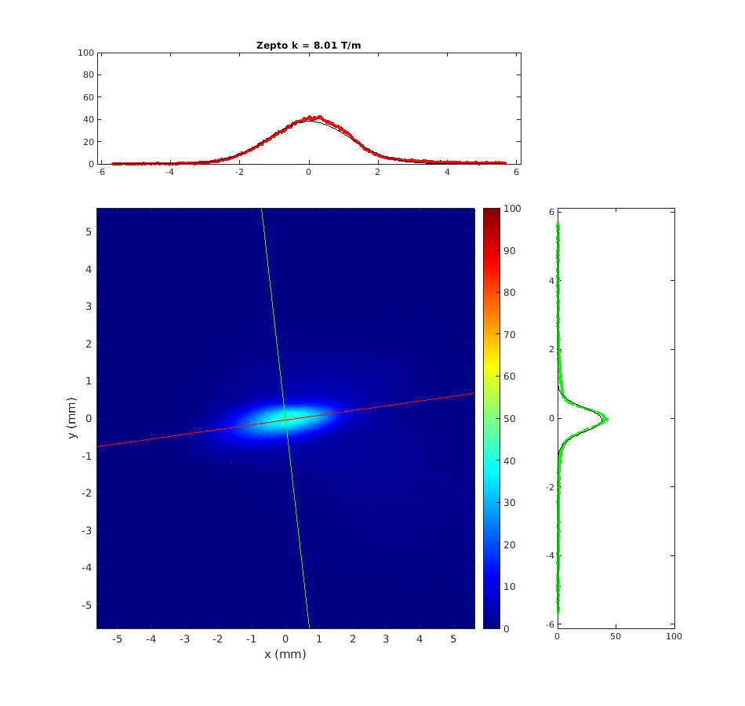
First testing on Diamond
Diamond Light Source have confirmed that they are able to inject through the ZEPTO quad into the storage ring and maintain the same injection efficiency that the electromagnet provided, and that they are able to effectively switch the magnet off!

Slide 23
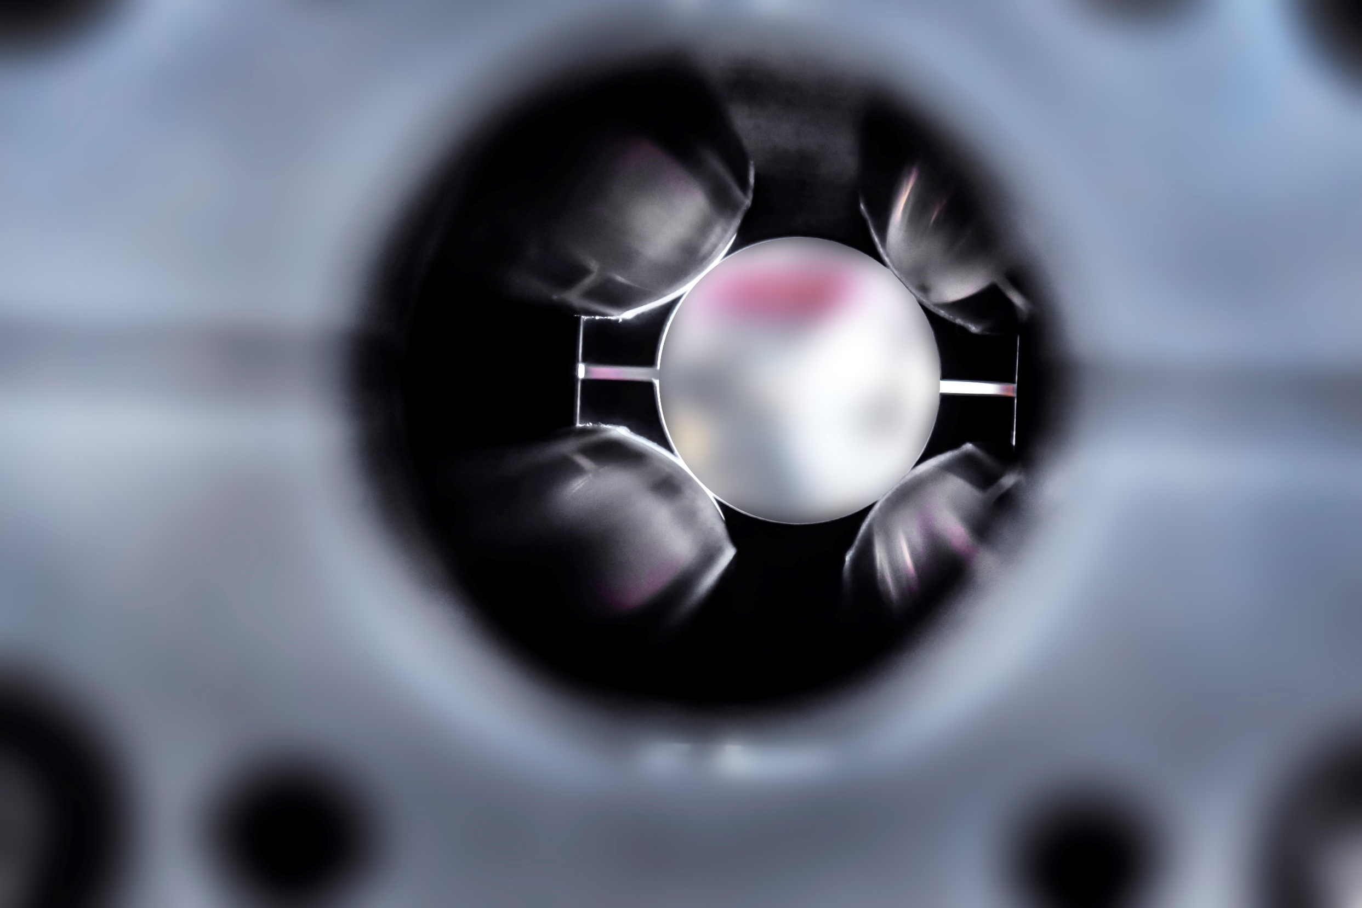
Conclusions
We have built a new ZEPTO quadrupole prototype with several evolutions over the original prototypes.
We have successfully demonstrated that it is possible to build a ZEPTO magnet that can be split and installed around an existing beam pipe.
We have shown that it is possible to keep the vertical magnetic centre position stable by individually moving the magnet blocks according to a look-up table.
More work is still needed to understand and prevent horizontal centre movement.
The tolerances on the outer short-circuit yoke are just as important as on the pole tips!
The magnet is now installed and working on Diamond!

Slide 24
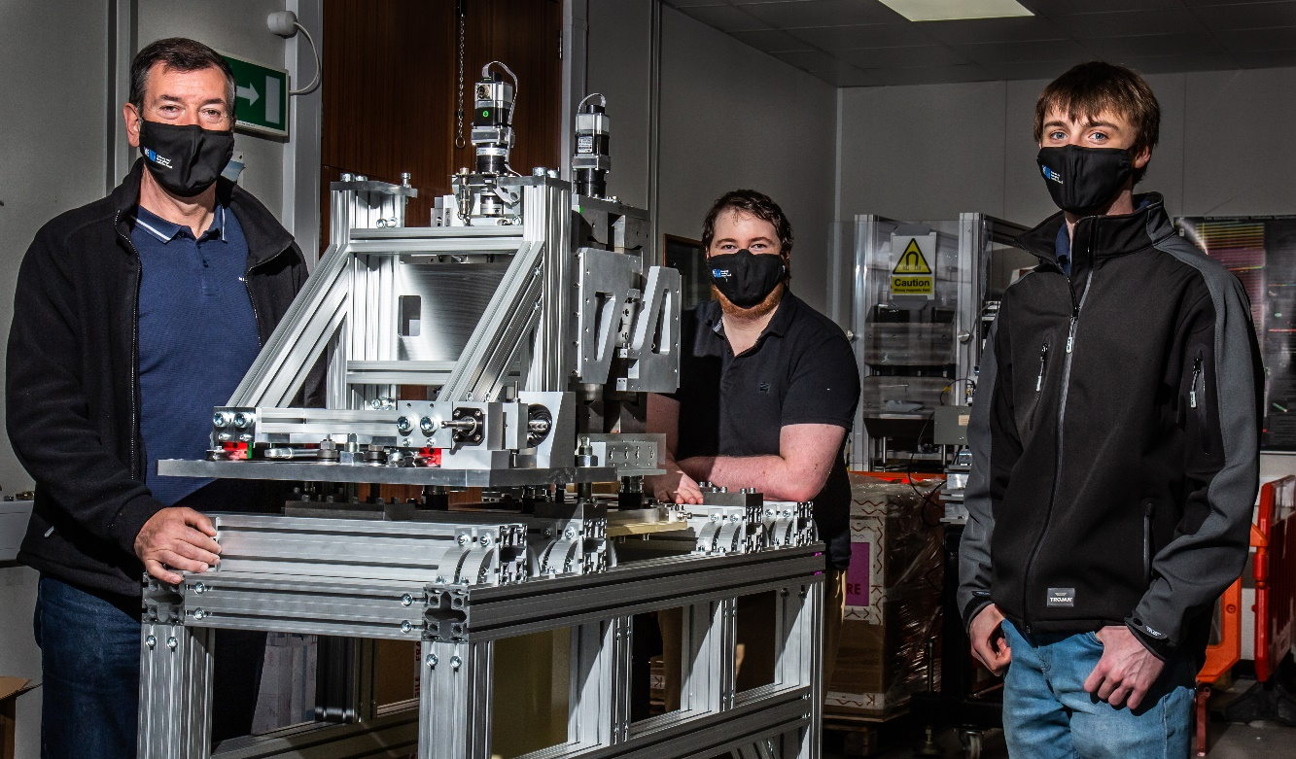




Acknowledgements
The team behind ZEPTO DLS prototype:
Ben Shepherd
Alex Bainbridge
Nick Krumpa
Alex Hinton
Group Leader & ZEPTO co-inventor
Design & Modelling
Mechanical engineering
Measurements
  + Thanks to Walter Tizzano, Rick Fielder & Ian Martin from Diamond Light Source
+ Thanks to Alex Headspith, Callum Otter, Ryan Cash, Mike Liptrot, Paul Hindley and Mike Lowe
  This work was funded by the STFC Proof of Concept Fund

Slide 25



Thank You
Science and Technology Facilities Council
@STFC_matters
Science and Technology Facilities Council

Slide 26
Frequently Asked Questions
1 How much did this prototype cost?
The budget was approximately £100,000 as this was a one-off. Large production runs would be significantly cheaper.
2 How does the cost of a ZEPTO magnet compare to an electromagnetic quadrupole?
The up-front cost of the magnet is higher due to the cost of materials and the labour-intensive assembly process; but money is saved on power supplies, infrastructure, cooling systems and long-term energy bills.
3 Are permanent magnets really a green alternative?
Its complicated. Mining rare earth materials is environmentally damaging and the carbon release from manufacturing a ZEPTO magnet is likely higher than for an electromagnetic alternative. However, the reduced power use can offset this within 1 year depending on the power grid of the country where they are used, and permanent magnet materials are now recyclable.
4 What about higher harmonics?
This design does break symmetry about the 45 degree lines, and so a small octupole harmonic will always be present. In addition, a sextupole harmonic has been measured suggesting the horizontal and vertical gaps between pole tips may not be equal.
5 Is ZEPTO technology patented?
Yes, patent numbers WO-2012046036-A1 and PCT/GB2020/050714

