Slide 1
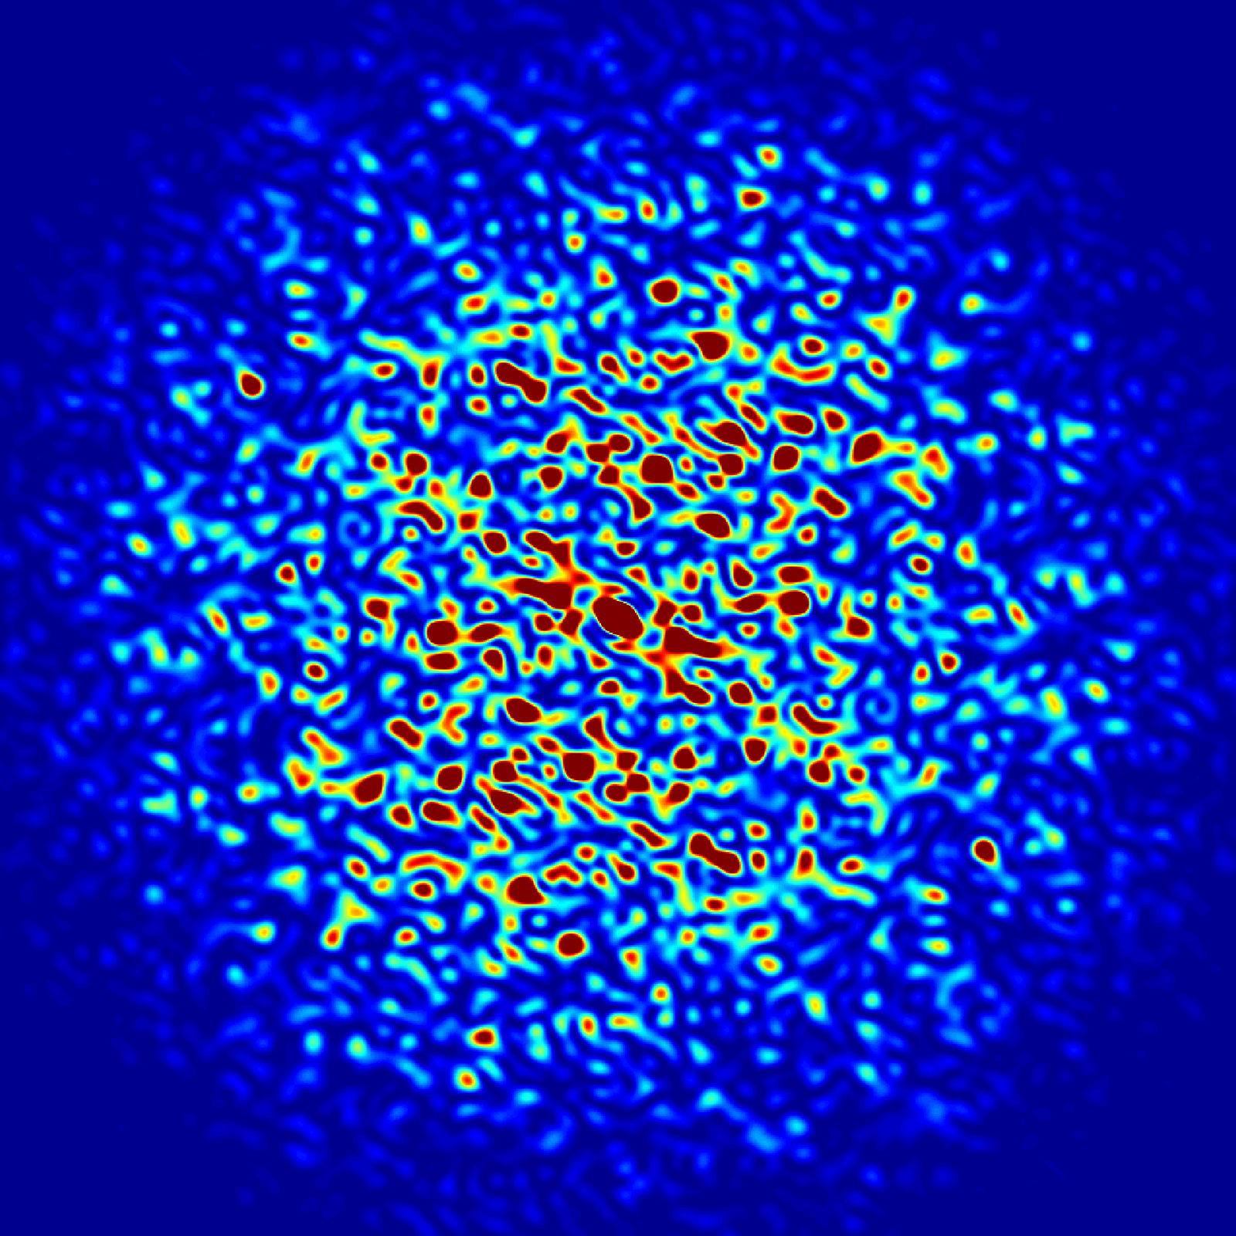
Performance of measurement systems for the Advanced Photon Source Upgrade storage ring magnets*
Animesh Jain, Charles Doose, Tyler Malas
Argonne National Laboratory
22nd International Magnetic Measurement Workshop (IMMW22)
Campinas, Brazil, September 26-30, 2022 (Virtual)
* Work supported by the US Department of Energy under contract DE-AC02-06CH11357
Notes:
Univ of Chicago Review, Aug. 30, 2010
0

Slide 2
Acknowledgements
Venus Apantenco Ralph Bechtold
Nicholas Bechtold Evan Carter
Gentillo Curescu Joseph DiMarco, Fermilab
Aric Donnelly William Jansma
Mark Jaski Michael Johnson
Roberto Lopez Kris Mietsner
Jamal Pegues Spiro Skiadopoulos
Robert Soliday Mathew Virgo

Slide 3
Introduction
It is planned to upgrade the Advanced Photon Source (APS) currently operating at Argonne National Laboratory to provide much brighter beams of X-rays (the
APS-U project).
As part of this upgrade, the entire storage ring will be replaced with a new storage ring based on a 42 pm emittance Multi-bend Achromat (MBA) lattice.
The new storage ring will contain over 1300 new magnets, which will have to be measured and aligned in an assembly of magnets.
The magnet production is nearing completion, with about 96% of magnets already delivered and measured.
A new magnetic measurement laboratory was built for the storage ring magnets and has been in operation for over three years now.
Performance of magnetic measurement benches for APS-U is presented here.

Slide 4
Advanced Photon Source Upgrade (APS-U)
2 bending magnets (Double Bend Achromat)
Present
Lattice
7 “forward” bending magnets
Doublet
Upgrade
Lattice
Multiplet
Multiplet
L-bend
Doublet
FODO
L-bend
L-bend
L-bend
6 “reverse” bending magnets
4 longitudinal gradient dipoles (L-bends; Dipole field only; A:M1, A:M2, B:M1, B:M2)
3 transverse gradient dipoles (Q-bends; dipole + quadrupole fields; A:M3, M4, B:M3)
6 reverse bending magnets (R-bends; dipole + quadrupole fields; A:Q4, A:Q5, A:Q8, B:Q4, B:Q5, B:Q8)
13 bends total (Multi-bend Achromat)

Slide 5
New magnetic measurement laboratory for APS-U
The existing space used for measurements during R&D phase was not big enough to accommodate the needs of the full APS-U production.
We needed space for 4 rotating coil benches, two fiducialization benches, and one Hall probe bench, in addition to space for incoming mechanical and electrical inspections, pre-survey of dipoles, and storage of some magnets to match the throughput of approximately one week.
A portion of an existing building at Argonne was identified as a suitable candidate around January 2018, but the space was being used for other purposes at that time.
The space was vacated, existing unwanted structure was demolished, and the space was re-built according to the needs of the measurement laboratory.
We received final occupancy of the new space in April 2019.

Slide 6
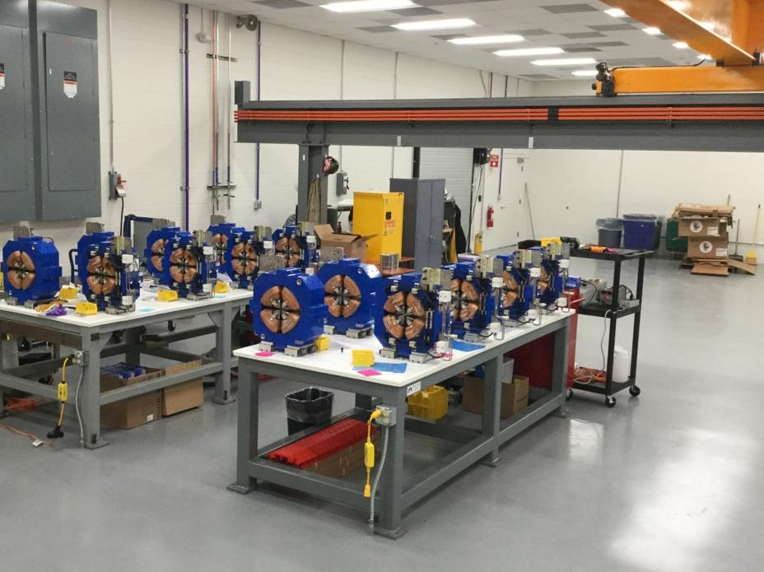
Magnet measurement lab: Incoming inspection area
The magnet manufacturers are responsible for meeting only the mechanical requirements, and not field quality, since all magnet designs are by Argonne, and the magnets are built as a “build-to-print” contract.
However, in the end, field quality is important and magnetic measurements are essential.
Incoming inspection area
Photo credit: Mark Jaski

Slide 7
List of APS-U measurement benches
0.48 m long printed circuit coil
(Fermilab built)

Slide 8
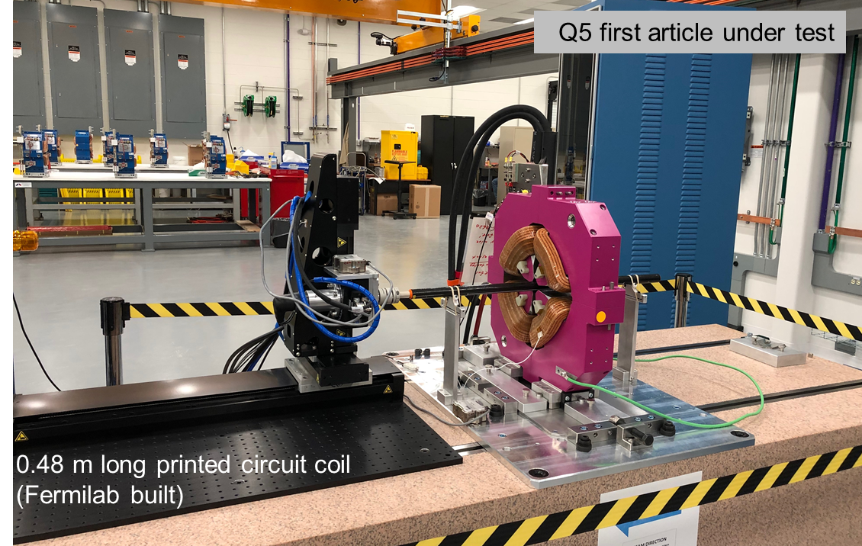
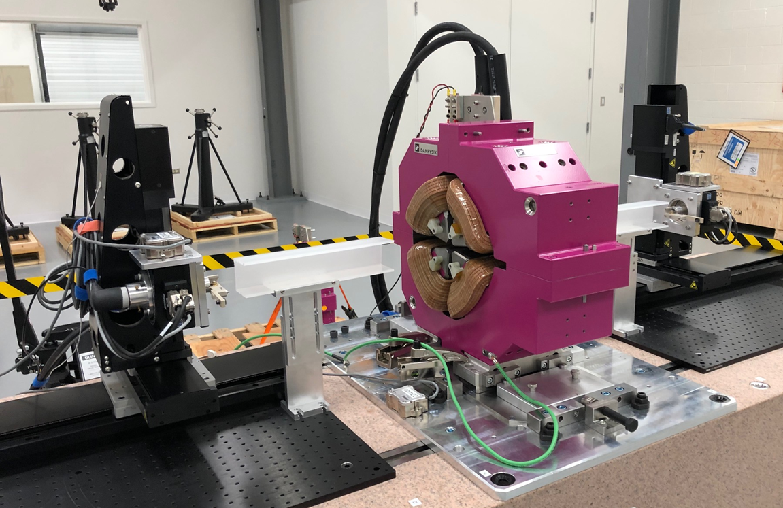
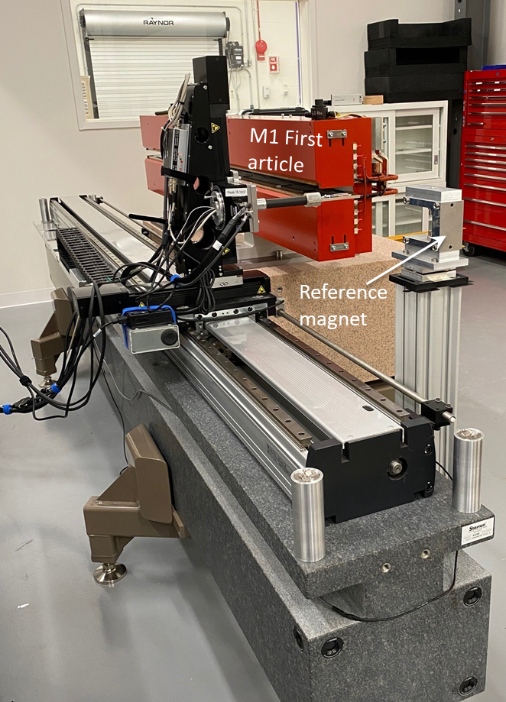
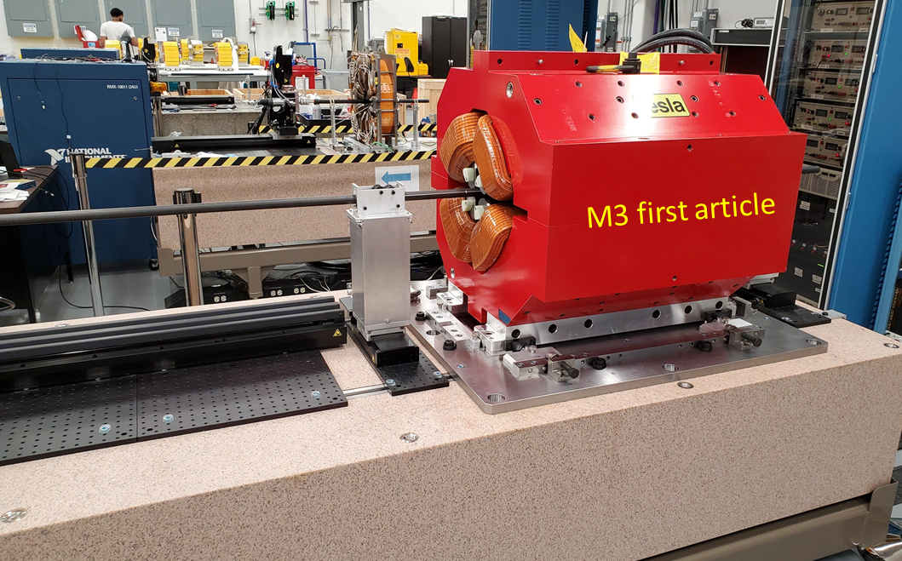
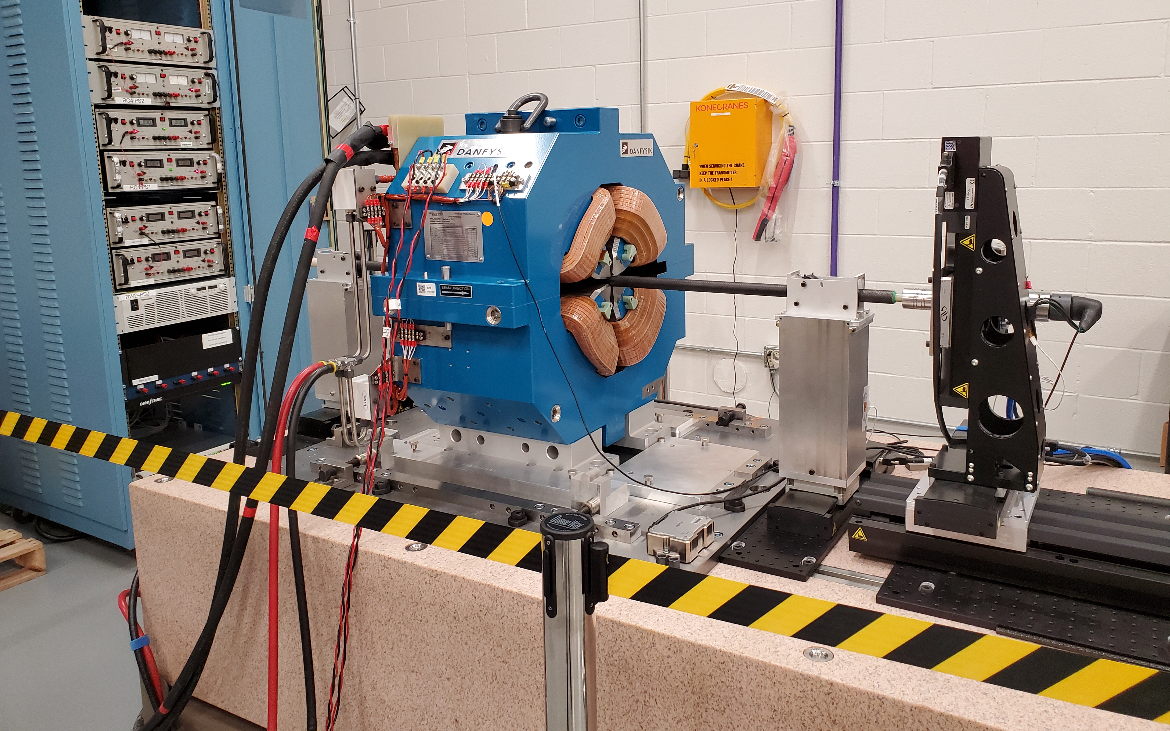
APS-U measurement benches
Q4 magnet under test
0.48 m long printed circuit coil
(Fermilab built)
RC1/RC2
RW1/RW2
Q7 magnet under test
HP1
0.48 m long printed circuit coil
(Fermilab built)
Talk by Charles Doose on Day 2
0.4 m long printed circuit coil
(Fermilab built)
1.0 m long printed circuit coil
(Fermilab built)
RC4
RC3

Slide 9
Hardware
Motion stages and controllers: Newport (except 3.5 m long stage for Hall probe)
Long 3.5 m stage for Hall probe bench: THK
Data acquisition: National Instruments (DSA, DAC, DVM, FPGA)
Inclinometers: Digi-Pas 5500 (~10 μrad RMS noise)
Hall probes: Senis F3A 3-axis, 5 V/Tesla (calibrated against NMR Metrolab 2026)
Main power supply: TDK-Lambda 300 A/50 V and 500 A/30 V
Corrector power supply: Kepco 20 A/20 V; two supplies in series in some cases.
Current measurement: Danisense DCCT with calibration windings
Data logger for a few parameters: Measurement Computing USB DAQ
All benches were designed to easily align the magnets using reference surfaces

Slide 10
Early difficulties
Some early printed circuit coils had a twist in the plane of the coil, which varied along the length. This resulted in a spurious skew 12-pole in quadrupoles that had large normal
12-pole (allowed term). The spurious skew term was roughly 1 “unit” (10^{–4} of the main field). This required a re-build of these coils. Twisting was minimized by Fermilab in the design of future coils.
The systems used during the R&D phase were developed using an earlier version (XPS-Q8) of Newport motion controller. These controllers were discontinued by Newport at the time of building the production systems, so we had to use a newer version (XPS-D) of the controller. There are significant differences between these two models, unfortunately for the worse, which caused many issues.
The alignment of the long rotating wire bench was found to be affected by deformation of the granite block supports under the load of the larger magnets. This was minimized but could not be completely eliminated.
Once commissioned, all systems have performed flawlessly resulting in efficient operation.

Slide 11
Newport XPS-D controller issues
The XPS-Q8 had encoder and trigger outputs for each drive slot, but the XPS-D has trigger outputs only on drive slots 1, 2, 5, 6. This impacts drive slot choice when using triggers based on encoder positions. (Not too serious, except for the Hall probe system.)
The pulse width of the trigger pulse (used to trigger the Dynamic Signal Analyzer) is defined differently and limited to a few values. This required changing the LabView code specific for the XPS-D controller for the Hall probe system. The rotating coil/wire systems use triggers generated by the FPGA, so were not affected.
The XPS-D back-panel encoder quadrature signals had high-frequency glitches at the cross-over points making it impossible for the FPGA code to reliably count the pulses. The fix was to use the raw Sine/Cosine signals which were squared up and level shifted to TTL using a home-built circuit. This provided clean quadrature signals that could be counted by the FPGA. All this could be done internal to the old XPS-Q8 without an external circuit.
The back-panel D-Sub and Lemo connector pinouts on the XPS-D are completely different from the XPS-8 so the wiring harnesses must be specific to the controller.
A fatal “following error” occurs in XPS-D when the number of spindle rotations reaches +/-35792 from when the controller is started. At one revolution per second, this means the controllers must be restarted, and the stages homed again, after about 10 hours of continuous operation. There is no solution for this issue, despite repeated requests for help from Newport. We live with it, but often run into this error leading to loss of productivity.
(This issue is apparently addressed by Newport in a firmware update, but it is only applicable to more recent serial numbers of XPS-D controllers. It does not work for the controllers we have, purchased in 2019 and 2020.)

Slide 12
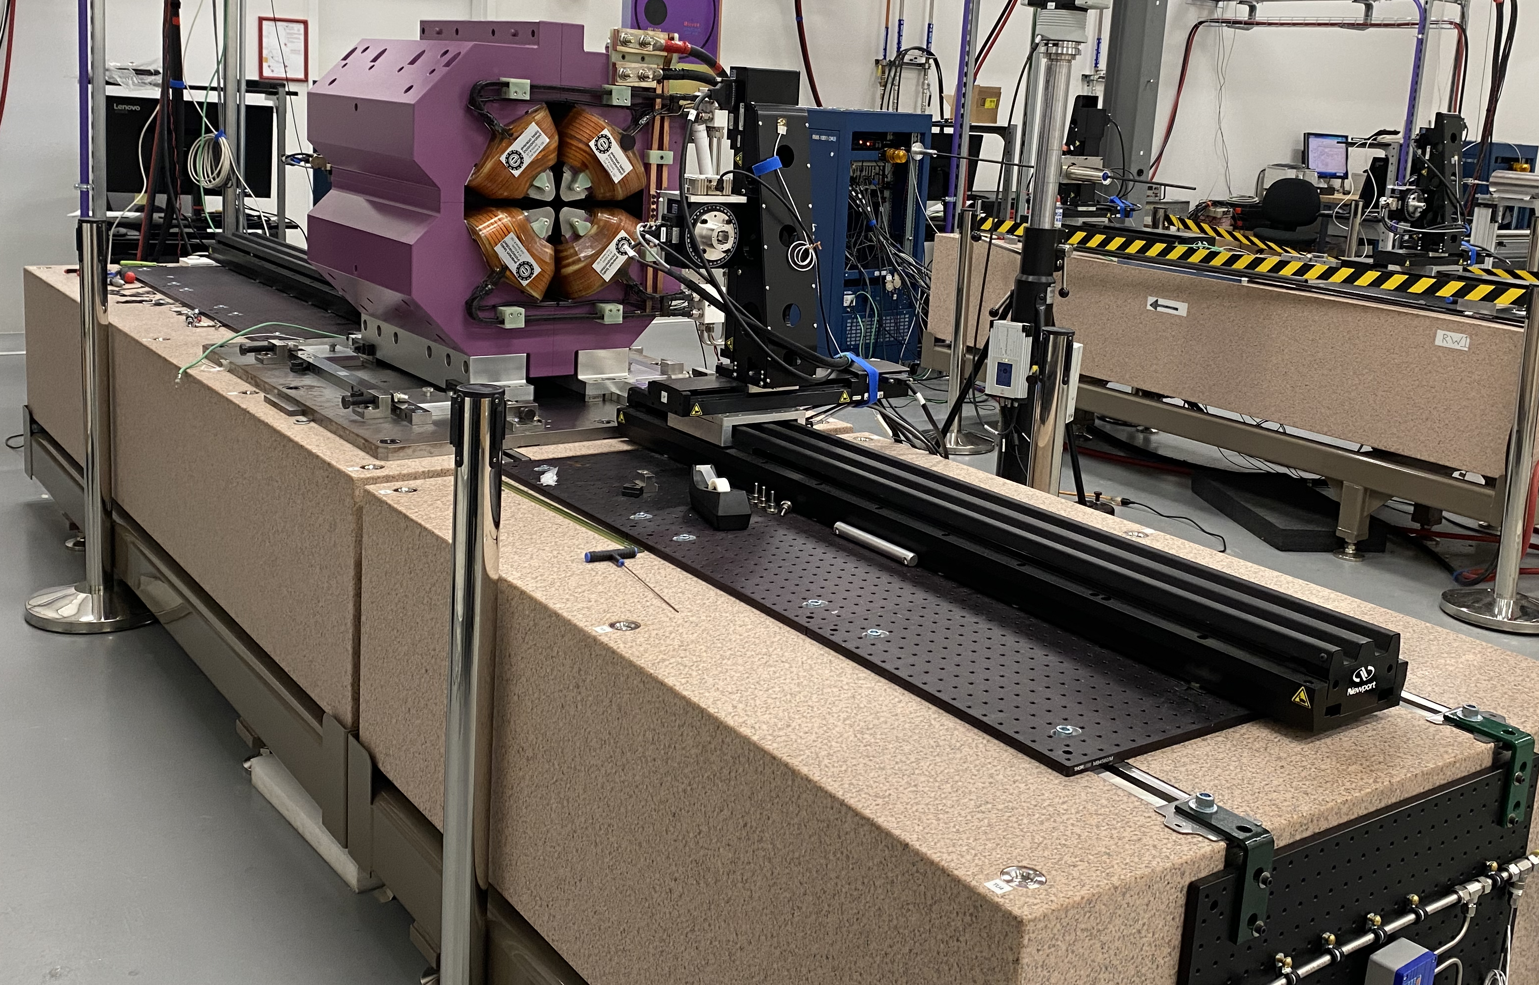
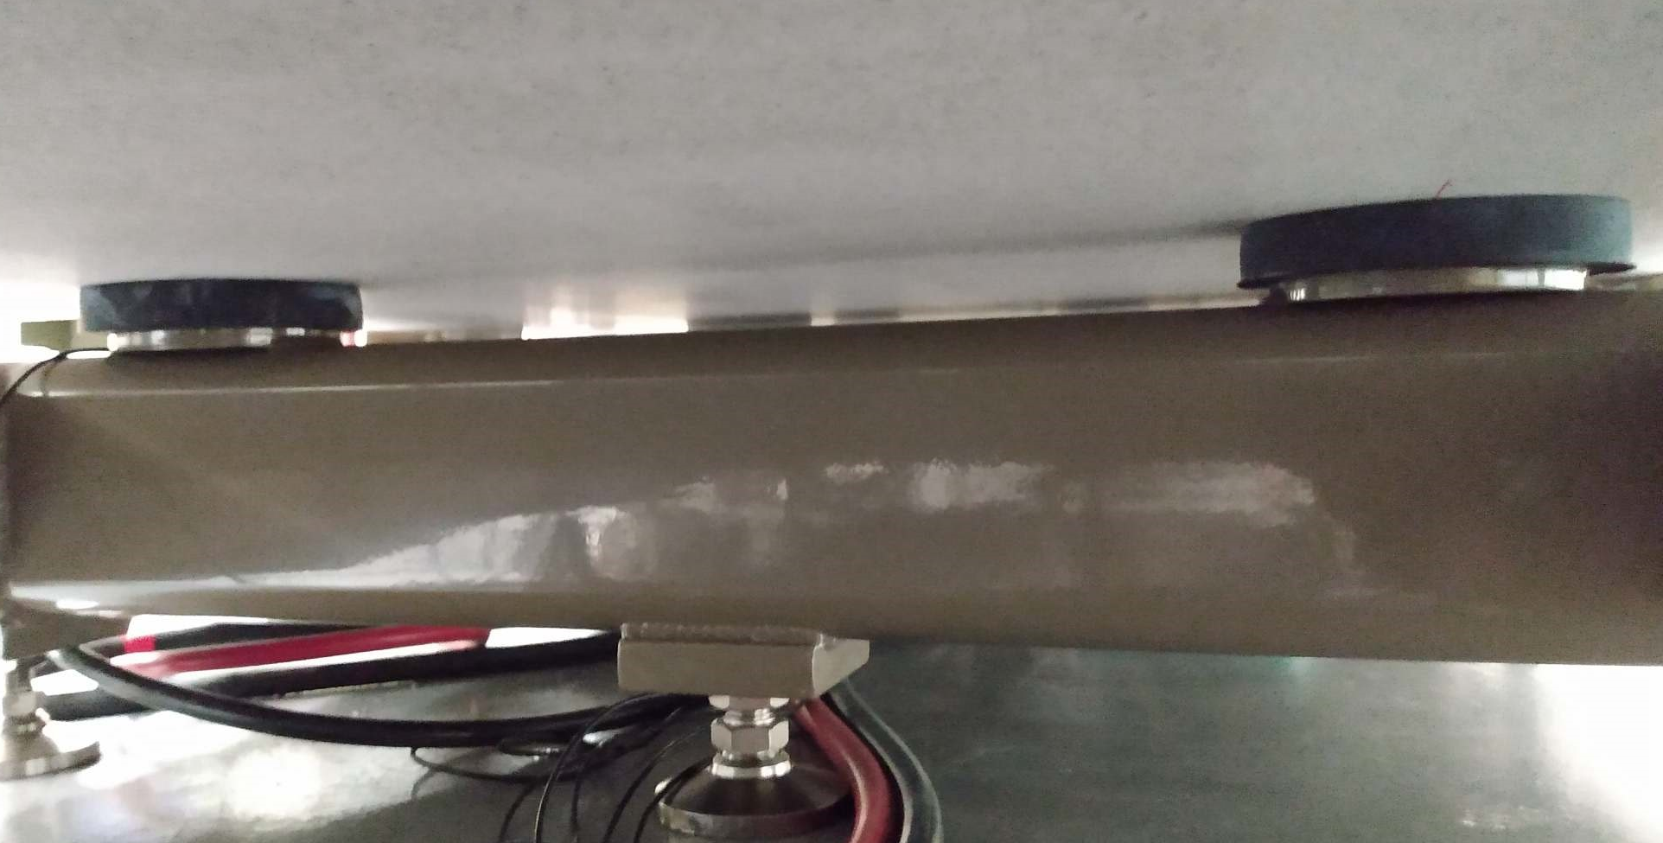
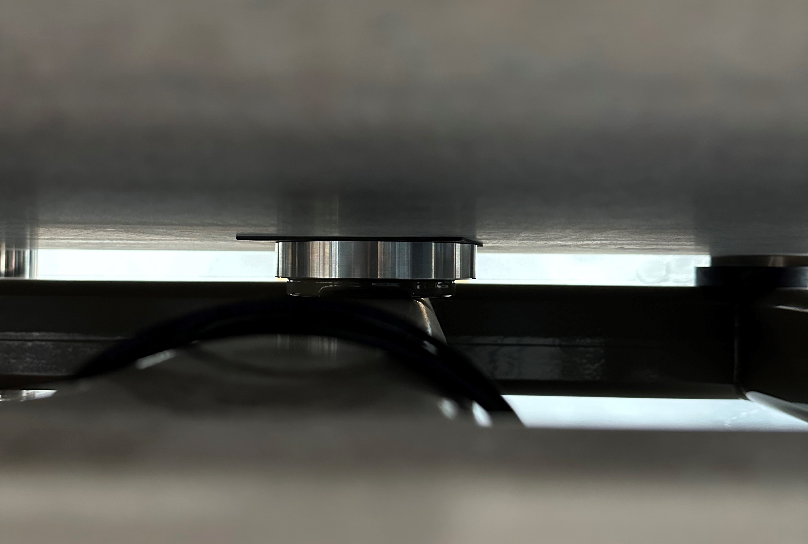
Long rotating wire bench alignment issue
Granite
Rubber Pads
Downstream (DS) 2.75 m
Upstream (US)
1.52 m long
Photo Credit:
Roberto Lopez
Granite support was split to keep the weight within crane limits.
Granite is supported on three pads on a steel frame.
There is a large change in granite alignment when a heavy magnet is placed.
Aluminum Pads with a thin elastomer sheet

Slide 13
Long rotating wire bench alignment issue
More than an order of magnitude improvement was achieved after replacing the rubber pads with aluminum pads.
The deflection is now within acceptable limits, although not fully eliminated.
A small adjustment is still made to the relative vertical positions of the stages at the two ends, depending on the type of magnet being tested.

Slide 14
Measurement repeatability
Standard deviation of DB2 signal = 32 ppm
(includes effect of current variation of 15 ppm RMS)

Slide 15
Measurement repeatability in a Q1 quadrupole
Integrated gradient = 18.4 T at 200 A
180 readings over ~1.5 hours
Field strength standard deviation is
~20 ppm
Field roll angle standard deviation is
~ 10 μrad
Use of dipole bucked signal makes measurement of main field immune to small rotational imperfections.
Higher harmonics are derived from Dipole + Quadrupole bucked signal.
Standard deviation of higher harmonics is given in ppm of the main quadrupole field at a reference radius of 10 mm.
Higher harmonics standard deviation is generally less than 1 ppm (0.01 “units”).

Slide 16
Magnet deliveries and measurement status*
All production magnets Q1-Q7, S1-S3, 8-pole correctors and M1-M4 are completed. (1273 magnets)
Fourteen out of fifteen magnet types are completed.
Only magnets remaining are the Q8 magnets, where 36 out of 82 magnets are completed. (46 remaining)
Magnetic measurements of the Q8 magnets are limited by magnet deliveries.
Q8 measurements are expected to be completed around mid-May 2023.
The present accelerator is scheduled to cease user operations on April 17, 2023, but the Q8 production will not be completed by then.
The last few magnet modules will have to be built during the removal period and installation of some early modules.
0.48 m long printed circuit coil
(Fermilab built)
* As of 23-Sep-2022

Slide 17
Measurement throughput
We have maintained a healthy measurement rate throughout the program, despite operating challenges due to COVID-19 pandemic since the very beginning.
Typically, the measurement rate was limited by magnet deliveries rather than measurement capacity.
Only one magnet type is now remaining to complete, and five out of the seven benches are retired.

Slide 18
Summary
The upgrade of APS at Argonne will require measurements of 1355 magnets for the new storage ring.
A new magnet measurement laboratory was built to handle the high volume of magnetic measurements.
Although considerable work was done during R&D to develop the measurement systems, there were still some challenges in the early stages.
Discontinuation of preferred motion controller, and the new controller lacking in many respects, had posed the biggest challenge.
All systems have performed remarkably well and with practically no down time. Only failures have been in a few power supplies, and one inclinometer, which were promptly replaced with spares.
The APS Upgrade magnet production is almost complete, with over 96% of all the 1355 magnets ordered already received and measured.
Full measurement efficiency was maintained despite challenges due to COVID-19 pandemic lasting throughout the measurement program. The remaining measurement work is expected to complete in the middle of May 2023.

