Slide 1
Measurement Activities and Upgrades at Helmholtz Zentrum Berlin
A Rich history of measurement
E. Rial on Behalf of HZB Undulator Group
IMMW22 – CNPEM, Brazil – 30.09.2022

Slide 2
HZB Undulator Group - Acknowledgement
Group Leadership
Theory
Operations &
Measurement
Stefan Gottschlich
Michael Scheer
Stefan Schäfer
Paul Volz
Carsten Kuhn
Electrical Engineering
Christoph Rethfeldt
Simon Gaebel
Atoosa Meseck
(Group Leader)
Ed Rial
(Deputy)
Mechanical Engineering
Stefan Grimmer
Sebastian Knaack
Annette Rogosch-Opolka
Technician Support
Jürgen Bakos
Florian Laube
Mario Strehlke
Johannes Bahrdt
(Project Support)

Slide 3
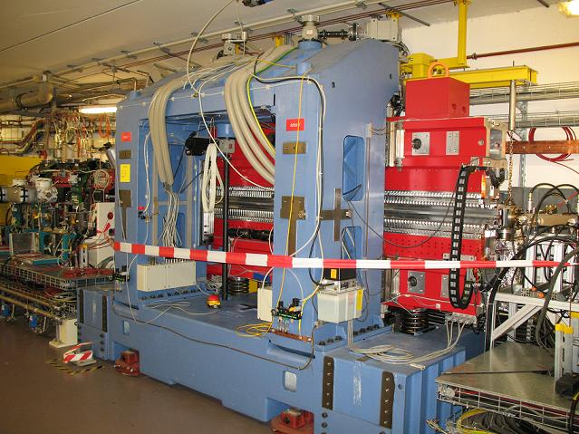
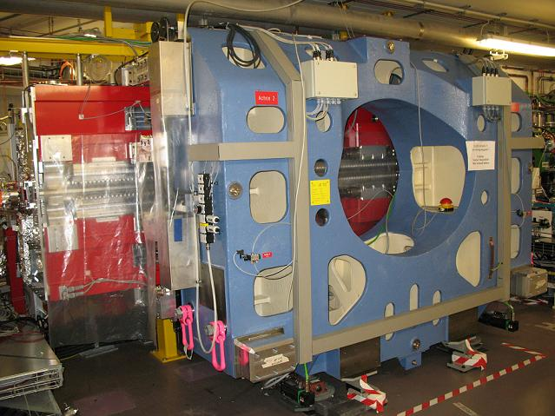
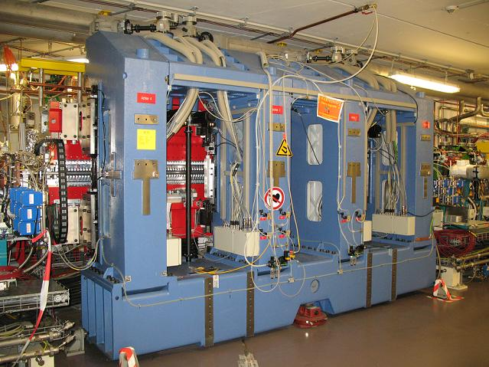
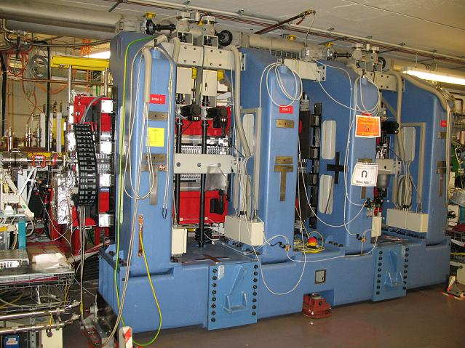
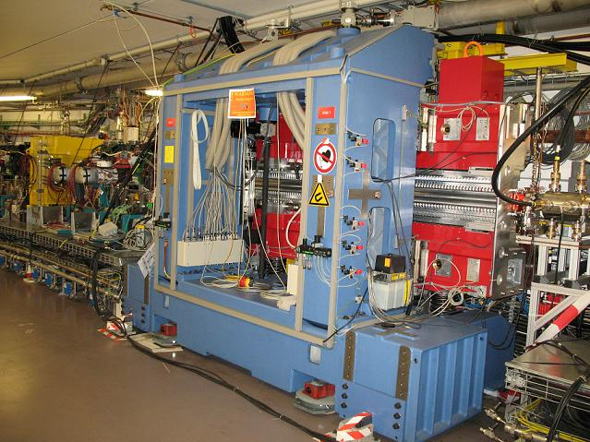
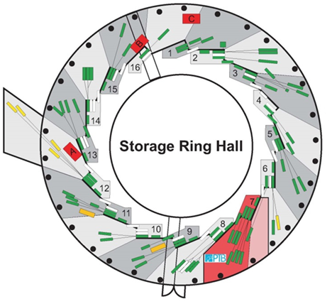
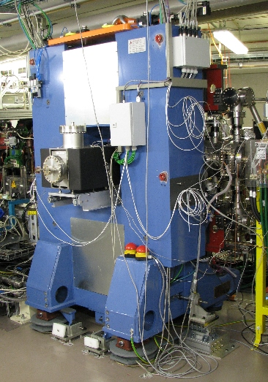
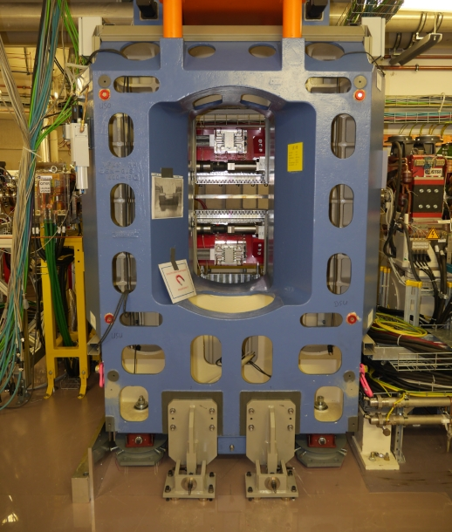
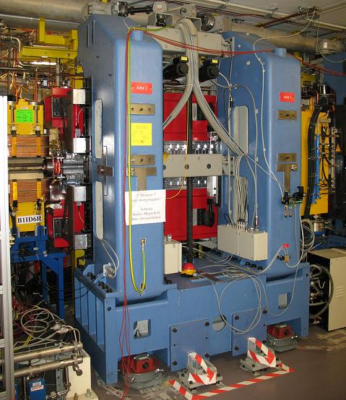
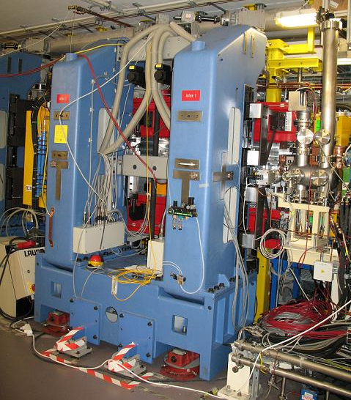
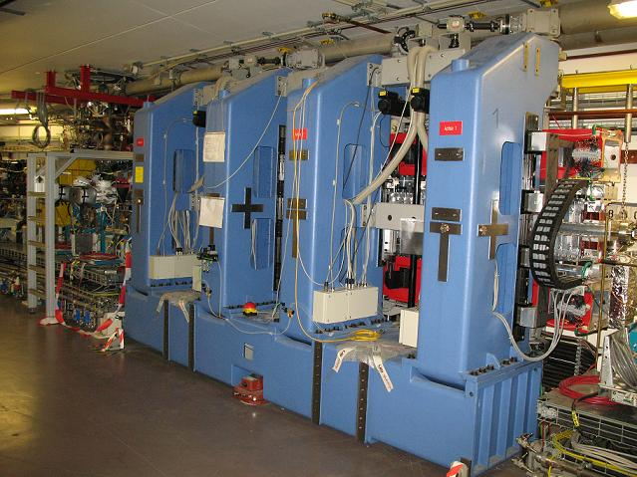
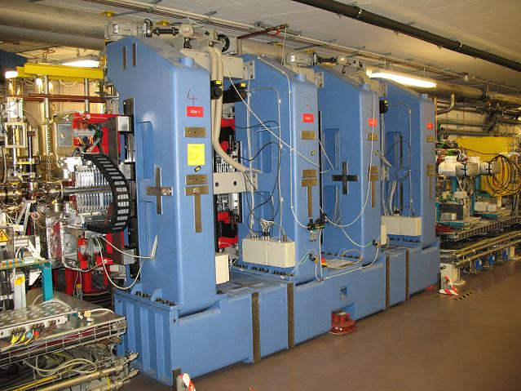
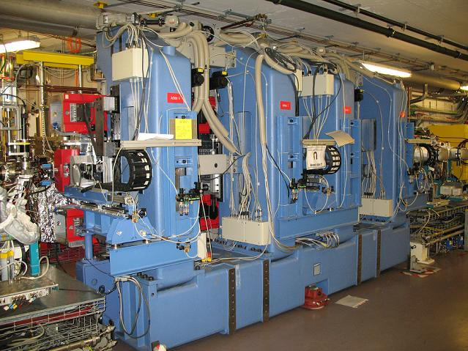
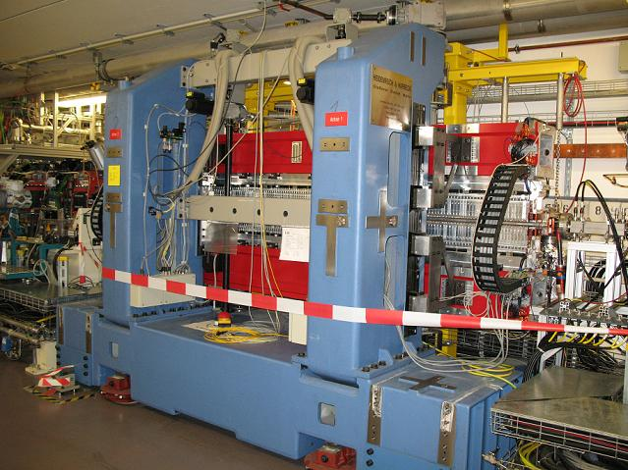
IDs at HZB
UE46
UE112
UE52
U49-1
UE49
CPMU17
UE48
U139
UE56-1
U125-2
U49-2
UE56-2
U41
1998
1999
1999
1998
1999
2000
2000
2001
2002
2002
2003
2004
2004
2006
2007
2007
2009
2010
2015
2017
2021
2023
U49-1
U125-1
UE56-1
UE56-2
U41
U49-2
U125-2
UE56
UE46
UE52
UE56 R
U139
UE49
UE112
U48
UE56 K
UE65
CU9
UE48
CU17
UE56S
UE51

Slide 4
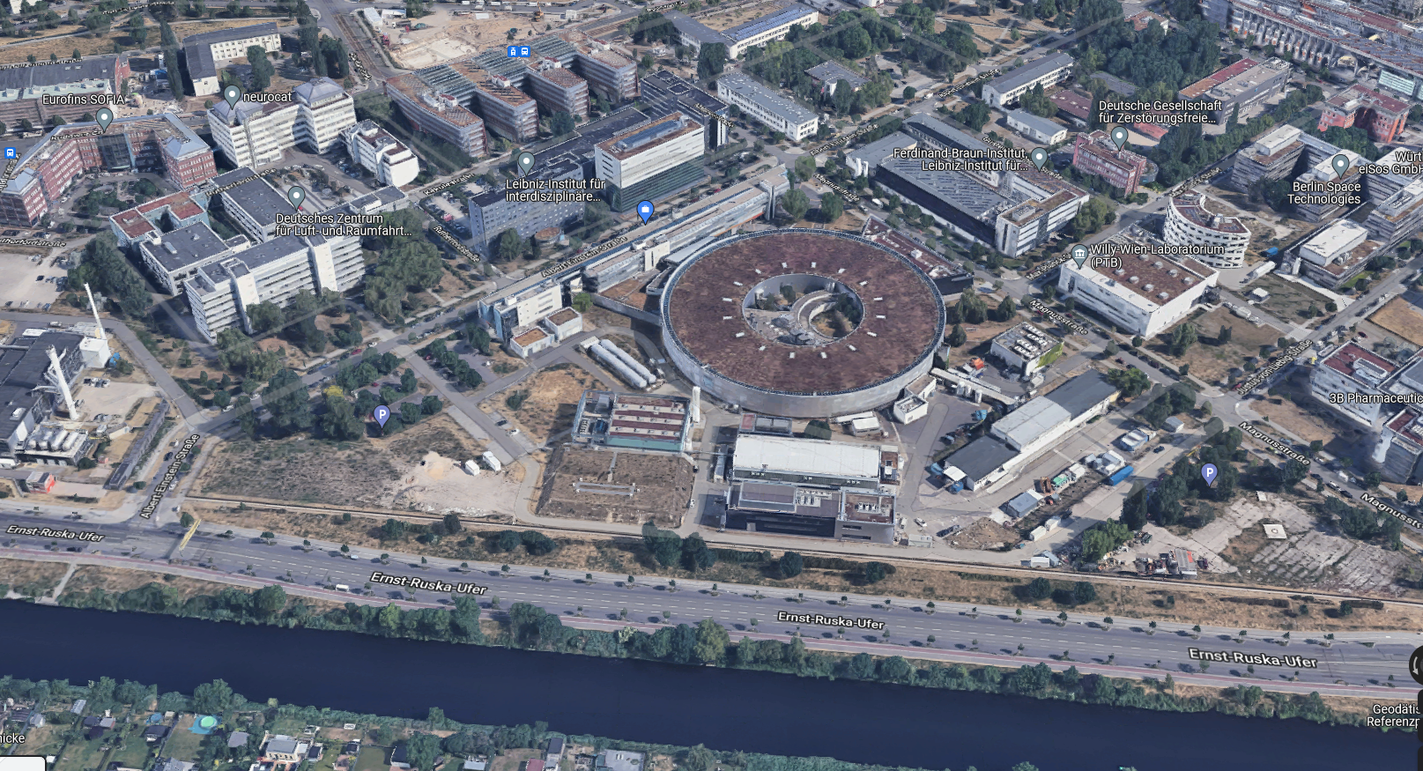
Facilities - Overview

Slide 5
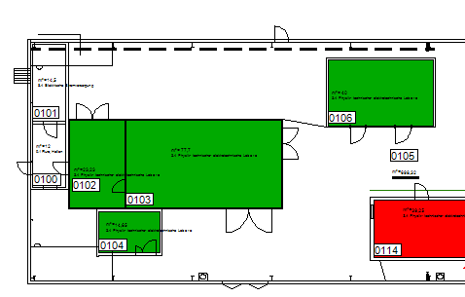
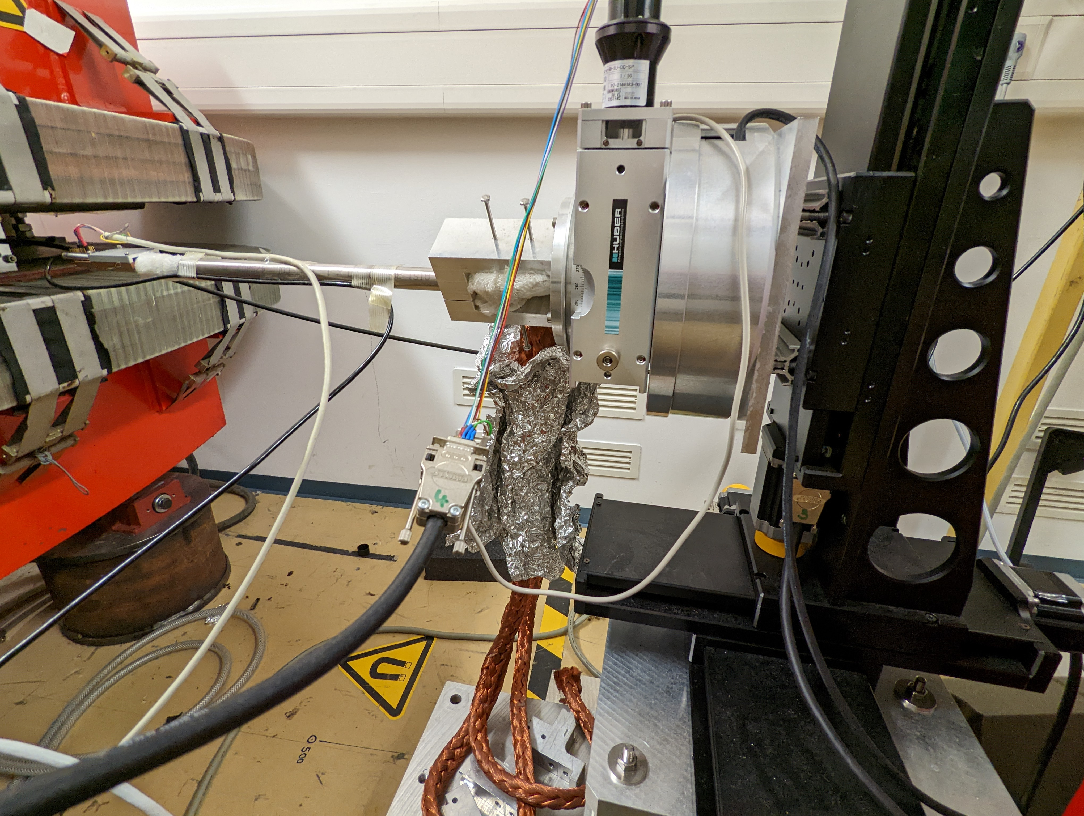
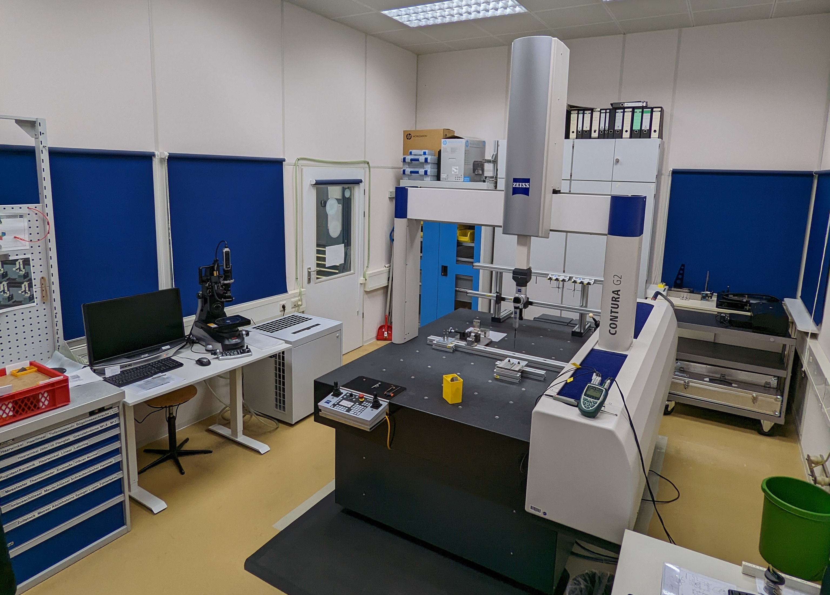
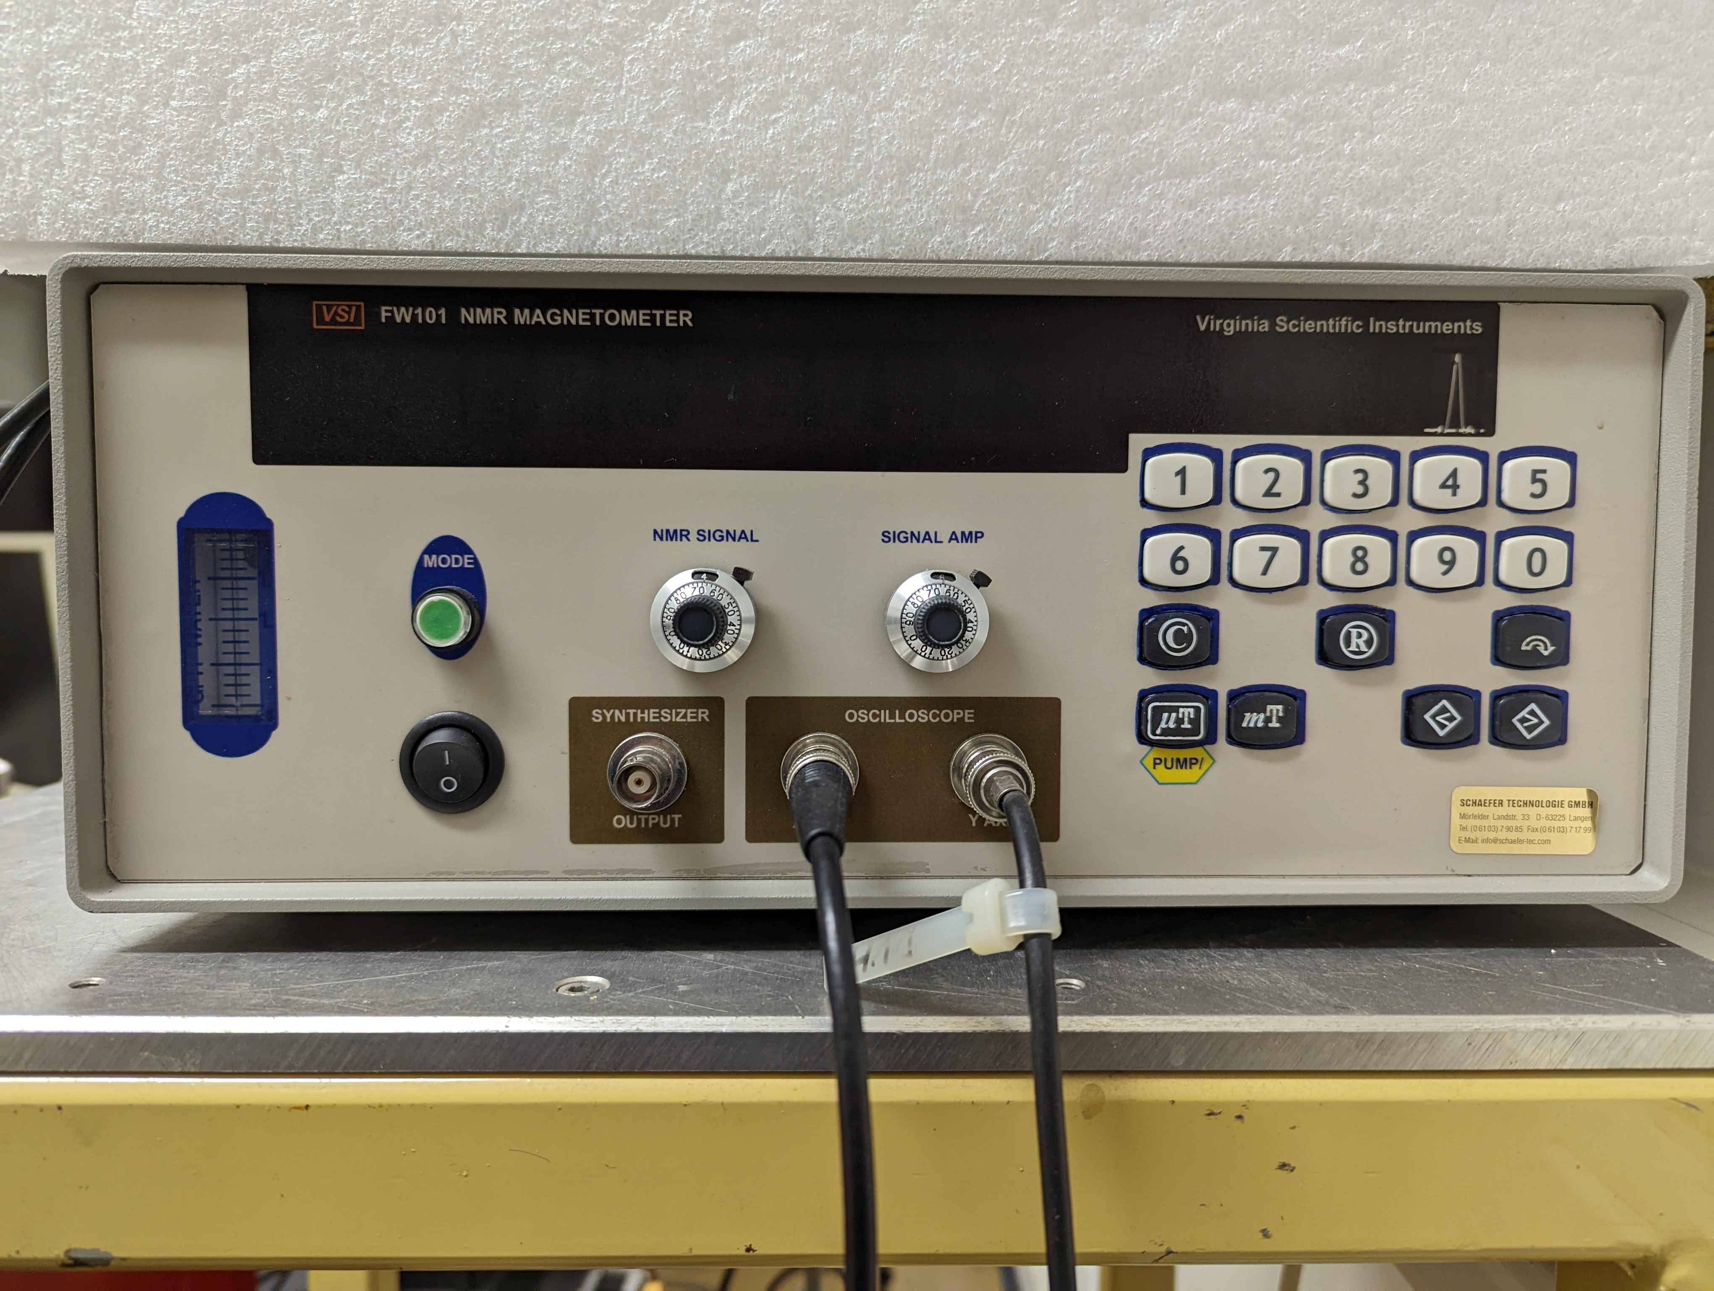
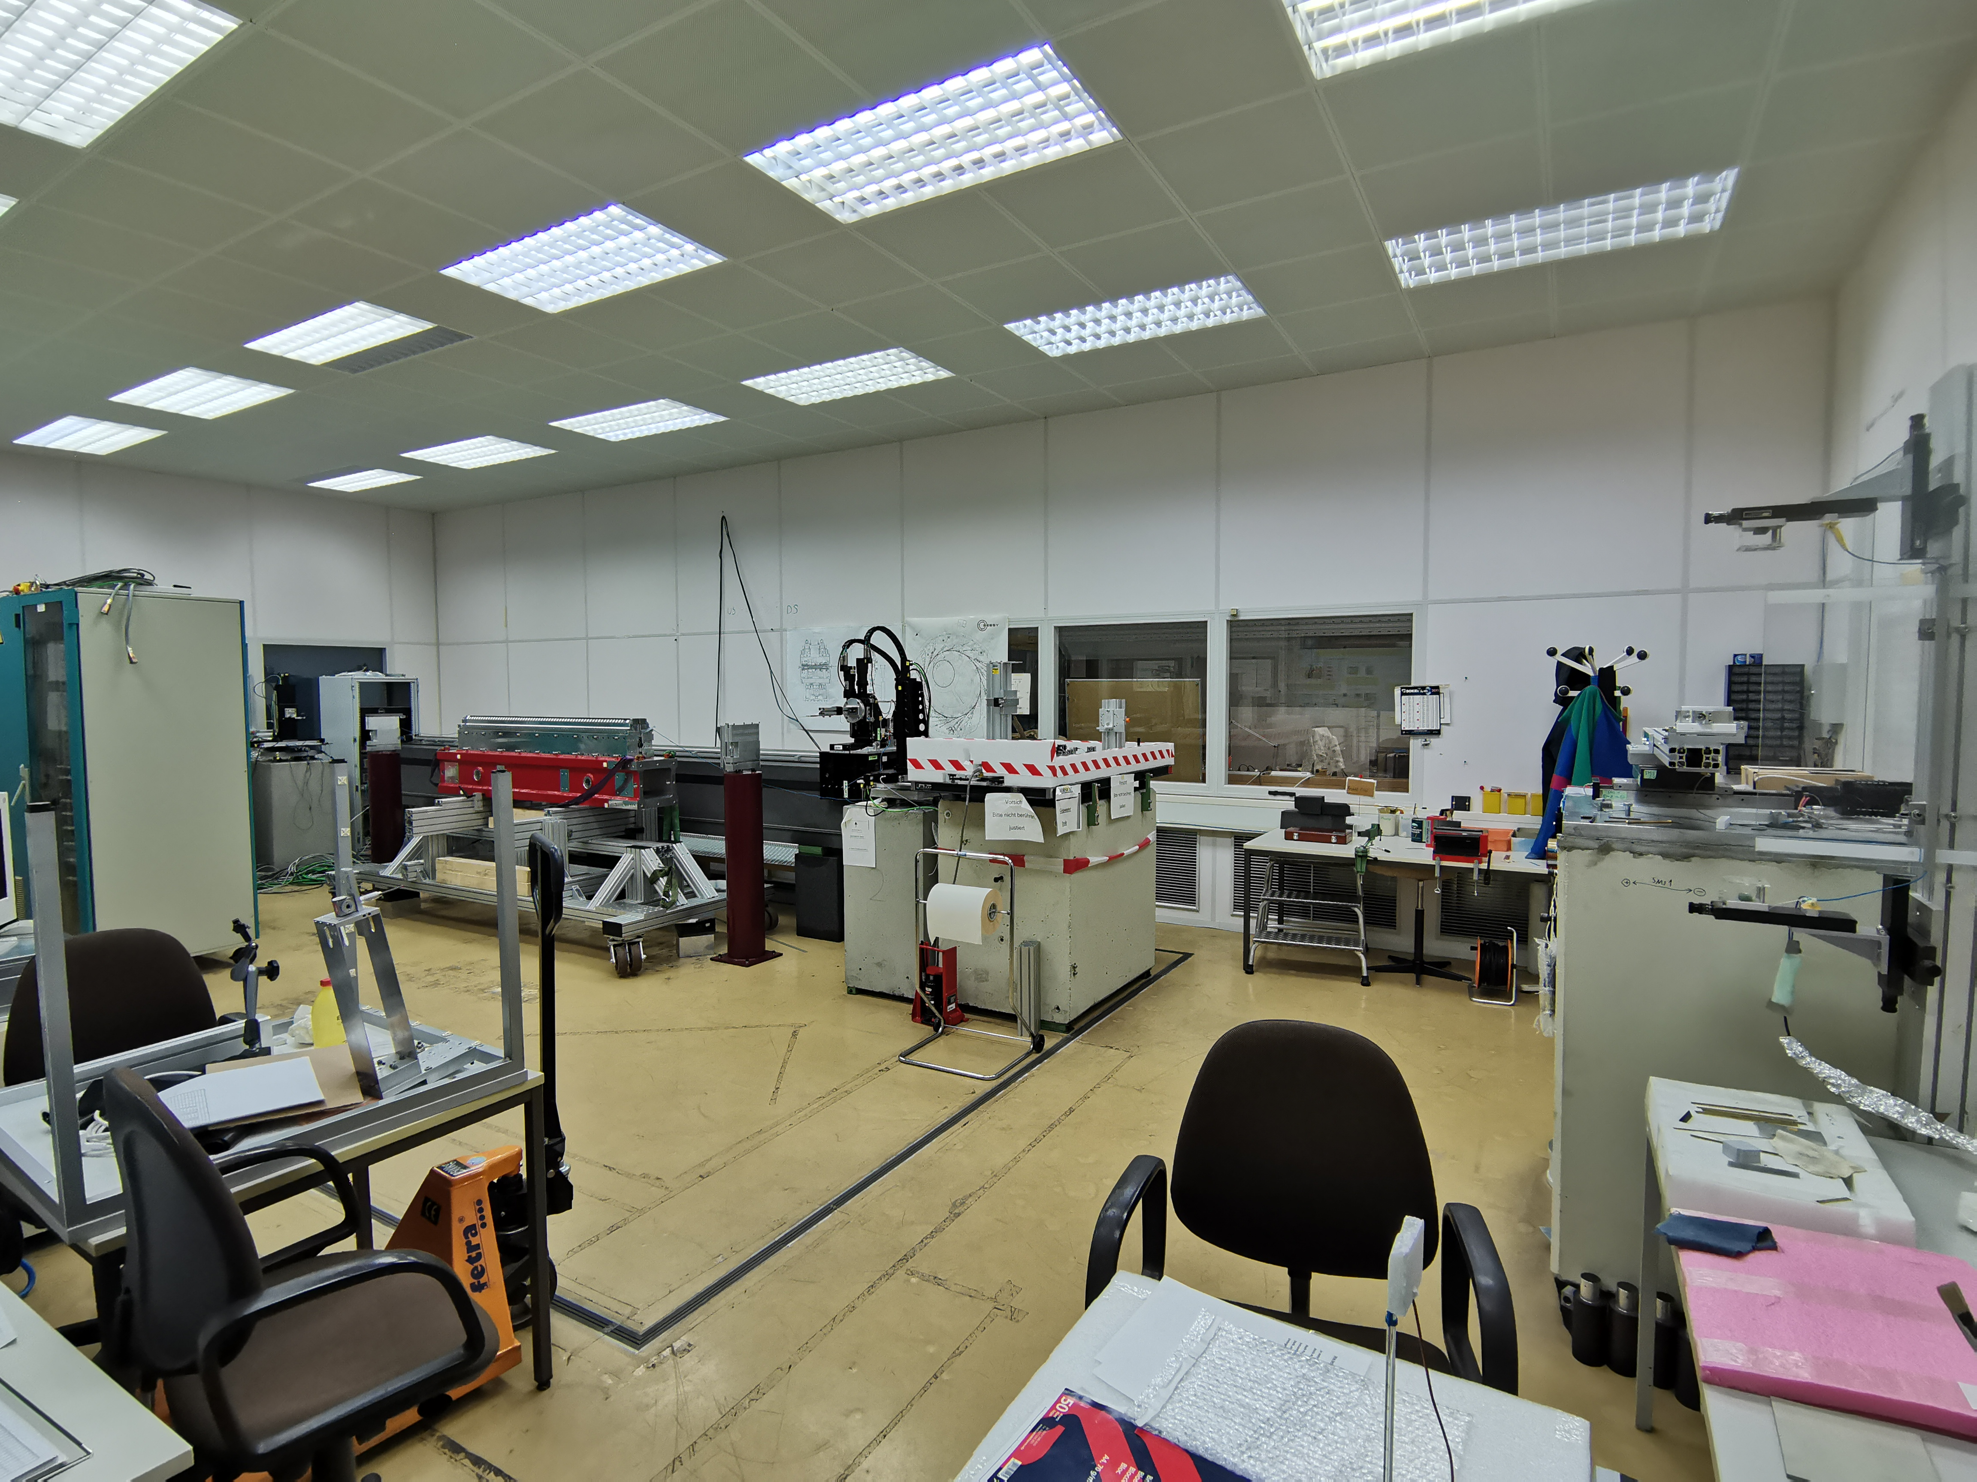
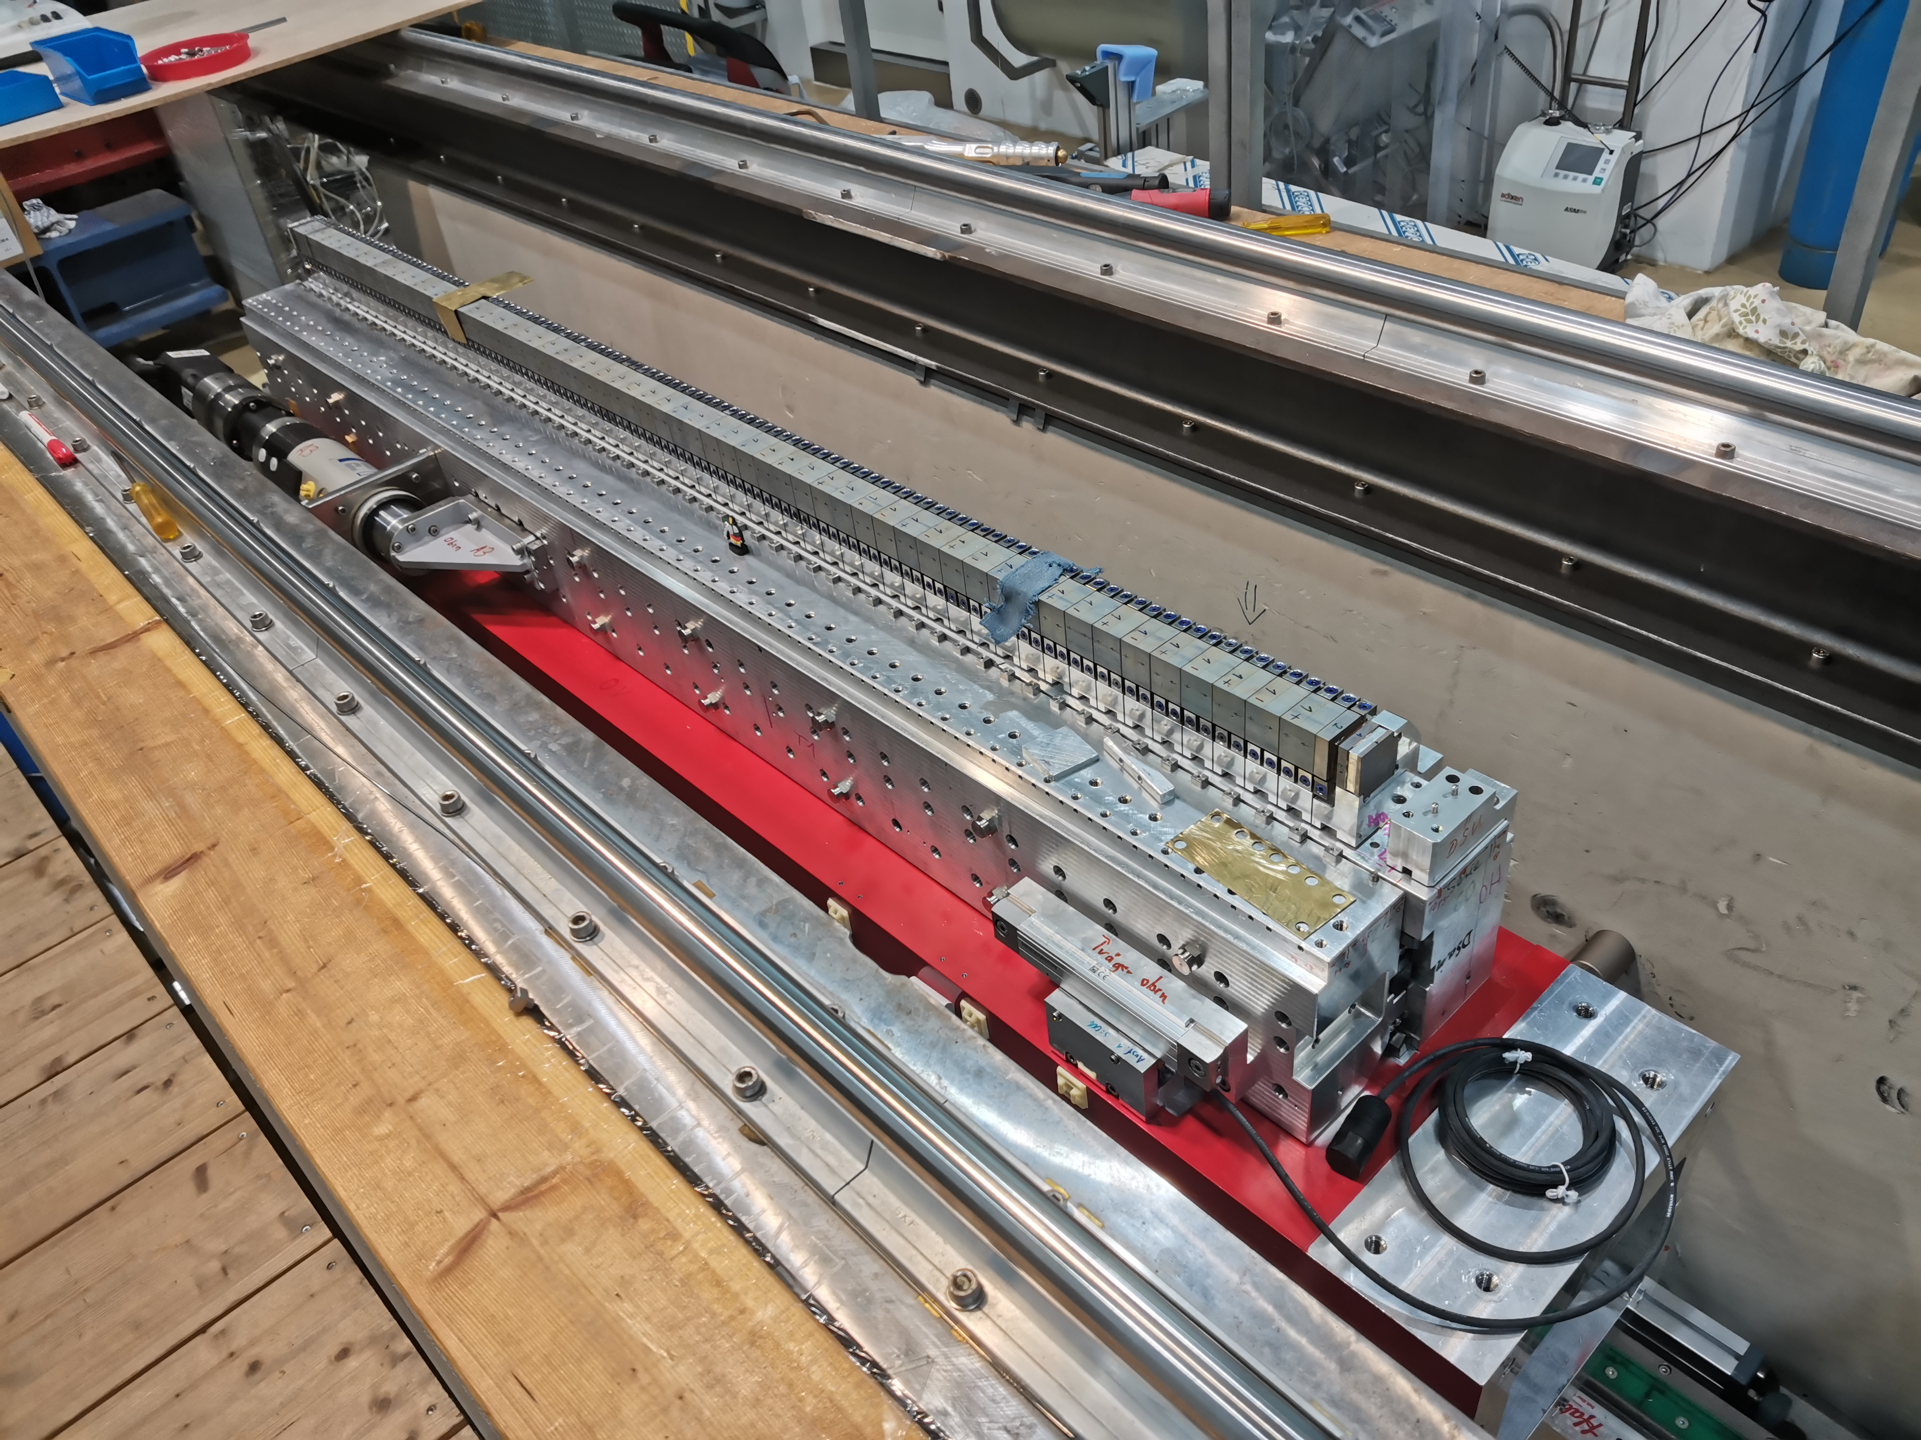
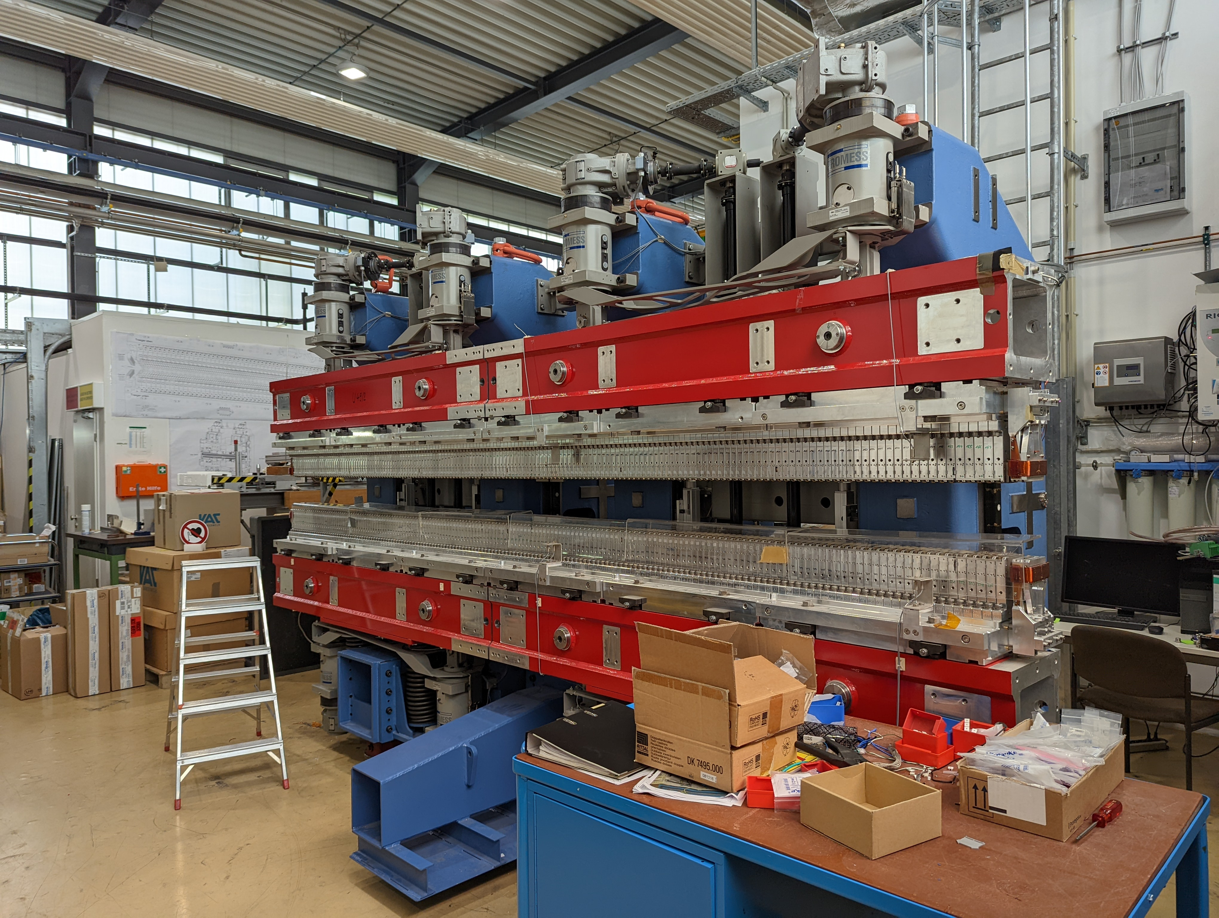
Facilities - Schwerlasthalle
NMR + Dipole
3D Zeiss CMM
Hall Probe Bench
Stretched Wire
Fixed Wire
Helmholtz Coils
Mechanical Assembly Area

Slide 6
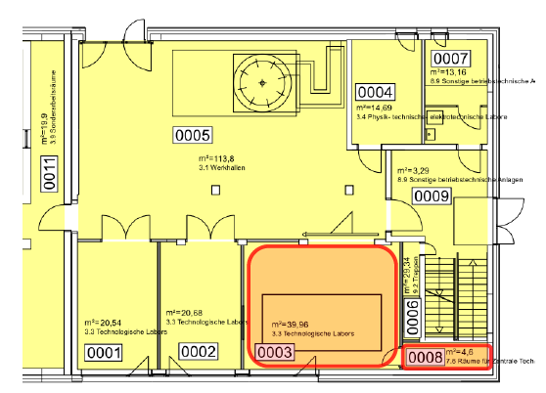
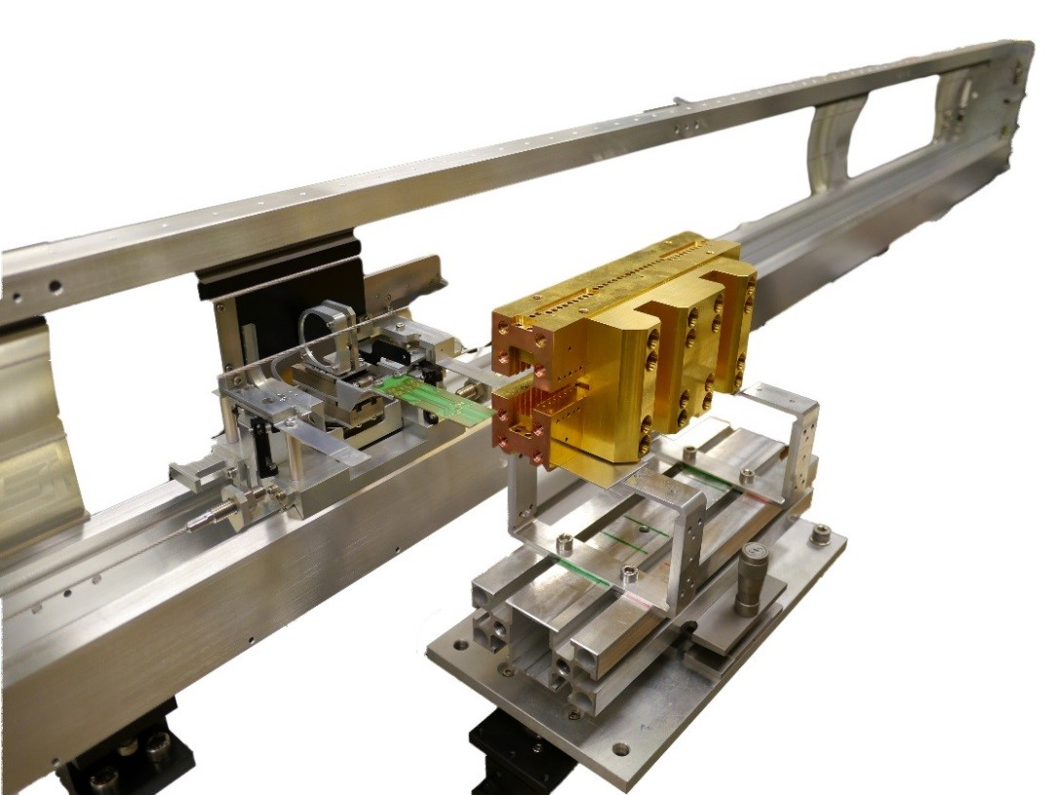
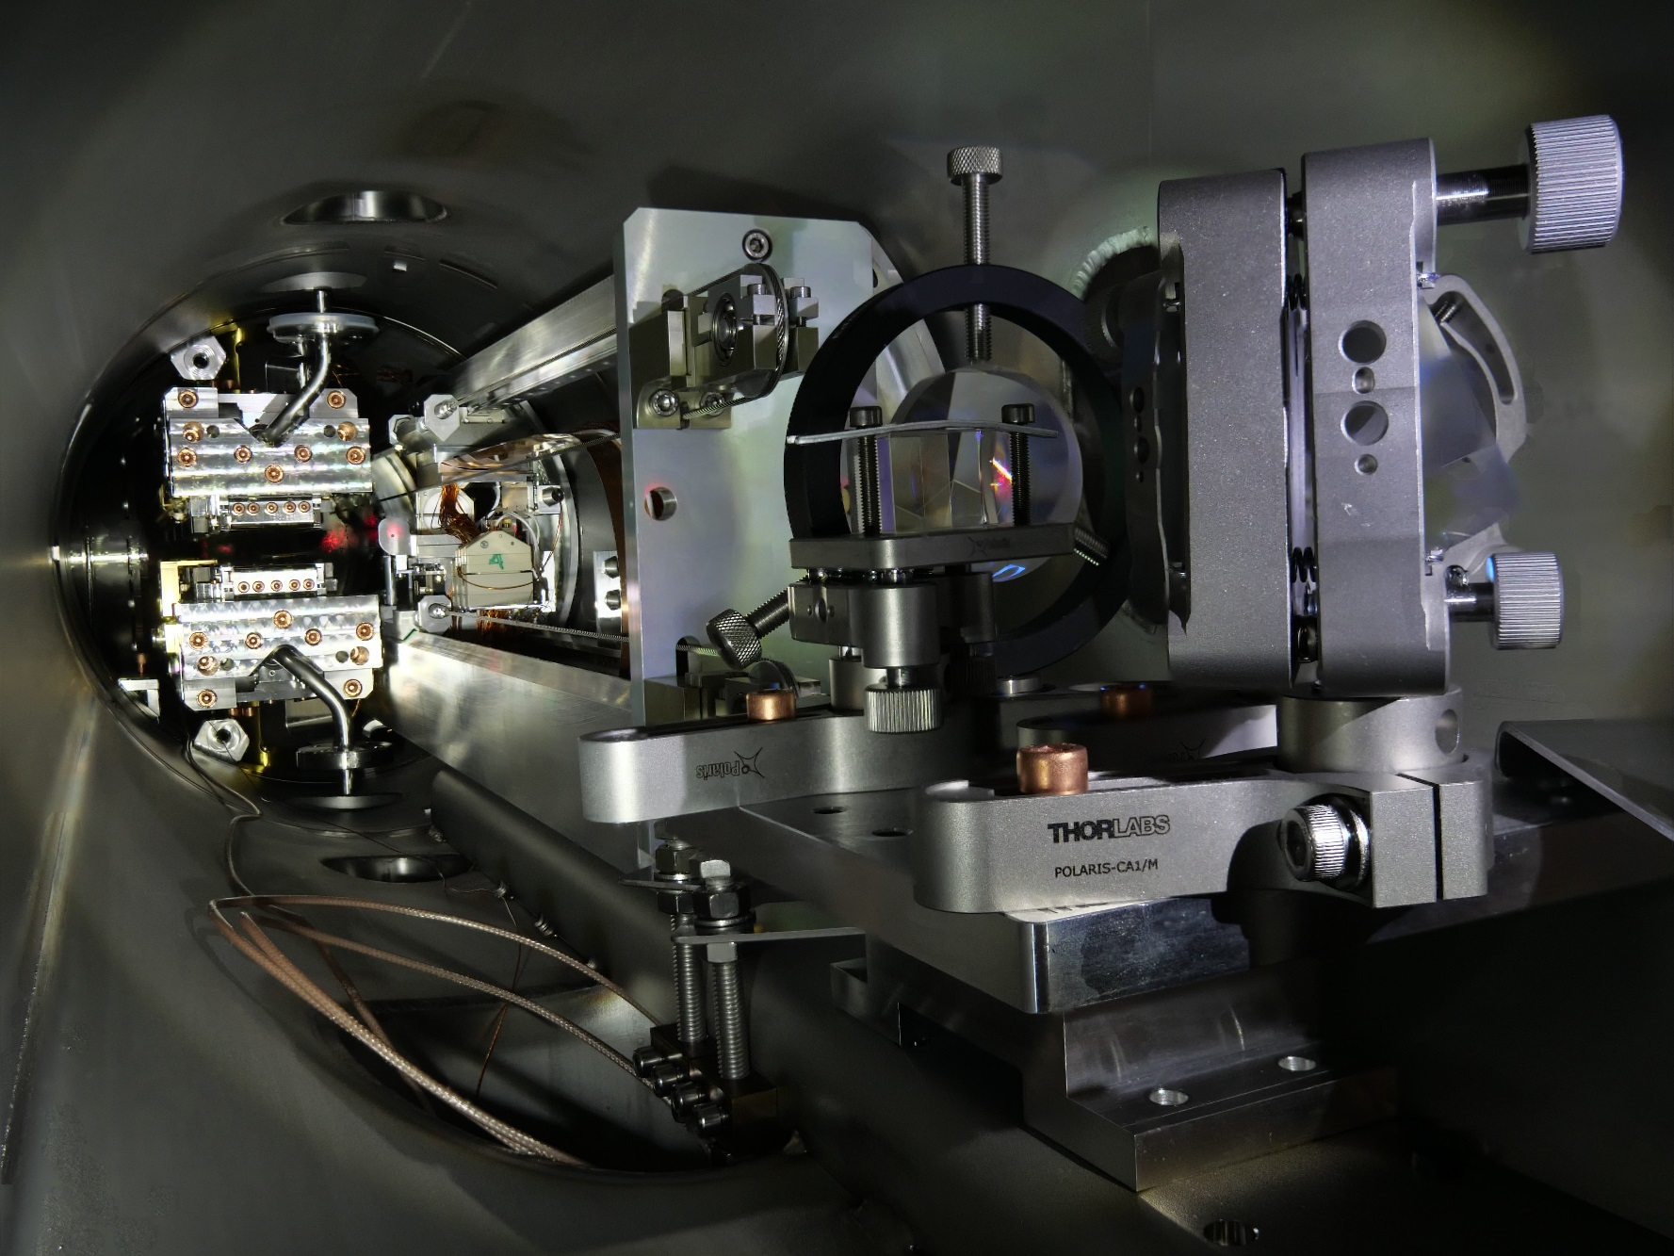
Facilities – Testinghalle 1
In-Vacuum Hall Bench
In-Vacuum Stretched Wire
Development Lab

Slide 7
Status Equipment 01.2019
Equipment | Hardware | Software
Hall Probe Measurement Bench | ANORAD Motion Control Agilent Voltmeter | PASCAL OS/2
Stretched Wire Bench | ANORAD Motion Control Agilent Voltmeter | PASCAL OS/2
Fixed Wire Bench | Berger Lahr (since 1996) Keithley Nanovoltmeter | PASCAL OS/2
Helmholtz Coils | SSB Antriebstechnik (<1996?) Agilent Voltmeter | PASCAL OS/2
In-Vacuum Hall Probe | Controls Techniques Digitax Agilent Voltmeter | Labview Windows
In-Vacuum Stretched Wire | Controls Techniques Digitax Agilent Voltmeter | Labview Windows

Slide 8
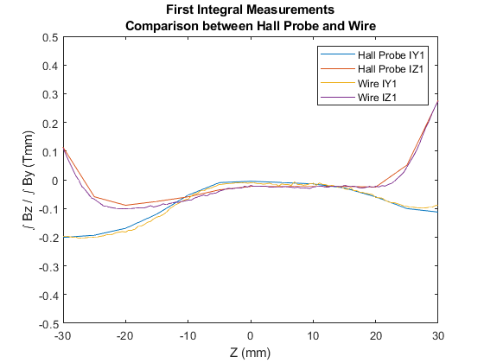
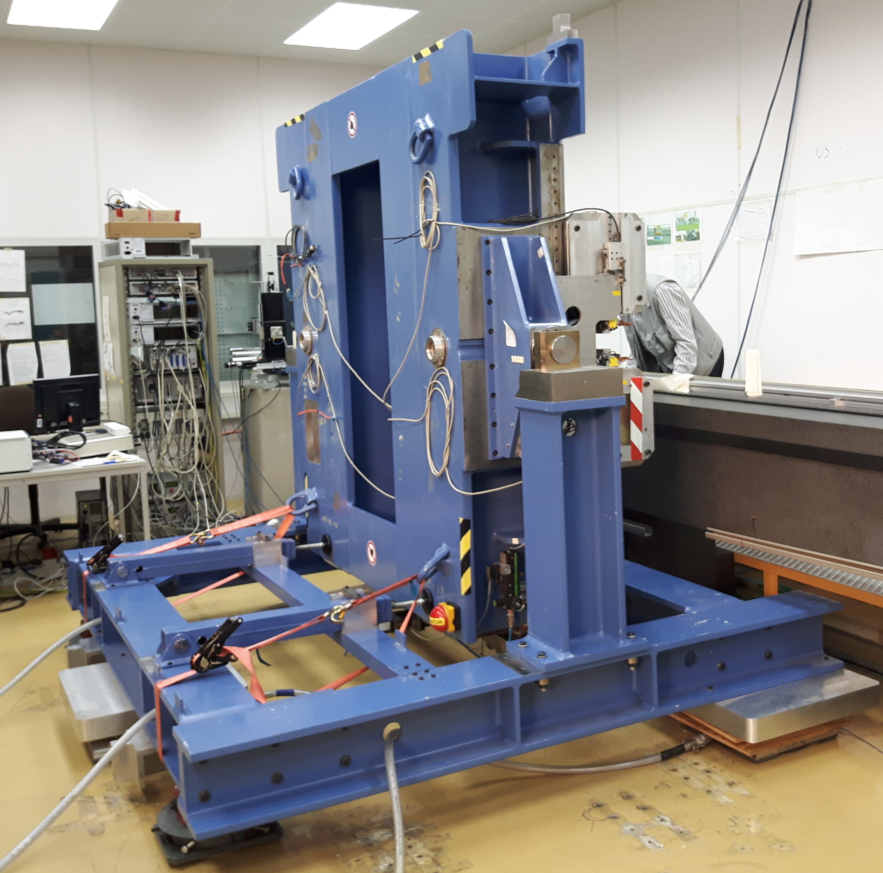
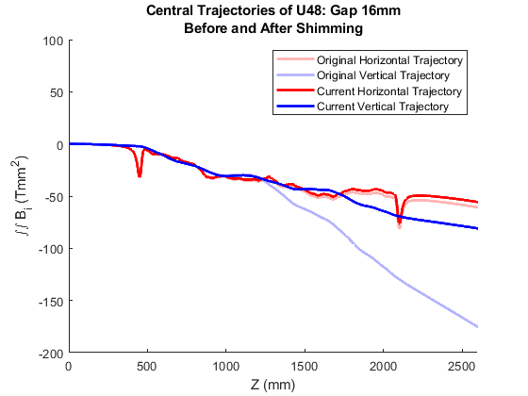
U48 – February - June 2019
¹MAGNETIC TUNING AND INSTALLATION MODIFICATIONS OF UNDULATOR U48 FOR THE DELHI LIGHT SOURCE (DLS), M. Tischer et al
IPAC2021, Campinas, SP, Brazil, doi:10.18429/JACoW-IPAC2021-WEPAB131

Slide 9
Status Equipment 2019
Equipment | Hardware | Software
Hall Probe Measurement Bench | ANORAD Motion Control Agilent Voltmeter | PASCAL OS/2
Stretched Wire Bench | ANORAD Motion Control Agilent Voltmeter | PASCAL OS/2
Fixed Wire Bench | Berger Lahr (since 1996) Keithley Nanovoltmeter | PASCAL OS/2
Helmholtz Coils | SSB Antriebstechnik (<1996?) Agilent Voltmeter | PASCAL OS/2
In-Vacuum Hall Probe | Controls Techniques Digitax Agilent Voltmeter | Labview Windows
In-Vacuum Stretched Wire | Controls Techniques Digitax Agilent Voltmeter | Labview Windows
Obsolescence and
Technical Debt

Slide 10
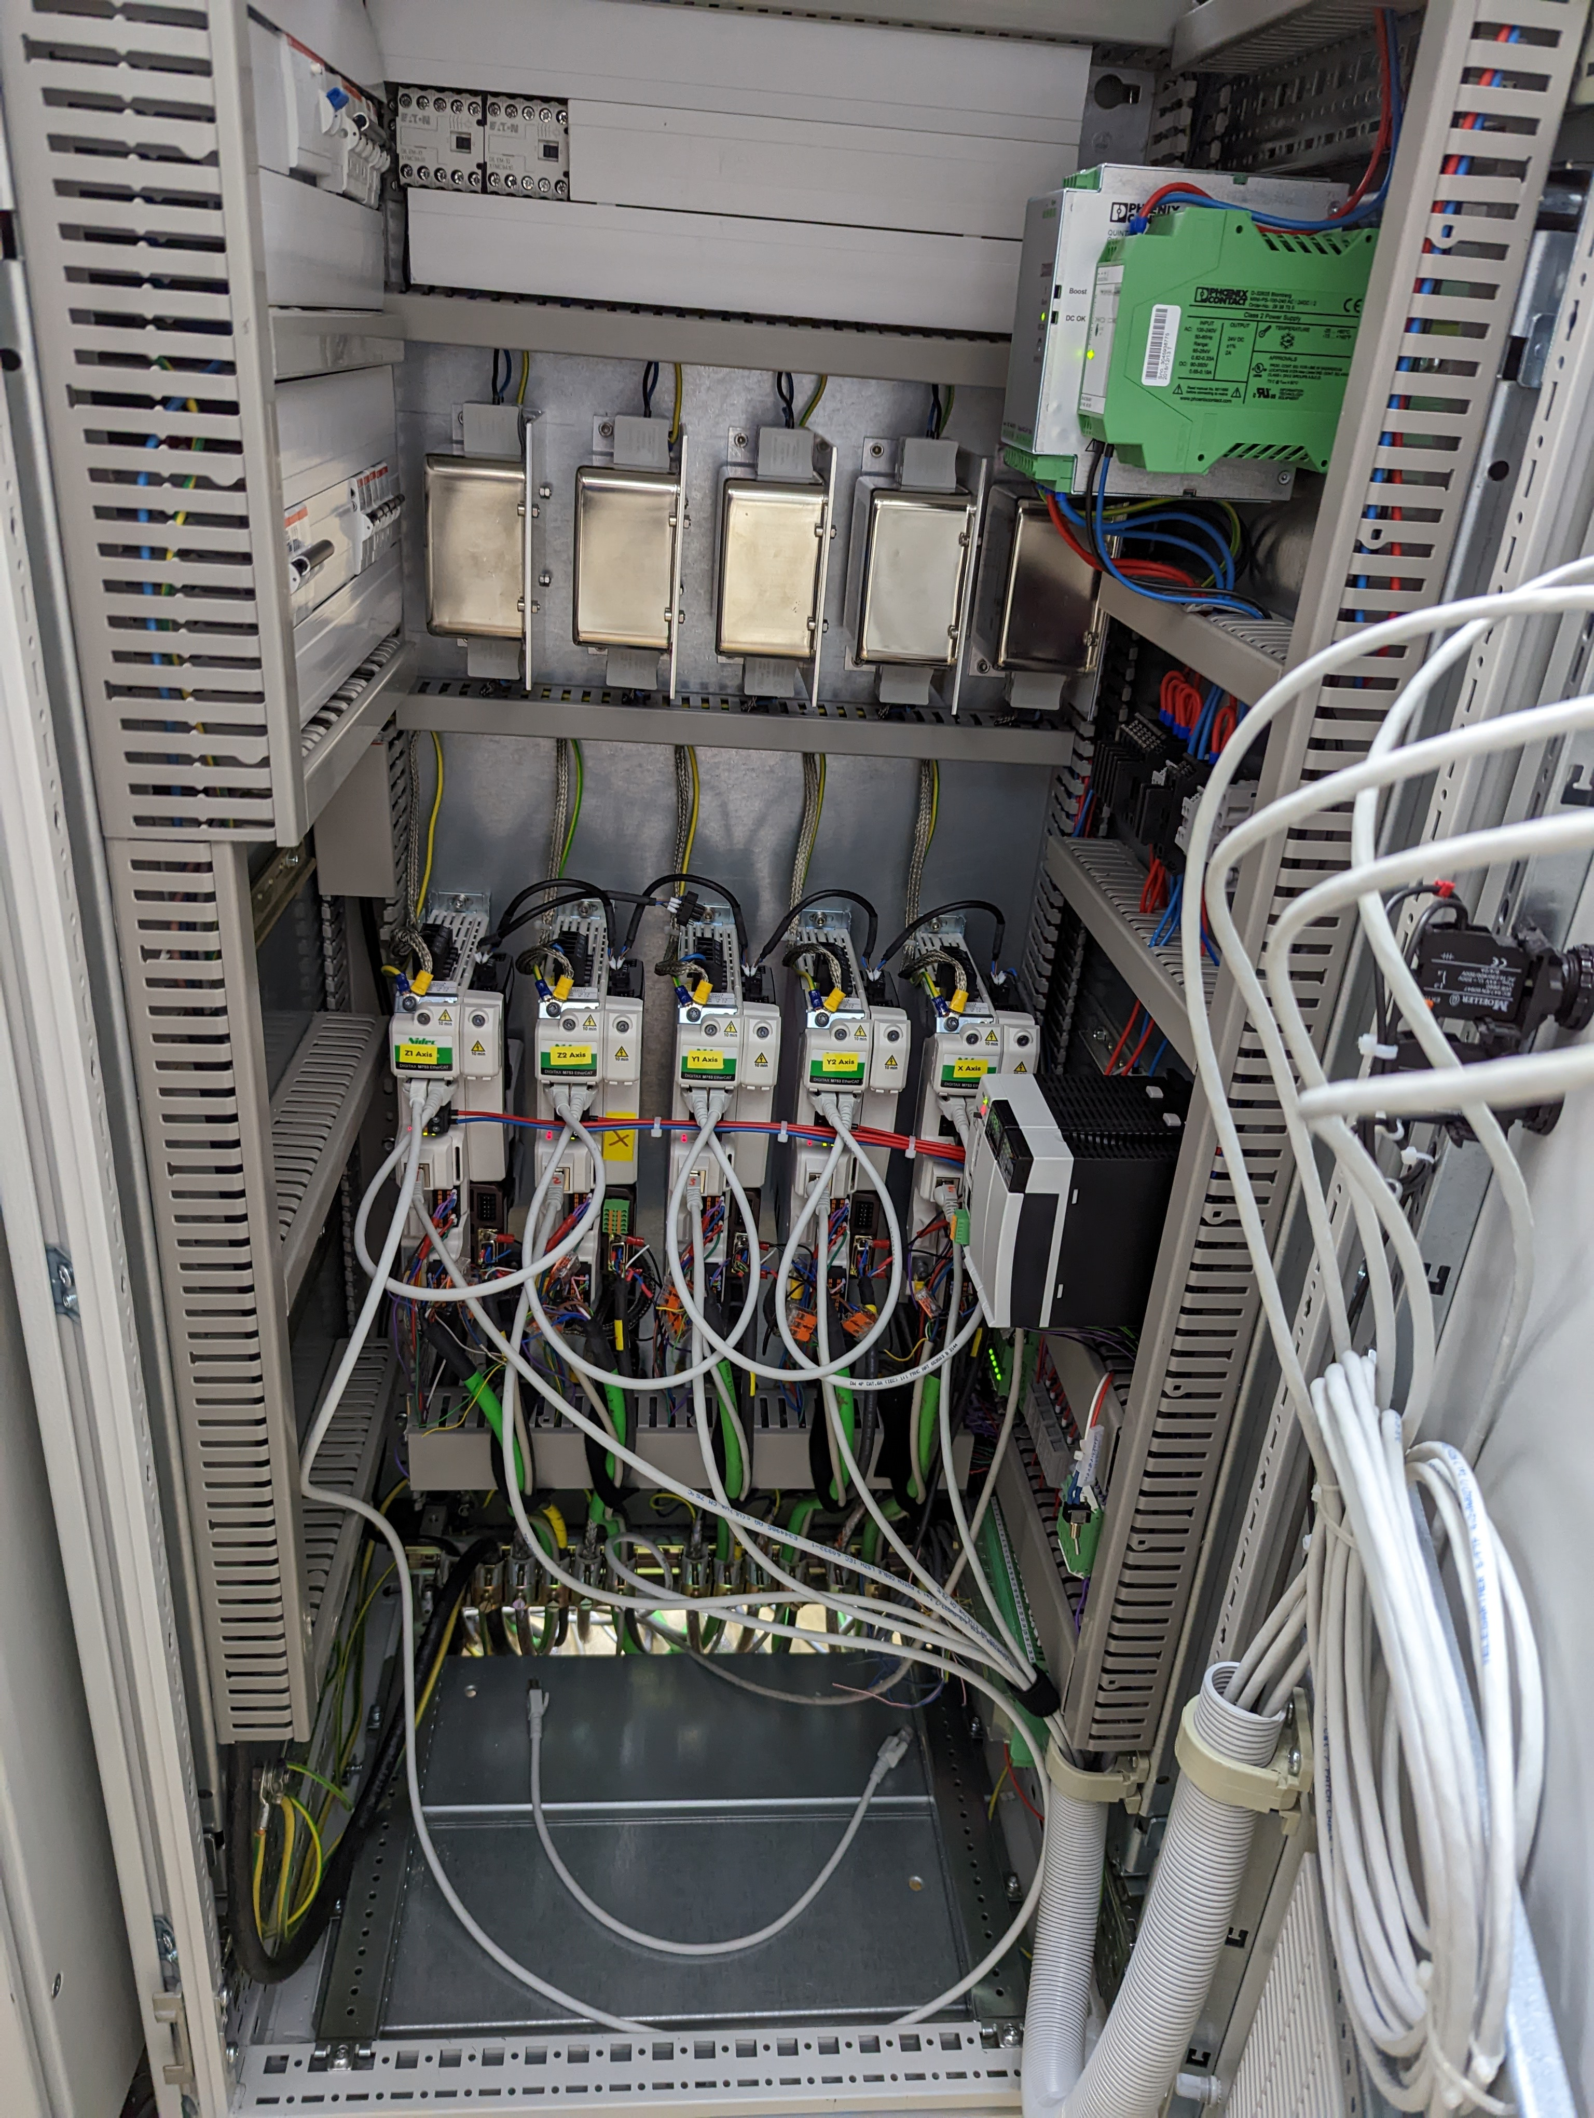
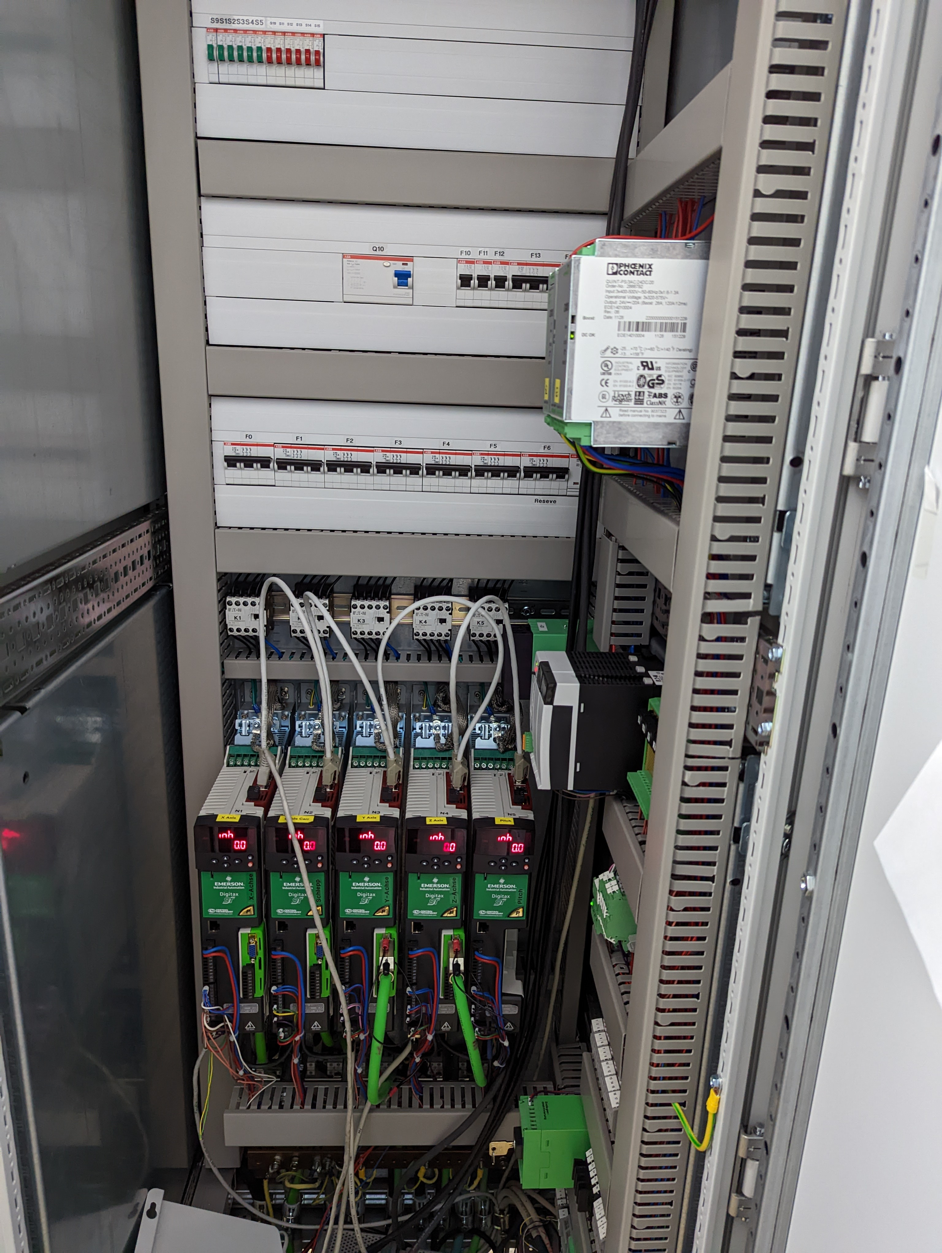
Granite Measurement Bench Upgrade
Welcome to the 21st Century
Component | Original | Replacement
PC | IBM | Dell PC
Operating System | OS/2 Warp | Windows
Motion controller | ANORAD | Control Techniques Digitax
Software | Borland PASCAL | Labview
    Weaknesses in the data storage, and analysis pipeline remain!

Slide 11
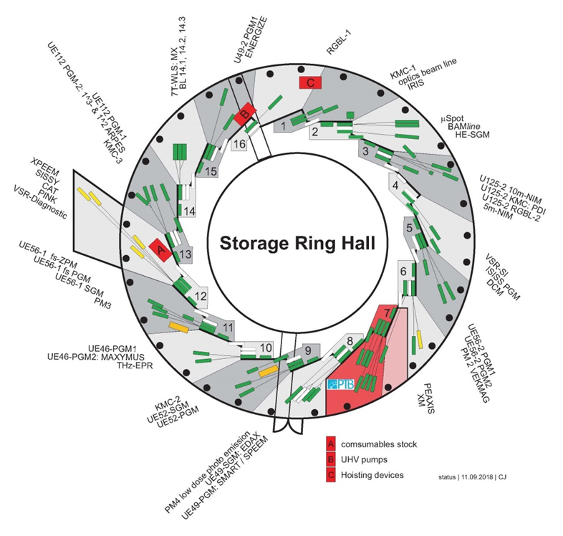






Undulator Rochade – Castling IDs
1. A new UE51 in section 15 replaces of U49-2
2. U49-2 moves to section 5 and replaces UE56-2
3. UE56-2 – modules separated and refurbished
4. UE56-module 1 replaces old UE56 at Slicing
5. UE56-module 2 goes to SESAME
UE51
U49-2
UE56-2
U49-2
UE56-2
UE56
UE56
HESEB
UE56

Slide 12
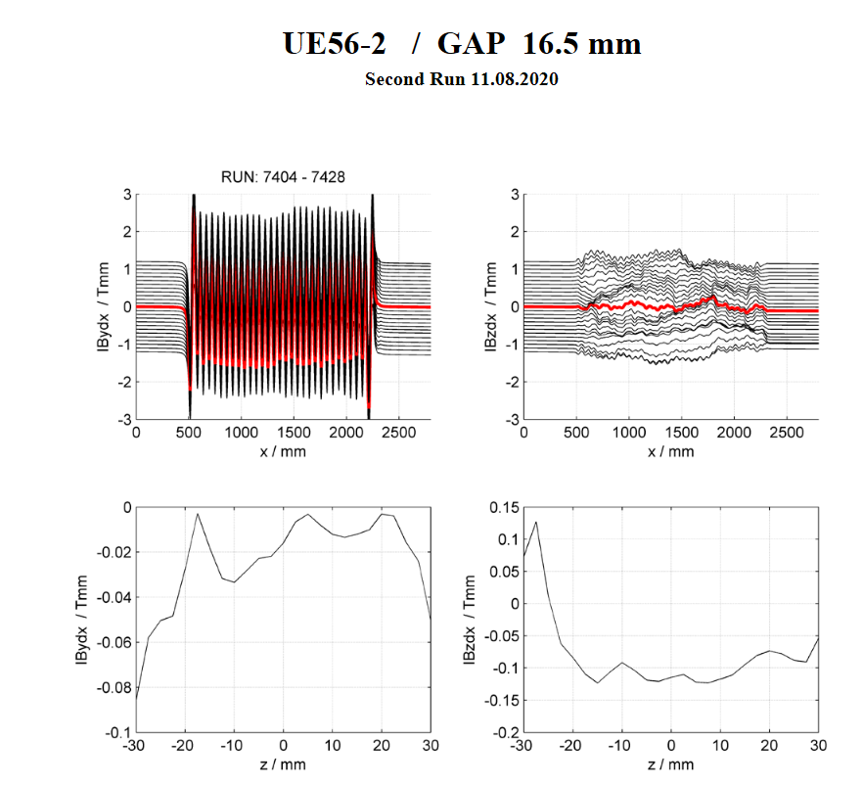
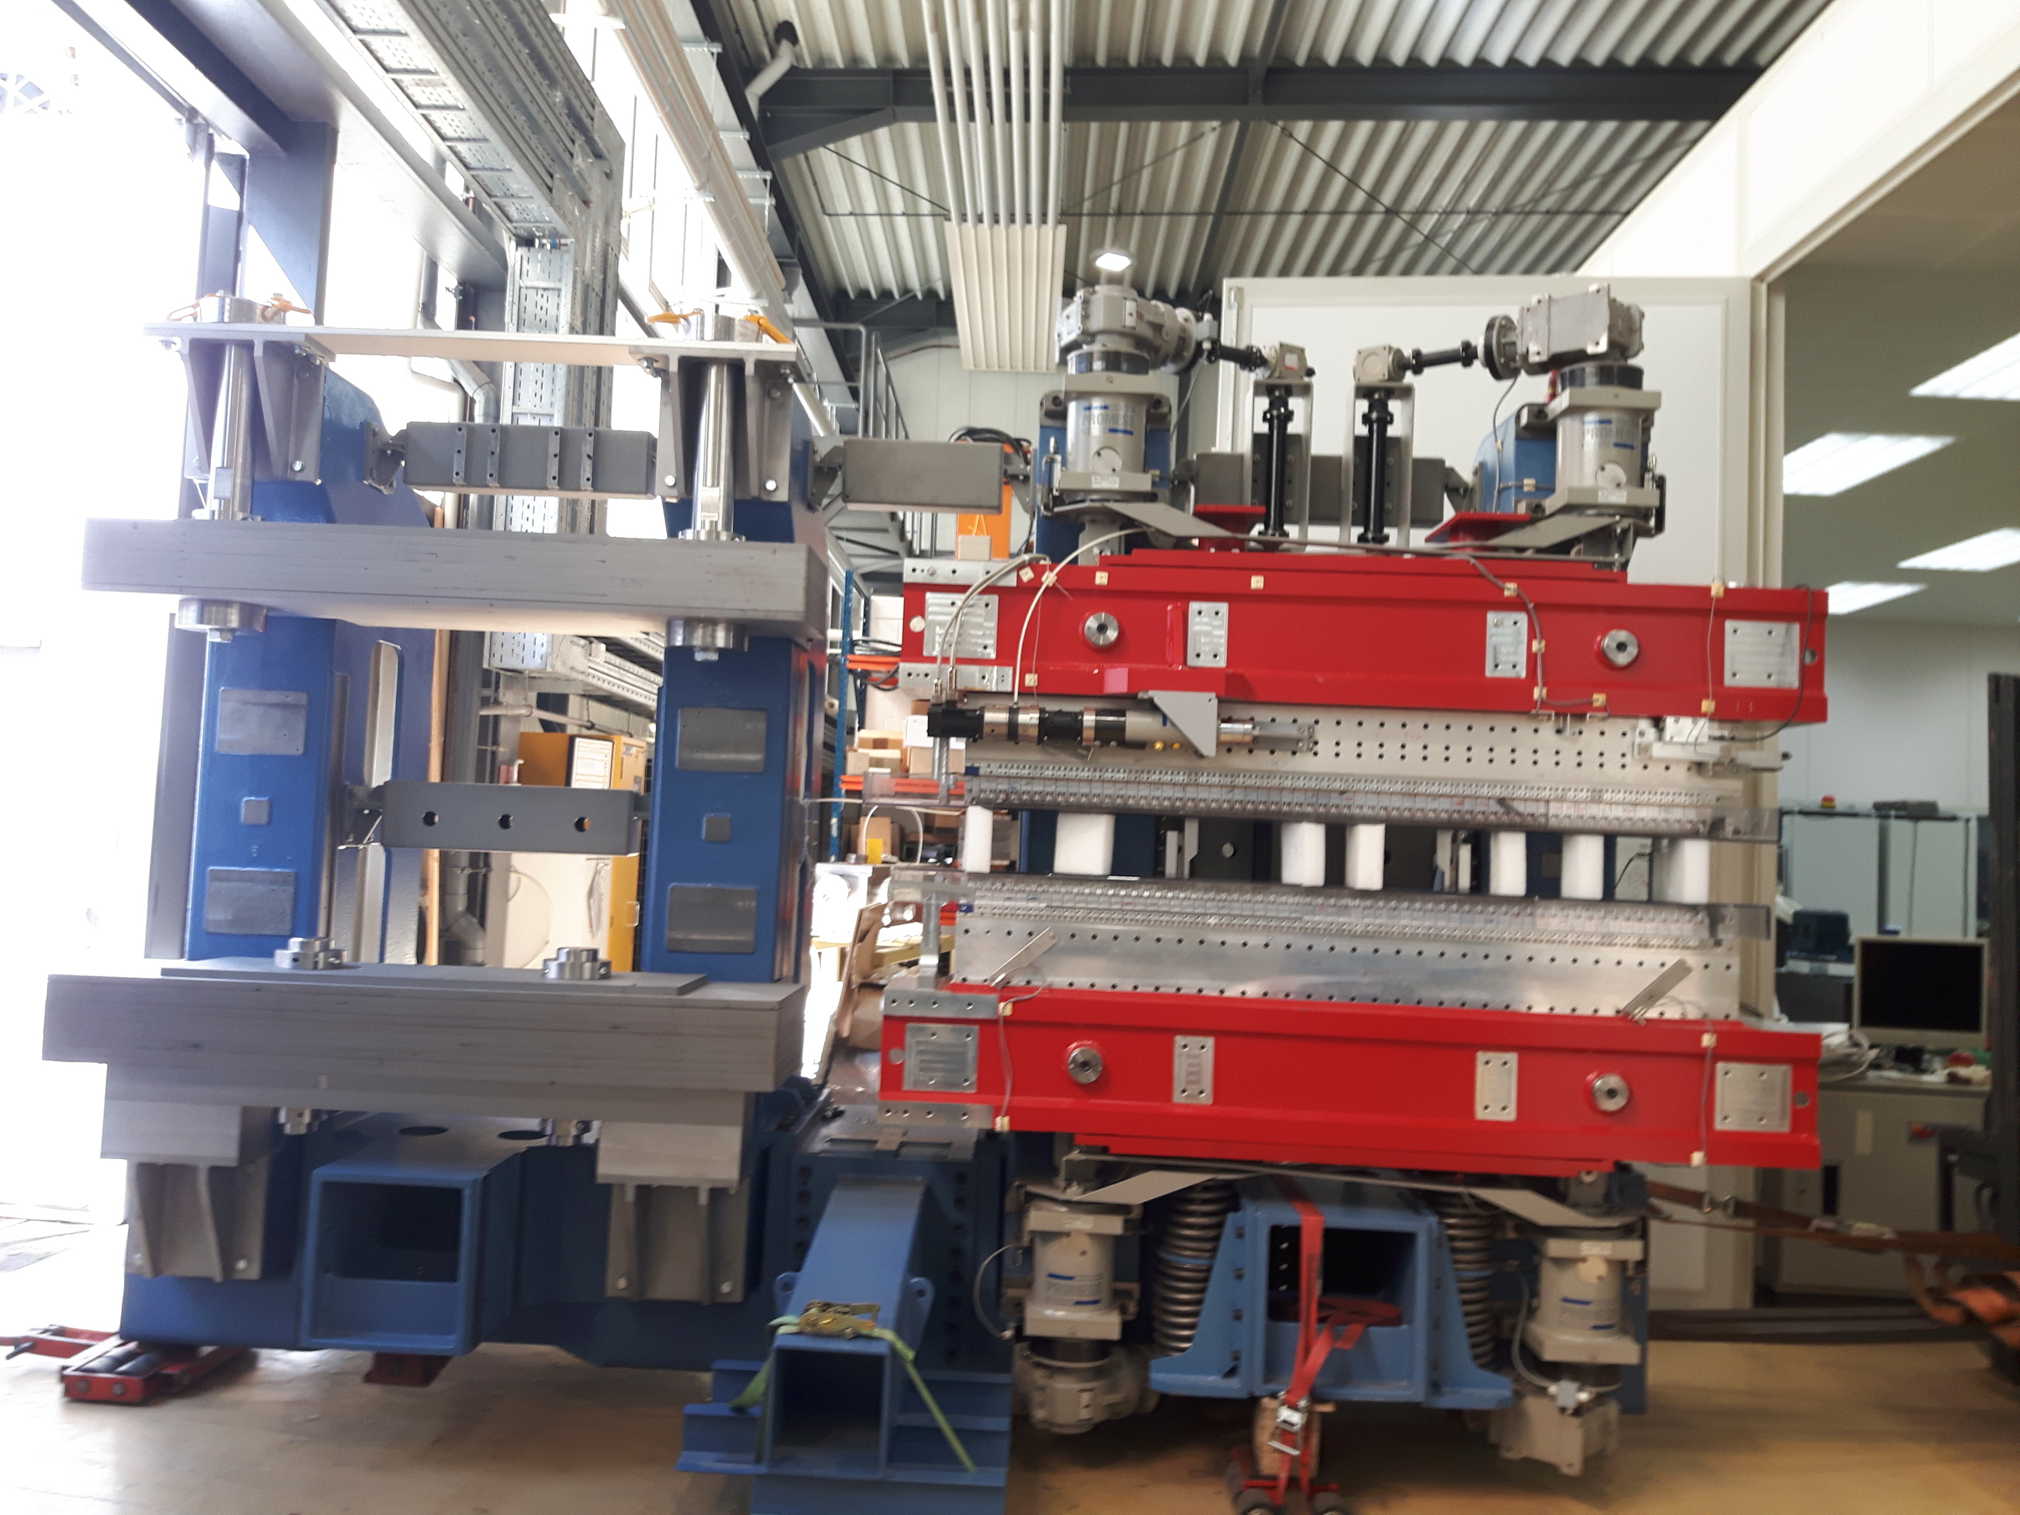
UE56-2 – August 2020

Slide 13
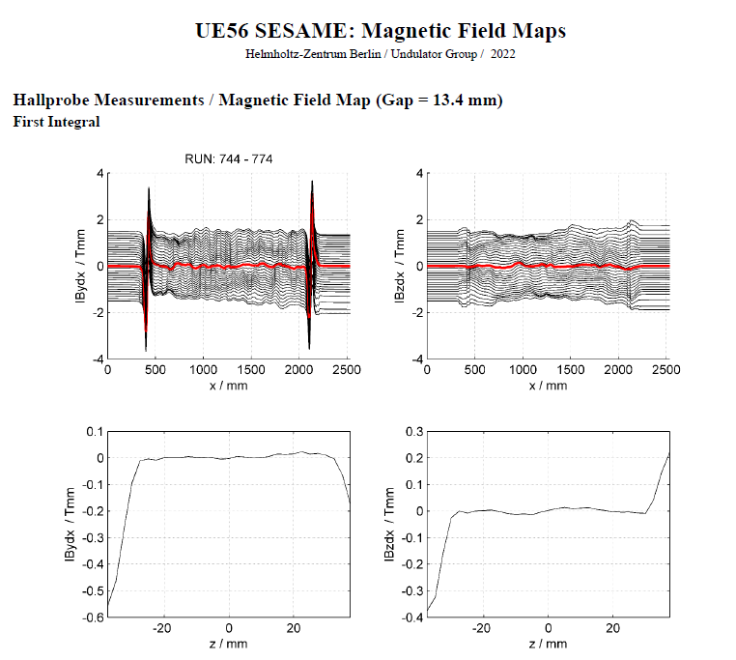
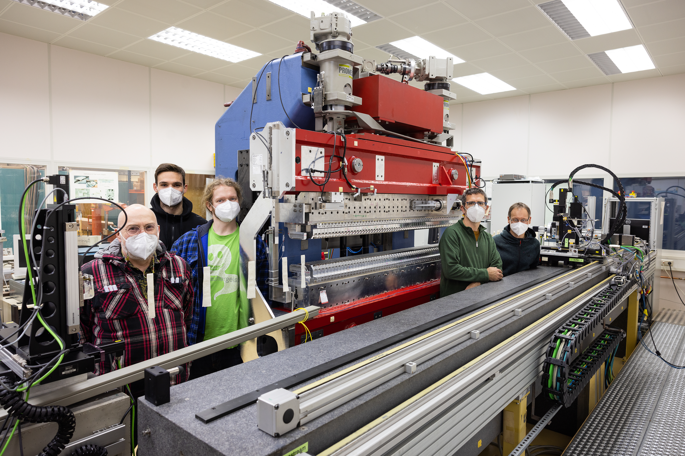
UE56 SESAME –January 2022

Slide 14

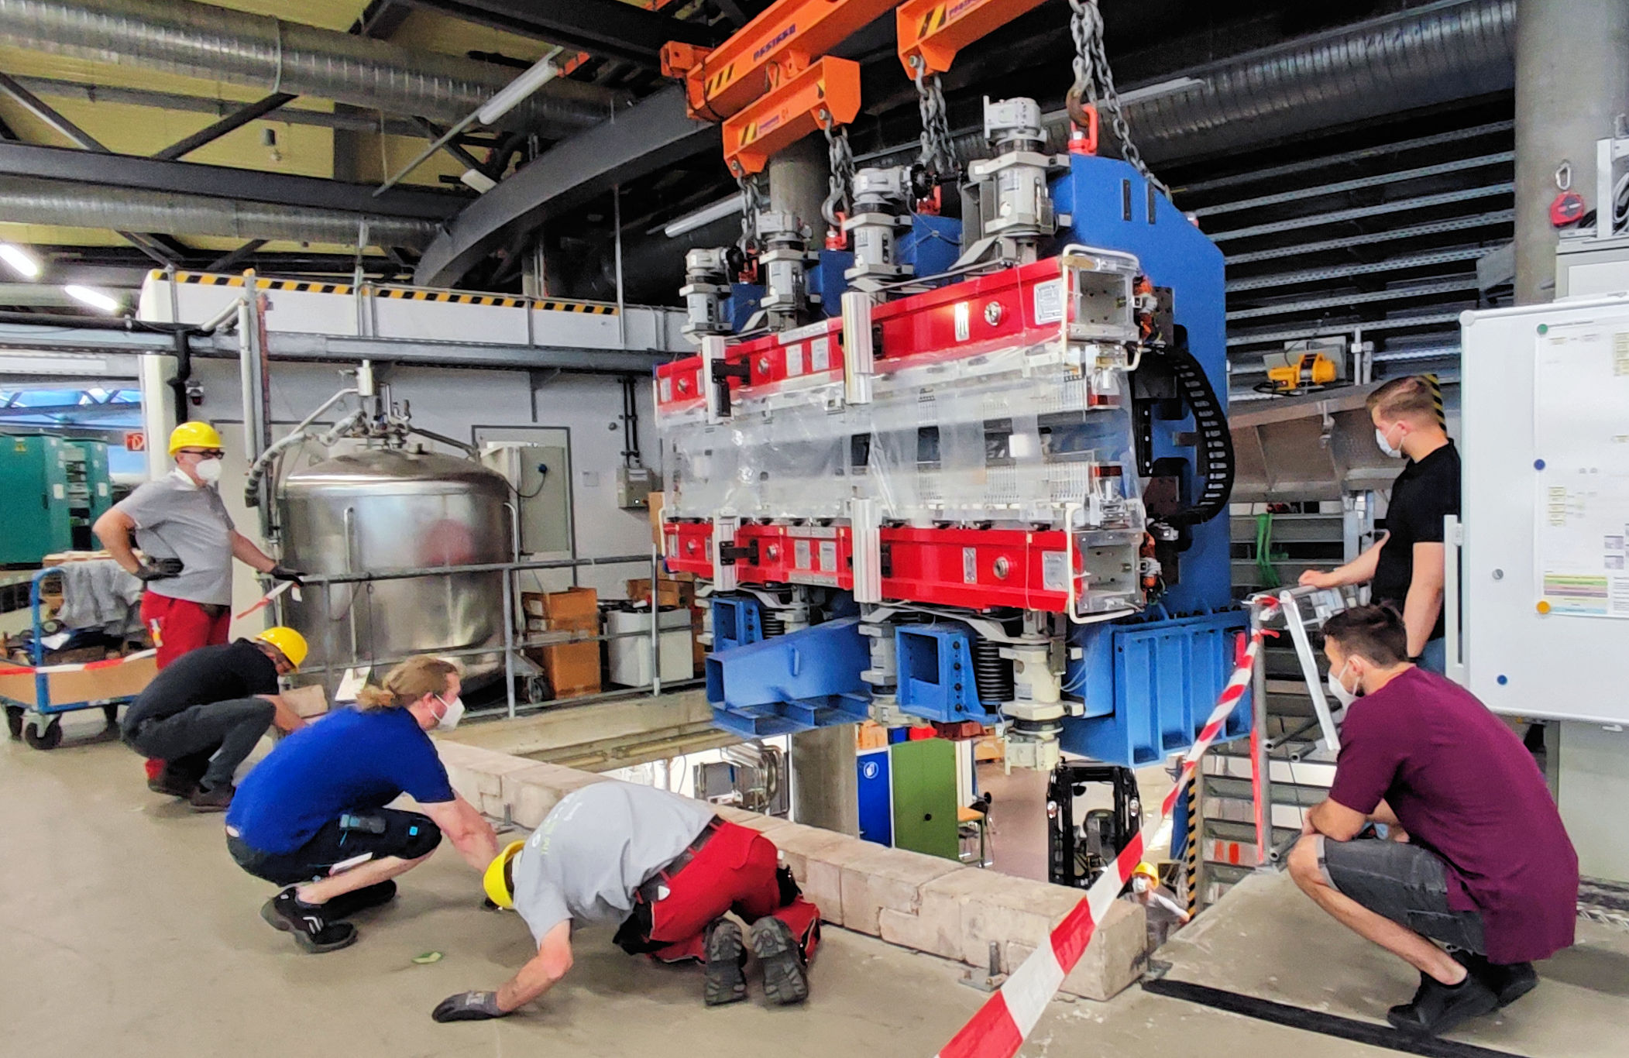
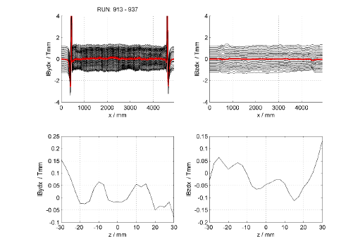
U49-2 – August 2022

Slide 15
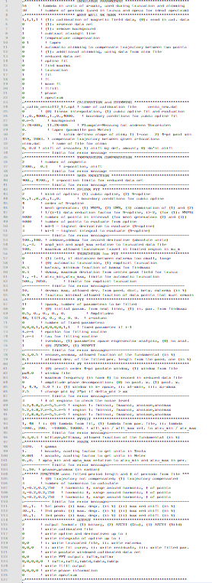
Shimming Cycle
Shim
Measure
Analyse
Predict
Apply
  Measure
        Single scan trajectories saved to individual files
        Metadata and Data saved separately
        Organised by Folder
        Not possible to integrate undulator motion
  Analyse
        Standalone analysis programme used
        126 line input text file
        Multiple data input files
          Expert users only!
          Prone to user error…
  Predict
        Standalone shim programme
          Virtual Shims, Iron-Shims, L-Shims,
          Magic Fingers
          ASCII Data input (Metadata free)
          ASCII Output (Metadata free)
  Apply
        Post-processing required to make outputs technician-readable
  Process is SLOW!

Slide 16
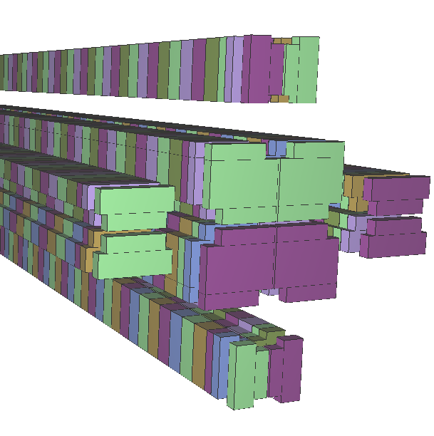
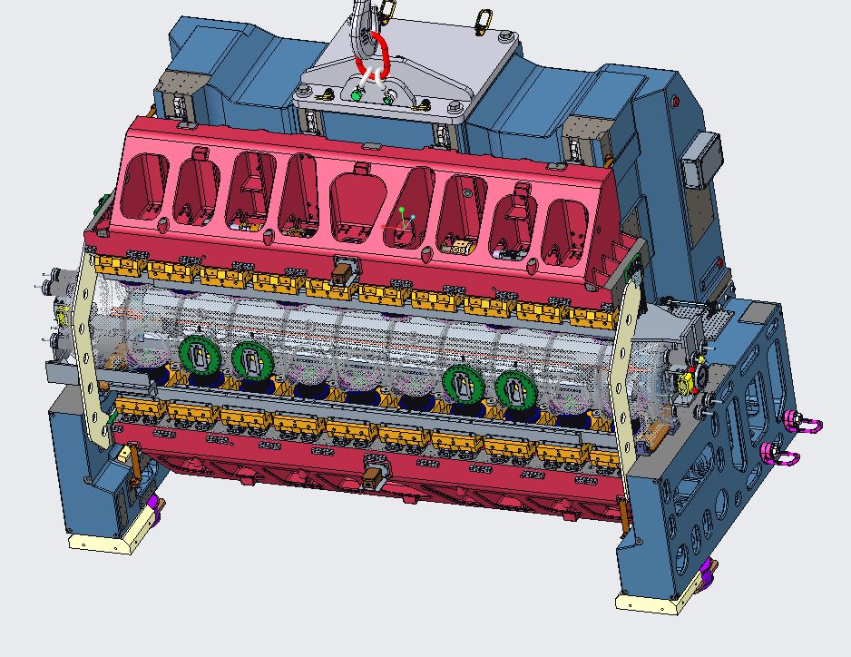
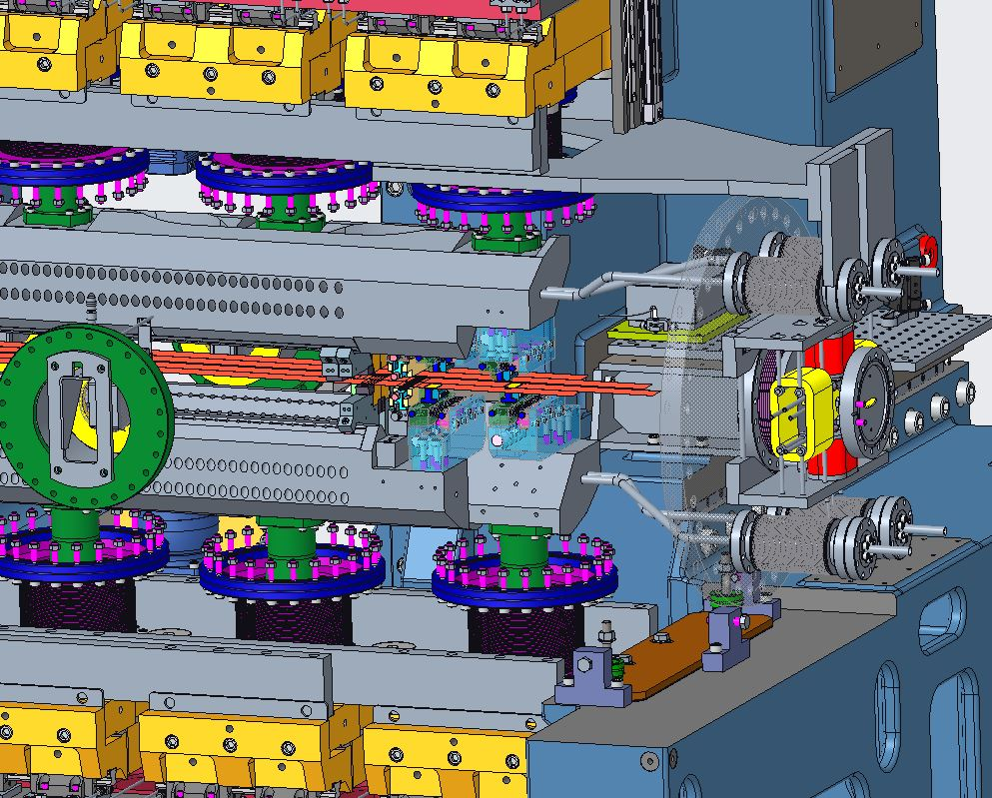
Ambitions – (Cryogenic) In-Vacuum APPLE
  IVUE32¹
    In-Vacuum APPLE-II Device
        6mm minimum gap
        3.5m length
  Cryo-APPLE²
    Cryogenic In-Vacuum APPLE Device
        4 mm minimum gap
        ~1m length
  In-Vacuum Hall Probe Bench
          Improved position feedback
          Length Extension
          Improved Vacuum Compatibility
  In-Vacuum Stretched Wire
        Integration of Pulsed Wire Measurement System

Slide 17
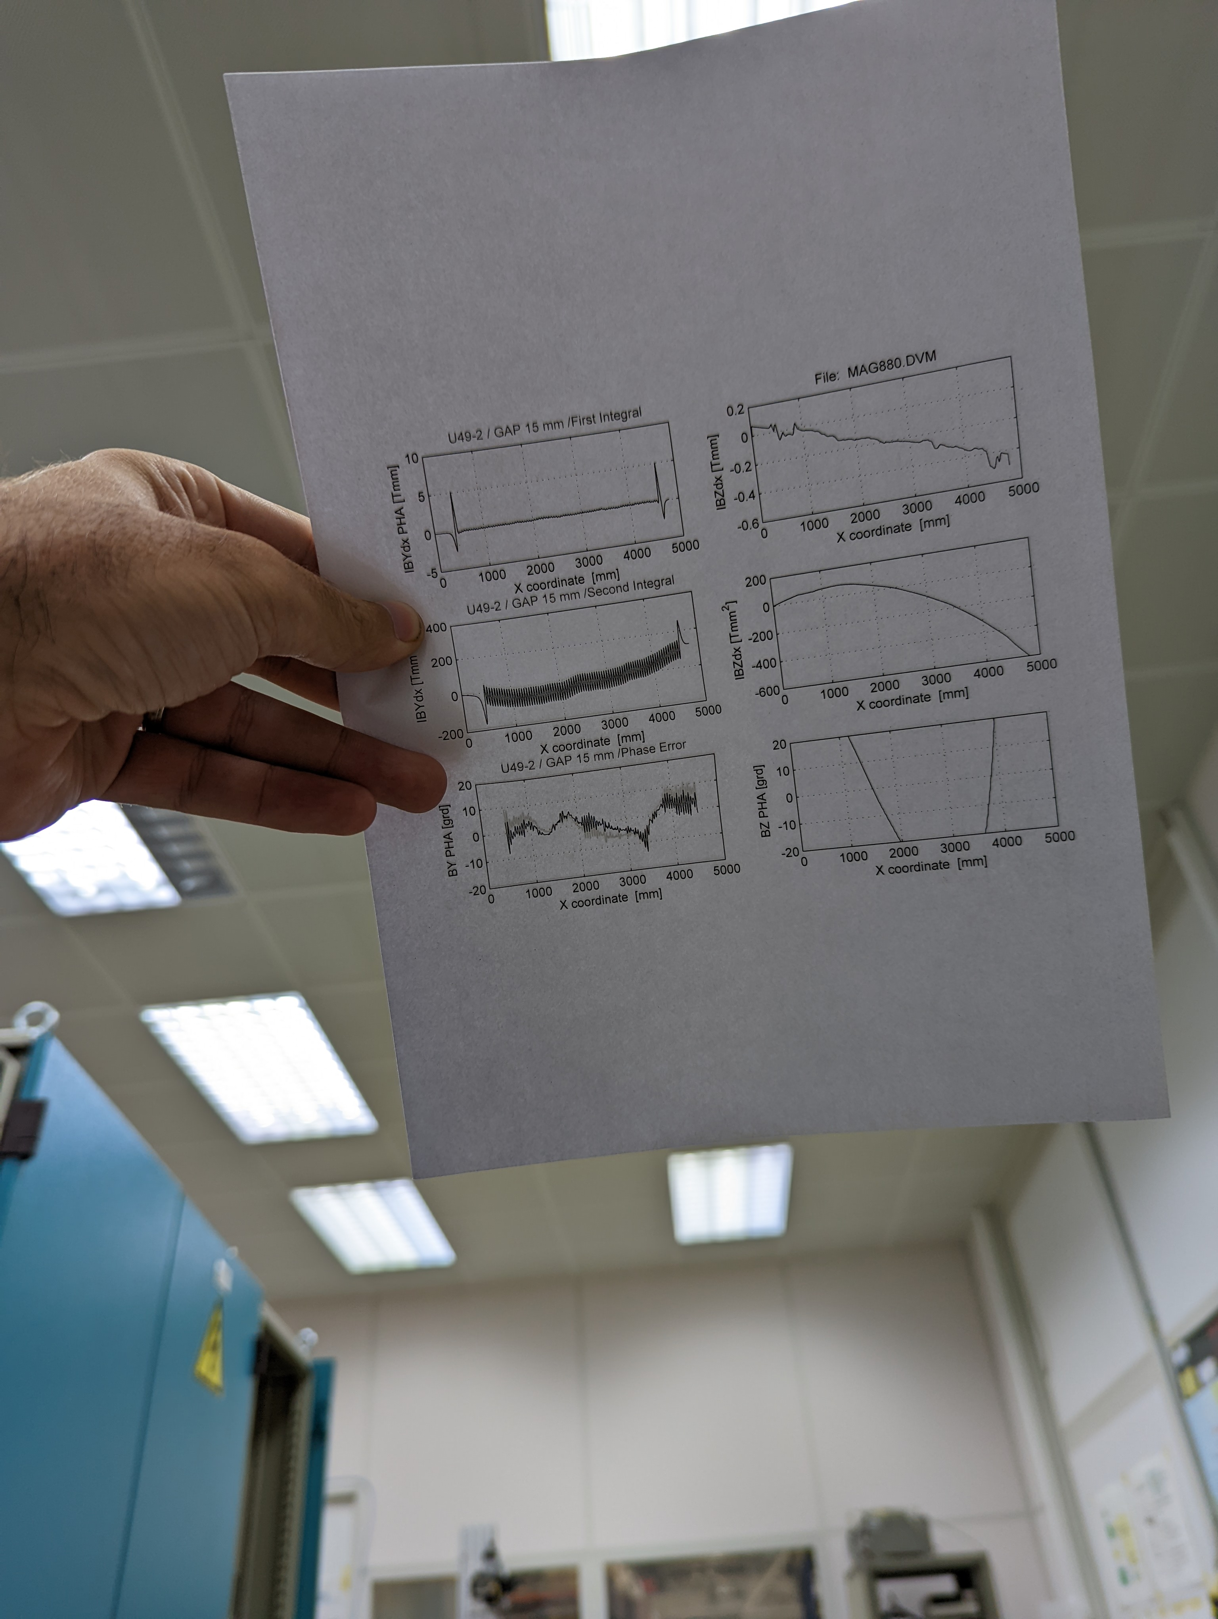
Measurement Process Issues
Opportunities
  A Title
    No communication between measurement system and measurement target.
        Not possible to automate overnight/long duration measurements with changing e.g. gap, shift, current.
        Dead time on the measurement system
        Make the measurement and target control systems communicate
    Analysis requiring separate software/people/PCs and high level expertise
        Analysis turnaround on the order of hours
        Dead time on the measurement system
        Refactor analysis code, simplify usability. Port to Python or create Python wrapper.
    (Badly) decentralised data storage – local drives, backup drives, poor network coverage, no data display standards (Proliferation of ROOT, Python, MatLab personalised tools)
        Difficult to track data from raw to analysed
        Difficult to compare measurements
        Introduce a Traceable Data Standard for measurements and allow easy step to step comparison

Slide 18

Process Roadblocks
Main roadblocks are
  Data Format Choices
      Text ASCII
        Easily readable, open format
        Non-self-describing
        Not secure
          Files in folders easily accidentally ‘dragged’ to the wrong place
        Unlinked data and metadata
        Low density data format
  Software Choices
      OLDER Measurement SYSTEMS
        Control program PASCAL
          In house expertise retired
          Limited support for modern data formats
      NEWer Measurement Systems
        Control Program Labview
          Not a data analysis package
          Proprietary
      Analysis/SHIM
        Analysis/Shim: FORTRAN/RATFOR
          Not a language for motion controllers
          Computationally fast
          Multiple system dependencies
            Not easily transferrable PC to PC
          High barrier to entry
            Requires Expert User

Slide 19



Process Options
Data Format OPTIONS
  TDMS
        Hierarchical
        High Density
        Self Describing
        Python bindings
        Designed for Labview Systems
        National Instruments Proprietary Data Structure
  HDF5
        Hierarchical
        High Density
        Self Describing
        Python bindings
        Open Data Format
Control Systems
  Labview
        In-Group Expertise
        Strong Real-Time Functionality
        Proprietary
          Patchy driver support
          Expensive
          Small User Base
        Generates strong opinions…
  EPICS
        Wider Support Base in and out of house
        UI tools, archiving, driver support
        Open Source
        Growing Python interface environment
          PyEPICS, Ophyd, Bluesky
        Easier integration with EPICS controlled motors on measurement target systems
          Undulators, Electromagnets

Slide 20

Conclusions
  Strategise
        Explore solution space
          Software
          Controls
          Data Storage
          Fail Fast Mentality
Strategise
Plan
  Plan
        Desired Outcomes
        Timescales
        Costs
        Staff
  Execute
        Assess programme against milestones.
        Continue to provide measurements during development.
        Report progress at IMMW23
  Resource
        Scientist/Engineer
        Motion Control Expert
        Structured Student Support
Execute
Resource

