Slide 1
Magnet Section Activities at the Paul Scherrer Institute: Status and future challenges
Stéphane Sanfilippo on behalf of the Magnet Section &CHART Team :: Paul Scherrer Institut
International Magnetic Measurement Workshop 22 @Brazilian Center for Research in Energy and Materials (CNPEM)

Slide 2
Main activities (2019-2024)
  Magnetic design
  CAD design
Magnets for the upgrade of the
Swiss Light Source
SLS2.0
  Procurement
  Assembly (PM &SC magnets)
  Tests @ 4.2 K and 10 K
  Magnetic measurements
  Maintenance &Repair
Magnets for HIPA
LTS & HTS magnet development
for CHART
  Spare
HIPA= High Intensity Proton Accelerator
CHART = Swiss Accelerator and Technology
Notes:
Canted Cosine Teta → Canted Cosine Theta

Slide 3

















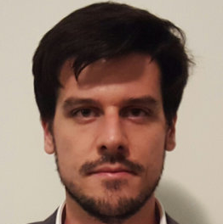




Magnet section organigram
S. Sanfilippo
Design and analysis
Superconducting Magnets
Engineering and measurements
C. Calzolaio
S. Sanfilippo a.i.
A. Gabard
M. Daly*
D. Sotnikov*
J. Kosse*
A. Brem*
D. Araujo*
H. Garcia*
Th. Michlmayr*
O. Kirby*
G. Montenero
V. Vrankovic
R. Riccioli (Post Doc)
C. Zoller
M. Duda
S. Hellmann
R. Deckardt
R. Felder
P. Berger
S. Müller
S. Sidorov
+ 1 technician in 2023
60% for SLS2.0
* CHART financing
+ 2 technicians in 2023
Notes:
Canted Cosine Teta → Canted Cosine Theta

Slide 4
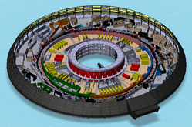
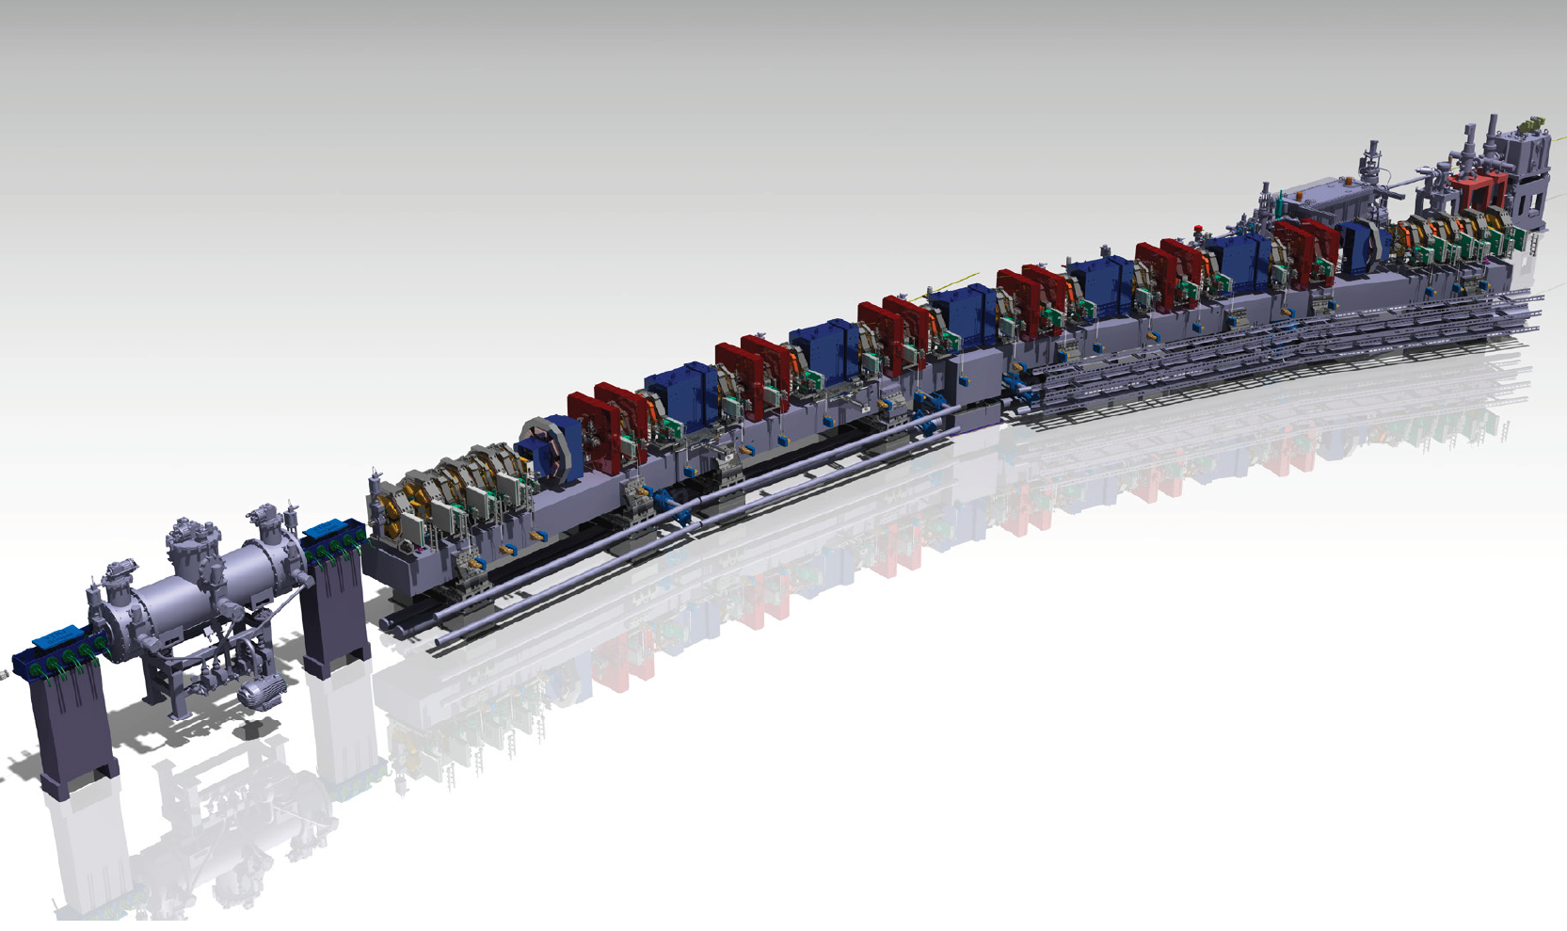
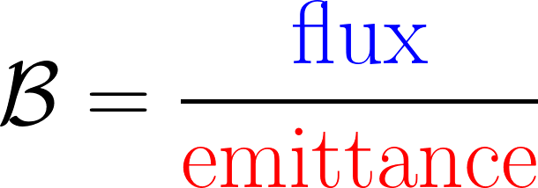
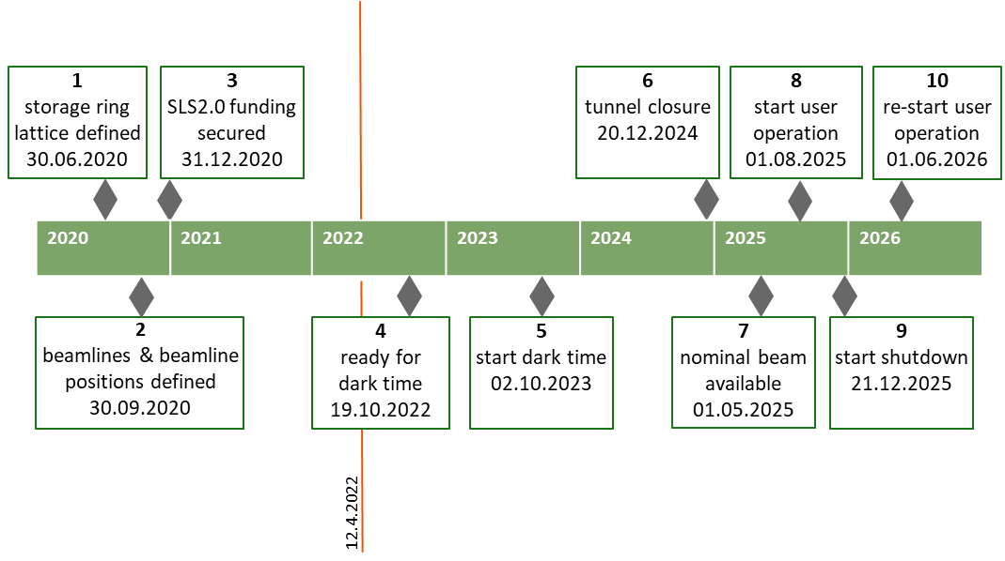
Project SLS 2.0
x 35
Brilliance
Phase 1
Phase 2
Notes:
Canted Cosine Teta → Canted Cosine Theta

Slide 5
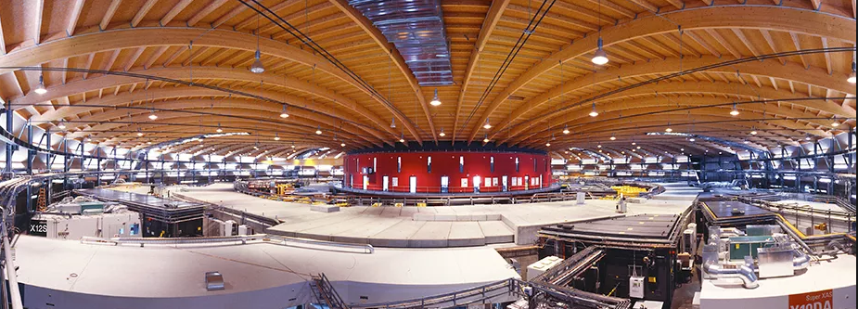
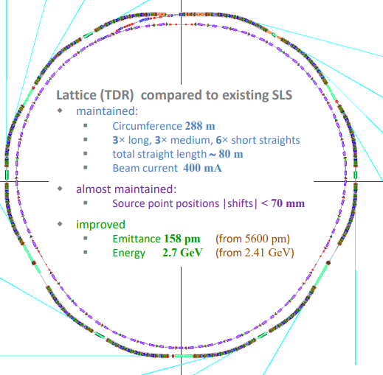
SLS now … to SLS 2.0 in 2025
SLS 2.0
288 m circumference = 80 m straights + 208 m arcs
Energy of 2.4 GeV
288 m circumference
12 × TBA (triple bend achromat) lattice
straight: 6 × 4 m, 3 × 7 m, 3 × 11.5 m
3 NC 3T super-bends
Horizontal emittance 5.5 nm
Vertical emittance ≈ 5 pm
User operation since June 2001
18 beam lines in operation
12 Multi-bend achromatic arcs
7BA best compromise: low emittance, nonlinear dynamics and magnet feasibility.
Energy increase from 2.4 to 2.7 GeV
Re-use of the SLS injector
Notes:
Canted Cosine Teta → Canted Cosine Theta

Slide 6
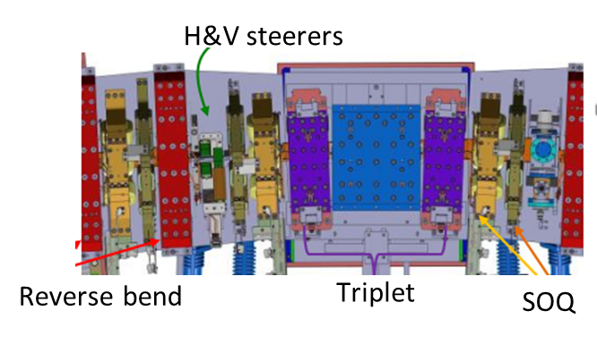
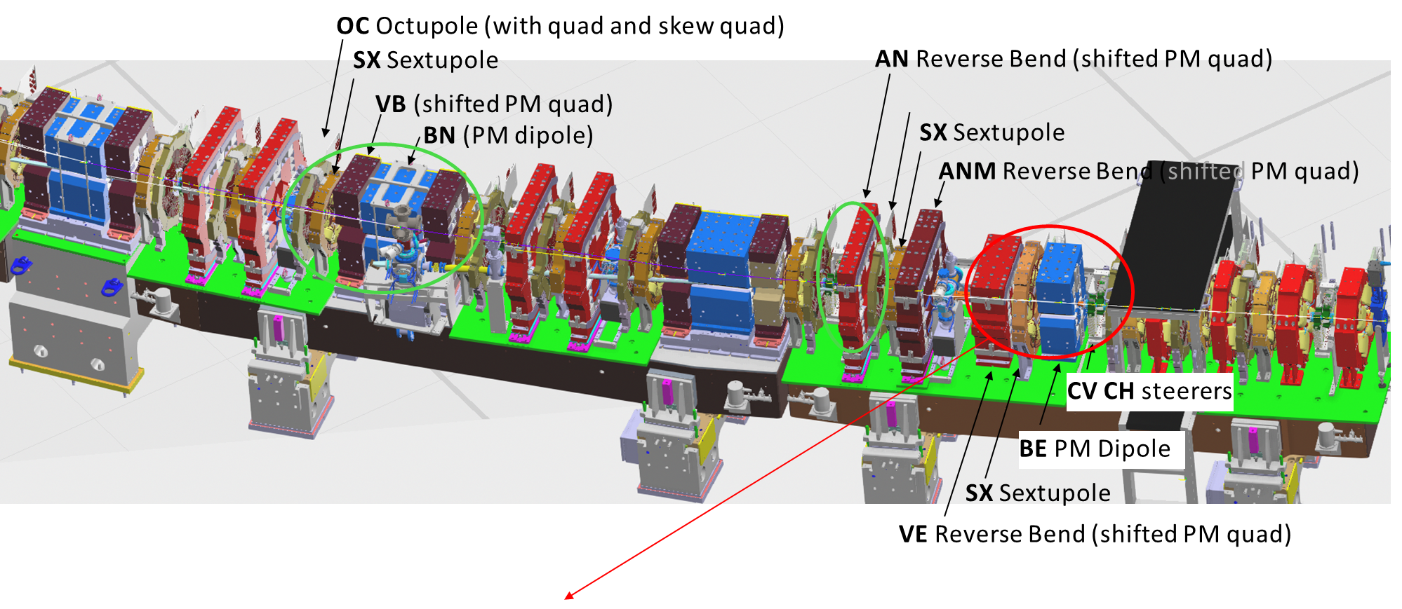
Challenges for the SLS 2.0 magnet design
& production & measurements
High field and gradients (>1T)
Combined function magnets (OC+Nquad+SkewQuad)
Tight tolerances (field quality 0.01….0.1 %; aligment below 30 micrometers)
Three types of magnets (electro/permanent/superconducting)
High number of magnets
Dense packing of magnets (Cross-talk effects)
Tight schedule for the design, production and measurements

Slide 7
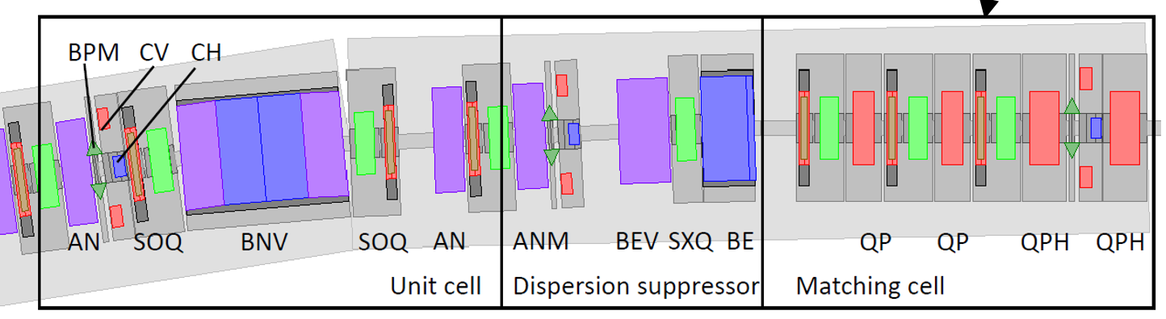
Magnet list
Permanent Magnets
BN 56 Dipole
BS 4 Dipole
VB 96 Quad
VBX 24 Quad
Triplet 60
AN 120 Quad
ANM 24 Quad
BE 24 Dipole
VE 24 Quad
Total : 372
Electromagnets
QP 55 Quad
QPH 53 Quad
SXQ 24 6-Poles
SX 264 6-Poles
OC 264 8-poles
SOQ 264
CHV 112 Steerer
Total: 780
+ two 5 T superconducting superbends (phase 2-2026)
Notes:
Canted Cosine Teta → Canted Cosine Theta

Slide 8

Status of the SLS2.0 magnet production (September 2022)
• Magnetic and CAD design completed
• Calls for tender completed (including the SC superbends)
almost all the purchase orders are signed
• Infrastructure & Magnetic systems : completed at 80 %
• Magnetic measurements : 112 electro-quadrupoles were measured
(Zoller & Montenero talk)
Notes:
Canted Cosine Teta → Canted Cosine Theta

Slide 9
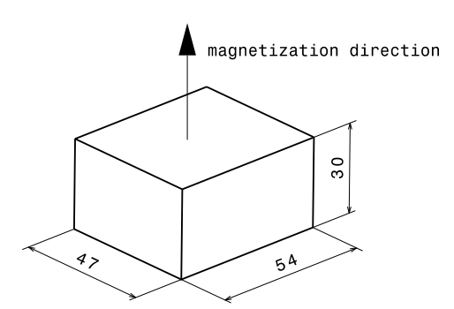
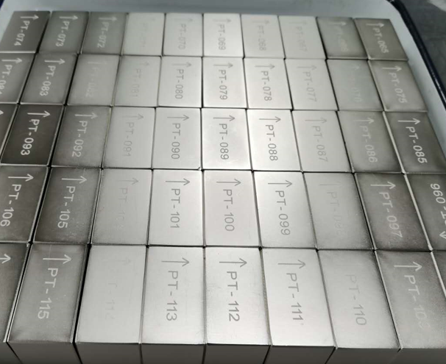
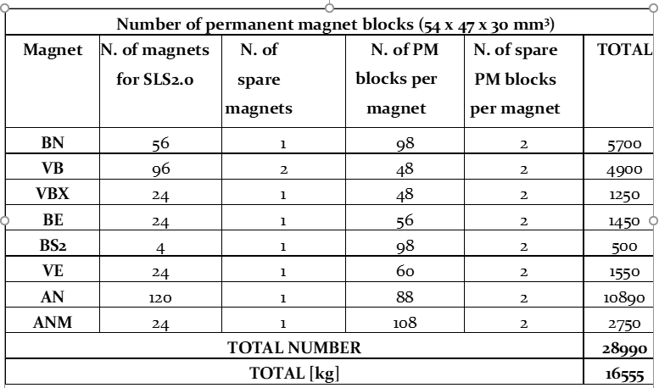
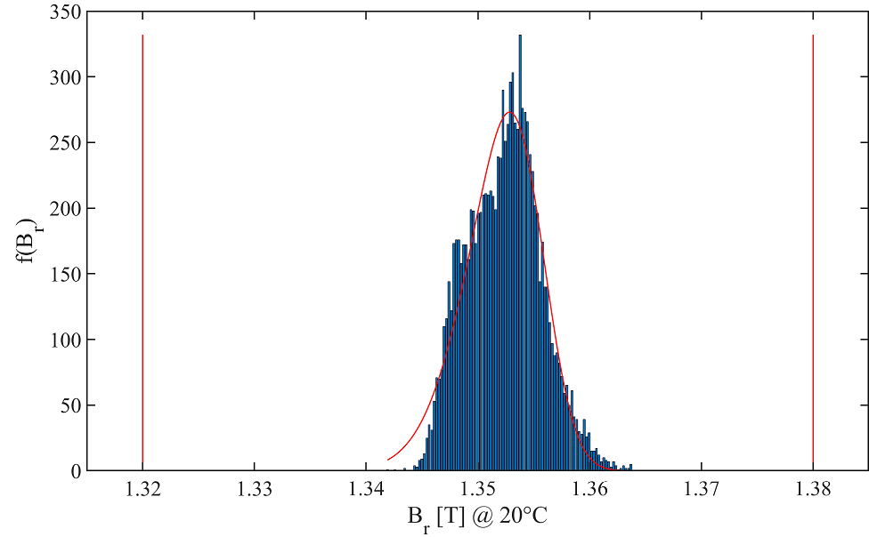
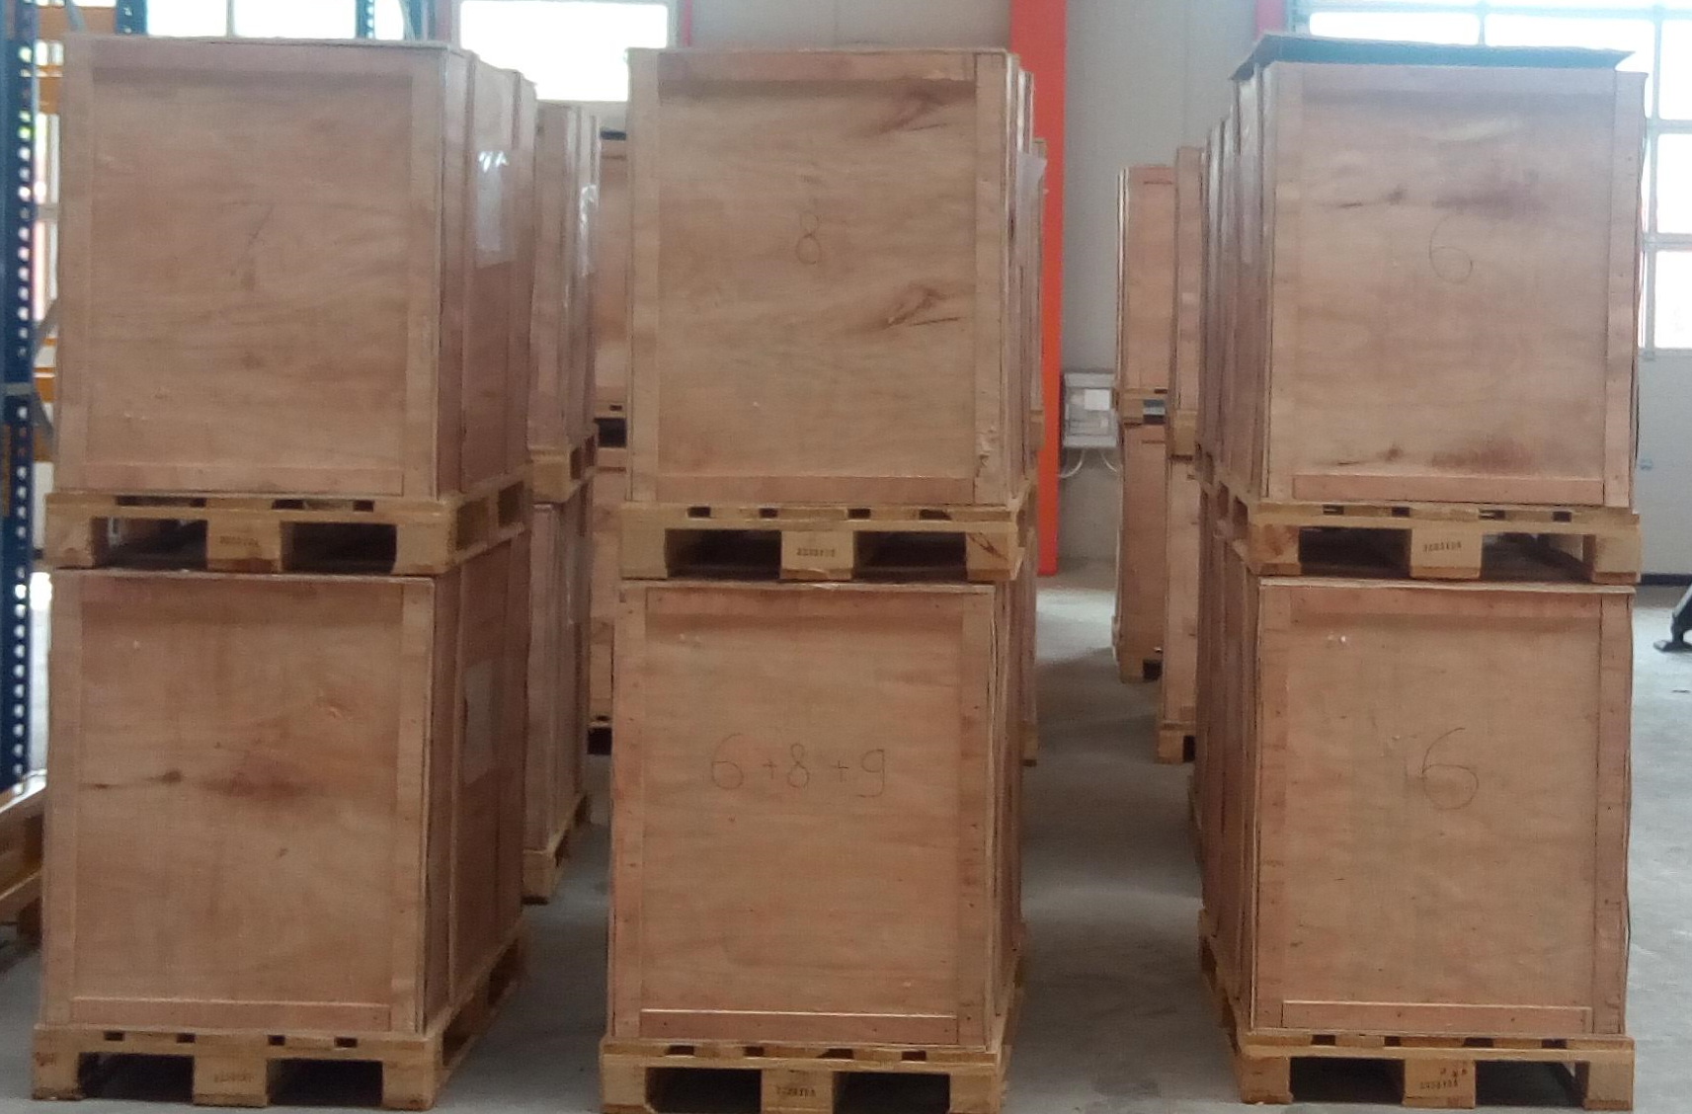
Permanent Magnet Material for the blocks
1 block size for all magnet types: 30 mm x 47 mm x 54 mm
Rare earth : Nd₂Fe₁₄B ( Remanent field B_{r}: ~1.35 T @ 20°C)
Weight : 0.57 kg
Coercive field : 1015 kA/m
Temperature dependence : -0.12 %/°C
(thermal stabilization needed)
We need about 34 000 blocks
16.6 Tons
10400 blocs
specs
First 10’000 blocks (september 2022)

Slide 10
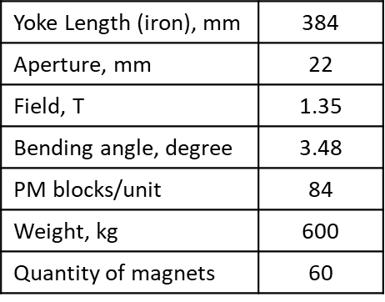
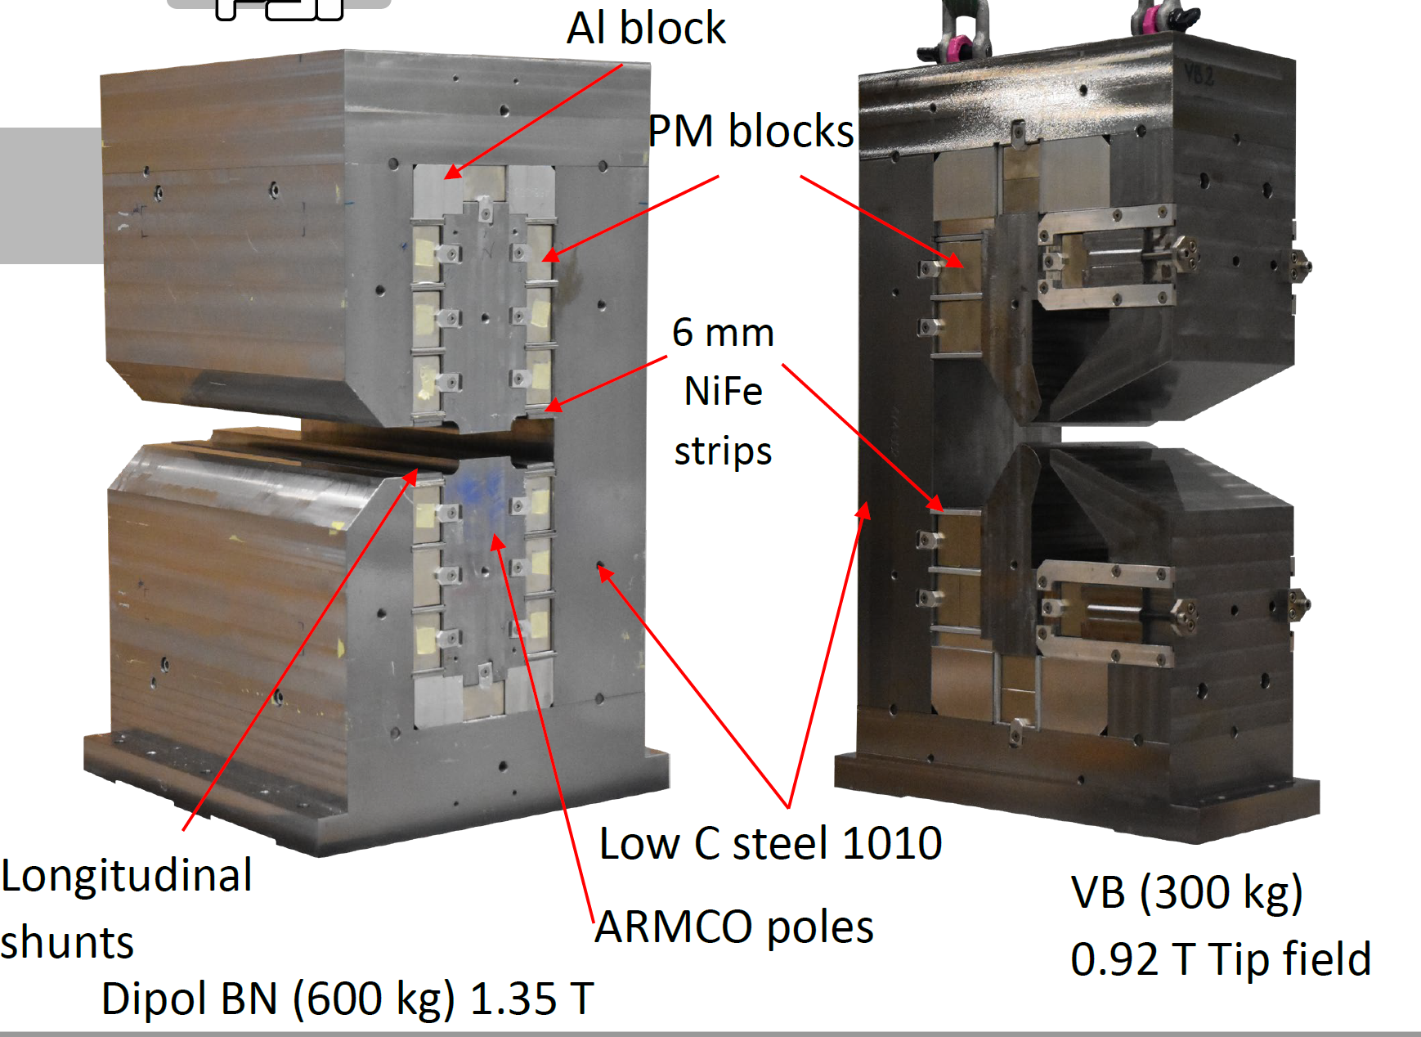
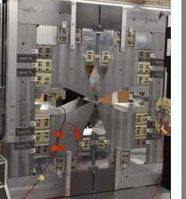
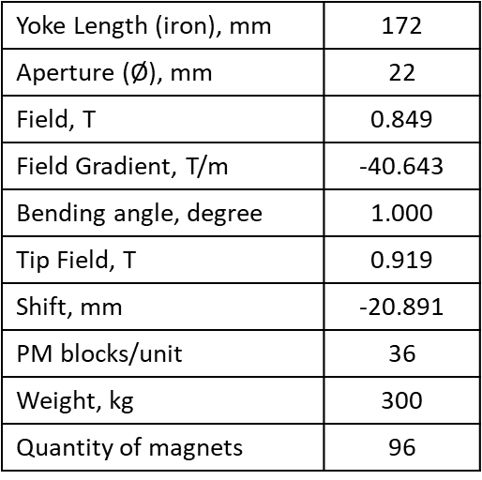
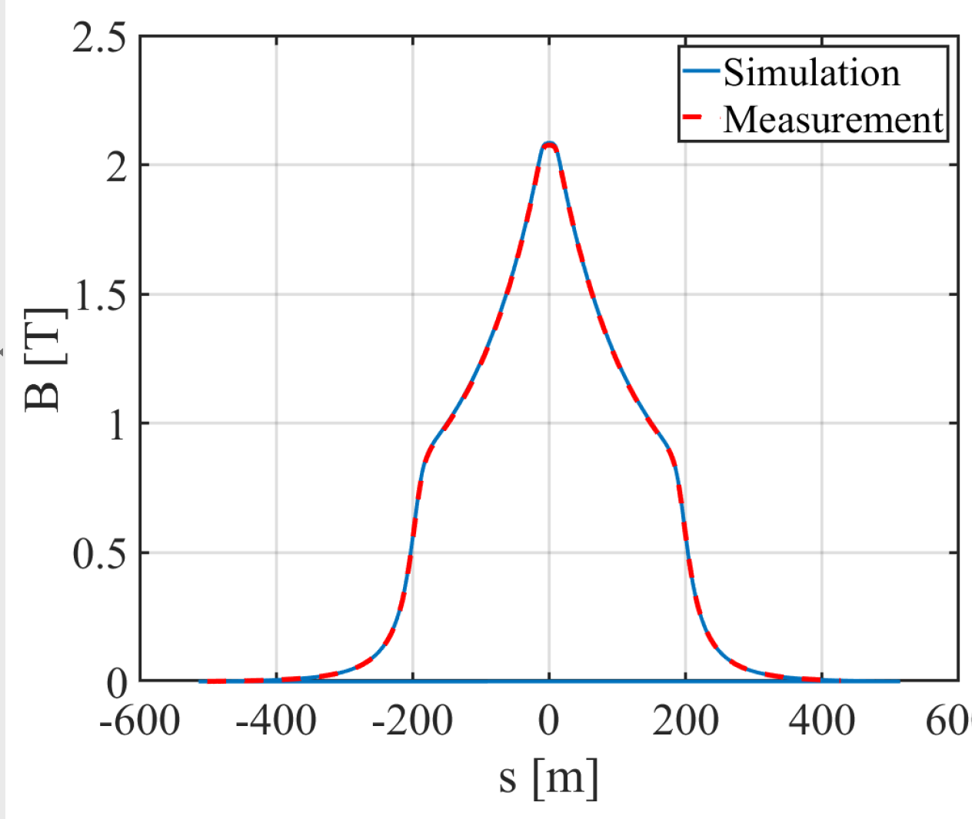
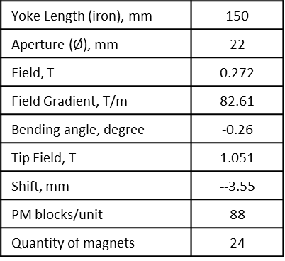
Permanent magnets for SLS2.0
BN
focusing
quadrupole
Triplet VB/BN(S)/VB
VB
2T superbend
ANM
Triplet VB/BN/VB

Slide 11
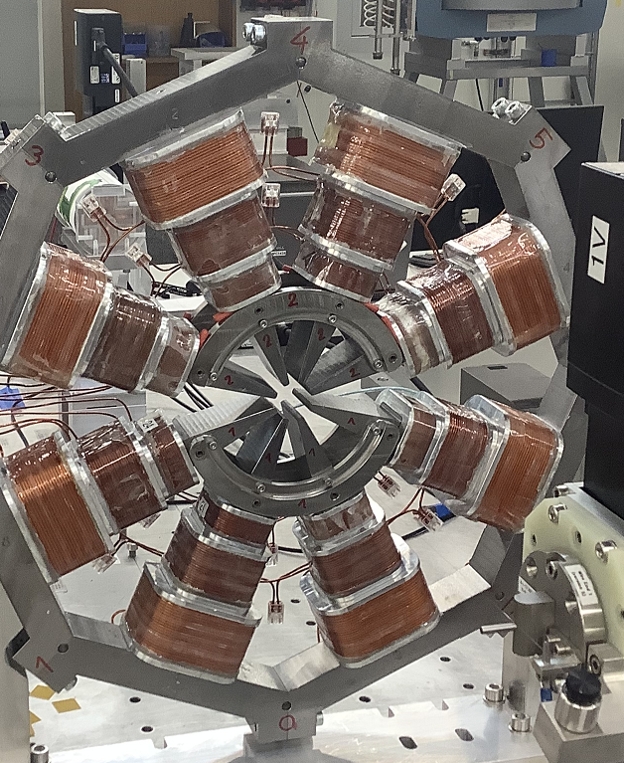
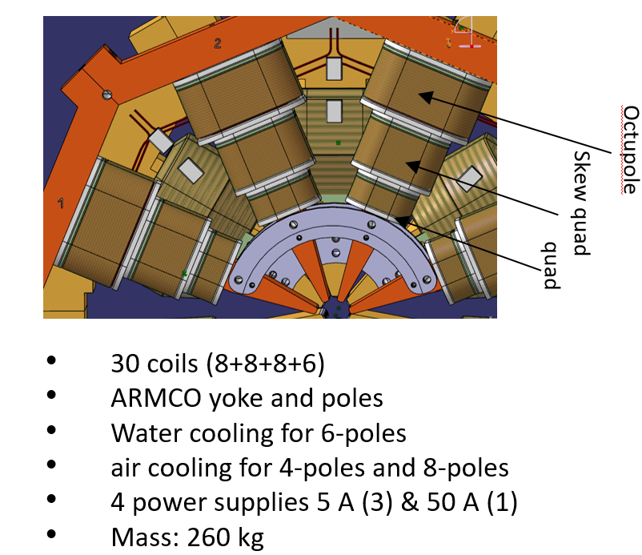
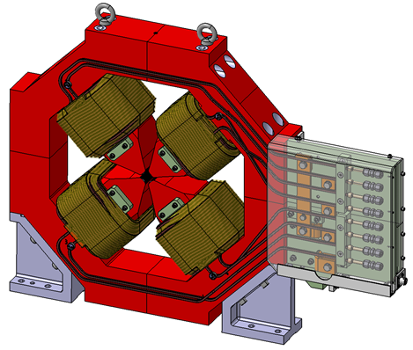
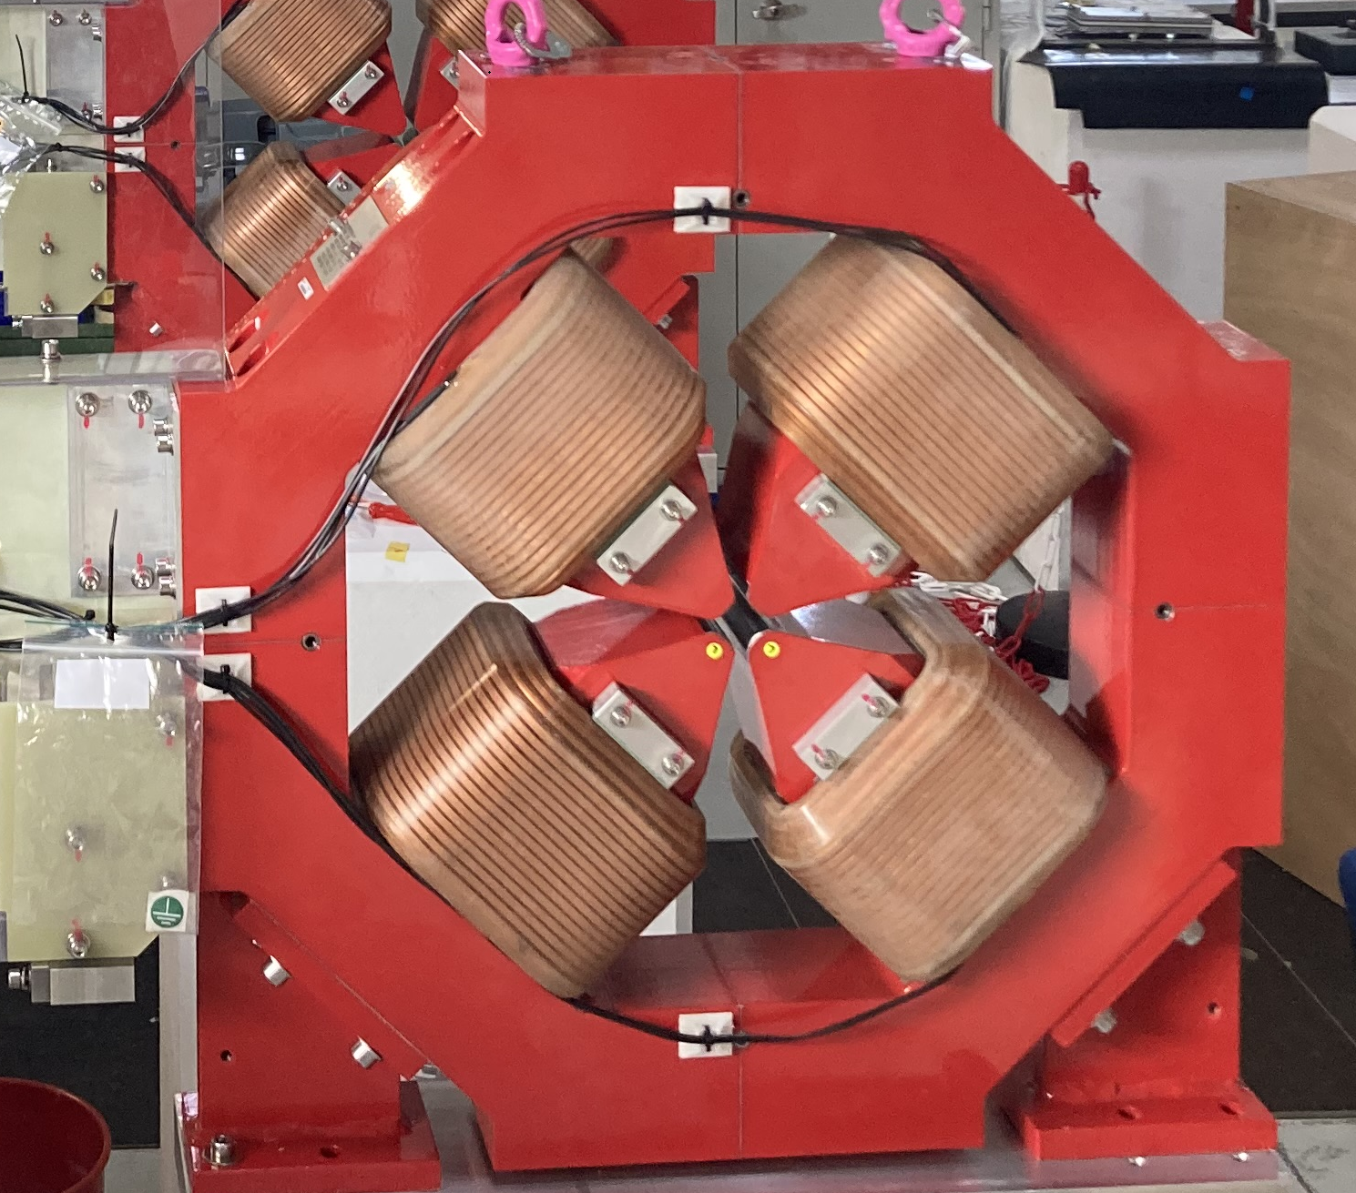
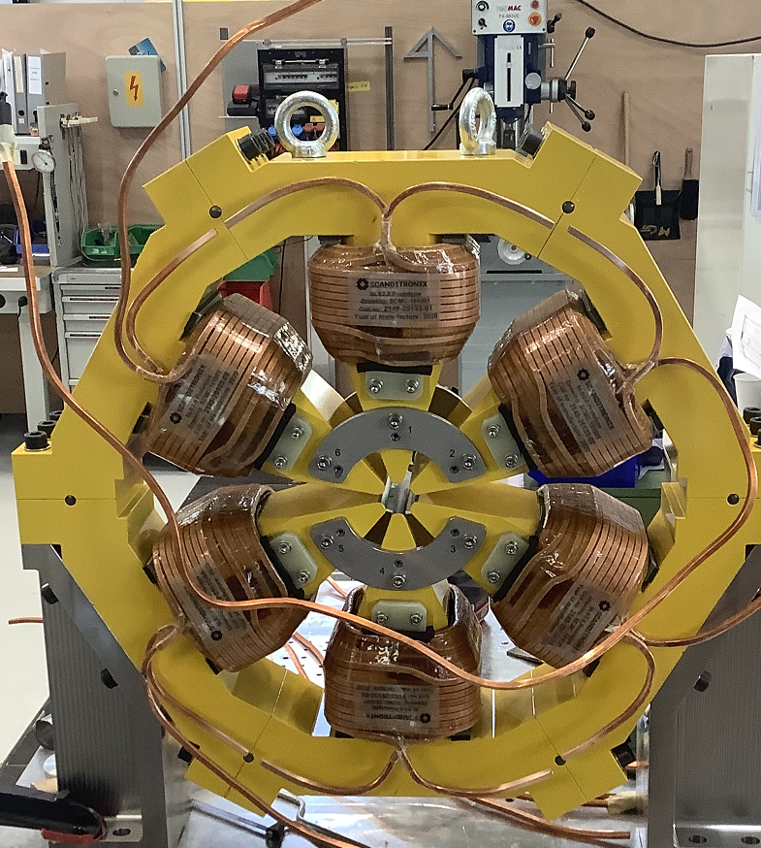
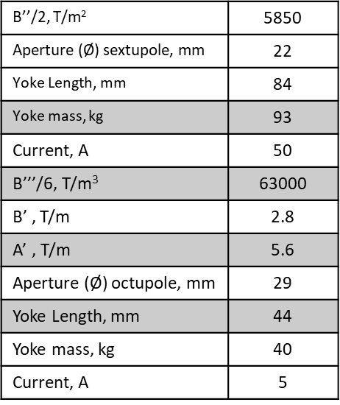
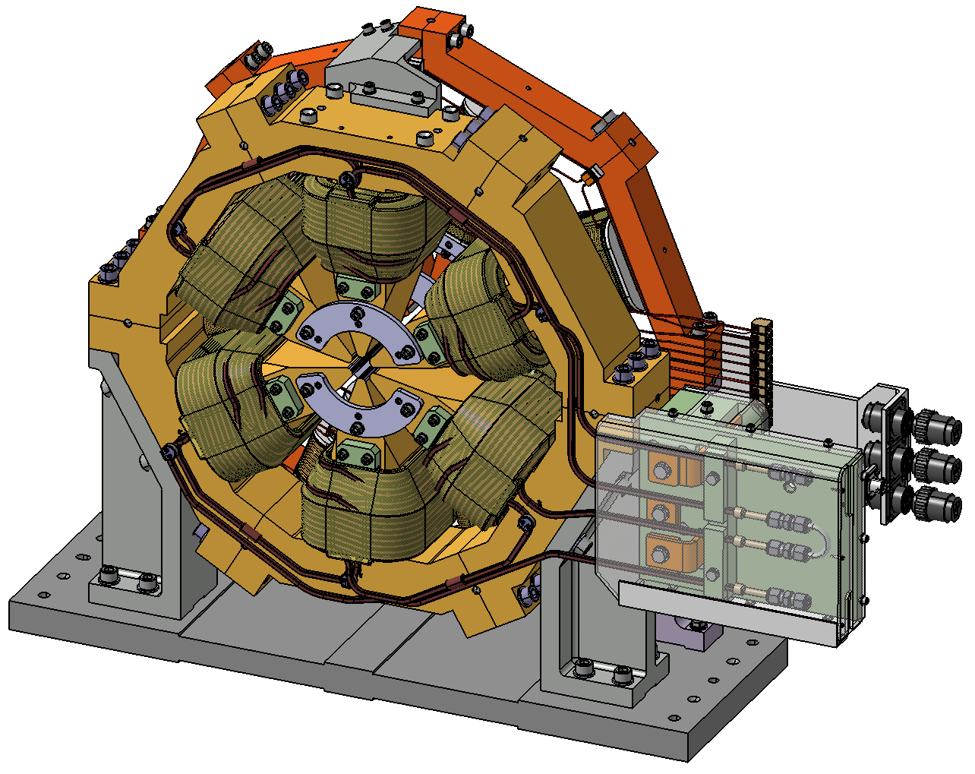
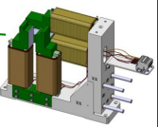
SLS2.0 electro magnets
Sextupole and octupole module
SLS-2 Q- Poles
H&V correctors

Slide 12
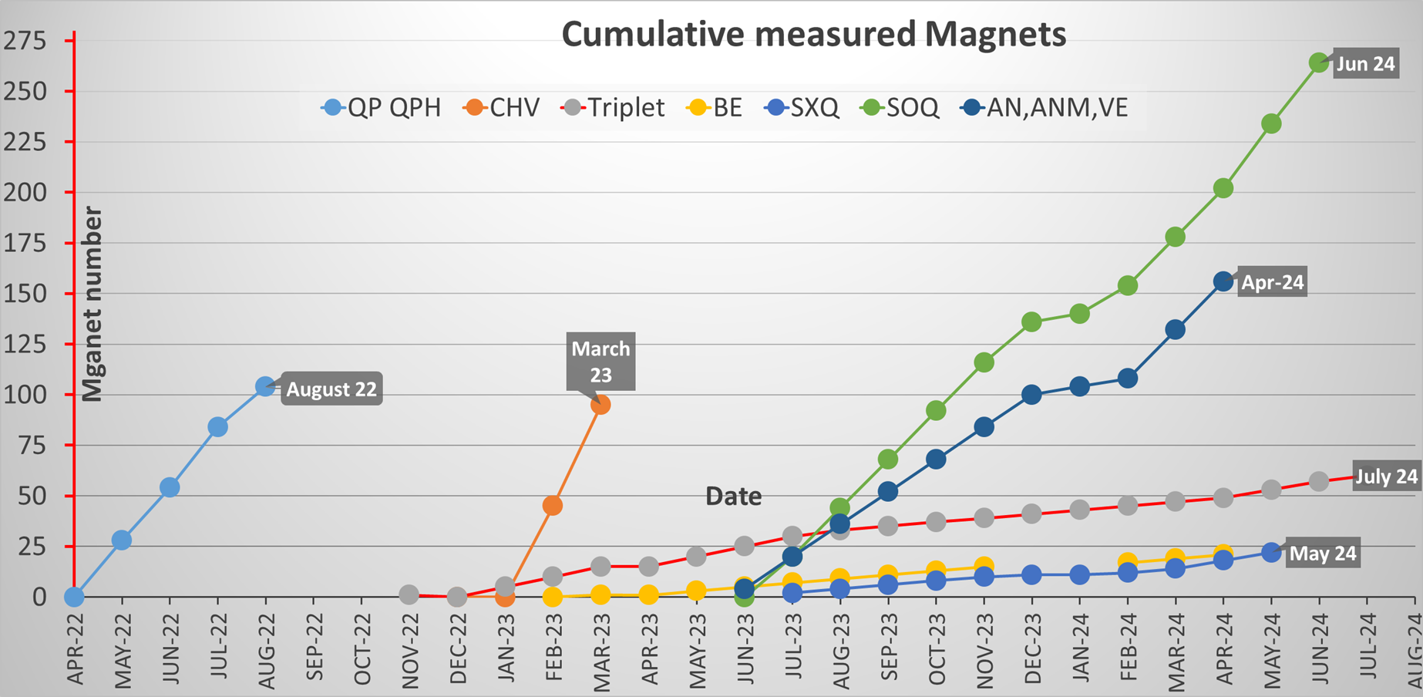


Magnetic measurements schedule
SLS
July 2024
Very aggressive schedule (>1000 magnets in 26 months)
Parallelization of the measurements after June 2023
Last measured magnets : July 2024
Notes:
Canted Cosine Teta → Canted Cosine Theta

Slide 13
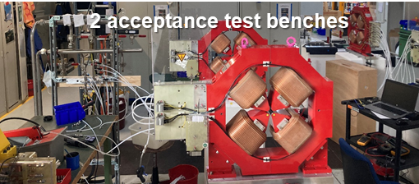
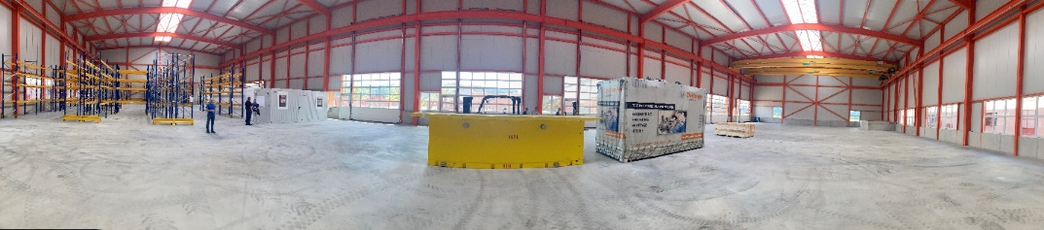
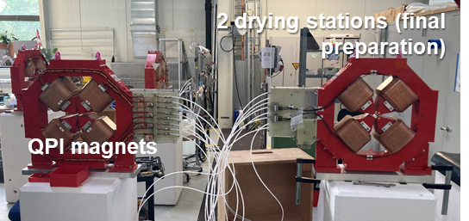
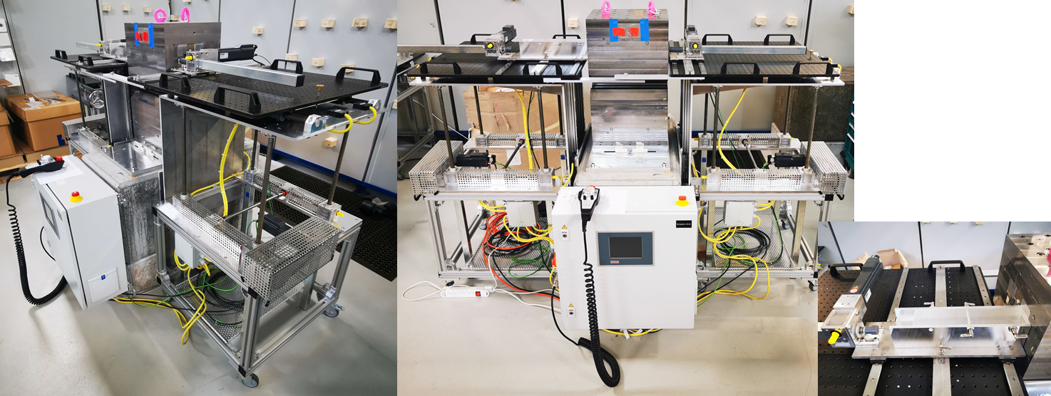
Infrastructure : 2 buildings
(Mag. Lab & Assembly Facility)
Mag.Lab
Electromagnet delivery
Electromagnet inspection and acceptance tests (2 workstations)
Magnetic measurements (all the magnets)
Assembly facility
PM blocks and yokes delivery
PM dipoles and quadrupoles assembly
(2 benches)
PM dipoles and quadrupoles assembly ready for measurements
Storage or magnet assembly (all) in the girders
Assembly facility
QPI magnet
PM magnets assembly benches

Slide 14
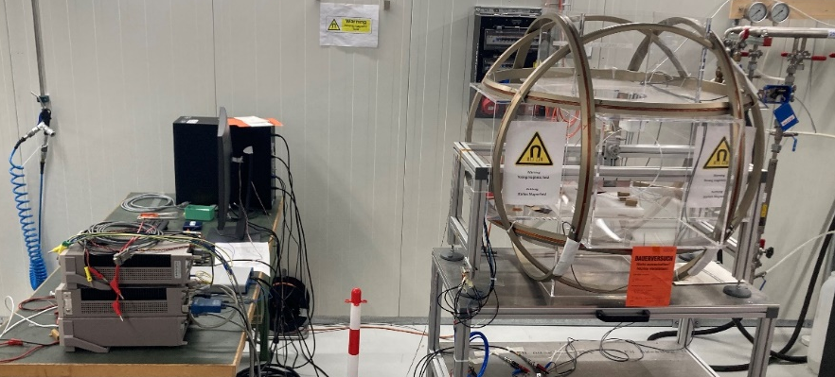
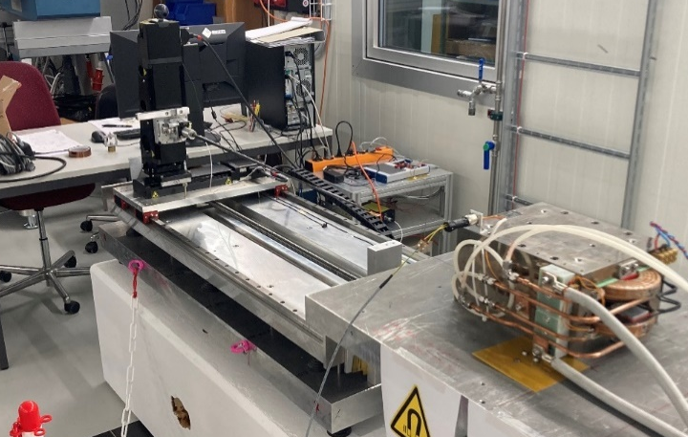
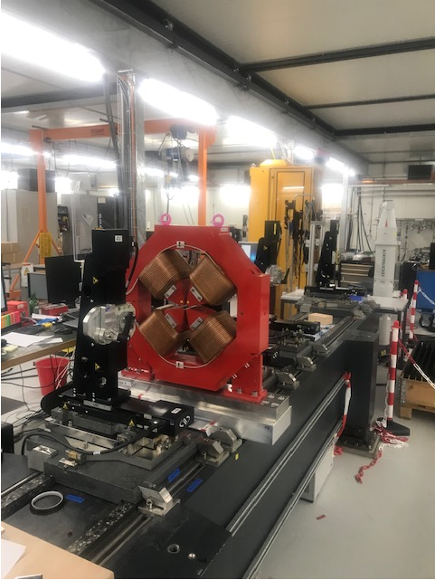
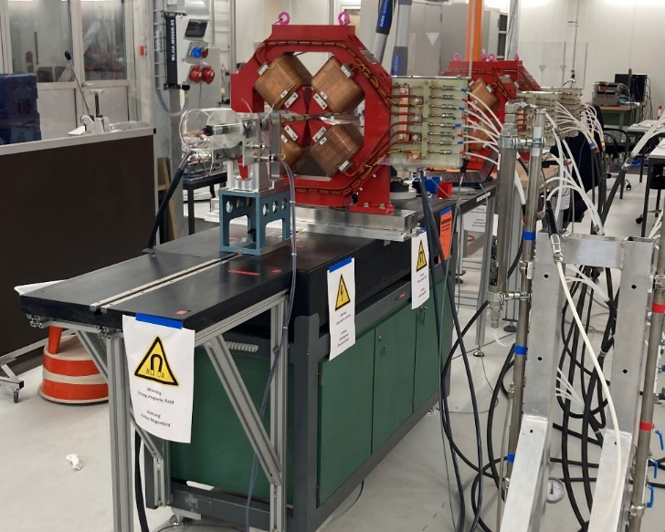
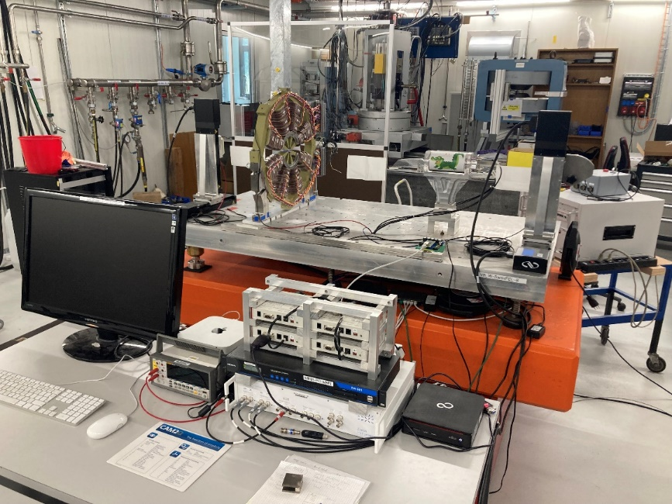
Measurement systems (Mag.Lab)
Compact Field Mapper
Helmholtz-coils
Moving Wire (1+1)
Vibrating Wire (1+1)
Rotating Coils (1+1)
Dipole Field Integral →Moving wires (2)
CHV, Quadrupoles, Sextupoles, Octupoles (Field Integral, Multipoles) →Rotating coils (2)
Axis (SOQ) → Vibrating wires (2)
100 % operational July 2023
Notes:
Canted Cosine Teta → Canted Cosine Theta

Slide 15
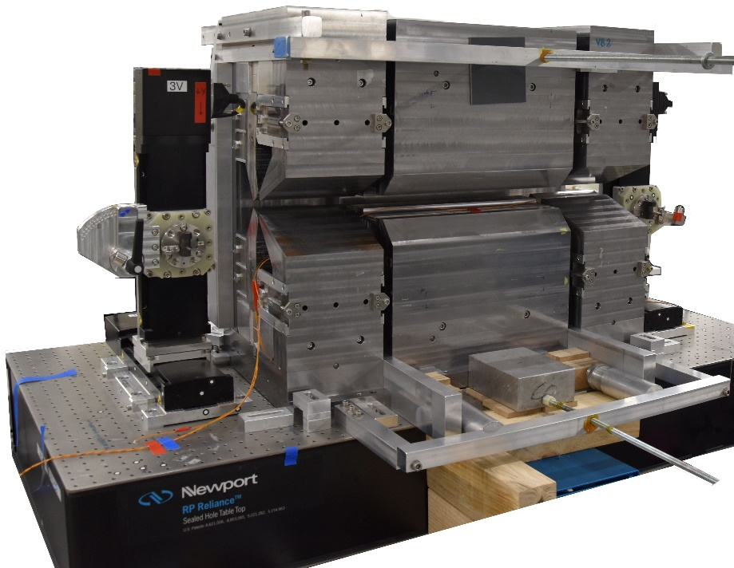
Challenge (1):
Triplet measurements and alignment
Step 1 : 2 VB(X) Alignment and measurement
  Install VB magnet support on the measurement bench and align it for matching nominal VB axis to the measurement bench axis
  Install VB magnet on the measurement bench
  Measurement of the vertical axis offset
  Set new vertical starting position of the wire according to 3
  Sub procedure-Horizontal axis offset measurement
    Horizontal measurement in the reference position
    Flip the magnet 180 degrees w.r.t. y axis
    Horizontal measurement in the flipped position
    Flip back the magnet and repeat reference measurement
  Calculate horizontal axis offset using data from 5
  Set new horizontal starting position of the wire according to 6
  Sub procedure-Field adjustment to the design value
    Measure the integral field gradient due to Bx component
    Adjust the field gradient with moderator plates
    Repeat a) and b) until integral measured gradient differs for design <0.06%
  Repeat from 3. to 7. for final refinement
  Measure integral field tilting the wire according to final position of the VB(x) on the triplet (used at Step2.4)
Step 2 :BN (BS2) alignment and measurement
  Align triplet drawer in order to have BN nominal mechanical axis aligned with measurement bench axis
  Sub procedure-Field adjustment to the design value
    Measure the integral field gradient due to By component
    Adjust the field gradient with shimming plates
    Repeat a) and b) until integral measured field differs for design <0.2%
    Measure the integral field gradient due to By component
    Adjust the field gradient with moderator plates
    Repeat d) and e) until integral measured field differs for design <0.06%
  Step 3 : measurements of the triplet
  Remove BN(BS2) from triplet drawer
  Install 2 x VB(x) with support on the drawer
  Slide in the BN(BS2) magnets between the 2 x VB(x) on the triplet drawer
  Measure integral field of the triplet and compare with the sum of the integrals of single magnets: the ratio has to match FEM simulations
  Adjust VB position if ratio from 4 is off more than 0.2%
Complicated
1 triplet /week

Slide 16
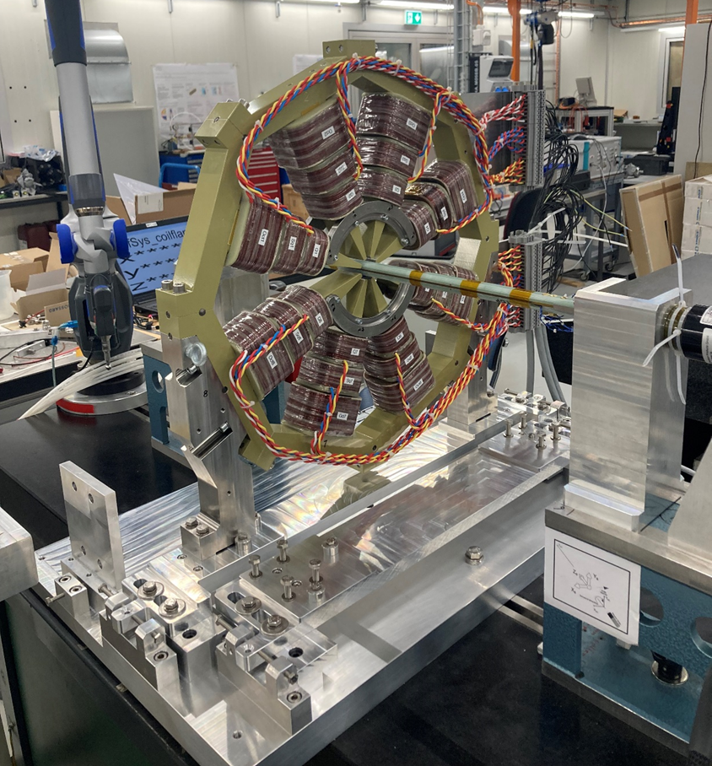
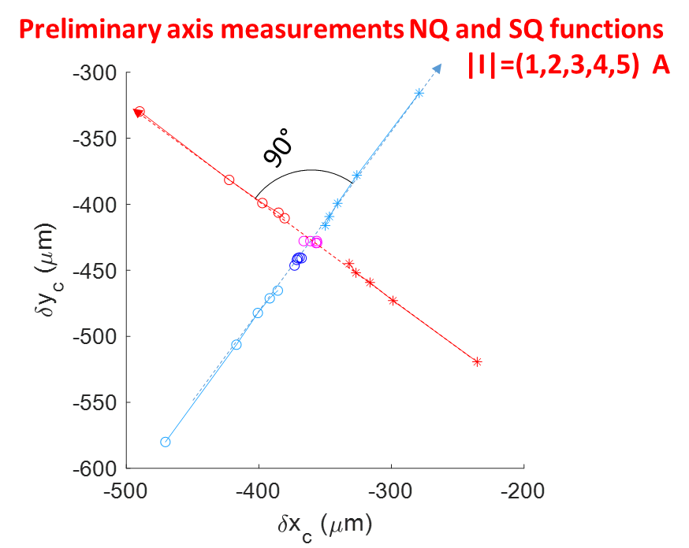
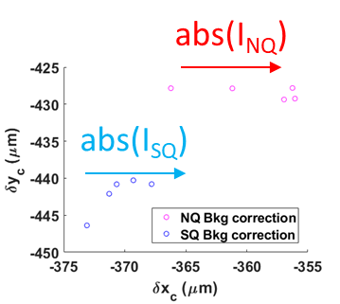
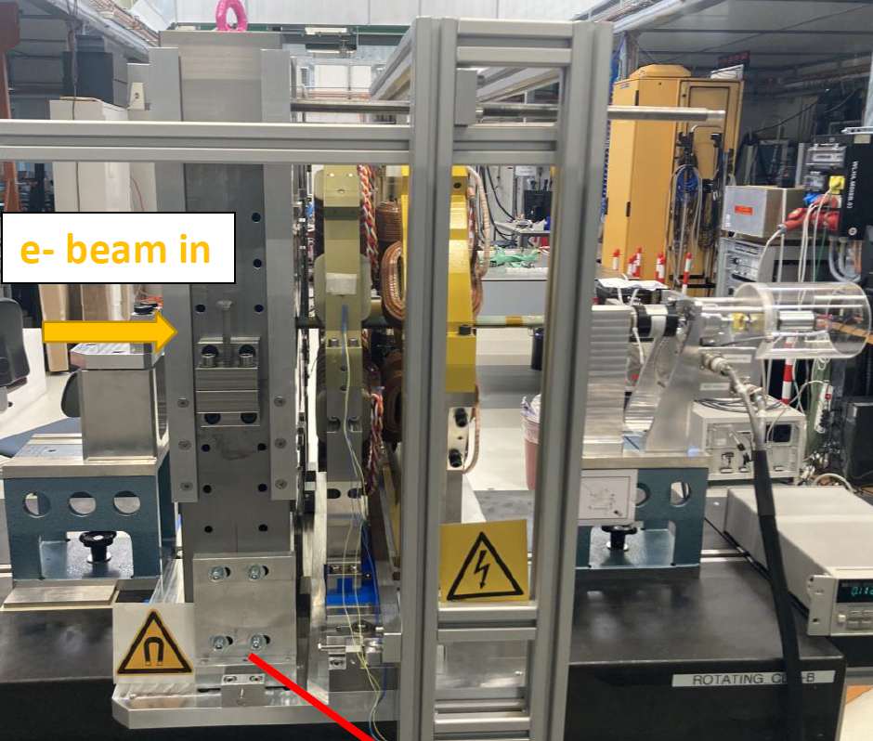
Challenge (2):
Alignement of the SOQ
(sextupole & octupole)
Align the SOQ within 30 micrometers
Axis position of the sextupoles (magnetic, mechanic?)- RC, v.wire?
• Multi-function octupoles:
axis position using the normal (NQ) skew quad (SQ)- no octupole powering
Position change :
when all the functions are powered
Cross talk coming from the neighbors (sextupole, big permanent magnet)

Slide 17
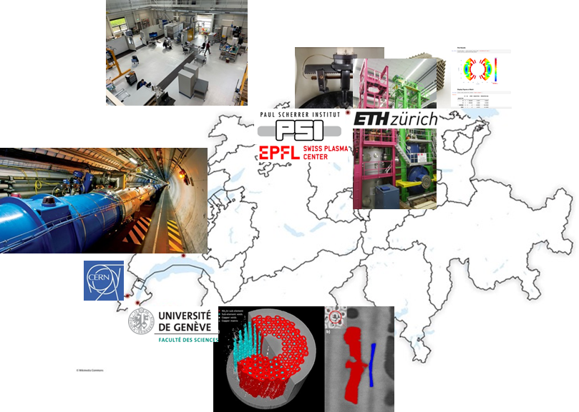
CHART activities at PSI
CHART = “Swiss Accelerator Research and Technology”
Swiss research network, consisting of national and international research institutes in Switzerland
Members : CERN, EPFL, ETHZ, UniGE, PSI (Home Institut)
Goal: Support of future accelerators in Switzerland
Main task: Future Circular Collider FCC @CERN
~50% R&D for superconducting magnets
Funding by the participating institutes
(CERN ~40% of the total budget)
Support of the State Secretariat for Education and the ETH Board

Slide 18
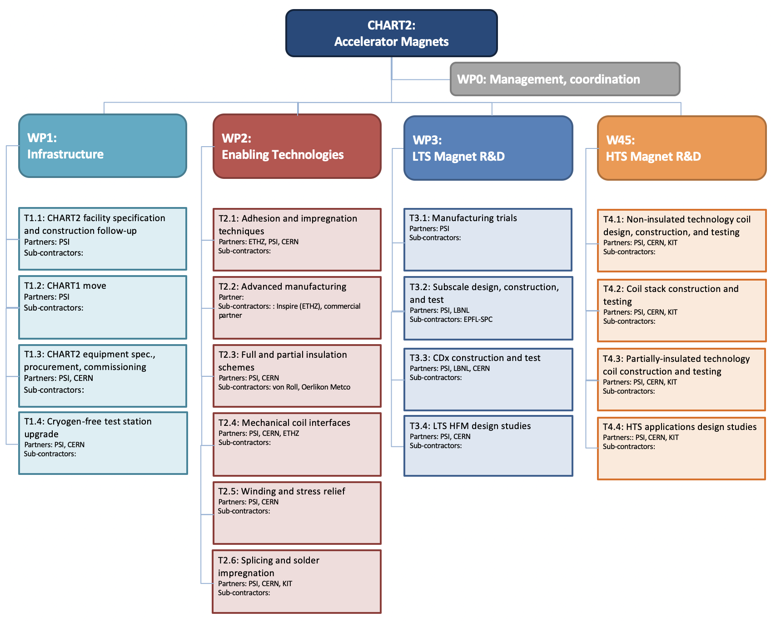

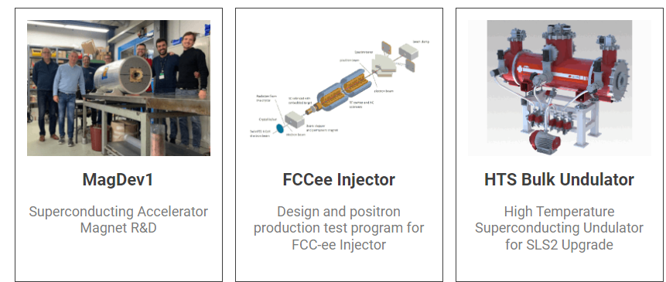
CHART goals
Design and construction of superconducting magnets
Coil winding and magnet assembly
R&D in LTS and HTS materials (key technologies)
Development of an infrastructure for LTS and HTS magnet assembly (MagDev Lab) and test
Promote synergies (competences, topics, personnel, equipment) with PSI projects (HTS Superbends, P³ experiment, superconducting gantry...)
B. Auchmann
https://chart.ch/psi/
CHART project at PSI

Slide 19
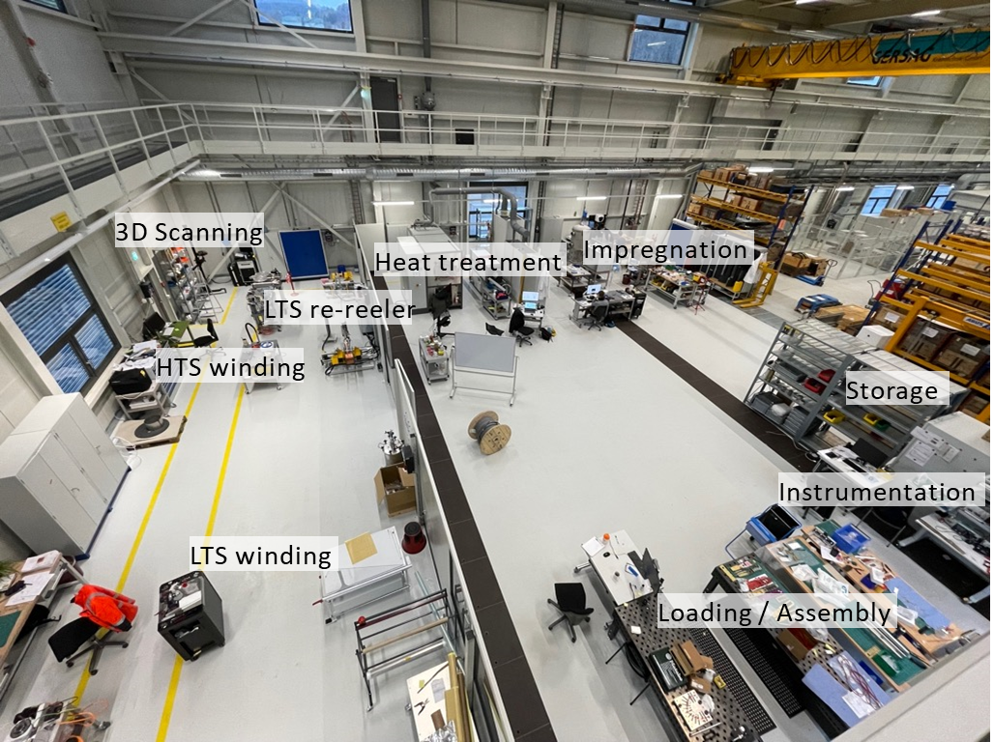
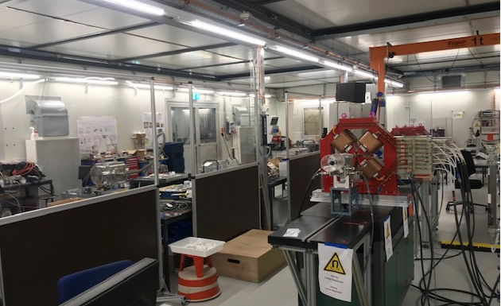
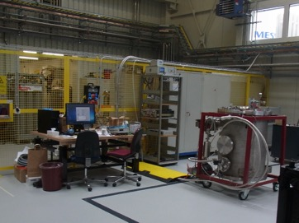

Competence center : Magnets & Insertion Devices
Infrastructure
SC magnets
Know-how
Common workshop, production tools
Winding machines
Impregnation oven
Measurement systems
PM and electro magnets
Insertion Devices
HTS & LTS coils and magnets
Measurement hutch
Cryogenic test station
Workshop
Resource
1100 m² for Insertion Devices & Magnets
Notes:
Canted Cosine Teta → Canted Cosine Theta

Slide 20






Examples: superconducting magnet activities
CHART (in test at CERN)
CHART 18 T@10 K
SLS2.0 (in preparation)
Building and test of a positron source at PSI (P³ experiment)
HTS SC solenoid
2 NC or SC long solenoids around the 3 GHz cavities

Slide 21

What ‘s next : Project IMPACT
2022
2023
2024
2025
2026
2027
Mag. Design
& simulations
Simulations II
Mech. Design
TDR
tender
preparation
Tendering
phase
Assembly
&
tests
Installation
Notes:
Canted Cosine Teta → Canted Cosine Theta

Slide 22




Superconducting Dipole for compact gantry
PSI gantries: Volumetric Rescanning (5MeV/100ms)
→ Fast field ramps and energy changes
Upgrade with new concepts
Items | Gantry 2 | SC Gantry | +
Weight | 45 t (AMF3): 2 T Cu dipole | 4-5 t 3 T SC dipole | Compact, lighter
Scanning aperture | 12x20 cm² | 27x22 cm² | Reduced patching
Power supply | 85 kW | 20 kW | cost
Magnet-geometry CCT:
Operating parameters
Geometrie: Canted Cosine Theta (CCT)
conductor: REBCO tapes
T_{op} >10 K
Cooling: Cryo-cooler
Lamé-Kurve for rectangular apertures
2022
2023
2024
2025
2026
2027
Design
pre-study
EU proposal
demonstrator
demonstrator construction
and test at PSI
Gantry magnet

Slide 23
Challenges - summary
Production and measurement of a massive number of magnets for the SLS upgrade : the main priority for the next two years
Triplet measurements and SOQ alignment are measurements challenges
A huge effort is developed for the infrastructure and the parallelization of magnetic measurements to comply with the tight schedule
Development of the technologies for superconducting magnets design, assembly and test is taking an increasing part of the activities within the CHART program
A competence center for PSI magnets and Insertion devices is now operative

Slide 24






Thank you
for your attention
S. Sanfilippo, P. Berger, C. Calzolaio, R. Deckardt, M. Duda, R. Felder, A. Gabard, S. Hellmann, G.Montenero, S. Müller, R. Riccioli, S. Sidorov, V. Vrankovic, C. Zoller;
D. Araujo, A. Brem, M. Daly, H. Garcia, O. Kirby, J. Kosse, Th. Michlmayr, D. Sotnikov and B. Auchmann :: Paul Scherrer Institut

