Slide 1
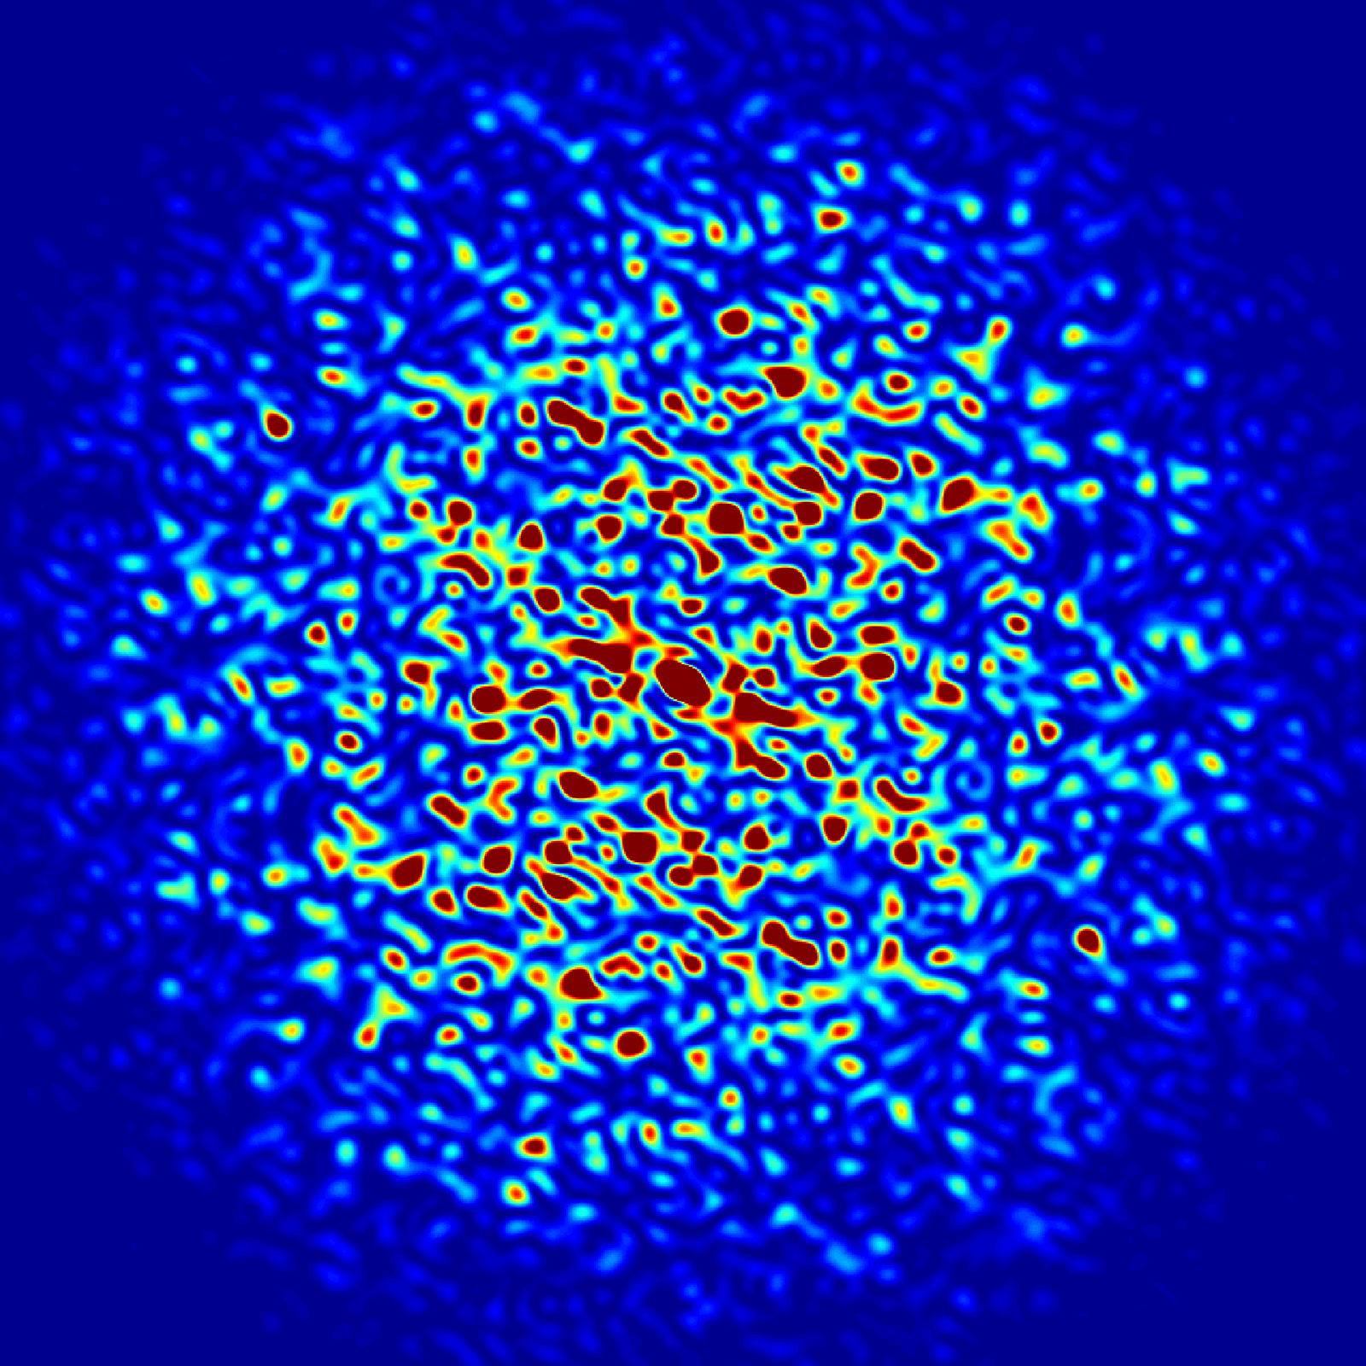
The Hall probe measurement system for the Advanced Photon Source Upgrade dipole magnets*
Charles Doose, Animesh Jain, William Jansma, Mark Jaski, Scott Izzo,
Roberto Lopez, Spiro Skiadopoulos, Venus Apantenco
Argonne National Laboratory
22nd International Magnetic Measurement Workshop (IMMW22)
Campinas, Brazil, September 26-30, 2022 (Virtual)
* Work supported by the US Department of Energy under contract DE-AC02-06CH11357
Notes:
Univ of Chicago Review, Aug. 30, 2010
0

Slide 2
Acknowledgements
Nicholas Bechtold Ralph Bechtold
Gentillo Curescu Evan Carter
Aric Donnelly Michael Johnson
Kris Mietsner Jamal Pegues
Robert Soliday

Slide 3
Introduction
It is planned to upgrade the Advanced Photon Source (APS) currently operating
at Argonne National Laboratory to provide much brighter beams of X-rays
(the APS-U project).
This upgrade requires a completely new lattice using relatively small bore and high field density magnets with 30 µm rms magnet to magnet alignment tolerance.
The 160 main dipole magnets utilize a longitudinal gradient using five separate pole sections per magnet yielding a beam trajectory with a varying bend radius.
Since a single power supply is used for all the dipole magnets, the integrated fields are tuned, during magnetic measurements, using adjustable field clamps.
This presentation describes the Hall probe measurement system, HP1, used to measure and tune these longitudinal gradient dipole magnets.

Slide 4
Outline
Design features of the Hall probe system
Measurement system overview
  Motion stages
  Reference magnet and zero-Gauss chamber
  Hall and NMR probe assembly
  Magnet base
APSU dipole magnet design and pre-survey
Motion vectors, Stage and Magnet frames
Various coordinate transformations
Calibration of B_{x}, B_{y} and B_{z} Hall probe sensitive directions
Measurement sequence
End-field clamp tuning

Slide 5
Design features of the measurement system
Ease of magnet installation without the need for aligning the magnet to the measurement system stage motion. This is accomplished by using “pre-survey” data to define the geometric magnet-frame and creating a survey model of the measurement stage and magnet frames.
Uses a 3-axis Hall probe, Senis F3A type.
Motion of the Hall probe can be specified in either the stage or magnet frames.
Ability to calibrate the Hall probe sensitivity against NMR using the magnet under test
Correct for angular errors of the XYZ individual elements.
Ability to accurately locate the active area of the Hall probe elements using a permanent magnet skew-quadrupole “Reference Magnet”.
A zero-Gauss chamber for measuring the Hall offset prior to measurements.
Perform on-the-fly Hall probe mapping along a grid specified in the magnet-frame.
Instantly calculate the integrated field from one or multiple Hall probe line scans to enable tuning the end-field clamps.

Slide 6
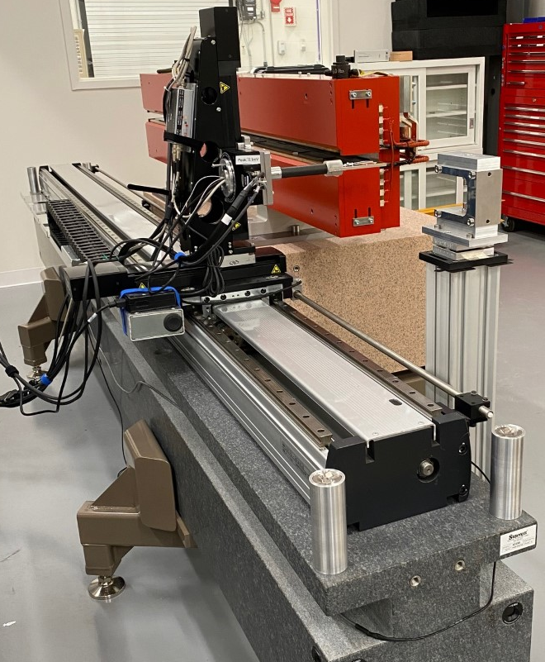
Hall probe system overview
Reference
Magnet
3.5-m Z-stage
200-mm X and Y stages
Rotary stage with Hall/NMR probe assembly
Magnet support base nominally locates
magnet position
Permanent magnet reference
Three SMR nests define stage-frame
Stage origin defined on upstream inboard side
Hall probe motion can be in stage or magnet frame.
Hall probe
Z
Y
X
Stage SMR nests

Slide 7
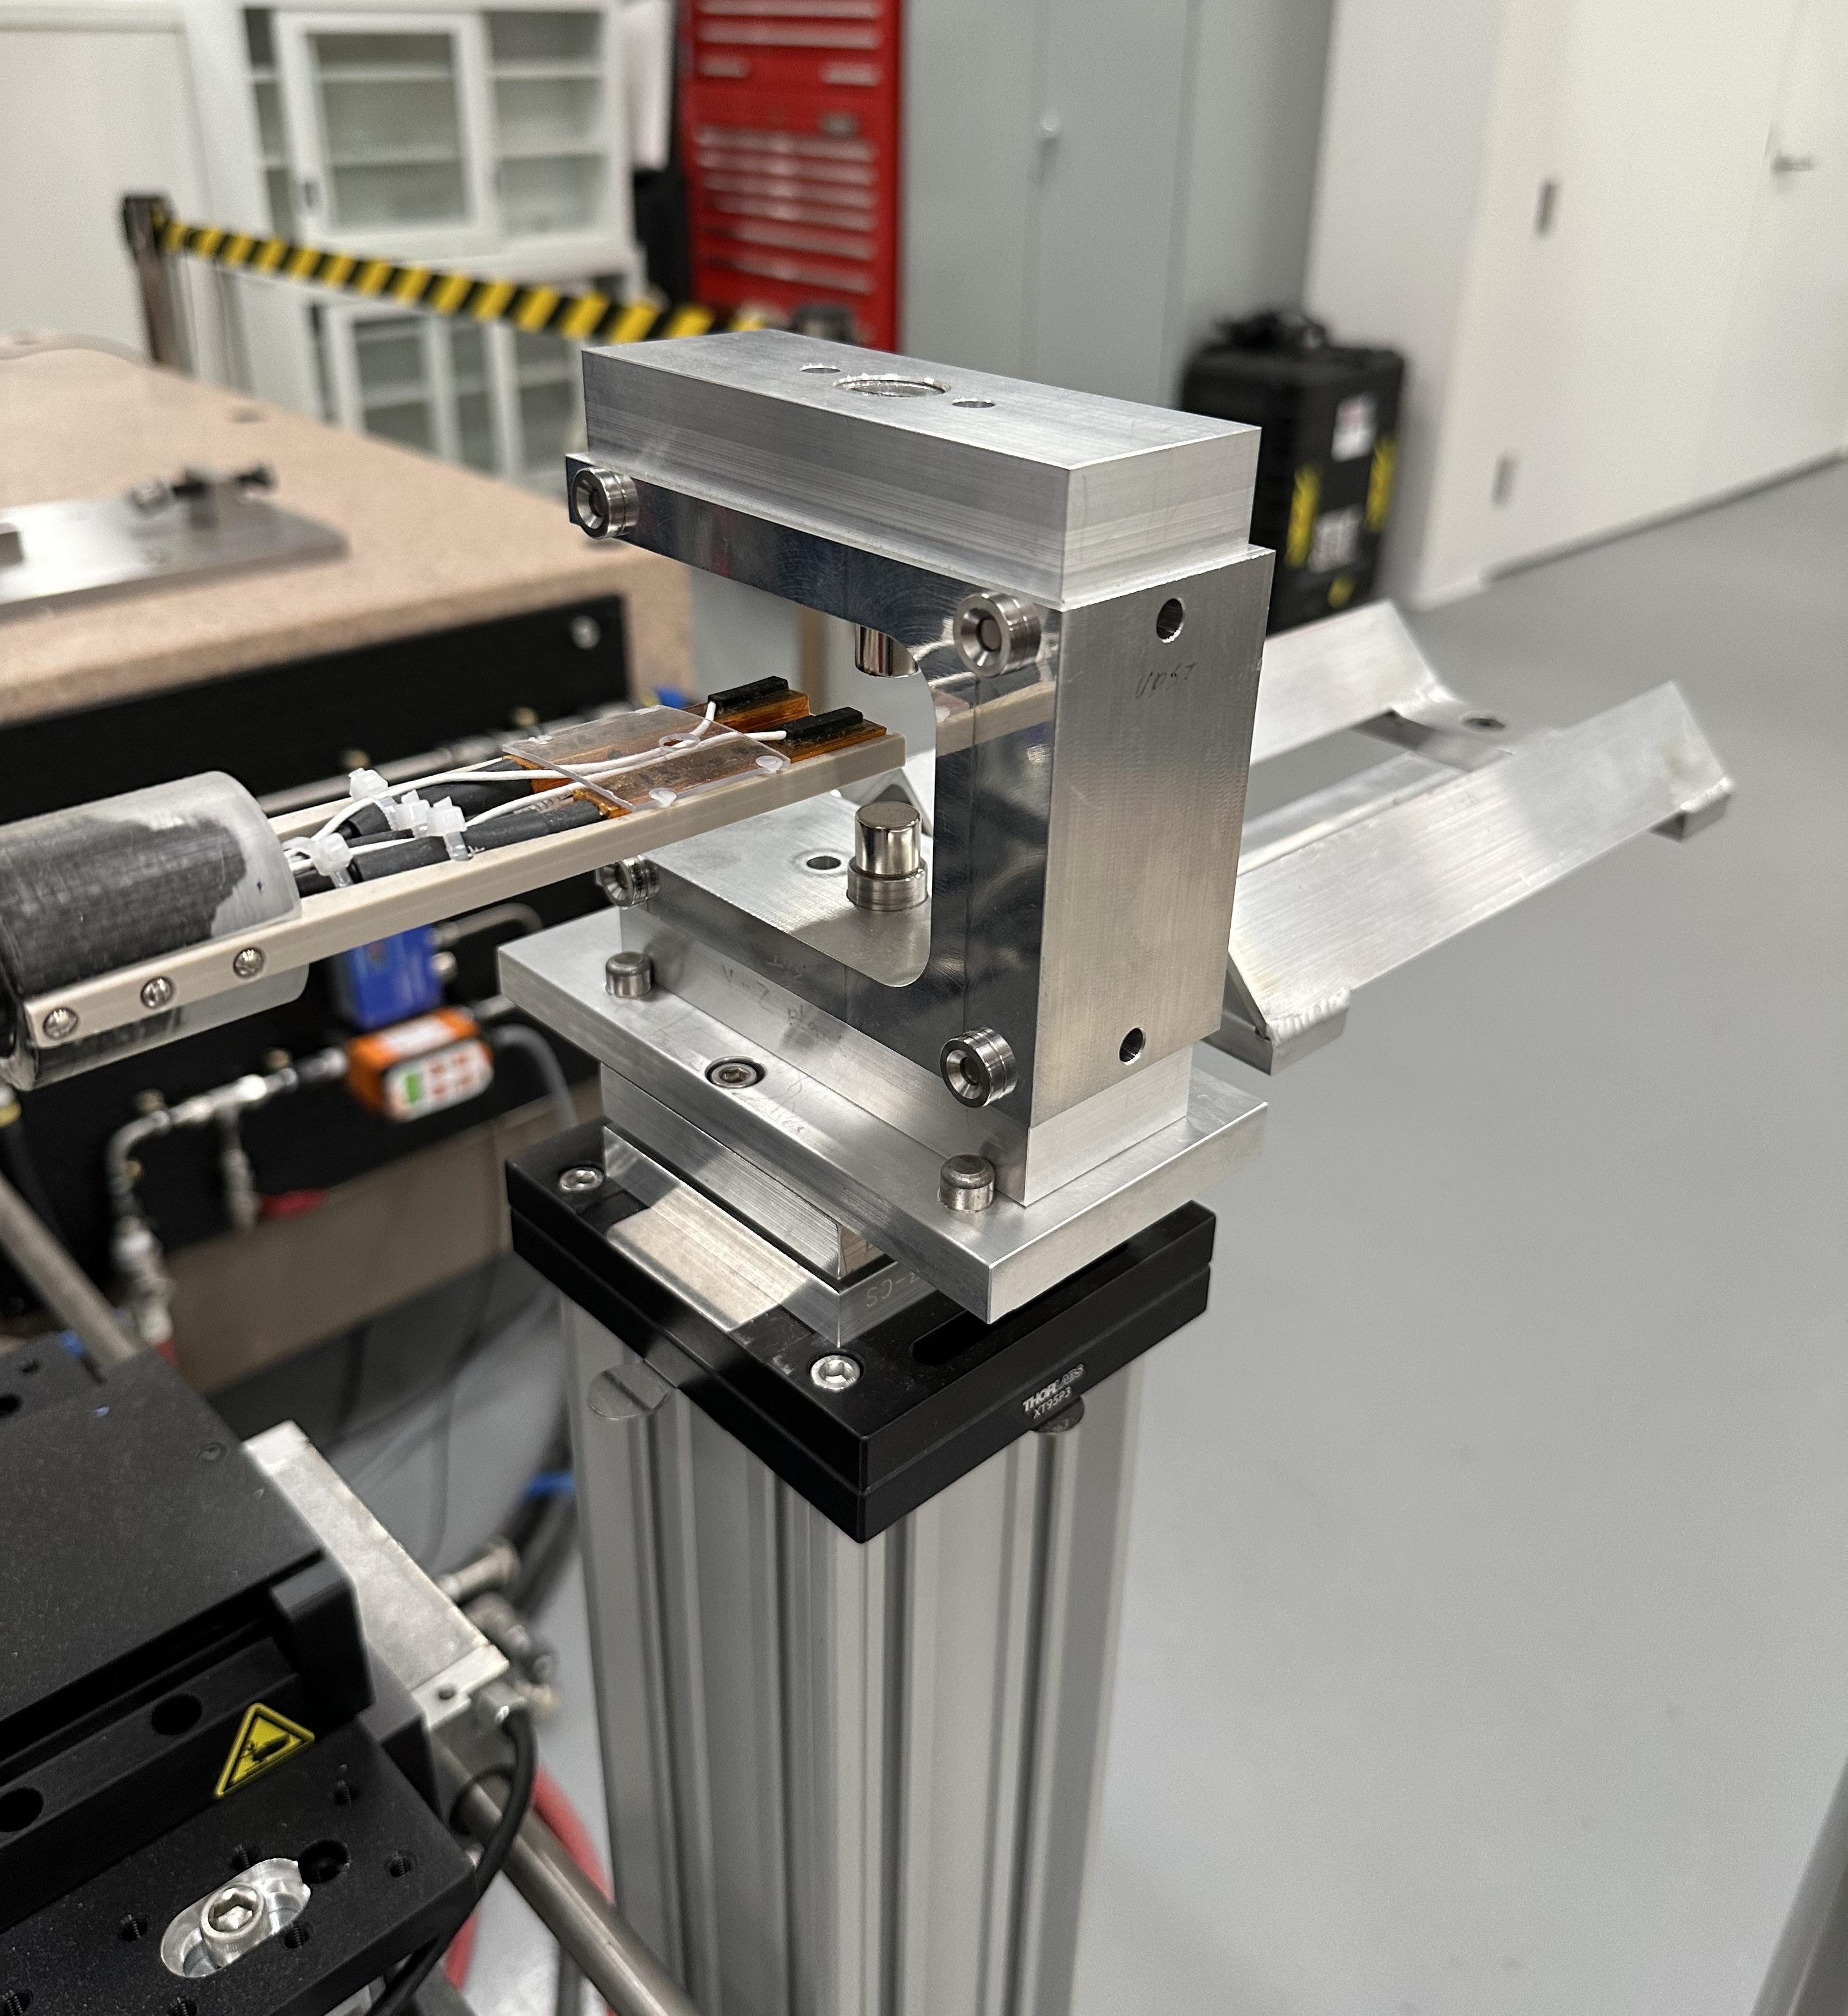
Reference magnet
The reference magnet is used to find the active area of the Hall probe elements in the stage-frame.
It is composed of two cylindrical permanent magnets configured as a skew-quadrupole. The assembly is located with three pins for repeatable location on it’s base.
The assembly was calibrated magnetically and surveyed. The frame contains SMR nests and a model of the nests and derived magnetic center is used for each measurement run.

Slide 8
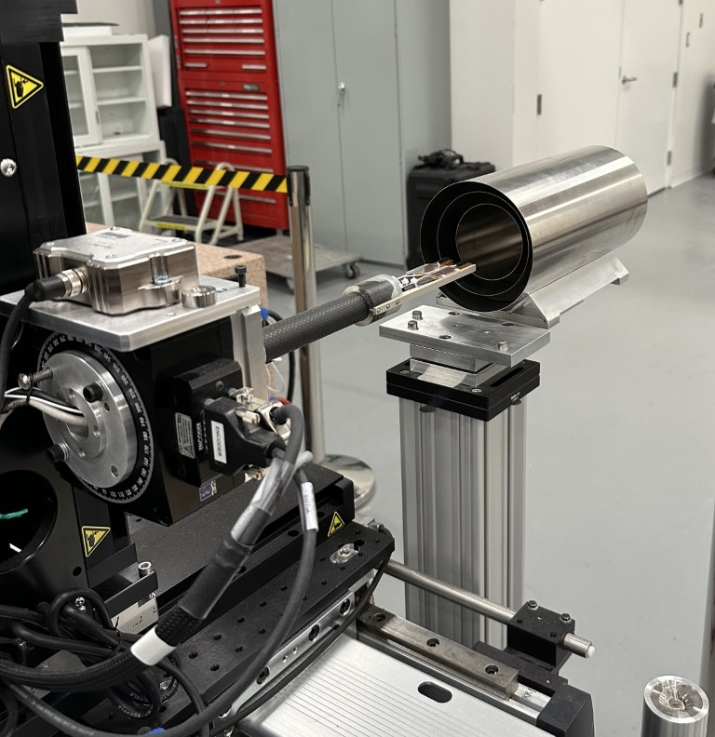
Zero-Gauss chamber
Prior to a measurement run, the reference magnet is removed, and the zero-Gauss chamber is placed on its cradle. The user then initiates a routine that automatically moves the Hall probe into the chamber and the zero offsets are saved to a file.
The chamber is then removed, and the reference magnet is placed back on the kinematic mount.

Slide 9
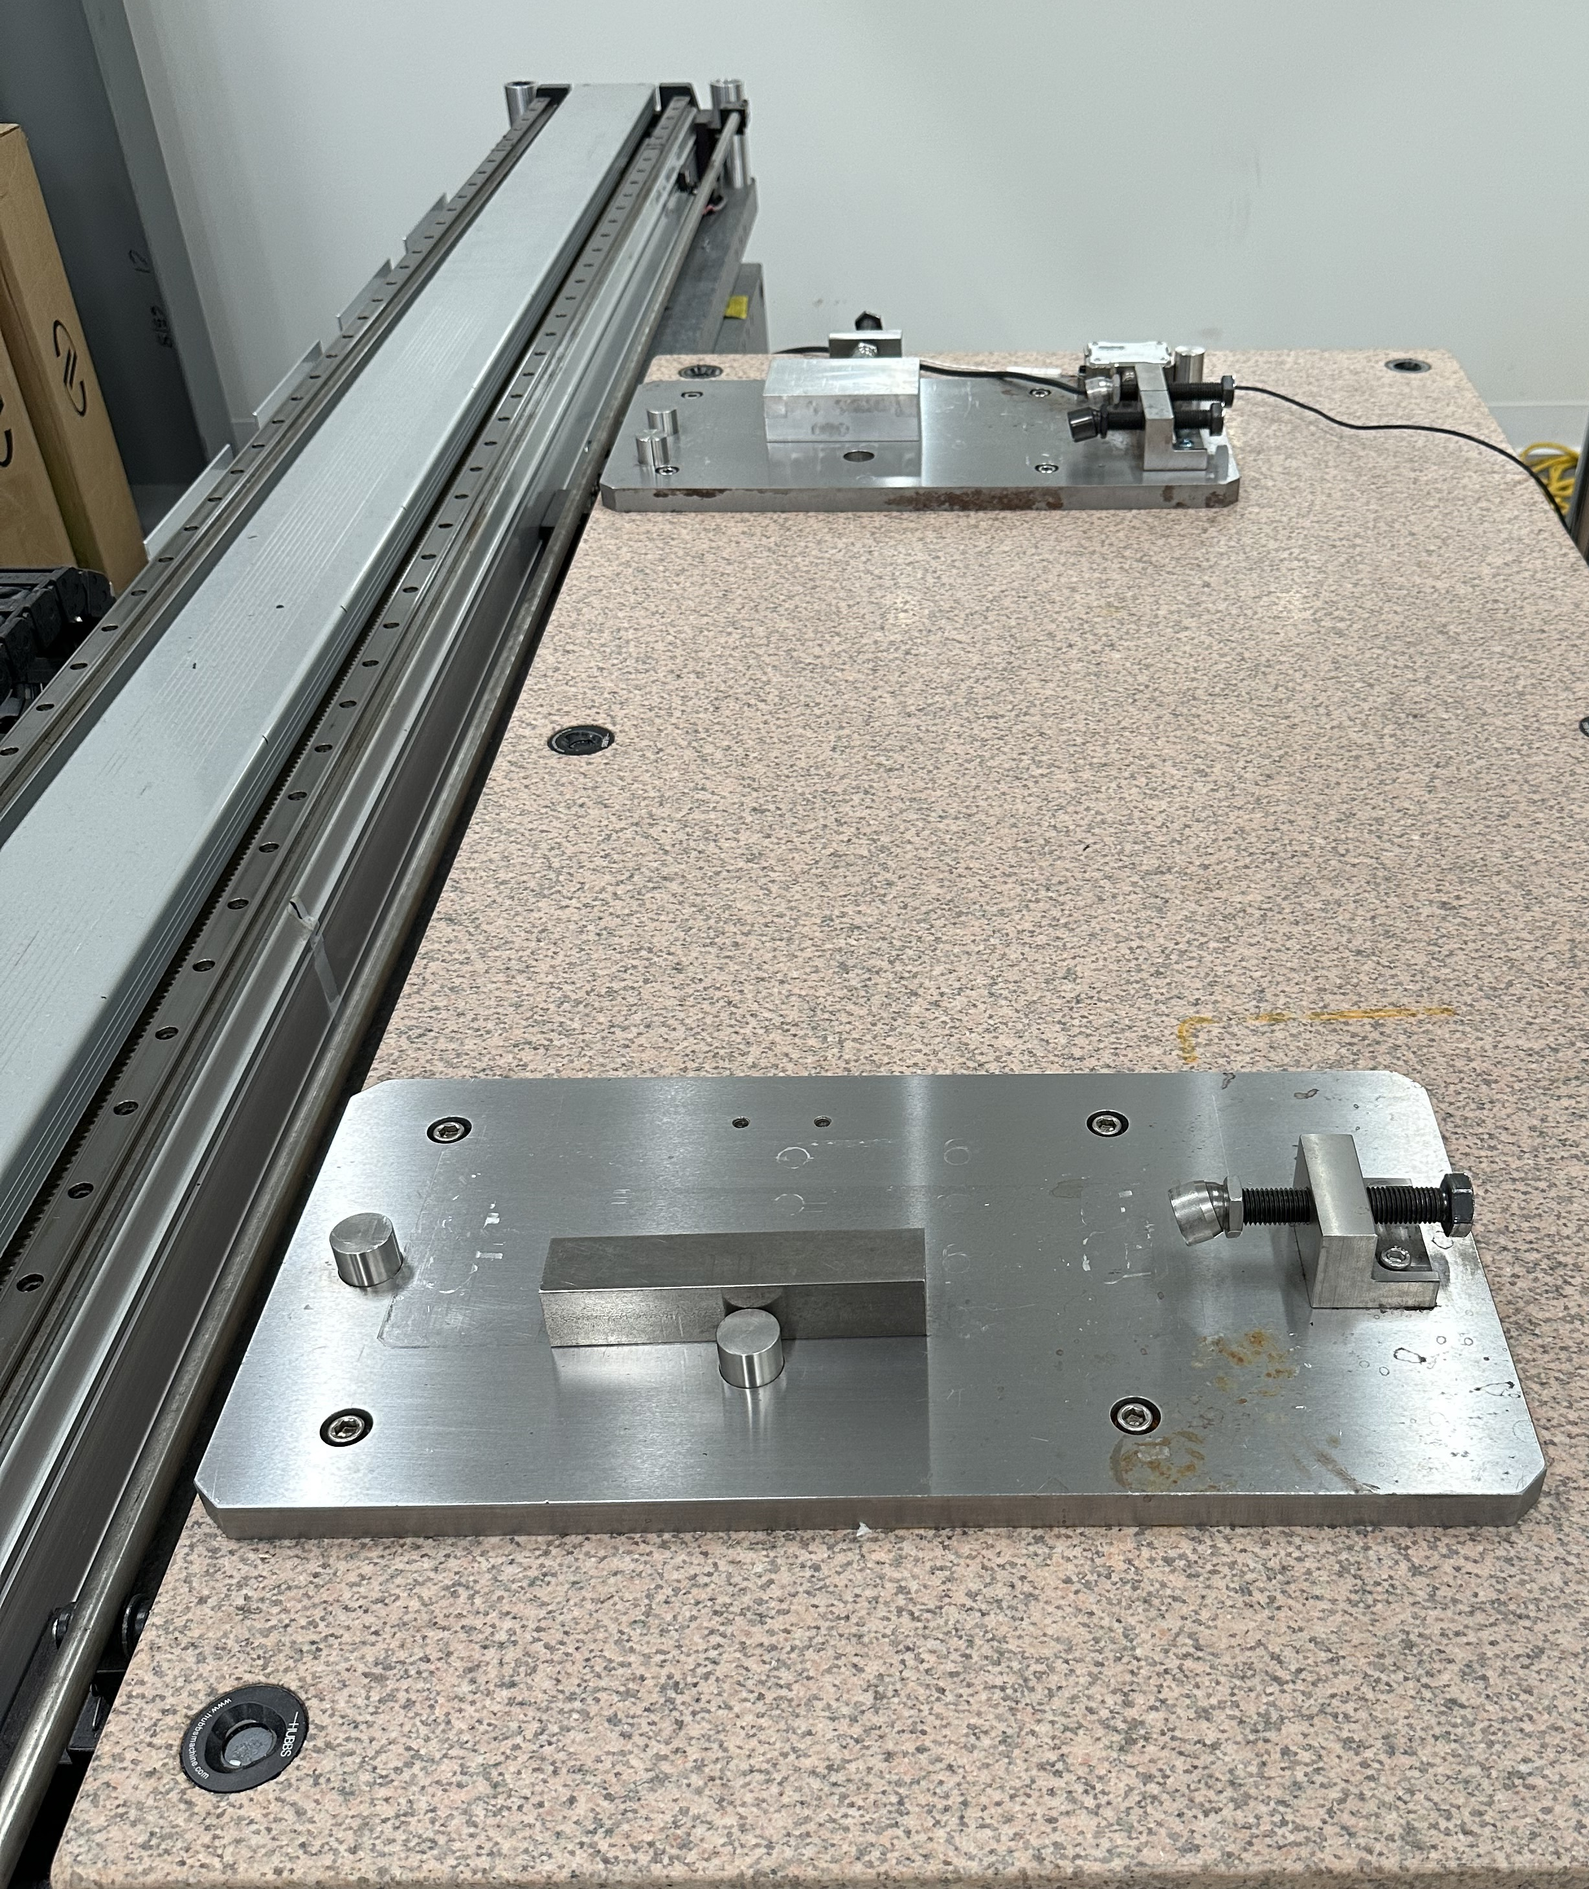
Magnet Base plates
The Magnets were supported on a granite surface plate with pinned steel plates to nominally locate them for measurements.
These plates provided repeatable locations of the magnets but were not designed for adjustment.
Installation of the magnet and survey of the measurement system prior to the Hall probe measurements typically took about one hour.

Slide 10
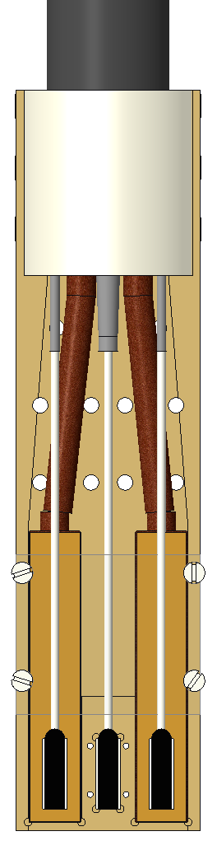
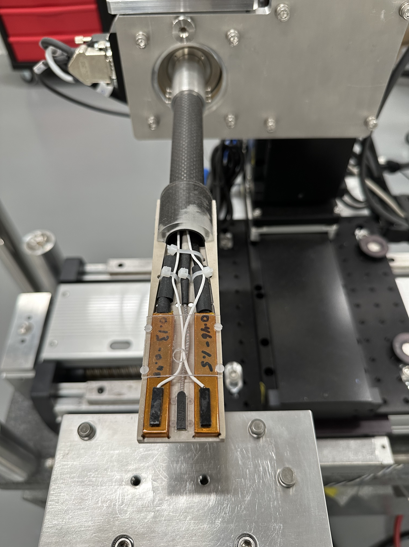
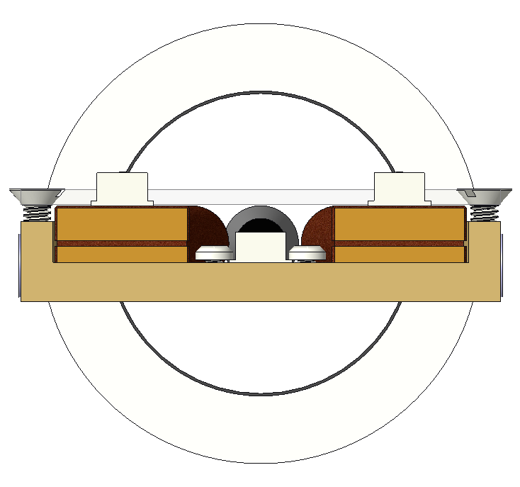
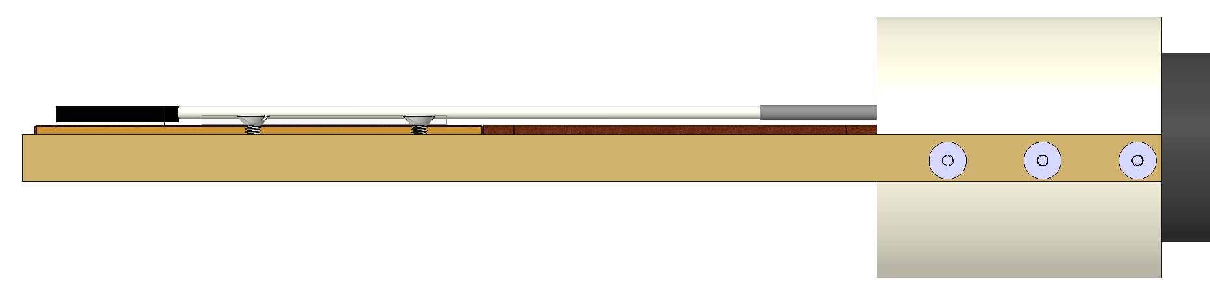
Hall and NMR probe assembly
Multi-piece construction of hall probe mount
3D Hall sensor, Senis F3A, probe center-mounted.
Two NMRs of different field ranges, Metrolab PT2026, used for in-situ calibration of sensitivity.

Slide 11
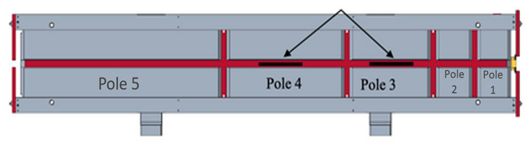
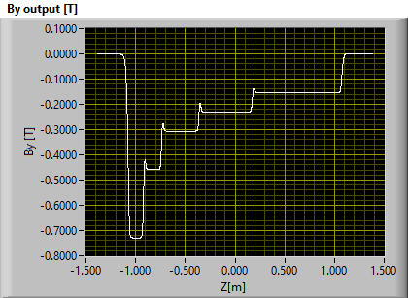
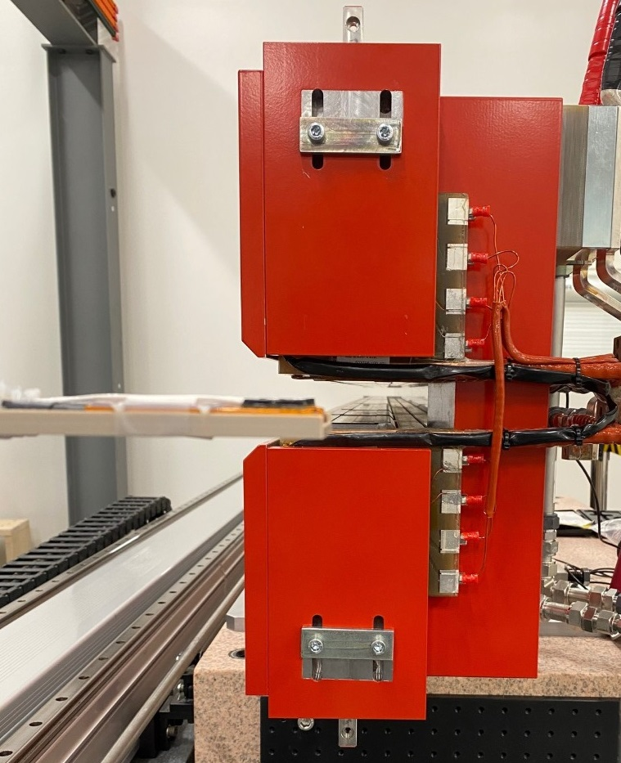
Dipole Magnet design and pre-survey
There are four flavors of APSU dipole magnets. All have five sets of poles with the maximum on-axis field at pole-1 and minimum at pole-5.
The pole gaps are all 28-mm, the coils determine the field strength for each set of poles.
A small SMR was used to map the upper and lower poles using a Laser-Tracker. An average mid-plane was fitted, and a “Magnet Frame” was created based on this. A model of the poles, mid-plane and exterior magnet fiducials was saved and used for magnet measurements and installation.
Typical field plot along magnet axis

Slide 12
Stage and Magnet frames
The magnet-frame was defined during
pre-survey of each magnet.
Pre-survey involved mapping the upper and lower poles, all magnet fiducials, and the upstream and downstream magnet faces. An average mid-plane and geometric center were then derived.
The magnet frame XYZ vectors and origin were defined using the pre-survey data.
Any desired point in the magnet frame was first transformed to the stage-frame and then the Hall probe was moved to that point using the motion vectors.
The stage-frame was defined by fiducials permanently mounted near the corners of the stage support structure.
The stage-frame is a true cartesian coordinate system with the origin placed
at the upstream inboard fiducial point.
The as-built motion of the XYZ stages was calibrated relative to the stage-frame.
The as-built stage motion vectors (not necessarily orthogonal) were used to move the probe to any desired point in the stage coordinate system.

Slide 13
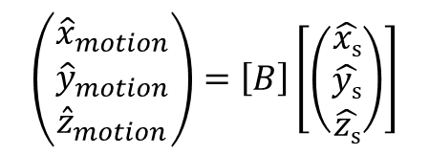



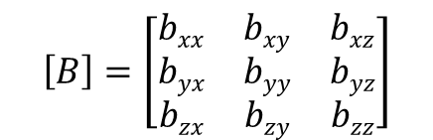
Reaching any arbitrary point in stage coordinates
Components of stage motion unit vectors in stage coordinates:
The [𝐵] matrix is derived from survey data of the as-built motion of the stages in the stage-frame
$$\left(\begin{matrix}{\hat{x}}_{motion} \\ {\hat{y}}_{motion} \\ {\hat{z}}_{motion}\end{matrix}\right)=\left[B\right]\left[\left(\begin{matrix}\hat{xs} \\ \hat{ys} \\ \hat{zs}\end{matrix}\right)\right]$$
$$\left[B\right]=\left[\begin{matrix}bxx & bxy & bxz \\ byx & byy & byz \\ bzx & bzy & bzz\end{matrix}\right]$$
← components of ${\hat{x}}_{motion}$ in stage frame
← components of ${\hat{y}}_{motion}$ in stage frame
← components of ${\hat{z}}_{motion}$ in stage frame
Note: ${\hat{x}}_{motion}$, ${\hat{y}}_{motion}$, ${\hat{z}}_{motion}$ are not necessarily orthogonal!
$$\left(xs,ys,zs\right)=desired point in stage coordinate system$$
$$\left(xr,yr,zr\right)=ref mag center in stage coordinates$$
$$\left(xpc,ypc,zpc\right)=stage encoder values at ref mag center$$
Stage encoder values needed to reach any desired stage coordinates:
The stages can be asked to place the Hall probe at any desired point in space, by knowing the directions of motion of each stage, and the encoder positions when the probe is at the center of the reference magnet.

Slide 14

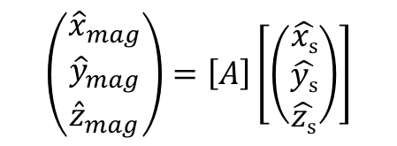
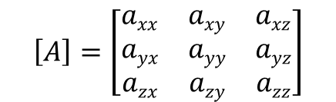

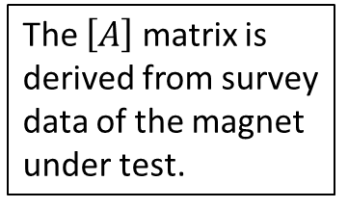

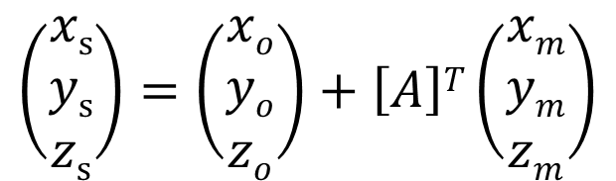
Conversion between magnet and stage coordinates
Components of Magnet Frame unit vectors in stage coordinates:
$$\left(\begin{matrix}{\hat{x}}_{mag} \\ {\hat{y}}_{mag} \\ {\hat{z}}_{mag}\end{matrix}\right)=\left[A\right]\left[\left(\begin{matrix}\hat{xs} \\ \hat{ys} \\ \hat{zs}\end{matrix}\right)\right]$$
The $\left[A\right]$ matrix is derived from survey data of the magnet under test.
$$\left[A\right]=\left[\begin{matrix}axx & axy & axz \\ ayx & ayy & ayz \\ azx & azy & azz\end{matrix}\right]$$
← components of ${\hat{x}}_{mag}$ in stage frame
← components of ${\hat{y}}_{mag}$ in stage frame
← components of ${\hat{z}}_{mag}$ in stage frame
$$\left(xo,yo,zo\right)=magnet center in stage coordinates$$
$$\left(xm,ym,zm\right)=desired point in magnet coordinate system$$
Stage coordinates corresponding to any desired magnet coordinates:
The stages can be asked to place the Hall probe at any desired point in the magnet frame using this transformation, and the equations on the previous slide.
Conversely, any set of encoder positions can be converted into either the stage frame coordinates or the magnet frame coordinates using reverse transformations.
$$\left(\begin{matrix}xs \\ ys \\ zs\end{matrix}\right)=\left(\begin{matrix}xo \\ yo \\ zo\end{matrix}\right)+\left[A\right]T\left(\begin{matrix}xm \\ ym \\ zm\end{matrix}\right)$$

Slide 15
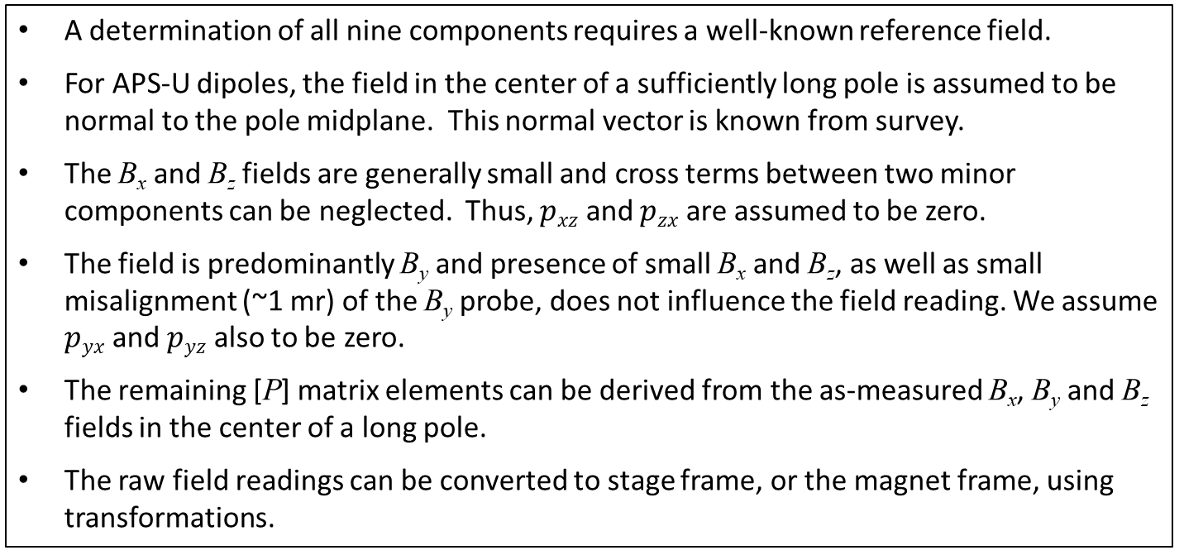
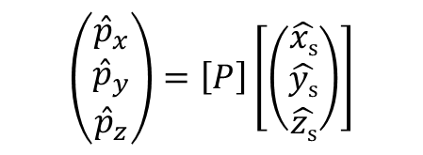
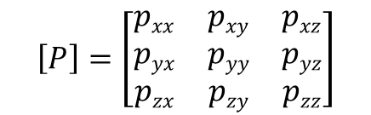

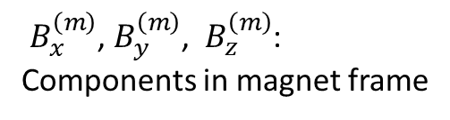



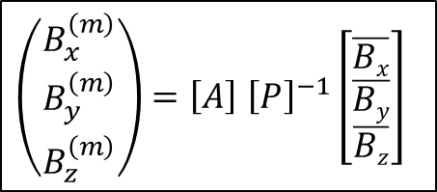
Hall probe sensitive directions
The B_{x}, B_{y} and B_{z} probes measure fields along respective vectors ${\hat{p}}_{x}$, ${\hat{p}}_{y}$ and ${\hat{p}}_{z}$:
$$\left(\begin{matrix}{\hat{p}}_{x} \\ {\hat{p}}_{y} \\ {\hat{p}}_{z}\end{matrix}\right)=\left[P\right]\left[\left(\begin{matrix}\hat{xs} \\ \hat{ys} \\ \hat{zs}\end{matrix}\right)\right]$$
$$\left[P\right]=\left[\begin{matrix}pxx & pxy & pxz \\ pyx & pyy & pyz \\ pzx & pzy & pzz\end{matrix}\right]$$
← components of ${\hat{p}}_{x}$ in stage frame
← components of ${\hat{p}}_{y}$ in stage frame
← components of ${\hat{p}}_{z}$ in stage frame
A determination of all nine components requires a well-known reference field.
For APS-U dipoles, the field in the center of a sufficiently long pole is assumed to be normal to the pole midplane. This normal vector is known from survey.
The B_{x} and B_{z} fields are generally small and cross terms between two minor components can be neglected. Thus, $pxz$ and $pzx$ are assumed to be zero.
The field is predominantly B_{y} and presence of small B_{x} and B_{z}, as well as small misalignment (~1 mr) of the B_{y} probe, does not influence the field reading. We assume $pyx$ and $pyz$ also to be zero.
The remaining [P] matrix elements can be derived from the as-measured B_{x}, B_{y} and B_{z} fields in the center of a long pole.
The raw field readings can be converted to stage frame, or the magnet frame, using transformations.
Conversion directly from raw-field readings to magnet-frame:
$\left(\begin{matrix}B_{x}^{\left(m\right)} \\ B_{y}^{\left(m\right)} \\ B_{z}^{\left(m\right)}\end{matrix}\right)=\left[A\right]$ ${\left[P\right]}^{−1}\left[\begin{matrix}\overline{Bx} \\ \overline{By} \\ \overline{Bz}\end{matrix}\right]$
$\overline{B_{x}}$, $\overline{B_{y}}$ and $\overline{B_{z}}$ : raw readings
$B_{x}^{\left(m\right)}$, $B_{y}^{\left(m\right)}$, $B_{z}^{\left(m\right)}$:
Components in magnet frame

Slide 16
Typical measurement sequence
The magnet and stage system were surveyed to determine the magnet vectors in the stage-frame.
Hall probe zero offset was performed.
Hall probe sensitivity and calibration matrix were determined
Reference magnet center was measured magnetically
Magnet current was cycled and set to a previously determined nominal measurement value
One on-axis Z-scan was performed at the nominal current, the results determined how much the field clamp needed to be adjusted.
After the field clamp was tuned, a series of Z-scans at many X-positions were performed at the nominal current and ±5% of nominal.
Measurements were also performed energizing the 1st and 2nd field integral correction coils.
Typical total measurement time was five hours per magnet.

Slide 17
Integrated field tuning with field clamps
The integrated field was adjusted by changing the gap between steel field-clamps on the ends of the yoke.
After an initial Z-scan was performed the required change in the field-clamp gap was calculated based on the difference between the measured and desired integrated field strength.
Typically, only one iteration of adjusting the high-field end clamps was required to obtain the required integrated field.
Field-clamps
with fixing screws

Slide 18
Integrated field errors in M2 dipoles

Slide 19
Summary
The upgrade of APS at Argonne will require measurements of 1355 magnets for the new storage ring, including 160 longitudinal gradient dipoles of four different flavors.
A new Hall probe-based system was designed and built to measure and fiducialize these dipole magnets.
The Hall probe system was designed such that a precise alignment of the magnet relative to the measurement stages was not required. The motion of the Hall probe was corrected using motion vectors and transformations between the stage-frame and the magnet-frame.
The sensitivity (magnitude and direction) of the Hall probe elements were calibrated in-situ prior to performing measurements of each magnet.
The integrated field strengths of the dipole magnets were tuned to within ±0.05% of the desired value.
All of the 160 dipole magnets were measured over a 20-month time period from January 2021
to August 2022. The system performed flawlessly throughout the measurement campaign.

