Slide 1

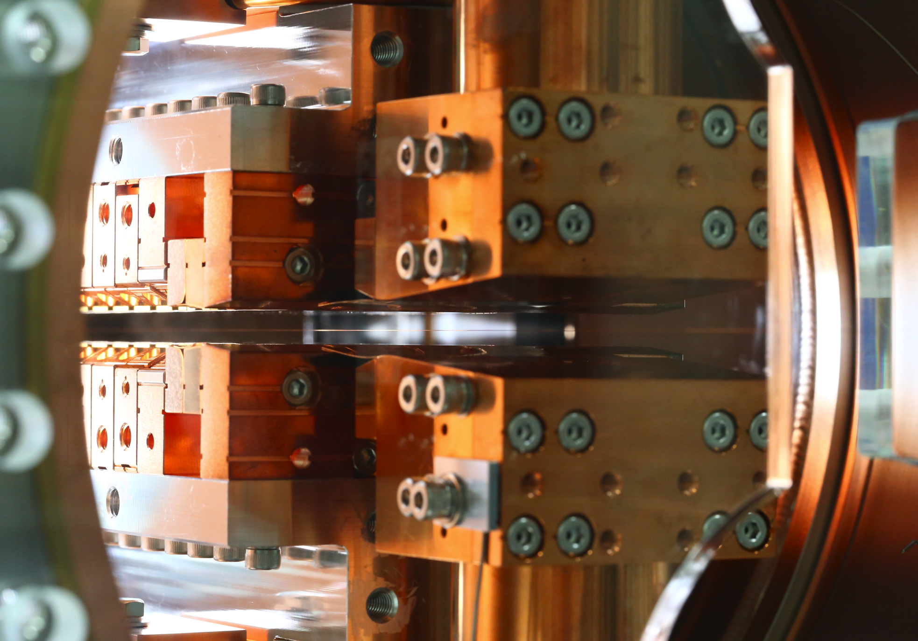
Pulsed wire magnetic field measurement system for in-vacuum undulator
C.W. Chen, H. Chen, J.C. Huang, C.S. Hwang
22nd International Magnetic Measurement Workshop (IMMW22)

Slide 2
Outline
Introduction
Pulsed wire system composition
(1) Wire tension , (2) Wire sag measurement,
(3) Wire-displacement Detection system,
(4) Current pulse circuit , (5) Oil damper
Pulsed wire system for magnetic-field measurements
Summary

Slide 3
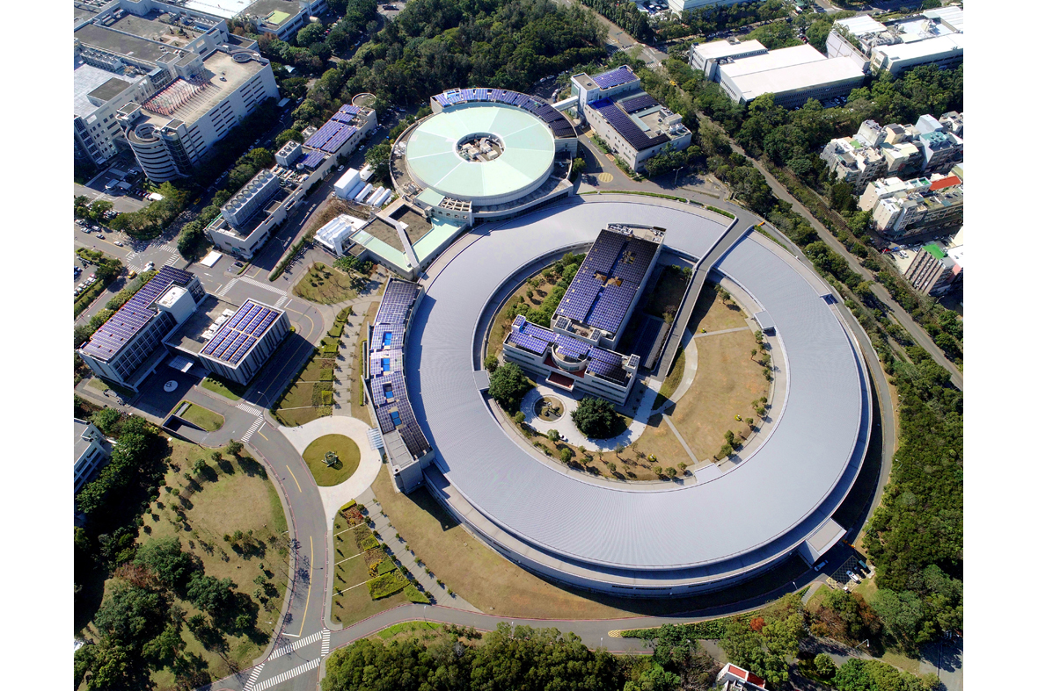
Aerial view of NSRRC
Taiwan Light Source
(TLS)
Taiwan Photon Source
(TPS)
Ref. https://www.nsrrc.org.tw/NsrrcWebSystem/UPLOADS/CHINESE/IMAGES/9/05f0058a5c.jpg

Slide 4
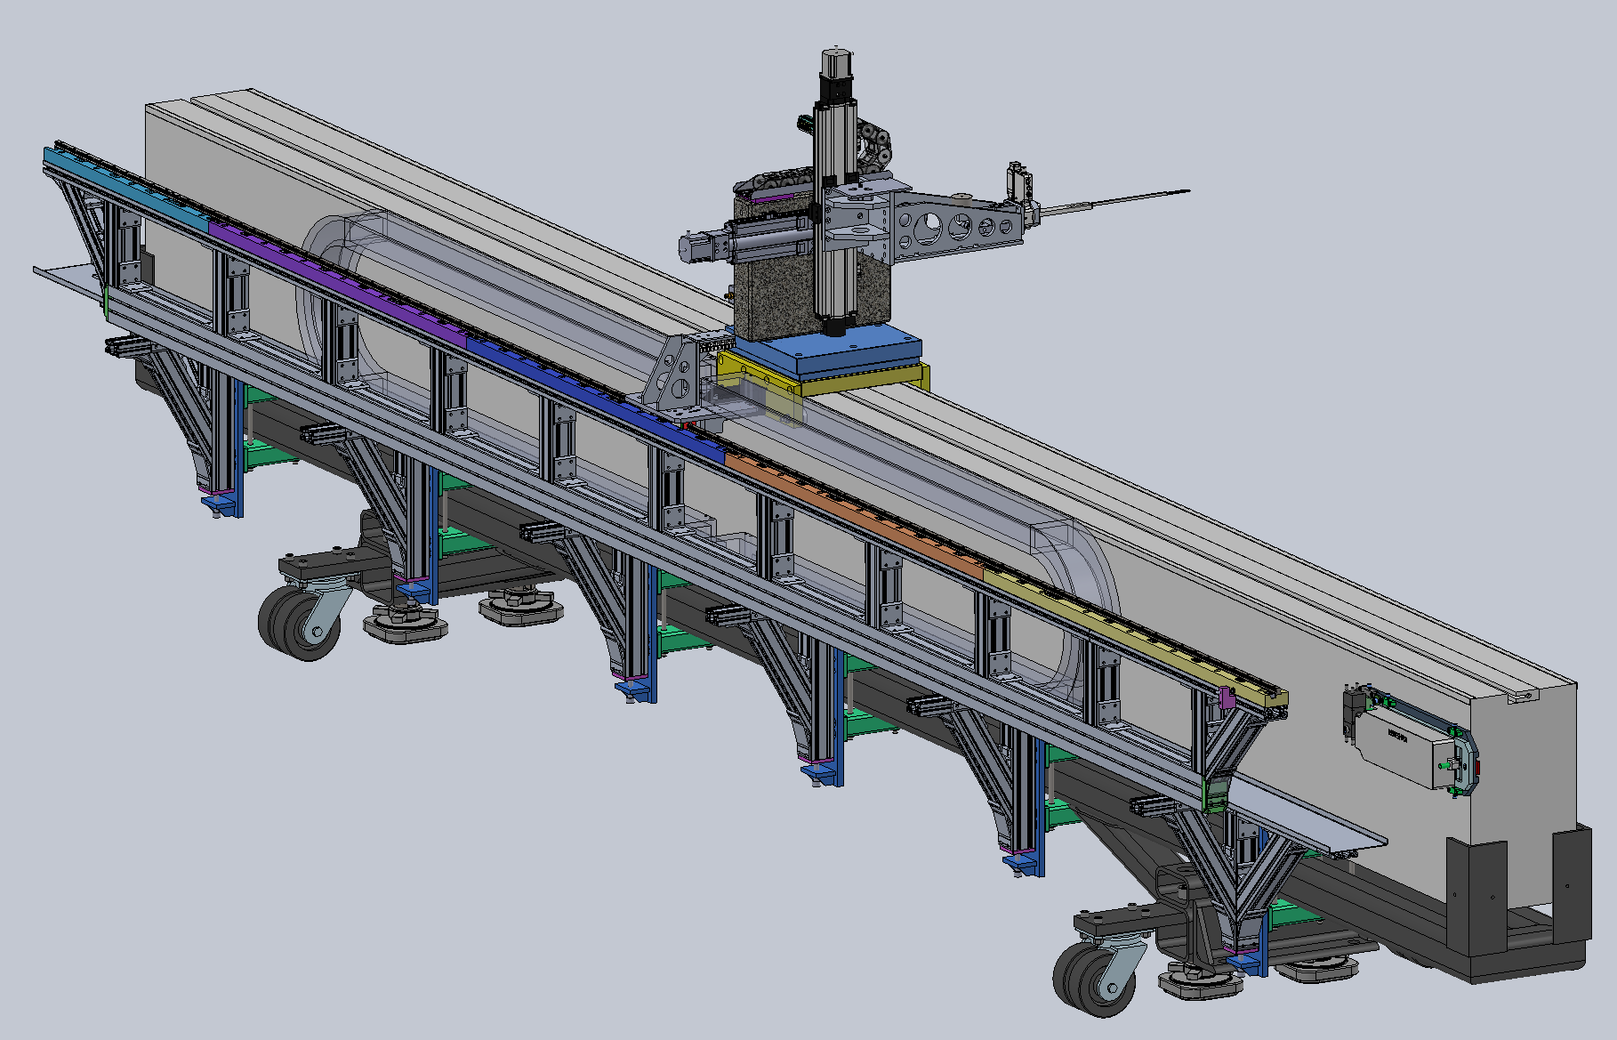
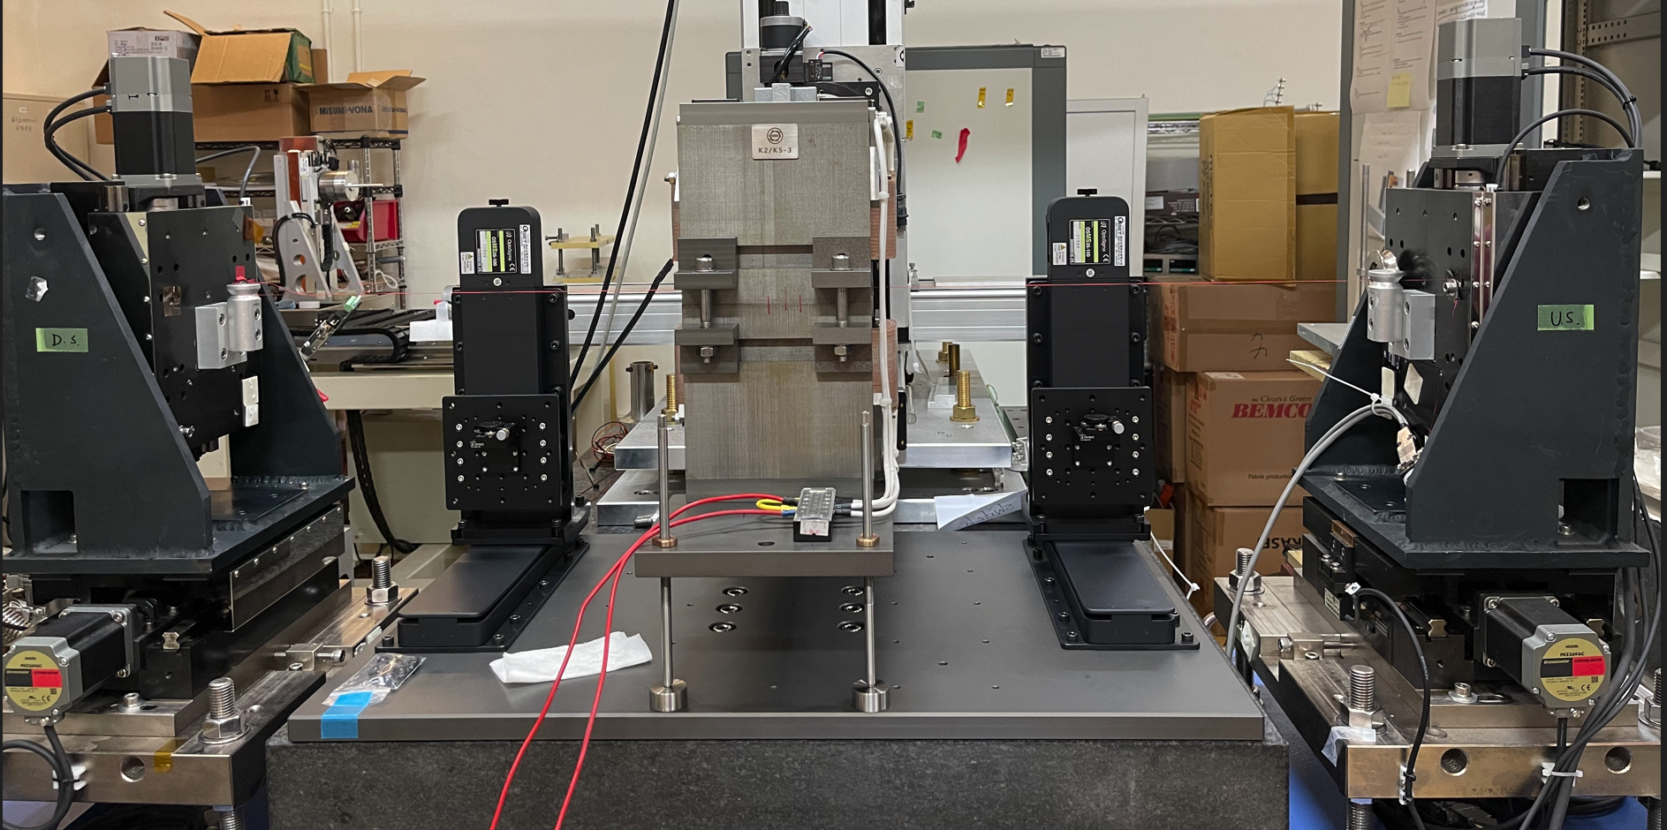
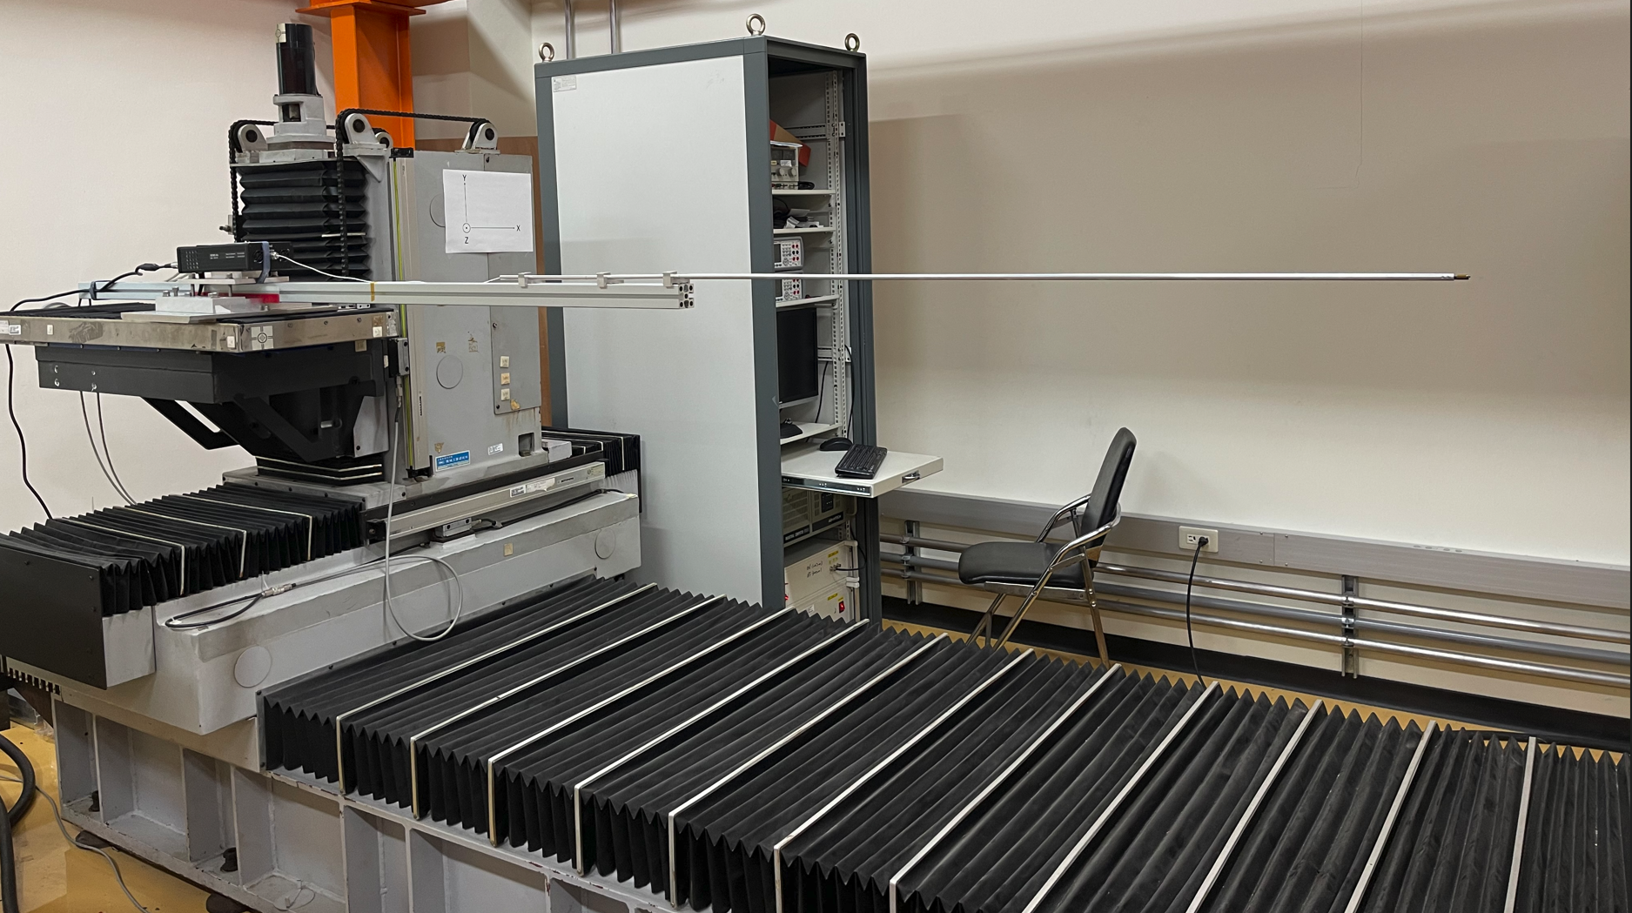
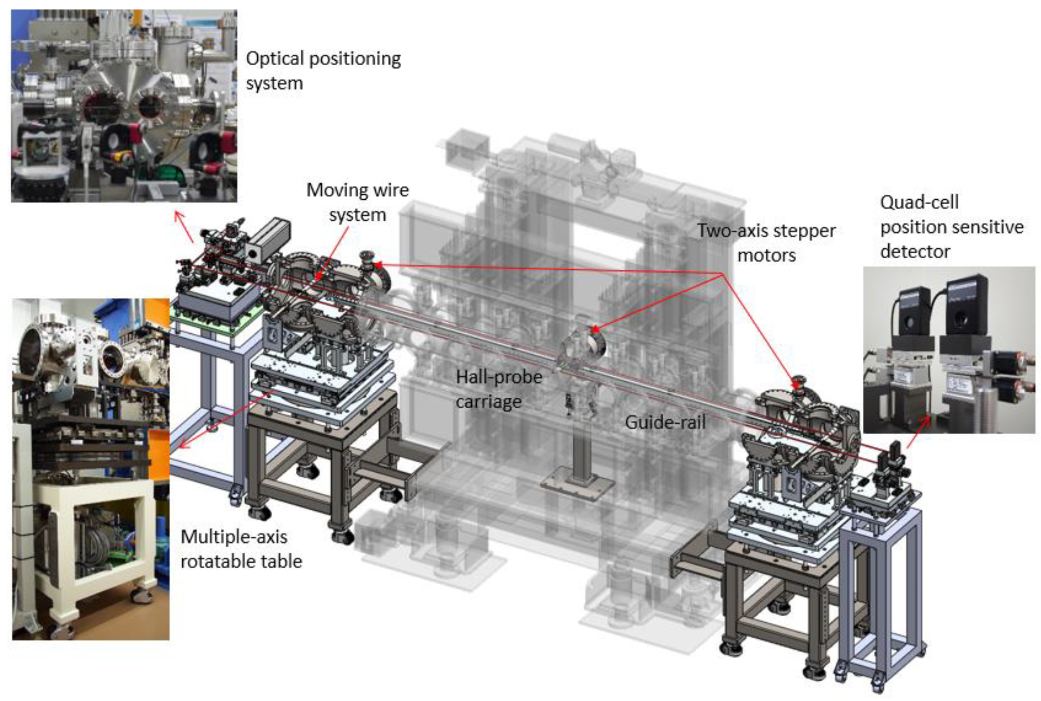
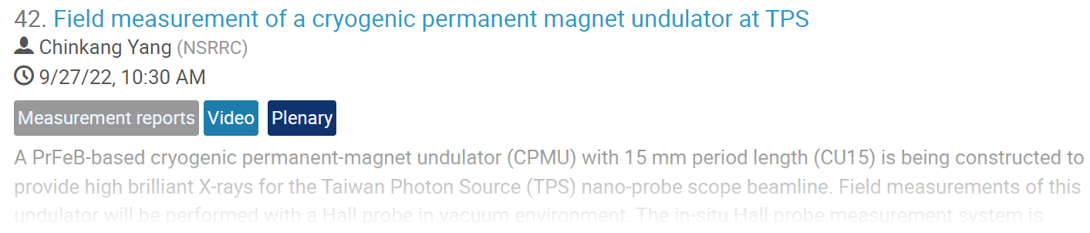
Magnetic Field Measurement Technology in NSRRC
(1) Hall probe measurement bench for insertion devices
long bench (5.5m)
Hall probe
(3) Stretch wire system
2
Rotation Stage
8 turns BeCu wire
Linear Stages
3
Granite platform
Motorized stage
Cable trunking
Interferometer
4
magnet
1
(2) Hall probe measurement bench for accelerator magnets
(4) In-situ field measurement system
Hall probe
XYZ Motorized stage

Slide 5
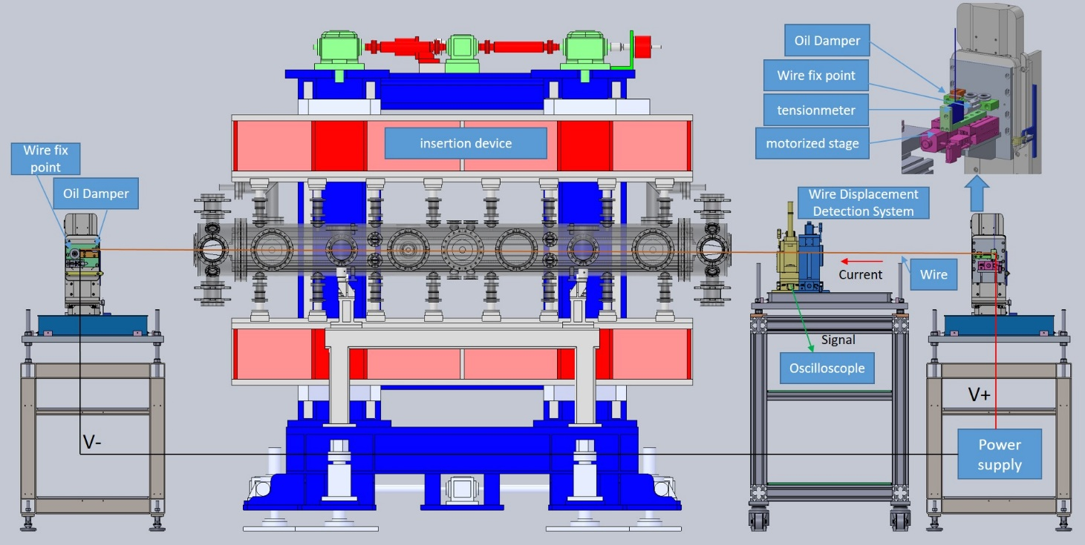
Pulsed wire system composition

Slide 6
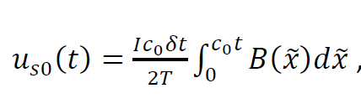
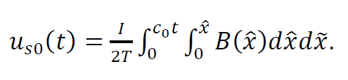

Pulsed wire measurement(PWM) system
Fast measurement
Magnet alignment
First and second Field integral measurements
Local field measurement (Similar to Hall probe)
Theory
Lorentz Force
General traveling wave
From Warren (1988)
Ref. 1. T.C. Fan, F.Y. Lin, C.S. Hwang and Ian C. Hsu, “Pulsed wire magnetic field measurements on undulator U10P”, Proceedings of the 2001 Particle Accelerator Conference, Chicago
2. R.W. Warren. “Limitations on the use of the pulsed-wire field measuring technique”, Nuclear Instruments and Methods in Physics Research Section A, Vol.272, 257-263 (1988)

Slide 7
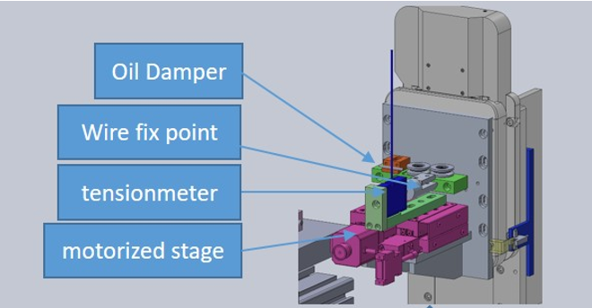
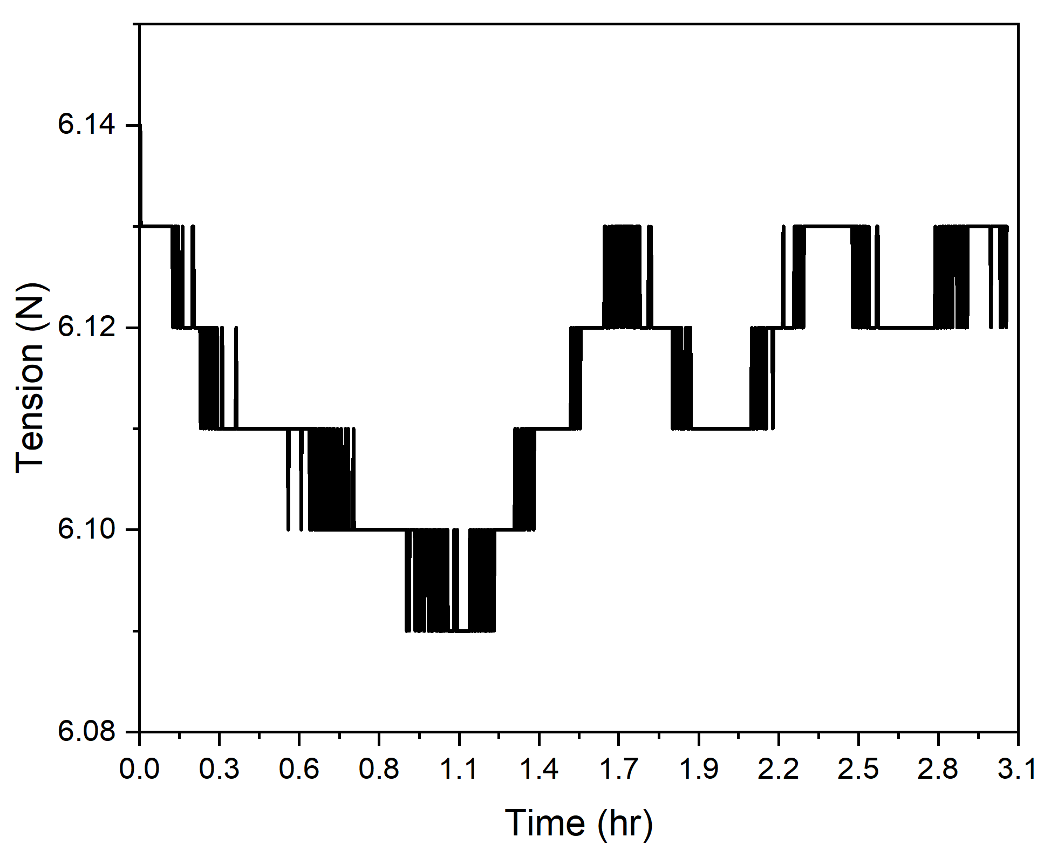
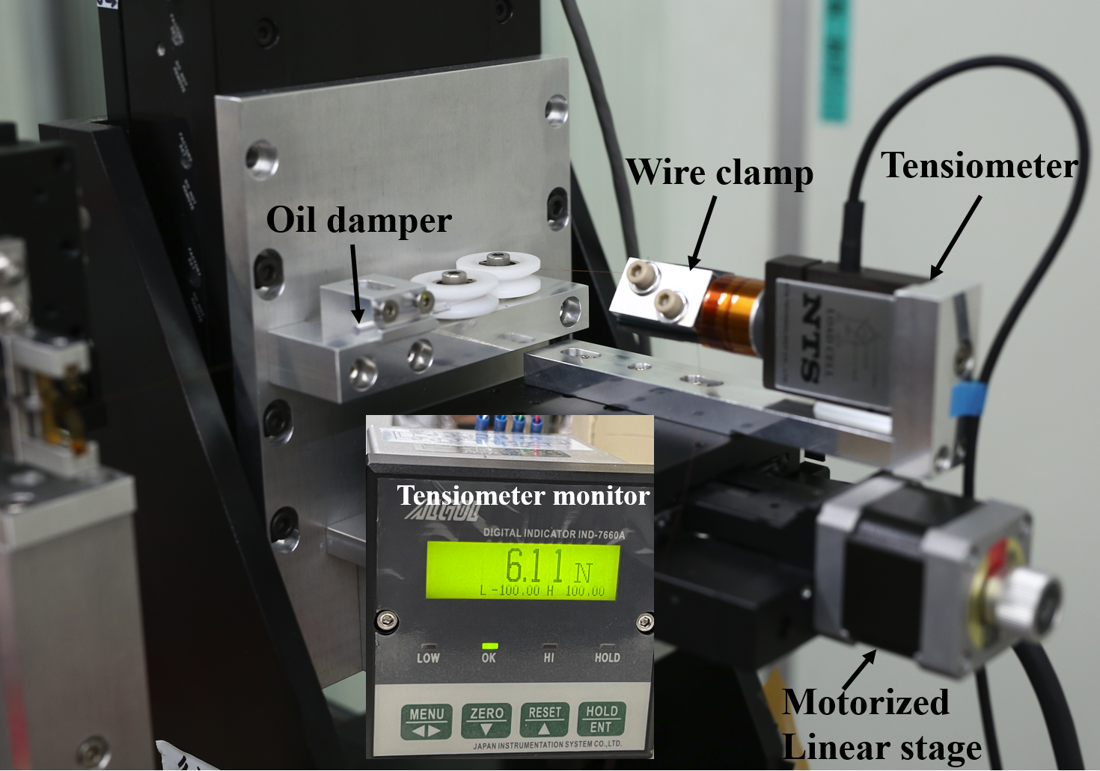
Tension
1. wire on one side is fixed at a clamp to connect the tensiometer
2. tensiometer is mounted on a motorized stage to control the wire tension.
3. test wire clamp
wire tension varies by ±0.02N

Slide 8
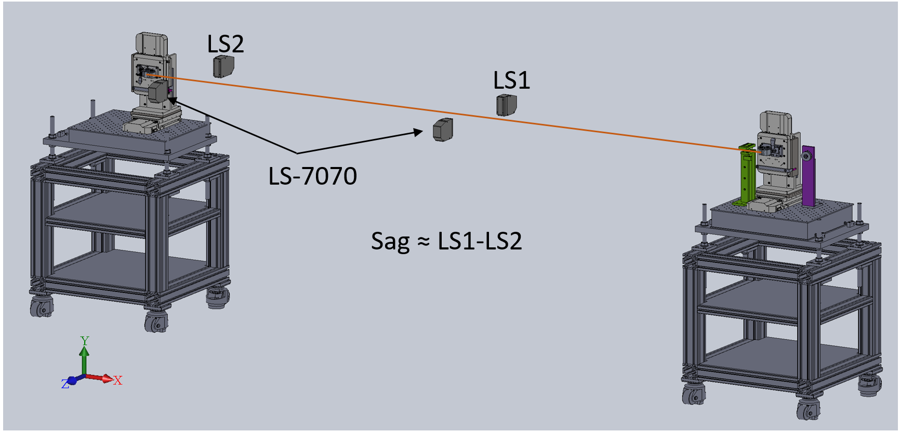
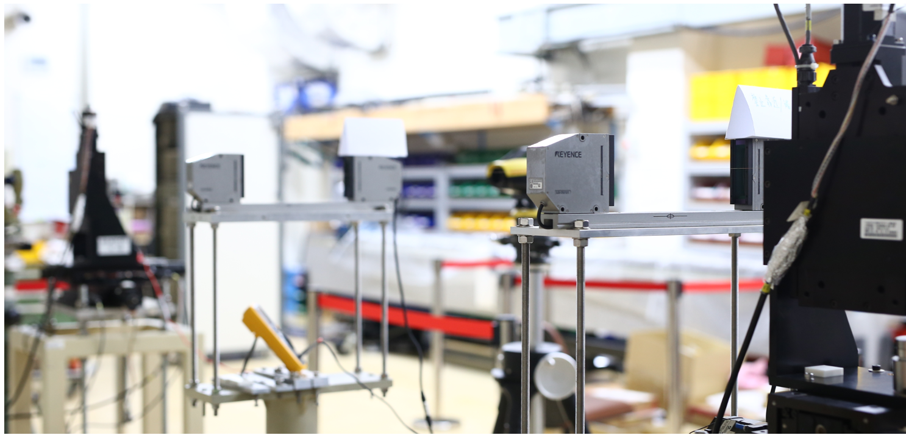
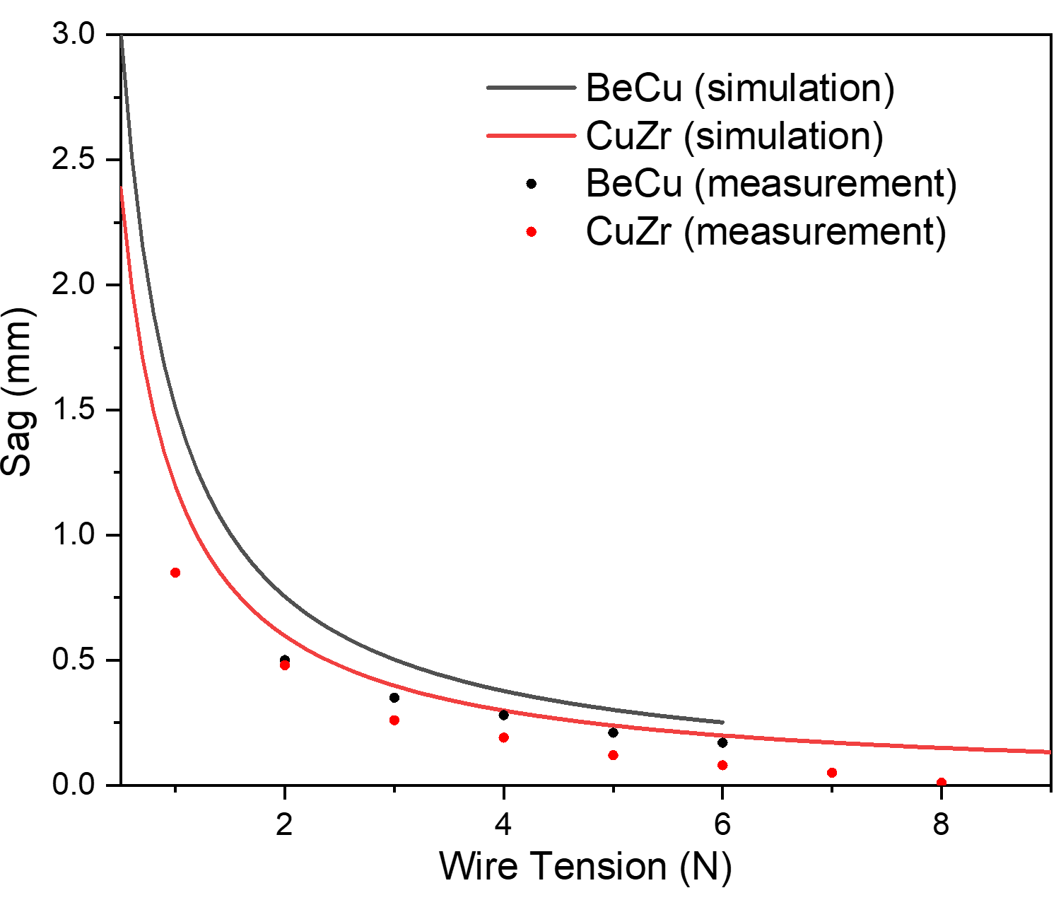
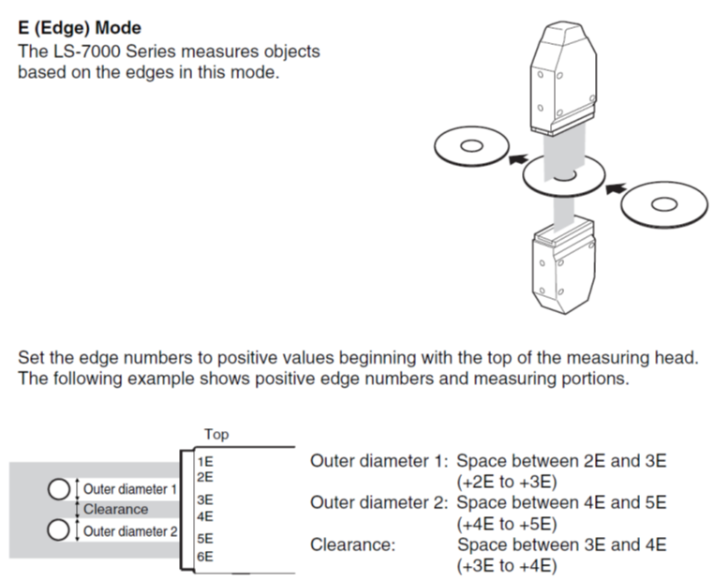
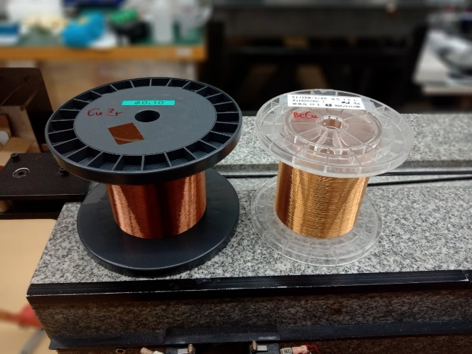
Wire sag measurement
LS1
LS2
LS7070 : High-speed, High-accuracy Digital Micrometer
Wire length : 4m
Wire diameter : 100μm
CuZr
BeCu
The relative amount of wire sag is determined by LS2-LS1.
The sag of a CuZr wire is smaller than that of a BeCu wire under the same conditions.

Slide 9
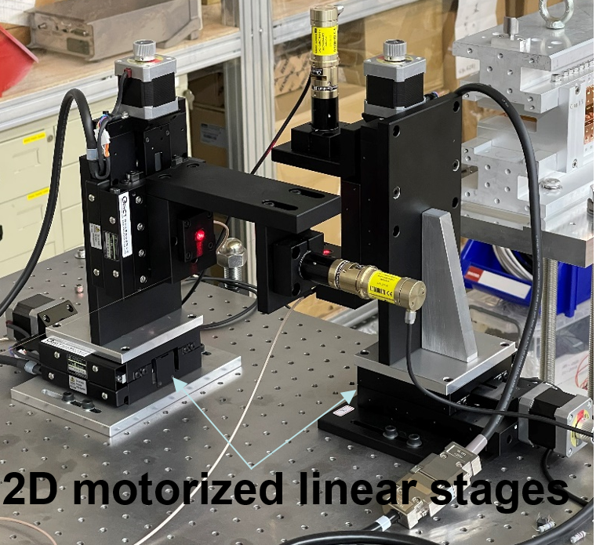
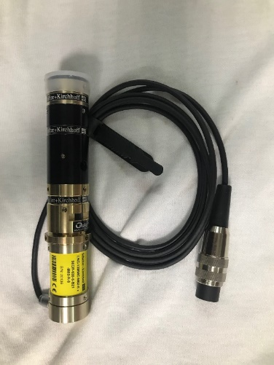
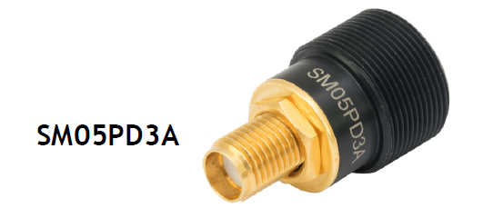
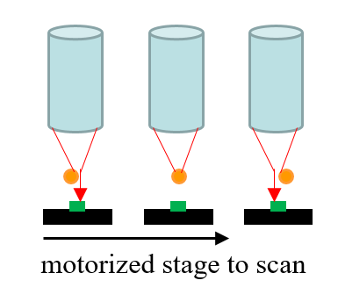
Wire-displacement Detection System
LNC-13MMC, 633 mm,
Schäfter+Kirchhoff GmbH
Photodiode
Diode Laser
1. laser beam focused on the wire
2. photodiode is installed on the opposite side of the laser to detect the light intensity that is not blocked by the wire
Laser
Wire
photodiode
These slopes with values around 0.25V/μm are the transfer coefficient of voltage and wire displacement

Slide 10
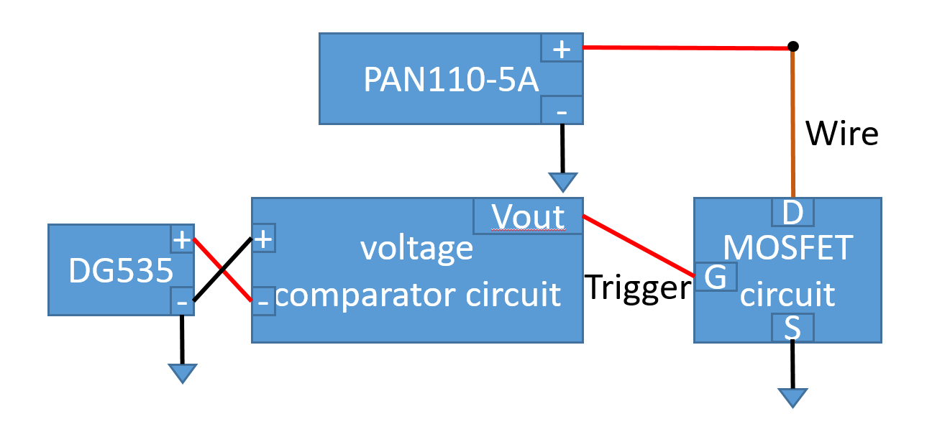
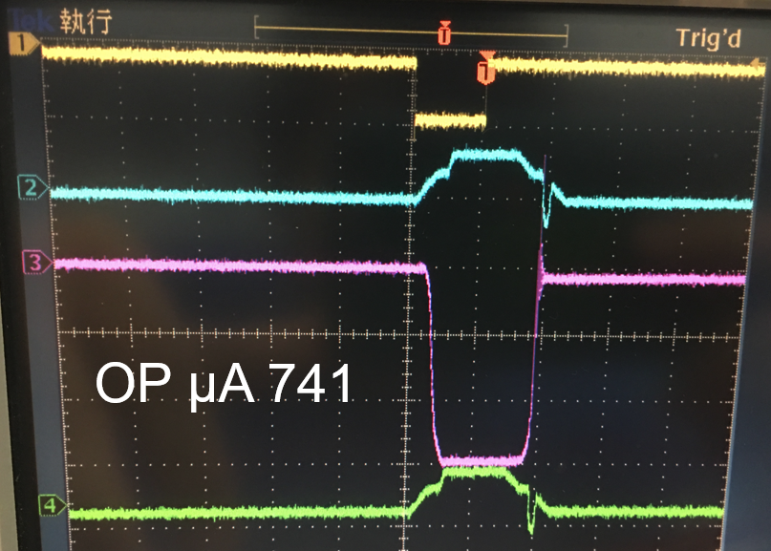
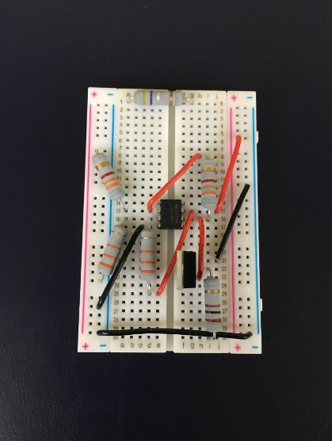
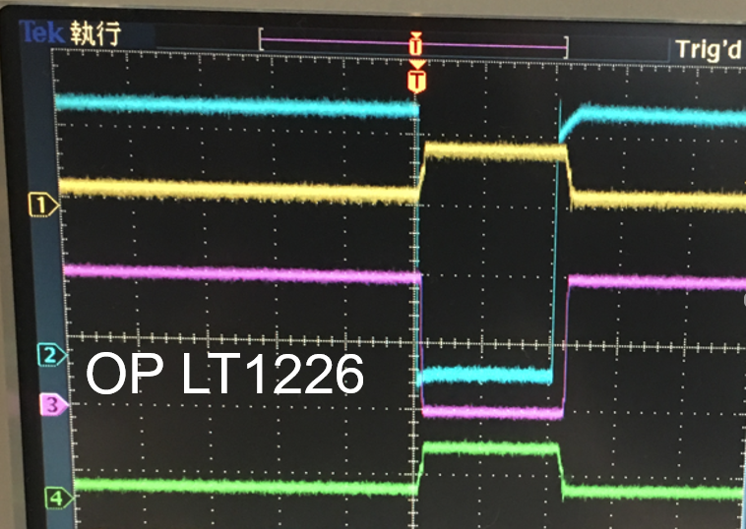
Current pulse
Power supply
Pulse generator
filter noise from the circuit
LT1226 - Low Noise Very High Speed Operational Amplifier
MOSFET (IRF840)
Switching on (rise time 21ns)
Switching off (fall time 9ns)
OP (μA741)
rise time & fall time 300ns
OP (LT1226)
rise time & fall time 8ns
MOSFET

Slide 11
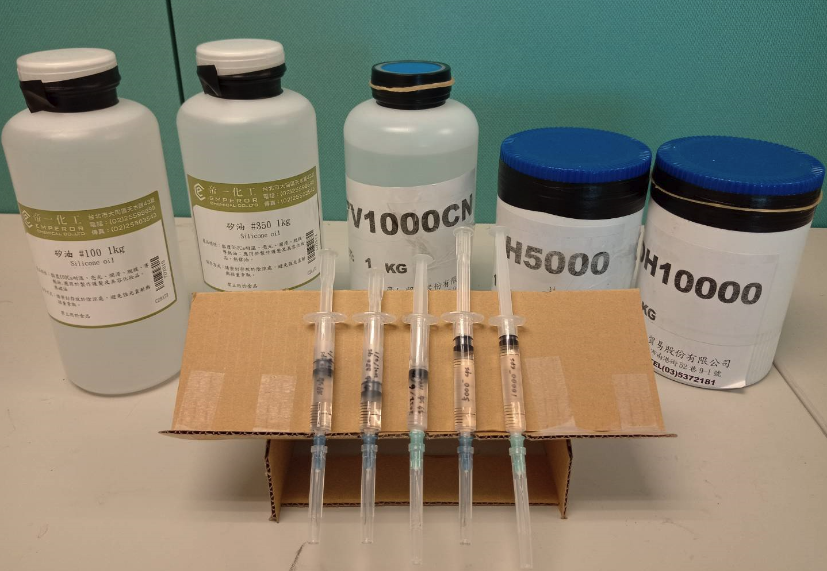
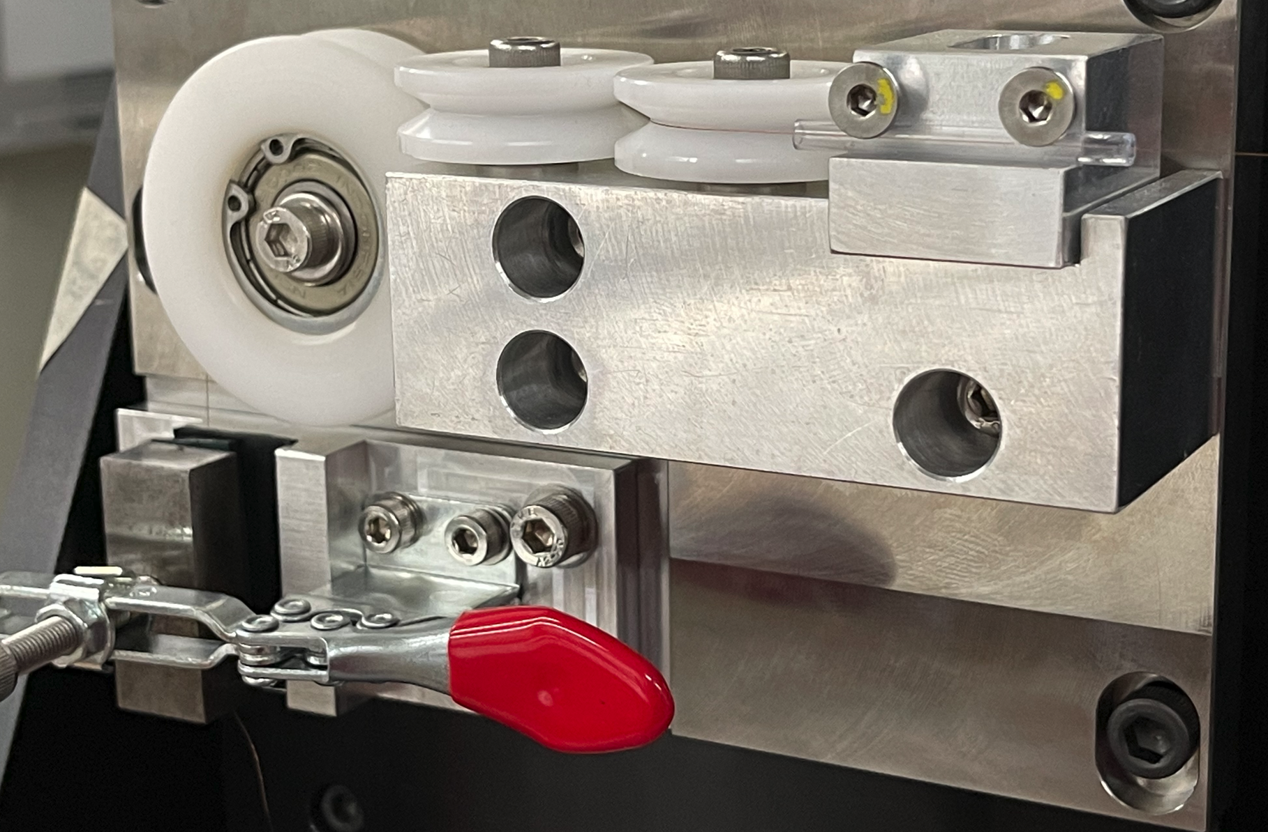
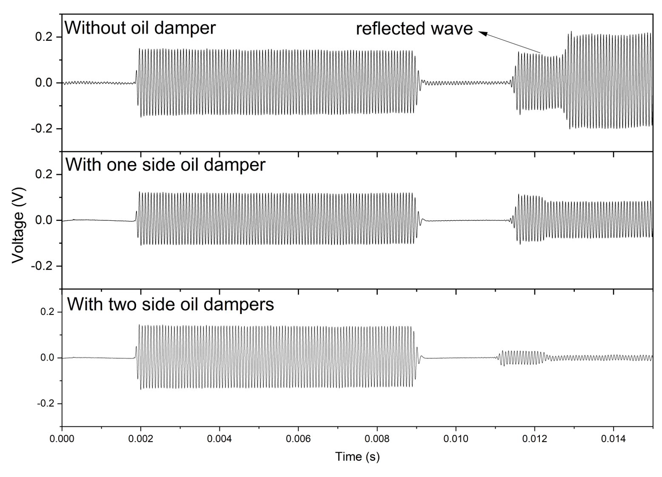
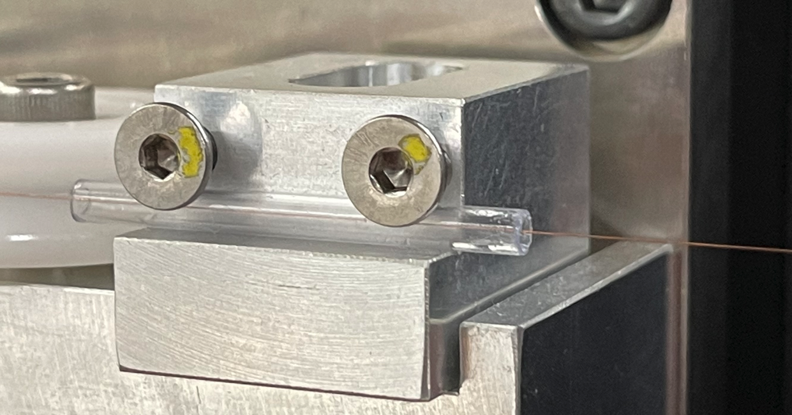
Oil dampers
the oil damper near the wire-fixing points to eliminate dispersion and reflected waves
Oil damper
different silicone oil of viscosity
used the oil dampers in PWM
Wire-fixing point
Oil damper
injection oil
Plastic tube
Wire

Slide 12
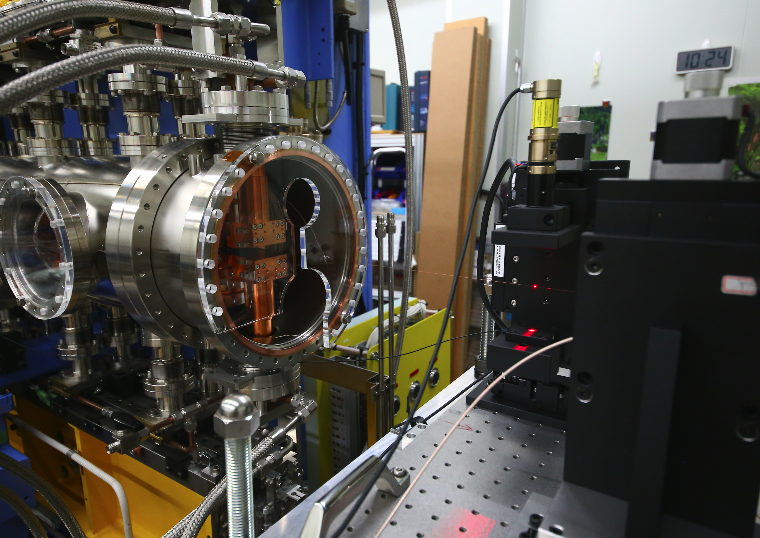
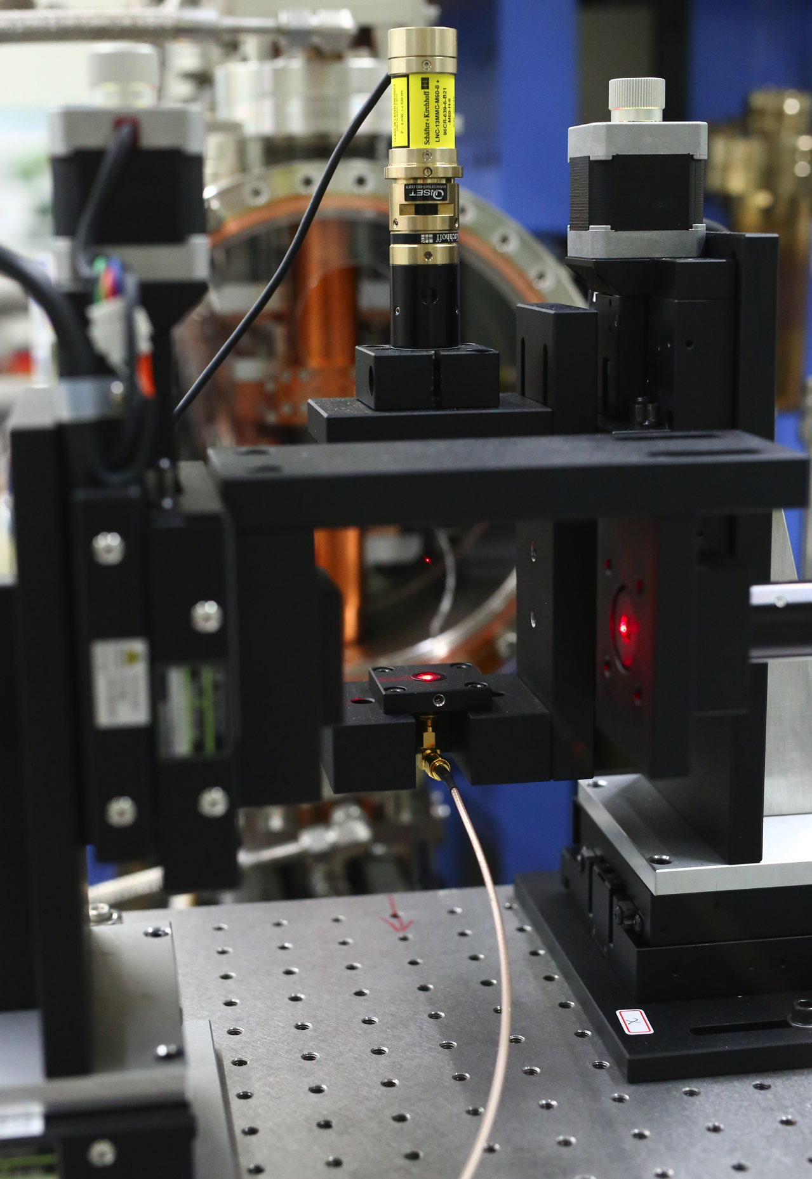
Pulsed wire system
for magnetic-field measurements

Slide 13
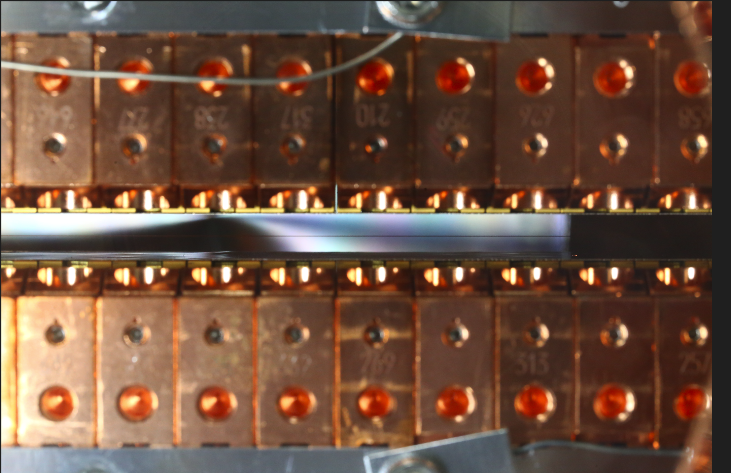
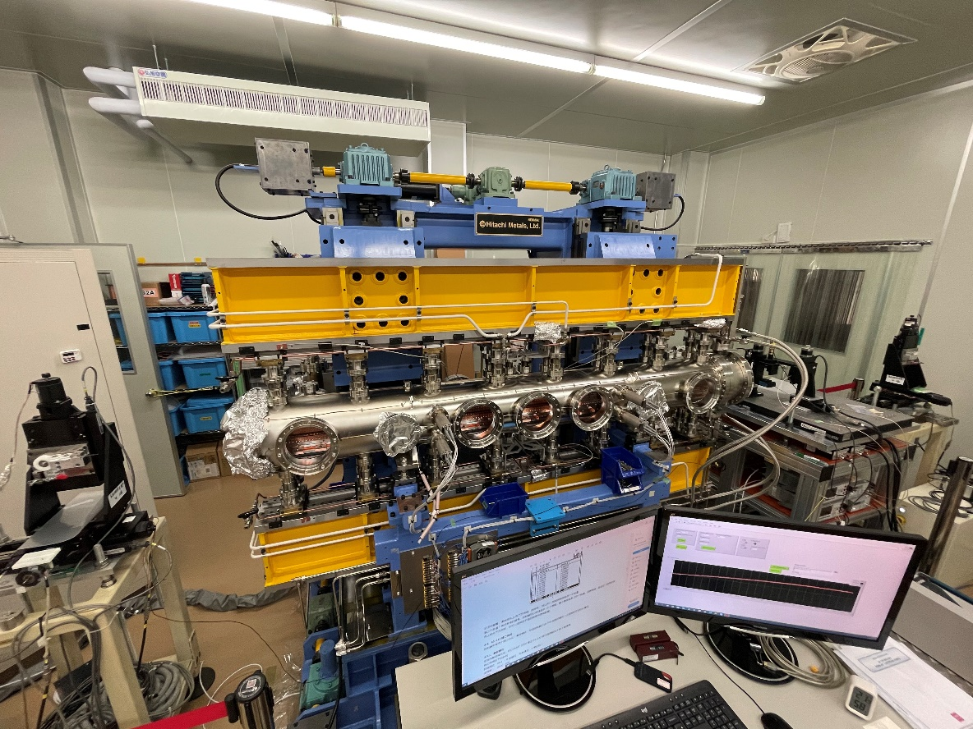
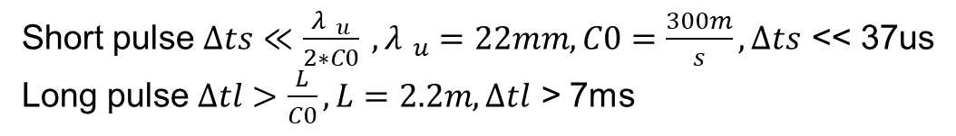
PWM system for 2m-IU22
Short pulse $∆ts≪\frac{{λ }_{u}}{2∗C0} ,{λ }_{u}=22mm, C0=\frac{300m}{s},∆ts$ << 37us
Long pulse $∆tl>\frac{L}{C0}, L=2.2m, ∆tl$ > 7ms
Wire
Wire
Short Pulse: 10us
Long Pulse : 20ms
Tension : 6N
Wire R =38.1 ohm
Wire Voltage : 50V
Wire D:100um CuZr
Wire L : ~5m
Ref. 1. C.W. Chen, H. Chen, J.C. Huang and C.S. Hwang, “Pulsed-wire system for magnetic-field measurements on an in-vacuum undulator at NSRRC”, Physics Open , (2022)
2. P. N’gotta , M. Ebbeni, A. Thiel, H. Tarawneh, First Results of a Pulse Wire Measurement System for ID Characterization at MAX IV, IMMW21 Grenoble, France.

Slide 14
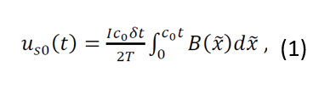
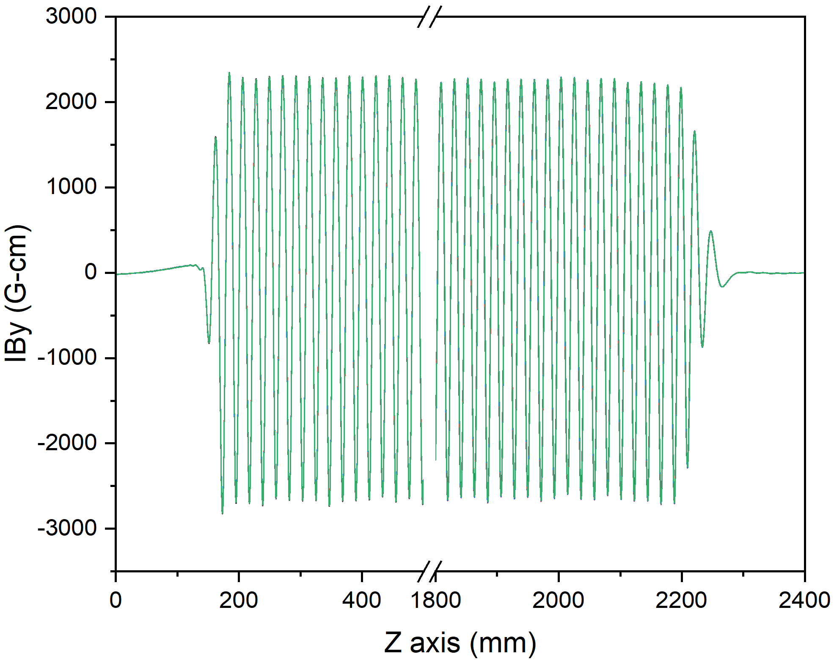
First integral field measurement
Short Pulse: 10us
The first integral field of the Hall-probe measurement is obtained on numerical integration of the results of the magnetic-field measurement.
the pulsed-wire measurement data are inserted into equation (1) to obtain the first integral field
the difference between the two measurement methods is about 1%
more then 5 times
Repeatability : ± 1 G-cm

Slide 15
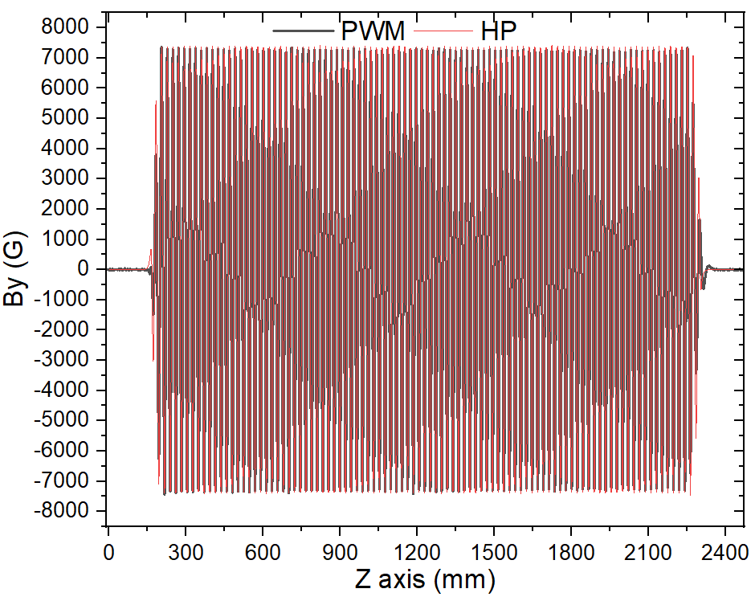
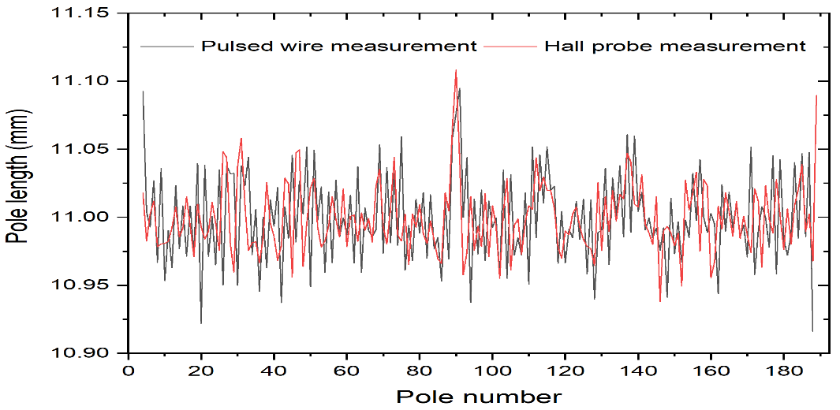
Magnet field results
IBy
differential
the average pole lengths of the pulsed-wire and Hall-probe measurements are 10.9995 mm and 10.9990 mm; the variation is less than 1 %
the variation peak to peak is less than 1 %

Slide 16
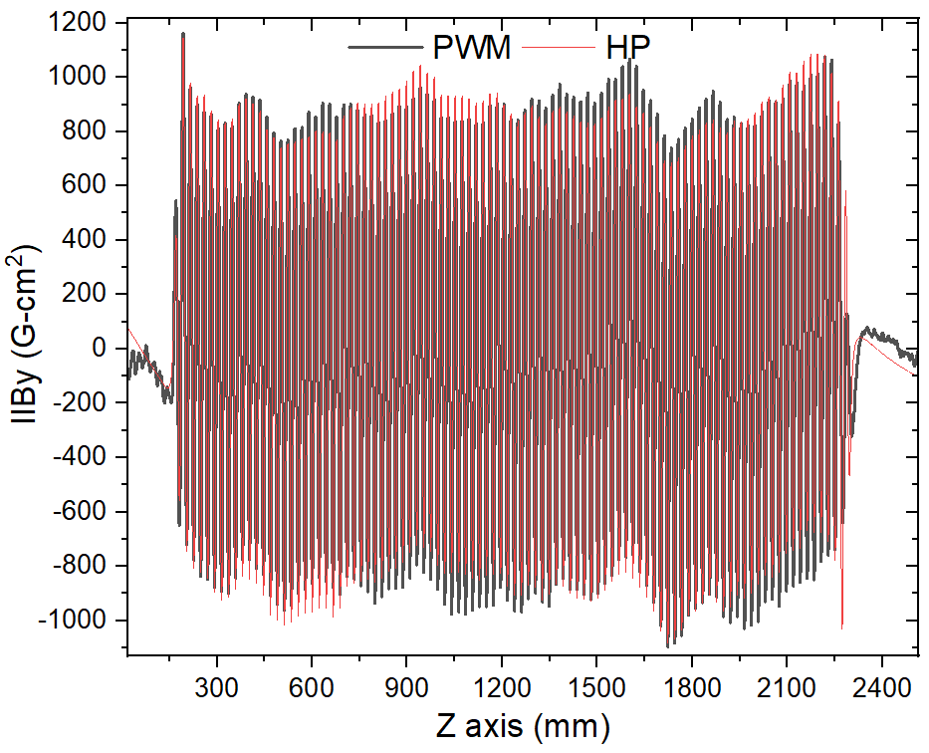
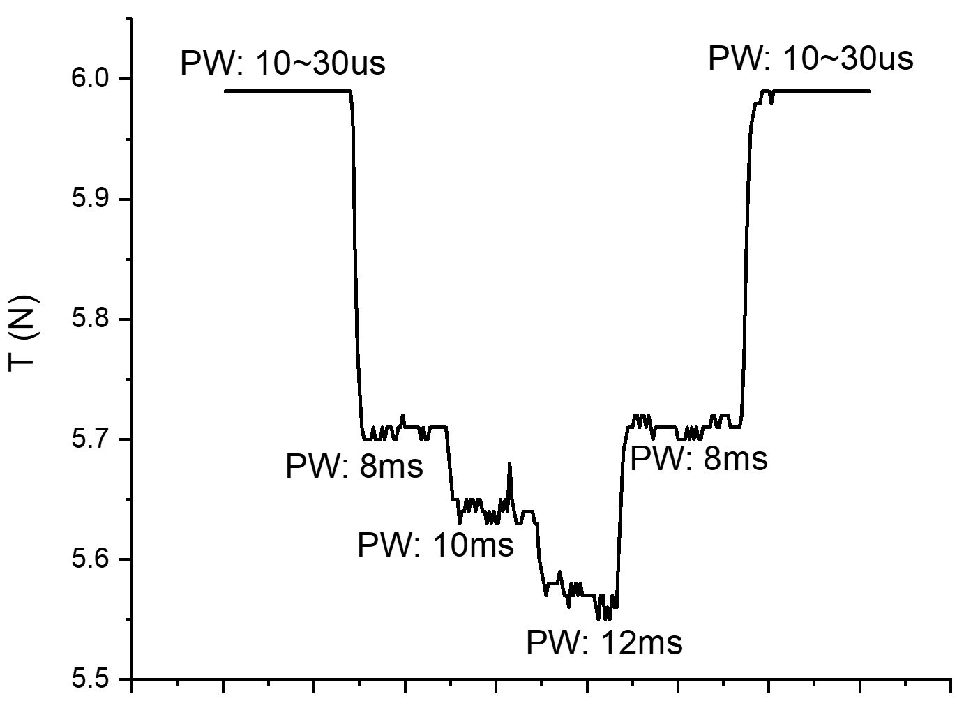
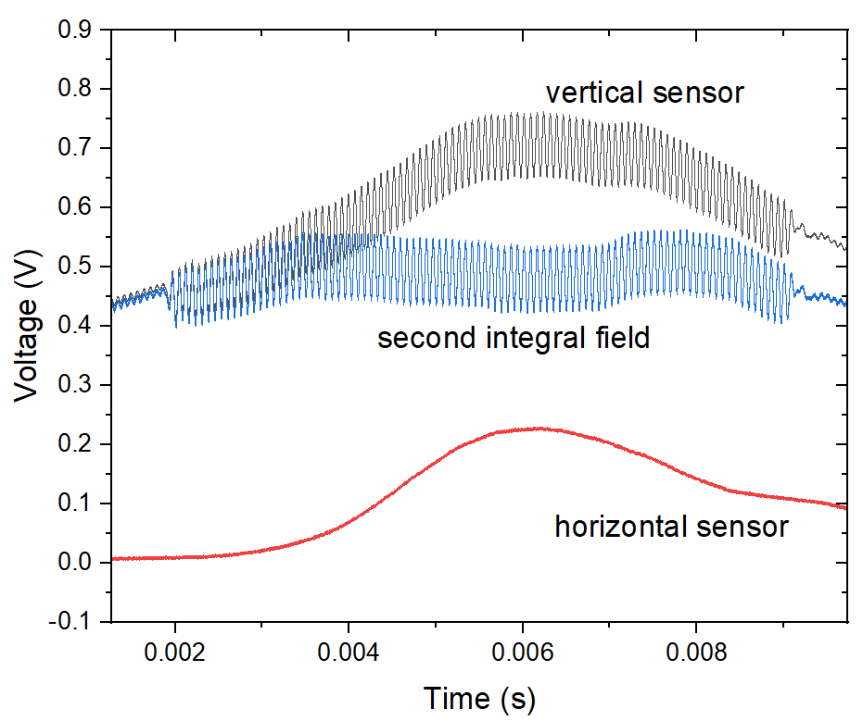
Second integral field measurement
Long Pulse : 20ms
the performance of the second integral field is similar, but the amplitude is slightly different
The momentum change is different in the case of the 1st and 2nd integral field measurement. The tension will be also different.
The solution is either to adjust the suitable tension for the 1st and 2nd integral field measurement or subtract the couple effect from the vertical axis to avoid the disturbance.
During the pulsed-wire measurement, we observed that both the vertical and horizontal optical sensor pair detected the displacement signal

Slide 17
Summary
the CuZr wire is better than BeCu wire in both resistance and sag at the same diameter and length
the oil dampers can absorb wave dispersion and most reflected waves
the results of the pulsed-wire measurement with a undulator (length 2 m) are compared with the Hall-probe measurement
the performance of magnetic fields is similar
the pole-length errors and peak to peak are both less than 1 %
the difference in peak magnetic fields between the two measurement systems are less than 1 %.
the first and second integral fields are similar
the pulsed-wire system provides quick measurements of the magnetic field and is easy to install on any undulators
in the future we can apply to measure the magnetic field of undulators with small gaps

Slide 18

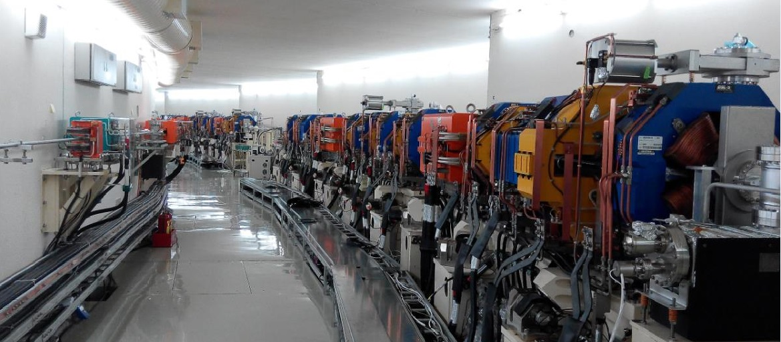
Thank you for your attention

