Slide 1


Slide 2
Sirius Magnetic Measurement Systems
Vitor Soares
22nd International Magnetic Measurement Workshop
26-30 September

Slide 3
Outline
Introduction
Helmholtz Coil System
Rotating Coil Bench
Hall Probe Bench
Stretched Wire Bench
Next steps

Slide 4
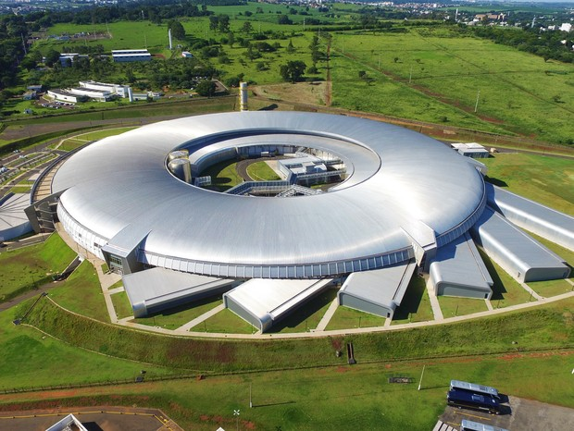
Introduction
Sirius is a 3GeV 4th generation synchrotron light source located in Campinas, Brazil
It is currently on the first phase of beamline implementation, which will have six definitive undulators (1 Delta Undulator, 2 IVUs, 2 VPUs and 1 Apple-II)
Right now five beamlines are being commissioned with Kyma planar undulators and a 2 T Wiggler from UVX was installed by the beggining of September to commision on another beamline;
The Delta Undulator is being constructed in-house, the other five undulators will be comercial IDs;

Slide 5
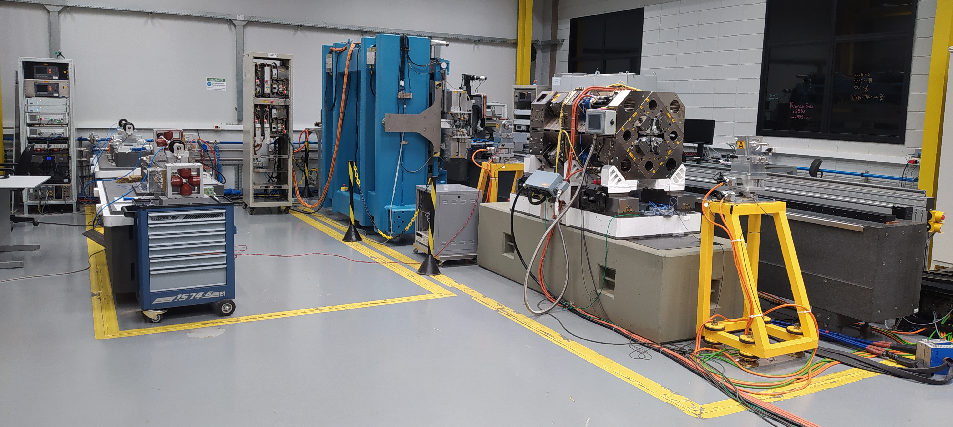
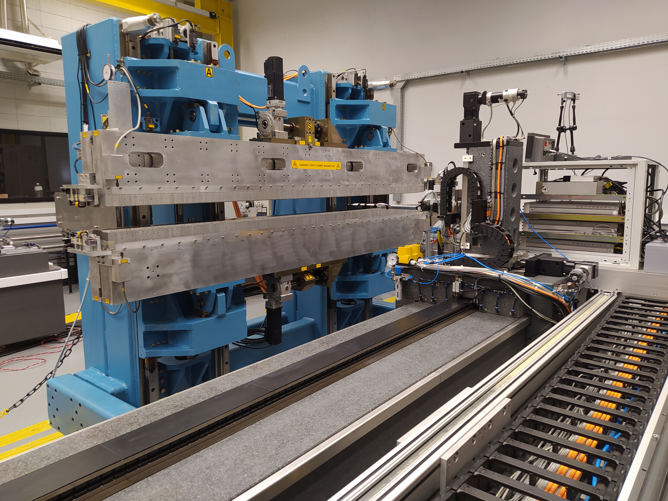
Introduction
The aim of this poster is to present an overview of the magnetic characterization systems used during the implementation of Sirius' 1st phase
Except from the Hall Probe bench, the other presented systems were developed in-house
All of the high level control softwares and UI were written in Python and PyQt
Currently measuring a 2.8 m long Apple II undulator from UVX which will be installed on Sabiá beamline for comissioning while the development

Slide 6
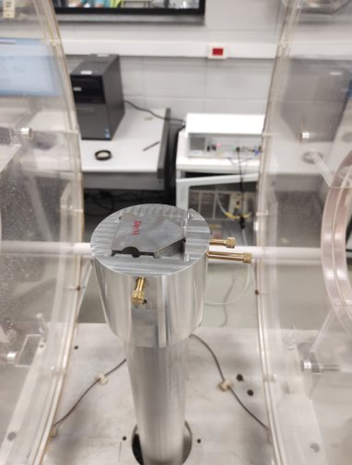
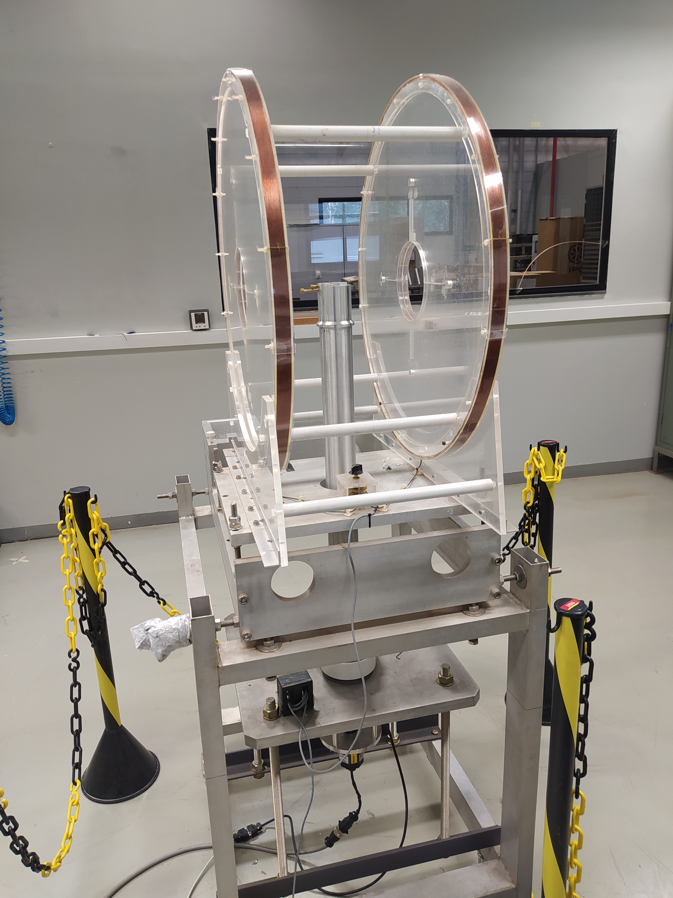
Helmholtz Coil System
Measurement of Delta Undulator NdFeB blocks dipole moments
- Positioning screws make sure the blocks are aligned with reference sufaces
- Signal acquired by a Metrolab FDI-2056 digital integrator
Helmholtz Coil
Coil Radius [mm] | 347.4
Distance Between Coils [mm] | 330.6
Copper Wire Diameter [mm] | 0.25
Coil Cross Section [mm x mm] | 22 x 6
Electric Resistence per coil [Ohm] | 854
Angular Speed [rps] | 1
Encoder Resolution [pulses/turn] | 360000
Angular Positioning Error [deg] | 0.015
Dipole moment amplitude precision [%] | 0.15

Slide 7
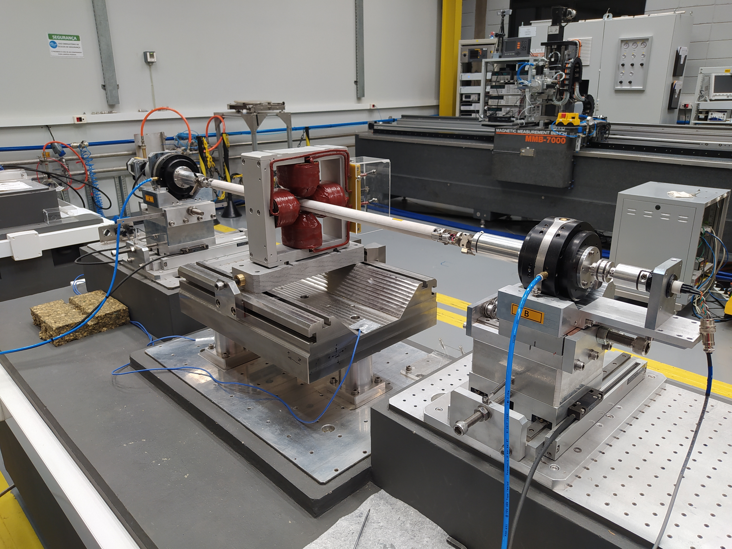
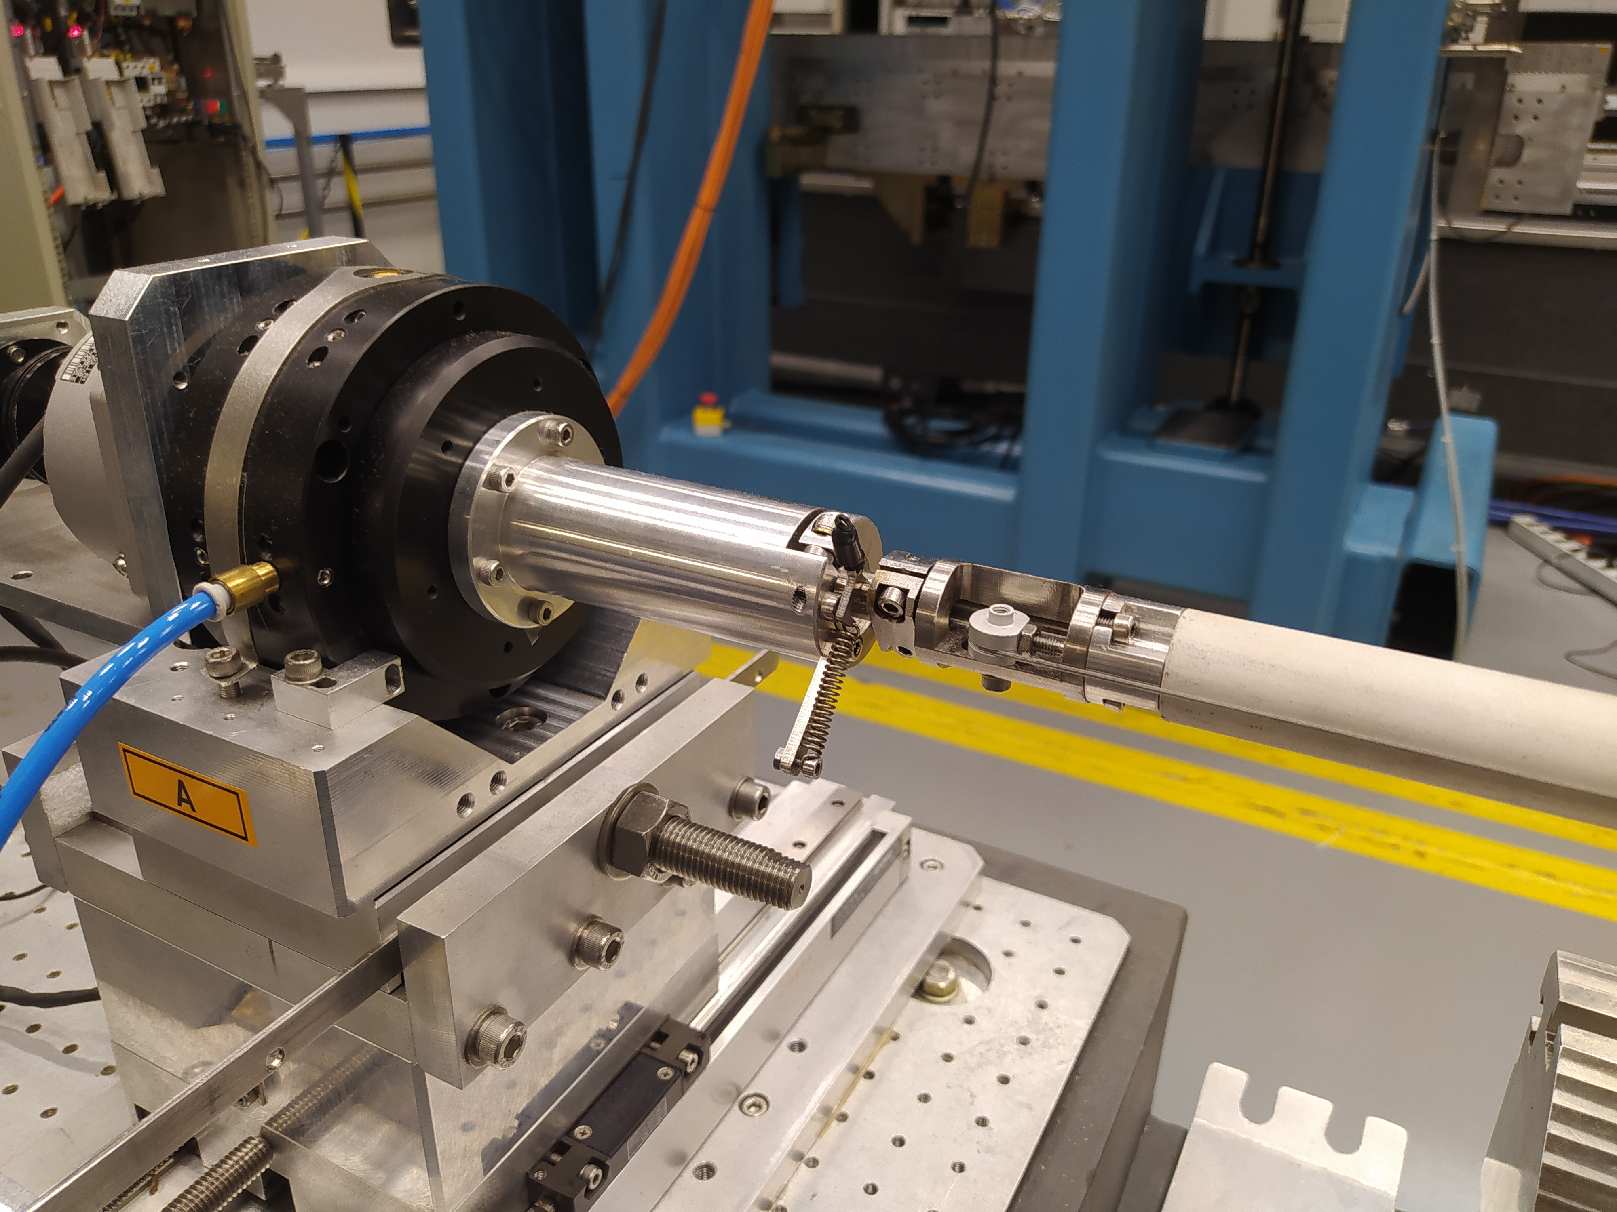
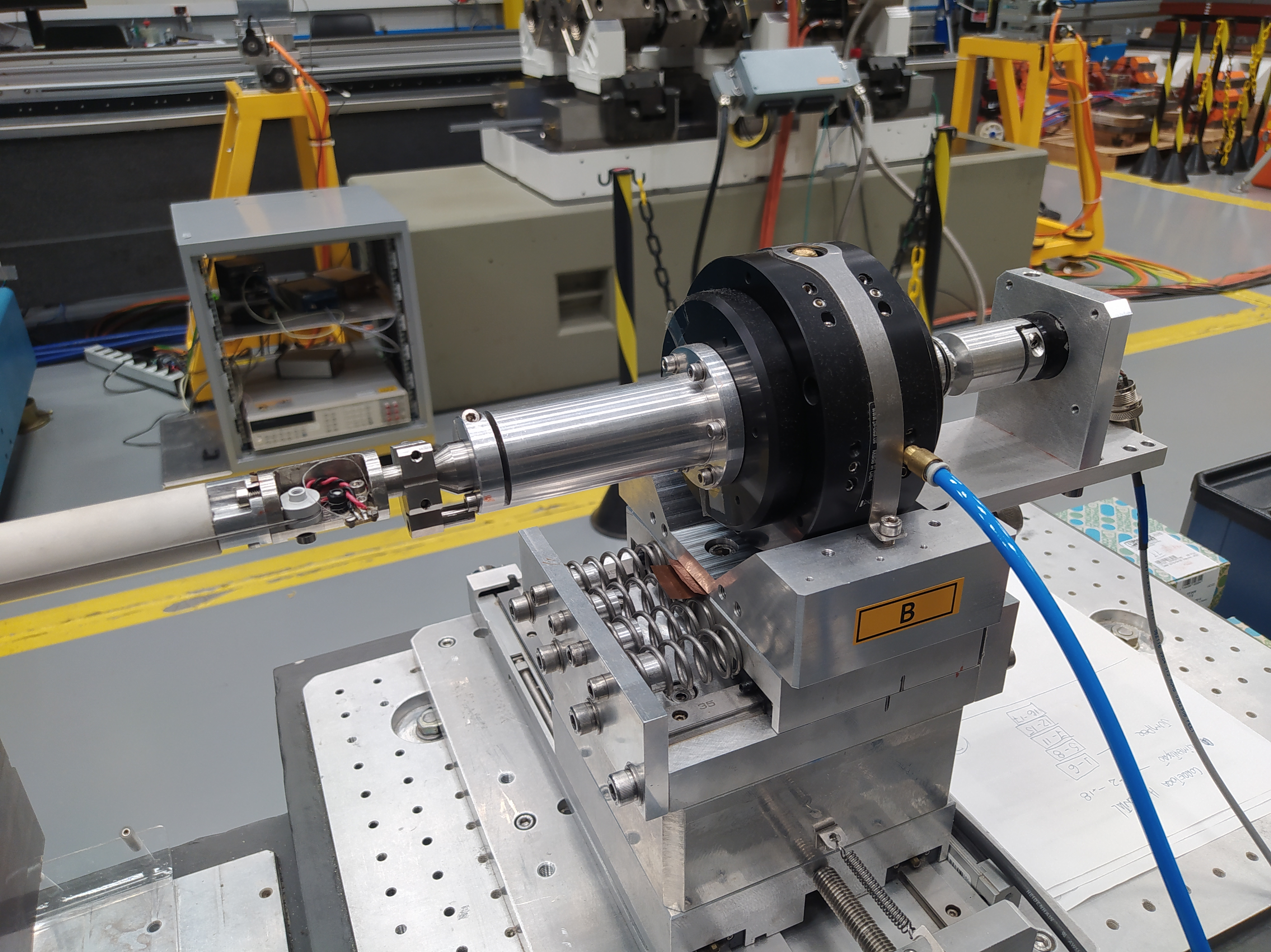
Rotating Coil Bench
Measurement of integrated multipoles of ID's feedforward orbit correctors and skew quadrupoles
Measument of Delta Undulator single NdFeB blocks and block keepers field integral profiles
- Two radial rotating coil​ benches
- Ceramic rigid body with spring tensioners to avoid sag​
- Spring tensioner to ensure mounting reapeatability
- Air bearings
- Mercury rotating contact
- Signal acquired by Metrolab FDI-2056 digital integrator​
Rotating Coil
Length [mm] | 800
Number of turns | 9
Tungsten Wire Diameter [mm] | 0.1
Radius [mm] | 13
Angular Speed [rps] | 1
Encoder Resolution [pulses/turn] | 360000

Slide 8
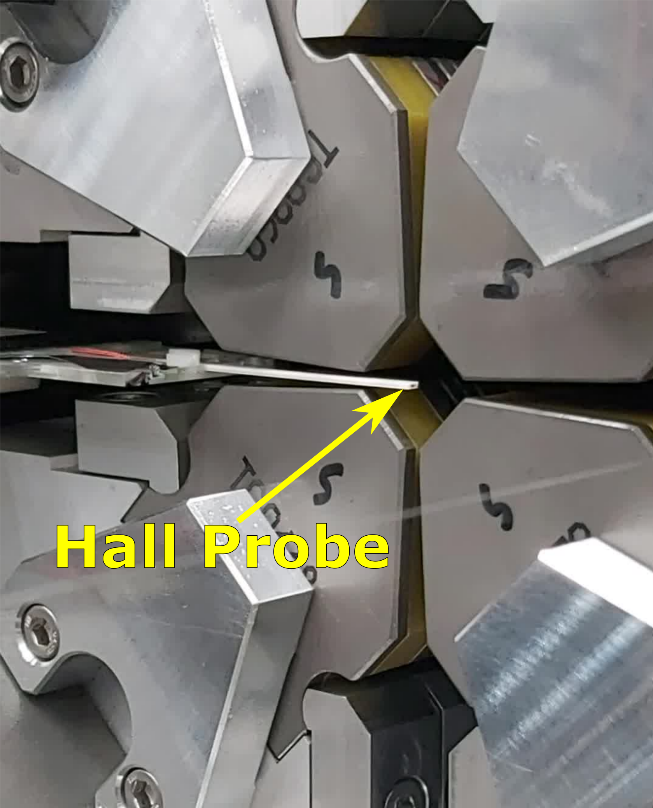
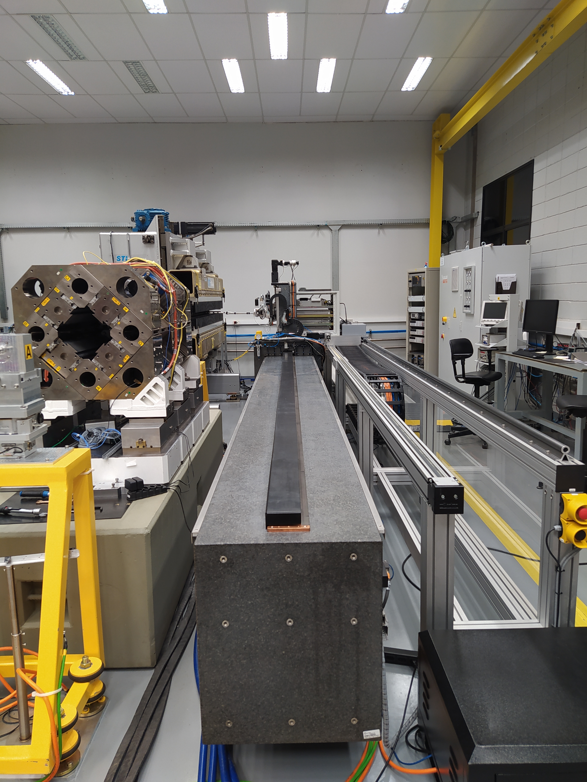
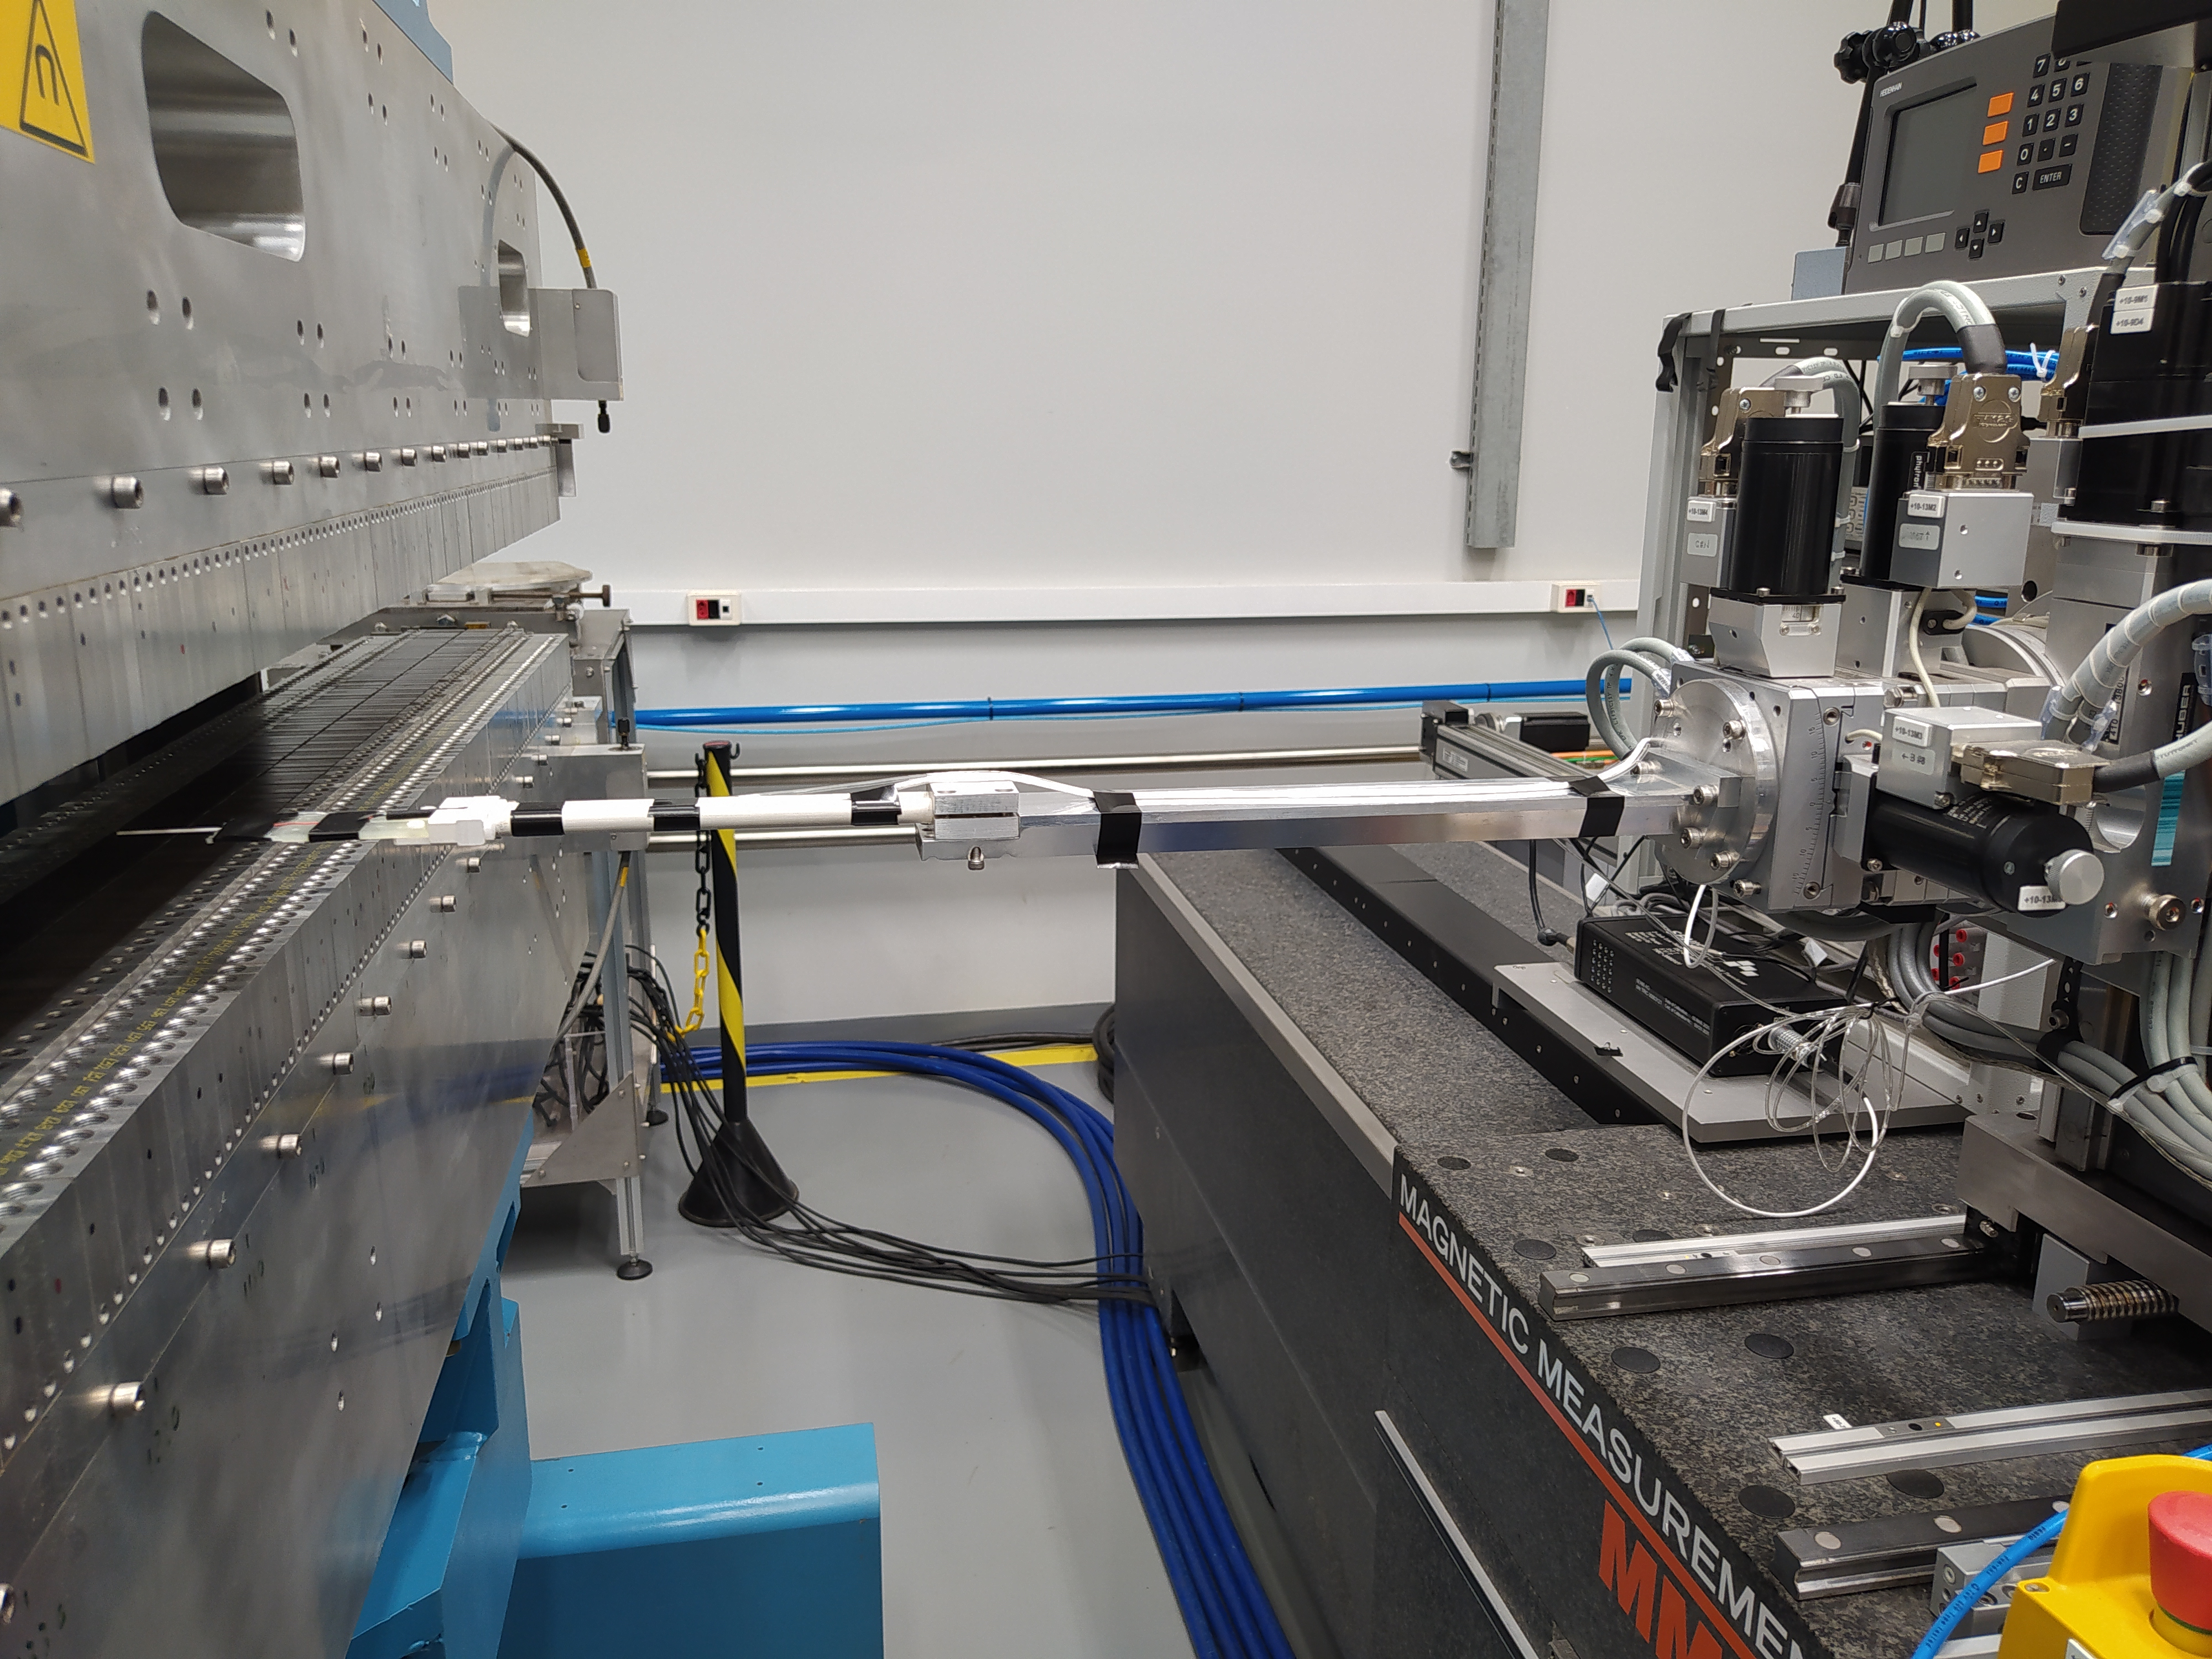
Hall Probe Bench
Measurement of field maps from fully assembled devices and NdFeB magnet block keepers
- Senis 3-axis Hall probe, 0.75 mm thick
- Hall probe is attached to a TVE Support in a ceramic rod
- Hall probe B vs V curve calibrated with a Metrolab PT 2025 NMR
- Probe angles are calibrated with calibration dipoles
Hall Probe Bench
Granite single block length [m] | 8 m
Travel Range [m] | 7 m
Longitudinal Linear Error | < ± 9 μm
Horizontal and Vertical Linear Error | < ± 15 μm
Roll, Pitch and Yaw | < ± 15 mrad
Notes:
Hall probe is attached to a TVE support in a ceramic rod
Hall probe is calibrated with NMR (

Slide 9
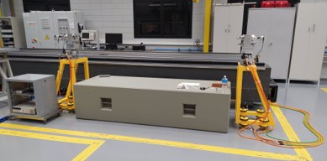
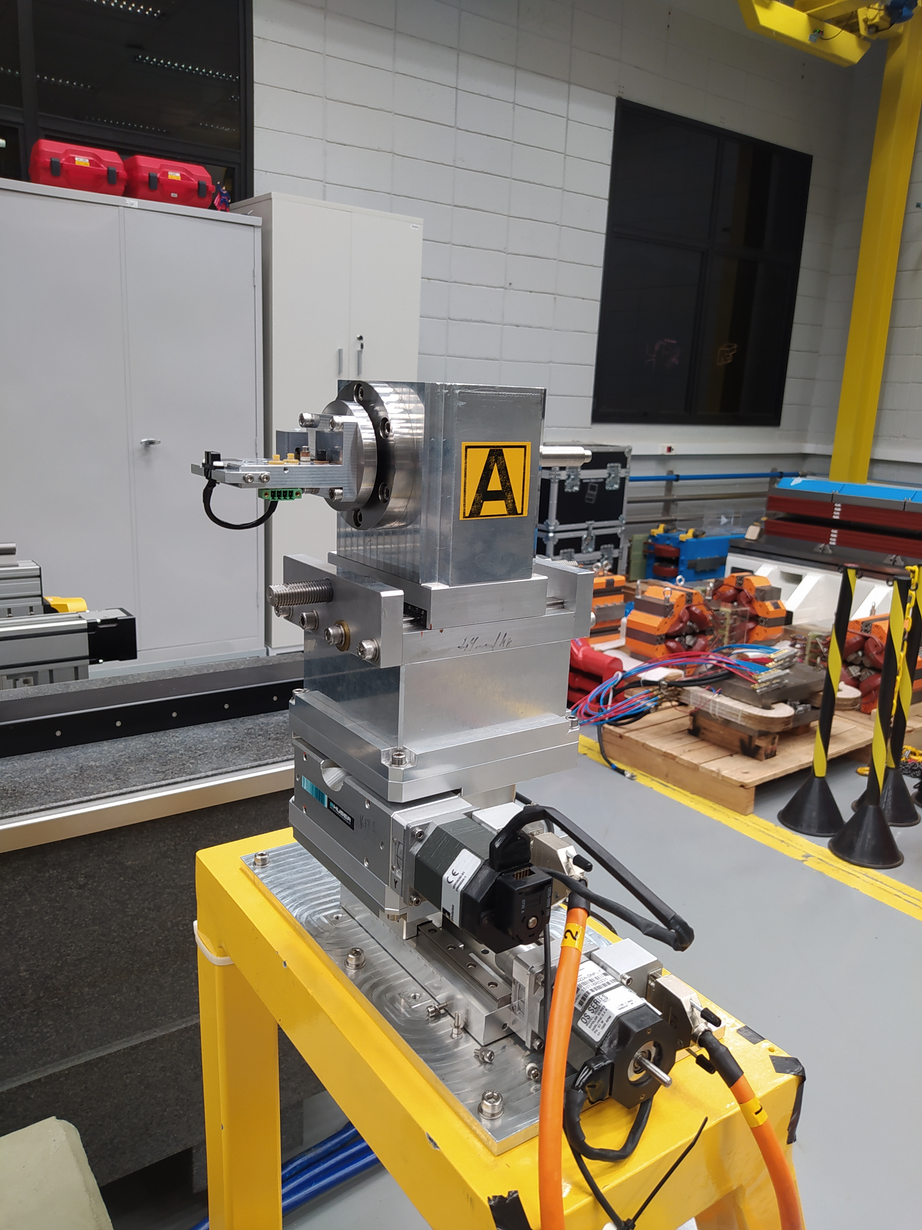
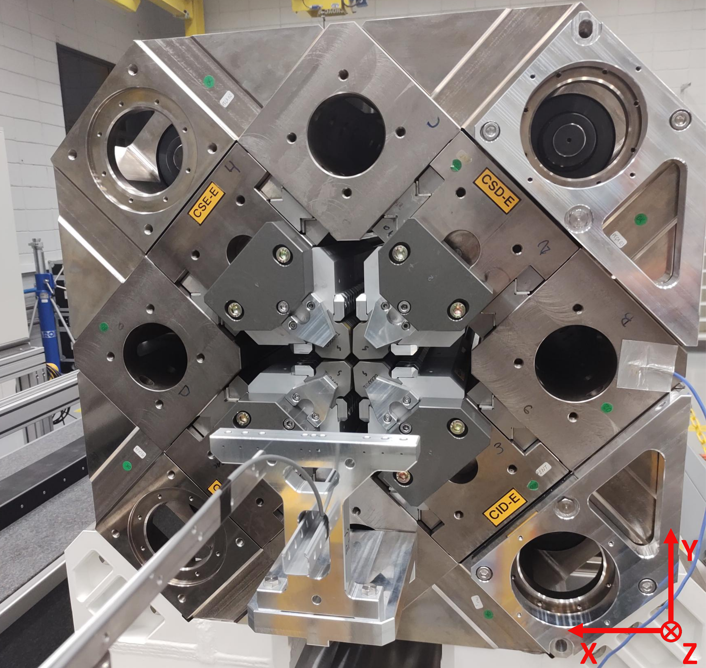
Stretched Wire Bench
Measurement of first and second field integrals of insertion devices
- 0.1 mm tungsten wire
- A22 low noise DC amplifier
- 8 1/2 digit Keysight voltmeter acquires the signal
- Huber linear stages with DeltaTau controllers
- Vertical stage maximum speed is limited to 0.5 mm/s (new vertical actuator project will be tested soon)
- Vertical fiducialization with the optical level
- Horizontal fiducialization by touching a steel cylinder at know location with repeatability of 5 μm
- Optical sensor to adjust the wire's resonance frequency
Typical standard deviation in a measurement
 | First integral [G.cm] | Second Integral [kG.cm²]
Vertical | 3 | 0.8
Horizontal | 9 | 2.8
Notes:
Vertical fiducialization with optical level +- 10 um
Horizontal fiducialization with contacts +- 5 um

Slide 10
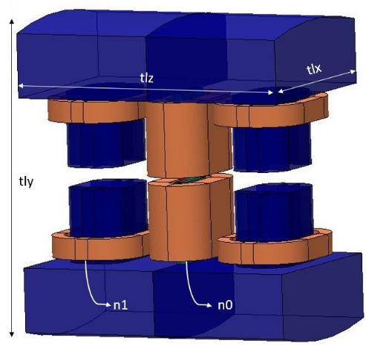
Next Steps
Upgrades on the Stretched Wire Bench to improve the signal to noise ratio are being carried out;
In order to measure small aperture devices, the development of a Pulsed Wire Bench seems to be promising;
By the next year we will begin the prototyping of a Superconducting Wavelength Shifter, so we're considering acquiring cryogenic Hall Probes.
Notes:
Vertical fiducialization with optical level +- 10 um
Horizontal fiducialization with contacts +- 5 um

Slide 11
Sirius Magnetic Measurement Systems
Thank you for your attention!
Vitor Soares – vitor.soares@cnpem.br
Magnets Group – CNPEM Engineering and Technology

Slide 12





