Slide 1

EMMA: A Framework for Constructing Magnetic Measurement Systems
J. M. Nogiec
22nd International Magnetic Measurement Workshop

Slide 2
Outline
Need: ability to measure various magnets for external and internal use
Solution: software product line method based on a framework
EMMA Architecture: components and message-based middleware
Dataflow: message-based system
CBD: component-based development
Automation: coordination of components
Component: a standardized, loosely-coupled module
User Interface: SHELL and UI components
Observability: data and inner component states
Flexibility: assemble, configure, and tailor
Summary: EMMA features

Slide 3
Need and Objective
Need
    Ability to measure a variety of magnets for external and internal use.
Objective
    Reduce cost/effort of developing measurement systems, including efforts to design, implement, test & debug, and rework (reengineering and defect removal) software.
Practices
    REUSE + FLEXIBILITY + EXTENSIBILITY + OBSERVABILITY

Slide 4
Measurement System Family
The software product line method is used to develop a family of measurement systems. These systems are based on a common architecture and a common framework (EMMA) that promotes reuse and allows for configuring specific measurement systems from a set of reusable components.
SSW ROTATING COIL FIELD MAP MISCALLENOUS
SSW (QUADRUPOLE)
SSW (DIPOLE)
VIBRATING WIRE
ORNL PPU FLAT COIL
SUPERCONDUCTING HORIZONTAL (HL-LHC)
CONVENTIONAL HORIZONTAL
SUPERCONDUCTING VERTICAL
Mu2e DETECTOR FMS
POINT SCAN (VERTICAL)
POINT SCAN (HORIZONTAL)
CALIBRATION MAGNET POINT SCAN
ORNL PPU FMS
SPLICE SYSTEM
EMMA: A Framework for Constructing Magnetic Measurement Systems, J.M.Nogiec

Slide 5
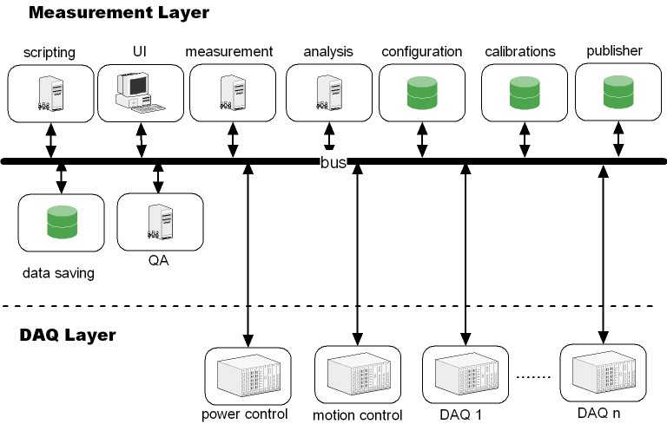
EMMA Architecture
Software Bus
  Message-based middleware, publish-subscribe bus.
  Each component runs in a separate thread(s).
  Local (via queues) and remote components (TCP/IP) sockets.
    Communication topics: property, control, and data.
Local Components
Remote Components

Slide 6
Dataflow
Component
properties
configuration
Measurement
parameters
Instrument
settings
Component
properties
Calibrations
UI
processing
Script
DAQ
Analysis
QC
Comments
Reduced data
Results
Assessment
data
Raw data
Log

Slide 7

Component-based Development (CBD)
components
component activator
measurement system
configuration
In EMMA, applications are assembled from components according to a given configuration.
Components ensure standardization and eliminate middle-level design, introduce well-defined interfaces, and provide encapsulation.
CBD allows for parallel development and independent evolution of software modules.

Slide 8
System Configuration
magic_code = “SSW_12.34.v7”
; Initial values of system properties
[system]
systemProperty_1 = SSW_0.1
systemProperty_2 = Stand_A
…
; Non-standard (system- specific) components
[components]
comp1@tab1 = local:pathToVI + pathToDecisionTable
comp2@tab2 = remote:pathToVI + pathTodecisionTable
…
; Automatic initialization events: topic:event = parameter
[events]
control.comp1:init.cmd = NONE
control.comp2:init.cmd = NONE
…
; Properties of components: property = value
[comp1]
property_1.1 = TRUE
property_1.2 = [[1, 5, 100], [100,10,200]]
[comp2]
property_2.1 = “SIMULATOR”
property_2.2 = 1234.56
…
  Framework uses the configuration file to start both local and remote components.
  A configuration file has system, components, events, and component property sections.
  Each file section contains a set of name-value pairs that define the initial state of the system.

Slide 9

Example: Rotating Coil System Components
Leica AT960
UI
Tracker
30kA Power Supply
Archiver
Archiver
UI
Current
Extensible Digital Integrator
Aggregator
Analysis
QC
Integrator
Galil DMC-4210
Motion
UI
UI
UI
Aerotech CP10
Rotation
IFIX Gateway
Script
Config
Log
Starter
UI Shell
Property
E-log
Store
SYSTEM COMPONENTS

Slide 10
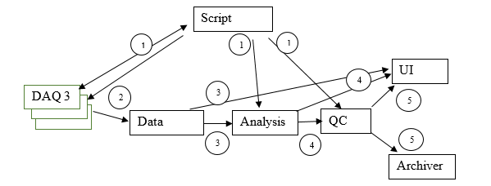
Coordination of Independent Components
Coordinator
Independent components require coordination to perform required functions.
EMMA allows for coordination of components via both orchestration (a mediator component coordinates by sending control events) and via dataflow-based choreography (implementing a functionality based on the data moving through the system of components). A typical organization of the components for a measurement combines both the orchestration and dataflow–based choreography

Slide 11
Automation by Coordination via Scripting
parameters
Python
script
Script component
software bus
The Script component communicates with other components via the software bus, directing a sequence of execution that follows a measurement algorithm.
The script does not process any data but fulfills a purely controlling role.
The script can request actions and modify component properties.
An EMMA script is not intended to contain any measurement parameters, which instead are read from a separate parameter file.

Slide 12
EMMA: coordination script
# A skeleton of Point_Scan script
#------------------------------------------------------------------------------
# Iterate over currents and positions and take data
def script(options):
try:
run = emma.generateRunId()
emma.sendParCmd('control.all', 'run.start', 'run', run)
emma.log("Start " + run + “ run”)
# Read positions and currents from a parameter file
lines = emma.readFile(options.file)
(currents, positions) = processPar(lines[i].strip())
# Initialize components
emma.sendCmd('control.motion', 'init.cmd')
emma.awaitEvent('control.system','init.ack', ‘motion', 5)
emma.sendCmd('control.hall', 'init.cmd')
emma.awaitEvent('control.system','init.ack’, ‘hall', 5)
emma.sendCmd('control.ps', 'init.cmd')
emma.awaitEvent('control.system','init.ack’, ‘ps', 5)
# Ramp current, move and read Hall probe
step = 0 # step counter
for i in currents:
# ramp current
emma.setProperty('property.ps', 'set.cmd', 'target', current)
emma.sendCmd('control.ps', ‘ramp.cmd’)
emma.awaitEvent('control.system’,’ramp.ack’, ‘ps’, 50)
#Move and read Hall probe
for position in positions:
# start of step
step += 1
emma.sendParCmd('control.all', 'step.start', 'step', step)
emma.log(" Step " + str(step) + ' ('+ current + '[A]' +\
', ' + position + '[m])', 'Info’)
# move to position
emma.sendParCmd('control.motion', ‘move.cmd’, 'destination', position)
emma.awaitEvent('control.system’,’move.ack', ‘motion’, 50)
# take data
emma.rpc('control.hall', ‘read.cmd’, 'control.system’,’read.ack’, ‘hall’, 2) )
# end of step
emma.sendParCmd('control.all', 'step.end', 'step', step)
except Exception as e:
print(emma.getTime(), 'Exception', file=sys.stderr)
emma.error(' Exception: ' + str(e))
raise e
finally:
# set current to 0 …. and end test
emma.setProperty('property.ps', 'set.cmd', 'target', 0.0)
emma.sendCmd('control.ps', ‘ramp.cmd’)
emma.awaitEvent('control.system’,’ramp.ack’, ‘ps’, 50)
emma.sendParCmd('control.all', 'run.end', 'run', run)

Slide 13
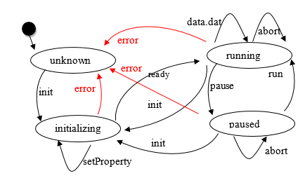
EMMA Component
properties
  Based on the same template.
  Asynchronous service provider.
  State machine driven with externally definable control logic (component behavior)
  Tailorable via properties
  Modifiable via plugins
  Controllable via control events
  Connector providing transparent connectivity:
    remote (TCP)
    local (queues)
  Template implementation available
  Independently developable
logic
component
plugin
universal connector
software bus
Commands and replies
Property queries and modifications
Data

Slide 14
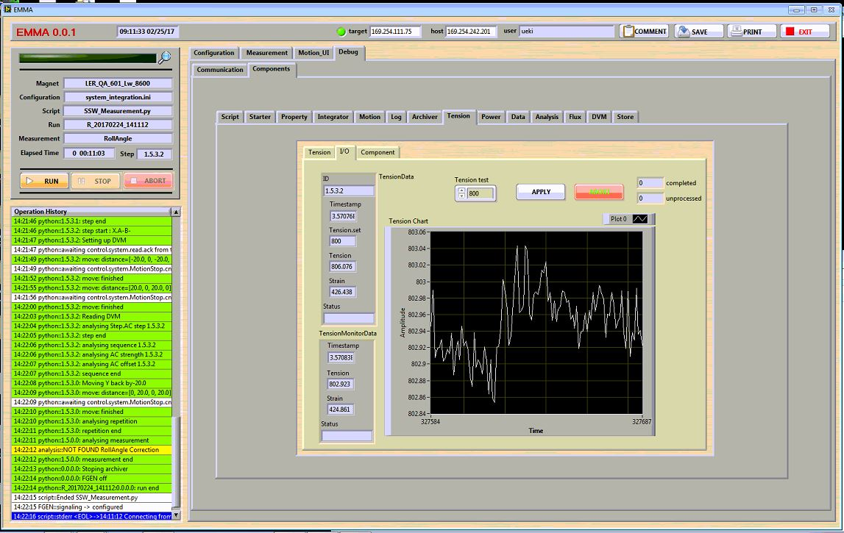
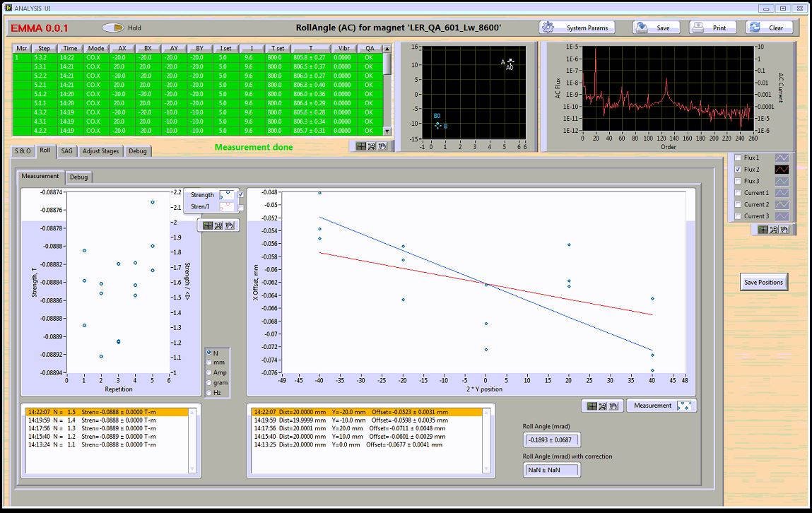
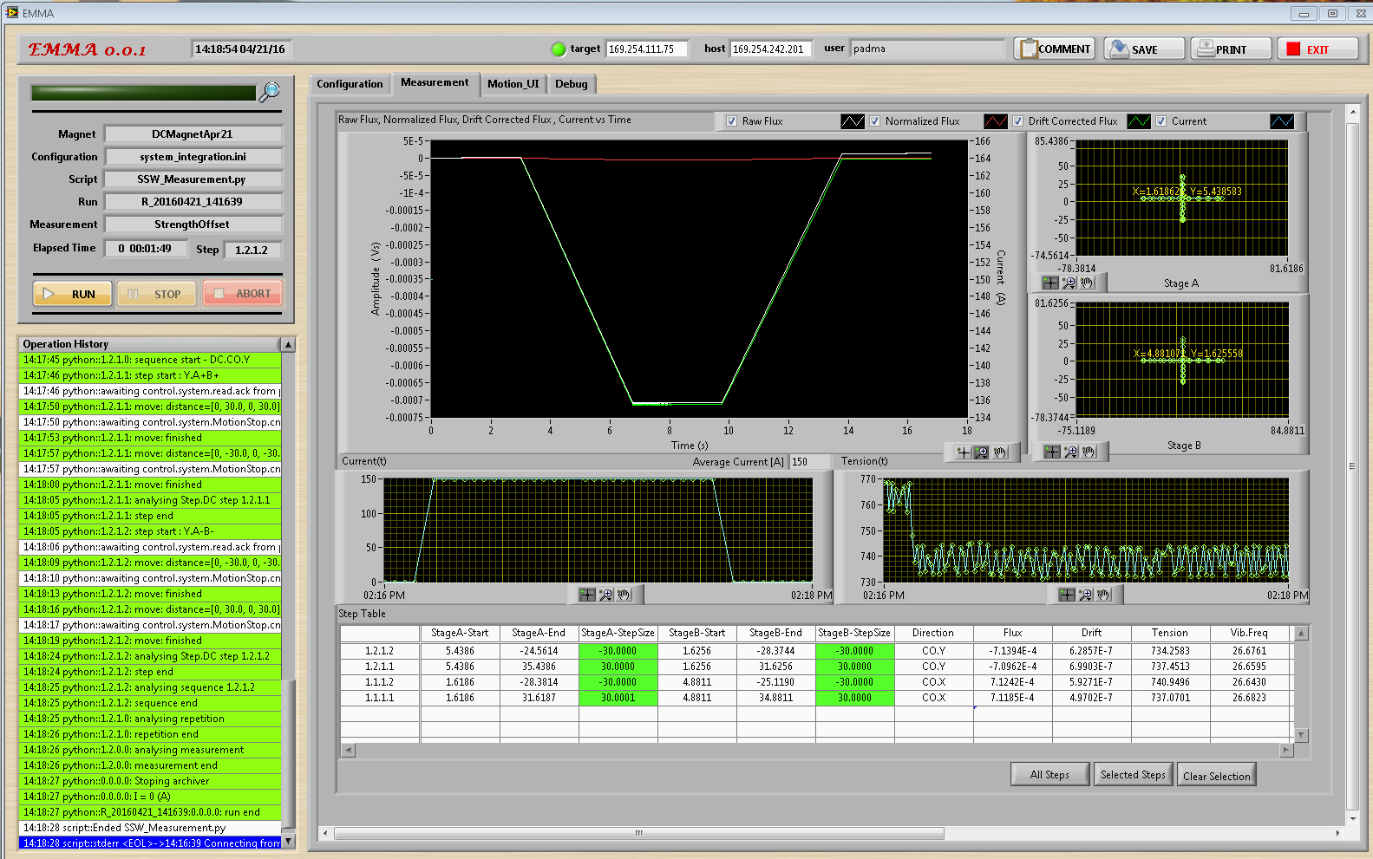
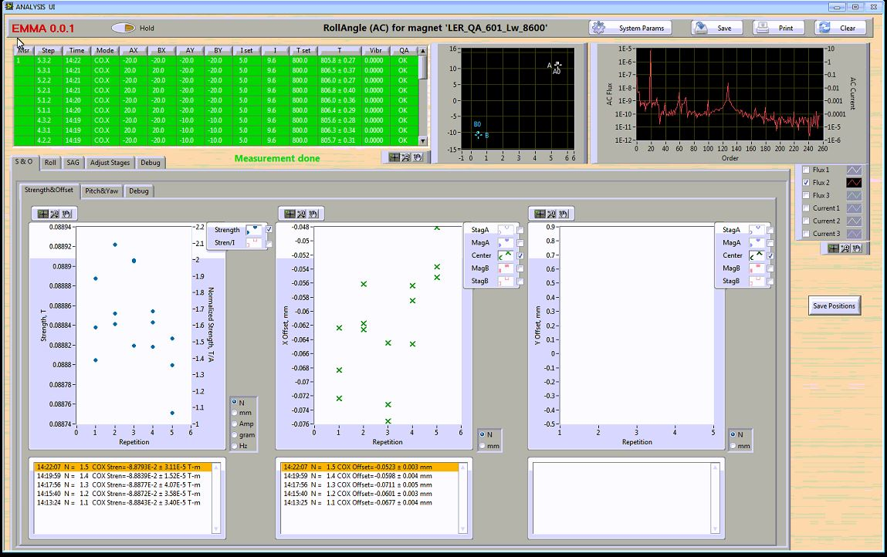
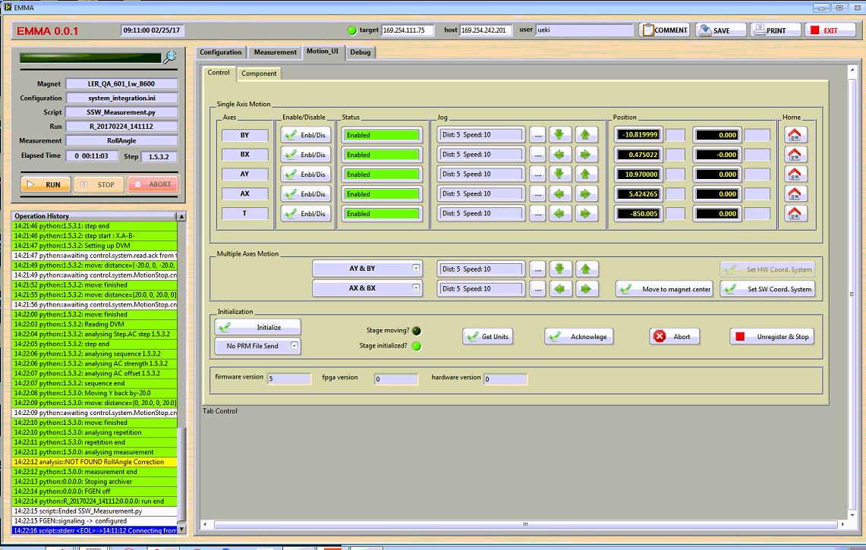
EMMA User Interface

Slide 15
User Interface: Shell Component
Metadata
Tabbed selection of views
Results - plots
Monitoring
data
Results -
numerical
System log
SSW Component Embedded in Shell
  The Shell component provides a set of panels located in a hierarchical tab structure and used as viewports for component front panels.

Slide 16
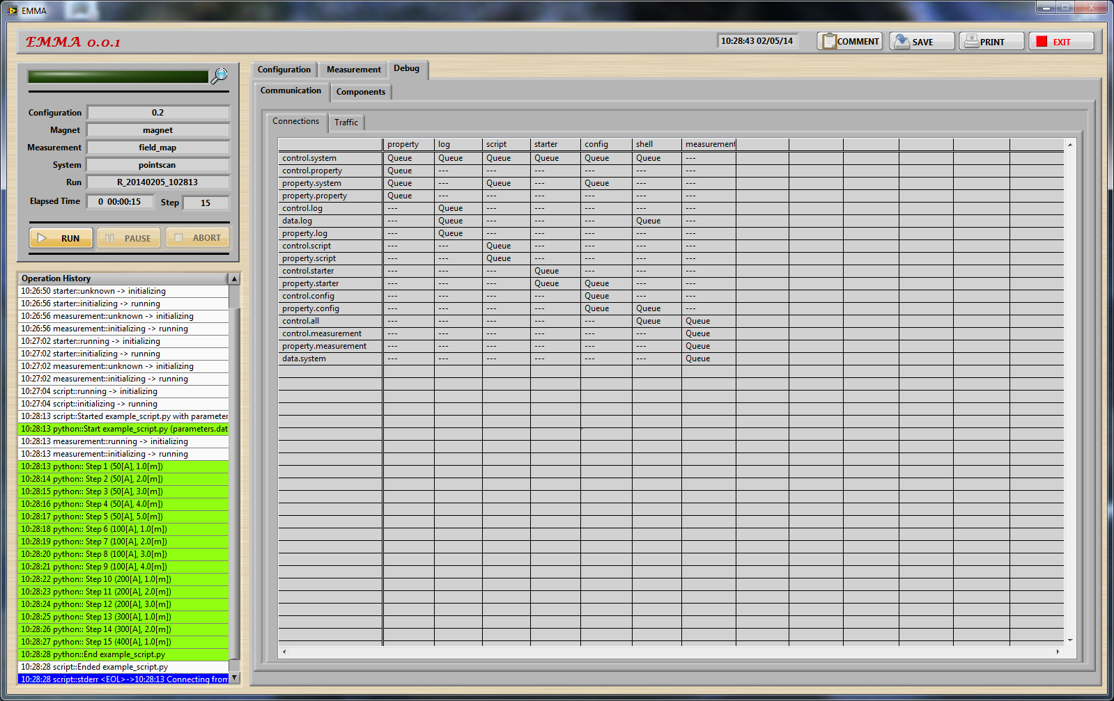
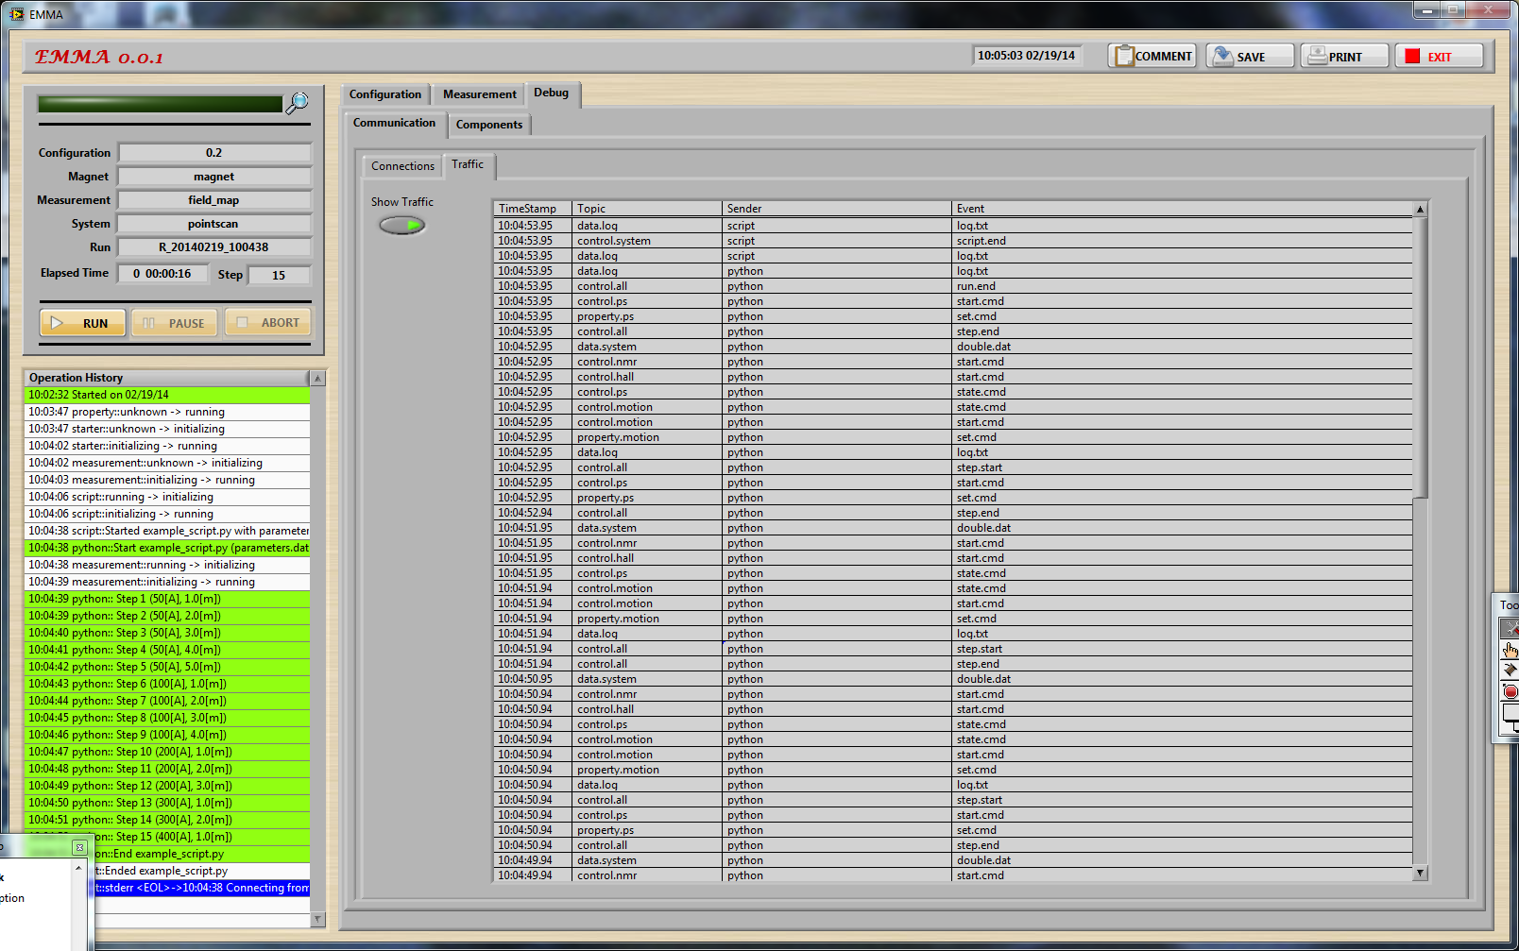
Observability: System Level
System Introspection Features
Event log (recent messages displayed in a color-coded list – red/yellow/gray)
Error status and count visible on the screen
Viewable event/message traffic log/history (on demand from UI)
Component connectivity view
Script progress

Slide 17
Observability: Component Debug Panels
Measurement screens
Communication debug screens
Component debug panels
  The Shell component includes viewports for component debug panels, each using several tabs to show current state, input and output data, control events, state machine decision table, manual operation buttons and controls, etc.

Slide 18
EMMA Flexibility
Variability | Implementation
Measurement procedure (sequence) | scripts
Modification in measurements conditions, independent variables | script parameters
Differences in DAQ hardware, motion system, instruments, probes | different components, component plugins or component properties component with access to probe & calibration service
Hardware settings, ranges, QC criteria | component properties
Different data to store | universal archiver component (TDMS), universal store component (XML)
Different visualization of data | SHELL configured with different UI components, UI component properties, standalone UI components
Distributed or local measurement systems | configuration allows to specify location of components
Different on-line analysis | universal analysis component with configurable plugins with algorithms in MATLAB, G language, C/C++, Python
Component behavior | modified via its properties (statically via configuration and dynamically via script), externally specified state machine logic component plugins

Slide 19
Summary: EMMA Features
Framework-based: compact yet powerful framework-based system for building families of related systems
Configurable: systems are built by configuring them from components – highly configurable system
Component-based design: modular, standardized, cohesive, composable
Loosely coupled components integrated into a system at run-time
Message-oriented architecture with encapsulation of code and state data
Supports local and distributed models (via local and remote components)
Measurement automation with parametrized Python scripts
Manual operation of current, motion and positioning systems
Observability at the system and component levels.
High level of reuse at the design and implementation levels.
Extensible and highly flexible system

Slide 20
References
J. M. Nogiec and K. Trombly-Freytag, “EMMA: a new paradigm in configurable software,” Journal of Physics: Conference Series, Nov. 2017.
J. M. Nogiec et al., “The application of coordination to magnetic measurement automation: an SSW system example,” IEEE Transactions on Applied Superconductivity, Jun. 2020.
J. M. Nogiec et al., "Designing a Magnetic Measurement Data Acquisition and Control System with Reuse in Mind: A Rotating Coil System Example," MT27 Special Issue of the IEEE Transactions on Applied Superconductivity.
J. M. Nogiec et al., " Software Architecture and Hardware Organization in Mu2e Solenoid Field Mapping System,” MT27 Special Issue of the IEEE Transactions on Applied Superconductivity.

Slide 21
Acknowledgments
The success of EMMA wouldn’t be possible without contributions from my colleagues. Special thanks to Padma Akella and Peter Thompson for developing various EMMA components and Dana Walbridge for documenting and testing of the measurement systems.

