Slide 1

… riding the wave
A Stretched Wire
Tomography System at Kyma
Mirko Kokole

Slide 2
Introduction
Technique of SW tomography first proposed and demonstrated by ESRF at IMMW19 in Grenoble in 2019
Kyma already has a Small Stretched Wire Bench
  for characterization of single magnets and small modules
Adaptation of the SW Bench to a SW Tomography system
  Addition of only one rotary stage necessary

Slide 3
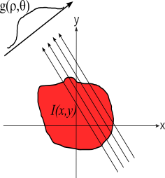
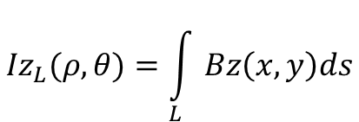
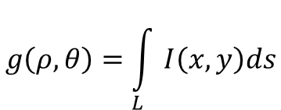
Radon Transform and Field Integrals
Radon transform is a path integral along the line L(ρ,θ) of the function I(x,y).
$$L\left(ρ,θ\right)=\left\{\left(x,y\right)∈ℝ×ℝ:xCos\left(θ\right)+ySin\left(θ\right)=ρ\right\}$$
$$g\left(ρ,θ\right)=\int_{L}{I\left(x,y\right)ds}$$
Field integral is a path integral of the magnetic field density along a specific line.
$${Iz}_{L}(ρ,θ)=\int_{L}{Bz\left(x,y\right)ds}$$
Field integral over a line L is equivalent to the Radon transform of the magnetic field along the line L.
From field integral measurements scans at different angles we can reconstruct a 2D map of the magnetic field density.
A stretched wire bench with a rotary stage can be used to measure 2D magnetic field map.

Slide 4
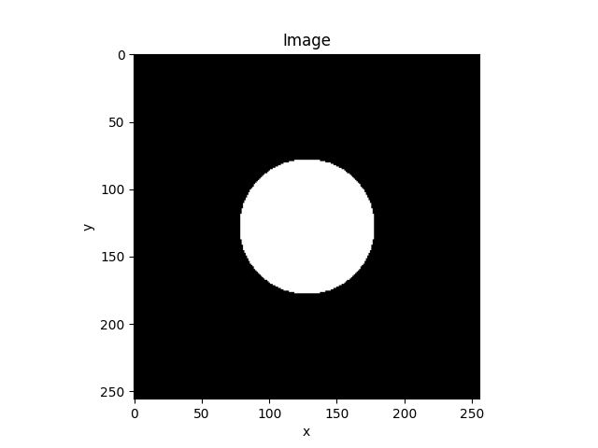
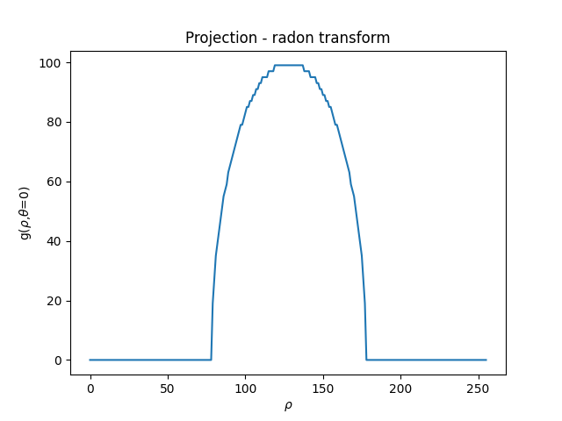
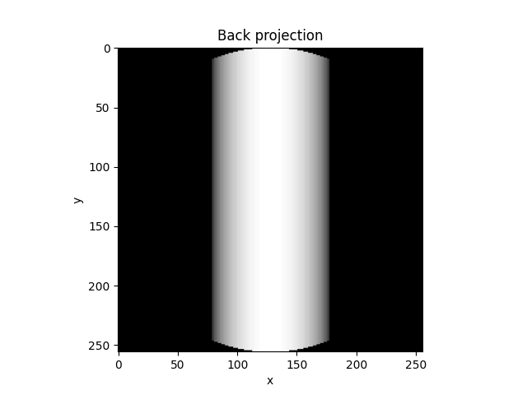
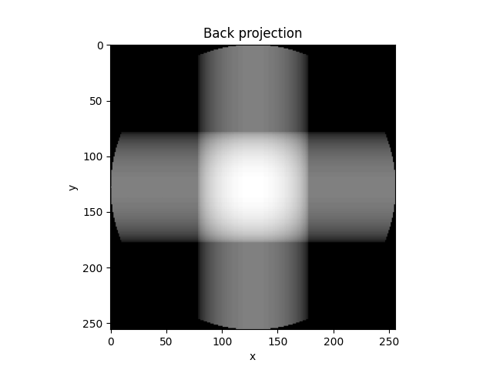
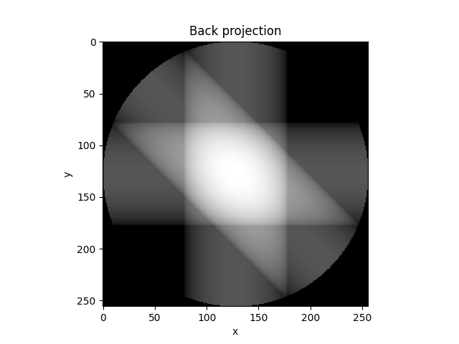
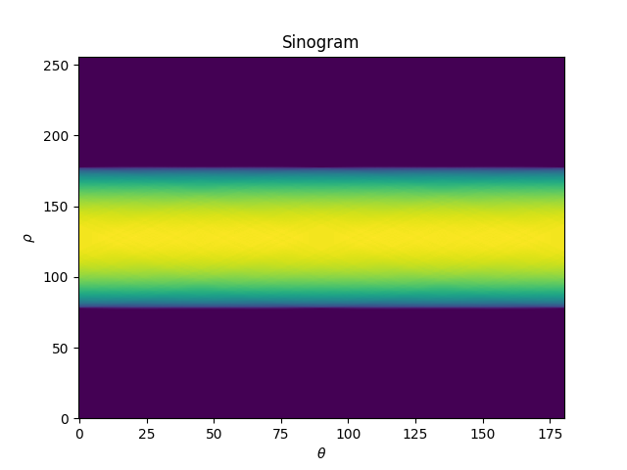
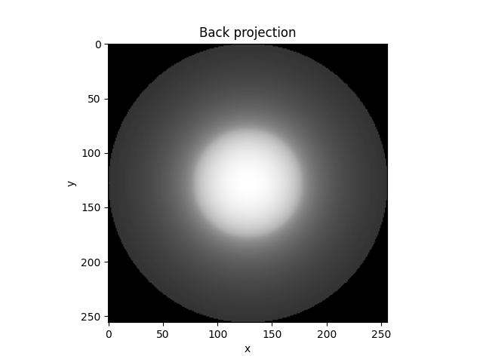
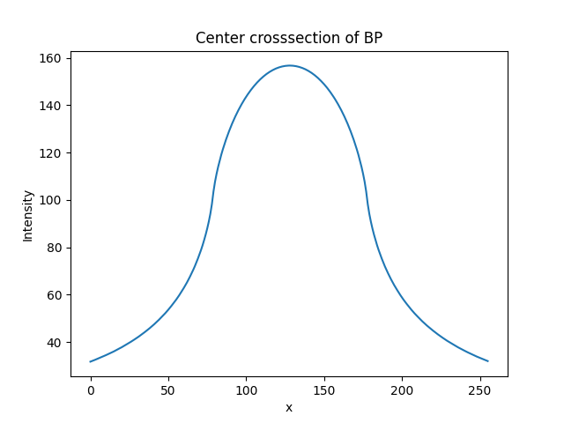
A Simple Back Projection - Laminograms

Slide 5


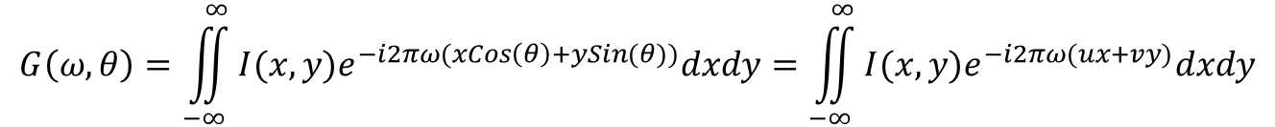
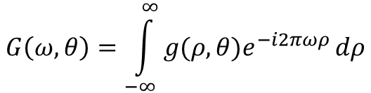
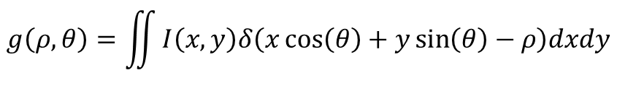

Inverse Radon T. and Fourier Slice Theorem
$$g\left(ρ,θ\right)=\iint{I\left(x,y\right)δ\left(x\cos\left(θ\right)+y\sin\left(θ\right)−ρ\right)dxdy}$$
A projection function
$$G\left(ω,θ\right)=\int_{−∞}^{∞}{g(ρ,θ)e^{−i2πωρ}}dρ$$
Fourier transform of a projection function
$$G\left(ω,θ\right)=\iint_{−∞}^{∞}{I(x,y)e^{−i2πω(xCos\left(θ\right)+ySin(θ))}dxdy}=\iint_{−∞}^{∞}{I(x,y)e^{−i2πω(ux+vy)}dxdy}$$
$$v=ω Sin\left(θ\right)$$
$$u=ω Cos\left(θ\right)$$
$$I\left(x,y\right)=\int_{−∞}^{∞}{\left|ω\right|G(ω,θ)e^{−i2πωρ}}ⅆω$$
Inverse radon transform is a Fourier transform of a $G\left(ω,θ\right)$multiplied by a filter function $\left|ω\right|$.

Slide 6
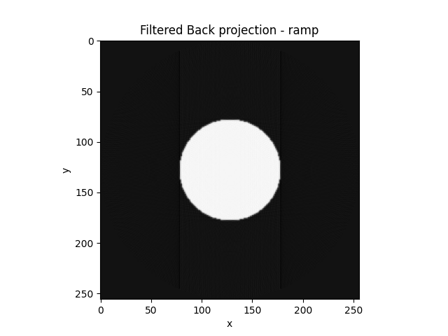
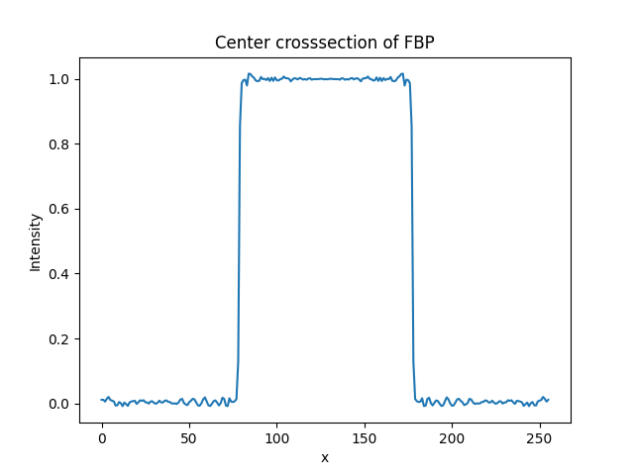
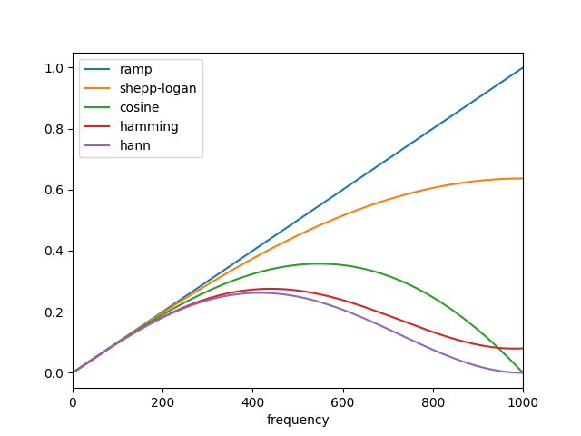
Filtered Back Projection

Slide 7
Small Stretched Wire Bench
Basic design parameters
  Small size convenient to transport.
  Control by Raspberry Pi (SBC)
  Routines written in Python for ease of use
  Keithley Nanovolt 2182A meter

Slide 8
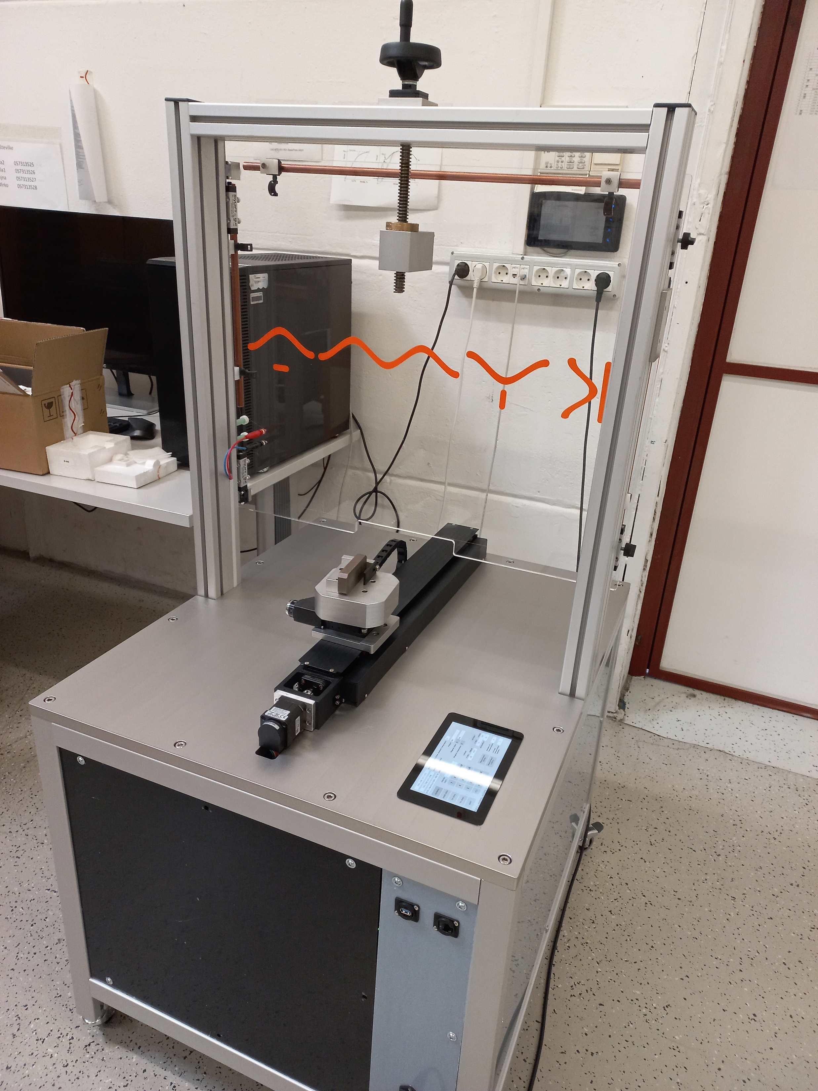
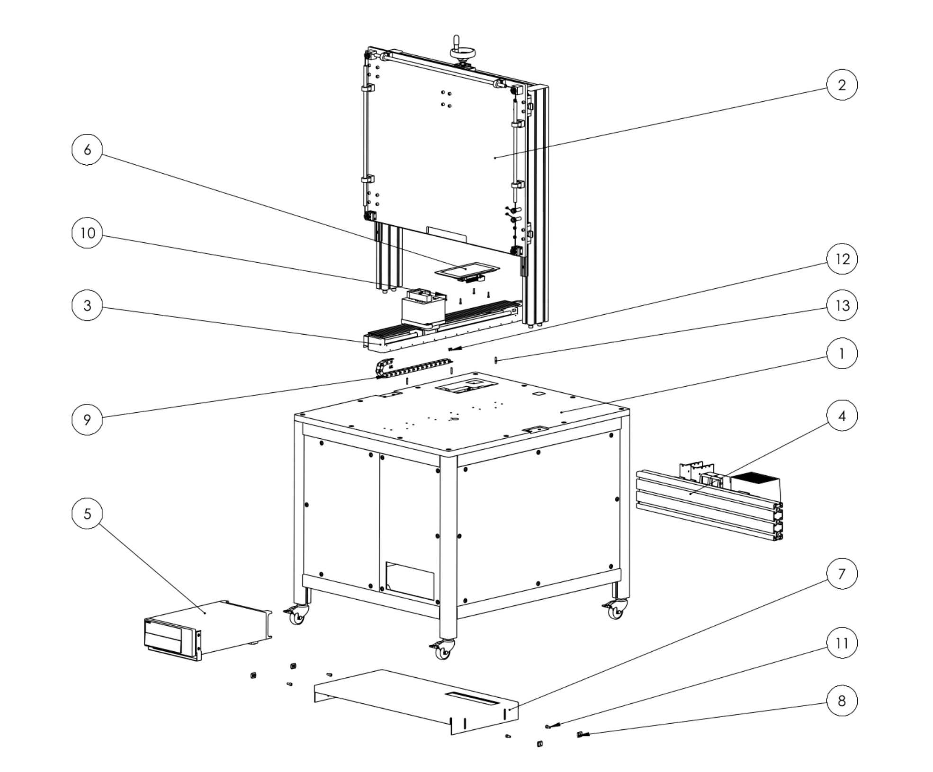
Stretched Wire Bench - Construction
Fixed single strand wire loop
Linear translation stage
Rotary stage

Slide 9
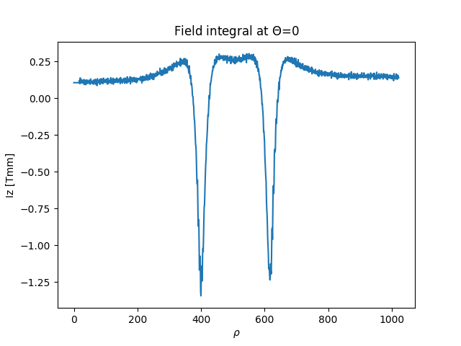
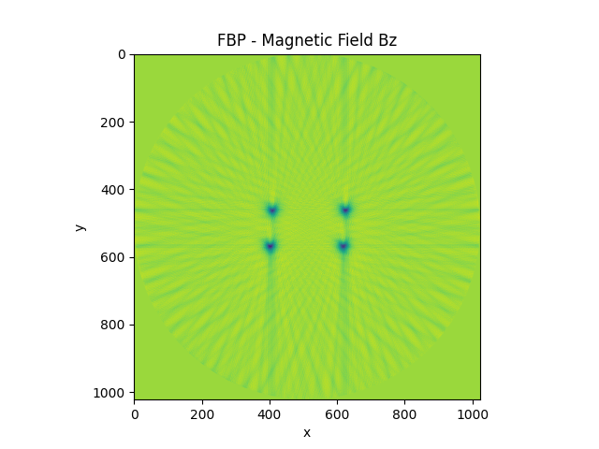
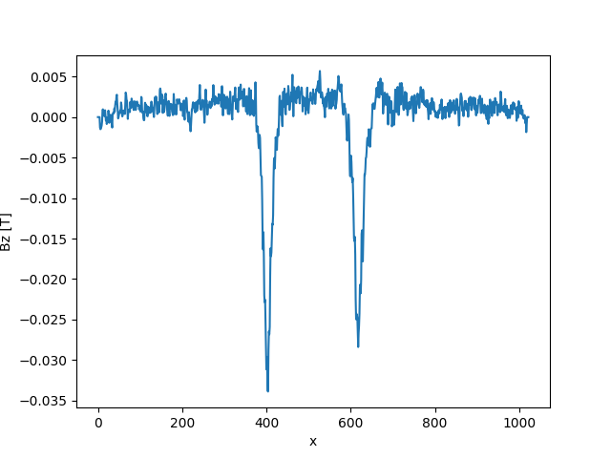
First Measurements
A set of 4 cylindrical magnets was used for the first measurements.

Slide 10
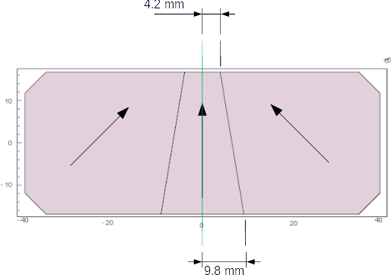
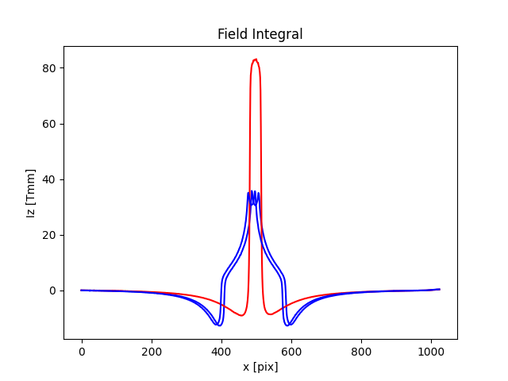
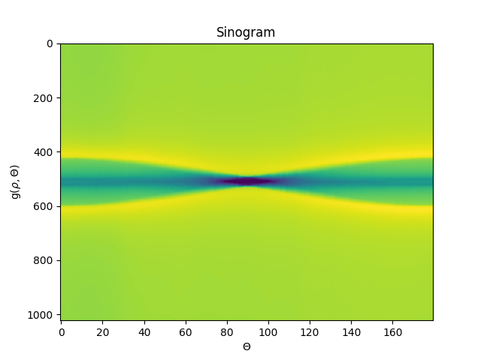
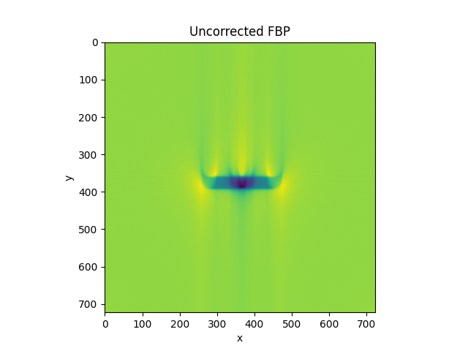
Measurements of a magnet block
A segmented magnet block made from 3 glued pieces was used for tests.

Slide 11
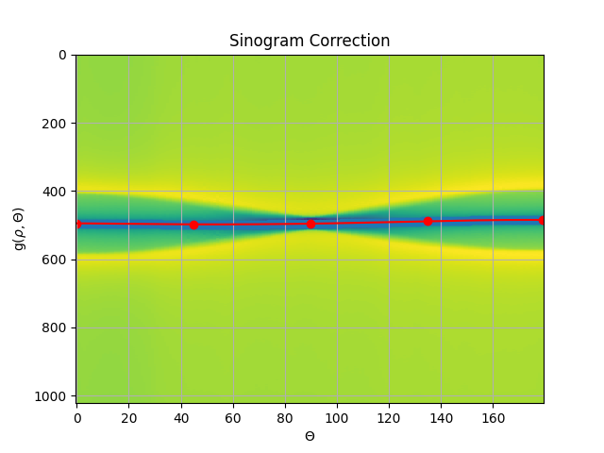
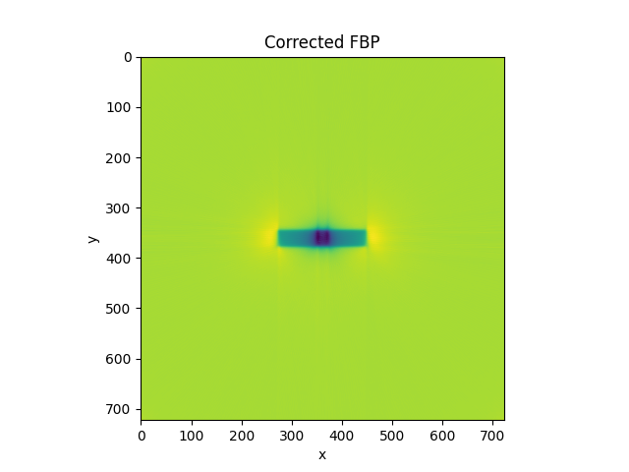
Axis shift correction
Each point in an image follows a sinus curve on a sinogram.
Misalignment of the rotation axis can be corrected by removing a sinus fit from a sinogram.
Jun K, Yoon S. Alignment Solution for CT Image Reconstruction using Fixed Point and Virtual Rotation Axis. Sci Rep. 2017 Jan 25;7:41218. doi: 10.1038/srep41218. PMID: 28120881; PMCID: PMC5264594. https://arxiv.org/ftp/arxiv/papers/1605/1605.04833.pdf

Slide 12
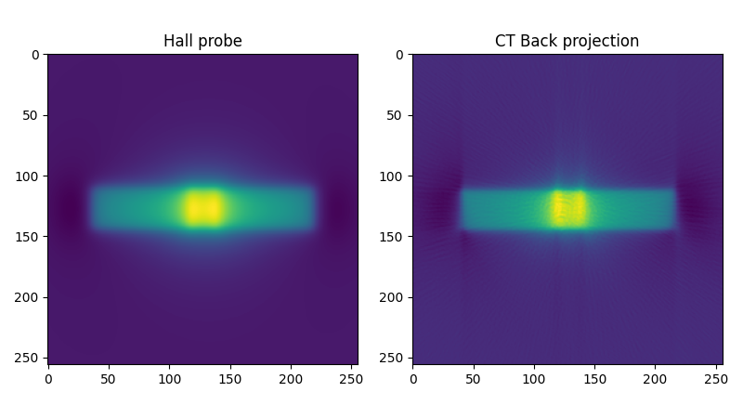
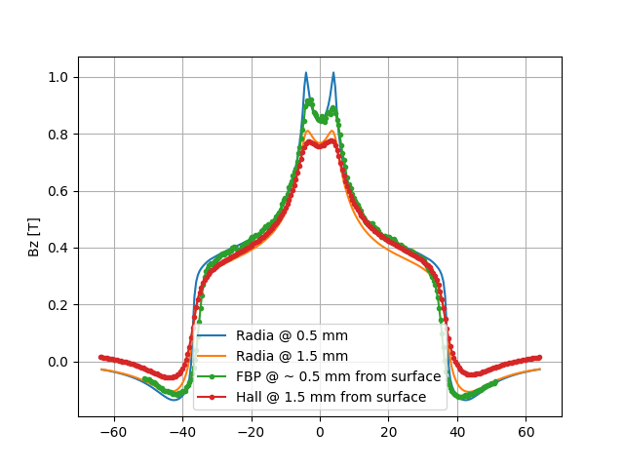
Comparison with a Hall probe
2D Hall probe field map
  Distance from surface 1.5 mm
  Longitudinal and horizontal step 0.5 mm/point
  128 x 128 point field map was created
SW Tomography
  Distance from surface was ~ 0.5 mm
  Field integrals measured at 180 angles
  Horizontal step was 0.4 mm/point

Slide 13
Conclusions
A dedicated SW Tomography bench was designed and assembled
First tests are very promising.
Advantages:
  Magnetic field very close to the surface can be measured.
  A dedicated bench can be used for magnet quality control
  Data could be used for further optimizations
Open questions:
  Can we measure absolute values of magnetic field?

Slide 14
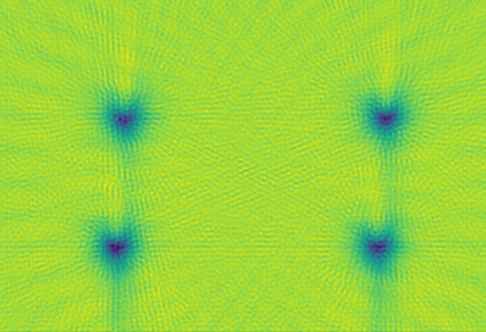
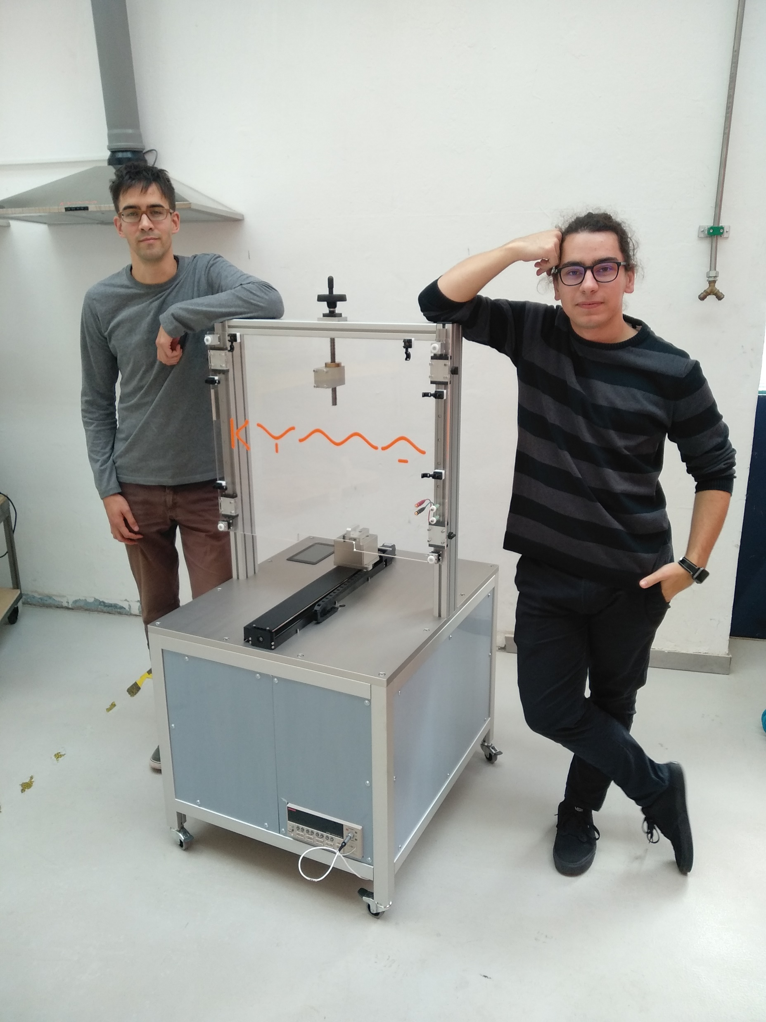
Thanks to the Team!
Special thanks to Andrej Nabergoj and Žan Mahnič

