Slide 1
A Static-Sample Magnetometer for Characterizing Weak Magnetic Materials
Mariano Pentella,
CERN, TE-MSC-TM
22nd International Magnetic Measurement Workshop (IMMW22)
Campinas, Brazil (Online)
29 September 2022
mariano.pentella@cern.ch

Slide 2
Outline
Introduction
Magnetic characterization of materials
Characterization of weak magnetic materials
Static-sample magnetometer
Experimental results
Summary and conclusions
Mariano Pentella, CERN, TE-MSC-TM
22nd International Magnetic Measurement Workshop (IMMW22) Campinas, Brazil (Online)
29 September 2022

Slide 3
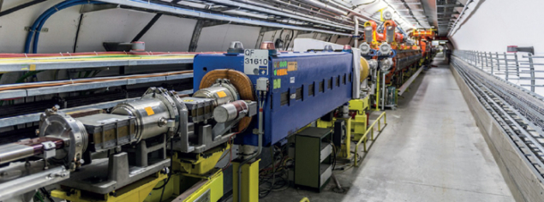
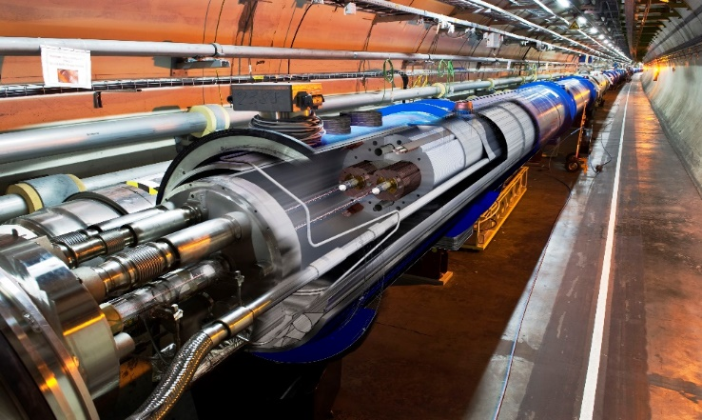
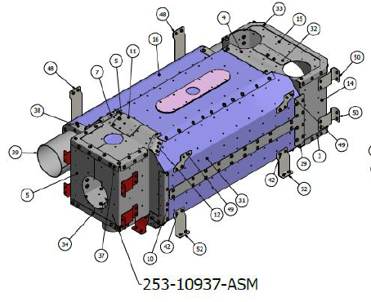
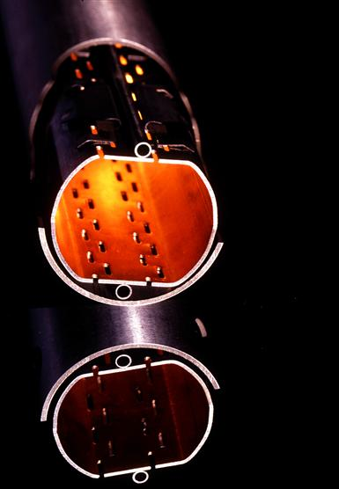
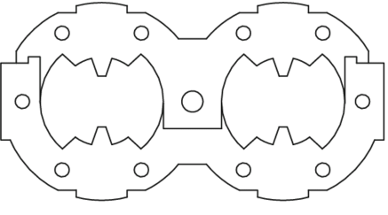

Introduction
Materials have to display - thermal, electrical, mechanical, magnetic - properties compatible with the target application
In particle accelerator applications assessing how a material behaves under the effect of a magnetic field is crucial
Normal conducting and superconducting magnets
In particular, many elements need to be “transparent” to the applied field to not perturb it, and thus not influence the beam stability.
Measurements of low magnetic permeabilities are required
$$μ_{r}<1.1$$
Collars, vacuum chambers, beam screens, etc.
Magnetic shields
Mariano Pentella, CERN, TE-MSC-TM
22nd International Magnetic Measurement Workshop (IMMW22) Campinas, Brazil (Online)
29 September 2022

Slide 4
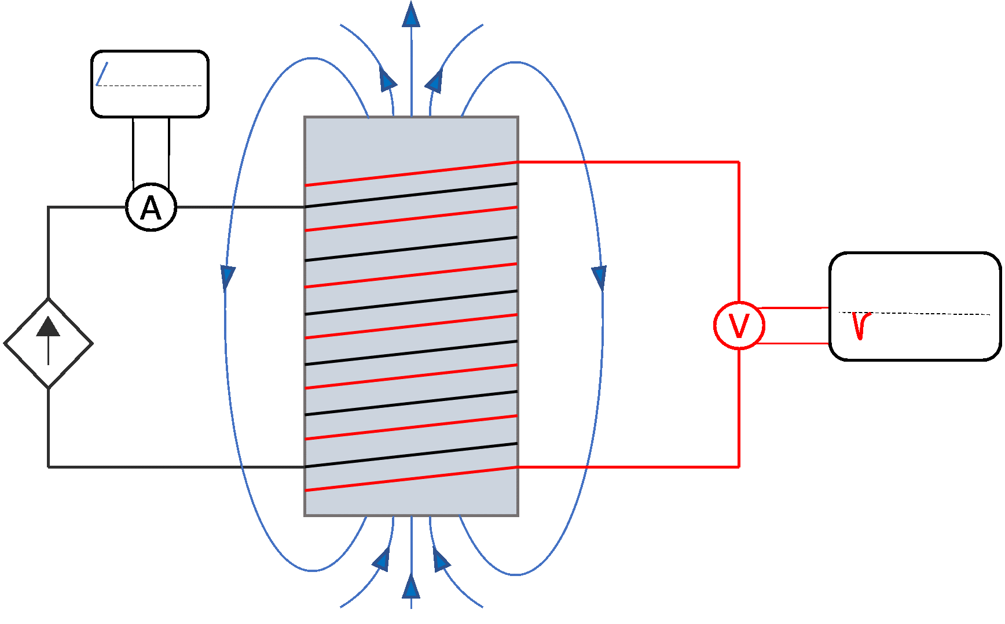
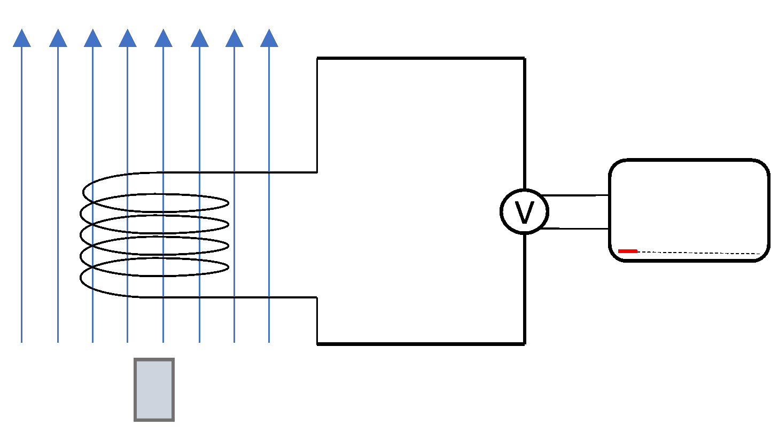
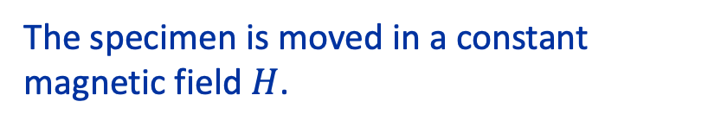
Magnetic characterization of materials - 1
The measurement methods can be grouped in three macro-areas
Fluxmetric methods: the sensing element, generally a pick-up coil, detects flux variations. The cause of the flux variations determines a sub-classification:
Transformer principle
Magnetometer principle
Application of a time-varying magnetic field $H$.
The specimen is moved in a constant magnetic field $H$.
Toroidal permeameters, bars, rods, Epstein frame, etc.
Vibrating and rotating sample magnetometers
Mariano Pentella, CERN, TE-MSC-TM
22nd International Magnetic Measurement Workshop (IMMW22) Campinas, Brazil (Online)
29 September 2022

Slide 5
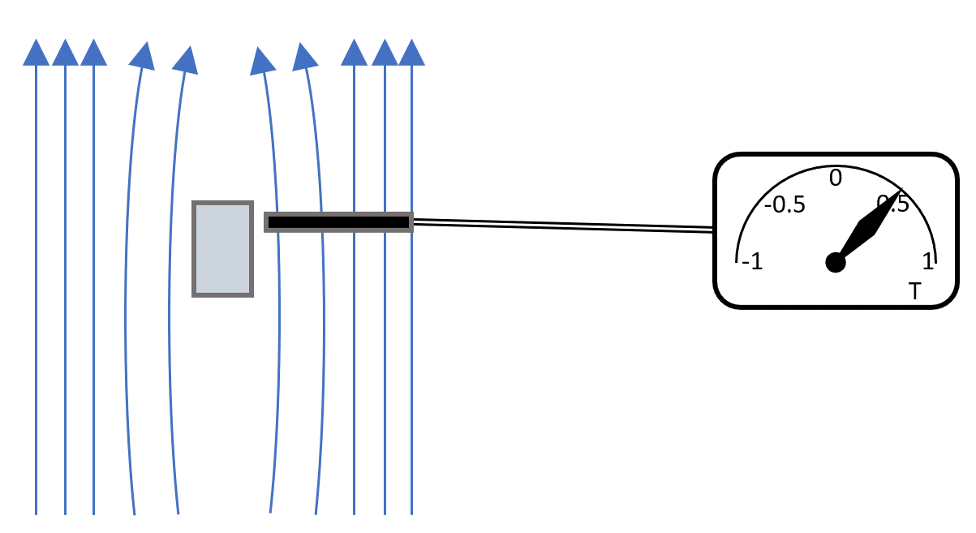
Magnetic characterization of materials - 2
The measurement methods can be grouped in three macro-areas
Flux distortion methods: the presence of a test specimen having $μ_{r}≠1$ under a uniform field $H$ determines a local distortion of the field lines. This distortion can be mapped by a sensor and the permeability (or the magnetization) can be evaluated by inverse-problem solving.
A vast choice of sensor technologies can be used for this approach: fluxgate magnetometers, Hall probes, NMR
Mariano Pentella, CERN, TE-MSC-TM
22nd International Magnetic Measurement Workshop (IMMW22) Campinas, Brazil (Online)
29 September 2022

Slide 6
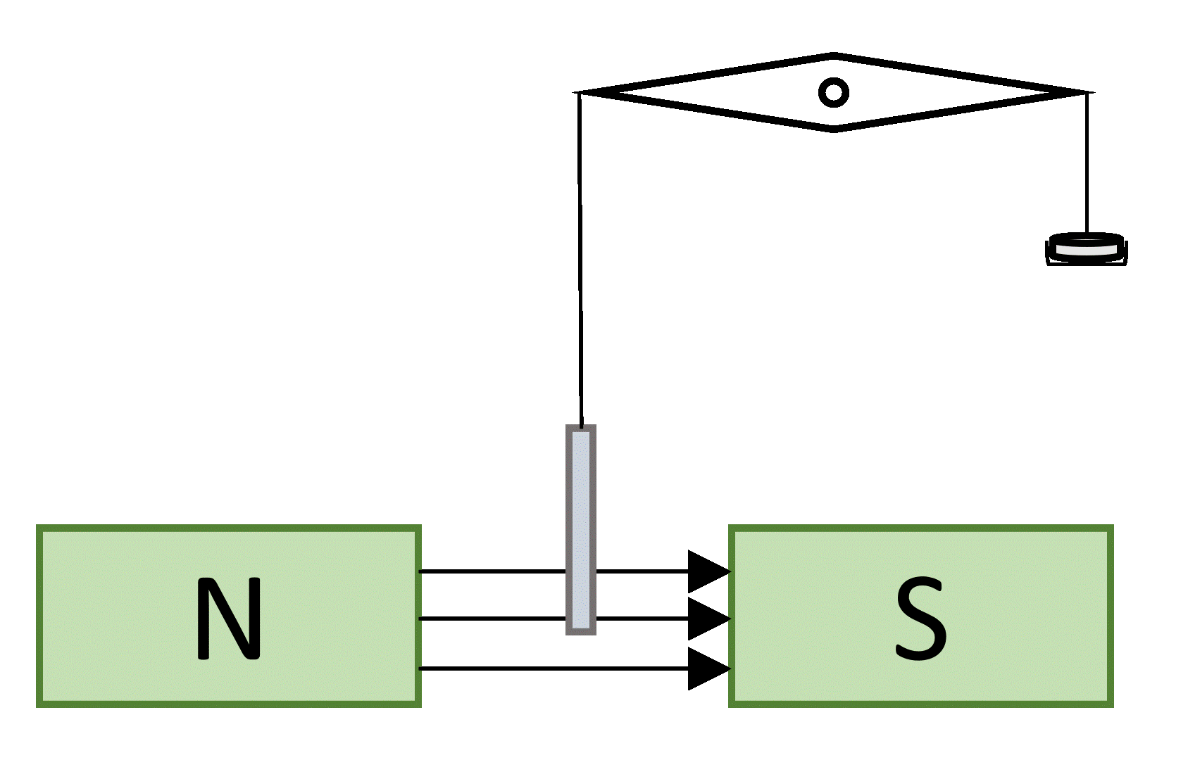
Magnetic characterization of materials - 3
The measurement methods can be grouped in three macro-areas
Force detection techniques (Gouy/Faraday balance): the force on a test specimen under the effect of an applied magnetic field can be detected by a change in the apparent mass. This apparent change of mass is proportional to the magnetic permeability of the specimen.
Mariano Pentella, CERN, TE-MSC-TM
22nd International Magnetic Measurement Workshop (IMMW22) Campinas, Brazil (Online)
29 September 2022

Slide 7
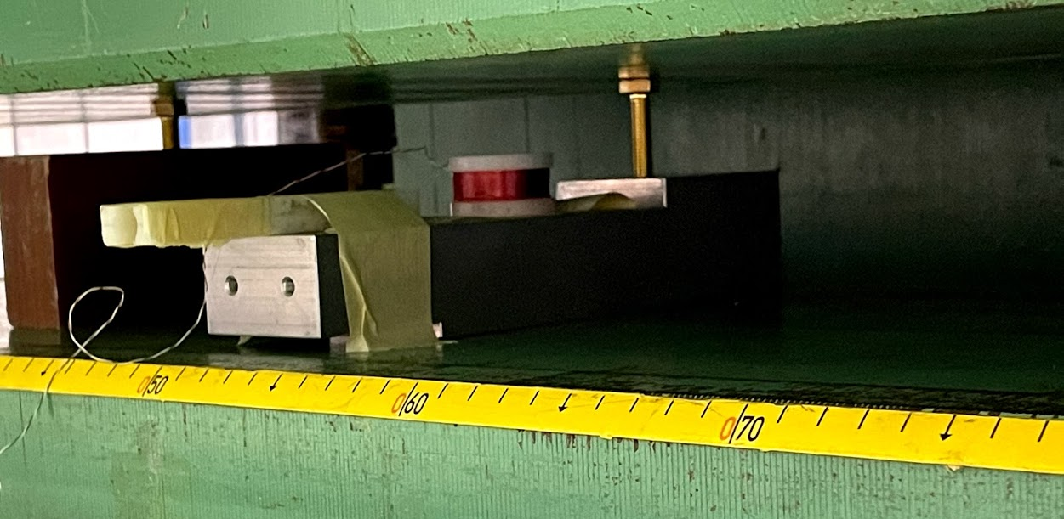
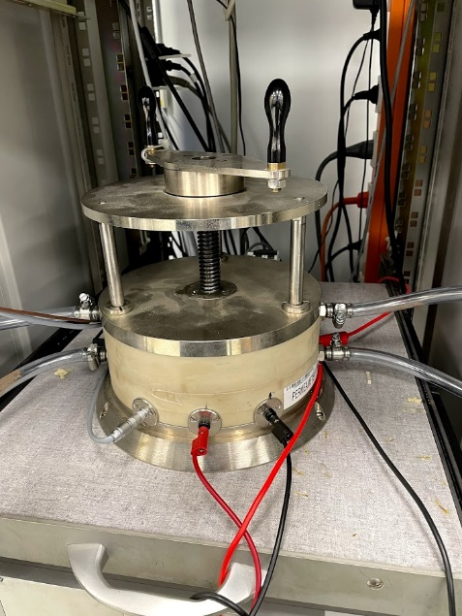
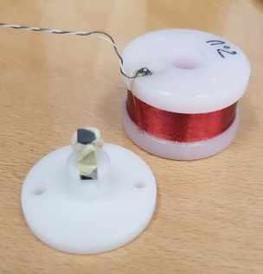
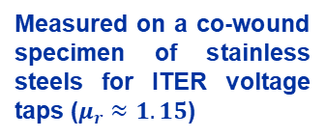

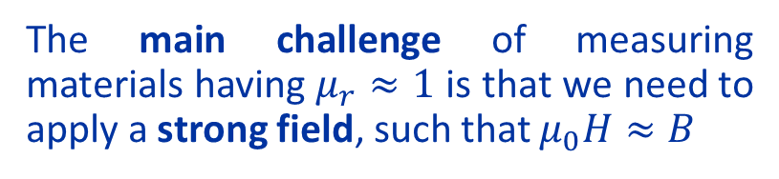
Characterization of weak magnetic materials - 1
Toroidal permeameters commonly used for ferromagnetic steels $μ_{r}≈1000$ do not have enough resolution for this kind of application
Measured on a co-wound specimen of stainless steels for ITER voltage taps ($μ_{r}≈1.15$)
Flux-metric method using an open sample (brick shaped)
Even if we do that, however…
The lower the permeability, the more the uncertainty of the $B$-field measurements has to decrease
The main challenge of measuring materials having $μ_{r}≈1$ is that we need to apply a strong field, such that $μ_{0}H≈B$
Magnetic permeability and repeatability bars measured on a specimen of stainless-steel type 316L
Mariano Pentella, CERN, TE-MSC-TM
22nd International Magnetic Measurement Workshop (IMMW22) Campinas, Brazil (Online)
29 September 2022

Slide 8
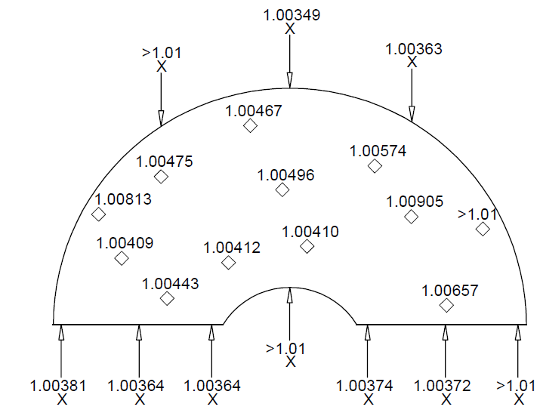
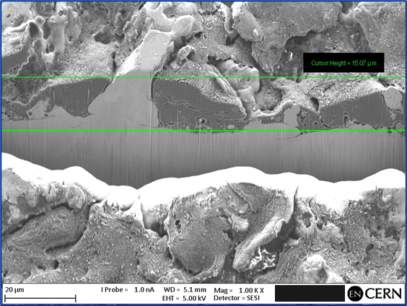
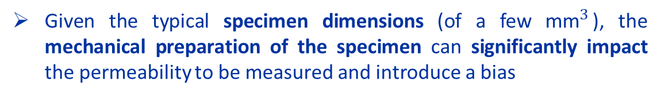
Characterization of weak magnetic materials - 2
Vibrating sample magnetometry (VSM) represents the reference solution due to its resolution (${10}^{−5}$). However, it presents two main limitations:
Given the typical specimen dimensions (of a few ${\text{mm}}^{3}$), the mechanical preparation of the specimen can significantly impact the permeability to be measured and introduce a bias
Multiple samples are necessary to obtain a result which can be considered as representative of a material batch
Stainless steel type 316 after EDM cut – FIB-SEM scan
Stainless steel type 316 – VSM specimens vs SSM specimen (black)
Permeability map of a stainless-steel type 304L plate for the CMS HGCAL (High-Granularity CALorimeter). Measured at 0.1 T.
Mariano Pentella, CERN, TE-MSC-TM
22nd International Magnetic Measurement Workshop (IMMW22) Campinas, Brazil (Online)
29 September 2022

Slide 9
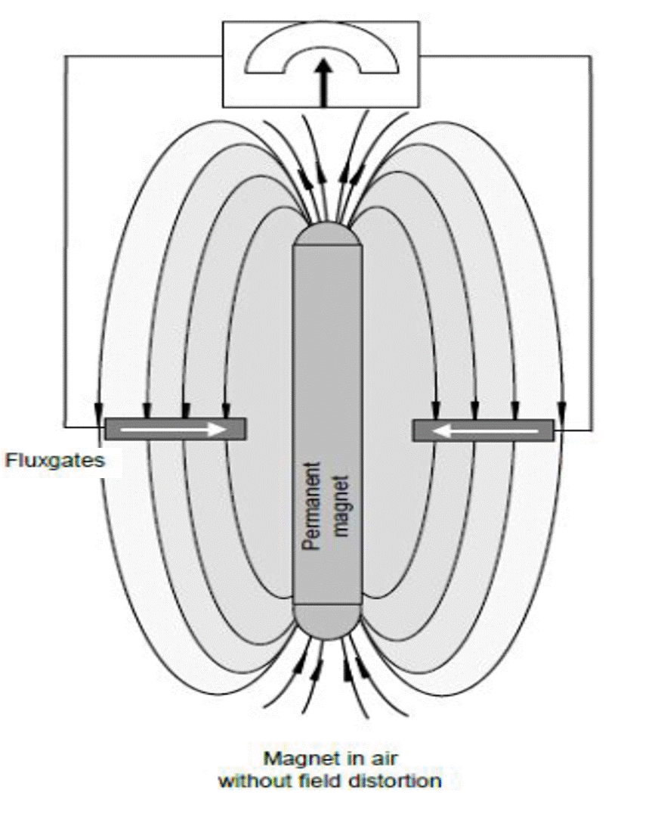
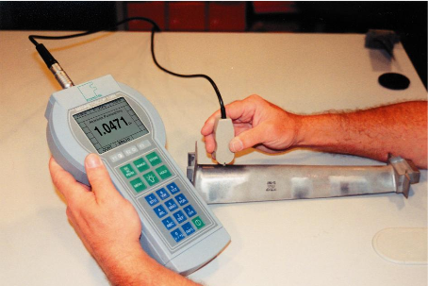
Characterization of weak magnetic materials - 3
Bulky specimens can be measured effectively using flux-distortion detection techniques, which are reported in the ASTM and IEC standards. However, they have never been fully exploited in the literature so far.
Such measurement principle is generally adopted in commercial portable instruments, such as the Foerster Magnetoscop
Portable instrument mainly used for in-situ inspections of finished parts
An important feature is that the instrument is not limited to a specific specimen shape
Limited accuracy (5 % of measured value)
No field sweep. Measurements possible only at 80 kA/m (about 0.1 T).
Foerster Magnetoscope working principle
Can we improve the measurement accuracy, have the possibility to change the test field, without losing the flexibility in terms of specimen geometry?
Mariano Pentella, CERN, TE-MSC-TM
22nd International Magnetic Measurement Workshop (IMMW22) Campinas, Brazil (Online)
29 September 2022

Slide 10
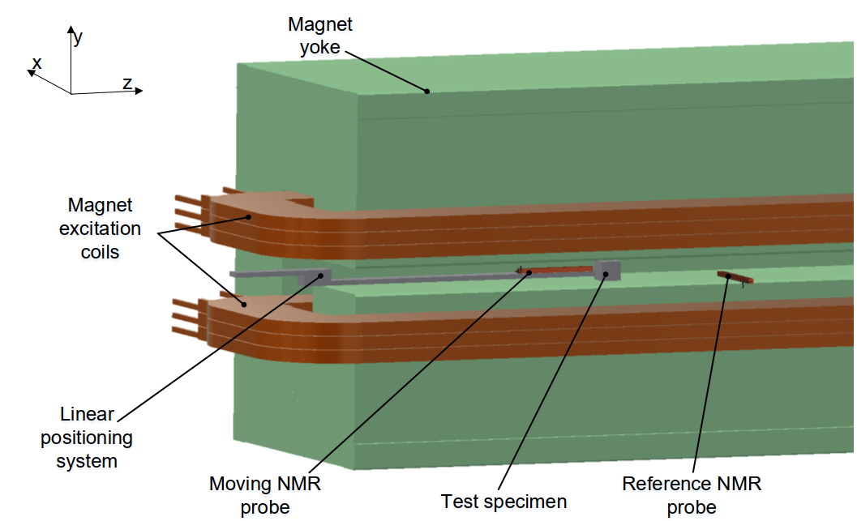
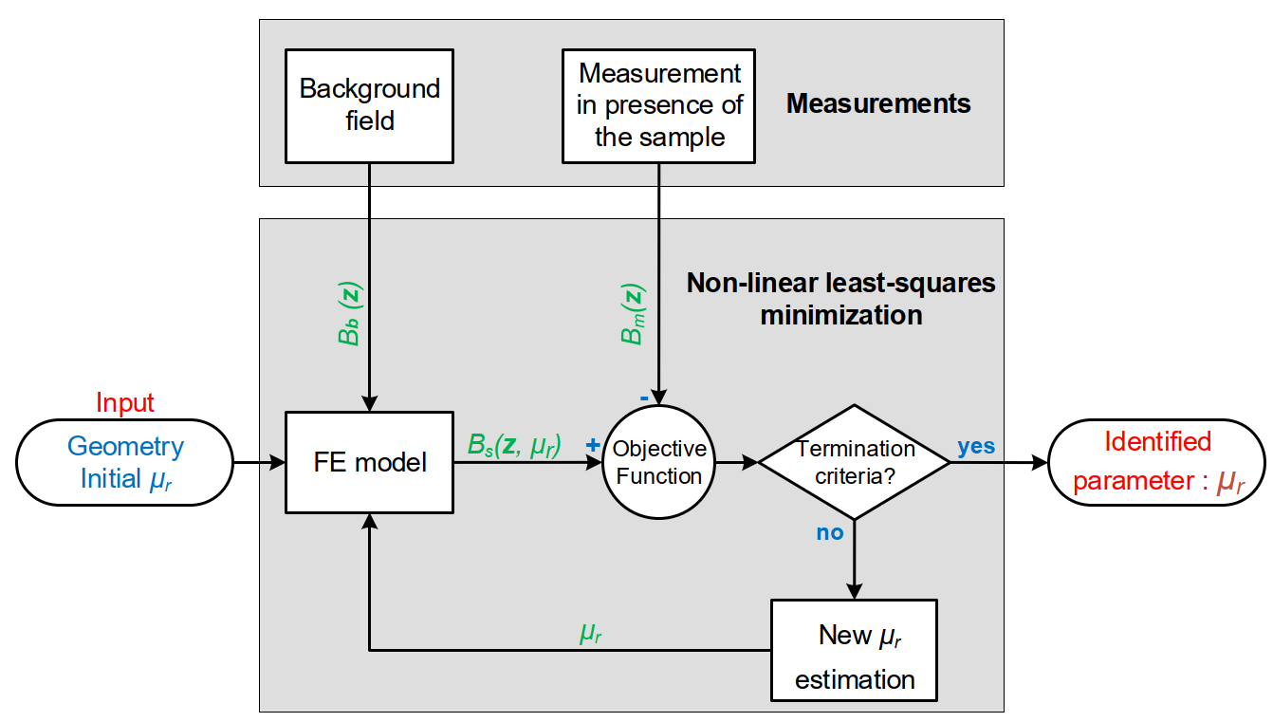


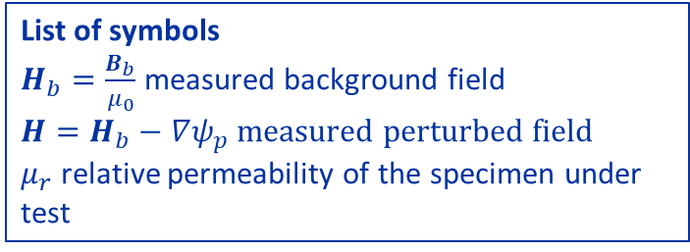
Static-sample magnetometer - 1
Example of output of the problem
$$μ_{r}=1.00268$$
$$∇ ∙\left[μ_{r}μ_{0}\left(−∇ψ_{p}+H_{b}\right)\right]=0$$
The model used for the Finite Element (FE) Analysis is a magnetostatic model in terms of reduced magnetic scalar potential formulation.
Boundary conditions set to 0
List of symbols
$H_{b}=\frac{B_{b}}{μ_{0}}$ measured background field
$H=H_{b}−∇ψ_{p}$ measured perturbed field
$μ_{r}$ relative permeability of the specimen under test
Mariano Pentella, CERN, TE-MSC-TM
22nd International Magnetic Measurement Workshop (IMMW22) Campinas, Brazil (Online)
29 September 2022

Slide 11
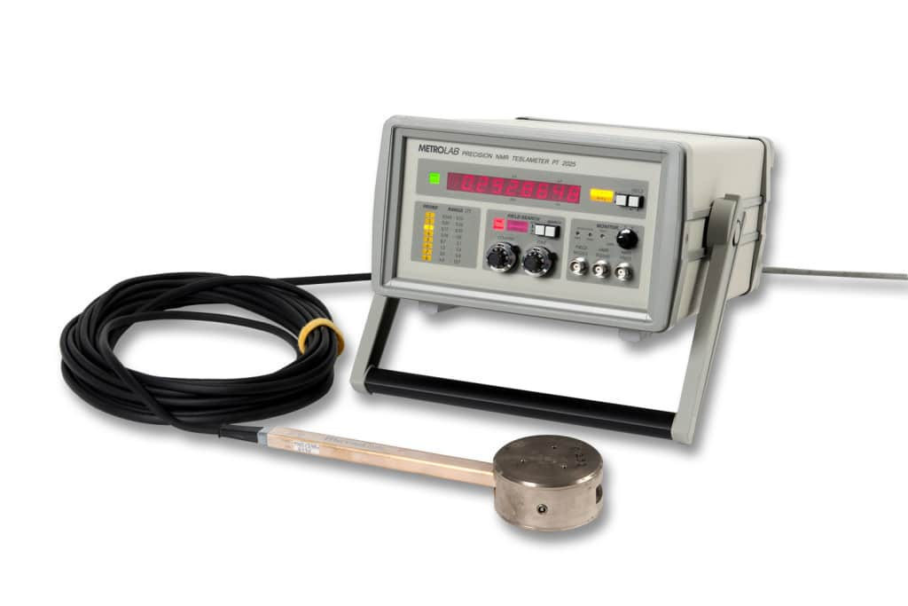
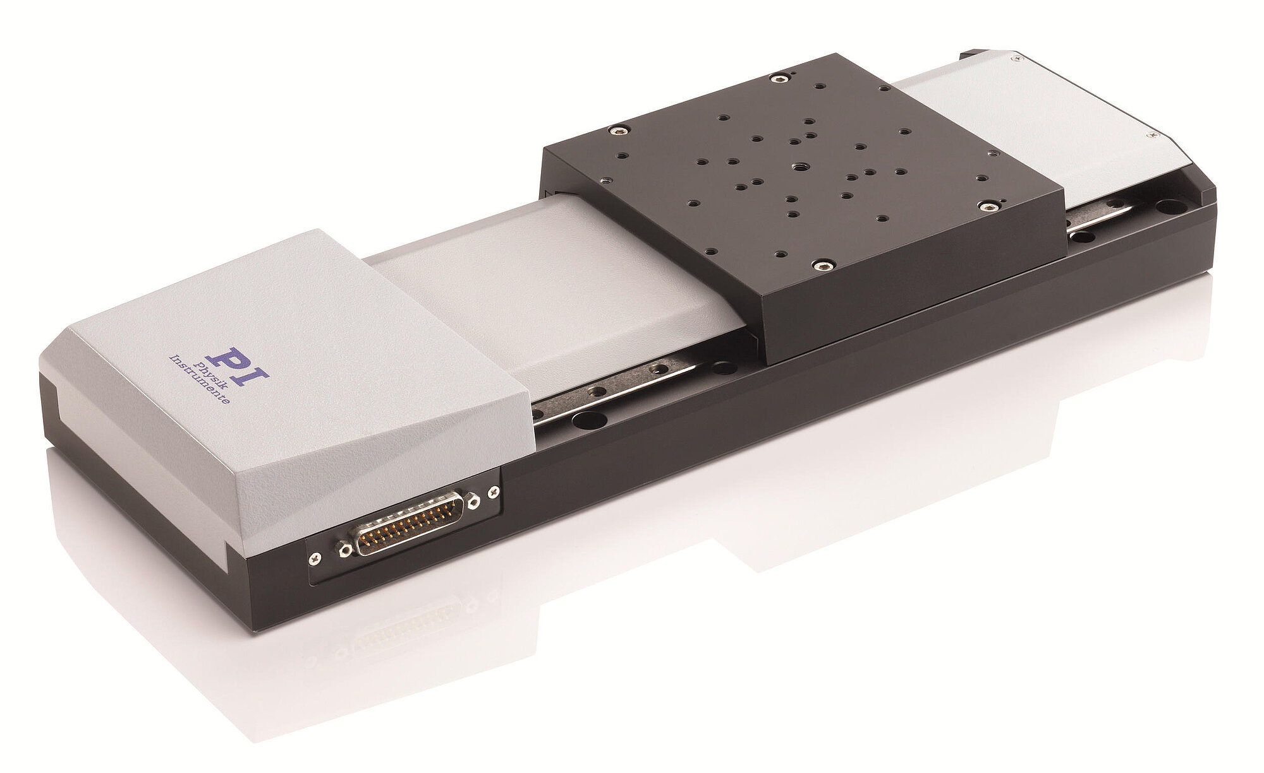
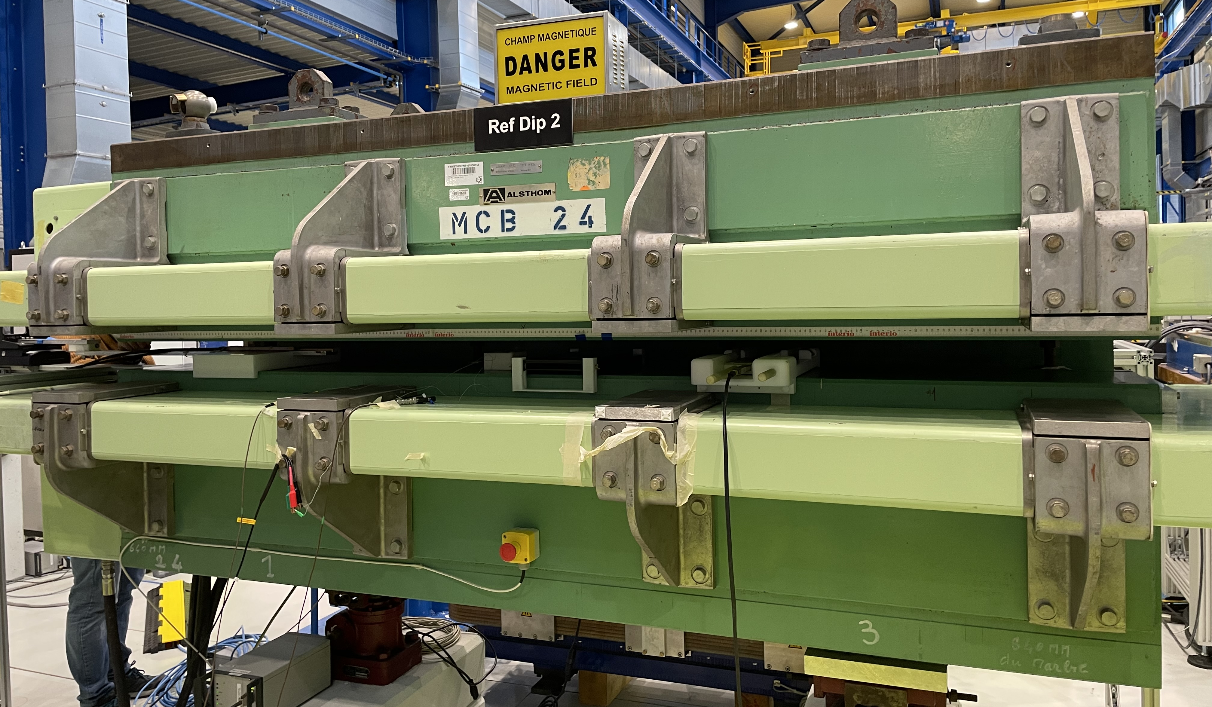
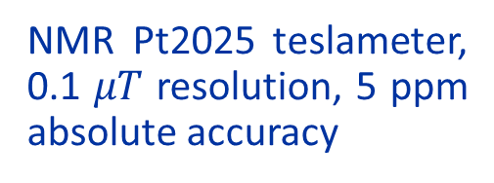

Static-sample magnetometer - 2
NMR Pt2025 teslameter, 0.1 $μT$ resolution, 5 ppm absolute accuracy
Reference dipole, field range 0-1.2 T
PI linear positioning system
$$Q=\log_{10}\left|\frac{\overline{B_{y}}\left(x,y\right)−\overline{B_{y}}\left(0,0\right)}{\overline{B_{y}}\left(0,0\right)}\right|$$
Field map of the dipole magnet measured by NMR at an excitation current of 316 A.
Integrated field quality (courtesy of M. Liebsch), measured by SSW
Mariano Pentella, CERN, TE-MSC-TM
22nd International Magnetic Measurement Workshop (IMMW22) Campinas, Brazil (Online)
29 September 2022

Slide 12
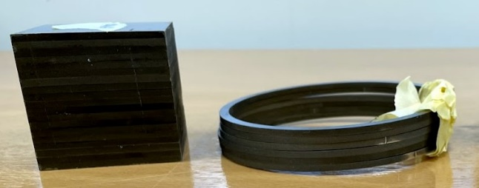
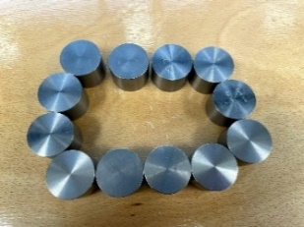
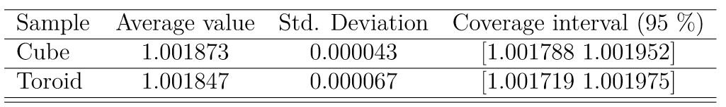
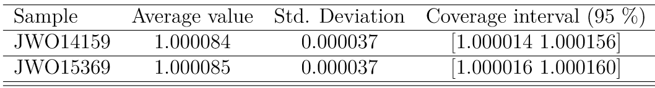
Experimental results - 1
10RM18 for HL-LHC magnets’ collars
WHA ASTM B-777 class 3 for radiation shielding (95 % tungsten)
Specimens:
A stack of laminations 60x60 mm, 3 mm thick
A stack of 6 toroid, 114mm De, 105mm Di, H 3 mm
Specimens:
12 bulk cylinders 35 mm diameter and 25 mm thick
Monte Carlo simulation results
Interlab. check
Monte Carlo simulation results
Interlab. check
JWO14159
Cube
Mariano Pentella, CERN, TE-MSC-TM
22nd International Magnetic Measurement Workshop (IMMW22) Campinas, Brazil (Online)
29 September 2022

Slide 13
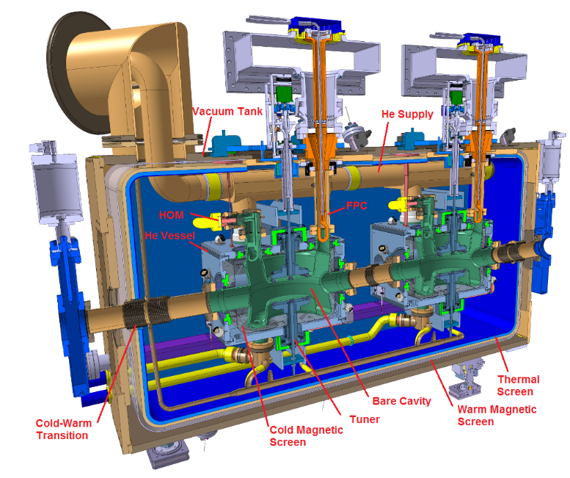
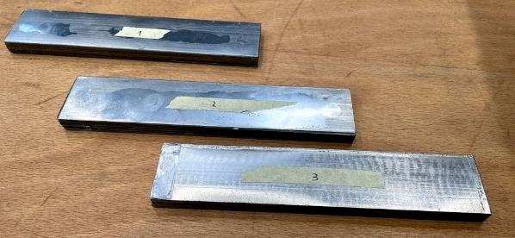
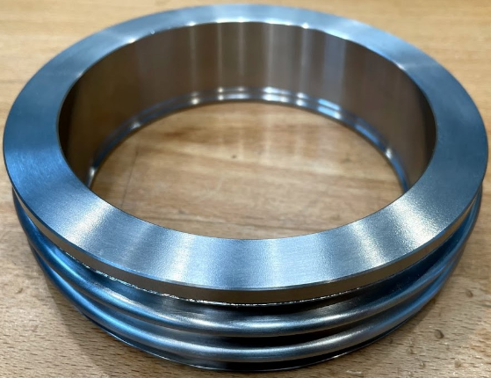
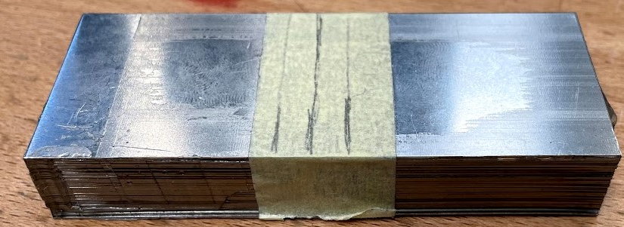
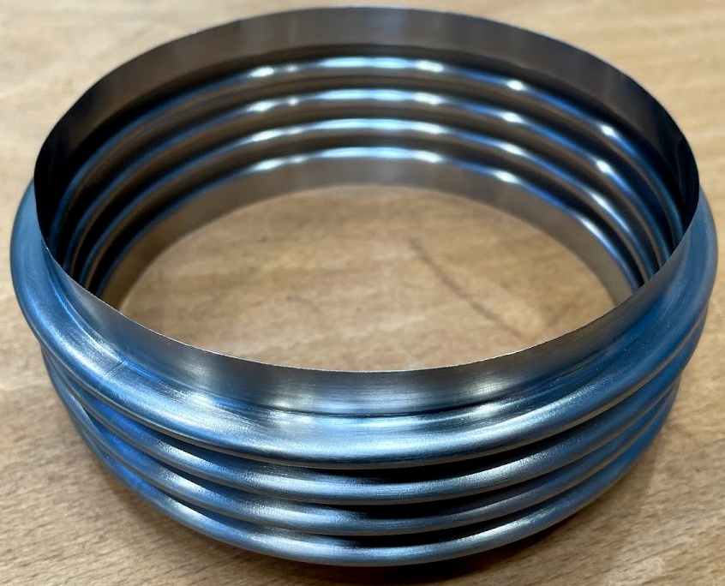
Experimental results - 2
Characterization of AISI type 316L, grades 1.4404 and 1.4441
Impact of deformation
Impact of deformation
Finished parts
DQW cryomodule layout
Specimens of raw material
We can use a CAD drawing to model simple finished parts
Mariano Pentella, CERN, TE-MSC-TM
22nd International Magnetic Measurement Workshop (IMMW22) Campinas, Brazil (Online)
29 September 2022

Slide 14
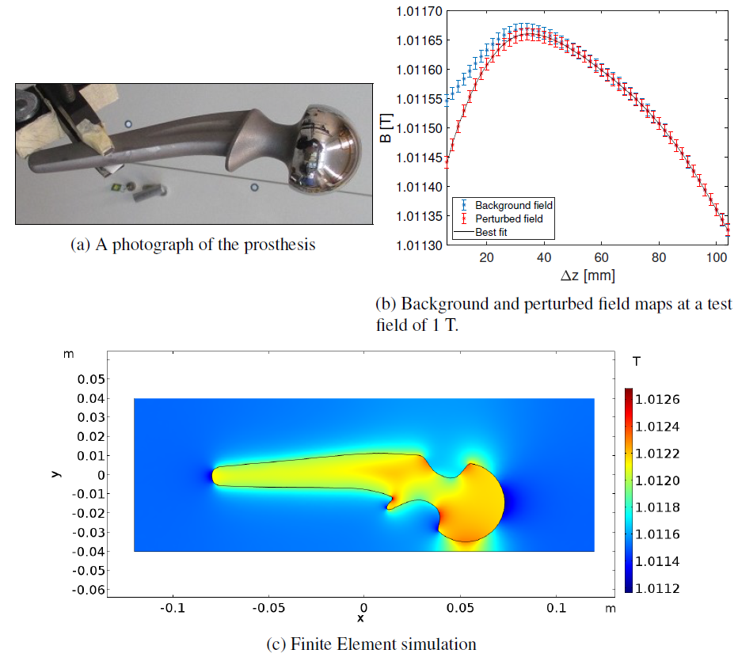
Experimental results - 3
In the absence of an available drawing, 3D scans can be used and imported in the FE software, thus fully exploiting the potentiality of using FE Analysis
Measurement of a hip prosthesis made of F-75. Computed permeability 1.00093±0.00003
Mariano Pentella, CERN, TE-MSC-TM
22nd International Magnetic Measurement Workshop (IMMW22) Campinas, Brazil (Online)
29 September 2022

Slide 15
Summary and conclusions
A Static-Sample Magnetometer (SSM) was conceived and developed to meet an increasing demand of weak magnetic material measurements, to be used in a broad spectrum of projects and applications at CERN
The measurement is based on the flux-distortion detection principle, combined with Finite Element Analysis. The permeability resolution is in the order of 10⁻⁵, and the uncertainty of 10⁻⁴, with the method showing unprecedented performance in comparison with commercially available instruments.
Similarly to commercially available instruments, we can test specimens having various shape and dimensions (compatible with the magnet gap). In addition, test at several field values are possible.
A cold version with cold specimen in a warm magnet bore is currently under study
Pasquale Arpaia, Marco Buzio, Alessandro Parrella, Mariano Pentella, and Pedro M. Ramos. "A Static-Sample Magnetometer for Characterizing Weak Magnetic Materials." IEEE Transactions on Instrumentation and Measurement 70 (2020): 1-9.
Mariano Pentella "Characterization of magnetic materials at extreme ranges of field, temperature, and permeability”, Doctoral Thesis, https://iris.polito.it/handle/11583/2964790, 2022
Mariano Pentella, CERN, TE-MSC-TM
22nd International Magnetic Measurement Workshop (IMMW22) Campinas, Brazil (Online)
29 September 2022

