Slide 1
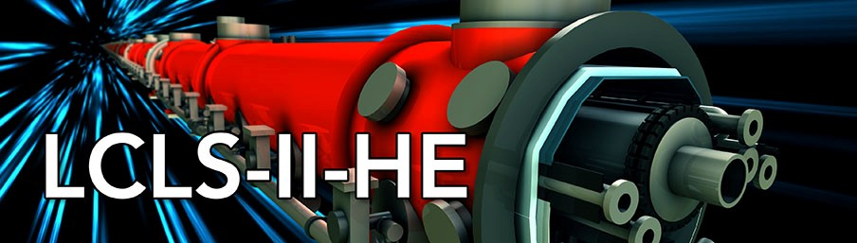





SLAC Undulator And Phase Shifter Measurements
Zachary Wolf, Yurii Levashov, Scott Anderson
9/27/22

Slide 2
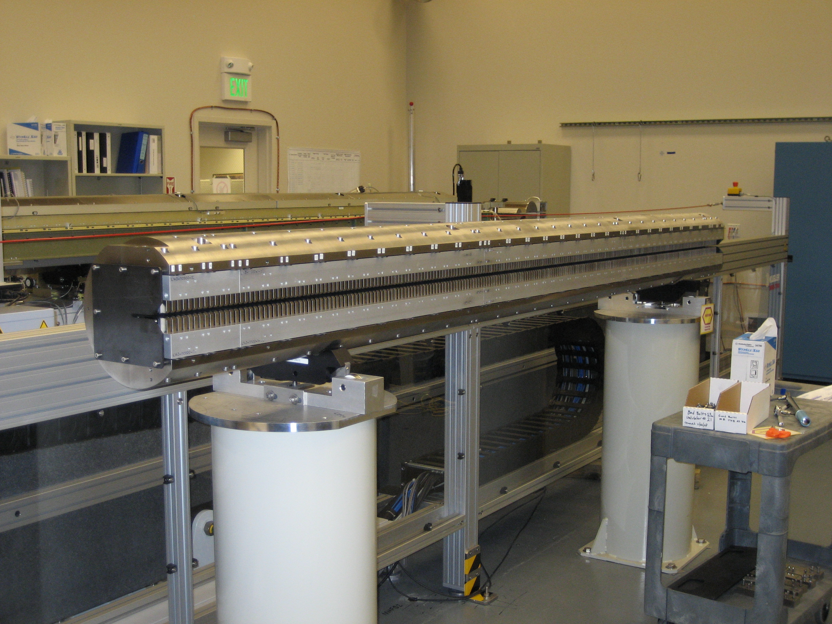
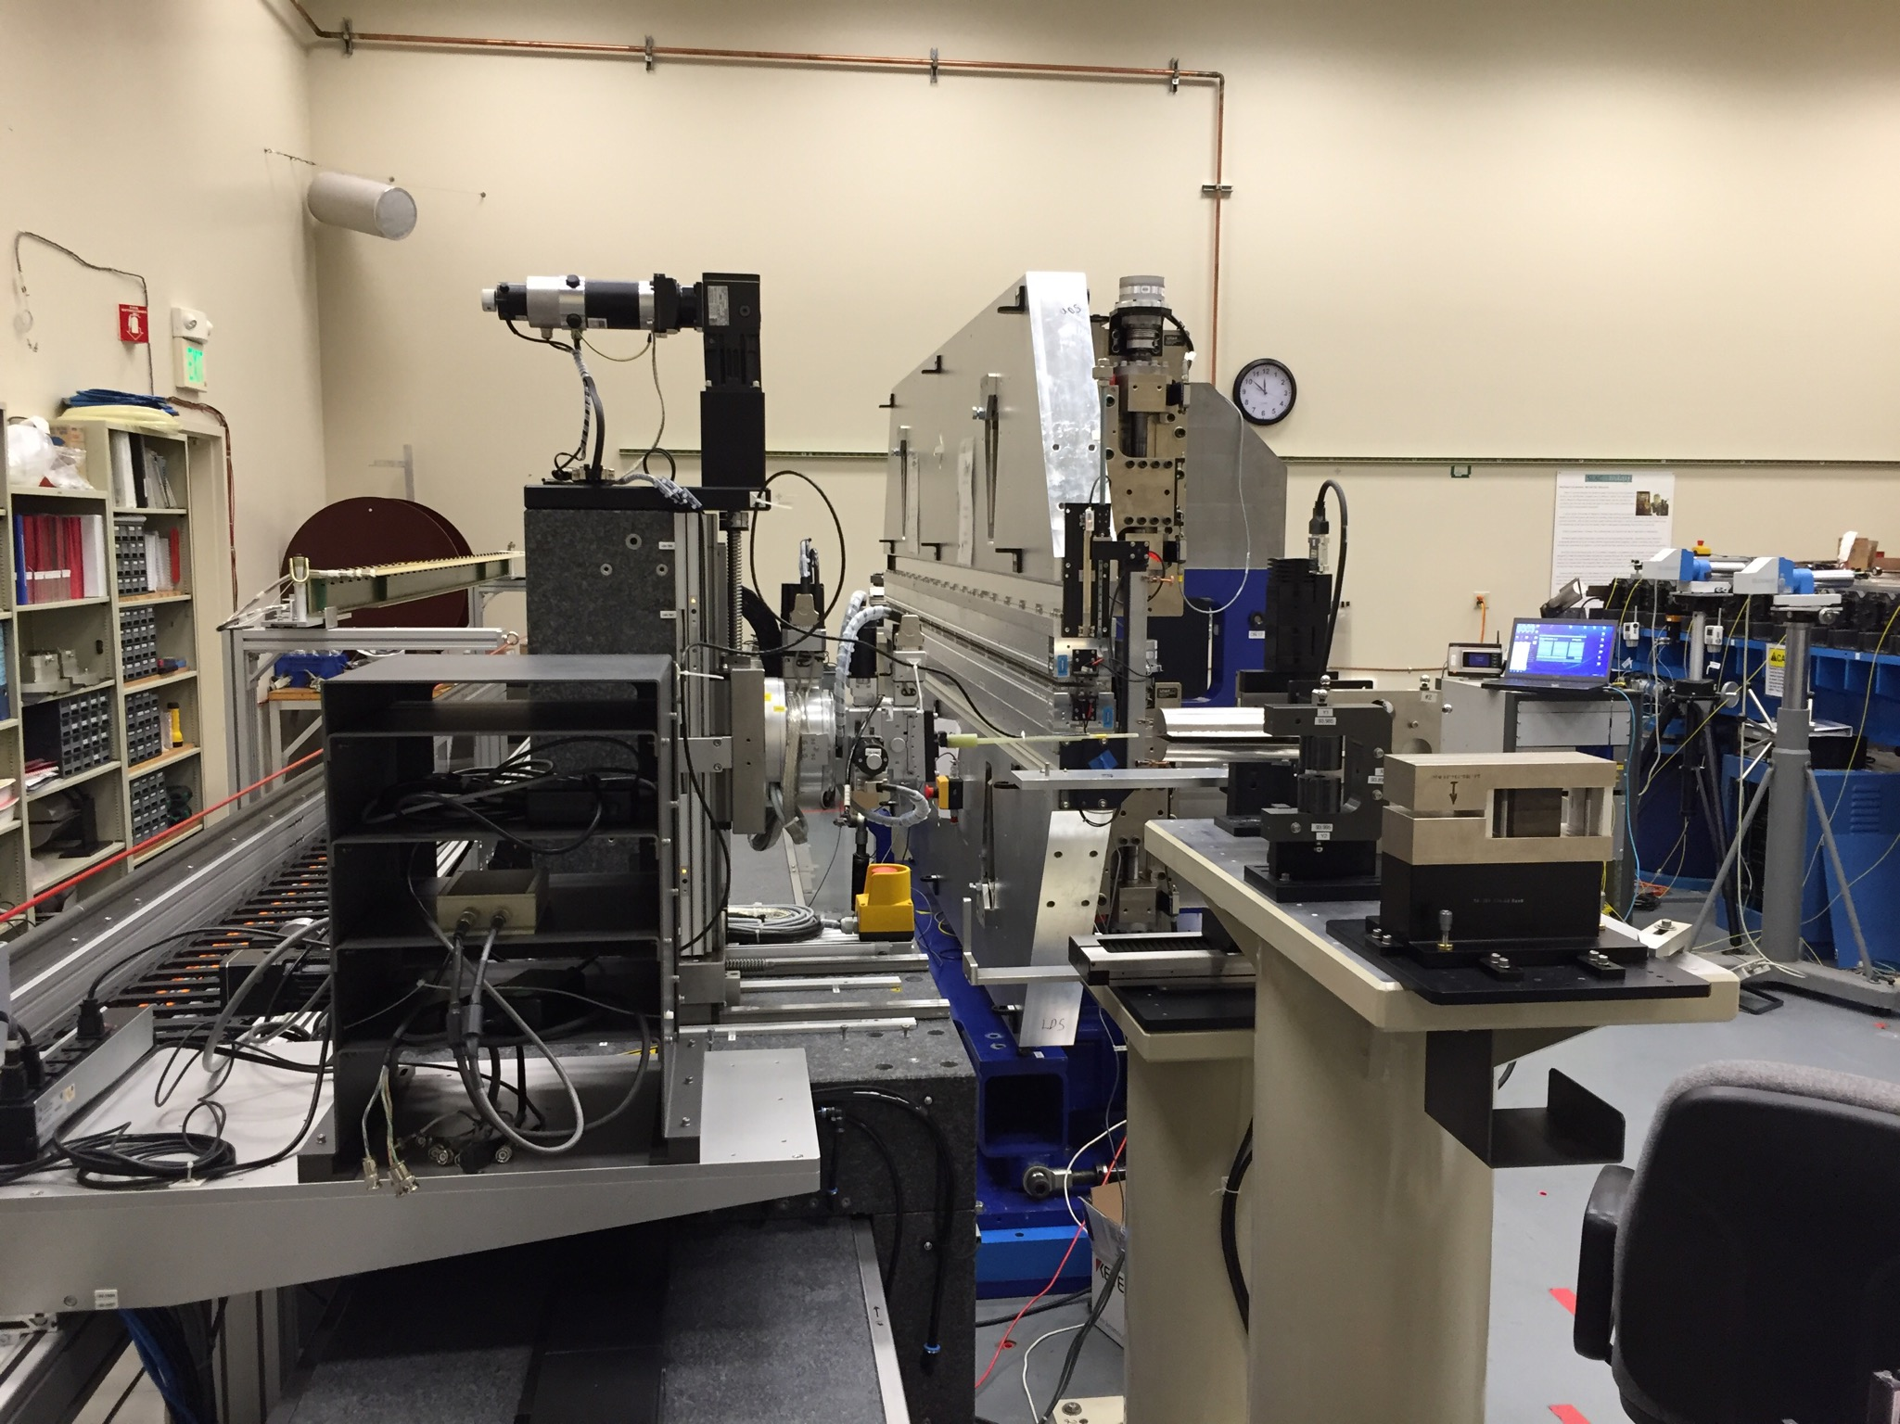
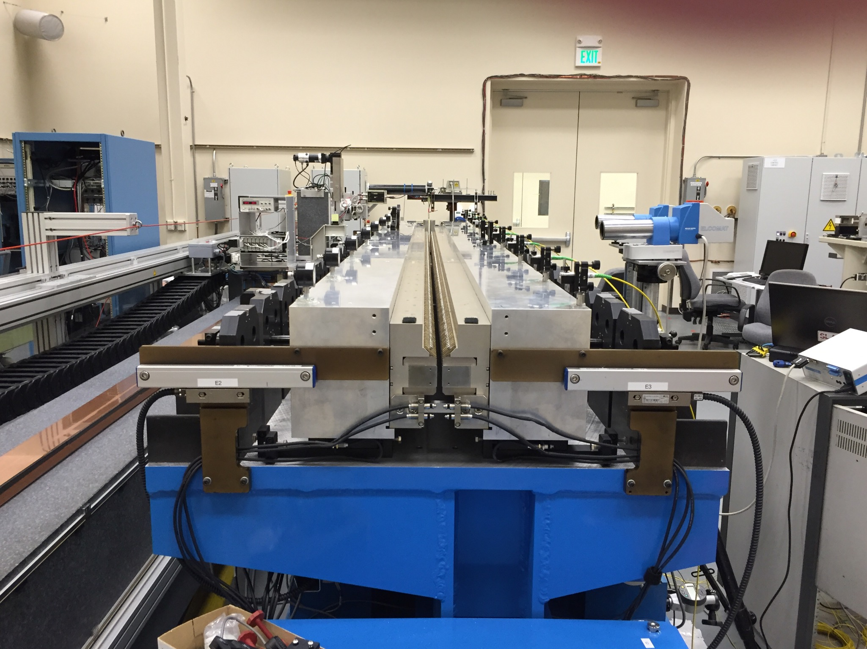
SLAC Recent Projects Using Undulators
LCLS, completed 2009, 33 undulators, 1 delta undulator
LCLS-II, copper linac 2019, 4 Gev SC linac in progress, 33 HXR undulators and 32 phase shifters, 21 SXR undulators and 20 phase shifters
LCLS-II-HE, 8 GeV SC linac in progress, add/refurbish to make 30 SXR undulators, 29 phase shifters, 3 delta undulators, 3 superconducting undulators
LCLS
LCLS-II SXR
LCLS-II HXR

Slide 3
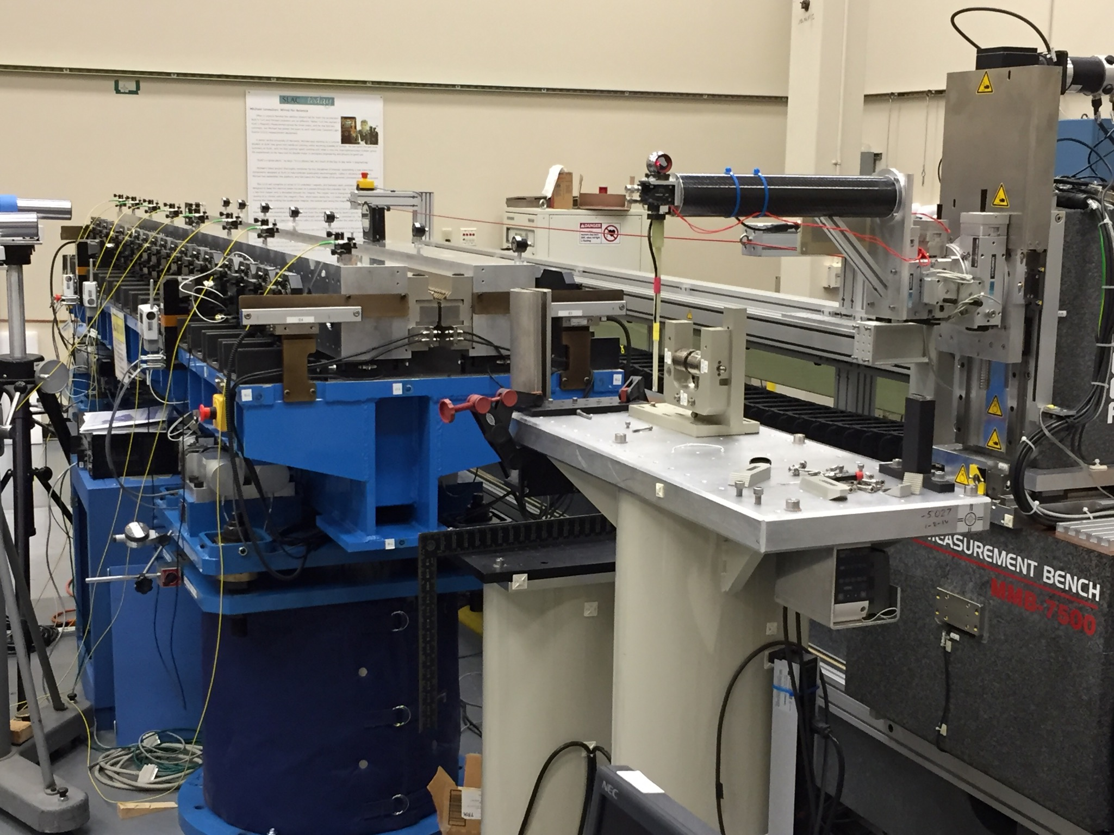
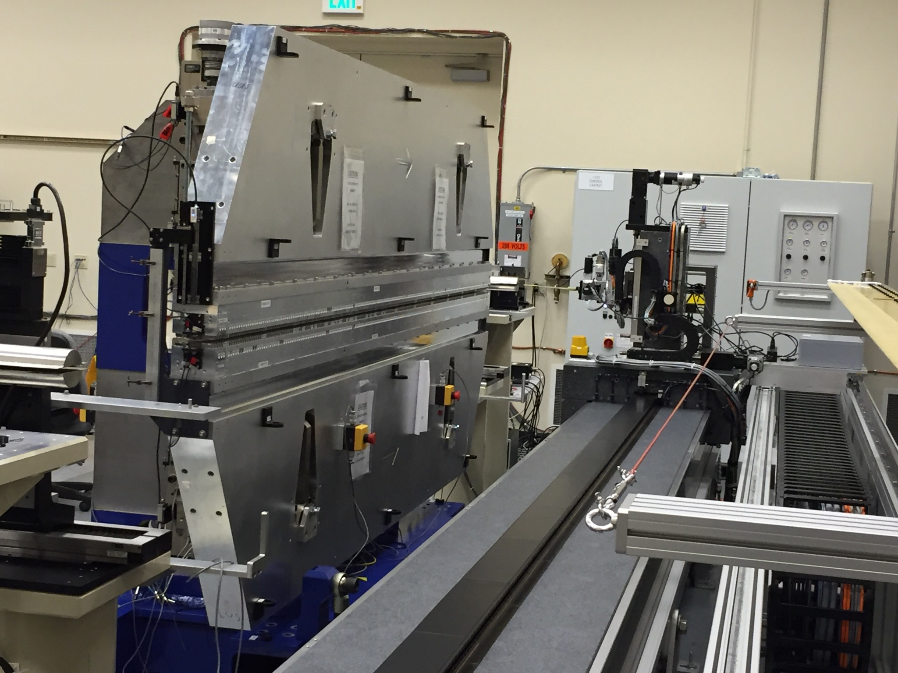
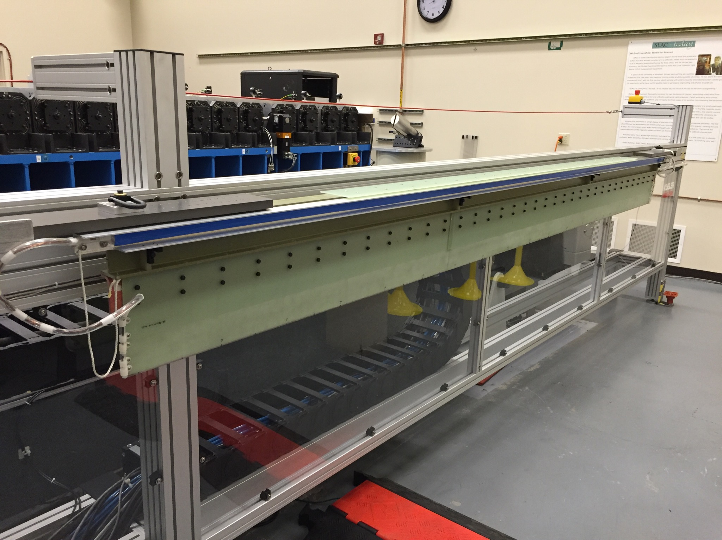
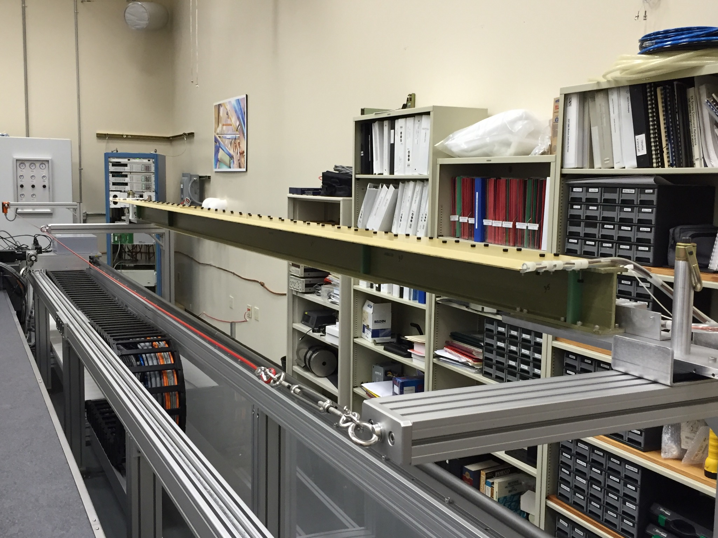
LCLS Undulator Measurements
Probes move in a straight line. Field integrals are done with a moving coil with 130 turns.
HXR
SXR

Slide 4
Measurement Bench Straightness
X Y straightness spec: < 14 μm
Pitch and yaw spec: < 4.2 μrad

Slide 5
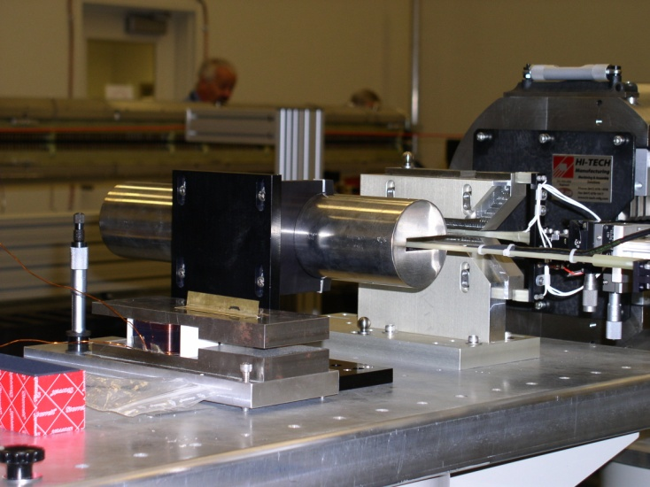
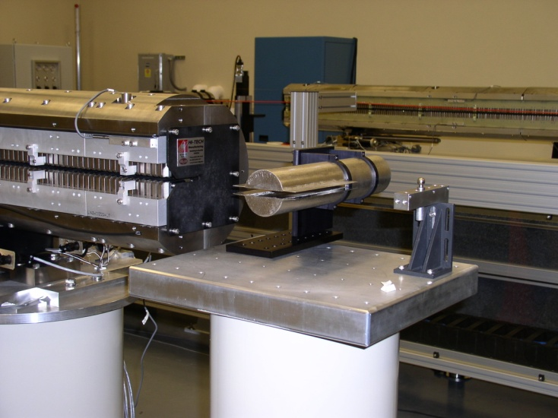
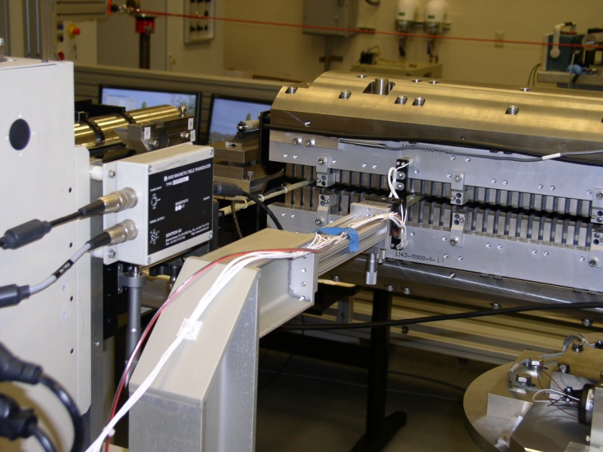
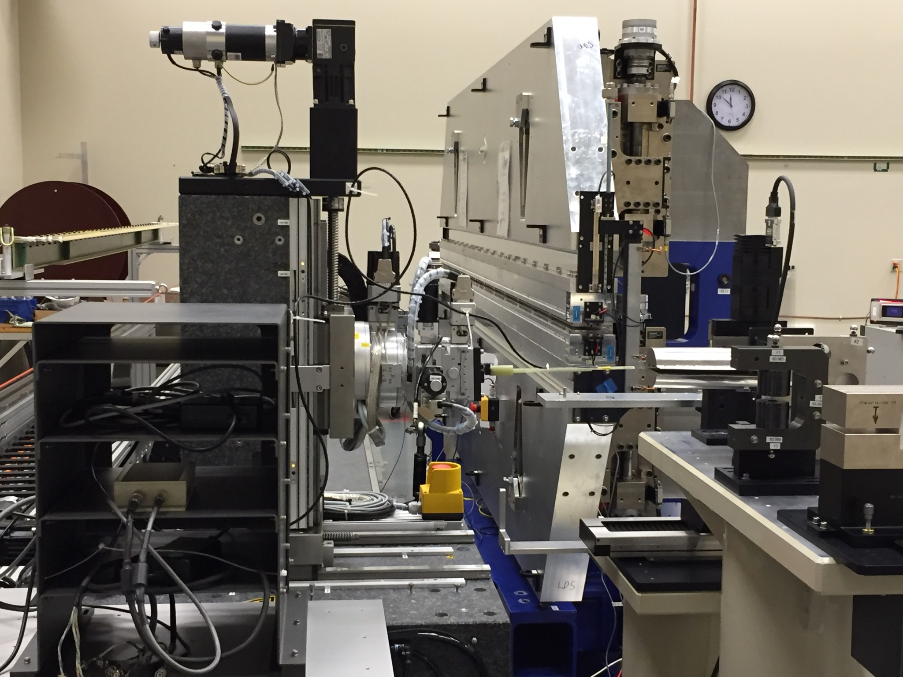
Hall Probe Measurements
Laboratory temperature stable to 0.1 deg C
Beginning
zero field
measurement
Ending
zero field
measurement
Further offset correction from
field integral measurements
Sentron Hall probe
Vertical field magnet

Slide 6
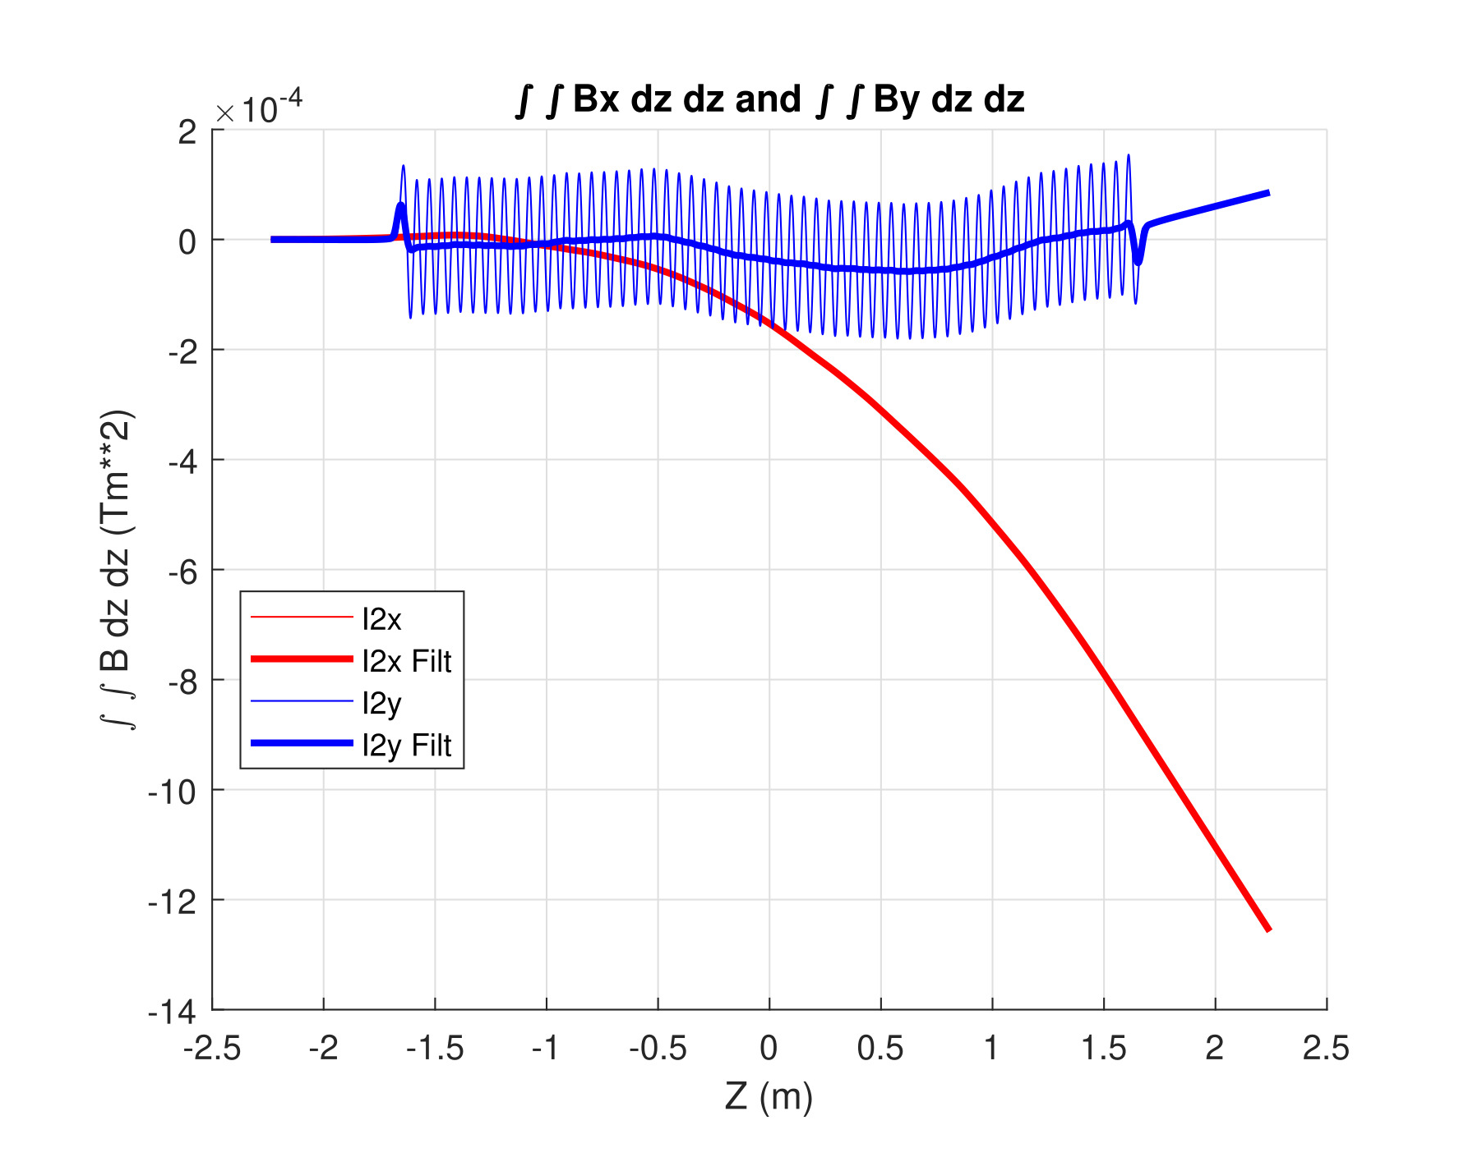
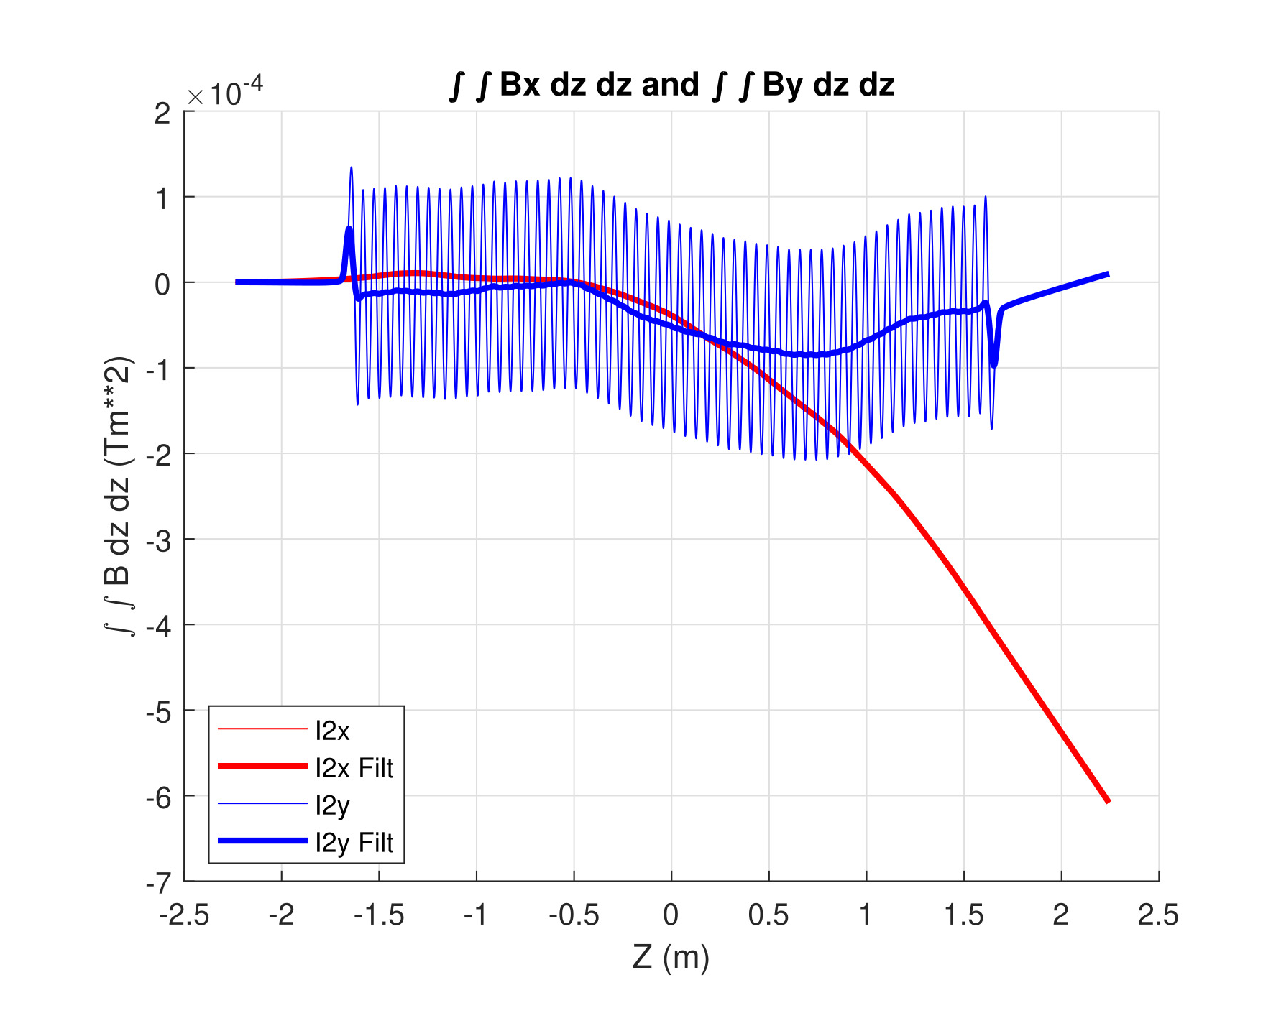
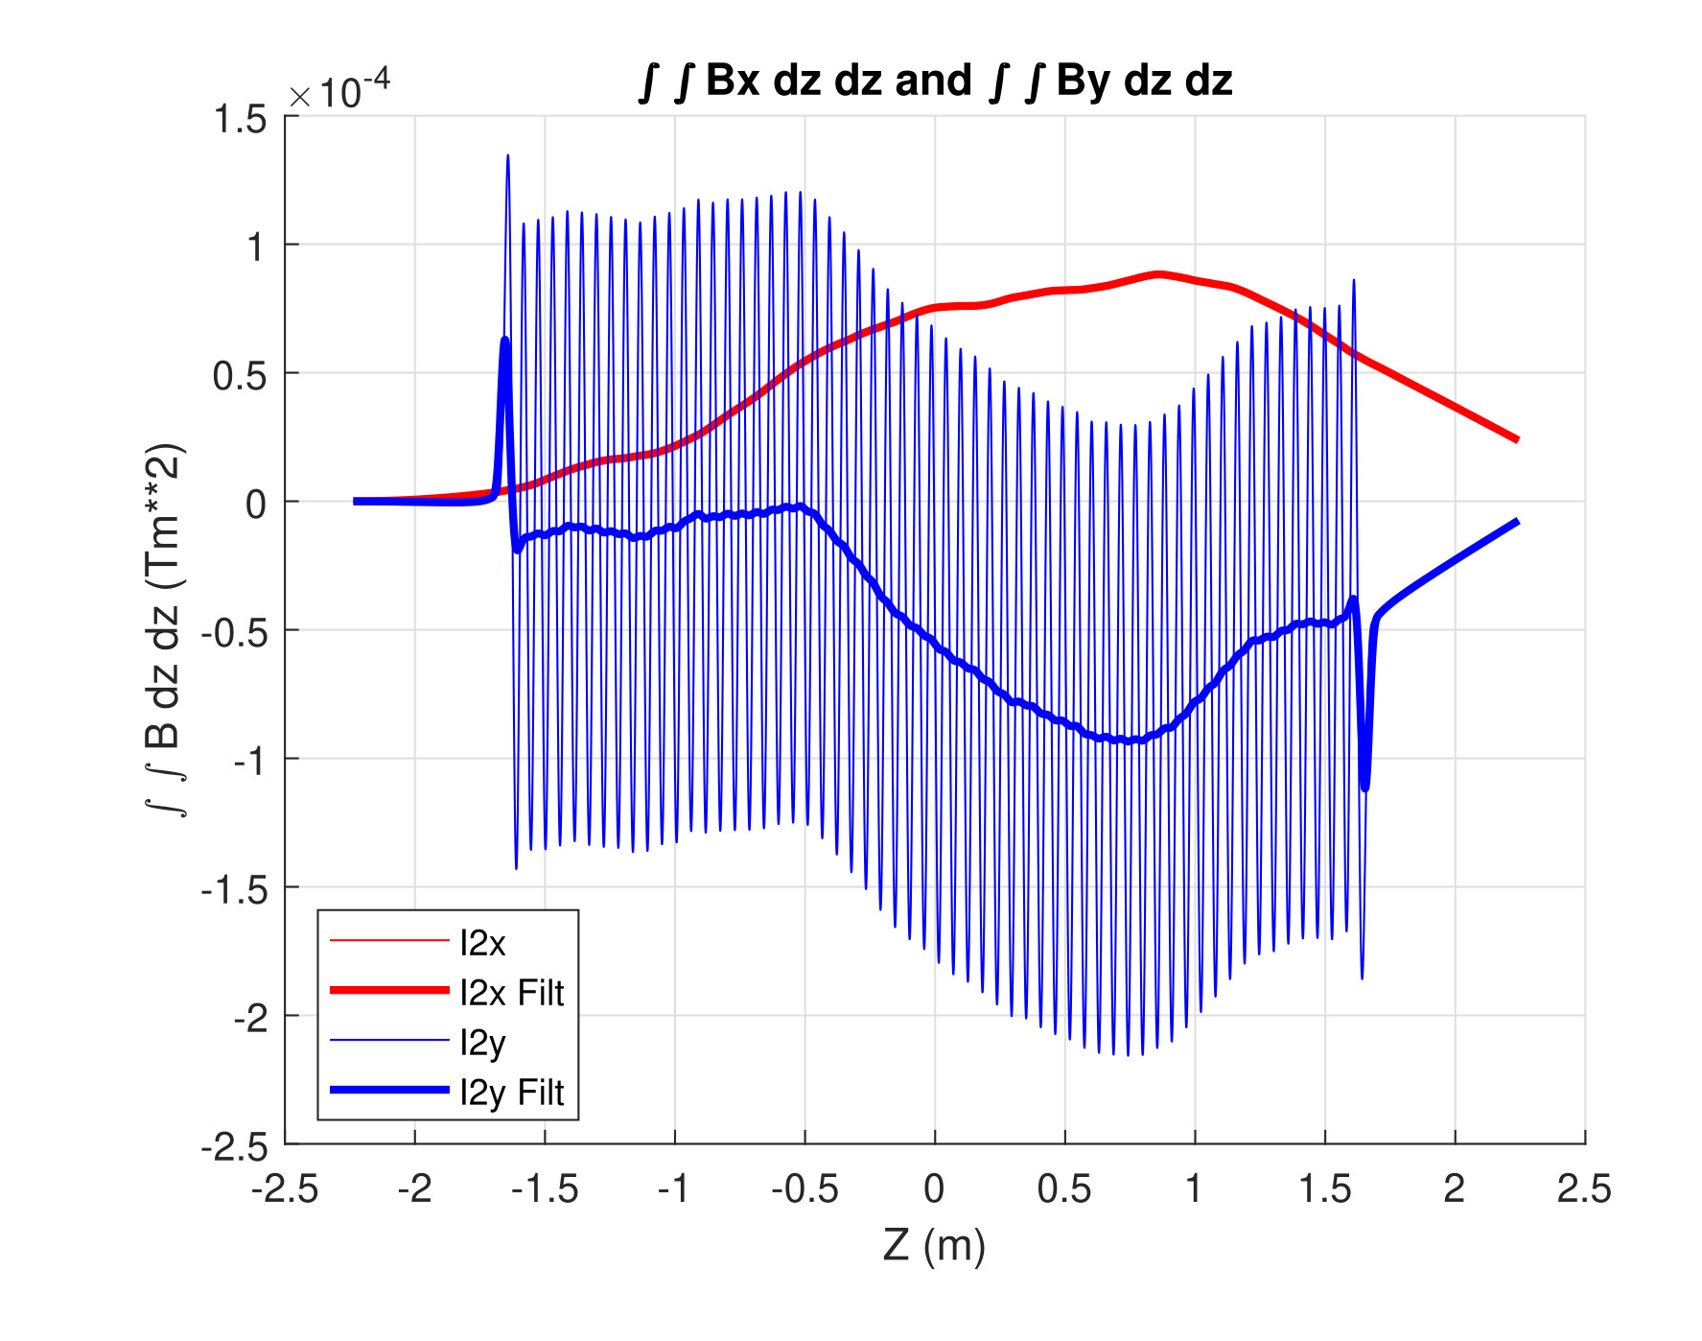
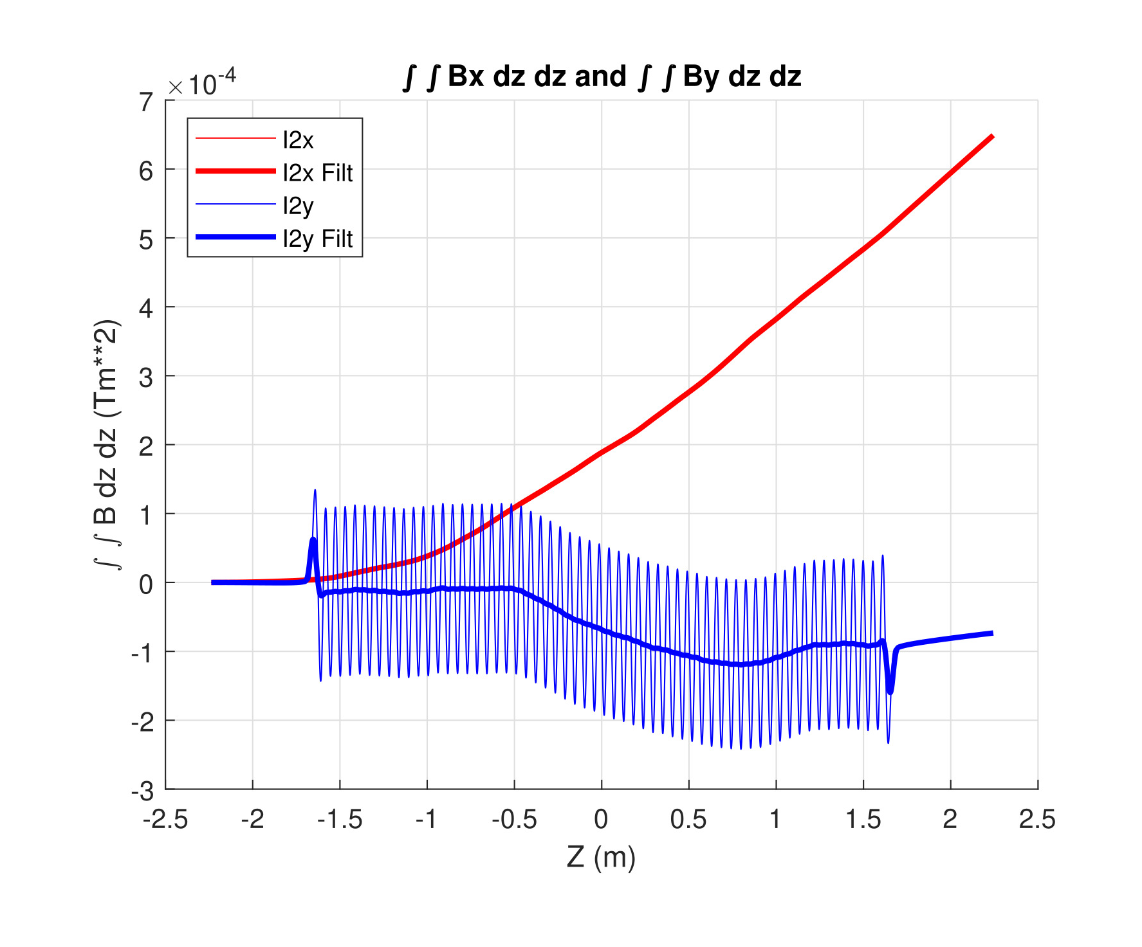
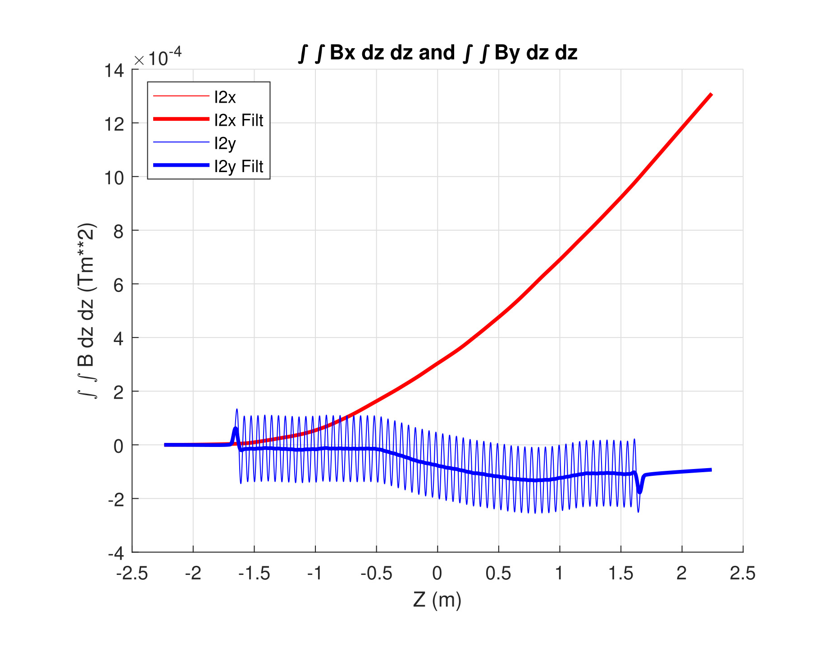
Long Coil Correction
Without correction:
6 Tm^2
12 Tm^2
0 Tm^2
-12 Tm^2
-6 Tm^2
Y_{Hall} = -0.50 mm
-0.25 mm
0.00 mm
0.25 mm
0.50 mm
Off the midplane, the field has a B_{z} component that changes sign at y = 0
Small imperfections in the probe cause B_{z} to make a B_{x} signal
Use field integral measurements from a long coil to correct the Hall probe B_{x} to give the same first and second field integrals as from the long coil
Typical size of correction ~0.2 G (for measurements on the midplane)

Slide 7
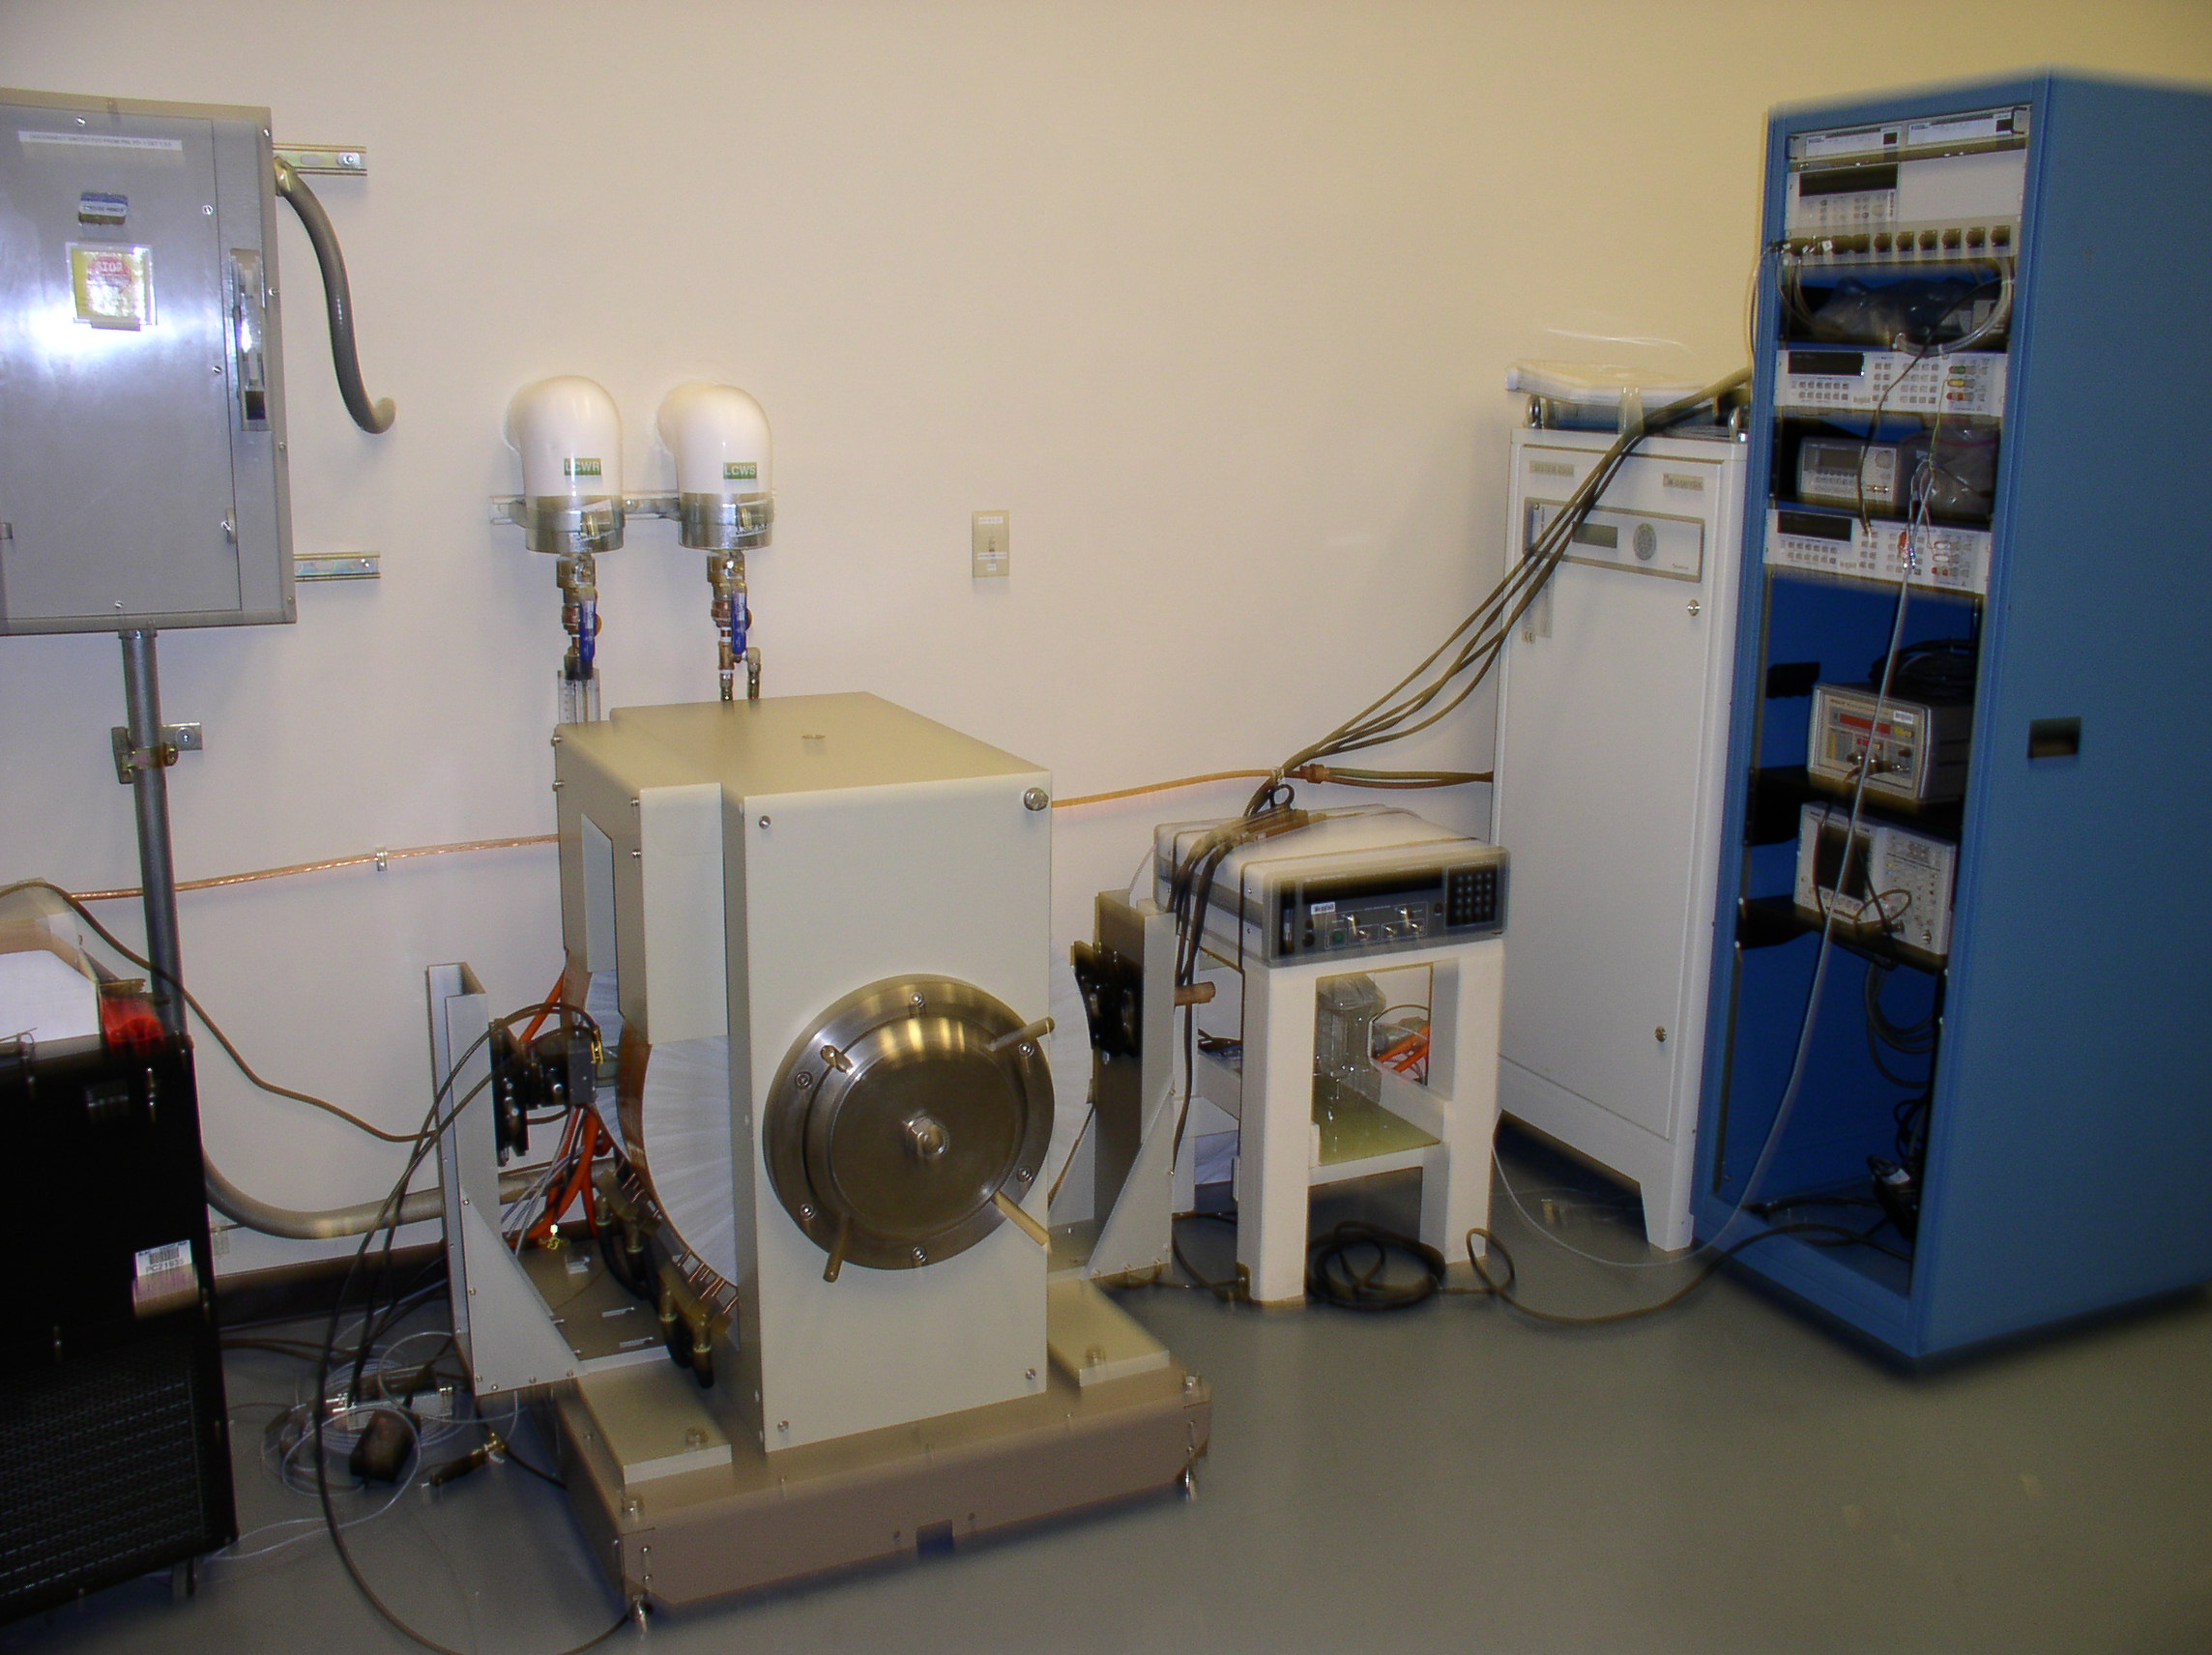
Hall Probe Calibration
HP3458
Chiller
For probe
temperature
Magnet
Metrolab
NMR

Slide 8
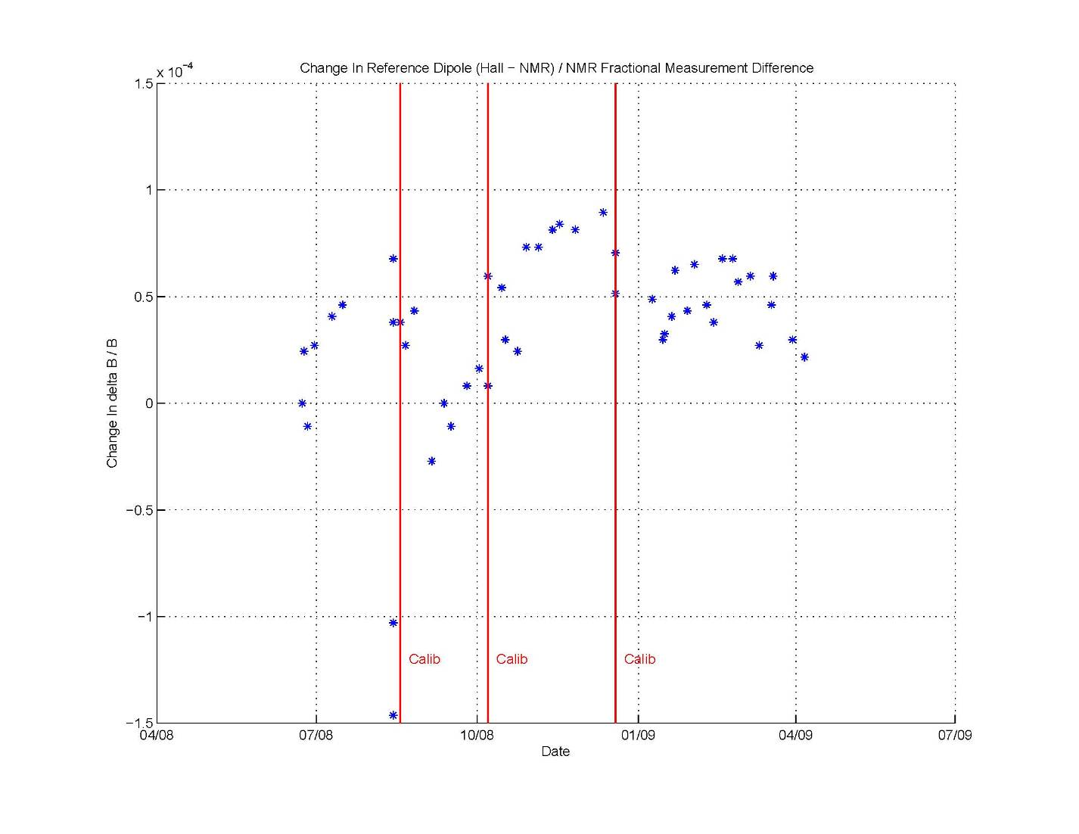
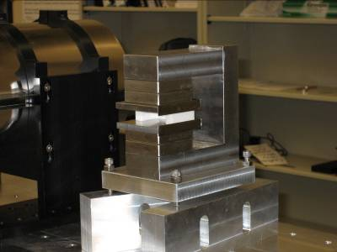
Reference Dipole
Reference Dipole,
uniform field,
NMR measurements
(B_{hall} – B_{nmr}) / B_{nmr}
is stable to better than10⁻⁴ with recalibrations.

Slide 9
LCLS Reference Undulator
±1.5x10⁻⁴

Slide 10
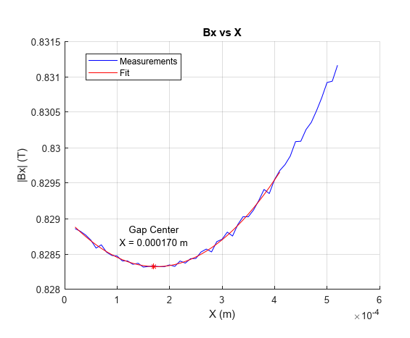
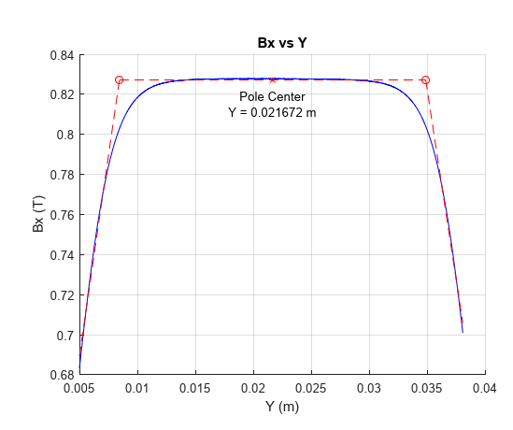
Measure Undulator On Magnetic Axis
HXU
Every N’th pole find the magnetic center.
Fit a line to the magnetic centers down the undulator.
Move the undulator so that the probe moves down the magnetic axis.

Slide 11
Measure K On The Magnetic Axis
HXU
No sensitivity in Y
Measure on the magnetic axis, x = 0, y = 0.
Fiducialize to the magnetic axis.
Small alignment errors will not make K go out of tolerance.

Slide 12
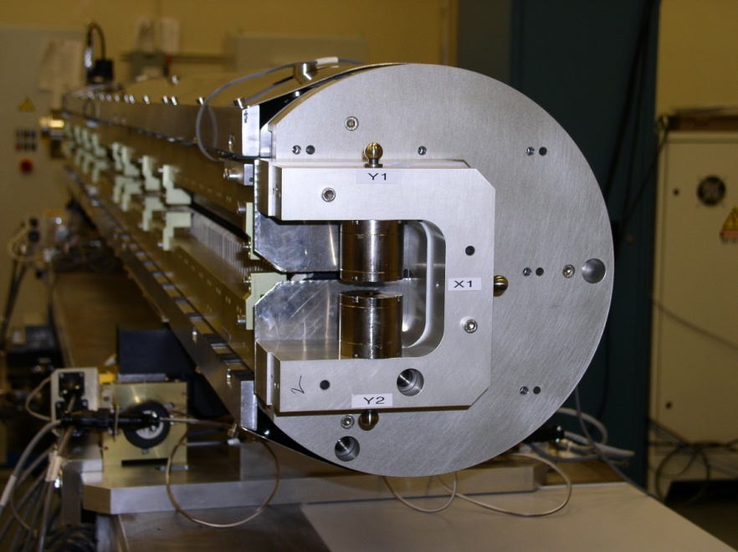
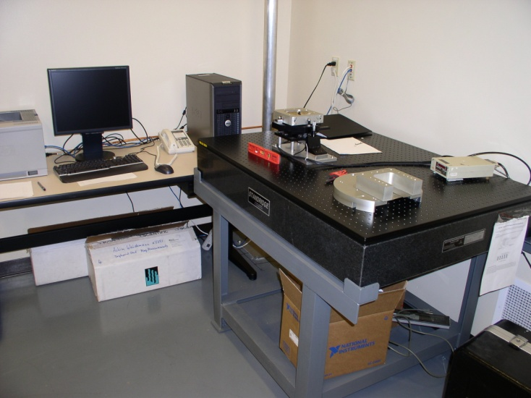
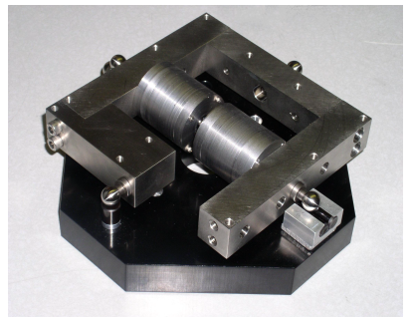
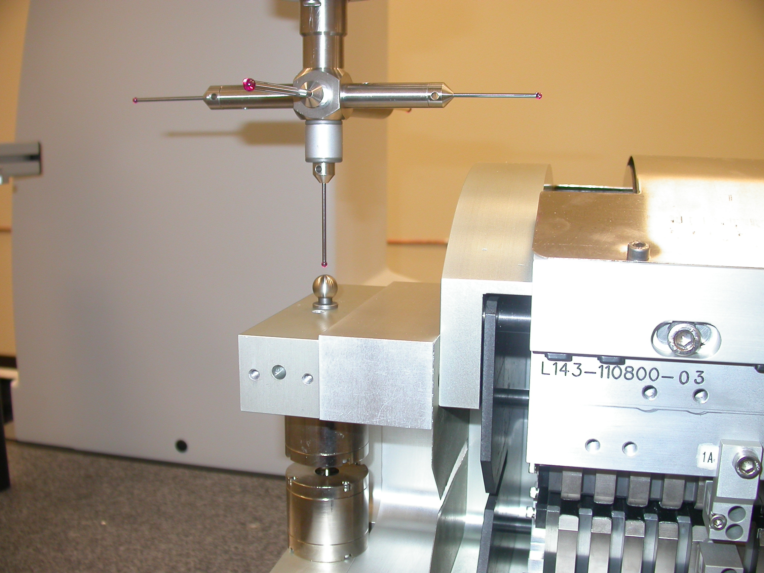
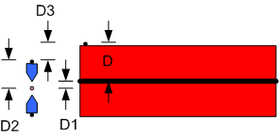
Undulator Fiducialization
D1
D2
D3

Slide 13
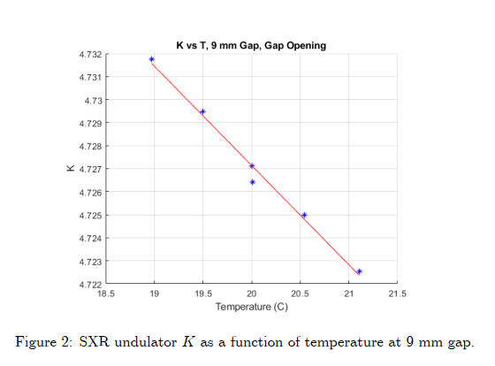
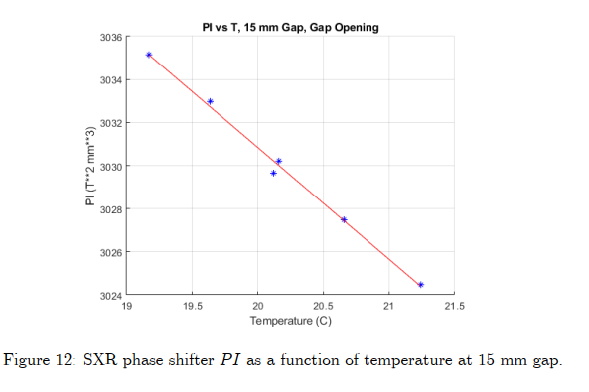
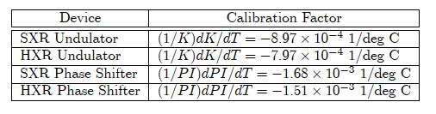
Temperature Calibrations

Slide 14
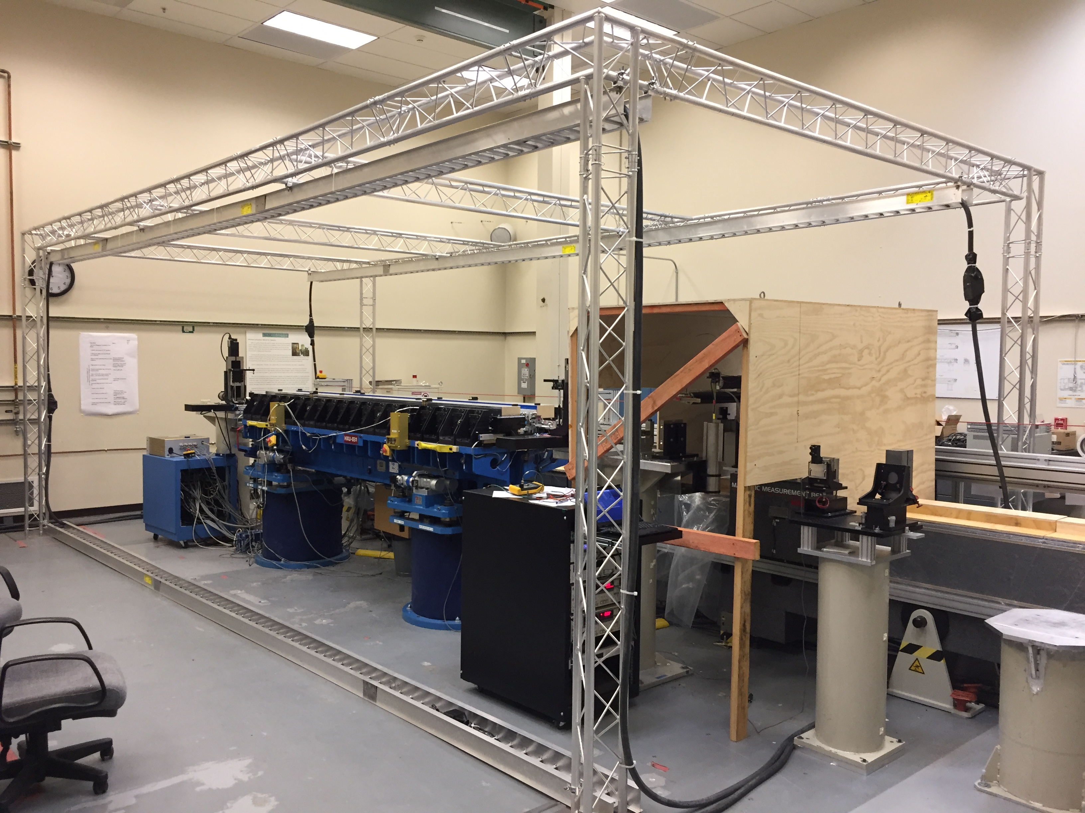
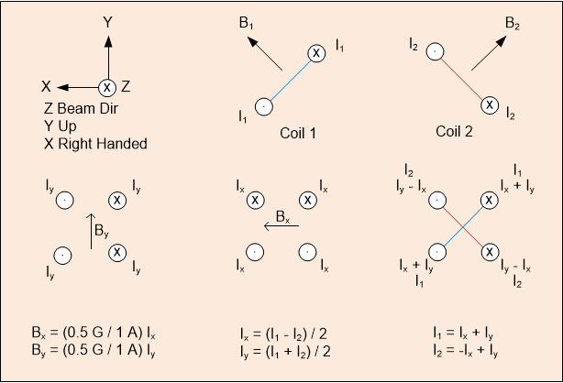
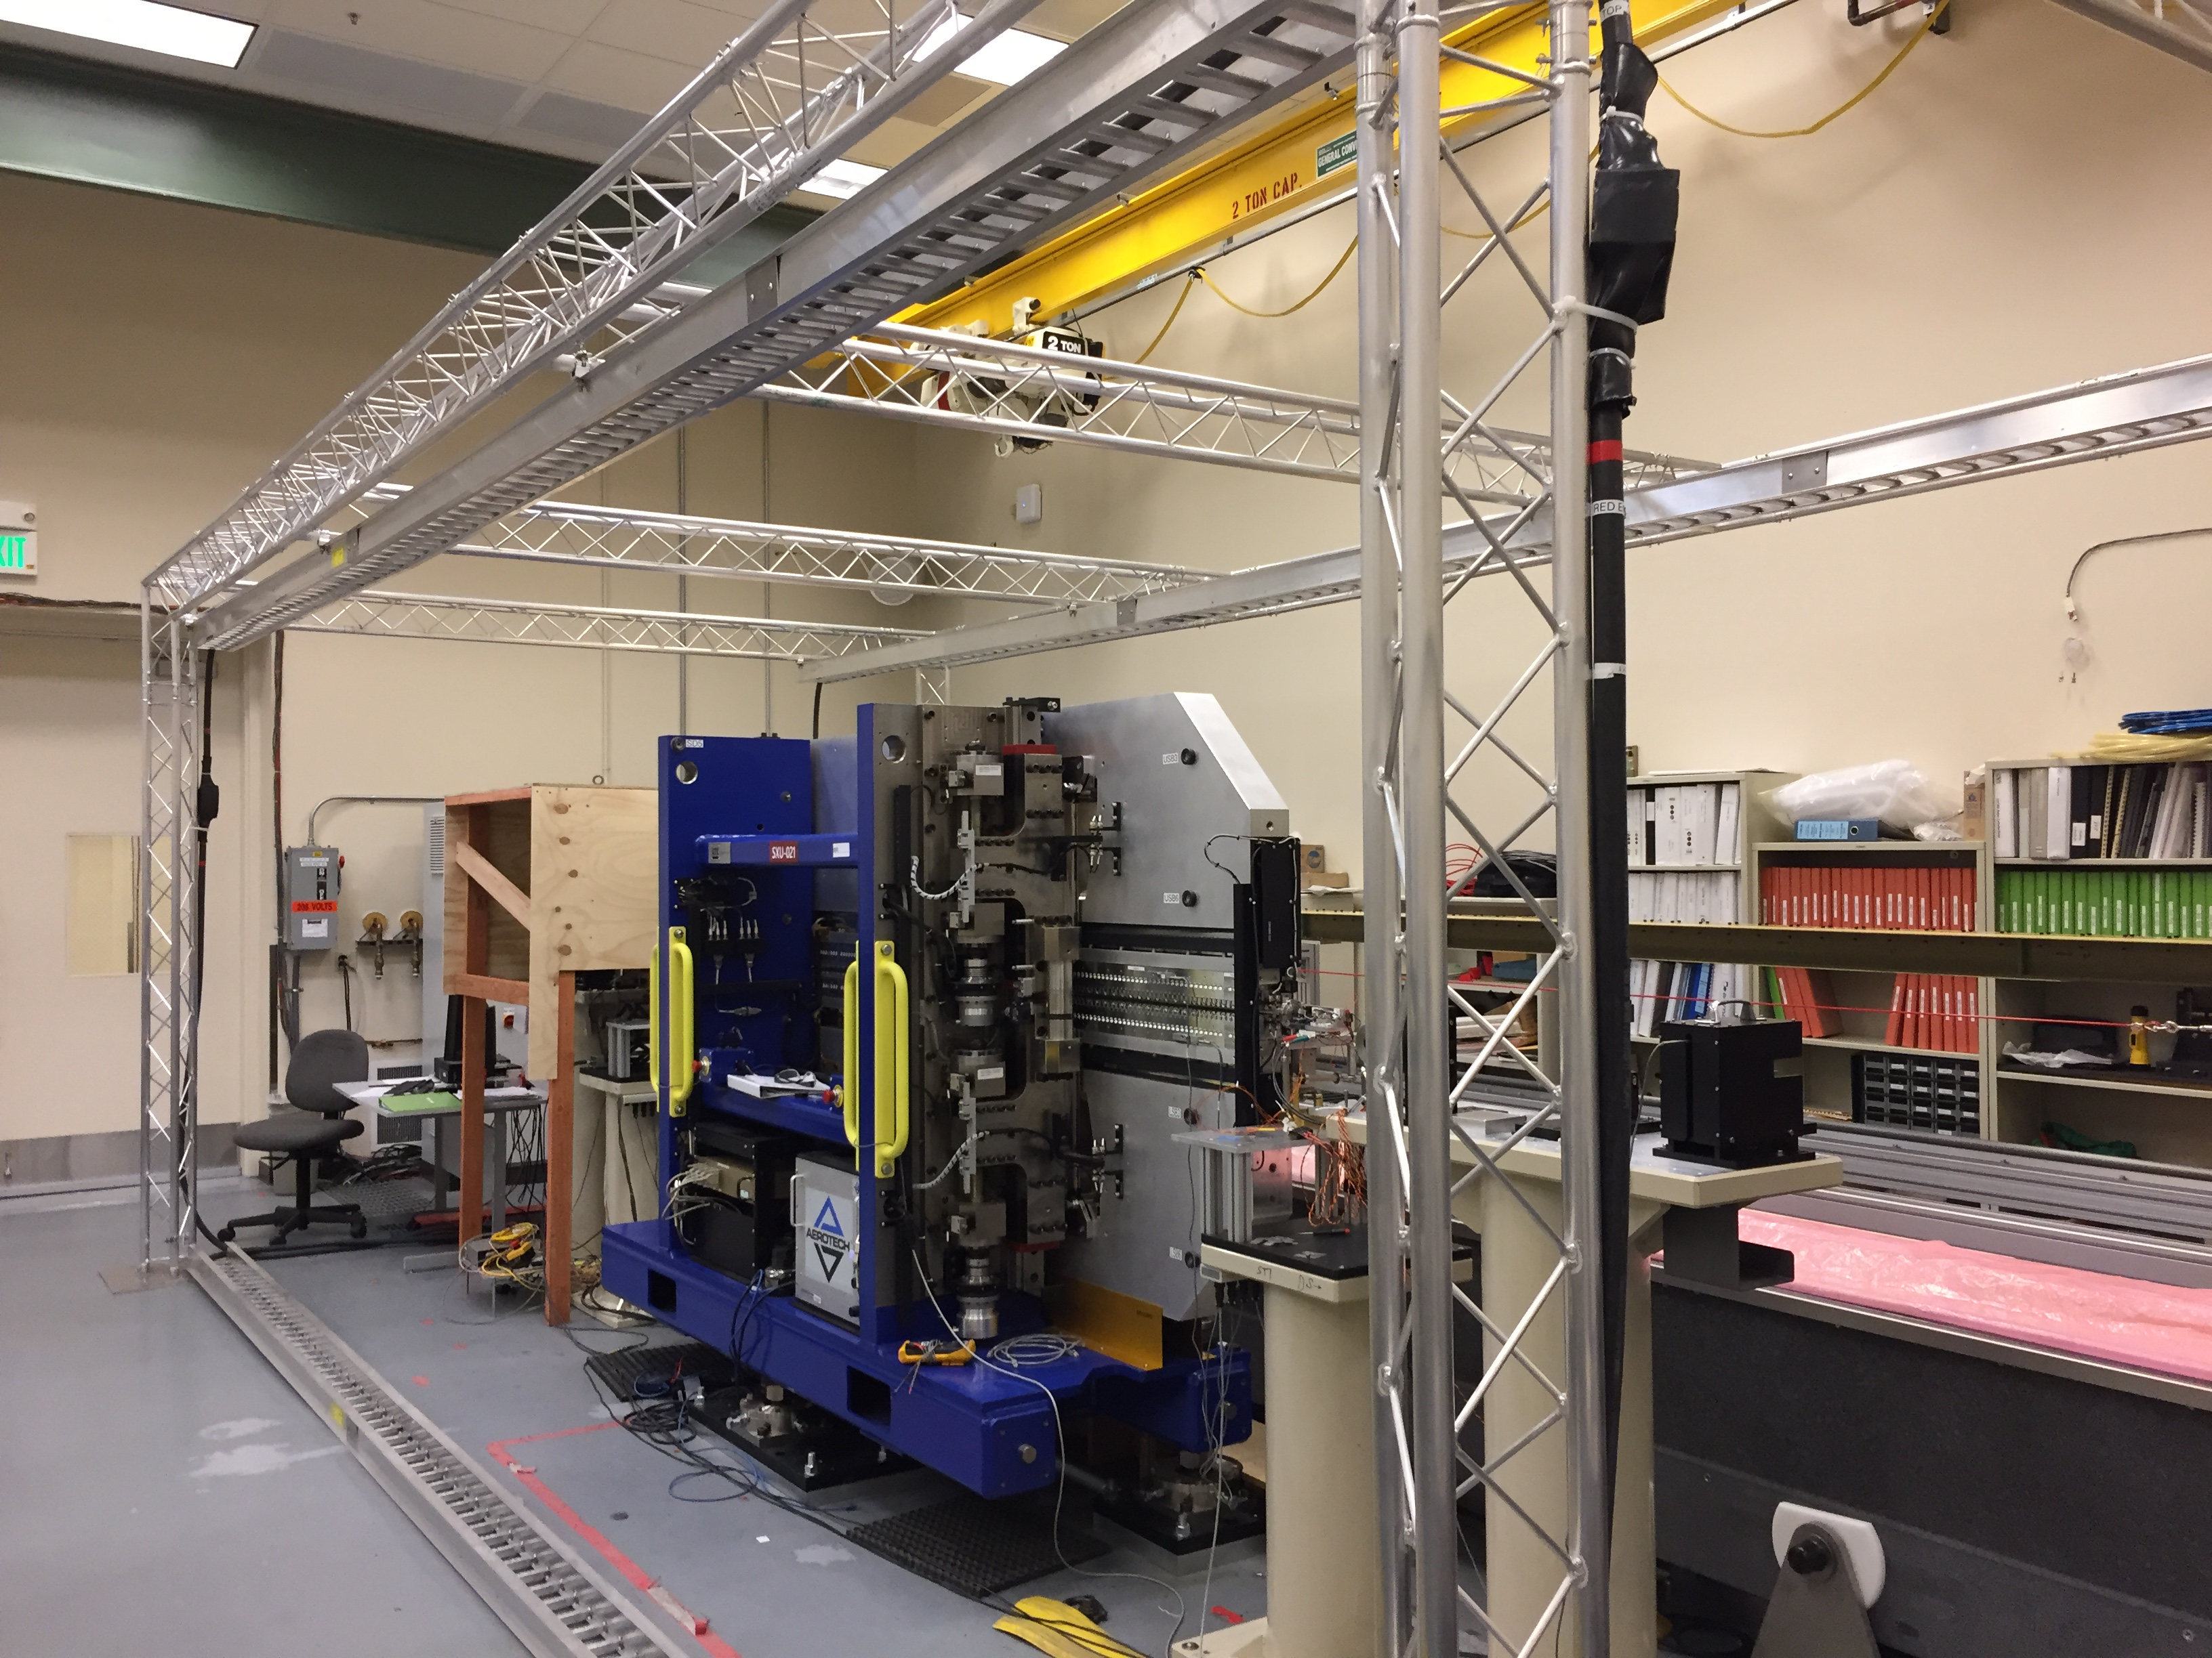
Earth Field Correctors
Benches have tunnel orientation.
Correct difference between MMF
and tunnel.
Corrector windings on beam pipe
Apply external fields using Helmholtz coils.
Determine the corrector currents needed to cancel an applied external field as a function of undulator gap.

Slide 15
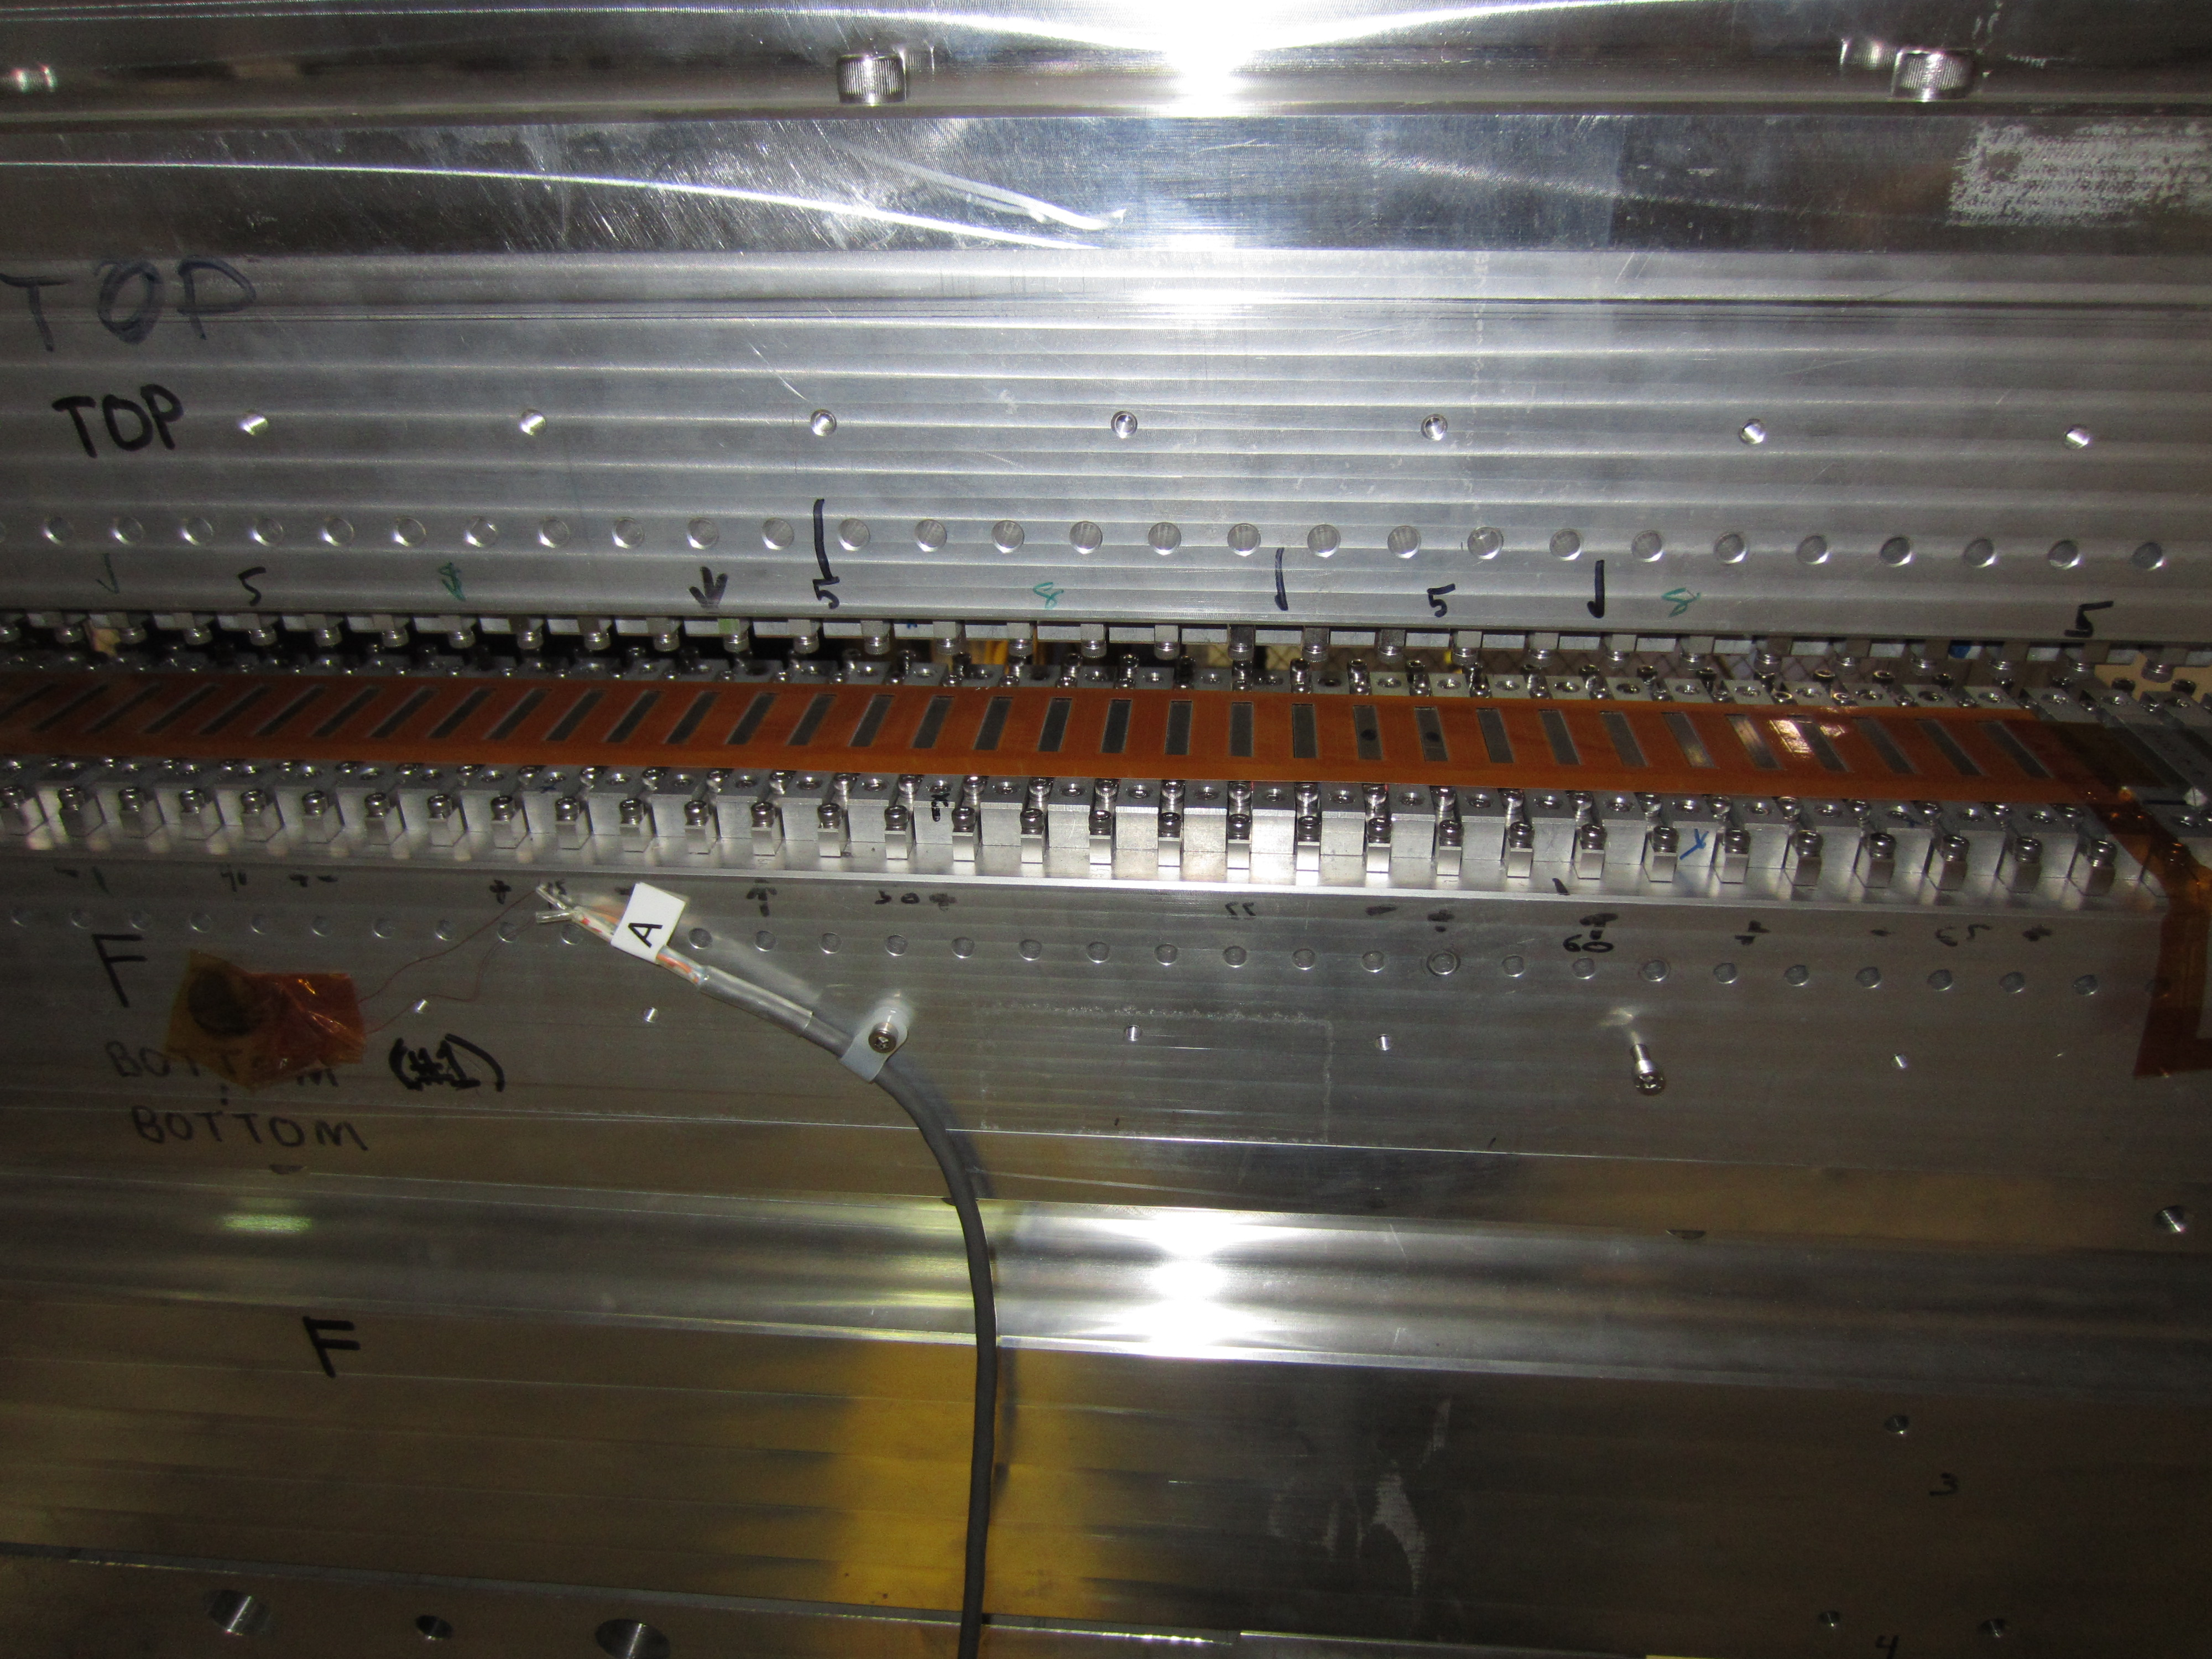
Radiation Damage Detection
Printed Circuit Coils:
Kapton
1 m long
125 microns thick
2 layers
36 turns per pole
0.1 VS signal
Measure flux change as the undulator gap is changed.
Look for differences over time.

Slide 16
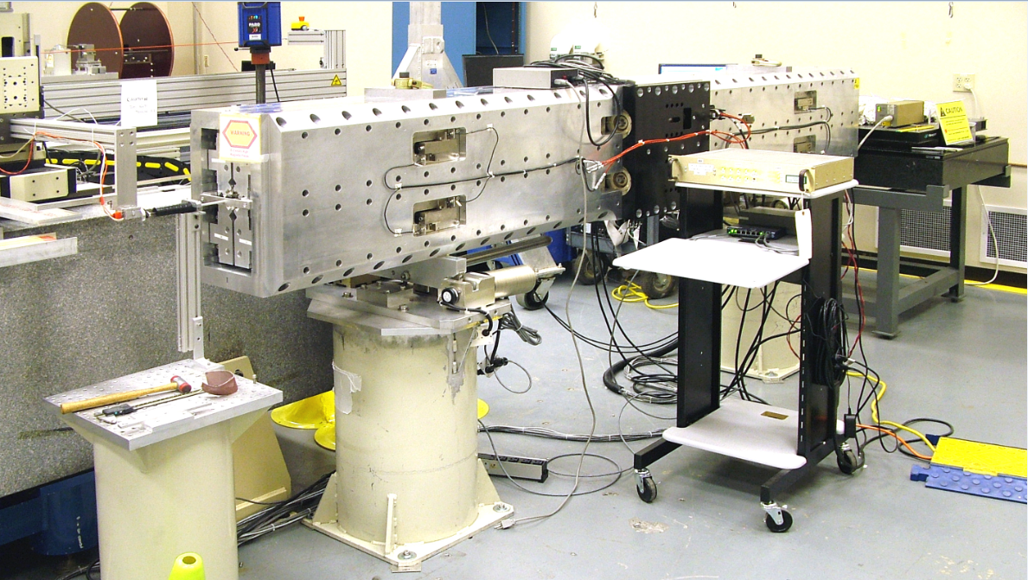
Delta Hall Probe Measurements
The only access for measurements is through the end of the beam pipe.
A carbon fiber tube was used to pull the probes through the undulator.

Slide 17
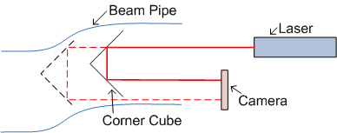
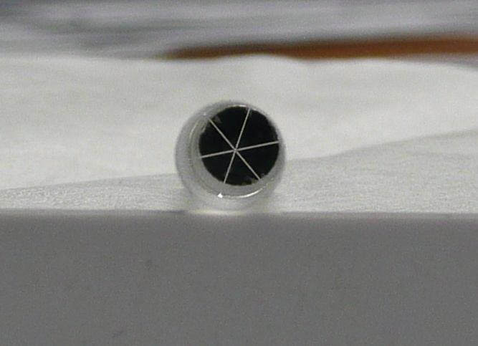
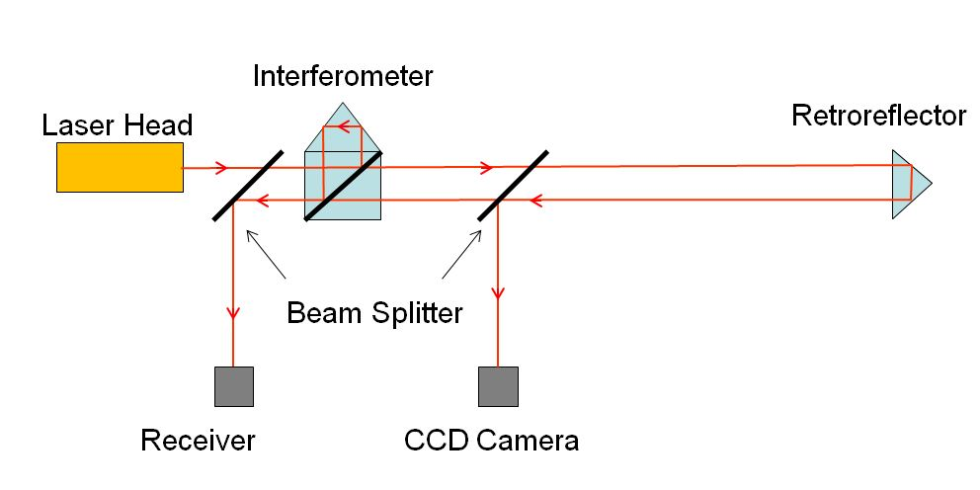
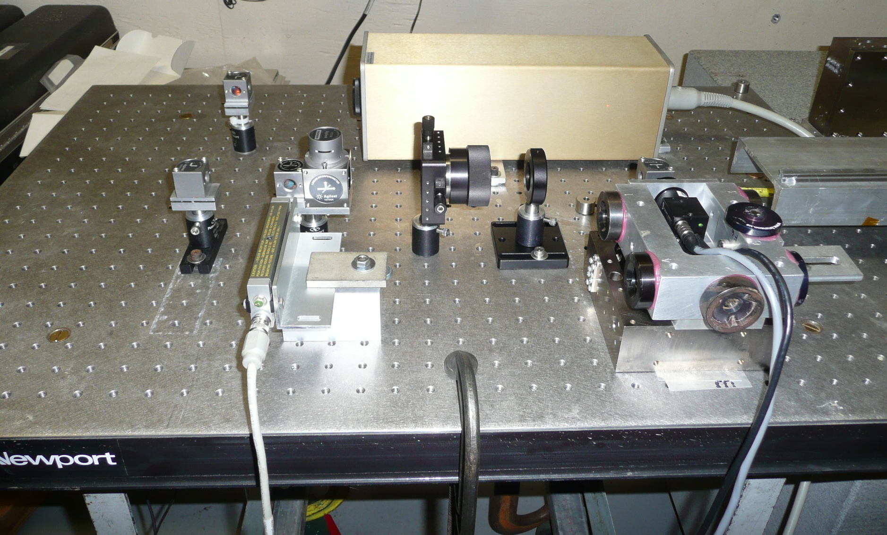
Measure Probe Position
Georg Gassner
Transverse location from corner cube. Longitudinal location from interferometer.

Slide 18
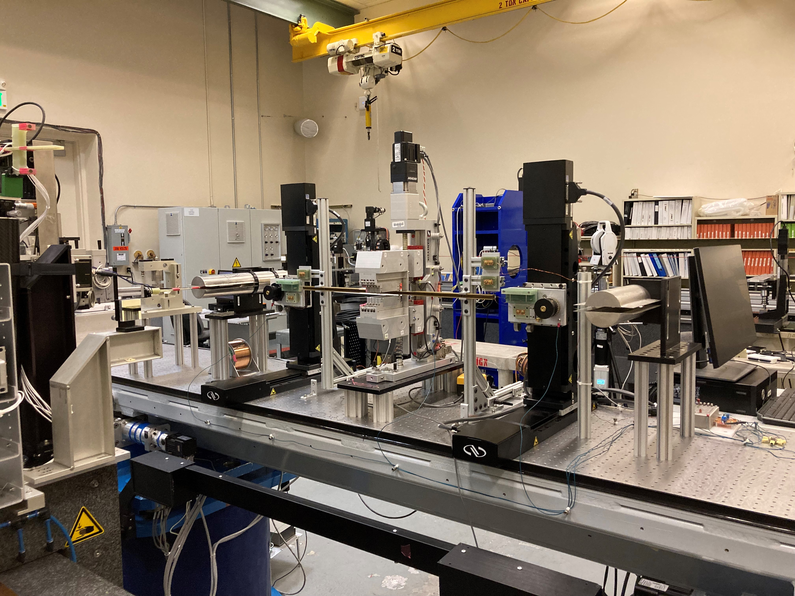
Phase Shifter Measurements
HXR Measurement Bench
The magnetic measurement system is built on an LCLS undulator girder. It can be removed to allow HXR undulator measurements.

Slide 19
Prototype Measurements, Field Integrals
Field integrals are within tolerance:
I1XY < 20 µTm
I2XY < 60 µTm²
Measured with a single stretched wire with a preamplifier.

Slide 20
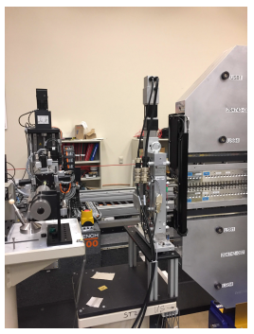
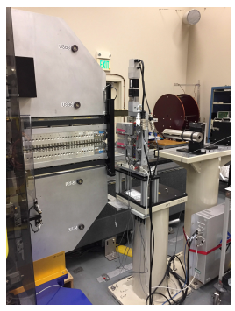
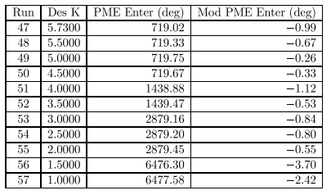
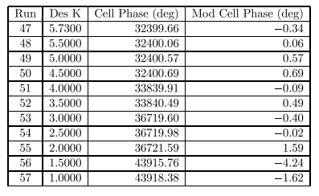
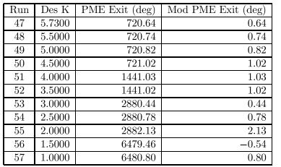
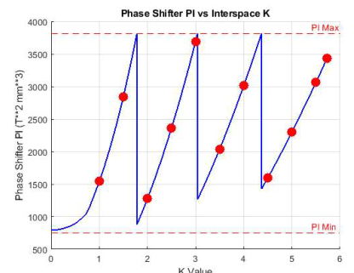
SXR Phase Shifters
Phase matching test
SXPS-16349 SXU-001 SXPS-16345

Slide 21
SXR Phase Shifter Lessons Learned
During production the reference stayed within tolerance but indicated a small drift
After much searching, we found that the encoder scales were attached with double sided tape (no datum). They slowly drifted down from their weight.

Slide 22
Conclusion
SLAC has had an undulator and phase shifter measurement program for many years.
Granite measurement benches guide Hall probes for undulators with side access.
Coils with many turns are used to measure field integrals. Recently a preamplifier is allowing single wire field integral measurements for phase shifters.
Many checks and calibrations of the Hall probe are required to achieve δK/K ≈ 10⁻⁴.
We are now trying to achieve the same measurement accuracy for enclosed bore undulators. We are in the middle of this effort.

