Slide 1
Implementation of Model Predictive Control for Slow Orbit Feedback Control
in MAX IV Accelerators Using PyTango Framework

Slide 2
Implementation of Model Predictive Control for Slow Orbit Feedback Control
in MAX IV Accelerators Using PyTango Framework

Slide 3
Implementation of Model Predictive Control for Slow Orbit Feedback Control in MAX IV Accelerators Using PyTango Framework
Carla Takahashi
Software & Accelerator Development

Slide 4
Outline
Introduction
Orbit Control
Model Predictive Control
Implementation
MPC Design
Tango Device
Results
Tests on Storage Rings
Challenges
Software & Accelerator Development

Slide 5
Orbit Control
Introduction
Storage Rings Orbit at MAX IV
Software & Accelerator Development

Slide 6
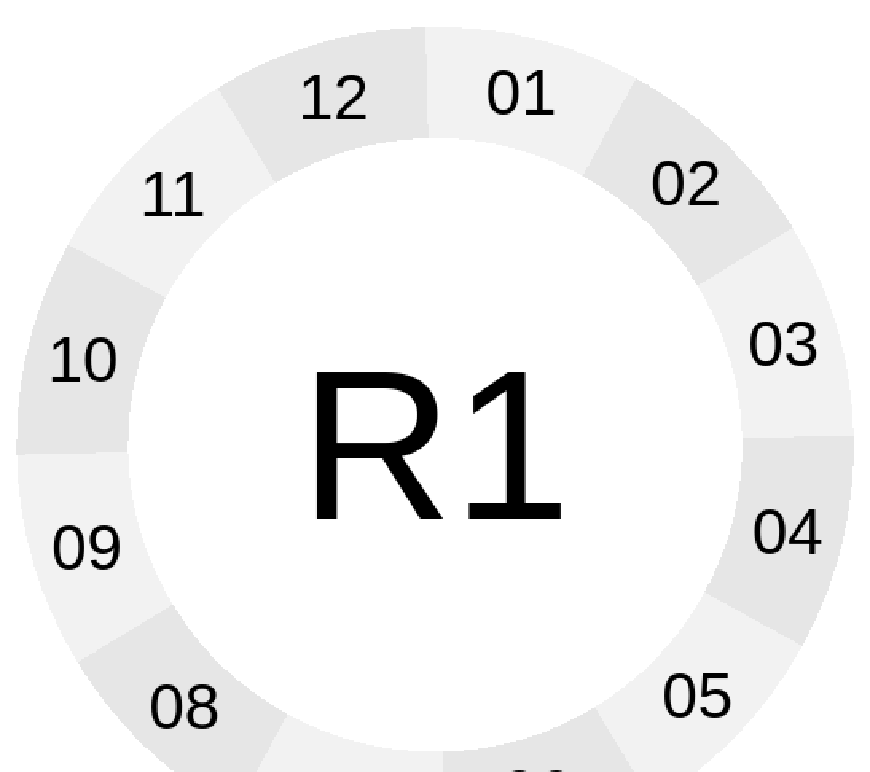
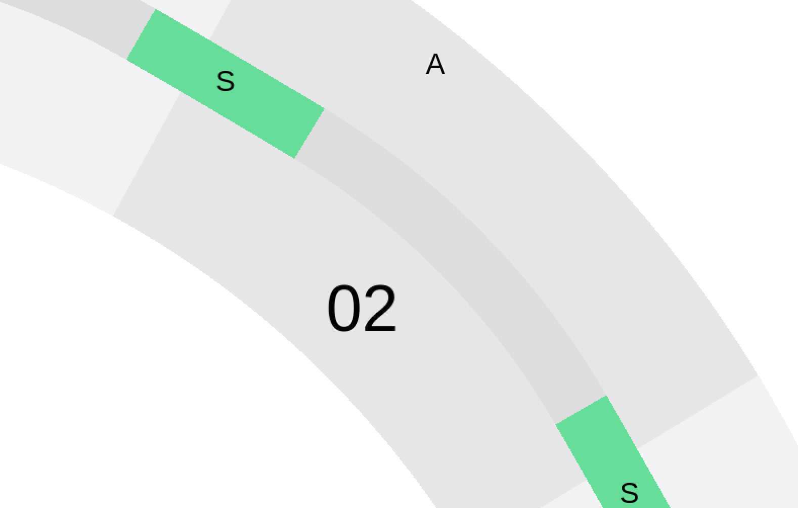
Storage Ringes at MAX IV
The accelerator complex at the MAX IV laboratory consists of a 3 GeV, 250 m long full energy linac, two storage rings of 1.5 GeV and 3 GeV and a Short Pulse Facility.
Transverse stability of the beam is commonly achieved via feedback solutions with various different implementations.
At the MAX IV light source, there are two separate feedbacks working together in two different, but overlapping frequency regions and sets of sensors.
The Fast Orbit Feedback has 10 kHz repetition rate and attenuates noise up to 50 – 150 Hz in the most critical regions.
The Slow Orbit Feedback is implemented in software over a distributed control system and should work with a rate up to 10Hz

Slide 7
Ring Structure

Slide 8
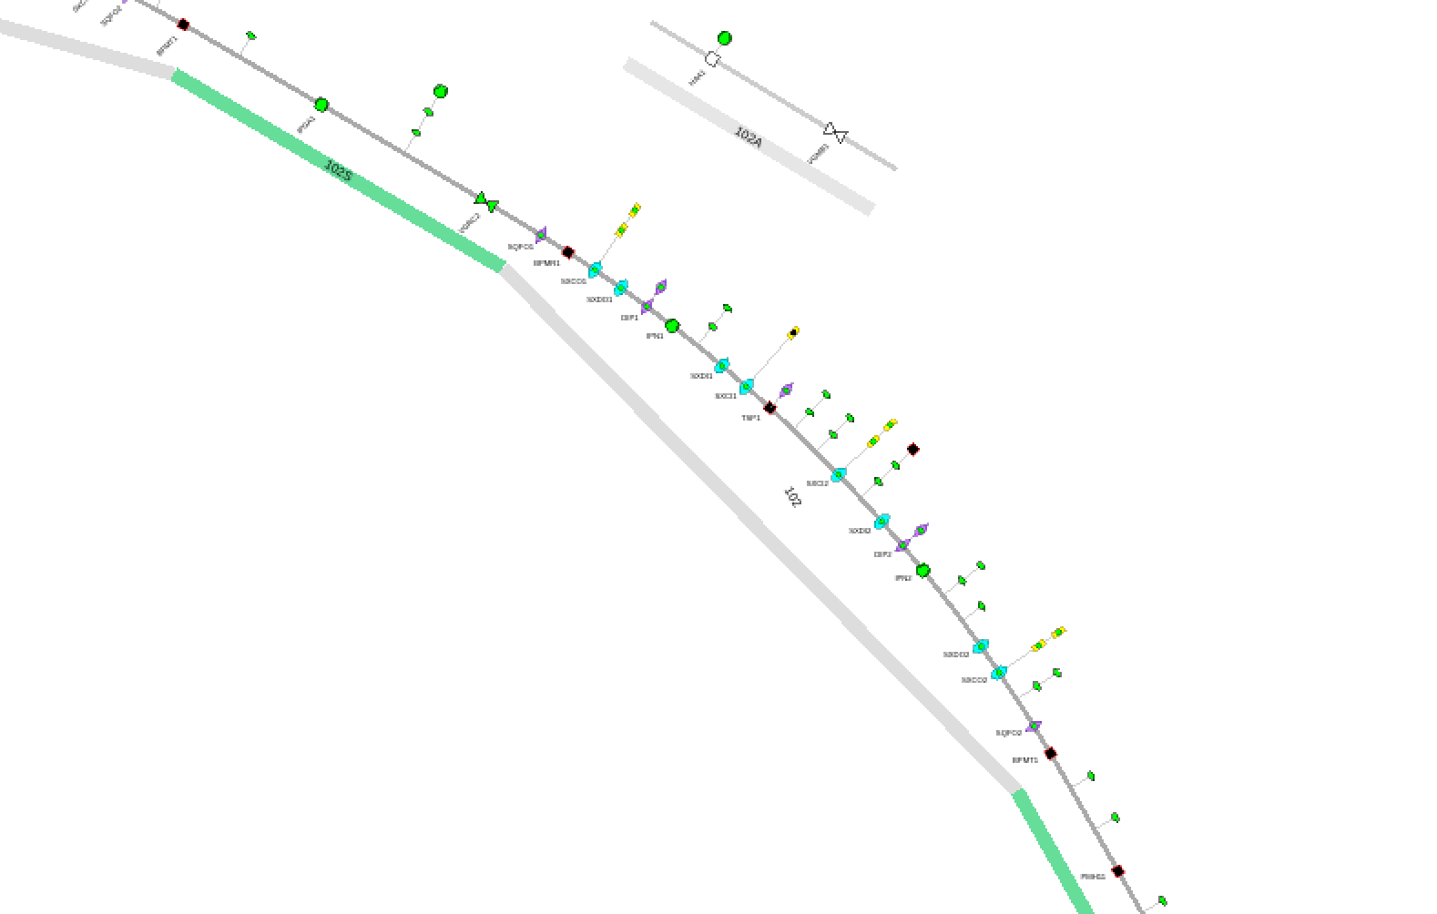
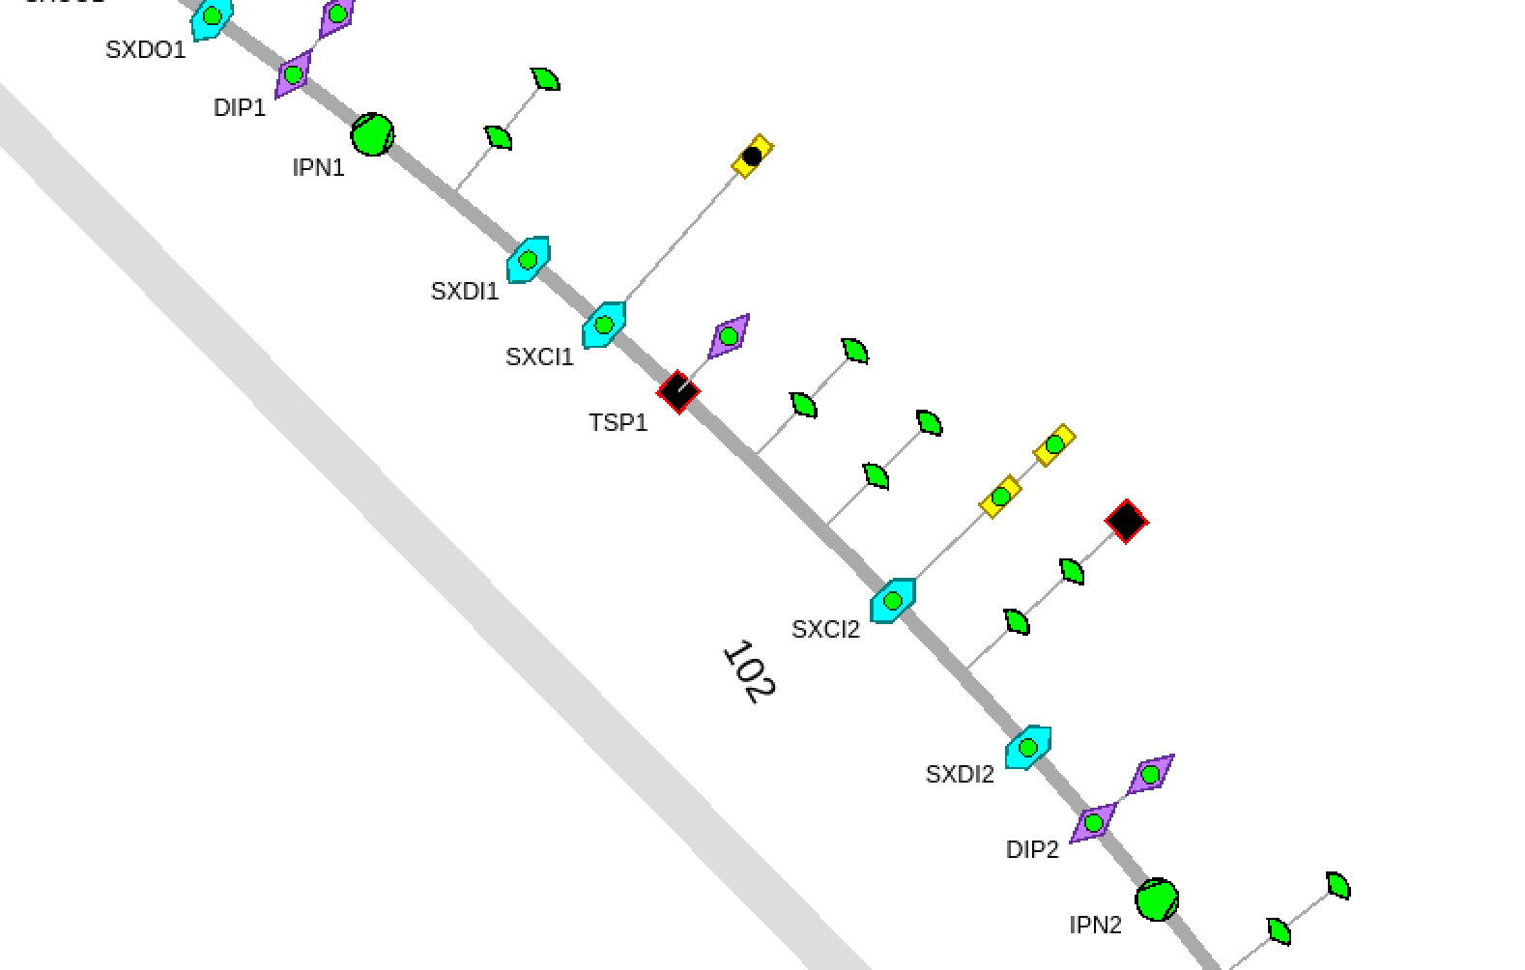
Ring Structure

Slide 9
The BPMs are interfaced in TANGO so the beam positions in both planes are available as attributes.
The attributes push events at the 10 Hz rate of the “slow” Libera data acquisition stream.
There are 2 × 200 BPMs in the 3GeV ring.
There are 2 × 36 BPMs in the 1.5GeV ring.
Corrector Magnets are Controlled with ITest BiLT BE2811 Power Supplies
The power supplies are interfaced in TANGO.
They are fast enough to operate in 10Hz.
There are 380 power supplies in the 3GeV ring (200 in the horizontal plan and 180 in the vertical plane)
There are 72 power supplies in the 1.5GeV ring (36 in each plane)
Beam Position Measurements from Libera Brillance+

Slide 10
Issues and Requirements
Issues and Requirements
Corrector magnets are easily saturated, for both the Slow and Fast Orbit FeedBack control systems.
When some of the the corrector magnets of the SOFB system are satured it can be hard to bring the feedback control system into operation again.
The BPM sensor readout have particular transient dynamics, in which it takes around 4 or 5 steps, around 0.5s for the sensor to reach the expected value.
The Fast corrector magnets, have a shorter operational range, thus the SOFB should help the with the offloading of the FOFB system.
Compensation of energy shifts can be achieved by adjusting the RF, which should also be managed by the SOFB system for an optimal solution.

Slide 11
Model Predictive Control
Introduction
Optimal Control for Constrained Dynamic Systems
Software & Accelerator Development

Slide 12
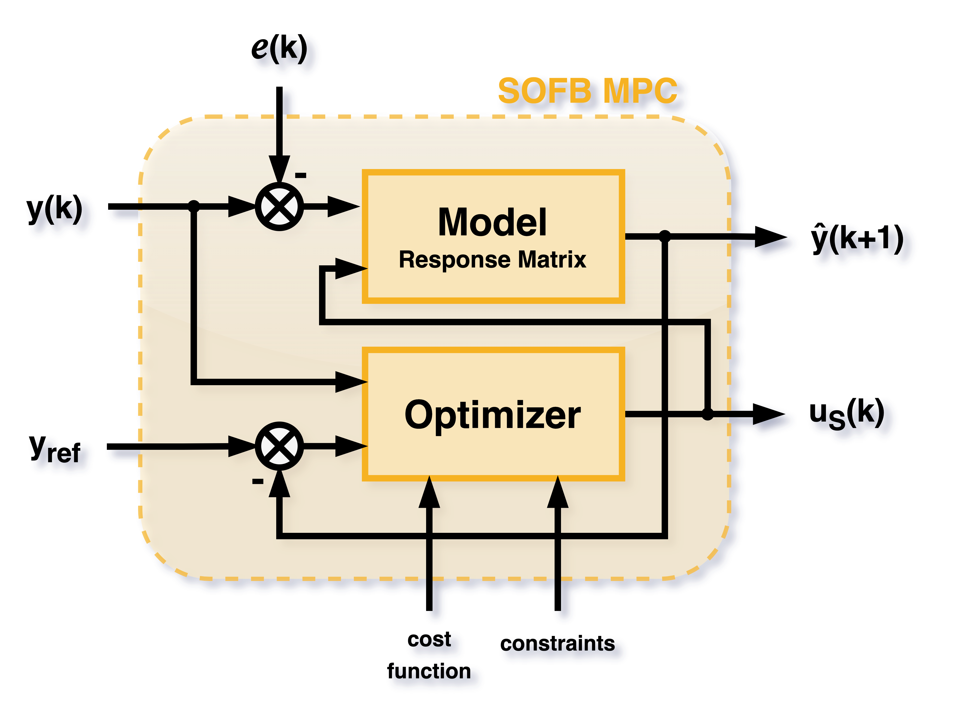
Theoretical Background
Model Predictive Control (MPC) is a control system that uses a model of the system’s dynamics to predict its future behaviour over a finite receding horizon.
The prediction is based on the current states, disturbances, and current and future control signals.
In each step, the optimization problem to minimize the cost function for the control signal is solved so that constraints on states and control actions are satisfied.
One of the big advantages of MPC is that the controller handles constraints which can be physical limits or safety limits on states and control signals.
Software & Accelerator Development

Slide 13
Mathematical Definition
This problem minimizes the cost function J.
e is the states error.
u is the control signal.
H_{p/u} is the prediction horizon.
The states cost function is given by Q₁.
The control signal cost function is given by Q₂.
The first term penalizes tracking errors.
The second penalizes control signals
The third penalizes state error at the end of the prediction horizon.
The sytem model is the first constraint of the optimization function.
The initial state is an estimation of the current state.
The states and control signal constraint can be defined.
$$\min_{x,u}{J=\sum_{i=k+1}^{k+H_{p}−1}{e_{i}^{T} Q_{1} e_{i}}+\sum_{i=k}^{k+H_{u}−1}{Δu_{i}^{T}Q_{2}Δu_{i}}+e_{k+H_{p}}^{T} Q_{f} e_{k+H_{p}}}$$
$$s.t.$$
$$x_{k+1 }=Φx_{k}+Γu_{k} \\ y_{k}=Cx_{k}$$
$$\overline{x}=x_{0}$$
$$\left|x\right|≤x_{max} \\ \left|u\right|≤u_{max}$$
Software & Accelerator Development

Slide 14
MPC Design
Implementation
Model and Controller Outline
Software & Accelerator Development

Slide 15
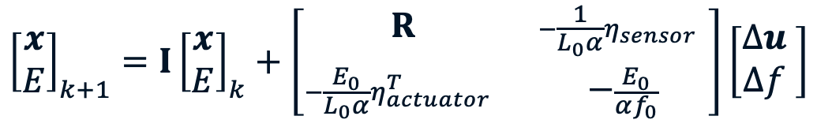

Model
Model
$${\left[\begin{matrix}x \\ E\end{matrix}\right]}_{k+1}=I{\left[\begin{matrix}x \\ E\end{matrix}\right]}_{k}+\left[\begin{matrix}R & −\frac{1}{L_{0}α}η_{sensor} \\ −\frac{E_{0}}{L_{0}α}η_{actuator}^{T} & −\frac{E_{0}}{αf_{0}}\end{matrix}\right]\left[\begin{matrix}Δu \\ Δf \end{matrix}\right]$$
The MPC model uses the Response Matrix as part of the system model.
The sensors are the BPM.
The actuators which receive the are the power supplies of the magnets.
The frequency delta can also be incoporeted into the MPC model to account for energy shifts.
The model is part of the optimization restriction
$$y_{k}=I{\left[\begin{matrix}x \\ \frac{ΔE }{E}\end{matrix}\right]}_{k}$$
Optimization
$$\min_{x,u}{J=\sum_{i=k+1}^{k+H_{p}−1}{e_{i}^{T} Q_{1} e_{i}}+\sum_{i=k}^{k+H_{u}−1}{Δu_{i}^{T}Q_{2}Δu_{i}}+e_{k+H_{p}}^{T} Q_{f} e_{k+H_{p}}}$$
$$s.t.$$
$$x_{k+1 }=Φx_{k}+Γu_{k} \\ y_{k}=Cx_{k}$$
$$\overline{x}=x_{0}$$
$$\left|x\right|≤x_{max} \\ \left|u\right|≤u_{max}$$
Software & Accelerator Development
$$\left|Δu\right|≤{Δu}_{max}$$

Slide 16
Optimization
Model
$${\left[\begin{matrix}x \\ E\end{matrix}\right]}_{k+1}=I{\left[\begin{matrix}x \\ E\end{matrix}\right]}_{k}+\left[\begin{matrix}R & −\frac{1}{L_{0}α}η_{sensor} \\ −\frac{E_{0}}{L_{0}α}η_{actuator}^{T} & −\frac{E_{0}}{αf_{0}}\end{matrix}\right]\left[\begin{matrix}Δu \\ Δf \end{matrix}\right]$$
The BPM sensor importances can be addressed by using the control signal cost matrices Q₁ and Q_{f}.
The corrector magnets importance can be addressed by using the control signal cost matrix Q₂.
The actuators saturation and sensor end scales are used to define the optimization function constraints.
The maximum actuator change is also limited.
$$y_{k}=I{\left[\begin{matrix}x \\ \frac{ΔE }{E}\end{matrix}\right]}_{k}$$
Optimization
$$\min_{x,u}{J=\sum_{i=k+1}^{k+H_{p}−1}{e_{i}^{T} Q_{1} e_{i}}+\sum_{i=k}^{k+H_{u}−1}{Δu_{i}^{T}Q_{2}Δu_{i}}+e_{k+H_{p}}^{T} Q_{f} e_{k+H_{p}}}$$
$$s.t.$$
$$x_{k+1 }=Φx_{k}+Γu_{k} \\ y_{k}=Cx_{k}$$
$$\overline{x}=x_{0}$$
$$\left|x\right|≤x_{max} \\ \left|u\right|≤u_{max}$$
Software & Accelerator Development
$$\left|Δu\right|≤{Δu}_{max}$$

Slide 17
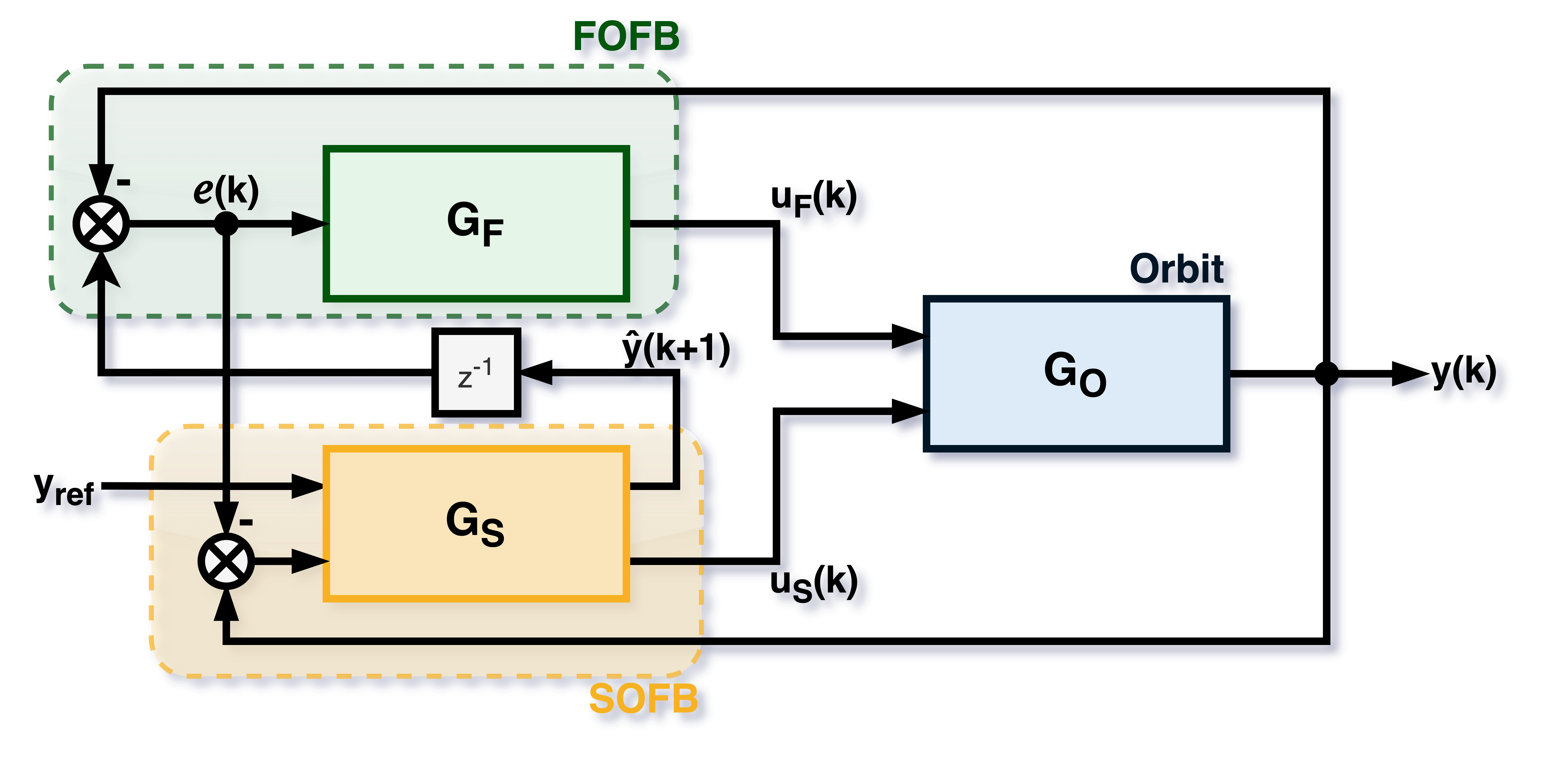
Control System Loop
Liberas
Fast CorrectorMagnets
FOFB Offloading
Mid-Ranging
BPM
Slow CorrectorMagnets
MPC Tango Device

Slide 18
Mid-Ranging
Mid-ranging Interaction with FOFB
Saturation is an issue for both the Fast Orbit FeedBack fast correctors and the Slow Orbit FeedBack slow correctors.
The Fast Correctors should optimally be working in the middle of its operational range.
A mid-ranging design was in implemented to offload the strain on the FOFB system.
The reference value of the MPC is adjusted to match the middle of the rage which the FOFB is working.
This offloading occurs every 5s.

Slide 19
Tango Device
Implementation
SOFB MPC implementation using PyTango Framework
Software & Accelerator Development

Slide 20
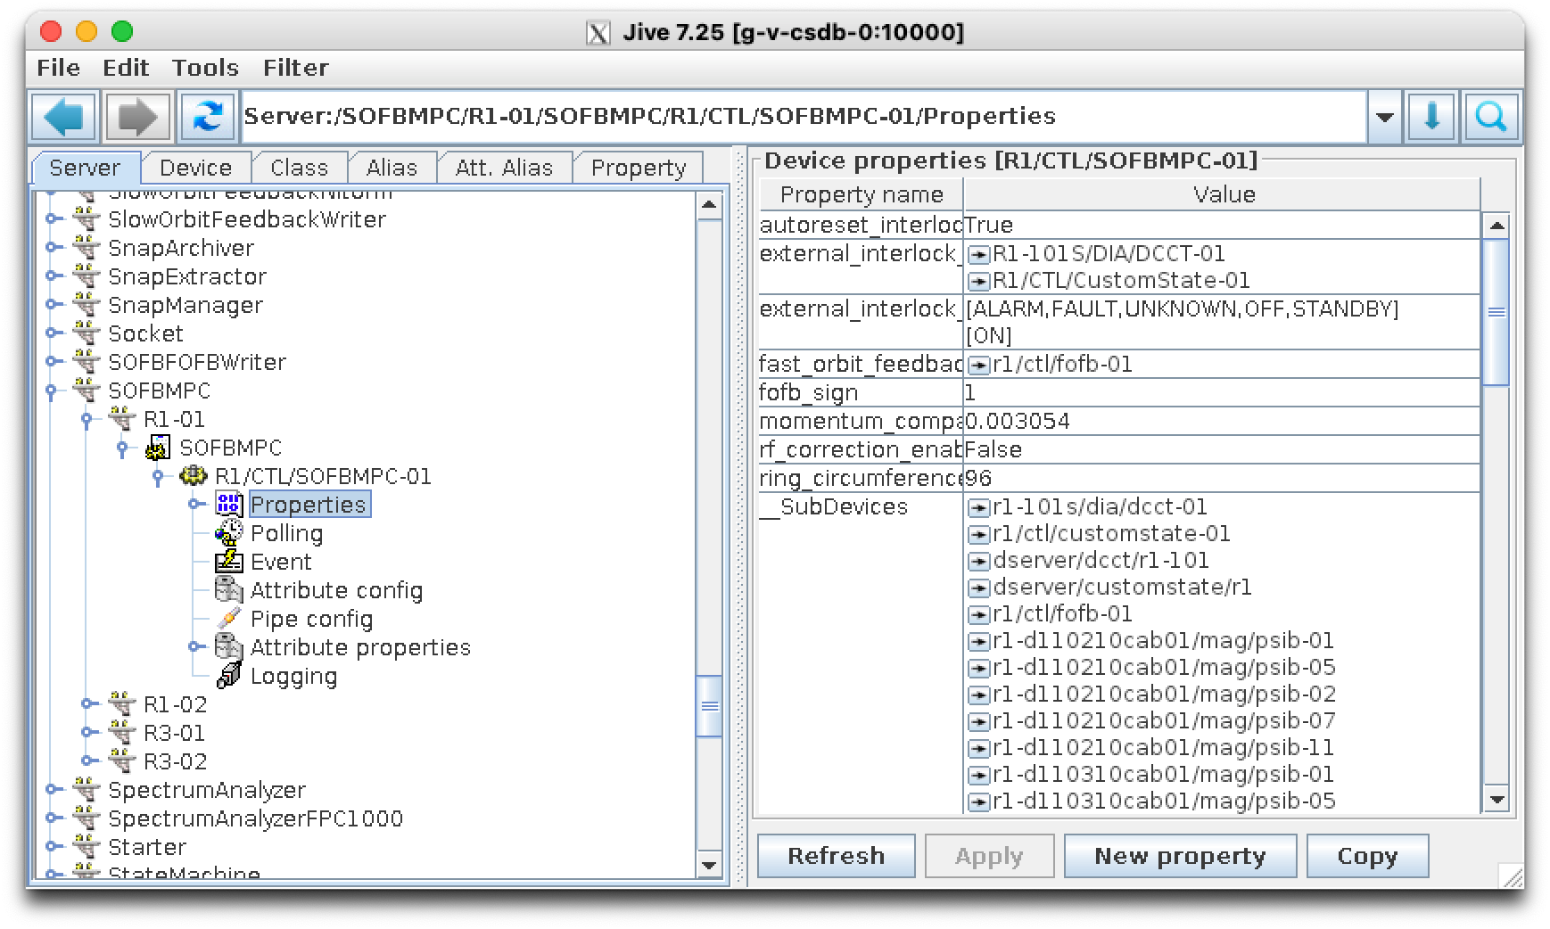
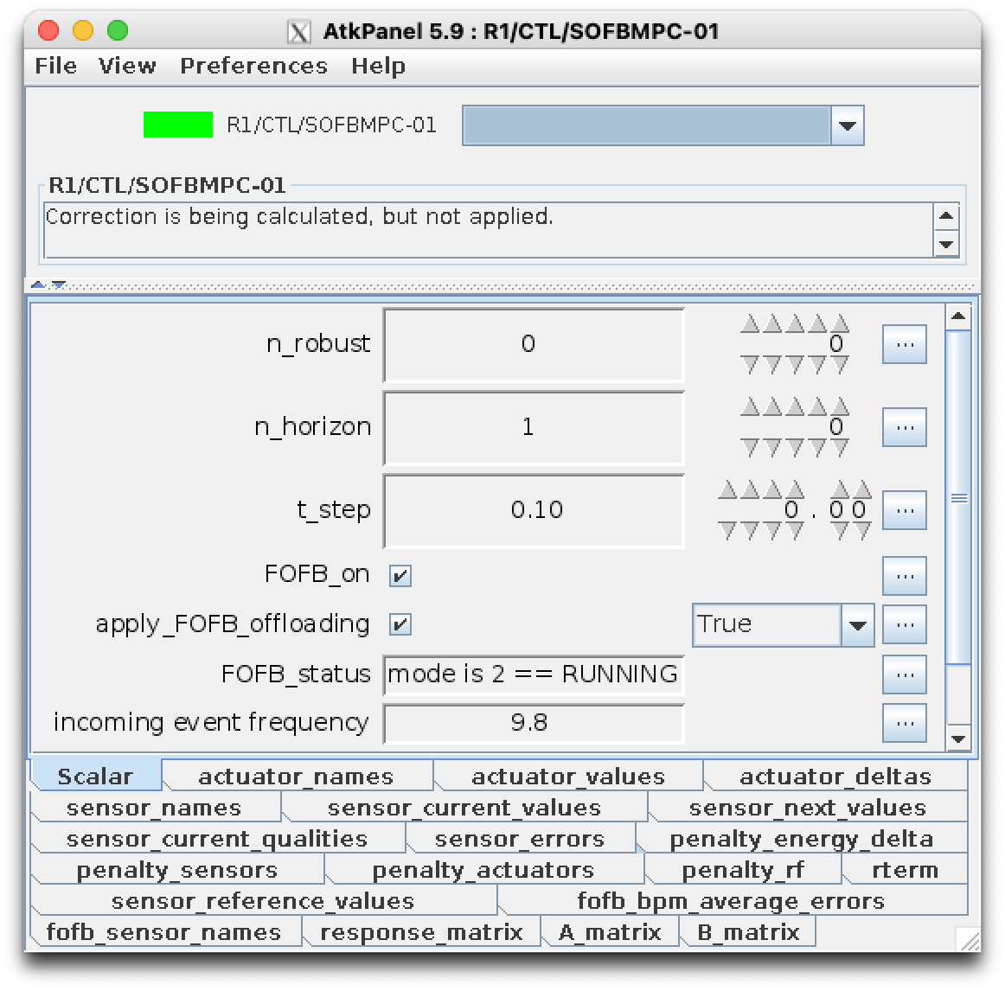
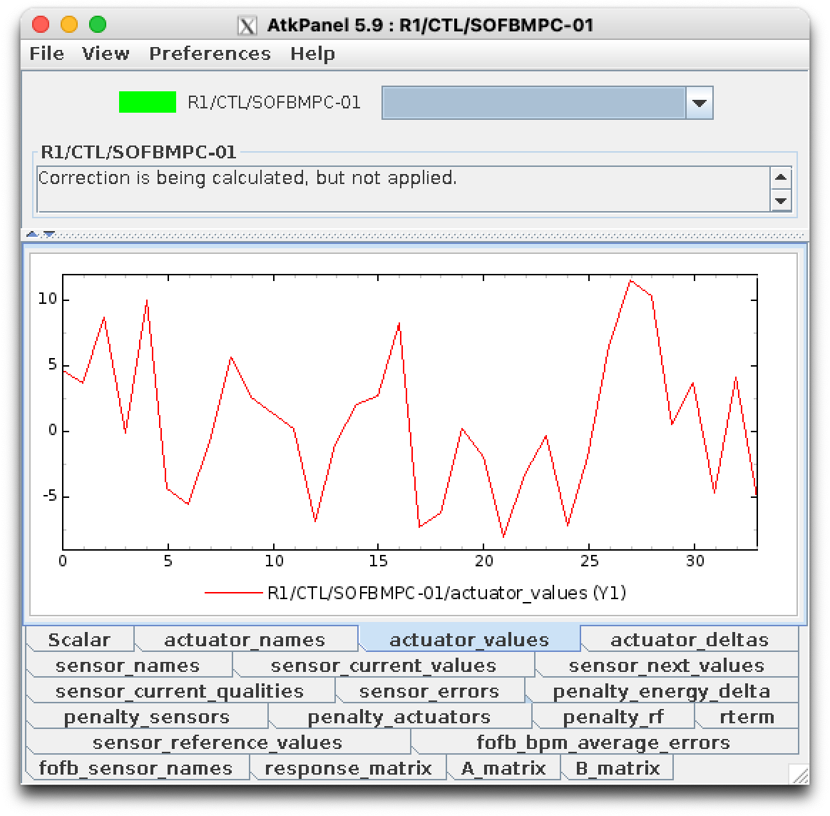
Device Server
The device server was implemented using in Python using PyTango framework for distributed control systems.
The Do-MPC library was used for the MPC implementation.
The interaction with the device can be done through Tango’s standard GUIs, Jive and Atk Panel.
Aditionaly it is possible to interact with the device using PyTango Client API in Python or its Matlab binding.
Software & Accelerator Development

Slide 21
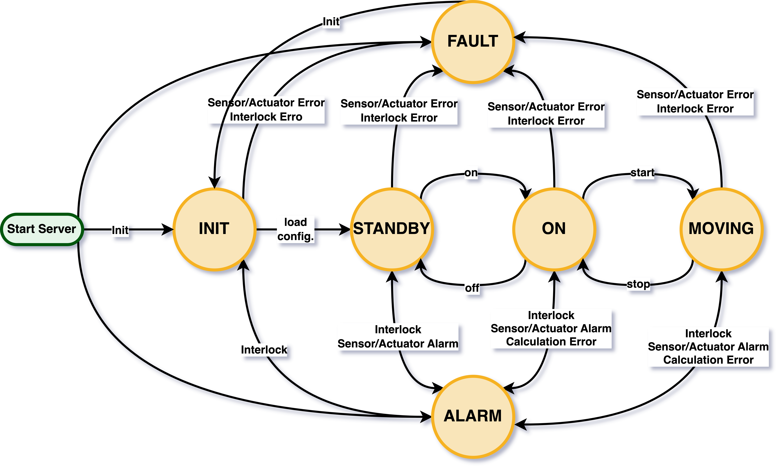
State Handling
The device transitions to STANDBY when all required cofigurations are finished. The status states which configurations are missing.
When on ON state, the controller calculates the constrol signal but does not update the MPC state neither apply the control signal to the actuators.
On MOVING, MPC states are updated and the control signal is applied.
Issues with read out rates, invalid sensor readings will cause controller to go to a reversible ALARM state.
Issues with external interlock and sensors or actuators faults will cause device to go to FAULT state, which require human intervention.
Software & Accelerator Development

Slide 22
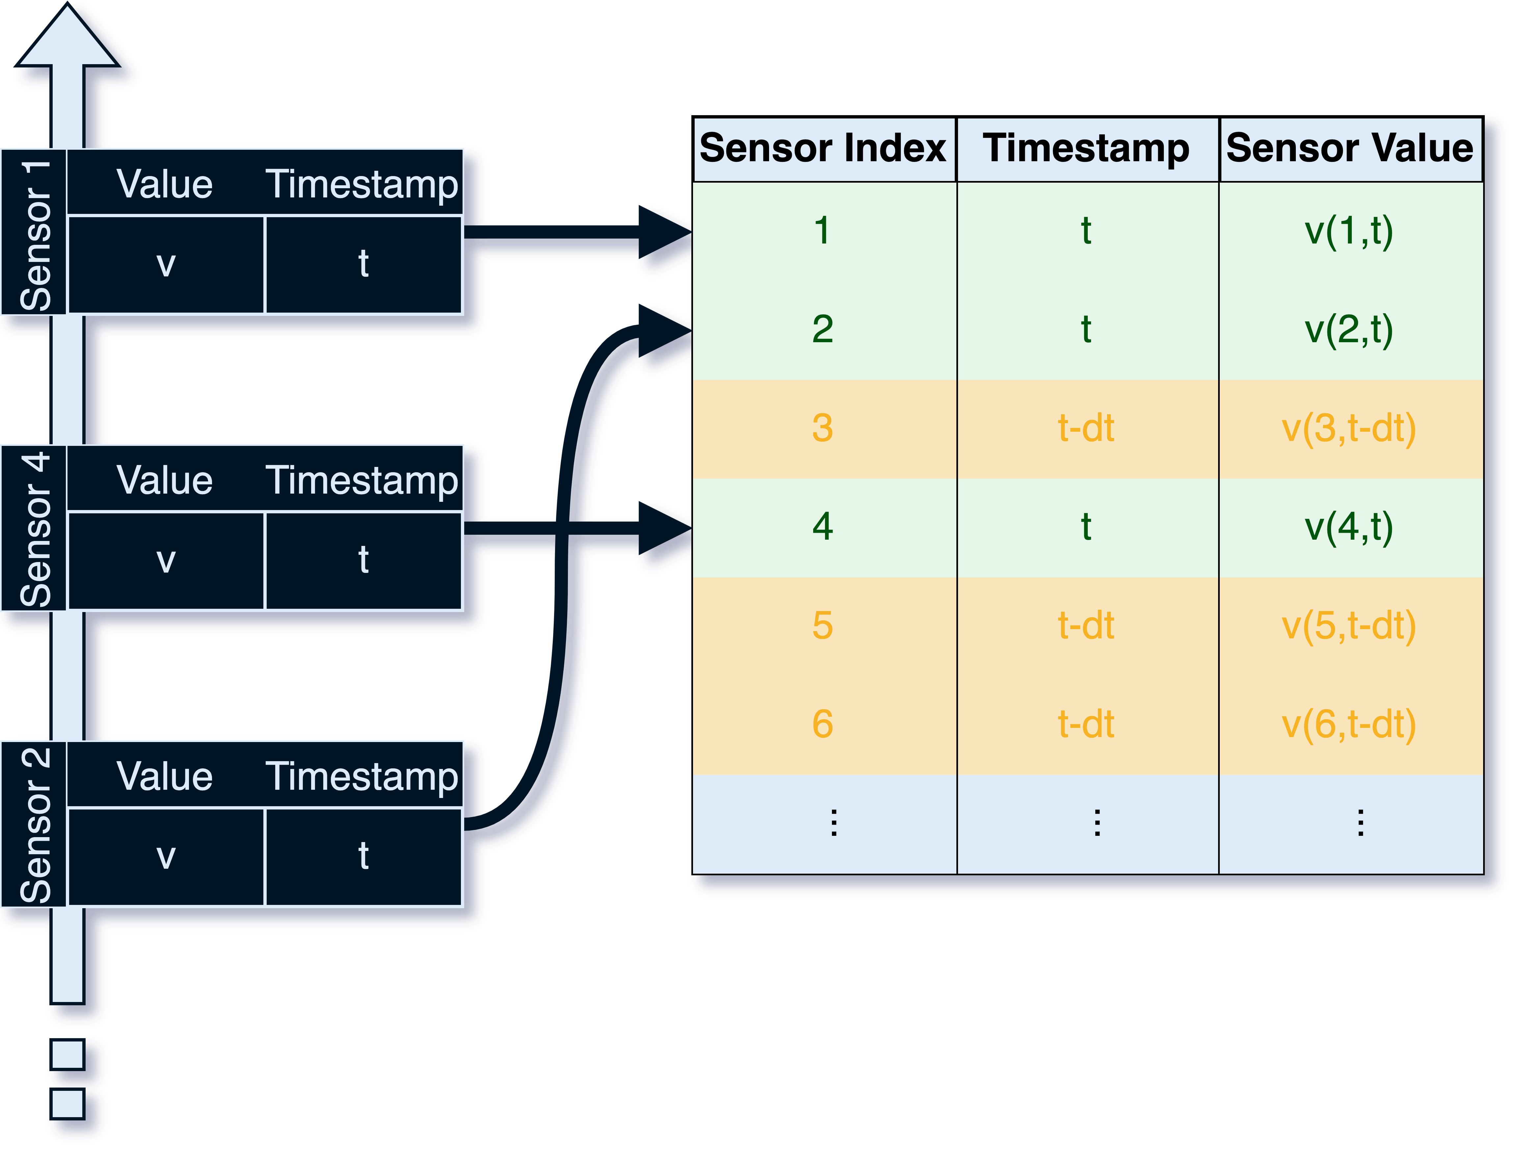
Sensor Events
The sensors event handling was inherited from the previously implemented orbit controller and it runs on a separated thread from the main control loop.
For each event that arrives from a sensor, the timestamp and value for that sensor is updated and the spread in the timestamps is calculated.
Once all events are within a tolerance time range, the sensor signal input can be considered for the next MPC step.
Software & Accelerator Development

Slide 23
Tests on Storage Ring
Results
Tests on 3GeV Ring
Software & Accelerator Development

Slide 24
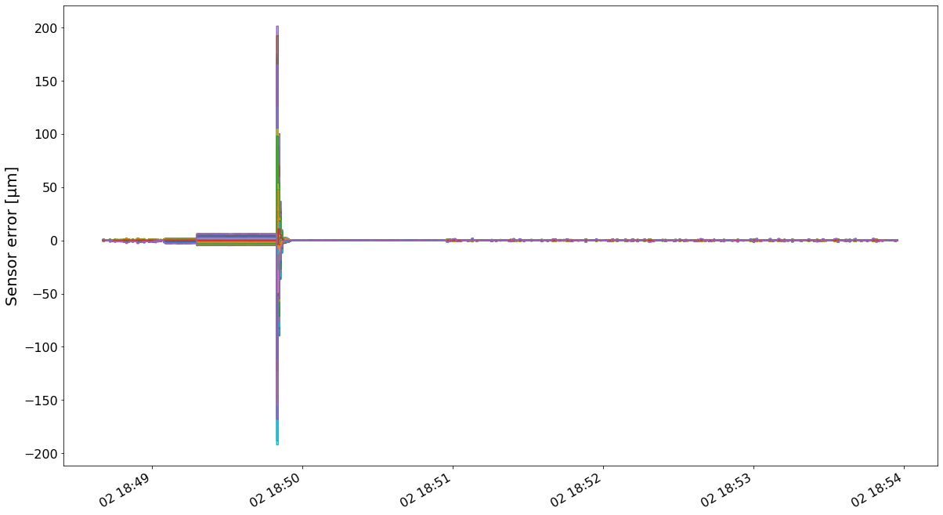
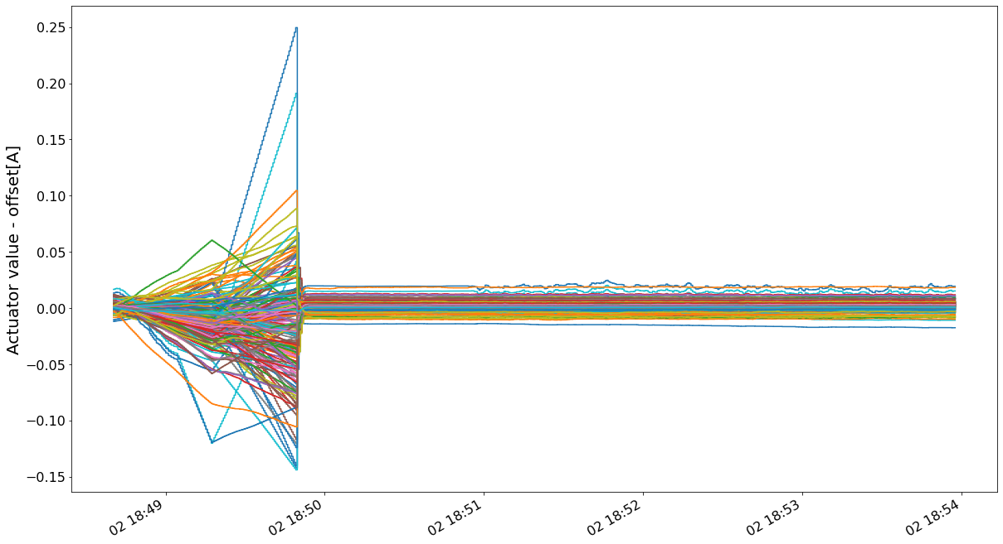
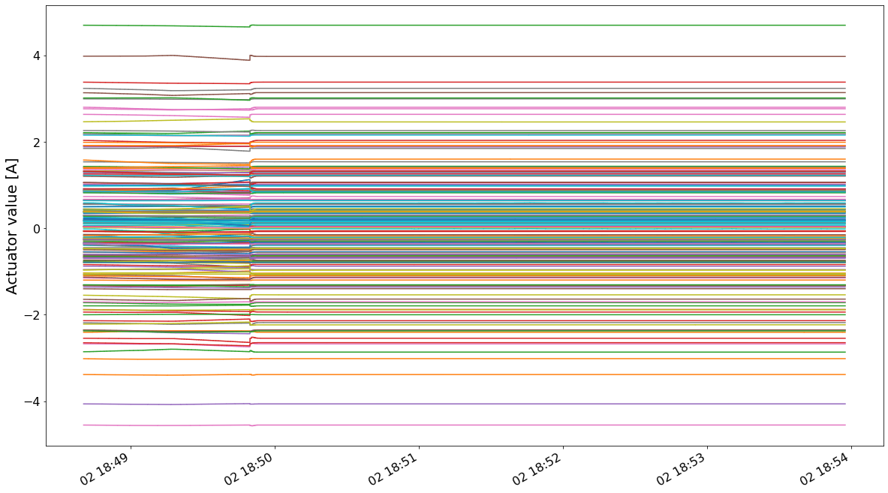
R3 Test
R3 Tests
The starting sensor error as around 20µm.
When the MPC, started the initial overshoot was around 200 µm.
Sensor constraints were not defined during this test.
On start, actuators had a kick but stabilized, this is more evident if we remove the signal mean.
The FOFB was started, which introduced some noise.
The actuation level remained stable

Slide 25
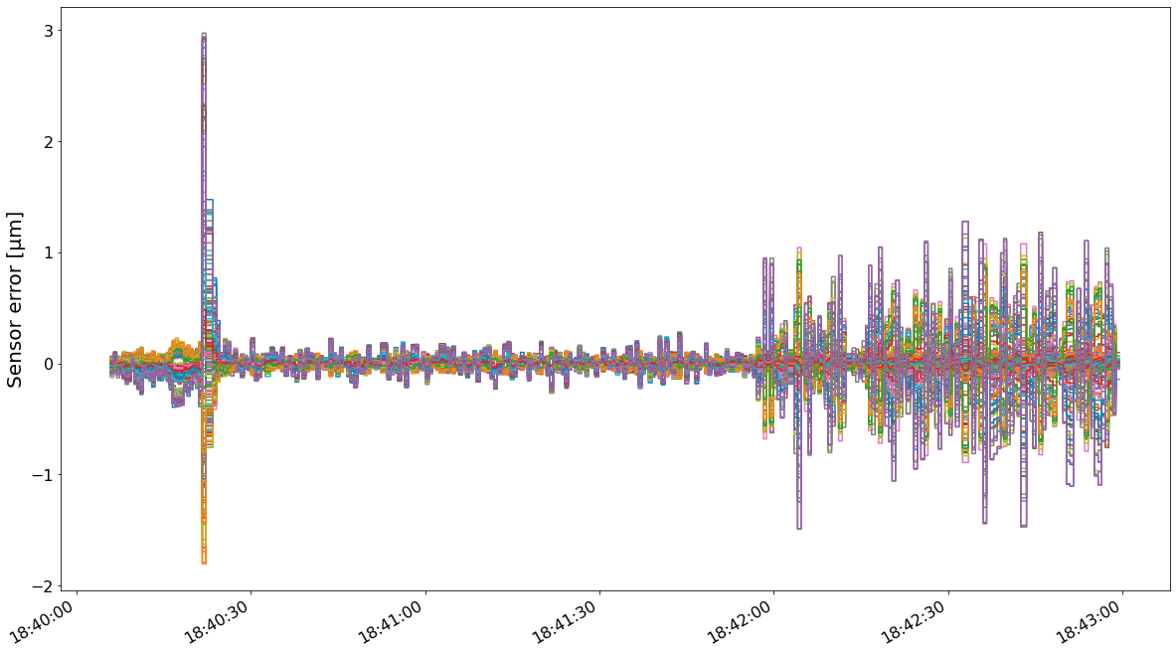
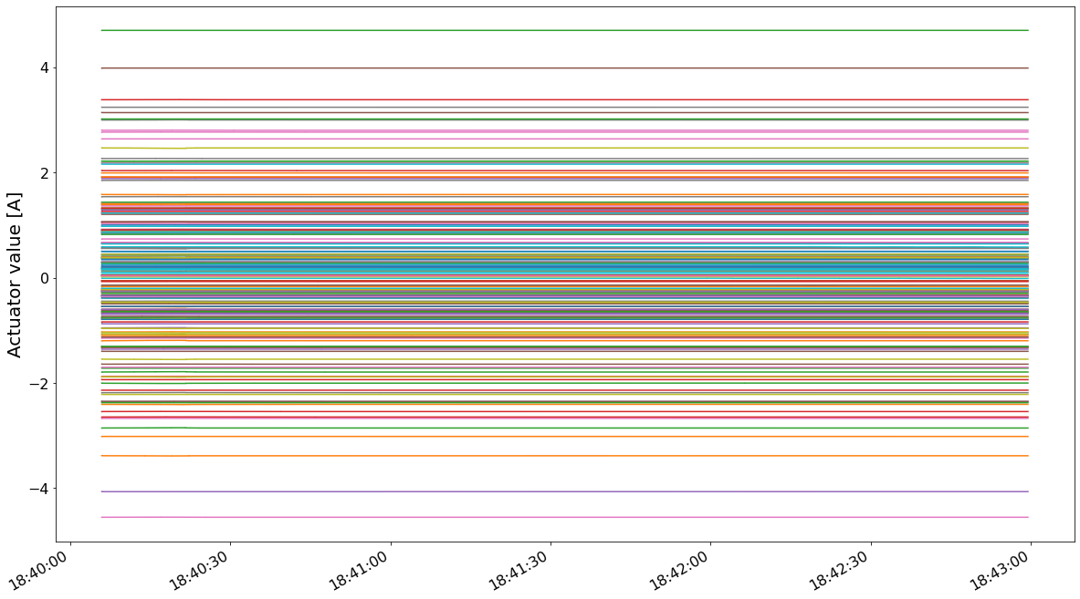
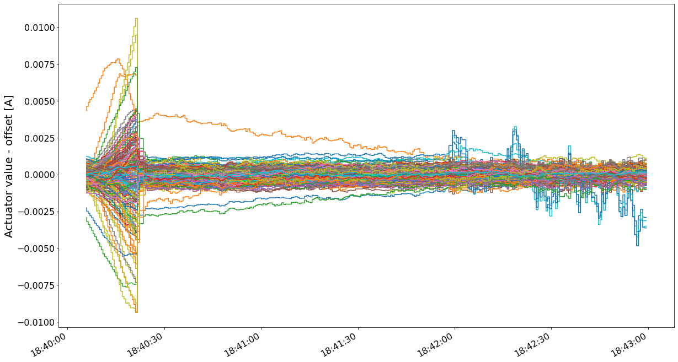
R3 Test
R3 Tests
When the MPC was started with the sensors near the setpoint, the overshoot was significantly smaller.
The actuators kick is barely noticiable in this case, but it is possibel to see the chages around the operational mean values.
When the FOFB was started the noise was introduced.

Slide 26
Challenges
Results
Findings and Room for Improvement
Software & Accelerator Development

Slide 27
Challenges
The RF adjustment does not work as expected
Calculation time for the 3GeV ring is rather slow and it might fail to meet time constraints under specific conditions, currently we are working on optimizing the implementation.
It is harder for operators with limited knowledge of the controller or the system to troubleshoot when anything goes wrong.

Slide 28
RF Frequency Adjustment
Model
$${\left[\begin{matrix}x \\ E\end{matrix}\right]}_{k+1}=I{\left[\begin{matrix}x \\ E\end{matrix}\right]}_{k}+\left[\begin{matrix}R & −\frac{1}{L_{0}α}η_{sensor} \\ −\frac{E_{0}}{L_{0}α}η_{actuator}^{T} & −\frac{E_{0}}{αf_{0}}\end{matrix}\right]\left[\begin{matrix}Δu \\ Δf \end{matrix}\right]$$
Inconsistencies on the dispersion function of the actuators caused the model to be unreliable.
$$y_{k}=I{\left[\begin{matrix}x \\ \frac{ΔE }{E}\end{matrix}\right]}_{k}$$
Optimization
$$\min_{x,u}{J=\sum_{i=k+1}^{k+H_{p}−1}{e_{i}^{T} Q_{1} e_{i}}+\sum_{i=k}^{k+H_{u}−1}{Δu_{i}^{T}Q_{2}Δu_{i}}+e_{k+H_{p}}^{T} Q_{f} e_{k+H_{p}}}$$
$$s.t.$$
$$x_{k+1 }=Φx_{k}+Γu_{k} \\ y_{k}=Cx_{k}$$
$$\overline{x}=x_{0}$$
$$\left|x\right|≤x_{max} \\ \left|u\right|≤u_{max}$$
Software & Accelerator Development
$$\left|Δu\right|≤{Δu}_{max}$$

Slide 29

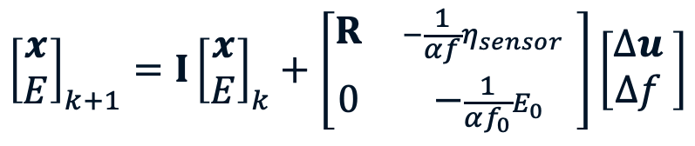
RF Frequency Adjustment
Model
$${\left[\begin{matrix}x \\ E\end{matrix}\right]}_{k+1}=I{\left[\begin{matrix}x \\ E\end{matrix}\right]}_{k}+\left[\begin{matrix}R & −\frac{1}{αf}η_{sensor} \\ 0 & −\frac{1}{αf_{0}}E_{0}\end{matrix}\right]\left[\begin{matrix}Δu \\ Δf \end{matrix}\right]$$
Inconsistencies on the dispersion function of the actuators caused the model to be unreliable.
It was opted to use a more minimal model to represent the frequency adjustment:
$$\begin{matrix}\frac{ΔE}{E_{0}}=−\frac{Δf}{f_{0}} \\ Δx=RΔu−\frac{Δf}{{αf}_{0}}η_{sensor}\end{matrix}$$
$$y_{k}=I{\left[\begin{matrix}x \\ \frac{ΔE }{E}\end{matrix}\right]}_{k}$$
Optimization
$$\min_{x,u}{J=\sum_{i=k+1}^{k+H_{p}−1}{e_{i}^{T} Q_{1} e_{i}}+\sum_{i=k}^{k+H_{u}−1}{Δu_{i}^{T}Q_{2}Δu_{i}}+e_{k+H_{p}}^{T} Q_{f} e_{k+H_{p}}}$$
$$s.t.$$
$$x_{k+1 }=Φx_{k}+Γu_{k} \\ y_{k}=Cx_{k}$$
$$\overline{x}=x_{0}$$
$$\left|x\right|≤x_{max} \\ \left|u\right|≤u_{max}$$
Software & Accelerator Development
$$\left|Δu\right|≤{Δu}_{max}$$

Slide 30
Future Work
The model can incorporate sensor readout delays, to allow shorter control cycles and increase prediction horizon. We already have a response matrix with an intermediate that accounts for the power supplies delay and slew rate.
Known disturbances can be incorporated to the MPC controller to improve states predictions and increase prediction horizon.

Slide 31
Thank you!
Contact info:
carla.takahashi@maxiv.lu.se

